Slide 1
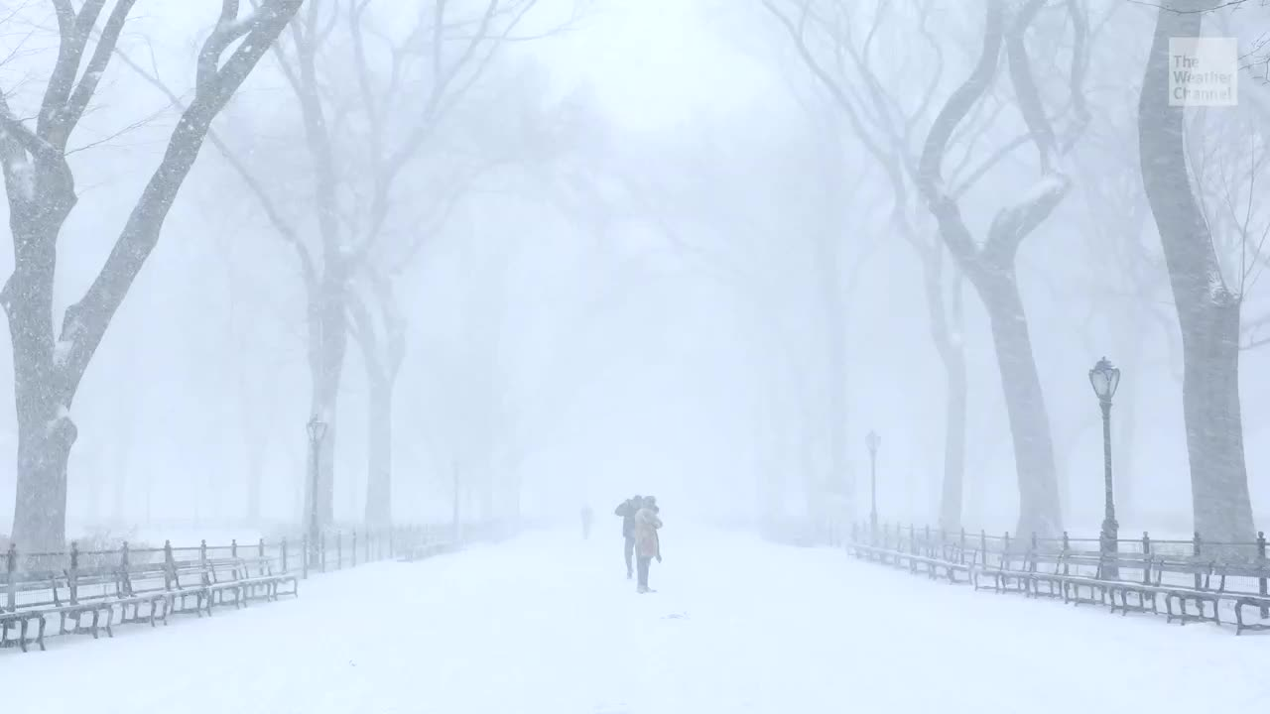
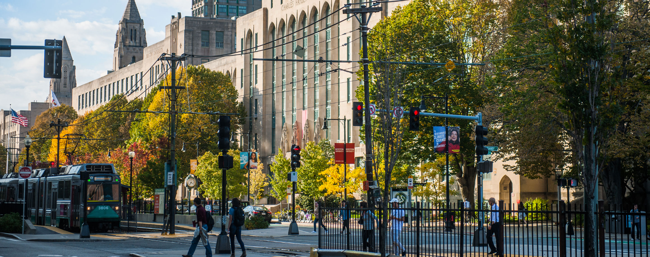
Evaluating the Efficacy of Extreme Weather and Climate Preparedness Across BU Campuses
Campus Climate Lab Presentations
January 27, 2023

Slide 2


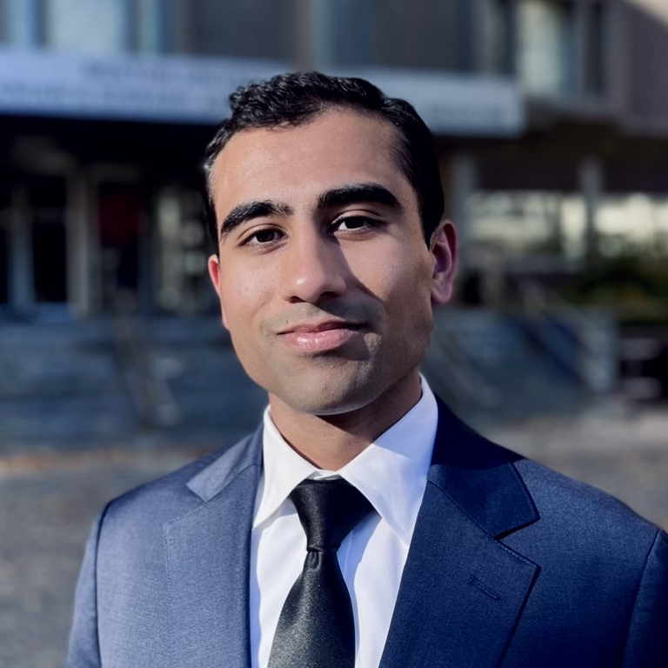


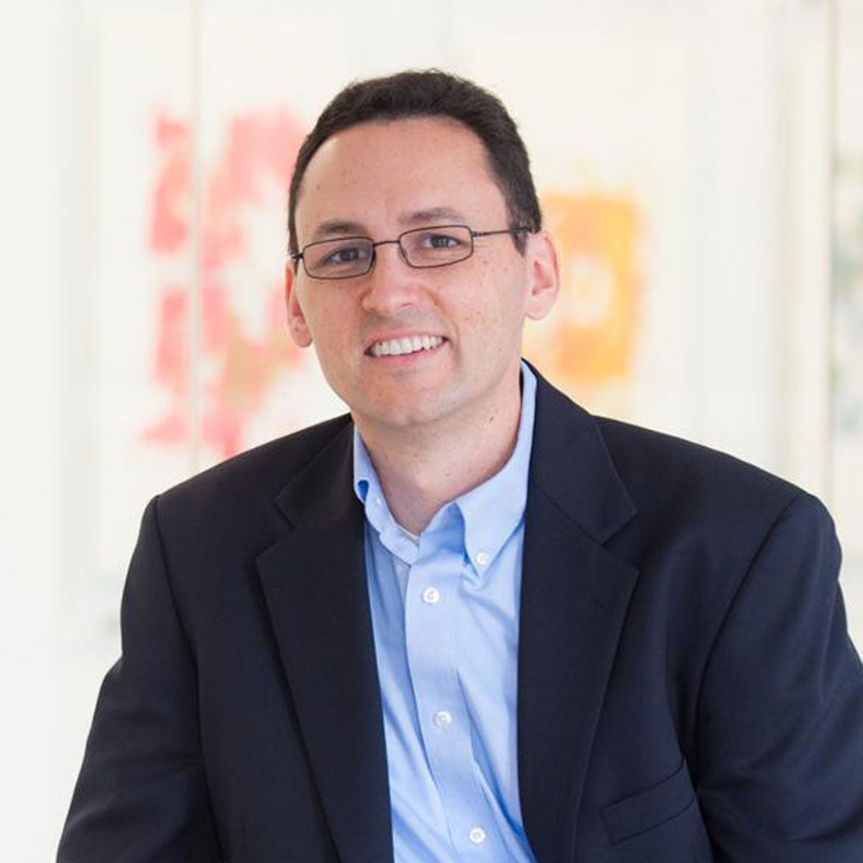
Our Team
Katharine Teigen
Quinn Adams
Neil Singh Bedi
Tanmayee Karanam
Dr. Amruta Nori-Sarma
Dr. Greg Wellenius
Notes:
Our team is comprised of MPH, medical, and PhD students as well as two professors in the environmental health department at SPH. We have expertise in….

Slide 3
Background
The climate crisis amplifies risks of exposure to extreme heat and extreme cold events as they continue to increase in severity, frequency, and duration.
  23 weather-related major disaster declarations were recorded in Massachusetts between 1990 and 2019, compared to 7 between 1960 and 1989.¹
Extreme Weather Preparedness Plans (EWPPs) are critical to public health infrastructure and often include early warning systems that are used to:
  Convey important information to the public about predicted periods of extreme weather
  Trigger various interventions
  Enhance preparedness
Given Boston University’s urban location within a socioeconomically diverse city, groups of students, faculty, and staff may be more vulnerable to extreme heat and cold events based on:
  Their level of exposure
  Susceptibility to negative health effects from extreme temperatures
  Adaptive capacity

Slide 4
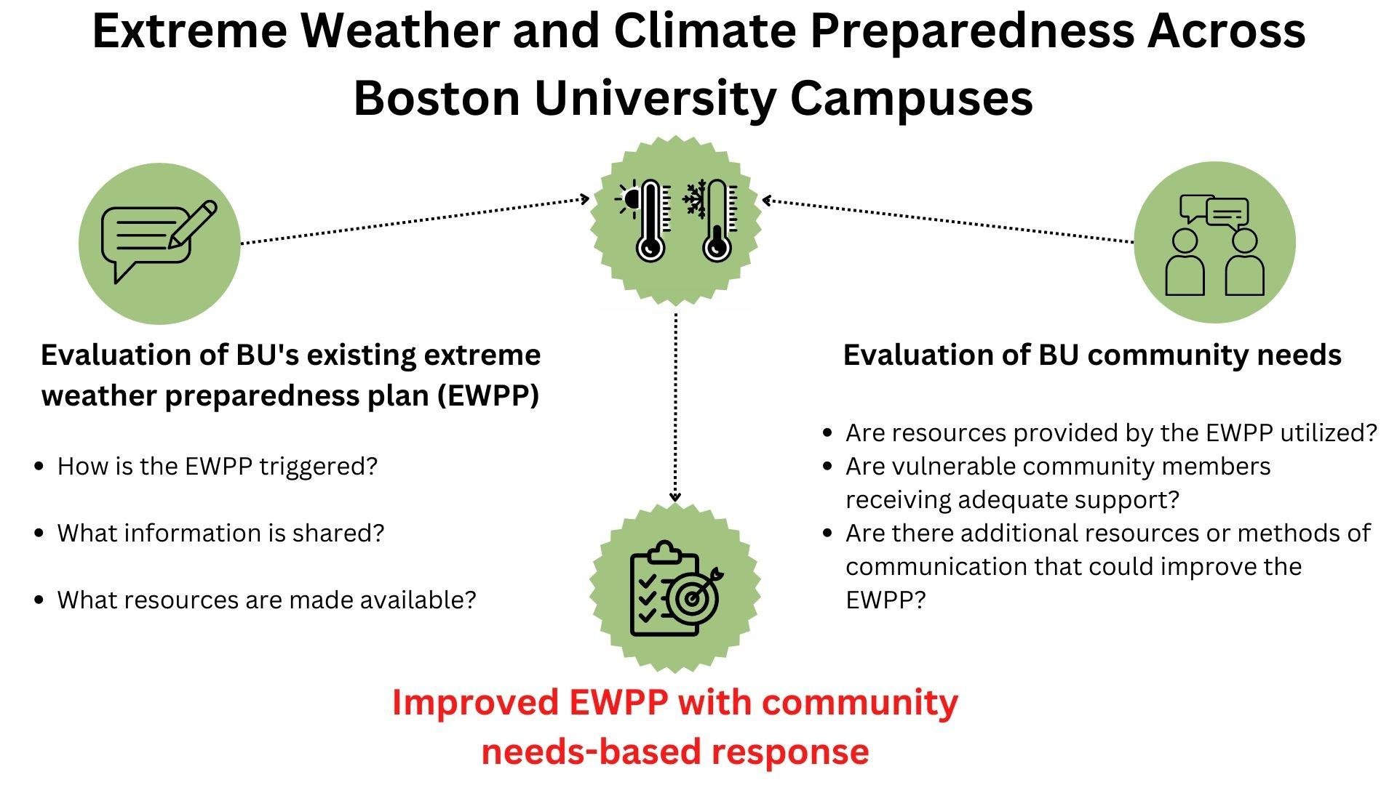
Research Aims

Slide 5
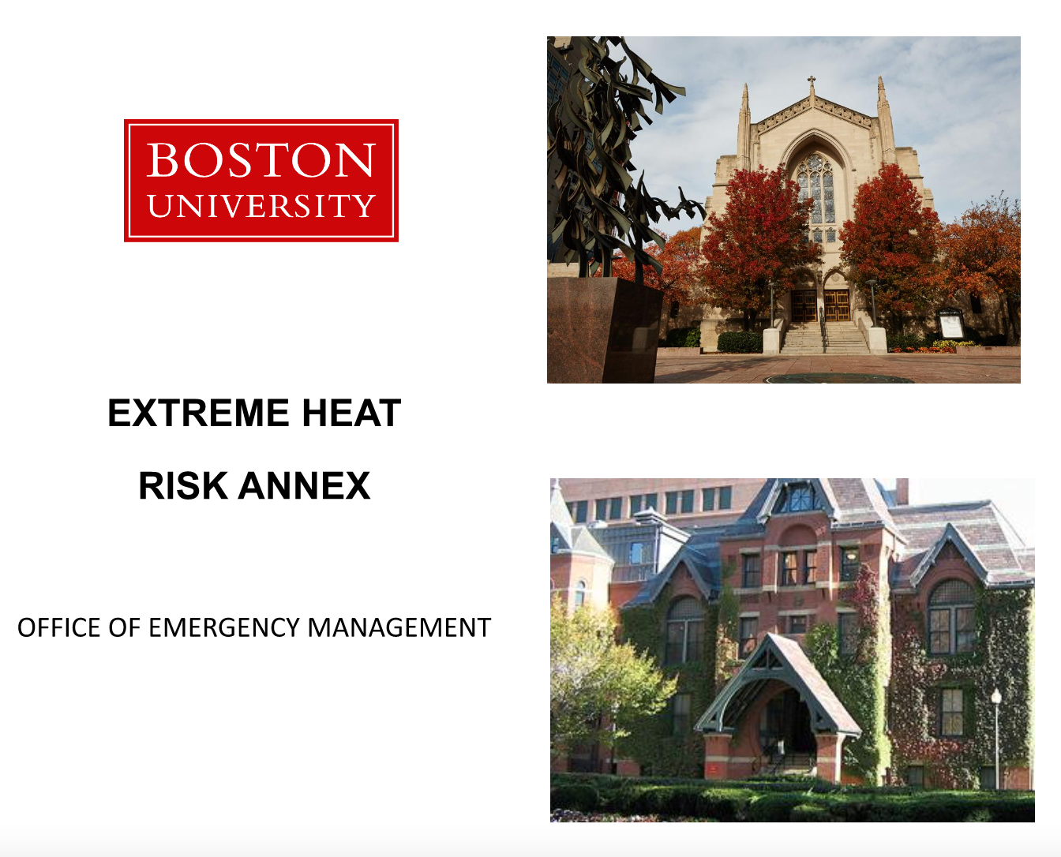
BU’s EWPP
Takeaways
During extreme heat:
Provide internal & external heat safety messaging
Daily calls with departments
Open/operate cooling centers
→ Used mostly by summer students and minors but better data are needed.
During extreme cold:
Currently no EWPP
→ Agreement needed on how to handle a snow call and then build plan accordingly.

Slide 6
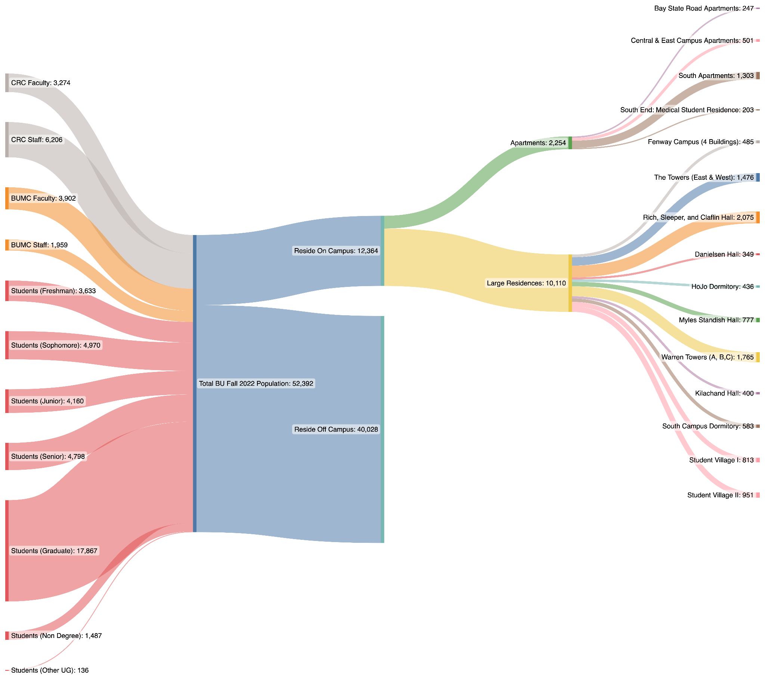
Collected Data
Total Fall 2022 BU Population (left) and their place of residence (right).
Takeaway:
In addition to the thousands that reside on campus, there are even more who live off campus, and understanding the needs of both students and faculty/staff as well as both on-campus and off campus residents is necessary.

Slide 7
Next Steps: Survey & Community Needs Assessment
Engaging the BU community to understand:
What aspects of the existing EWPP are beneficial and being utilized?
Who is most vulnerable during Extreme Weather events, and what resources might they need?
Reporting findings back to both Boston University and our climate and health networks to strengthen urban college communities and cities in their extreme weather response. Results will inform efficient resource utilization.

Slide 8
References
Extreme Weather Events. (n.d.). Mass.gov. Retrieved January 15, 2023, from https://www.mass.gov/info-details/extreme-weather-events
Acknowledgments
A special thank you to Rene Fielding and the BU Emergency Management team for their assistance in our data collection EWPP analyses. We’d also like to thank Adam Ostrowski of the Analytical Services & Institutional Research Office.

