Slide 1

EV Public
Infrastructure and Policies: Selected Results from Melting the ICE and Carbon-Free Boston
Presented at the Bloomberg New Energy Future of Mobility Summit
San Francisco CA
Feb 5 2019
Peter Fox-Penner
CO-PI
BU-CU-GEIDCO Research Collaboration

Slide 2
BU-CU-Geidco Collaboration
Collaboration between BU Institute for Sustainable Energy, Columbia University Center for Global Energy Policy and China’s Global Energy Interconnection Development and Cooperation Organzation (GEIDCO)
First research phase has focused on comparing Chinese and U.S. electric vehicle infrastructure policies and clean energy transition pathways.
Co-led with David Sandalow at Columbia and Prof. Justin Ren at BU
Supported by a generous grant from Bloomberg Philanthropies
http://www.bu.edu/ise/research/bu-columbia-u-geidco-partnership-research-on-the-global-sustainable-energy-transition/

Slide 3
About Melting the ICE
Research scope:
Edited volume of comparative study of city efforts to install EV charging infrastructure cities in China and the West
  Cities examined include Shanghai, Beijing, LA, Brookline, MA, and Oslo
Presents a visual EV Indexing tool to help cities prioritize EV infrastructure investments as EV adoption continues to grow
Book available for downloading April 2019
Research partners and supporters:
Collaborative efforts between ISE and Columbia University Center for Global Energy Policy

Slide 4
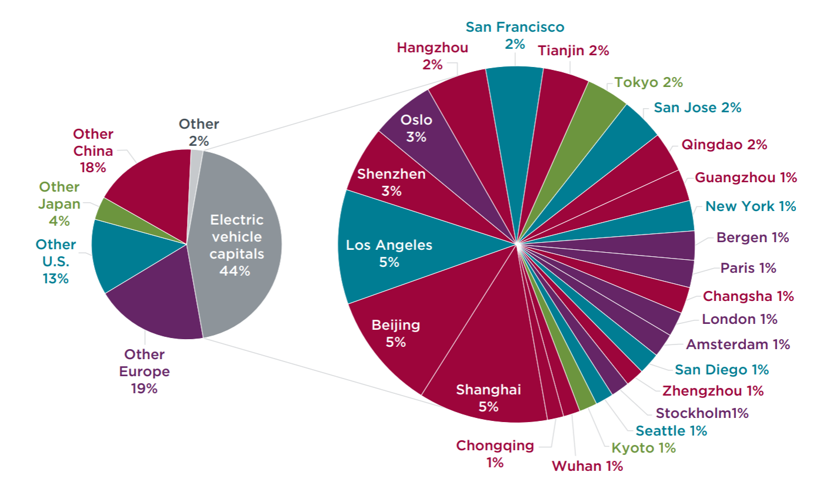
Cities are Where the EVs Are
Leading EV Cities, by Volume (not city-specific market share)

Slide 5
Lessons Learned – Melting the Ice
Widespread, easily accessible EV infrastructure is essential for EV adoption
More public infrastructure may be needed than estimated thus far
  Even at 5% EV penetration in some locations, charging congestion is occurring
  While most charging occurs at home, “home” must include multi-family dwellings, where a one-to-one deployment should be the standard (whether in-building, building-surface, or on-street parking)
  Leveraging existing infrastructure helps reduce costs and increase accessibility, e.g., charging tied to electrified mass transit, at gasoline stations, and public buildings and parking facilities
Even large cities with robust budgets do not have sufficient surpluses to enable reallocation of funds, should EV adoption accelerate and more public infrastructure is needed
  Cities need both state and Federal funding support
  Innovative funding mechanisms are needed, e.g., EV state or Federal highway fund, joint pubic-private partnerships where cities can use their share of proceeds for reinvestment in EV infrastructure and other EV services
Source: Melting the ICE, BU Institute for Sustainable Energy, forthcoming April 2019

Slide 6
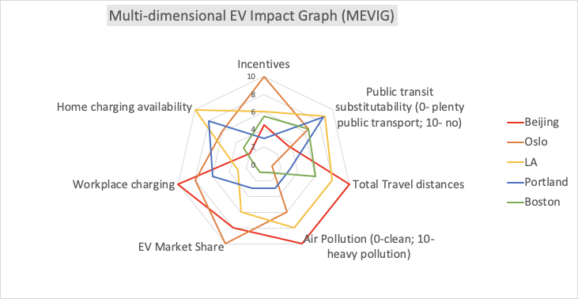
Each City has Distinctive EVSE Attributes
Source: Rocky Mountain Institute

Slide 7
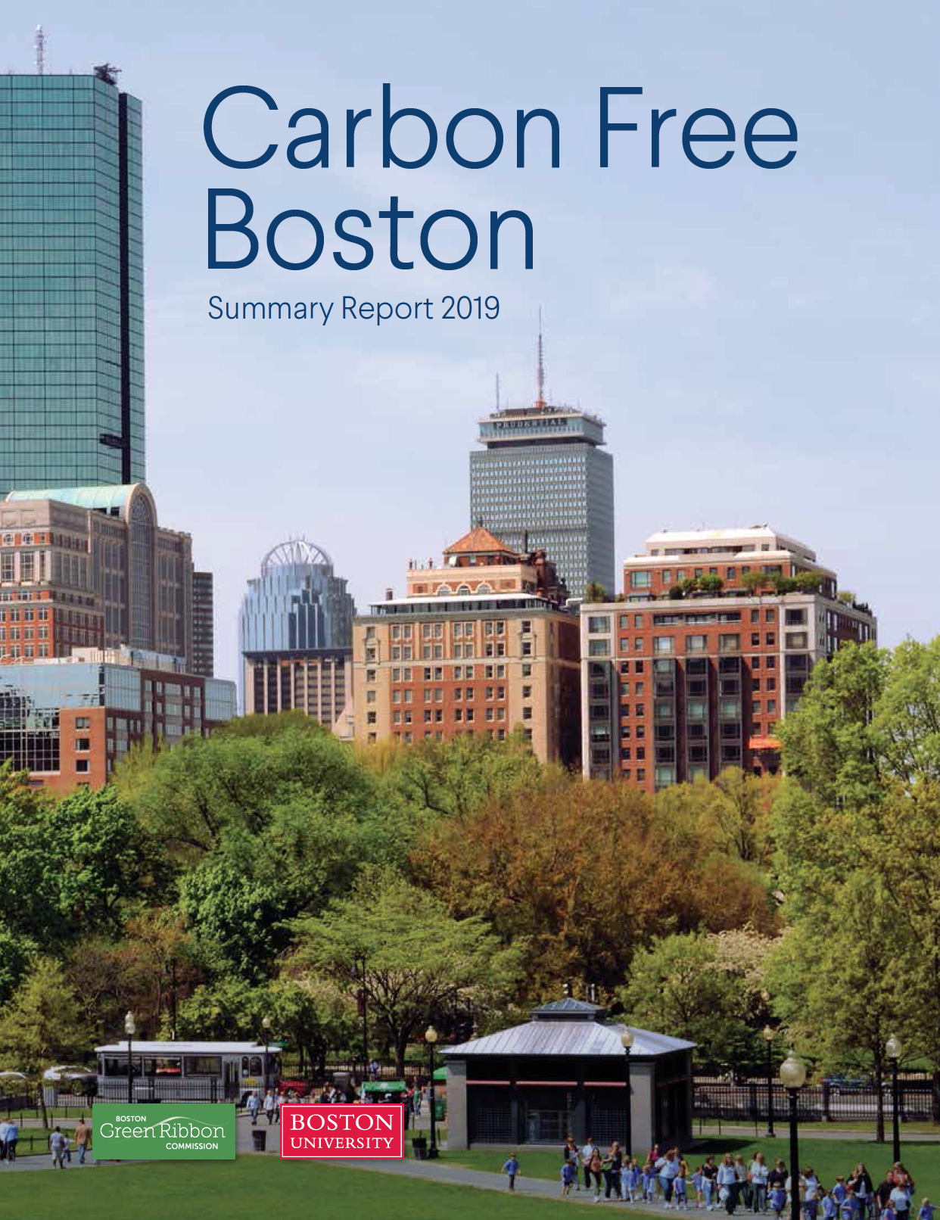
http://sites.bu.edu/cfb/files/2019/01/Carbon-Free-Boston-Report-web.pdf

Slide 8
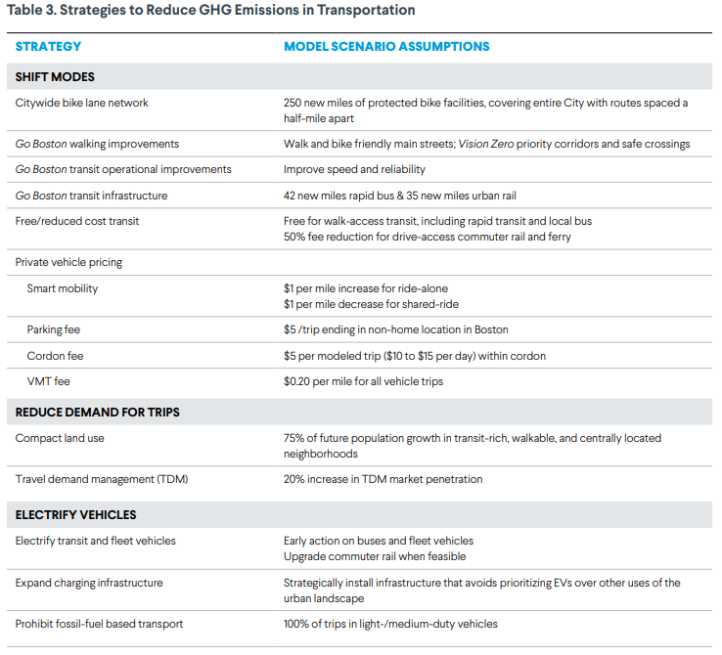

Slide 9
