Slide 1

Understanding Microsoft Teams
Teams Basic Mobile Demo

Slide 2

Demo
https://teamsdemo.office.com/mobile/index.html#/

Slide 3
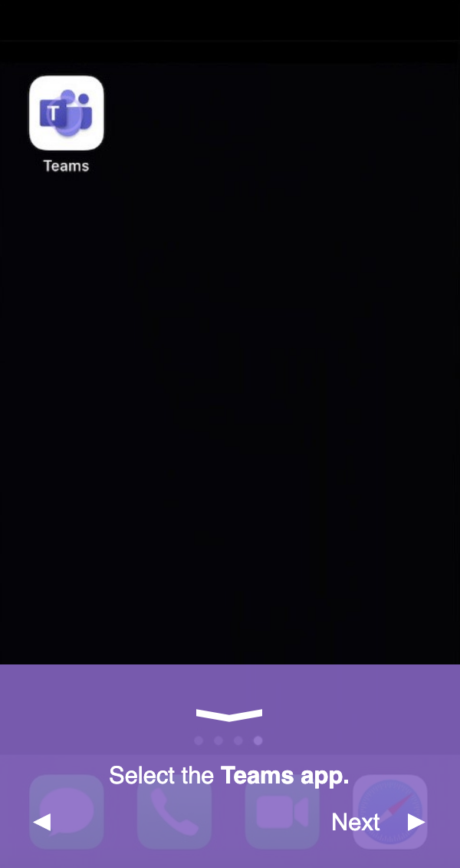
Open the App
Download link:
https://www.microsoft.com/en-us/microsoft-teams/download-app#office-CustomSpacingTemplate-uoh60pc
Select the Teams app.
300/565 dimensions

Slide 4
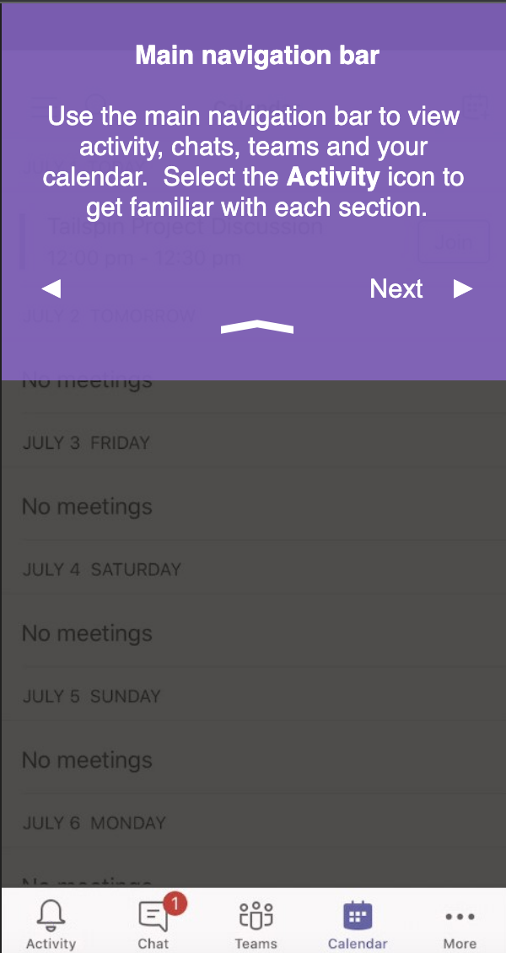
Navigation Bar
Use the main navigation bar to view activity, chats, teams and your calendar. Select the Activity icon to get familiar with each section.

Slide 5
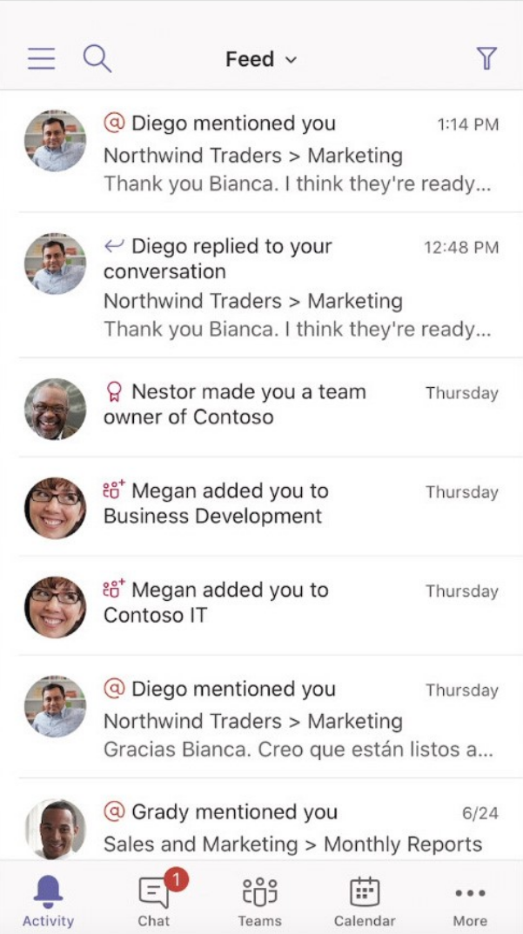
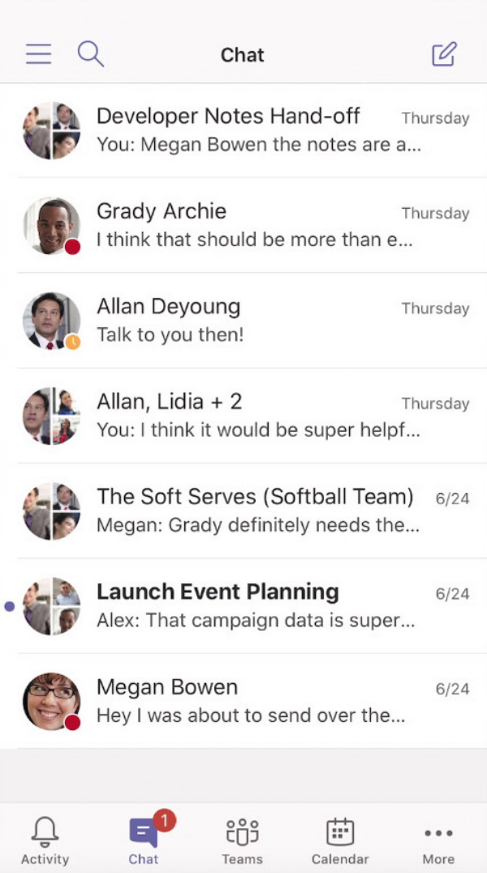
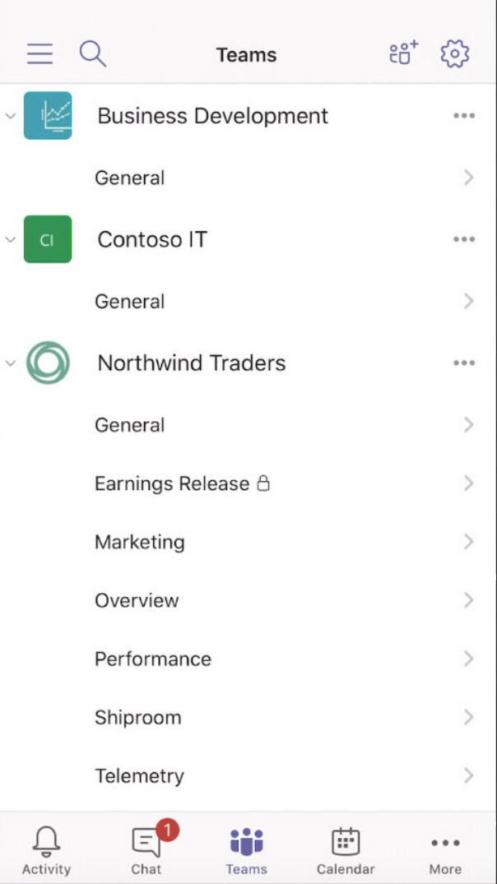
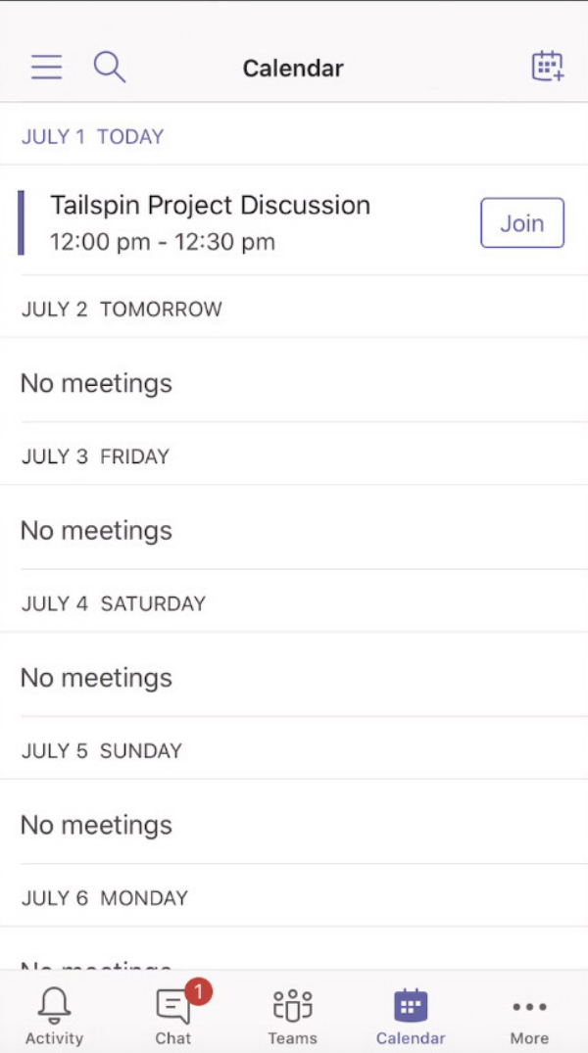
Different sections under Navigation Bar
Activity
Chat
Teams
Calendar

Slide 6
Navigation Bar
Use the main navigation bar to view activity, chats, teams and your calendar. Select the Activity icon to get familiar with each section.

Slide 7
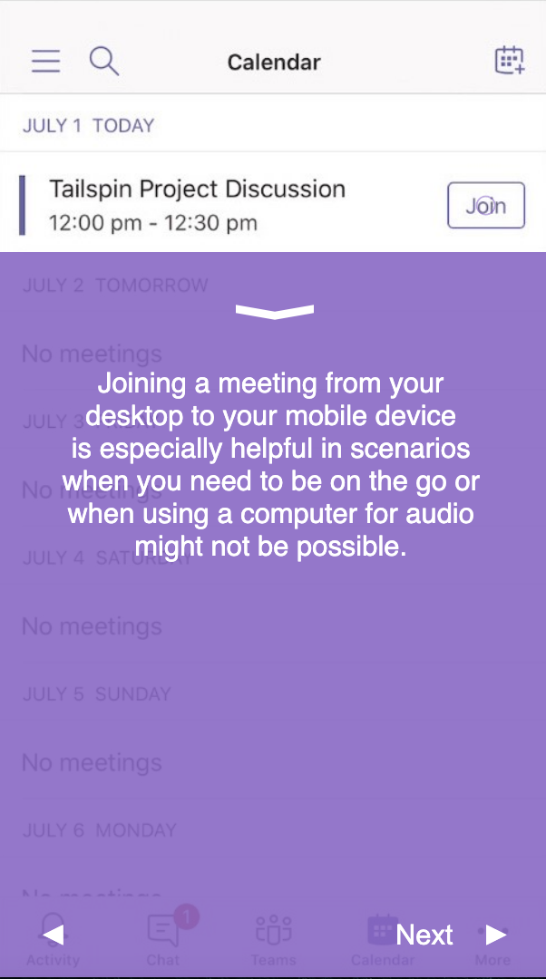
Joining a meeting
Join a meeting from your desktop to your mobile device is especially helpful in scenarios when you need to be on the go or when using a computer for audio might not be possible.

Slide 8
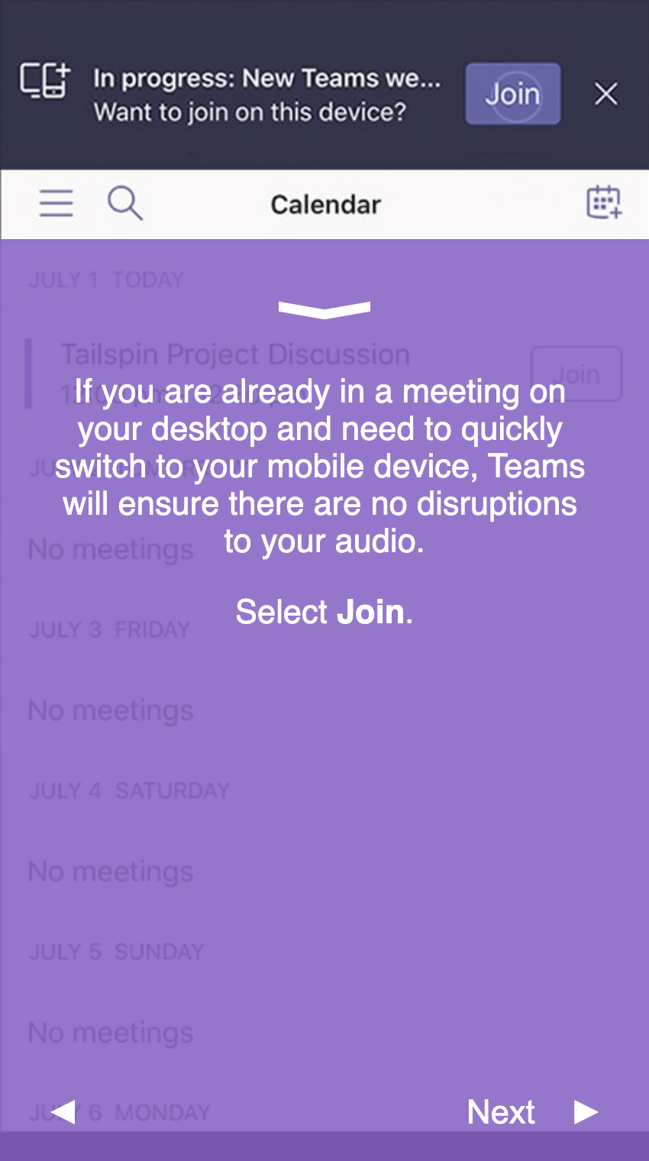
Joining a meeting
If you are already in a meeting on your desktop and need to quickly switch to your mobile device, Teams will ensure there are no disruptions to your audio.
Select Join.

Slide 9
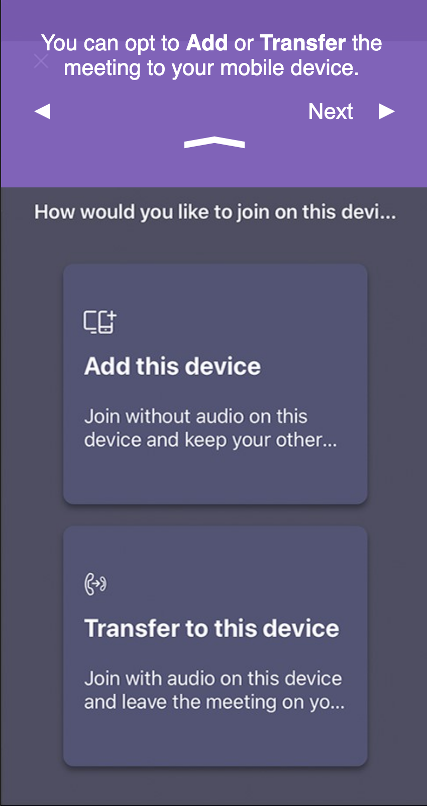
Joining a meeting
You can opt to Add or Transfer the meeting to your mobile device.

Slide 10
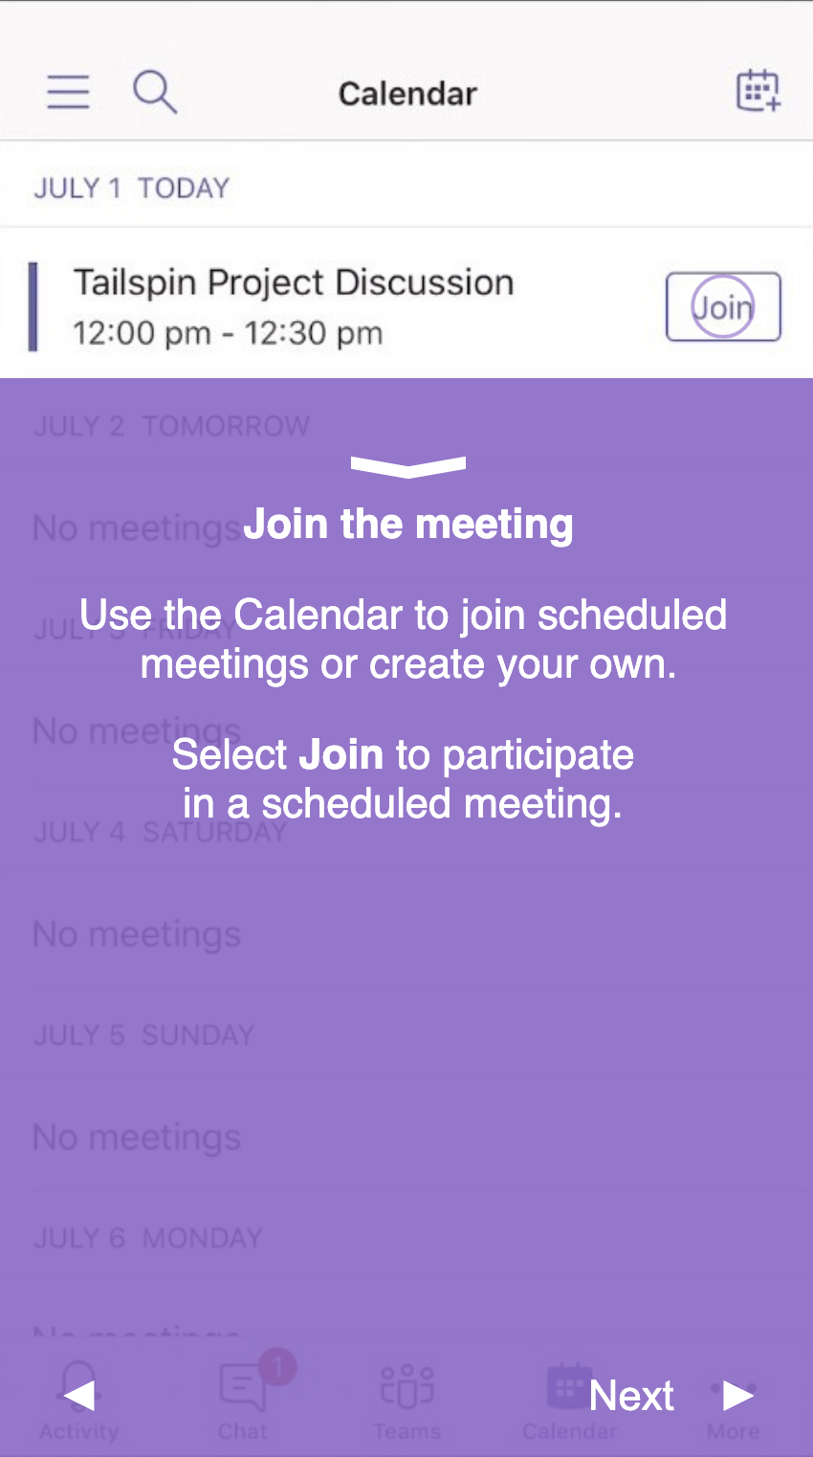
Joining a meeting
Use the Calendar to join scheduled meetings or create your own.
Select Join to participate in a scheduled meeting.

Slide 11
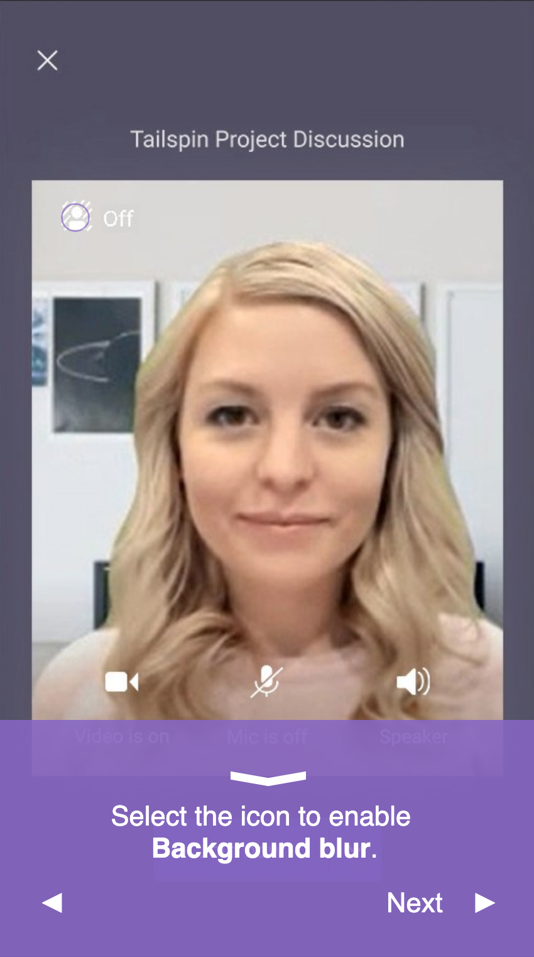
Joining a meeting
Select the icon to enable Background blur.

Slide 12
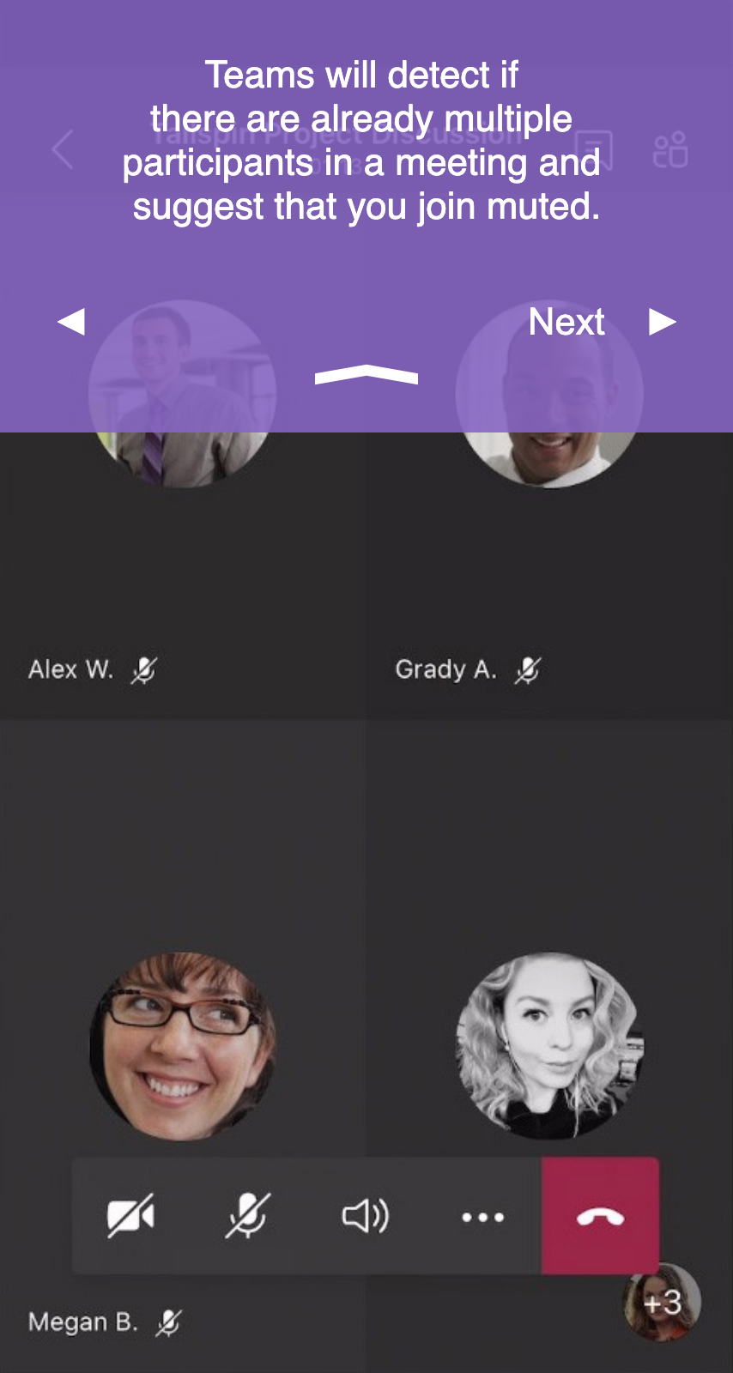
Joining a meeting
Teams will detect if there are already multiple participants in a meeting and suggest that you join muted.

Slide 13
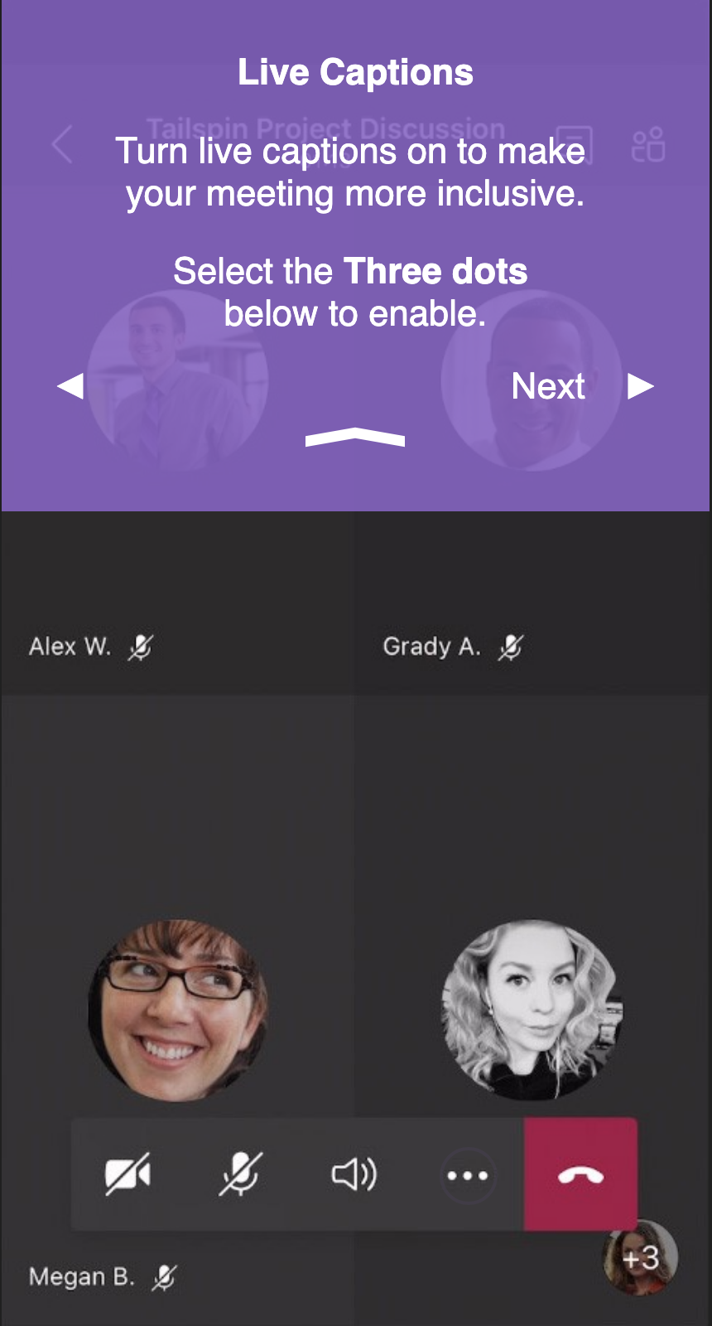
Joining a meeting - Live Captions
Turn live captions on to make your meeting more inclusive.
Select the Three dots below to enable.

Slide 14
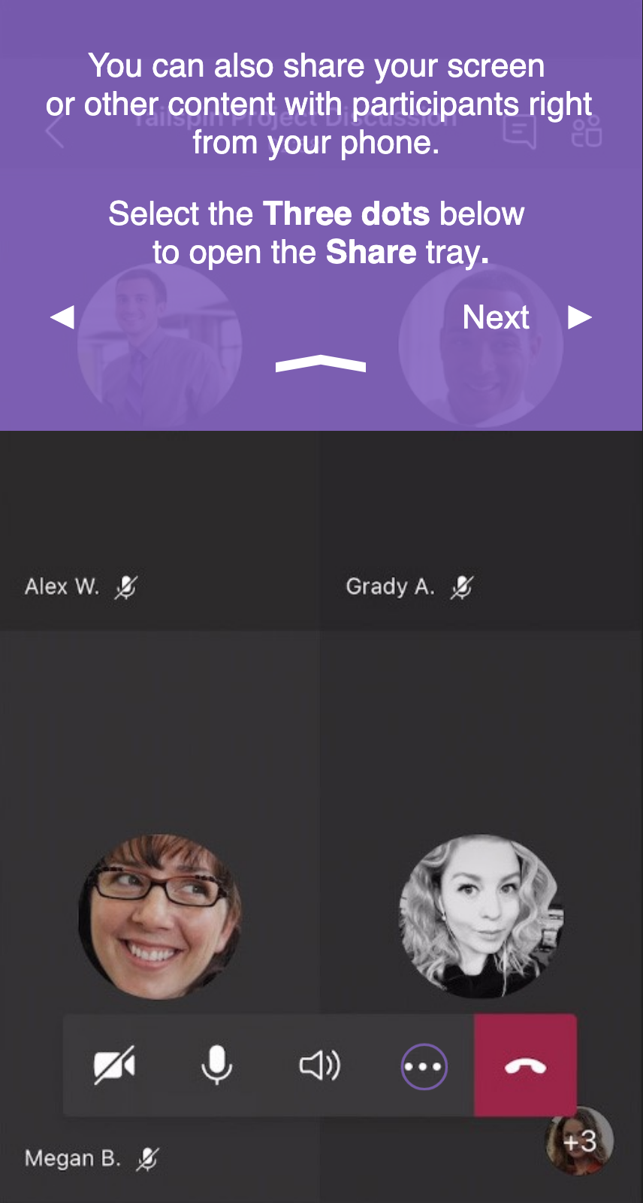
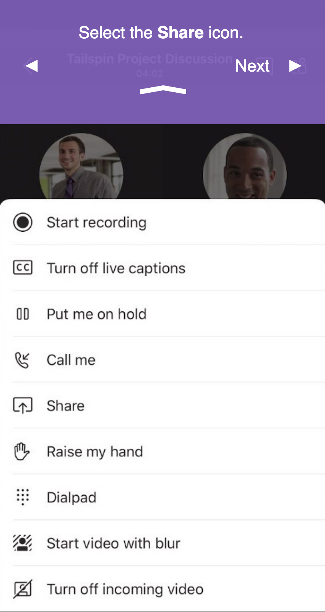
Joining a meeting - Share Screen
You can also share your screen or other content with participants right from your phone.
Select the Three dots below to open the Share tray.
Select the Share icon.

Slide 15
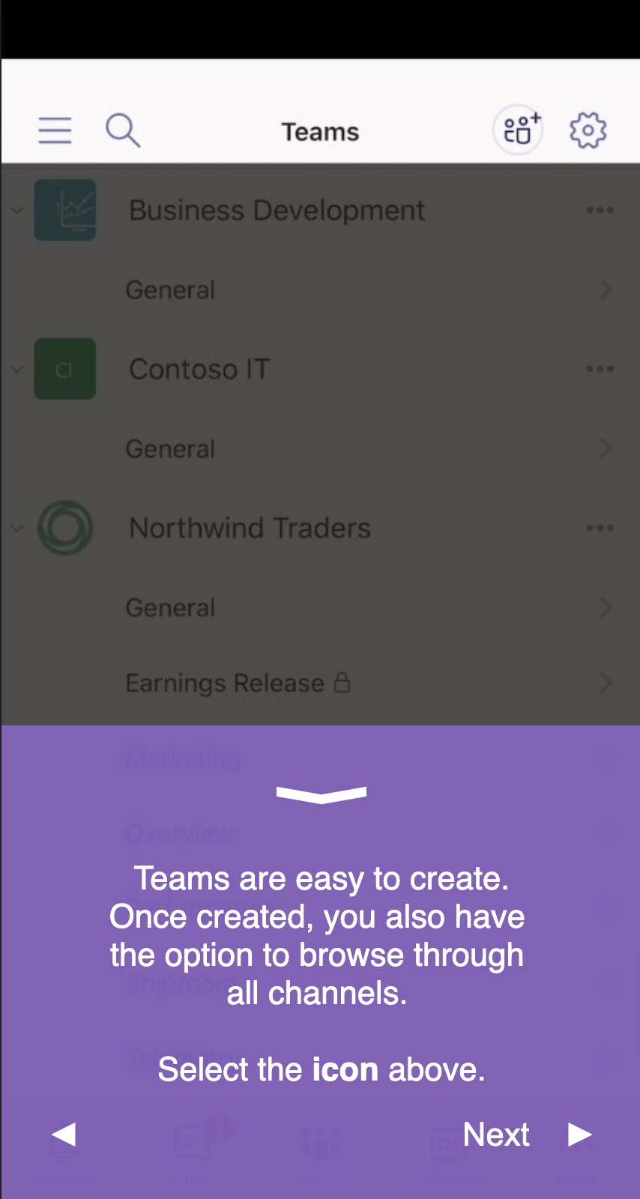
Joining a meeting
Teams are easy to create. Once created, you also have the option to browse through all channels.
Select the icon above.

Slide 16
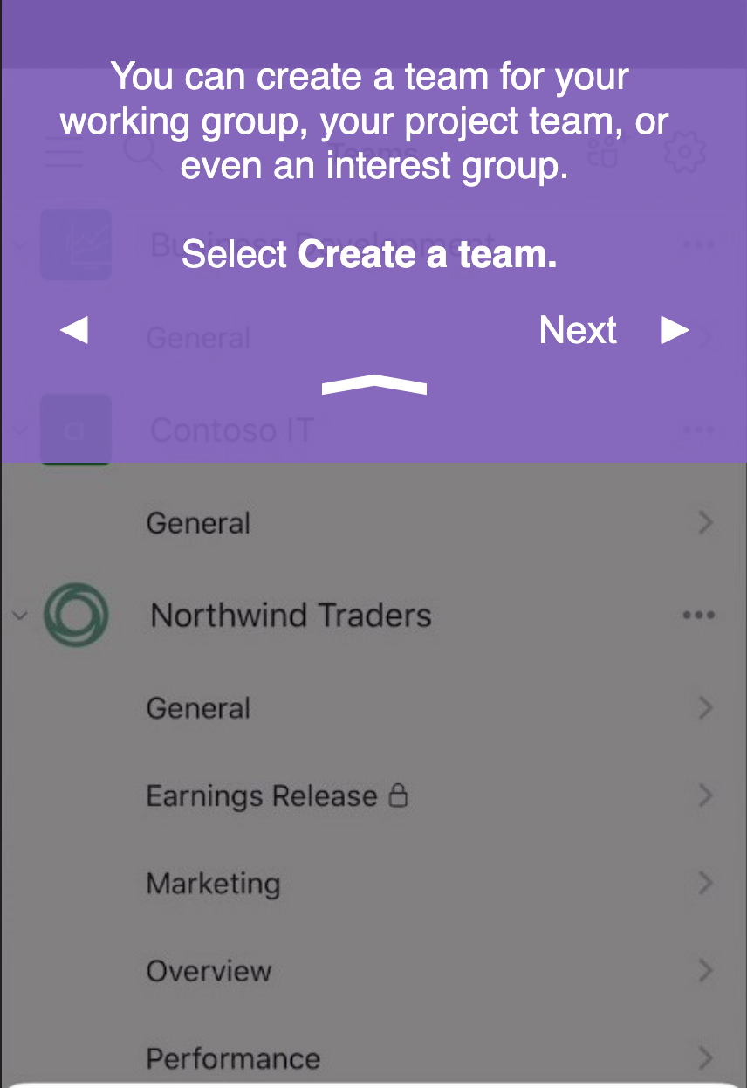
Creating a Team
In order to create a team please:
Send an email to ithelp@bu.edu

Slide 17
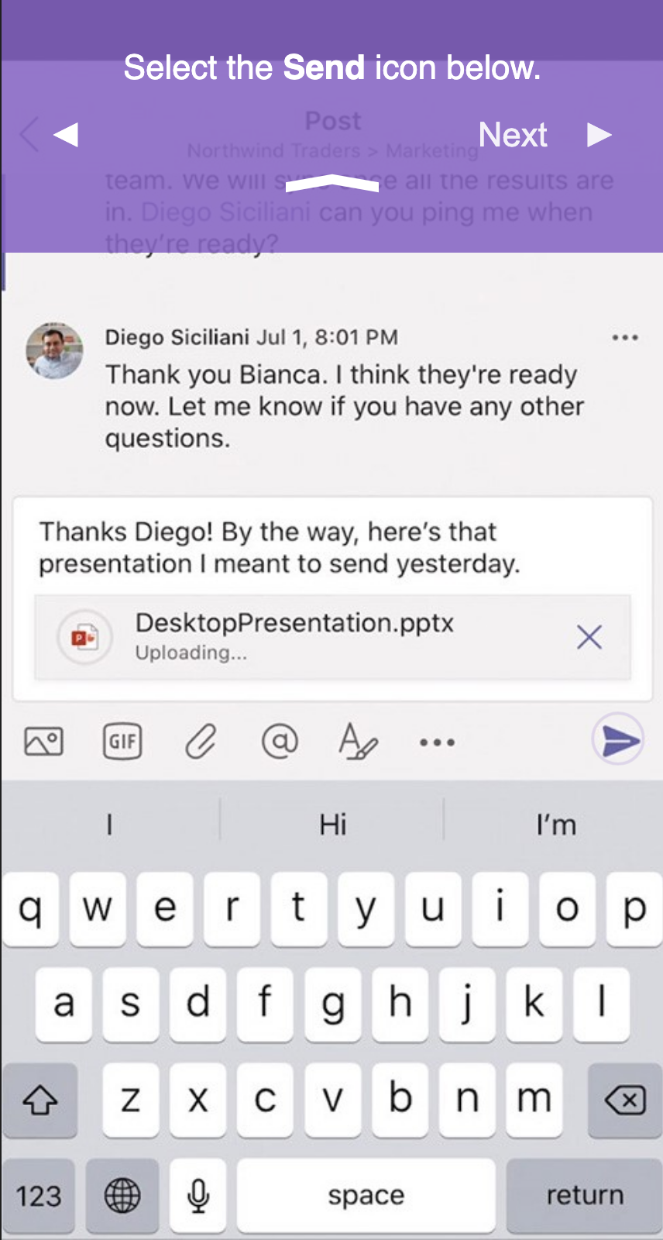
Texting
Select the Send icon below.

Slide 18
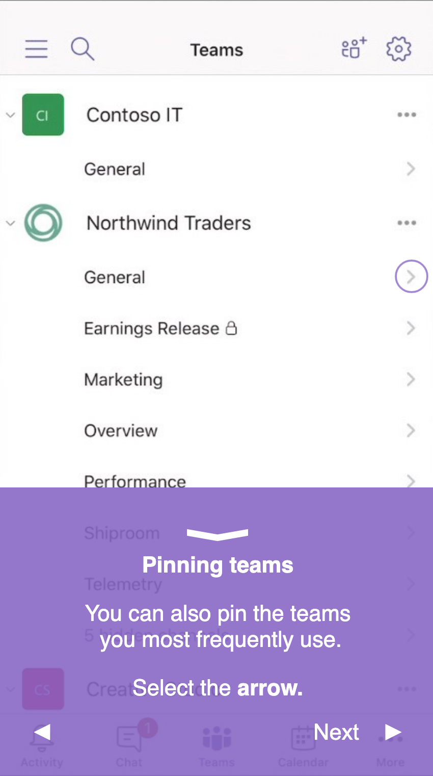
Pinning teams
You can also pin the teams you most frequently use.
Select the arrow.

Slide 19
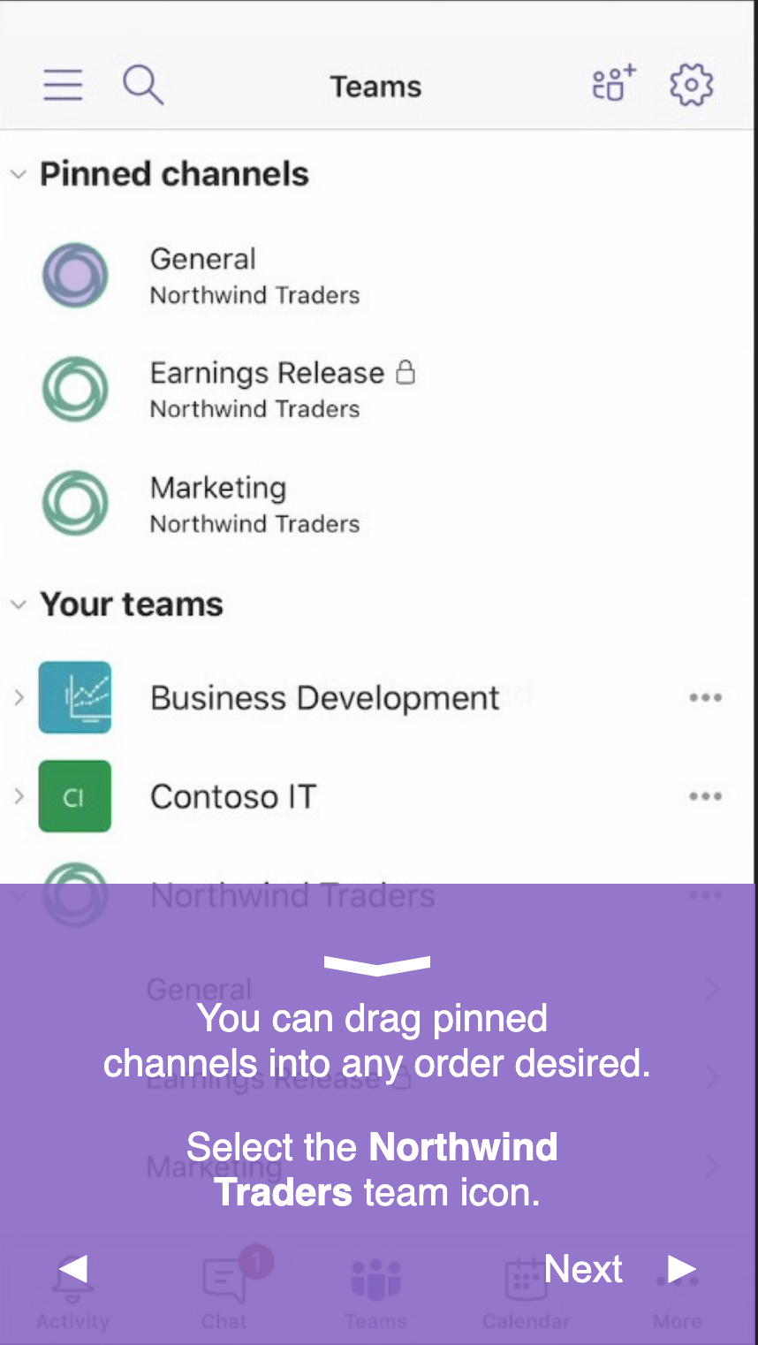
Pinning teams
You can drag pinned channels into any order desired.
Select the Northwind Traders team icon.

Slide 20
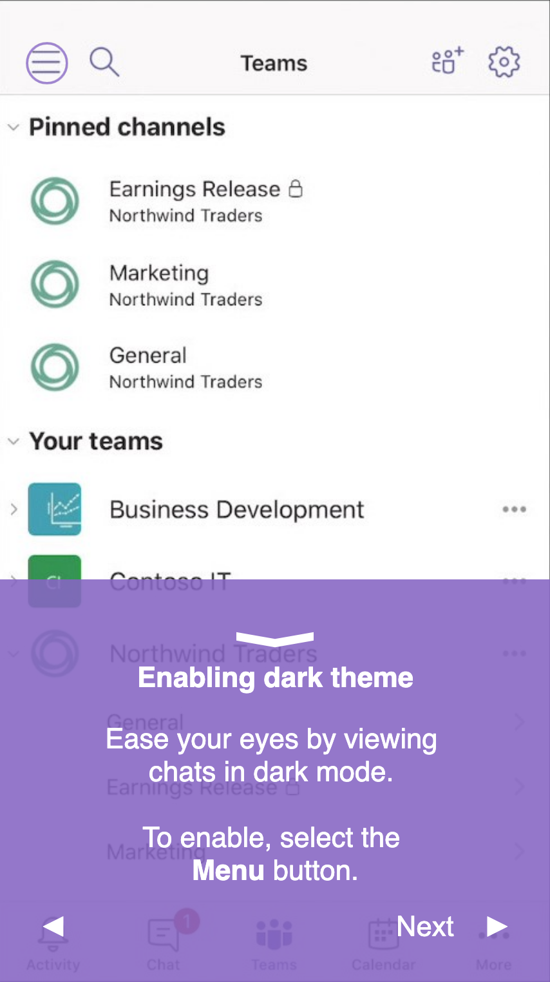
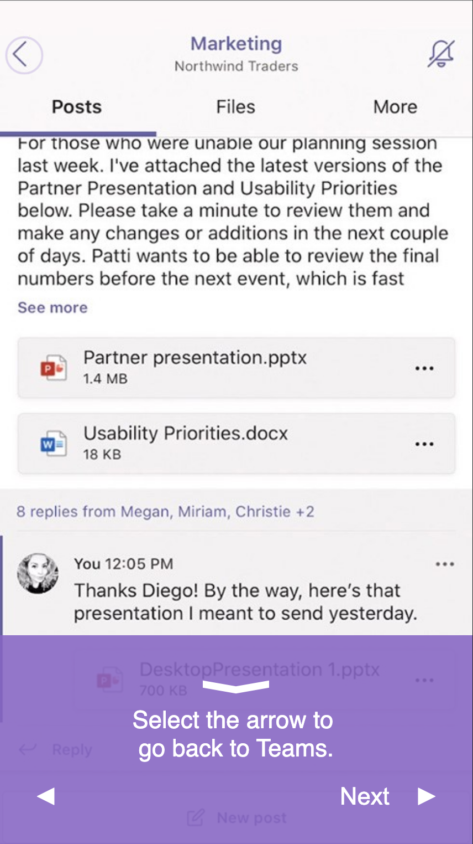
Enabling dark theme
Enabling dark theme
Ease your eyes by viewing chats in dark mode.
To enable, select the Menu button.

Slide 21
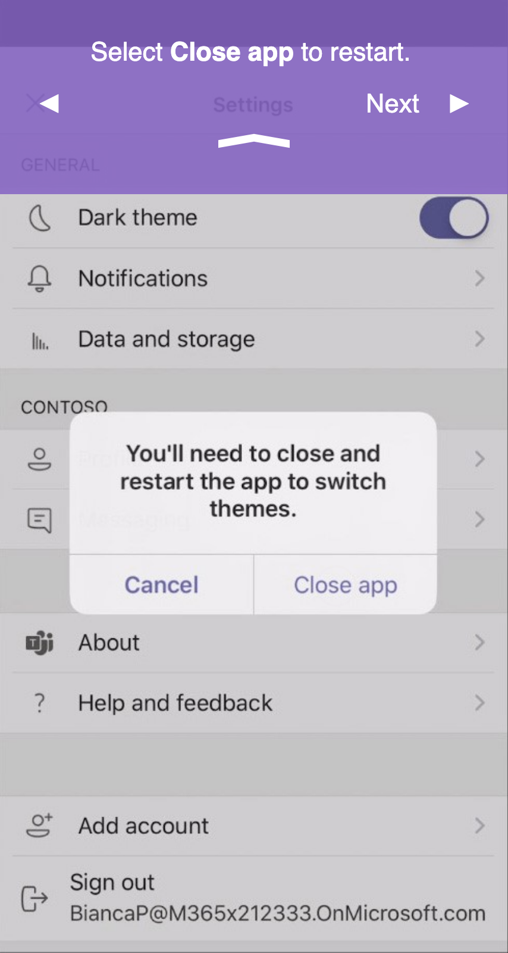
Enabling dark theme
Select Close app to restart.

Slide 22
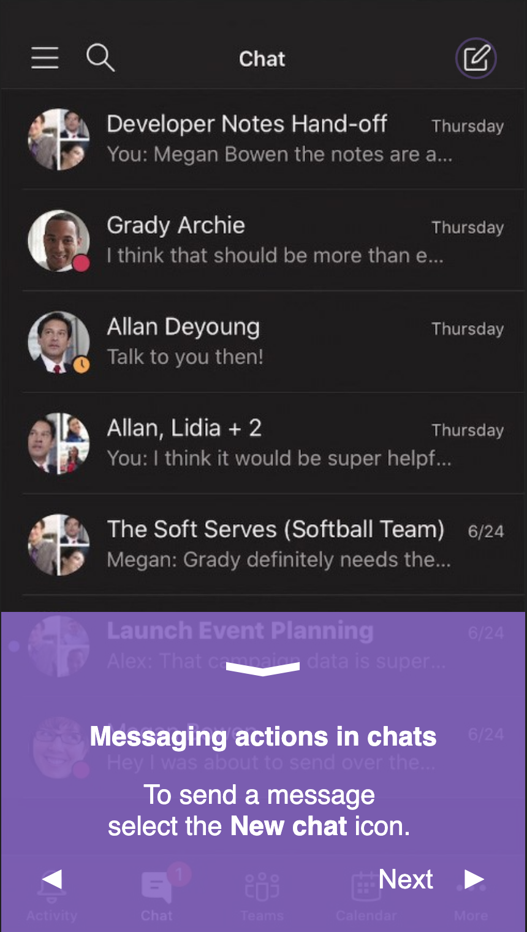
Messaging
Messaging actions in chats
To send a message select the New chat icon.

Slide 23
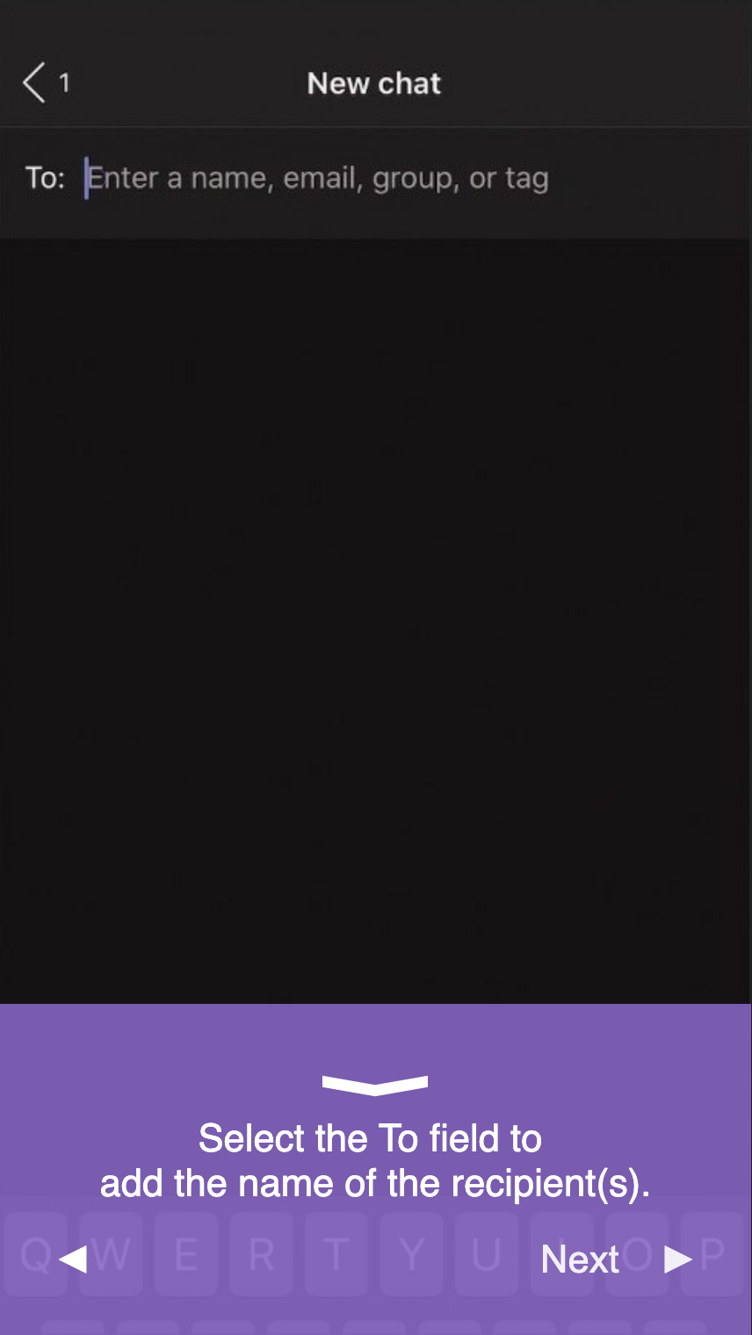
Messaging
Select the To field to add the name of the recipient(s).

Slide 24
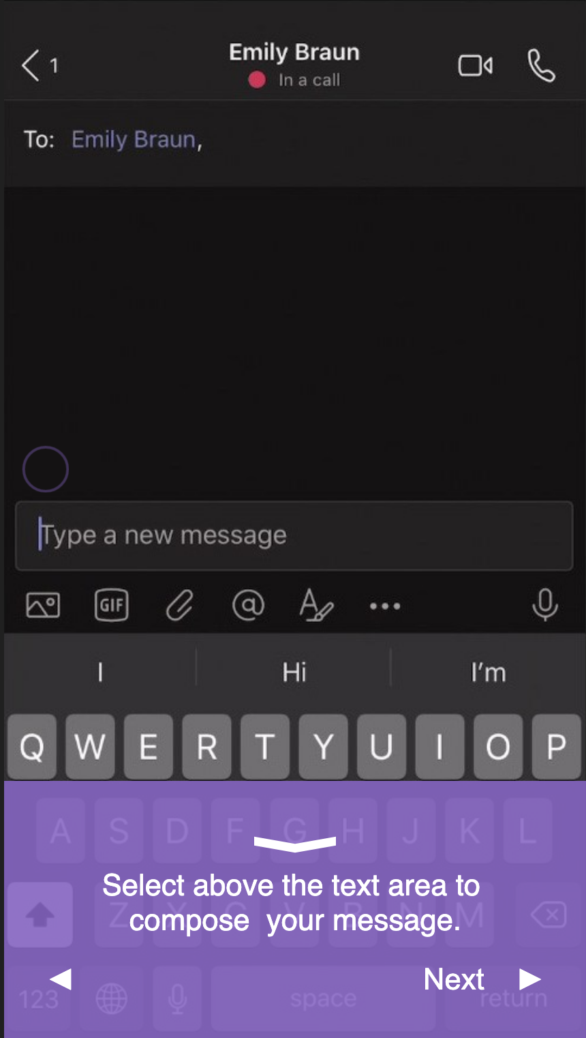
Messaging
Select above the text area to compose your message

Slide 25
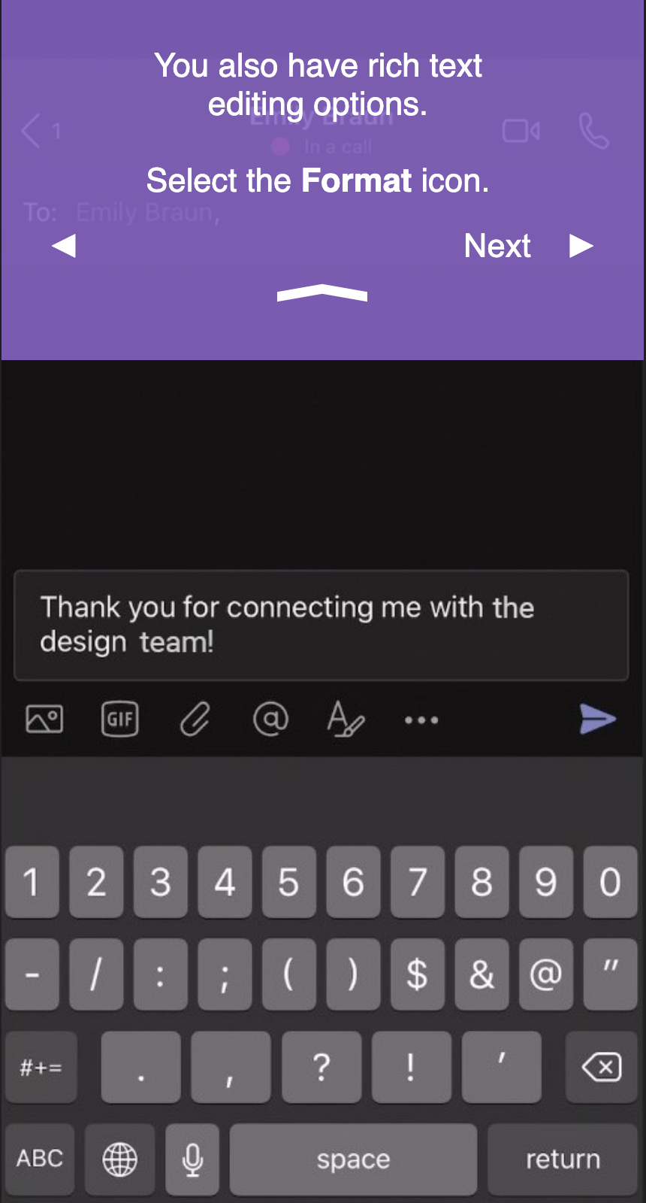
Messaging
You also have rich text editing options.
Select the Format icon.

Slide 26
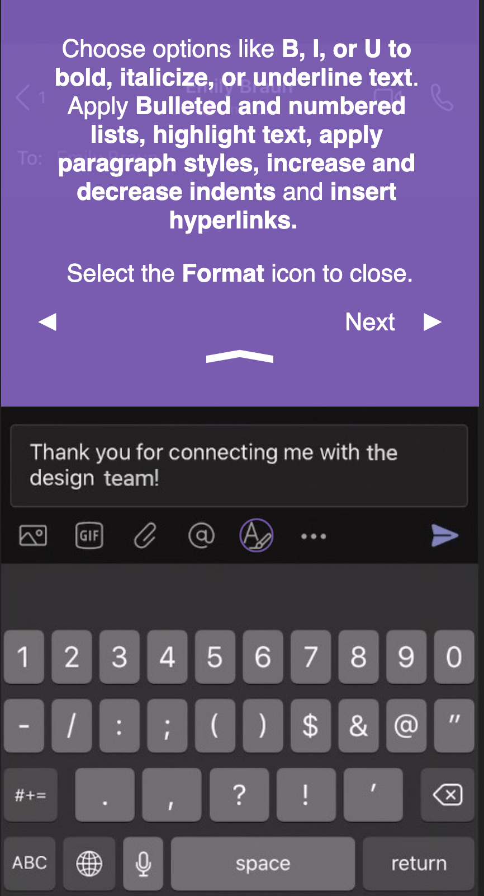
Messaging
Choose options like B, I, or U bold, italicize, or underline text. Apply Bulleted and numbered lists, highlights text, apply paragraph styles, increase and decrease indents and insert hyperlinks.
Select the Format icon to close.

Slide 27
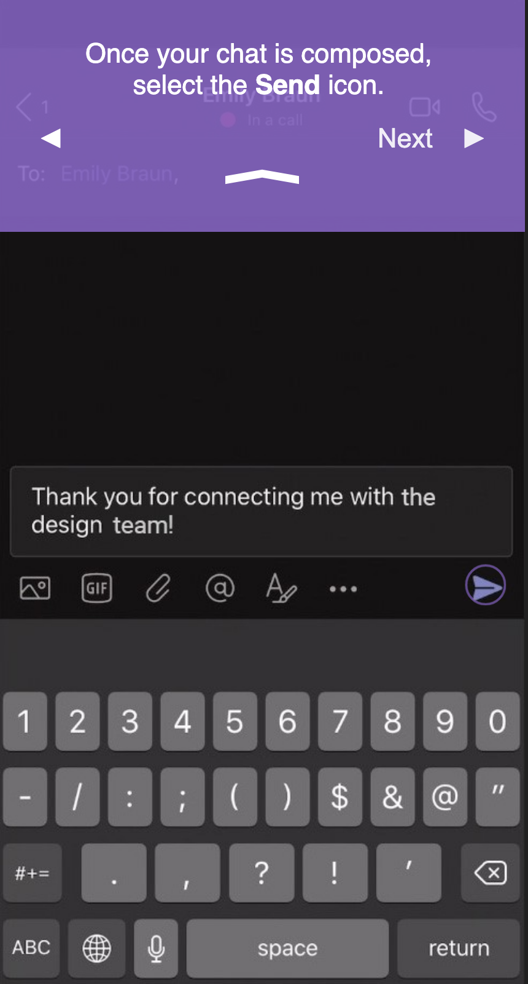
Messaging
Once your chat is composed, select the Send icon.

Slide 28
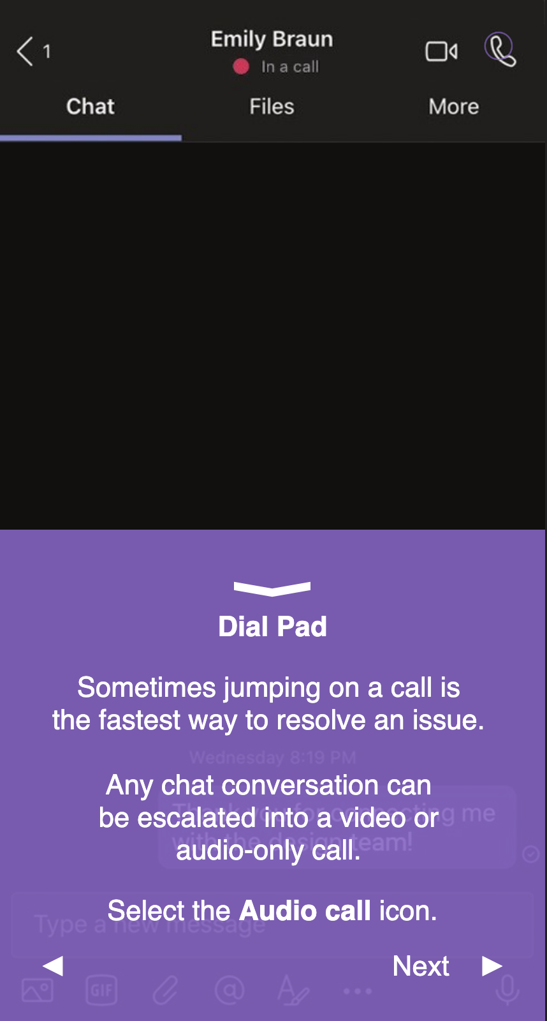
Dial Pad
Sometimes jumping on a call is the fastest way to resolve an issue.
Any chat conversation can be escalated into a video or audio-only call.
Select the Audio call icon.

