Slide 1

Talk About: Best Practices for LfA

Slide 2
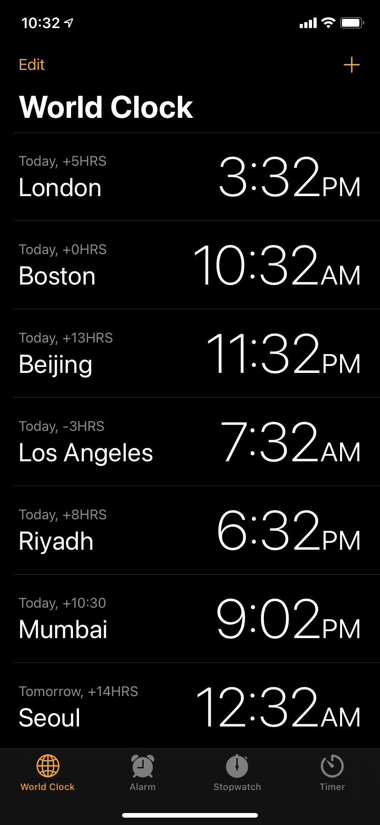
Challenges: Time Zones
Adjusting to the differences in time zones

Slide 3
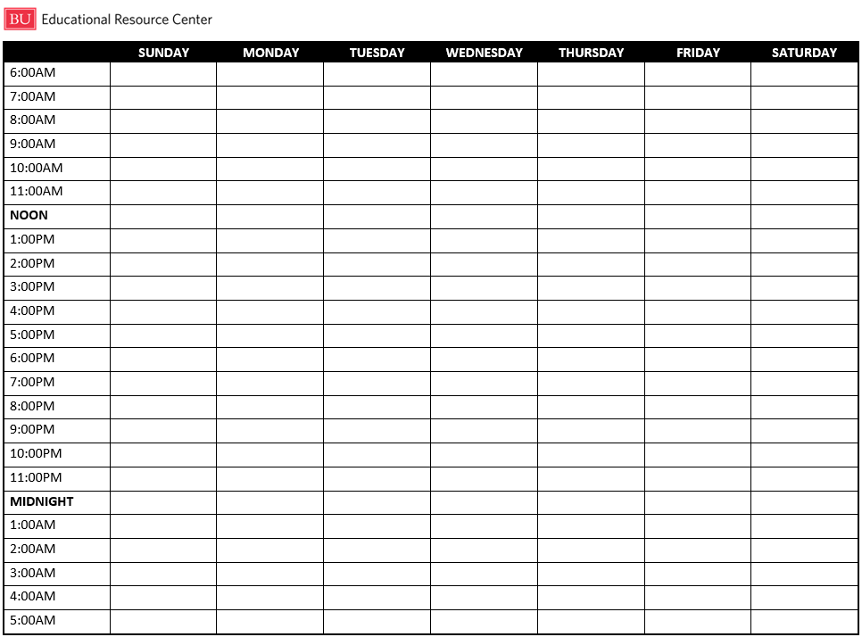
Best Practices: Create a 24-Hour Time Grid

Slide 4
How to Create Your Grid
Classes
Sleep
Meals and exercise
Study time
Free time

Slide 5
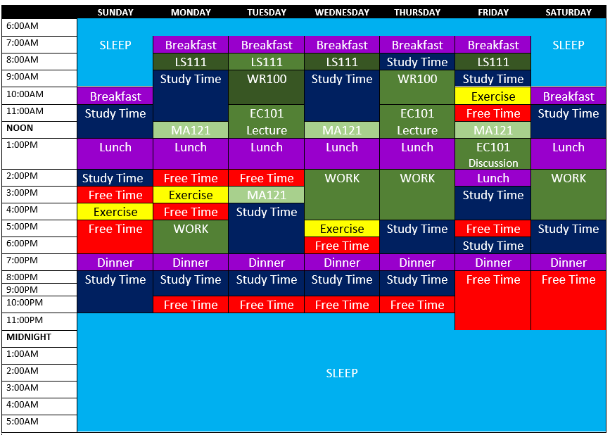
Boston

Slide 6
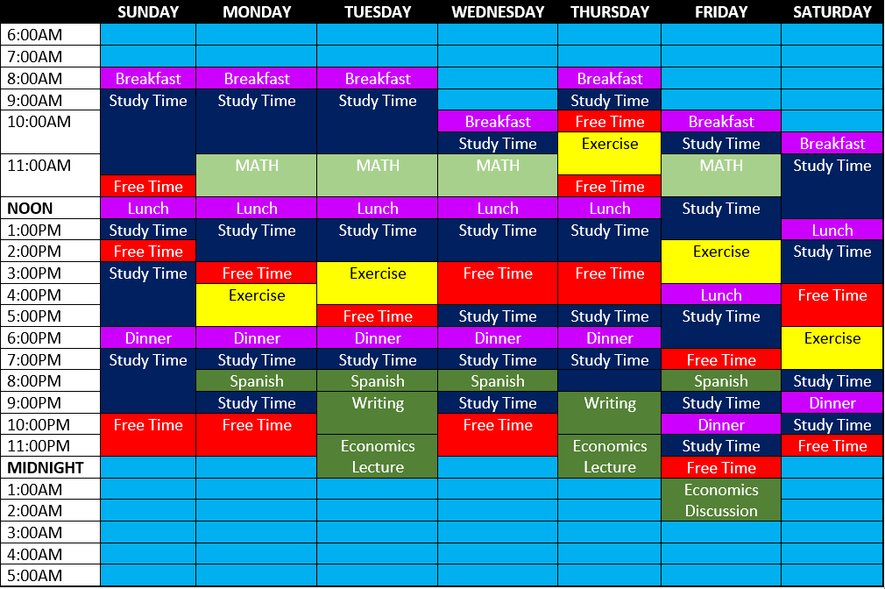
Boston + 12 Hours

Slide 7
Challenges: Communicating with Professors
Feeling disconnected from professors
Can’t attend office hours

Slide 8
Best Practices: Communicating with Professors
First class
Virtual office hours and meetings
Email etiquette

Slide 9
Challenges: Asynchronous Courses
Falling behind
Lack of motivation

Slide 10
Best Practices: Asynchronous Courses
Specific times
Tips to increase motivation
Chunking

Slide 11
Weekly Study Plan
CLASS | Biology
Assignments | Watch Asynchronous Lectures Read Chapter 13 (pages 150-185)
Sunday | Read pages 150-160, take notes
Monday | Watch lecture & take notes: 2-2:30pm, 3-3:30pm Read pages 161-166, take notes
Tuesday | Watch lecture & take notes: 7-7:30pm, 8-8:30pm Read pages 167-172, take notes
Wednesday | Watch lecture & take notes: 2-2:30pm, 3-3:30pm Read pages 173-178
Thursday | Watch lecture & take notes: 7-7:30pm, 8-8:30pm Read pages 179-185
Friday | Review notes from lecture & textbook

Slide 12
Challenges: Connecting to the Community
Disconnected from classmates
Disconnected from broader BU community

Slide 13


Best Practices: Connecting to the Community
Discussion forums
Zoom: chat & breakout rooms
Slack
Study group + accountability partner
Casual social interactions
Get involved

Slide 14
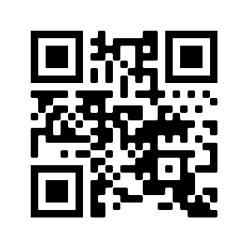
Looking for a Place to Study or Attend Class Remotely on Campus?
Study Space App: bu.edu/studyspace

Slide 15
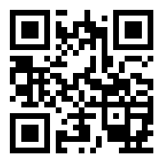

Services offered remotely via Zoom
bu.edu/erc
Academic Skills Advising
Language Link
Peer Tutoring
Workshops
Writing Assistance
@BU_ERC
@BUERC
@BUERC

Slide 16

Best Practices: Breakout Rooms
Introduce yourself:
Name
Program and year

Slide 17
Best Practices and Advice from IPM’s

Slide 18

Questions & Answers
in Chat

Slide 19
Additional Resources
Behavioral Medicine Sleep Hygiene
Behavioral Medicine Sleep Resources
Blackboard Learn Videos for Students
BU Information Services & Technology
Headspace

Slide 20
References
Amenabar, T. (2020, Sept. 6). How college students can make the most of remote learning. The Washington Post. Retrieved from https://www.washingtonpost.com/education/2020/09/06/remote-learning-college-zoom/
Ariga, A. & Lleras, A. (2011). Brief and rare mental “breaks” keep you focused: Deactivation and reactivation of task goals preempt vigilance decrements. Cognition, 118 (3), 439-443. doi.org/10.1016/j.cognition.2010.12.007.
Armstrong (2017, August 14). The roles of glucose in the brain. Retrieved from https://healthfully.com/358622-the-roles-of-glucose-in-the-brain.html
Berman, M. G., Jonides, J., & Kaplan, S. (2008). The cognitive benefits of interacting with nature. Psychological Science, 19, 1207–1212. doi:10.1111/j.1467-9280.2008.02225.x
Bouranova, A. (2020, Oct. 13). Life for international students? Fear. And resilience. BU Today. Retrieved from https://www.bu.edu/articles/2020/life-for-international-students-fear-resilience/
Cussler, S. & Gosselink, K. “Learning Strategies.” Academic Continuity, Mar. 2020, academiccontinuity.yale.edu/students/learning-strategies.
Diekelmann, S., & Born, J. (2010). The memory function of sleep. Nature Reviews Neuroscience, 11, 114–126. doi:10.1038/nrn2762
Doyle, T., & Zakrajesk, T. (2019). The new science of learning: How to learn in harmony with your brain. Second edition. Stylus Publishing.
Friedman, J. (2015, June 15). Ways to bounce back after falling behind in an online course. U.S. News & World Report. Retrieved from: https://www.usnews.com/education/online-education/articles/2015/06/15/ways-to-bounce-back-after-falling-behind-in-an-online-course
Goel, N., Rao, H., Durmer, J. S., & Dinges, D. F. (2009). Neurocognitive consequences of sleep deprivation. Seminars in Neurology, 29, 320–339. doi:10.1055/s-0029-1237117
George Washington University English for Academic Purposes. (2020). 10 tips for international students studying online at GW. Retrieved from https://eap.columbian.gwu.edu/sites/g/files/zaxdzs1941/f/10%20Tips%20for%20Online%20International%20Students_Summer%202020.pdf
Laskowski, A. (2020, Oct. 16). Dealing with loneliness in college during a pandemic. BU Today. Retrieved from https://www.bu.edu/articles/2020/loneliness-in-college-during-pandemic/

Slide 21
References continued
Jahnke, A. (2020, Oct. 13). Need to find a place to study or attend a class remotely while on campus? It just got easier. BU Today. Retrieved from http://www.bu.edu/articles/2020/new-student-study-app-reserve-safe-study-spaces/?utm_campaign=bu_today&utm_source=email_20201014_full&utm_medium=2_must_read_1&utm_content=student
Masento, N. A., Golightly, M., Field, D. T., Butler, L. T., & van Reekum, C. M. (2014). Effects of hydration status on cognitive performance and mood. The British Journal of Nutrition, 111(10), 1841–1852. https://doi.org/10.1017/S0007114513004455
Oppezzo, M., & Schwartz, D. L. (2014). Give your ideas some legs: The positive effect of walking on creative thinking. Journal of Experimental Psychology: Learning, Memory, and Cognition, 4, 1142–1152. doi:10.1037/a0036577
Pilcher, J. J., & Walters, A. S. (1997). How sleep deprivation affects psychological variables related to college students’ cognitive performance. Journal of American College Health, 46, 121–126. doi:10.1080/07448489709595597
Rasch, B., & Born, J. (2013). About sleep’s role in memory. Physiological Review, 93, 681–766. doi:10.1152/physrev.00032.2012
Rivera, J. (2020). 10 tips for success in online classes. Retrieved from: https://www.usf.edu/education/about-us/news/2020/tips-success-online-classes.aspx
Scheiderer, J. (2020, Dec. 28). What’s the difference between asynchronous and synchronous learning? Retrieved from: https://online.osu.edu/resources/learn/whats-difference-between-asynchronous-and-synchronous-learning
Verleger, R., Rose, M., Wagner, U., Yordanova, J., & Kolev, V. (2013). Insights into sleep’s role for insight: Studies with the number reduction task. Advances in Cognitive Psychology, 9, 160–172. doi:10.5709/acp-0143-8
Weidlich, J. & Bastiaens, T.J. (2019). Designing sociable online learning environments and enhancing social presence: An affordance enrichment approach. Computers & Education, 142. doi.org/10.1016/j.compedu.2019.103622
Yale Poorvu Center for Teaching and Learning. (2020, Nov. 17). 7 tips for online learning: How to excel as an online student. Retrieved from: https://poorvucenter.yale.edu/7-Tips-for-Online-Learning

