Slide 1
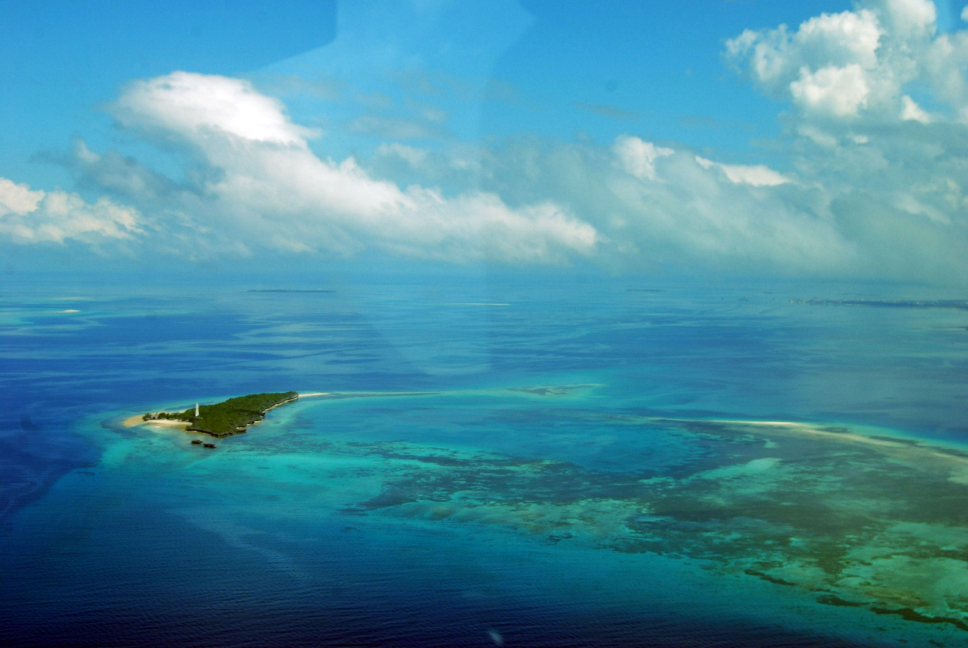


Zanzibar Global Health Technologies Program
Professor Muhammad Zaman
Informational Session

Slide 2
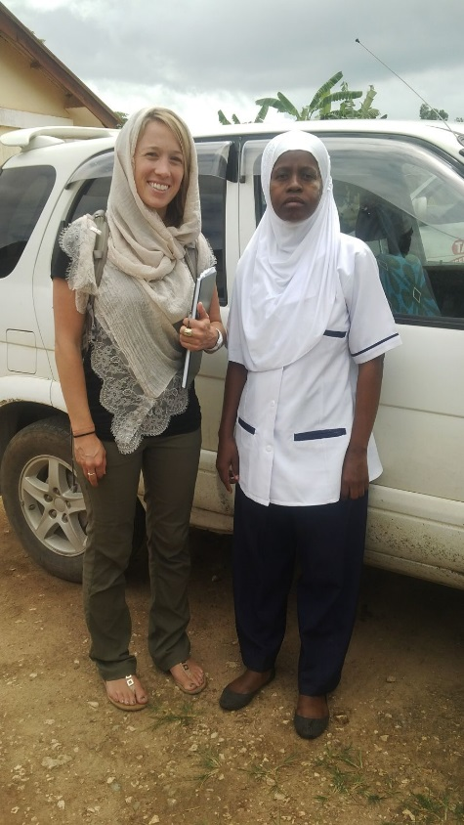
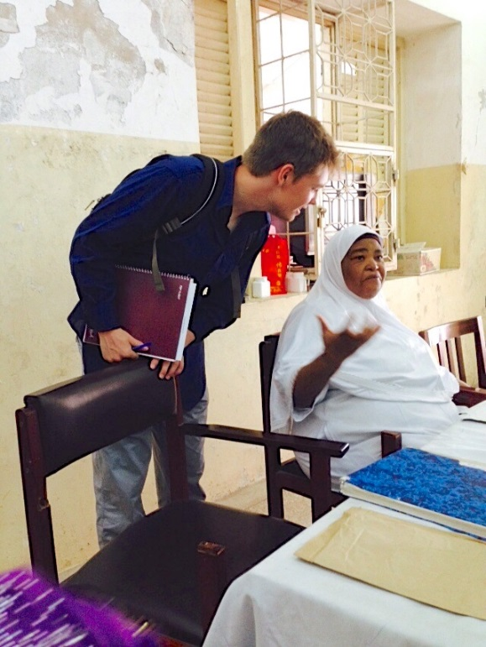
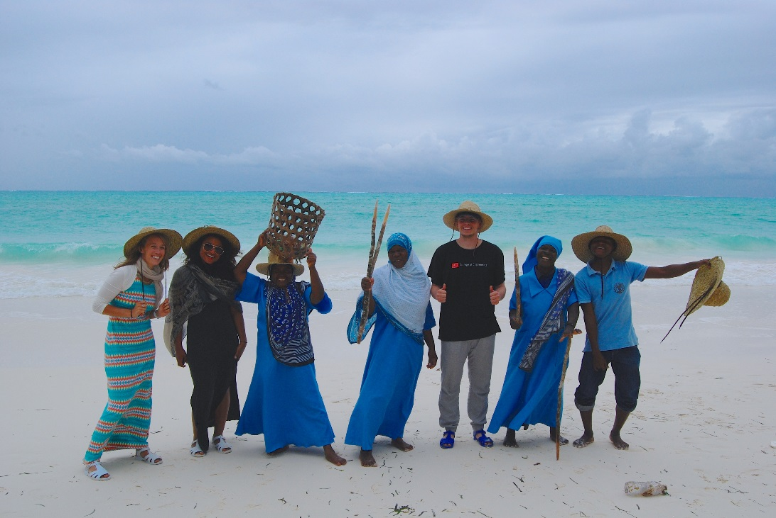
What makes this program different?
Project based curriculum
  You identify the problem and work towards your own solution!
Multidisciplinary
Gaining lab experience
Working in the field
Experience in a developing country
Working with local Zanzabari medical students
Input from local hospital staff
Cultural immersion
Experience beyond just developing a product in a lab
  Cultural barriers to adoption
  Policy aspects
  Field testing

Slide 3
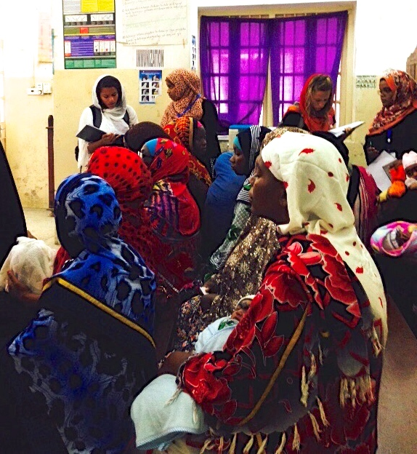
Outcomes
By the end of this program, you will have the ability to…
Apply knowledge and the fundamentals of engineering, mathematics and science to practical real-world problem
Design and conduct experiments
Collect, analyze and interpret data
Communicate effectively and work successfully in multidisciplinary and culturally diverse teams in a professional setting
Understand the social structures and societal values of the community in the context of technological adoption and usage
Recommend policy change based on lectures
Convey technical information to a non-scientific audience

Slide 4
Program Structure: Four Part Strategy
Designing device in Zaman Lab at BU (Fall 2015/Spring 2016)
Prototype testing with new and returning students (Summer 2016)
Continue work at BU while collaborating with SUZA students (Fall 2016/Spring 2017)
New students accepted into program (October/November 2016)
2015 2016
April May June July Aug Sept Oct Nov Dec Jan Feb March April May June July Aug Sept Oct Nov Dec
Work in BU lab
Work in lab + collaborate with SUZA
Work in BU lab
Zanzibar
New students accepted
Zanzibar

Slide 5
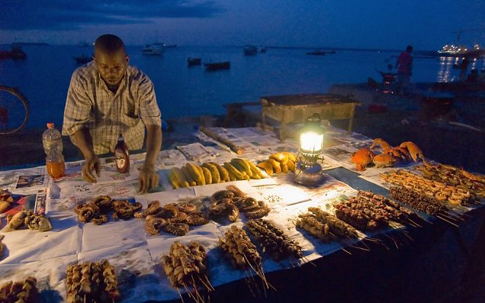
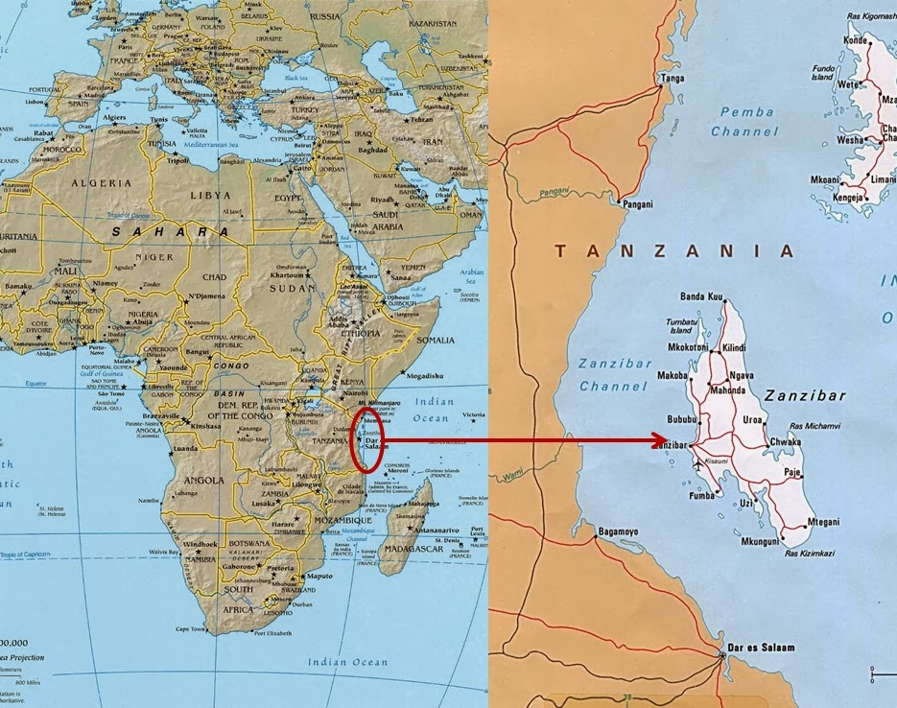
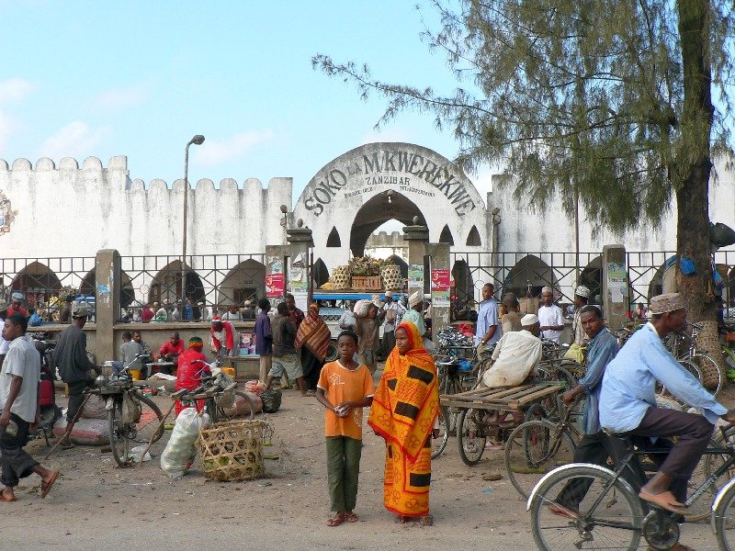
Zanzibar
Location: islands off east coast of Tanzania
  Unguja and Pemba
Population: 984,625
Languages: Swahili, English
Religion: 99% Muslim, 1% Christian
Economy: spice trade, tourism
History:
  1698: Sultanate of Oman
  Slave trade
  1890: British Protectorate
  1963: Independence and the Zanzibar Revolution
Government: semi-autonomous

Slide 6
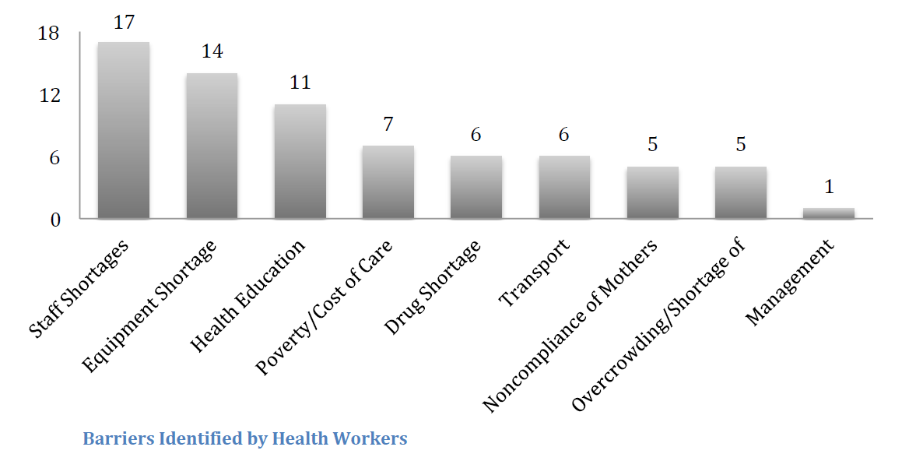
Public Health Issues in Zanzibar
Based on 2015 needs assessment:
Project focus:
Renal and liver function point-of-care diagnostic
*report by Sara Gravelyn
Notes:
116 mothers interviewed
Barriers identified by mothers – transportation, and cost of testing and supplements
Discuss at what stage of the project we are currently in;
discuss the considerations we are taking when building a device (cost, local context, portability, usability, reagents needed, etc)

Slide 7

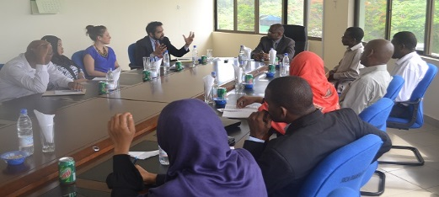
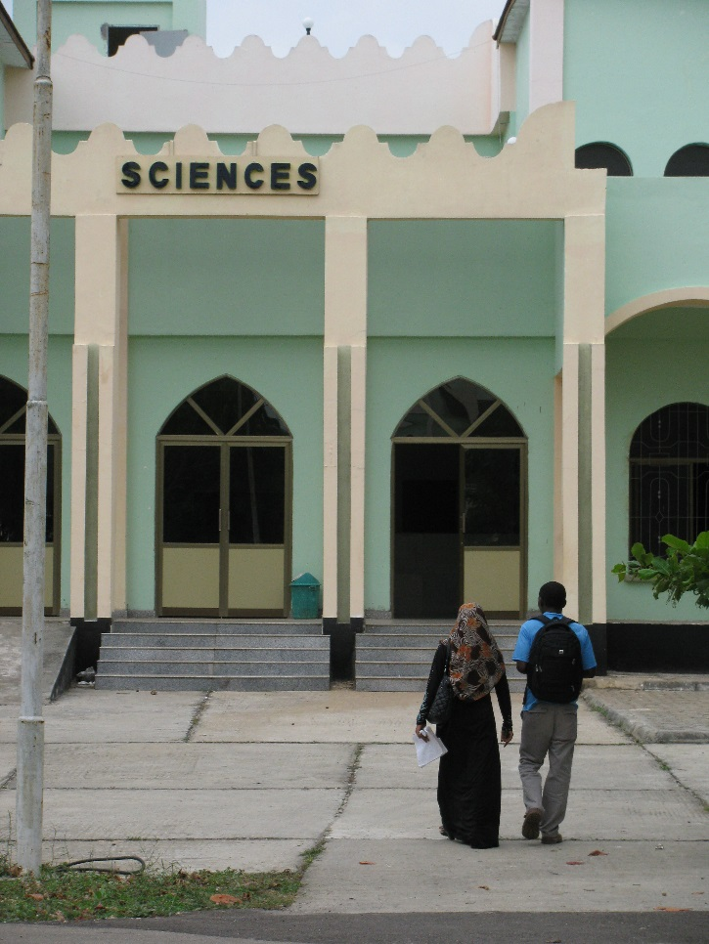
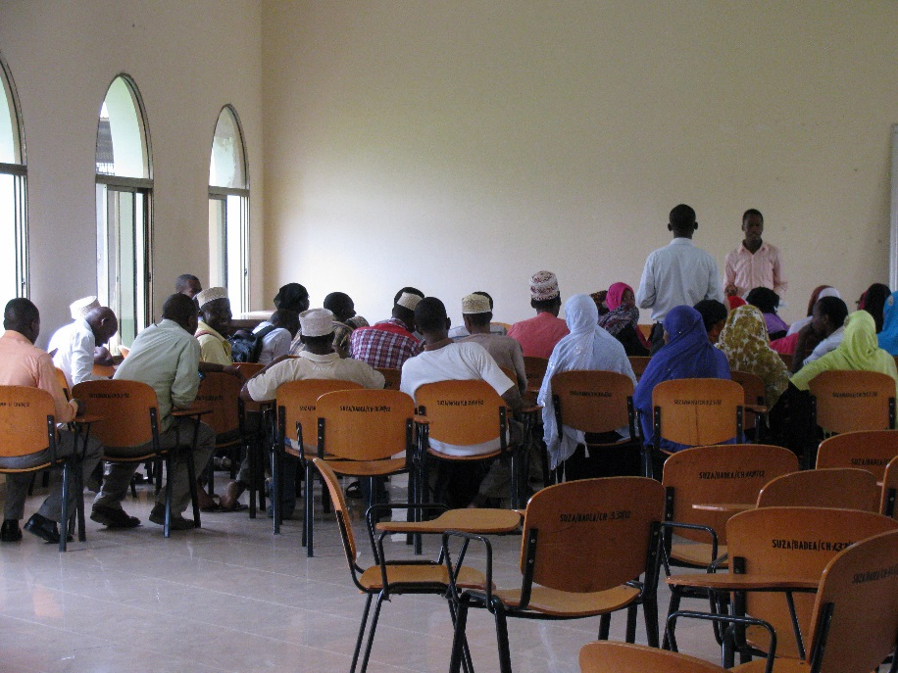
Summer field work
Partnering with State University of Zanzibar
  SUZA medical school affiliated with Mnazi Mmoja Hospital in Stonetown
Dates of Zanzibar field work: six week period during summer
Please note: to take part in this program, lab work is required but travel to Zanzibar is optional
Lab research and field testing in Zanzibar supervised Dr. Ishrat Bano (BU post-doc)
Accommodations are family homestays near the university

Slide 8
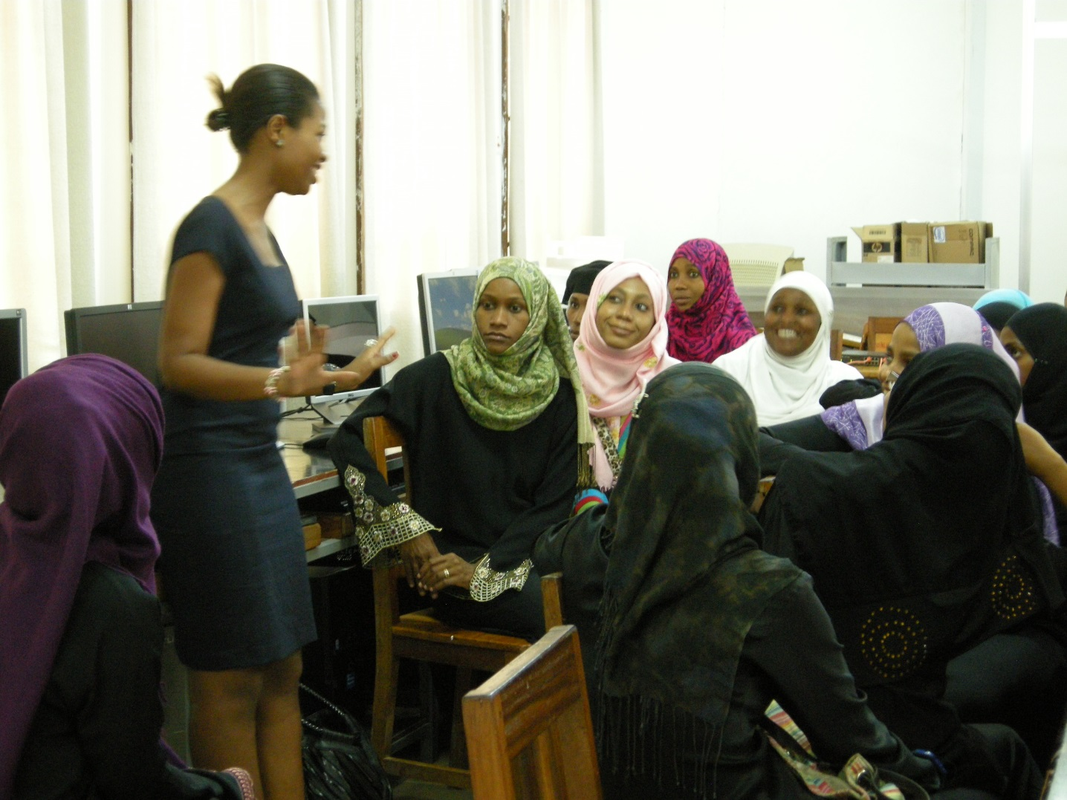
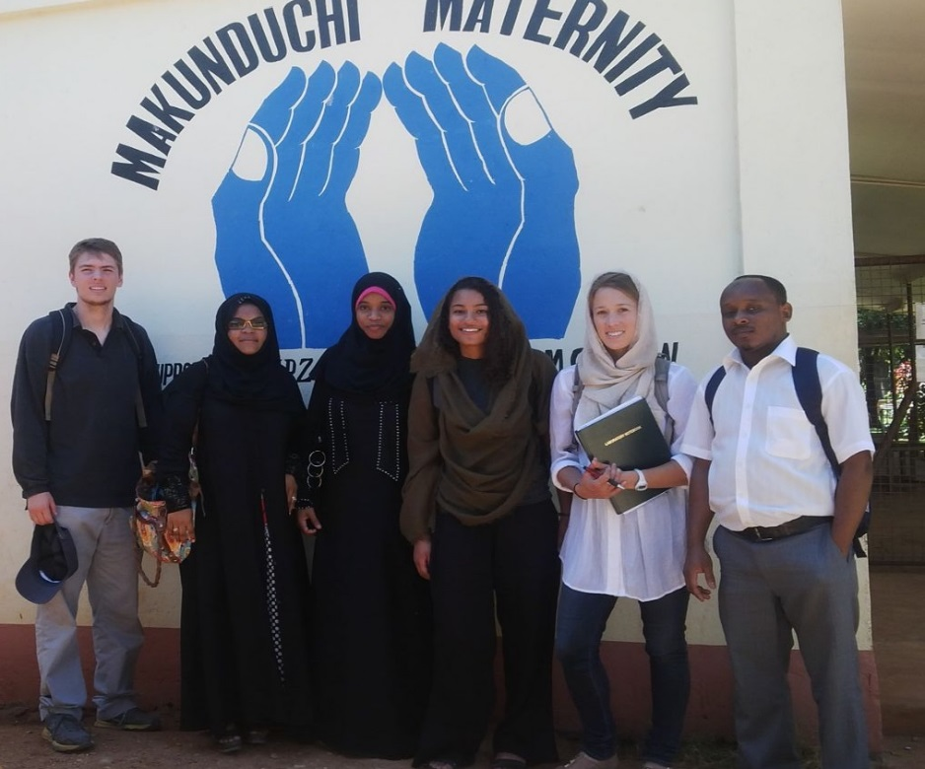
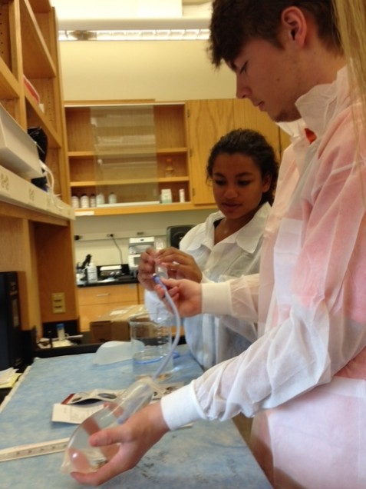
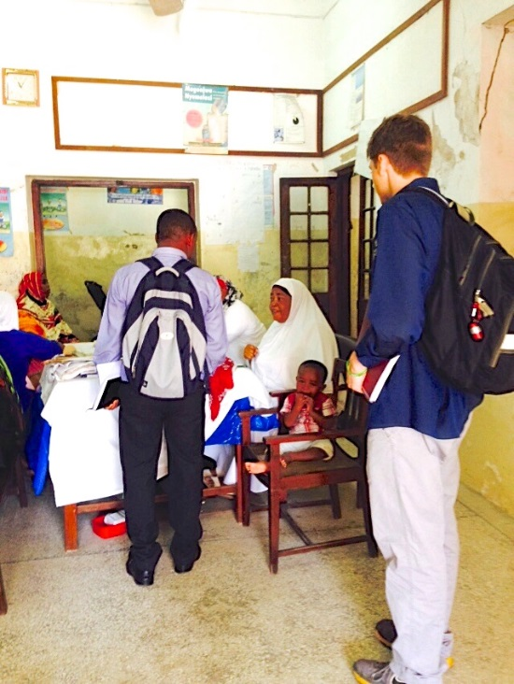
Fall and spring semester lab work
Current stage of program: preliminary research and design
  Review of point-of-care diagnostics currently in the market
  Survey medical community to develop device specifications
Working in Zaman Lab
  Estimated time commitment: 10 – 15 hours/week

Slide 9
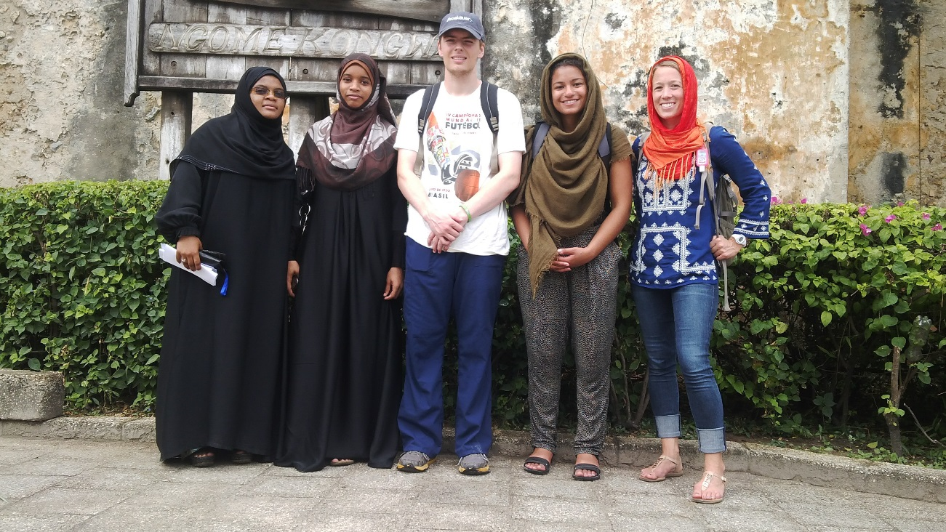
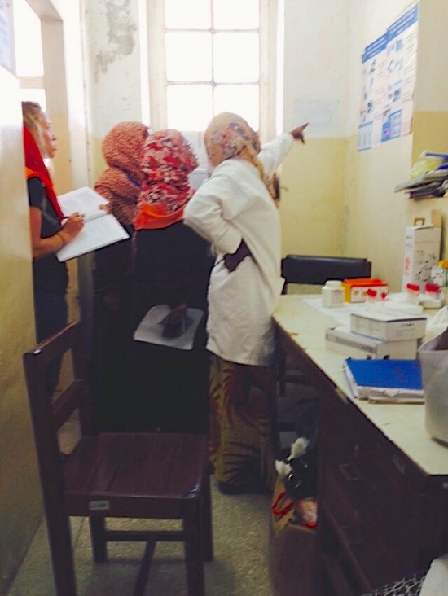
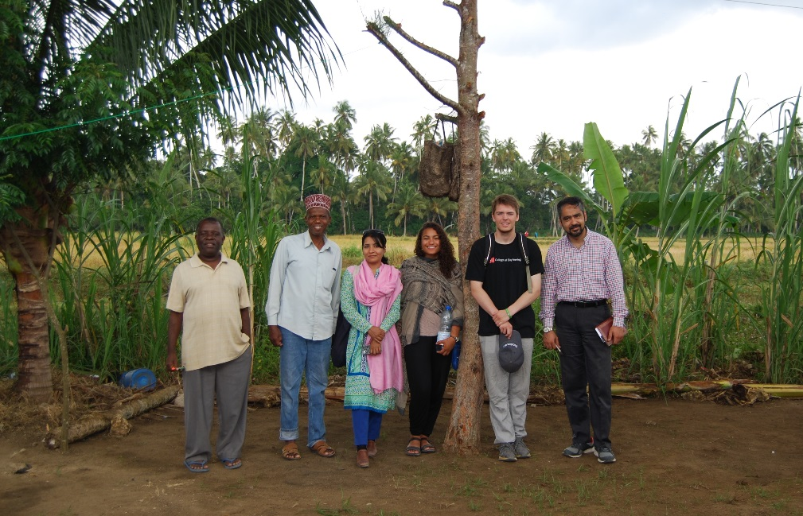
Assessment
Project
  Technical
  Policy
  Cultural
Blog posts
Final Report
Presentation
  In Zanzibar
  To BU community

Slide 10
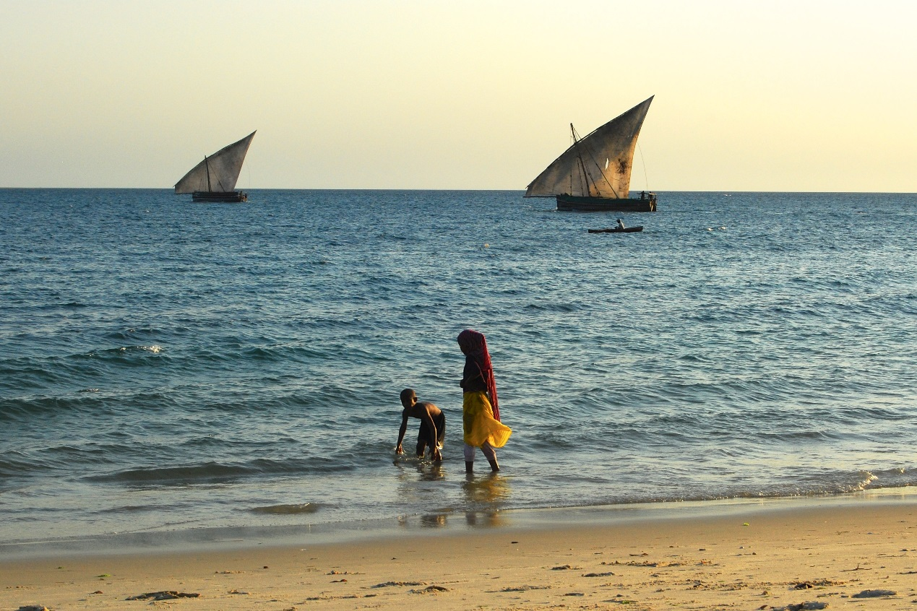
Application
Transcript
Can be unofficial copy
Essay
Brief, 1-2 page paper on a major health issue in sub-Saharan Africa and a basic idea on how to approach it
CV/Resume
Two minute video
Discuss why you should be accepted into the program
Please electronically send all of the following to Katie Clifford (clifford@bu.edu) by October 16th, 2015

Slide 11
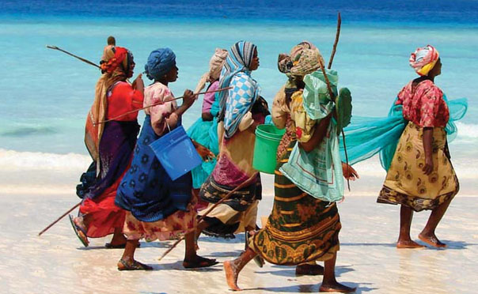
Questions?

