Slide 1


Special Training for
The Boston Consortium
May 31, 2023

Slide 2
SETTING INVESTIGATIONS UP FOR SUCCESS
011
What is the scope, what are the roles?

Slide 3

THE SCOPE OF THE INVESTIGATION
Allegations as the frame
Elements of each allegation
What if you need it only for credibility/reliability?
Too large: time, resources, loss of trust
Too small: not thorough, loss of trust
This Photo by Unknown Author is licensed under CC BY

Slide 4
EVIDENCE:
Gathering, Weighing, Analyzing
Avoiding Common Errors

Slide 5

Gathering EVIDENCE

Slide 6
Barriers to evidence collection
Non-participating parties, witnesses
Party who does not understand
Advice of advisor or family
Identity of witness unknown
Refusal to share materials
Materials lost or no longer accessible
Difficult topics
Notes:
BREAKOUT ROOM
Dealing with folks who are not cooperative
Let them know that they can participate partially
Don’t want to be interviewed, can still submit evidence, witness names, questions, respond to evidence, etc.
Stopping interviews for bad behavior by party or witness
Documenting what is sad and what is not said
Document questions asked, particularly if no answer is provided.
Document evidence sought but not obtained and the reasons therefore
Investigate the authenticity of evidence and document that process and what you learned about it

Slide 7

Evidence That is “Not Relevant”
questions and evidence about the complainant’s sexual predisposition or prior sexual behavior are not relevant
information protected under a legally recognized privilege, unless the person holding such privilege has waived the privilege
supportive measures
emergency removal

Slide 8
INVESTIGATION FLAWS
Who else saw that?
Didn’t ask
Didn’t gather
Inconsistency?
Weighing what you don’t have
Failed to explain
What do you mean?
Notes:
Investigation Time line- look at pre assault behavior

Slide 9

If You Didn’t Gather It, You Cannot Weigh It
“Then, when I learned they had seen it on the video, I got really upset”
What video?
Who saw it?
What was on it?
Who took it?
Do you have a copy?
Who has a copy?

Slide 10

She Texted Me “All the Time”
Do you have those texts?
May I have those texts?
Oh, they weren’t ‘texts,’ they were DMs?
Who else might have seen them?
Was anyone else copied?

Slide 11
They Never Explained
First Complainant said there were three friends of theirs in the bar. In the second interview, Complainant said there were “a few people, maybe 5 or 6 friends” in the bar. Based on this inconsistency, I find that Complainant lacks credibility.
Respondent never mentioned that they had been in a relationship with Witness 2, a key witness. Because they did not offer this information, Respondent lacks credibility.
The witness did not explain where she was standing, and how she could have seen into the room, and therefore is not a reliable witness.

Slide 12
“I Didn’t Want to, But I Felt Coerced”
What does that mean to you?
Can you describe what that felt like to you?
At the time, what did you think might happen if you said “no”?
How many times did they ask you? Over what period of time?
How many people were around? In what type of space?
In addition to asking repeatedly, was anything else going on?
Was there a threat? Of what? How was it expressed?

Slide 13

WHAT LANE IS YOUR LANE?
Investigator
Title IX Coordinator
Supervisor of Coordinator
College/University President
Counsel’s office
Outside counsel

Slide 14

DEAR COUNSEL . . . WHAT LANE ARE YOU IN?

Slide 15

HEARINGS
But that’s not what I heard . . .
Notes:
Jody

Slide 16
HEARINGS
Live, but can be remote
No compelled participation
Cross-examination/questioning
Relevancy: Hearing Officer/Panel
Written decision with road-map
No new evidence
Once more: No new evidence
Notes:
BREAKOUT ROOM
Dealing with folks who are not cooperative
Let them know that they can participate partially
Don’t want to be interviewed, can still submit evidence, witness names, questions, respond to evidence, etc.
Stopping interviews for bad behavior by party or witness
Documenting what is sad and what is not said
Document questions asked, particularly if no answer is provided.
Document evidence sought but not obtained and the reasons therefore
Investigate the authenticity of evidence and document that process and what you learned about it

Slide 17

Being Trauma-Informed
Training your panel/adjudicators
Asking questions
Asking “why”
Filtering questions of the parties
Preparing parties
Reviewing the investigation report
Sharing their story again
Answering questions again
The attraction of prurient interests

Slide 18

CULTURAL COMPETENCY AT A HEARING
Credibility based on . . .
The myth of “I know how I would have reacted . . .”
Impact statements

Slide 19
QUESTIONS ABOUT Credibility/RELIABILITY
If Complainant does not participate, can you judge credibility?
Do you need to see demeanor to note credibility?
Does an appeal officer ever determine credibility?

Slide 20
EVIDENCE:
Gathering, Weighing, Analyzing
Avoiding Common Errors

Slide 21
Evaluating the Evidence
Is it relevant?
Evidence is relevant if it has a tendency to make a material fact more or less likely to be true.
Is it authentic?
Is the item what it purports to be?
Is it credible/reliable?
Is the evidence worthy of belief?
What weight, if any, should it be given?
Weight is determined by the finder of fact!
Notes:
This slide will can remain and it can set the stage for Wednesday- where Joel and I will get more into evaluating evidence, OR, it can be removed from this presentation and used as a part of Wednesdays training. Hoping for your input Joel.

Slide 22
Authenticating Evidence
At 1:18 am, Pat captured a video of Elliott and Sam. In the video, Sam had one arm around Elliott’s shoulders, and Elliott’s head was resting on Sam’s shoulder. In the video, both Sam and Elliott, and at least 2 others, were loudly singing Happy Birthday, although the video cut out before the singers said the name of the person to whom they were singing.
Elliott alleged that Sam later sent him a threatening message, and the next day showed up at his dorm, uninvited, twice. Elliott stated he did not have the message, because it was on SnapChat, but had kept a screenshot of the message, although the screenshot cut off part of the message. Sam denied sending any threatening message, and also stated that he never used SnapChat.

Slide 23
practice on weighing evidence
Expert testimony
Polygraph examiner's report
News article that the college has a history of covering up sex assaults
Case involves DV and allegation of strangulation. Witness discusses respondent's repeated angry outbursts in social situations and class settings.

Slide 24
Credibility and Reliability
Why they are different
How to write about it
When a party attacks credibility of the other, but on a non-issue (delay in reporting, did not go to law enforcement, minimized the report in comments to a friend or family)
How to ask questions to get to the bottom of it without being offensive

Slide 25
Assessing Credibility and Reliability
NO FORMULA EXISTS, BUT CONSIDER THE FOLLOWING:
Opportunity to view
Ability to recall
Motive to fabricate
Plausibility
Consistency
Character, background, experience, & training
Coaching
Bias
Notes:
opportunity to view (lighting, distance, duration,
angle, obstructions, etc.)
ability to recall (e.g., passage of time, influence of alcohol/drugs)
motive to fabricate (e.g., interest in outcome, bias,
hostility, expectation of benefit)
plausibility (logical, consistent with experience and
common sense)?
consistency (internal or external)
character, background, experience, and training
Coaching
Your own bias and limited experience

Slide 26
Credibility/Reliability Analysis
Step by Step
Determine the material facts – focus only on material facts.
Determine which material facts are:
  Undisputed – consistent, detailed and plausible, and/or agreed upon by the parties [e.g., Marcy and Jack attended a fraternity party on April 5, 2019]
  Disputed – unsupported by documentary or other evidence, or are facts about which an element of doubt remains [e.g., Marcy alleged that Jack kissed her without her consent around 1am at the party, and Jack asserted he never kissed Marcy and went home early]
  State clearly which facts are accepted, and which are rejected, and state the reasons why.
“While Jack maintained that he never kissed Marcy and went home early, several witnesses corroborated that he was at the party until 3 a.m. In addition, a photo was submitted by a witness showing Jack kissing Marcy. Therefore, I find that Jack’s version of events cannot be credited as being more likely than not to be true.”

Slide 27
Internal Consistency
Consistency Over Time
Did the person share the same version of events in all settings, including interviews, in written and/or verbal statements and between documentary evidence?
Are there any discrepancies or contradictions?
Is there a sufficient explanation for any discrepancies?

Slide 28
Consistency with Other Evidence or Testimony
Is the testimony or evidence consistent with the other evidence?
Is the testimony or evidence inconsistent with the other evidence?
Is there a sufficient explanation for any inconsistencies?

Slide 29
Corroboration
Is there witness testimony (either by witnesses or people who saw the person soon after the alleged incident, or people who discussed the incidents with the person around the time they occurred) or documentary or physical evidence that corroborates the person’s testimony?
Is there witness testimony or documentary and/or physical evidence that are inconsistent with statements made during the interview or does not provide corroboration to the person’s version of events?

Slide 30
Inherent Plausibility / Logic
Is the testimony believable on its face?
Does it make sense?
Could it have occurred?
Does it make sense that this person knows this information?
What was their opportunity to view/hear/know?

Slide 31
Material Omission
Did the person omit material information?
If so, what?
  e.g., submitted partial text messages, or omitted text messages that could be perceived as unfavorable
Is there a reasonable reason for the material omission?

Slide 32
Past Record
Is there a history of similar behavior in the past?
  e.g., a supervisor had previous complaints of sexual misconduct
If so, this might impact whether a statement should be believed.
  For example, a respondent who states they never knew that a certain behavior was wrong, yet was written up for that same behavior; the history of similar past behavior makes the respondent’s statement less believable and less reliable.

Slide 33
Ability to Recollect Events
What is the extent the person was able to perceive, recollect or communicate the version of events?
  e.g., the person reported they were intoxicated, or the person reported they were sleeping

Slide 34
Transparency Is Your Friend
Investigator should show their work
Decision-maker should show their work, rationale, and road-map
Sanctioning officer should provide some rationale, particularly for mitigating or aggravating circumstances
Notice letters should clearly show how to file an appeal – to whom, what email, and the specific date
  No: Within 5 days of receipt
  Yes: Any appeal is due, with any relevant attachments, no later than 5 pm Eastern on Wednesday, March 15, 2027.

Slide 35

Why Give Them a Road Map?
Trust
Education
Trust

Slide 36
APPEALS AND SANCTIONS

Slide 37
ALL APPEALS
Trauma-Informed
Each in their lane: The limits of an appeal officer’s task
Fundamental Fairness
Due Process
Follow Your Process
Notes:
BREAKOUT ROOM
Dealing with folks who are not cooperative
Let them know that they can participate partially
Don’t want to be interviewed, can still submit evidence, witness names, questions, respond to evidence, etc.
Stopping interviews for bad behavior by party or witness
Documenting what is sad and what is not said
Document questions asked, particularly if no answer is provided.
Document evidence sought but not obtained and the reasons therefore
Investigate the authenticity of evidence and document that process and what you learned about it

Slide 38
Due Process During the Appeal Process
Equal Rights and Fair Process for Each Party
Using regular, published procedures
Grounds for appeal
Who is reviewing or hearing the appeal

Slide 39
Differences in Responsibility
INVESTIGATION
/HEARING
APPEAL
Review the Appeal
Determine Whether Grounds for Appeal Have Been Met
Make Decision Regarding Merits of Appeal
Investigate, Hearing
Determine What Happened
  Findings of Fact
  Findings of Policy
SANCTION

Slide 40
Differences in Burden
COLLEGE/
UNIVERSITY
Error correction
COMPLAINANT
RESPONDENT
Persuade and point out error with supporting evidence or facts
Notes:
The asterisk here is because there's nuance (of course!) in the NPRM – for all employees who aren't confidential, or employees with responsibilities like in that first bullet who are aware of an employee who may have experienced harassment, they can either (1) report to the TIXC or (2) give the TIXC's contact information and info about how to report to the person who told them about the conduct.
Proposed rules don't use "responsible employee" the way the 2014 Q&A and 2001 Revised Guidance used it, but we're essentially talking about the same thing.
In 2001 the definition was an EE who has the authority to take action to redress the harassment, who has the duty to report to appropriate school officials sexual harassment or any other misconduct by students or employees, or an individual who a student could reasonably believe has this authority or responsibility. This is a little narrower.
End harassment, prevent recurrence, and remedy effects is a callback to 2001 and of course 2011. Very different from the obligation to not be deliberately indifferent!

Slide 41
Was an appeal filed?
Review the information provided by Complainant and/or Respondent and determine whether it contains sufficient information concerning the grounds for appeal and the reasons related to those grounds.
This step is not to decide the merits of the appeal, but to identify the nature and scope of the issues to be addressed.
Notes:
Jody

Slide 42
IN THEIR APPEAL, RESPONDENT WRITES:
I have new evidence not previously available to me. Having read the hearing officer's report, I now know the hearing officer was biased (new evidence) because the hearing officer found against me, and there is no way that any unbiased hearing officer would have properly weighed the evidence and come to any conclusion other than the fact that complainant was lying.
The hearing officer failed to call 1 key witness. The Title IX coordinator should have been questioned, and she could have explained that Complainant was given a free pass and allowed to drop out of organic chem after it was obvious Complainant was going to fail. This would have proven that Complainant made up the complaint and filed only to avoid failing a difficult class.

Slide 43

What Does This Mean?
You are reviewing the appeal for what it says, not how it is said.
You are identifying what the party says went wrong in the process or whether the party has identified new information and IF the party has articulated that what went wrong or what is new, if true, would have led to a different outcome.

Slide 44
IS THIS GROUNDS FOR AN APPEAL?
Non-Participating Parties
Uncooperative Witnesses
Uncooperative Advisors

Slide 45
Dear Appeals Officer…
I am the victim of a false accusation…
The police were not contacted and I was not charged by law enforcement with a crime
After the supposed sexual assault, she sent me a friend request on Instagram and asked me to dance at a party
No one listened to my explanation or reviewed the evidence so they could see that I was falsely accused.

Slide 46
New Evidence: What Would You Do?
Evidence not provided with the appeal
Appeal states there is new evidence…
How do you know it is new?
It is new but is it relevant and reliable?

Slide 47
Procedural Error
There was a procedural error in the process that materially affected the outcome.
Someone was not interviewed
I was not allowed to cross-examine the complainant
Burden was put onto me to prove consent

Slide 48
Denial of A Process You Don’t Offer
Cross examination
Representation
Discovery
Subpoena / compel witnesses

Slide 49

When a Respondent Refuses to Participate in the Process but Claims Due Process is Violated
“The Plaintiff waived his right to challenge the process resulting in his expulsion by failing to participate in the process afforded him.”
- Herrell v. Benson

Slide 50

Bias
What constitutes bias?
The investigator was biased against me because…
The investigator was biased against (complainants/respondents generally) because . . .

Slide 51
Allegations for Bias
“Pro-victim bias does not equate to anti-male bias.” -Doe v. University of Colorado
Anti-violence bias does not equate to anti-male bias.

Slide 52

Allegations of Bias as the Basis for Appeal
An allegation of bias without factual support “no longer passes muster”.
-Doe v. University of Colorado

Slide 53

New Information
Who decides if it is new?
If it is new, would it change the findings/outcome
Who investigates new information?
Timeline

Slide 54


COMMON ERRORS ON APPEAL
Know the language of your policy
Drunk vs. Intoxicated vs. Incapacitated
  Language matters
  Clarity and consistency of application
Who has to prove consent?
Notes:
Cherie to read

Slide 55
Lesser-Included Charges
There are no lesser-included charges
Reflects lack of notice and opportunity to respond.
Powell v. St. Joseph’s University
Doe v. U.S.C.

Slide 56
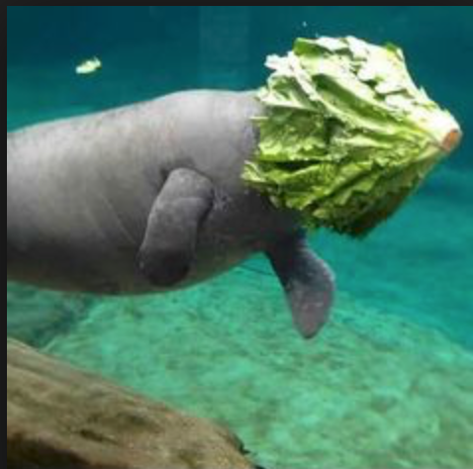
Sometimes Institutions Do the Wrong Thing
Missing deadlines for providing materials
Misunderstanding of consent or incapacitation
Errors at a hearing

Slide 57
QUESTIONS ABOUT Credibility on Appeal
If Complainant does not participate, can you judge credibility?
Do you need to see demeanor to note credibility?
Does an appeal officer ever determine credibility?

Slide 58
De NOVO APPEALS?
We Are Never, EVER, going back to this

Slide 59
Appeals Panels That Exceed Their Authority
Stay In Your Lane
How Do You Know
How To Correct

Slide 60
Transparency Is Your Friend
Investigator should show their work
Decision-maker should show their work
Sanctioning officer should provide some rationale, particularly for mitigating or aggravating circumstances
Appeal officer should provide a road map, but also education for a student, potential lawyer, potential judge

Slide 61
How Much Information to Provide on Appeal?
The appellate officer’s failure to plainly articulate why he granted the appeal, which resulted in a new hearing that found the respondent in violation, was “perplexing” to the reviewing court, along with the appellate officer’s ad hoc decision to request an independent Title IX opinion prepared in the course of determining the appeal.

Slide 62
Why Show Your Work:
When a Judge has a Different Definition of Consent
“Because she removed her own shirt when Respondent suggested having sex, there was insufficient proof of a lack of affirmative consent.” Haug v. SUNY Potsdam, 2018
As the Complainant did not report the rape, and did not initially think she had been raped . . . more likely there was an erroneous outcome due to gender. Doe v. Dordt University, 2022

Slide 63
Goals of Sanctions/Discipline
END
PREVENT
REMEDY
End The Harassment
Prevent The Recurrence
Remedy The Harm, Restore Equal Access

Slide 64
What Does the Sanction “Say”?
Who is valued, who is not?
Community values?
Notes:
Informal resolution
Current regs informal res = formal complaint, notice of allegations
A formal complaint no longer has to be filed for an informal resolution. (Still need to keep a record!)
recipient discretion whether to offer it, school decides whether it's appropriate based on facts and circumstances (NO if employee R, student C)
The proposed regulations would permit a recipient to offer an informal resolution process if appropriate whenever it receives a complaint of sex discrimination or has information about conduct that may constitute sex discrimination under Title IX in its education program or activity.
Participation in informal resolution must be voluntary.
Still not valid when employee is the accused party.
Not required to have informal processes

Slide 65


The Sanction Does Not Undo the Finding
No lesser sanction if you disagree with findings
Sanctioning officer must assume findings are correct

Slide 66
Sanctions Are Now Wrong Because Finding Was Wrong
Does appeals officer determine new sanction, or send case back for appropriate determinations?

Slide 67
Sanctioning Considerations
Expulsion/Termination not required
Must be able to articulate why the action taken is reasonably calculated to end the harassment
Must be able to articulate why the action is reasonably calculated to prevent the recurrence
Remedy: To restore or preserve equal access; implemented by Title IX Coordinator.

Slide 68
Factors to Consider
Impact
Past Conduct
Multiple violations
Abuse of power/position
Enhancements: filming the act, predation, weapon

Slide 69
Aggravating Circumstances
Multiple policy violations in one incident
Premeditation
Predation
Physical Violence
Harm to others, impact on complainant and/or community
Effort to conceal or hide the incident?
Did the behavior continue after intervention?
Refusal to attend past trainings
Past failures to comply with directives

Slide 70
Complainant’s Wishes Taken into Account?
An institution’s remedial measures do not amount to deliberate indifference simply because a reporting individual disagrees with their severity.
Butters v. James Madison Univ., 208 F. Supp. 3d 745, 762 (W.D. Va. 2016). Kelly v. Yale Univ., No. 3:01-cv-1591, 2003 WL 1563424, *4 (D. Conn. Mar. 26, 2003). Shank v. Carleton Coll., No. 16-CV-01154 (ECT/HB), 2019 WL 3974091, at *14 (D. Minn. Aug. 22, 2019), aff’d, 2021 WL 1228068 (8th Cir. Apr. 2, 2021).
Complainants do not have right to choose the particular sanction (or remedial measure)

Slide 71
I Never Want to See Them Again
Following a finding of sexual misconduct, the respondent was sanctioned with a no-contact order and deferred suspension. The complainant sued, alleging deliberate indifference, arguing that respondent should have been removed from campus to prevent any possible future encounters, which was more likely given that both were students in the same program and therefore more likely to access the same campus building.
What did the court say?

Slide 72
The Role of Impact Statements
Is it evidence?
Can a party be found not credible due to comment in an impact statement?
Bias to decision-maker?
Bias to appeal officer?

Slide 73
DETERMINING
THE PROPER SANCTION
Consistency
Foreseeability of repeated conduct
Past conduct
Does bias creep in?
Remorse?
Victim impact?

Slide 74
Can a Sanction Increase on Appeal?
In response to Complainant’s appeal
Sua sponte (meaning, just on their own determining it was not sufficient)

Slide 75
Appellate Officer/Panel May Not…
Substitute their own findings for the findings of the decision maker
Consider new evidence
Correct procedural errors on their own

Slide 76
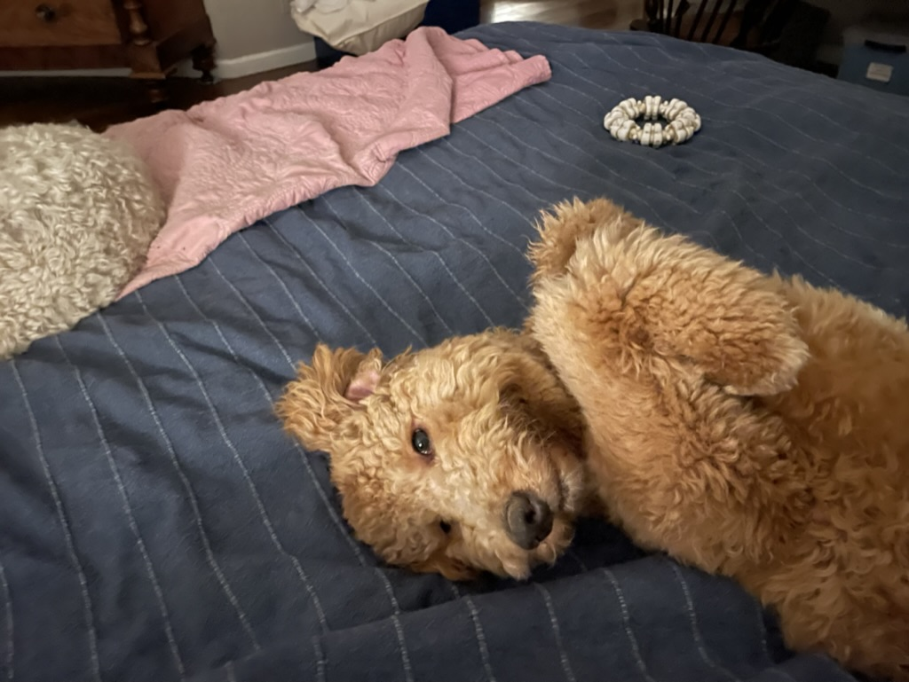
A Little HELP HERE, PLEASE

Slide 77
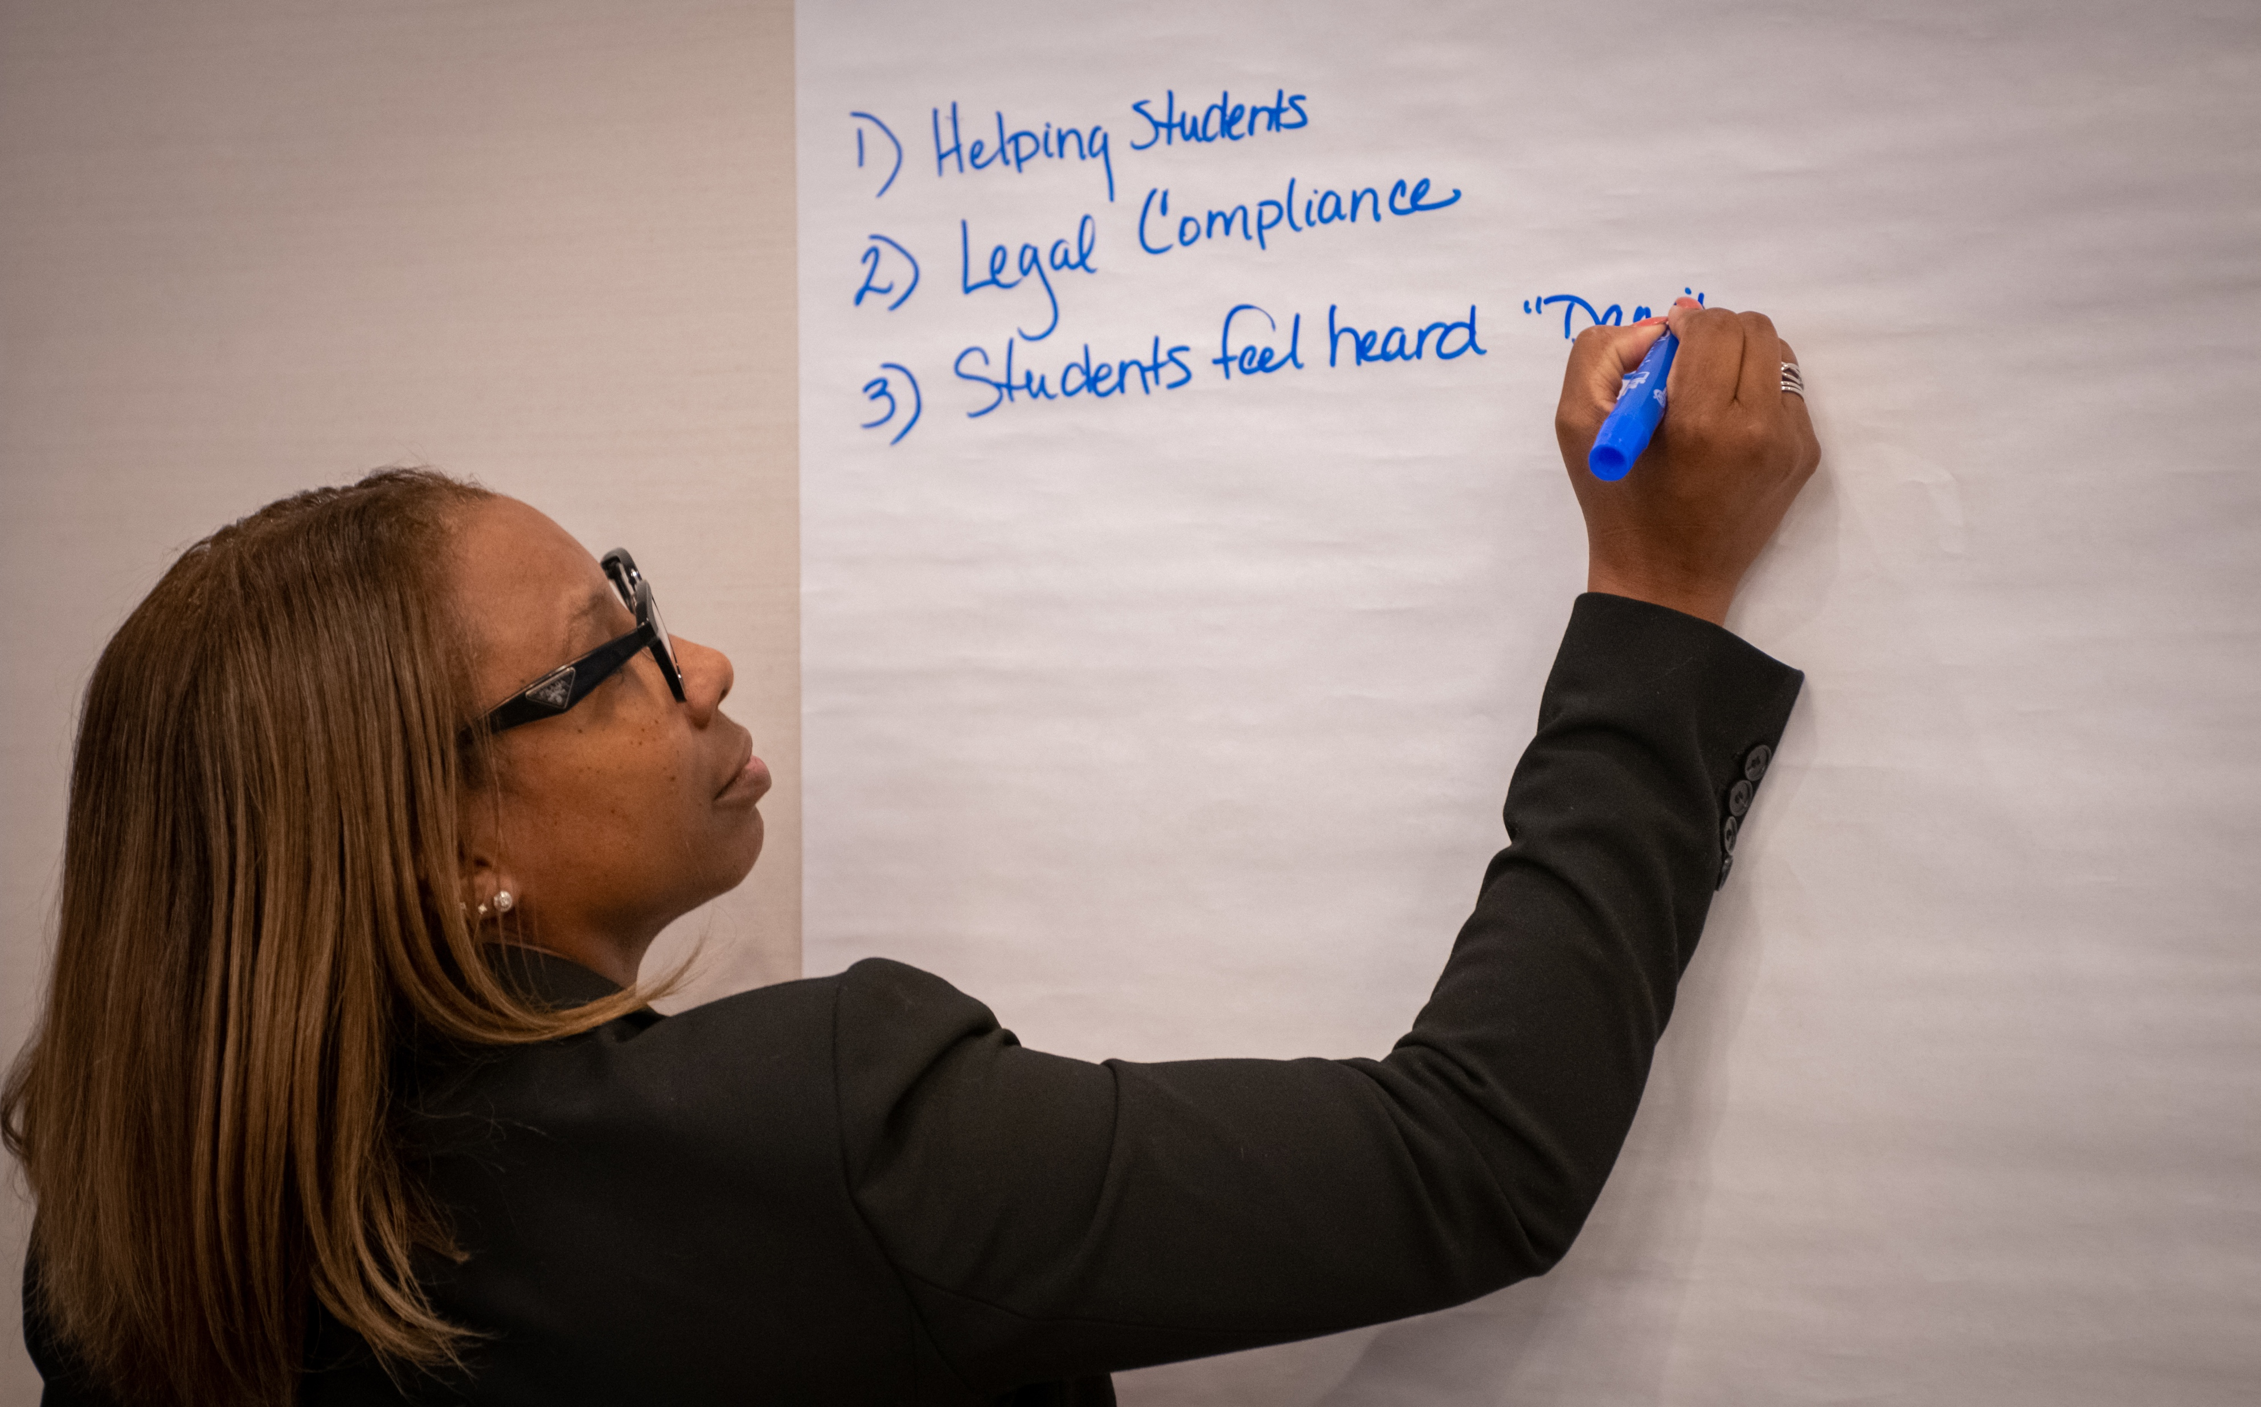
EMPLOYEE COMPLAINTS
Presumptions of skill, understanding
Presumptions of maturity
Sex Assault, DV in employee cases
Differences in supportive /remedial measures
Sanctioning
Notes:
Cherie to handle the PIVOT
Obligation to ensure that its education program or activity is free from sex discrimination regardless of notice.
Note application to ALL forms of sex discrimination, not just sexual harassment.
Cherie to handle the PIVOT
Obligation to ensure that its education program or activity is free from sex discrimination regardless of notice.
Note application to ALL forms of sex discrimination, not just sexual harassment.
Cherie to handle the PIVOT
Obligation to ensure that its education program or activity is free from sex discrimination regardless of notice.
Note application to ALL forms of sex discrimination, not just sexual harassment.
Cherie will note we are now talking about how to think about implementing new regulations on your campus, but also cleaning up your current practices if necessary
Jody will remind of need to remember overarching theme of new regs: Obligation to ensure that its education program or activity is free from sex discrimination regardless of notice.
Note application to ALL forms of sex discrimination, not just sexual harassment.

Slide 78
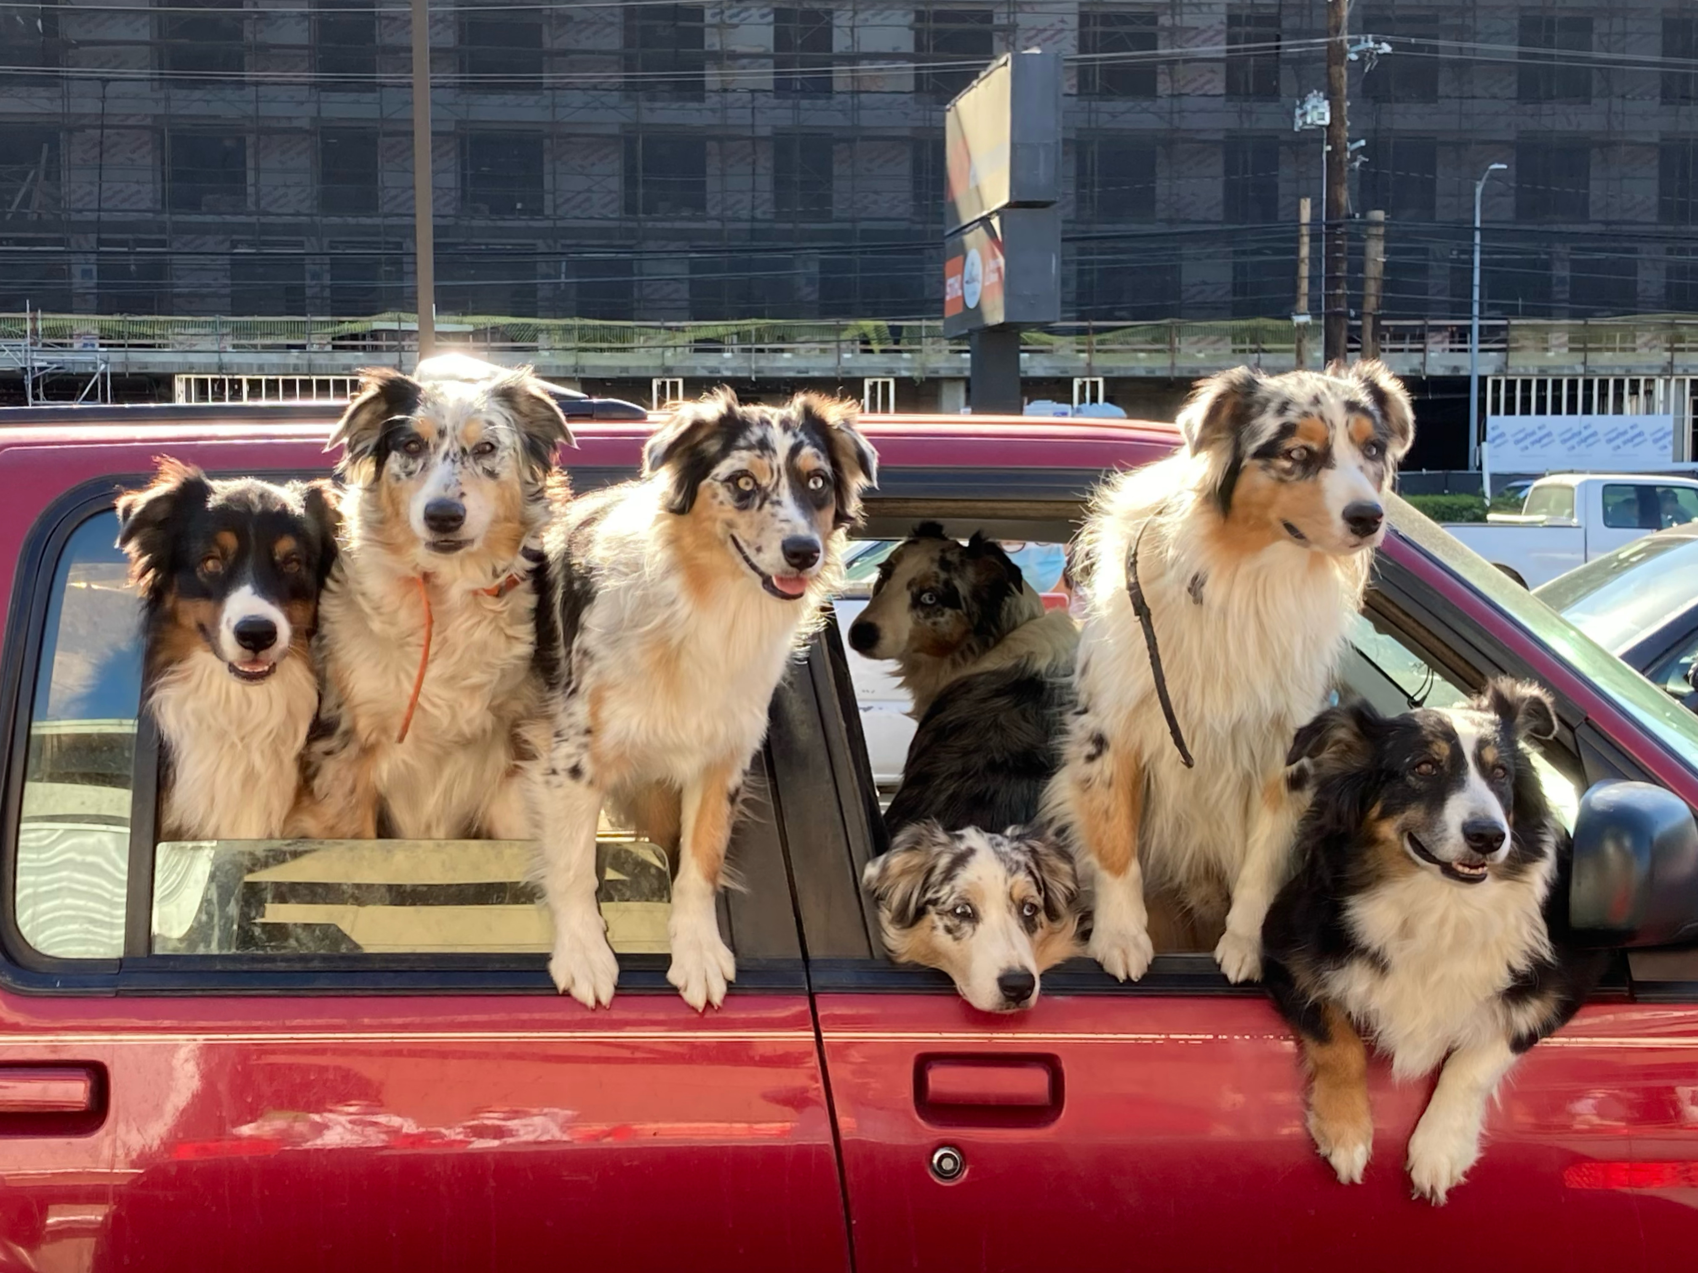
EMPLOYEE (staff, faculty) complaints
Presumptions of skill, understanding
Presumptions of maturity
Sex Assault, DV in employee cases
Differences in supportive /remedial measures
Sanctioning

Slide 79


Confidential vs. Privileged
  What is the difference?
  What does it mean to hold the privilege?
  Examples: counselors, clergy, social workers?
  Who is NOT covered: self-appointed, those not working in that capacity, not hired into that capacity
Notes:
Cherie starts by talking about importance of difference between confidential, privileged, and then goes to who is Not covered, gives examples

Slide 80
ThE FUTURE OF THE TITLE IX OFFICE
How will you cover breadth of ALL Title IX – related cases?
Elevated leadership of the office?
Are we treating some harassment/discrimination as more or less important?
Where do we want differences in procedure, where do we want it all to be the same?

Slide 81

TITLE IX PROTECTS PREGNANT & PARENTING STUDENTS
On October 4, 2022, the Department of Education released an updated resource related to pregnant and parenting students.
In the FAQ, the Department clarified that students cannot be discriminated against based on a student’s pregnancy, childbirth, false pregnancy, termination of pregnancy, or recovery therefrom.
34 C.F.R. § 106.40(b)(1)

Slide 82

ADVISOR ISSUES
The advisor can be anyone, including an attorney or a witness.
Institutions cannot place restrictions on who can serve.
Institutions can create rules and guidelines for participation in the investigation and hearing.
No specific training required.
No “ineffective assistance of Advisor” claims
And what is a “good” advisor?

Slide 83

Questions?

Slide 84


THE RIVER CONNECT is a virtual community of experts and colleagues gathered together to help each other process the complexities of the work.

Slide 85






THANKS FOR JOINING US!
CONNECT WITH US
WE LOVE FEEDBACK
Your Opinion Is Invaluable!
info@grandriversolutions.com
/Grand-River-Solutions
/GrandRiverSolutions
/GrandRiverSolutions
Grandriversolutions.com

