Slide 1
TitLE IX Hearing chair
Training & Certification Course
August 26, 2020 | Virtual Instructor-Led Training

Slide 2
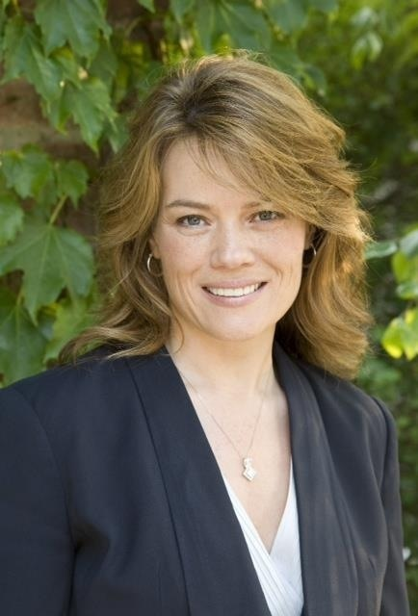

faculty
Brett A. Sokolow, J.D.
Belinda Guthrie, M.A.
Chair, TNG
President, ATIXA
Affiliated Consultant, TNG
Member, ATIXA Advisory Board

Slide 3
Agenda:
The Title IX Process
Bias, Conflicts of Interest, and Recusal
Preparing for the Hearing
Pre-hearing meetings
“Bucketing” Evidence
Hearing Logistics
Questioning
Understanding Evidence
    Relevance
    Reliability/Credibility
    Cross-Examination
  IX. Admissibility of Evidence
  X. Decision-Making Skills
  Xi. Facilitating Deliberation
  XII. Preparing the Outcome Rationale
  XIII. Interaction with Appeal

Slide 4
What is your mission as a chair?
Make key evidence “rulings”
Manage questioning
Facilitate deliberation
Make a finding/final determination (w/panel)
Draft a notice of rationale

Slide 5
What does it mean to be a CHAIR?
New Title IX regulations require a “decision-maker” to determine whether a Respondent has violated policy.
  May be a single person. Thus, you are both Decision-maker and Chair by default.
    One role is substantive, the other procedural
  May be a panel of decision-makers (often three), with one voting member as Chair to make all rulings on evidence and questions
  Chair should always be a voting member
  Most colleges will want the Chair to speak for the panel on matters of evidence, but some will want all panelists to do so collaboratively – thus all would be “Chairs”
  May be internal or external individuals (third-party neutrals).

Slide 6
The role of the chair
New Title IX regulations require that colleges and universities hold a live hearing.
  May take place in person; however, must provide an option for a video conference.
  Key new element is that the parties may cross-examine each other and witnesses, through an advisor.
The primary role of the Chair is to evaluate all evidence for relevance, facilitate questioning, rule on questions, and ensure that advisors observe appropriate decorum and follow all hearing rules.
  Some colleges may impose on Chairs to run hearing logistics as well, but this is not recommended.

Slide 7
Chair COMPETENCIES
The Legal Landscape
The Conduct/Disciplinary Process
Understanding Investigations
Title IX & VAWA Requirements
Pre-Hearing Evidence Review
Pre-Hearing Investigation Report Review
Critical Thinking Skills
How to Prepare for a Hearing
Hearing Decorum
Questioning Skills, including Relevance
Weighing Evidence, including Relevance
Analyzing Policy
Applying Standards of Evidence
Sexual Misconduct/Discrimination
Technology Used at Hearing
Controlling Evidence
Managing Advisors
SANE and Police Reports

Slide 8
Chair COMPETENCIES (cont.)
Presumption of Innocence
Due Process and Fairness
Domestic/Dating Violence
Bias/Impartiality/Conflicts of Interest
Stalking/Sexual Assault/Harassment
Deliberation
Sanctioning/Remedies
Understanding the Appeal Process
Cultural Competency
Intersection with Mental Health Issues
Concurrent Criminal Prosecutions
Impact of Failing to Testify/Answer
Drawing Inferences?
Manage Accommodations During Process
Fixing Procedural Deviations
Managing Impact Statements
Writing Decisions/Rationales
Role in Appeal Process?

Slide 9
The Challenge for all panelists
Community standards identify what constitutes sexual harassment within your community.
  The definitions and procedures used may be impacted by Title IX requirements.
It is not a question of right and wrong, but whether there has been a policy violation, proven by the standard of evidence.
Your role is to impartially uphold the integrity of the process.
You may not agree with your policy, but you must be willing to uphold it.

Slide 10
evidentiary Standard
  Clear and convincing evidence: It is highly probable that policy was violated.
    Highly and substantially more likely to be true than untrue; the fact finder must be convinced that the contention is highly probable.
    65% 75% 85% – part of the problem with this standard is there is no real consensus on how to quantify it.
  Preponderance of the evidence: “More likely than not.”
    The only equitable standard
    50.1% (50% plus a feather)
    The “tipped scale”

Slide 11
Evidentiary standards
No Probable Cause
Clear and Convincing
No Evidence
Preponderance of the Evidence
Beyond a Reasonable Doubt

Slide 12
THE “Title IX PROCESS:”
What happened before it got to a hearing?
Title IX
The IX Commandments
The General Phases of a Title IX Process
Ten Steps of an Investigation
Key Elements from new Title IX regulations

Slide 13
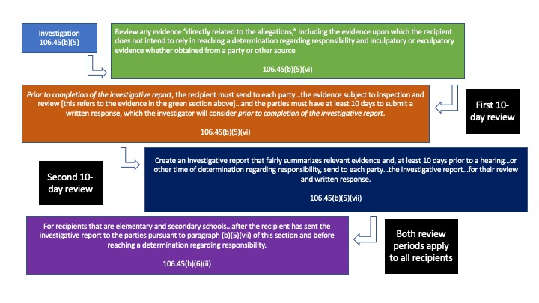
Evidence review periods

Slide 14
Advisors
Advisor can be anyone; no restrictions in the regulations.
  Already required under VAWA.
If a party chooses an advisor who is also a witness, you will need to assess how that impacts their credibility as a witness.
If a party does not have an advisor to conduct cross-examination at the live hearing, the institution must provide an advisor of the institution's choice without fee or charge to the party.
  Not required to be an attorney.
  No prior training required; no mandate for institution to train.
Institutions may still limit the role of advisors during the hearing with the exception of cross-examination and the ability to confer with the party.

Slide 15
Advisors
Advisors chosen by the party should conduct cross-examination, but the extent to which they do so may be influenced by strategy.
Thus, they can opt not to ask any questions. They have a right to conduct cross, but not an obligation to do so.
However, if they refuse to ask questions their advisee wishes them to ask, the institution will appoint an advisor who will do so.
An advisor appointed for the party will conduct cross-examination of the other party(ies) and witnesses, if that is the agreed upon strategy between advisor and advisee.
  The regulations envision that the advisor will not do more than repeat or rephrase questions framed by the party, but in many hearings, expect that the advisor will be far more active and engaged than that.

Slide 16
Presumption of non-responsibility
Title IX regulations require that published grievance procedures include a statement of a presumption of non-responsibility for the Respondent until a final determination is made.
Hopefully not a change from current procedures, because the determination has always been based on evidence, not presumptions.
What would it mean to presume neither “guilt” nor “innocence?”
  How does a presumption work in light of an affirmative consent policy?
  How is presumption of non-responsibility different than no presumption?
  What does it take to overcome a presumption?

Slide 17
Live hearing
Final regulations mandate live hearing for higher ed.
  Virtual hearings are permitted; do not violate due process
Must create audio/audiovisual recording, or transcript, of hearing and make it available to the parties for inspection and review.
Parties must attend hearing, otherwise all statements made by absent (or non-testifying) party must be excluded.
  What are considered “statements” and what effect will this rule have?
Will there be a facilitator role? Who? What do they do?
Must allow live cross-examination to be conducted exclusively by each party’s advisor (separate rooms still allowed). This winds up applying to direct examination in practice, as well.
Questions come from advisors, panel (if any), and Chair.

Slide 18
Bias, conflicts of interest, and recusal

Slide 19
Remember, you have no “side” other than the integrity of the process!

Slide 20
Conflict of Interest, Objectivity, and Bias
Existing mandate for impartial resolutions with fair procedures.
  Impartial, objective, unbiased, neutral, independent.
  What do each of these mean and how do we bring these qualities to our decision-making?
Final regulations prohibit conflicts-of-interest or bias with Coordinators, investigators, and Decision-makers/Chairs against parties generally or an individual party.
  What creates a conflict?
  How can you assure that you don’t have one?
  Do you feel that your institution has given you sufficient independence?

Slide 21
Bias
Among the most significant problems for hearing Decision-makers/Chairs
Bias can represent any variable that improperly influences a finding and/or sanction
There are many forms of bias and prejudice that can impact decisions and sanctions:
  Pre-determined outcome
  Partisan approach by investigators in questioning, findings, or report
  Partisan approach by hearing board members in questioning, findings, or sanction
  Intervention by senior-level institutional officials
  Not staying in your lane
  Improper application of institutional procedures
  Improper application of institutional policies
  Confirmation bias
  Implicit bias
  Animus of any kind, including race, religion, disability, etc.

Slide 22
Bias and Conflict of Interest
Types of conflicts/bias:
  Wearing too many hats in the process
  Legal counsel as investigator or Decision-maker/Chair
  Decision-maker/Chair who is not impartial
  Biased training materials; reliance on sex stereotypes
Simply knowing a student or an employee is typically not sufficient to create a conflict of interest if objectivity not compromised.
Also, having disciplined a student or employee previously is often not enough to create a conflict of interest.

Slide 23
recusal
Decision-makers/Chairs may determine that they need to recuse themselves from hearing a particular case or a party might seek a Decision-maker’s/Chair’s recusal.
This is why having an alternate Decision-maker/Chair identified and trained is always wise.
Your policy should define the process and circumstances by which a party may seek to recuse a Decision-maker/Chair.
Typically the Title IX Coordinator determines whether or not to honor the request.
If you yourself discern that you are not able to hear a case impartially, please let your Title IX Coordinator know immediately.

Slide 24
Preparing for the hearing

Slide 25
pre-hearing PREPARATION CHECKLIST
Provide Notice of Hearing (location, time, hearing decision-maker identification, conflict check, individuals attending, specific charges) to all Parties/Advisors
Conduct Meetings between Chair/Decision-maker and Parties/Advisors (optional)
Make Evidence and/or Question Rulings by Chair/Decision-Maker; Circulate to all Parties/Advisors (optional)
Revise/Disseminate Materials to Parties/Panel
Review of Investigation Reports/Materials by Decision-maker
Witness, Party, Decision-maker Logistics
Technology Arrangements
Technology Test
Obtain Assurance that Advisors are in Place and Willing to Cross-Examine
Determine whether any Parties/Witnesses may Refuse to Testify at Hearing

Slide 26
pre-hearing PREPARATION CHECKLIST PART II
Arrange for any Necessary Alternates (Decision-makers and/or Advisors)
Allow Challenge to any Decision-Maker on Basis of Bias/Conflict and Opportunity for Self-Recusal by any Decision-maker
Prepare and Refine Hearing Script
Prepare Questions from Decision-maker
Prepare Checklist of all Applicable Policy Elements
Set an “Order of Go” for Witness Testimony
Review Logistics with Parties, Advisors, Witnesses, Decision-maker, Sanctioning Authorities (if applicable), and/or Hearing Facilitator/Case Manager (if any)
Arrange for any Directly Related Evidence to be Available at Hearing
Inform Parties to Prepare Impact Statements for Submission at Start of Hearing
Check in with Parties for any Access, Accommodation, Interpreter Needs, Etc.

Slide 27
Pre-HEARING MEETINGS
What do you don’t pre-hearing, you’ll just have to do at the hearing.

Slide 28
pre-hearing meetings
Although not explicitly required or even mentioned in the Title IX regulations, it may be valuable to conduct pre-hearing meetings for each party and their advisors.
ATIXA strongly recommends this practice, because anything you don’t do pre-hearing will have to be done at the hearing.
Under the new regulations, hearings are likely to be longer and much more involved than ever before. If you further load them up with procedural issues that could have been addressed pre-hearing, they become even longer and can really wear down the energy of the participants.
Pre-hearing meetings can be virtual, in person, on paper, and/or with each party (and their advisors) separately.
  If you meet with each party (and their advisors) separately, you may face concerns of ex parte influence. To address that, you can record the pre-hearing meeting and share the recording between parties, and/or circulate a detailed memo of decisions and information between the parties that reflects each respective meeting/interaction.
  Another option might be to meet with advisors and Chair but not parties. Offer as option, because we shouldn’t exclude the parties if they want to participate.

Slide 29
pre-hearing meetings
Pre-hearing meetings can provide an opportunity to:
  Answer questions the parties and advisors have about the hearing and procedures.
  Clarify expectations regarding logistics, decorum, and technology (if applicable).
  Clarify expectations regarding the limited role of advisors and applicable rules.
  You may invite parties to submit questions to you in advance of this meeting but can’t not require it. This would enable you to rule on some questions pre-hearing. Make a record of pre-rulings to share with the parties and to remind you at hearing
  Discern any conflicts of interest/vet recusal requests.
  Understand (and perhaps preliminarily field) any questions regarding relevance of evidence or questions.
  Finalize the Buckets of evidence. But, be prepared for the parties to potentially raise the issues again at the hearing.
  Discern whether any party intends to “spring” last-minute evidence at the hearing, and address the issue proactively. Chairs need clarity on how policy addresses this issue.

Slide 30
PRE-HEARING PREPARATION
Could include:
  “Motions” hearing
  Meeting of Panel (to sift evidence and/or to craft, share, and assign questions)
  Review of Investigation Report (you really should know this well. Read twice?)
  Review of file of “directly related” evidence that was not relied upon by investigators
    Decide if this is reviewed by you only, or other panelists (if any) as well?
  Review of any questions pre-submitted by parties (if they have been invited to do so)
    Let’s discuss the merits/demerits of this practice…
Must include (Is this a Chair function? Who vets the Chair):
  Vetting of decision-maker/panel
  Conflicts check
  Recusal protocol
What About?
  Can you/should you meet with investigators?
  Should there be changes to the investigation report at this point?

Slide 31
PRE-HEARING PREPARATION
Part of what a Chair has to consider is the “can you unring the bell effect”.
Generally, panelists struggle with unhearing or disregarding evidence once they hear it. All “juries” do. It’s human nature.
So, a question for the Chair is whether you want to be methodical with the panel (or with yourself, if there is no panel) about tracking what evidence cannot be considered (this should be clear in the outcome rationale as well) and very deliberate about disregarding it, or whether instead you want to work pre-hearing to redact all evidence determined not relevant (directly related)
  If you work to do this pre-hearing, will you work with the investigator, or make modifications yourself, directly?

Slide 32
Must do: prep FOR THE HEARING
All Decision-Makers/Chair Should Review:
The Respondent’s written notice (NOIA) to understand all allegations, the formal complaint, and the notice of hearing.
Review the policy (policies) alleged to have been violated.
  Parse all the policy elements (what does it take to establish a policy violation?)
  Identify the elements of each offense alleged.
  Break down the constituent elements of each relevant policy.
Review all the materials carefully and thoroughly. Read the investigation report appendices, too!
Review the report a second time and note all areas of consistency/inconsistency of information. You should be able to make a “focus list” from this, of what topics are most important to try to resolve at the hearing.
Do you want to do any prequalification or review of the qualifications of any offered expert witnesses?

Slide 33
Preparing questions
Write down the following as a reminder:
  What do I need to know?
  Why do I need to know it?
    If the answer to this is not that it will help you determine whether or not a policy violation occurred, and you can explain a rationale for that; then it is not something you need to know!
  What is the best way to ask the question?
  Who is the best person to get this information from? The investigator? A party? A witness?
When dealing with conflicting or contested testimony apply a credibility analysis (covered later).

Slide 34
PREPARING FOR THE HEARING
Dress professionally – Jeans, t-shirts, shorts, yoga pants, sandals, etc., are not appropriate (unless they can’t be seen!)
Arrive prepared and early
Bring snacks and water/drinks
Silence your phone, but make arrangements for how you will reach your legal counsel, if needed.
Bring a pen and paper or note-taking device
  Less is better; note what you need to make a determination.
  Be clear on policy/expectations for keeping/destroying written notes
Clear calendar after the hearing – deliberation could take as little as 30 minutes or it could take much longer.

Slide 35
Quick tips on hearing logistics

Slide 36
The Hearing: general logistics
Recording
  How, by whom, etc.
  Redundant devices?
Attendance by parties and witnesses
Location and Room set-up
  Comfort items (water, tissues, meals if needed)
  Privacy concerns; sound machine
Seating arrangements
Materials
Access to administrative support if needed (phones, copiers, email)
Advisors
Parties and witnesses waiting to testify
Breaks
Use of A/V
Waiting for a decision

Slide 37
Hearing Decorum
Be professional, but you need not be lawyerly or judge-like
  This is not Law and Order – this is an administrative process at a school.
  You are not cross-examining or interrogating, you are striving to determine whether the Respondent(s) violated institutional policy.
Be respectful
  Tone, Manner, Questioning.
  Sarcasm or being snide is never appropriate.
  Maintain your composure: Never allow emotion or frustration to show.
  De-Escalate or take breaks if emotions/tension are running high

Slide 38
Hearing Decorum
Work to establish a baseline of relaxed conversation for everyone in the room.
Maintain good eye contact; “listen with your eyes and your ears”
Listen carefully to everything that is said.
  Try not to write too much when people are talking, but as Chair, you often need to track questions/answers to avoid permitting too much repetition, and in case you need to repeat a question back.
  If questioning, focus on the answer, rather than thinking about your next question
Nod affirmatively
Do not fidget, roll your eyes, or give a “knowing” look to another panel member
Do not look shocked, smug, stunned, or accusing

Slide 39
The Hearing
Hearing Testimony: The Role of the Chair/Decision-Maker
Determine the relevance of questions. Pause after each question to “rule” on relevance. Must state rationale for the record. Bases to exclude:
  Irrelevant
  Unduly repetitious (and therefore irrelevant)
  Abusive (and therefore irrelevant)
When necessary, the chair can provide a directive to disregard a question or information deemed irrelevant, abusive, or unduly repetitious (keep track of these for deliberations/rationale)
Manage advisors as necessary, including cross-examination.

Slide 40
The Hearing
Hearing Testimony: The Role of the Chair/Decision-Maker
In managing questioning, the Chair will typically work from a script in terms of flow and order of questioning/witnesses.
The Chair will have to make decision on (or follow the script/procedure) on issues like:
  How much of an evidence introduction an investigator should do to open the hearing
  Whether the Chair rules on every question, or just those that are irrelevant
  Will the Chair also rule on questions from the panel/from the Chair, or just from the advisors?
  Will the Chair state a rationale for whether a question is relevant or irrelevant?
  Will the Chair allow advisors to make a case for why a question should be permitted or not permitted?
  How will the Chair address evidence that the decision-makers should not rely on?
  When will decision-maker questions be timed? Before cross-examination, after, or both?

Slide 41
The Hearing
How will you manage the last-minute witness or evidence that is introduced at the hearing for the first time?
What does the policy say?
Will the last-minute introduction work an unfairness, given that all other evidence has been reviewed and vetted for weeks prior?
If the parties assent, can the evidence be introduced last minute, even if it has had been held back in bad faith?
If you will re-open the investigation to consider the evidence, does that pause the hearing entirely, or just part of the hearing related to that witness/evidence?
  How will that work in terms of the two ten-day review/comment periods? Should they be observed? Can parties waive or shorten them?

Slide 42
DECISION-MAKING SKILLS
Understanding Evidence
Relevance

Slide 43
Understanding Evidence
The formal federal rules of evidence do not apply in Title IX hearings, but rules crafted by OCR for Title IX cases do.
If the information helps to prove or disprove a fact at issue, it should be admitted because it is relevant.
If credible, it should be considered.
  Evidence is any kind of information presented with the intent to prove what took place.
  Certain types of evidence may be relevant to the credibility of the witness, but not to the alleged policy violation directly.
So, relevance goes to the admissibility of the evidence, and credibility to how much weight admissible evidence is given.

Slide 44
Evidence
No restriction on parties discussing case or gathering evidence
Equal opportunity to:
  - Present witnesses, including experts
  - Present evidence
  - Inspect all evidence, including evidence not used to support determination
No limits on types/amount of evidence that may be offered except that it must be relevant.
Parties may have access to all gathered evidence that “directly relates” to the allegations available for reference and use at the hearing, but they must make the case for its relevance.

Slide 45
Ask yourself
Is it relevant?
Is it reliable?
(Is it credible?)
Will we rely upon it as evidence supporting a rationale/the written determination?

Slide 46
relevance
Evidence is generally considered relevant if it has value in proving or disproving a fact at issue, and relevance means the evidence will be relied upon by the Decision-maker.
  Regarding alleged policy violation and/or
  Regarding a party or witness’s credibility.
The investigator will have made initial relevance “decisions” by including evidence in the investigation report…
Relevance is ultimately up to the decision-maker, who is not bound by the investigator’s judgment.
All relevant evidence must be objectively evaluated and considered – inculpatory and exculpatory.

Slide 47
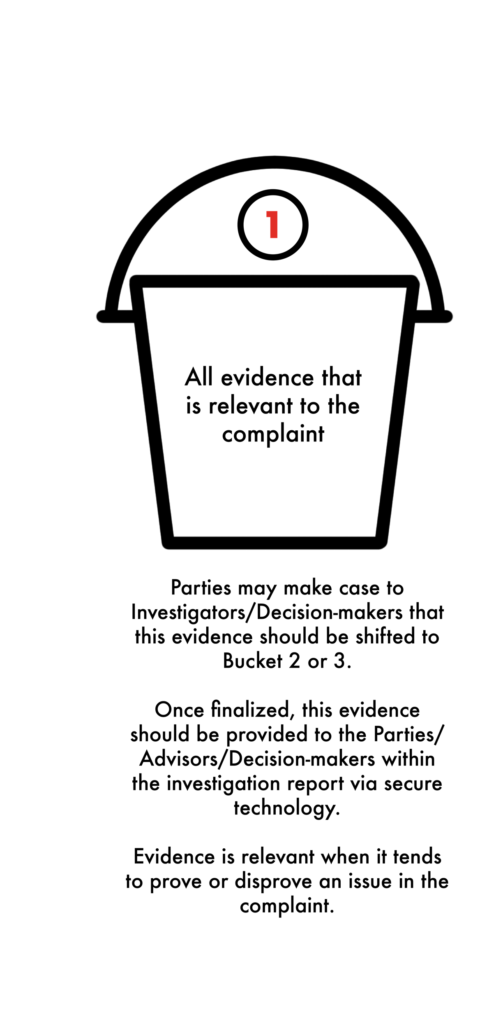
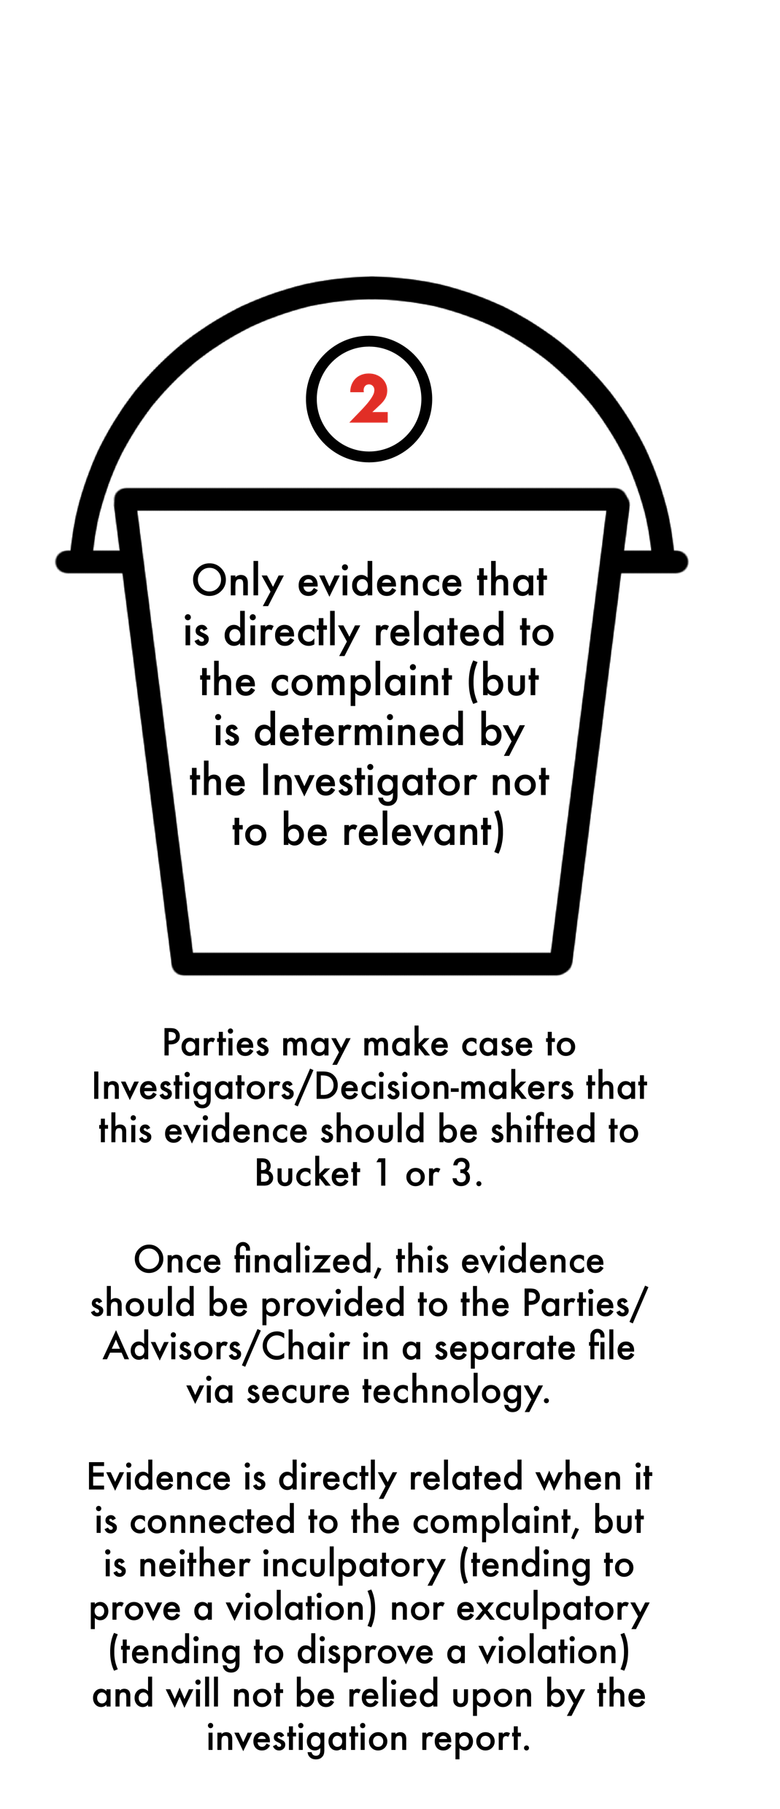
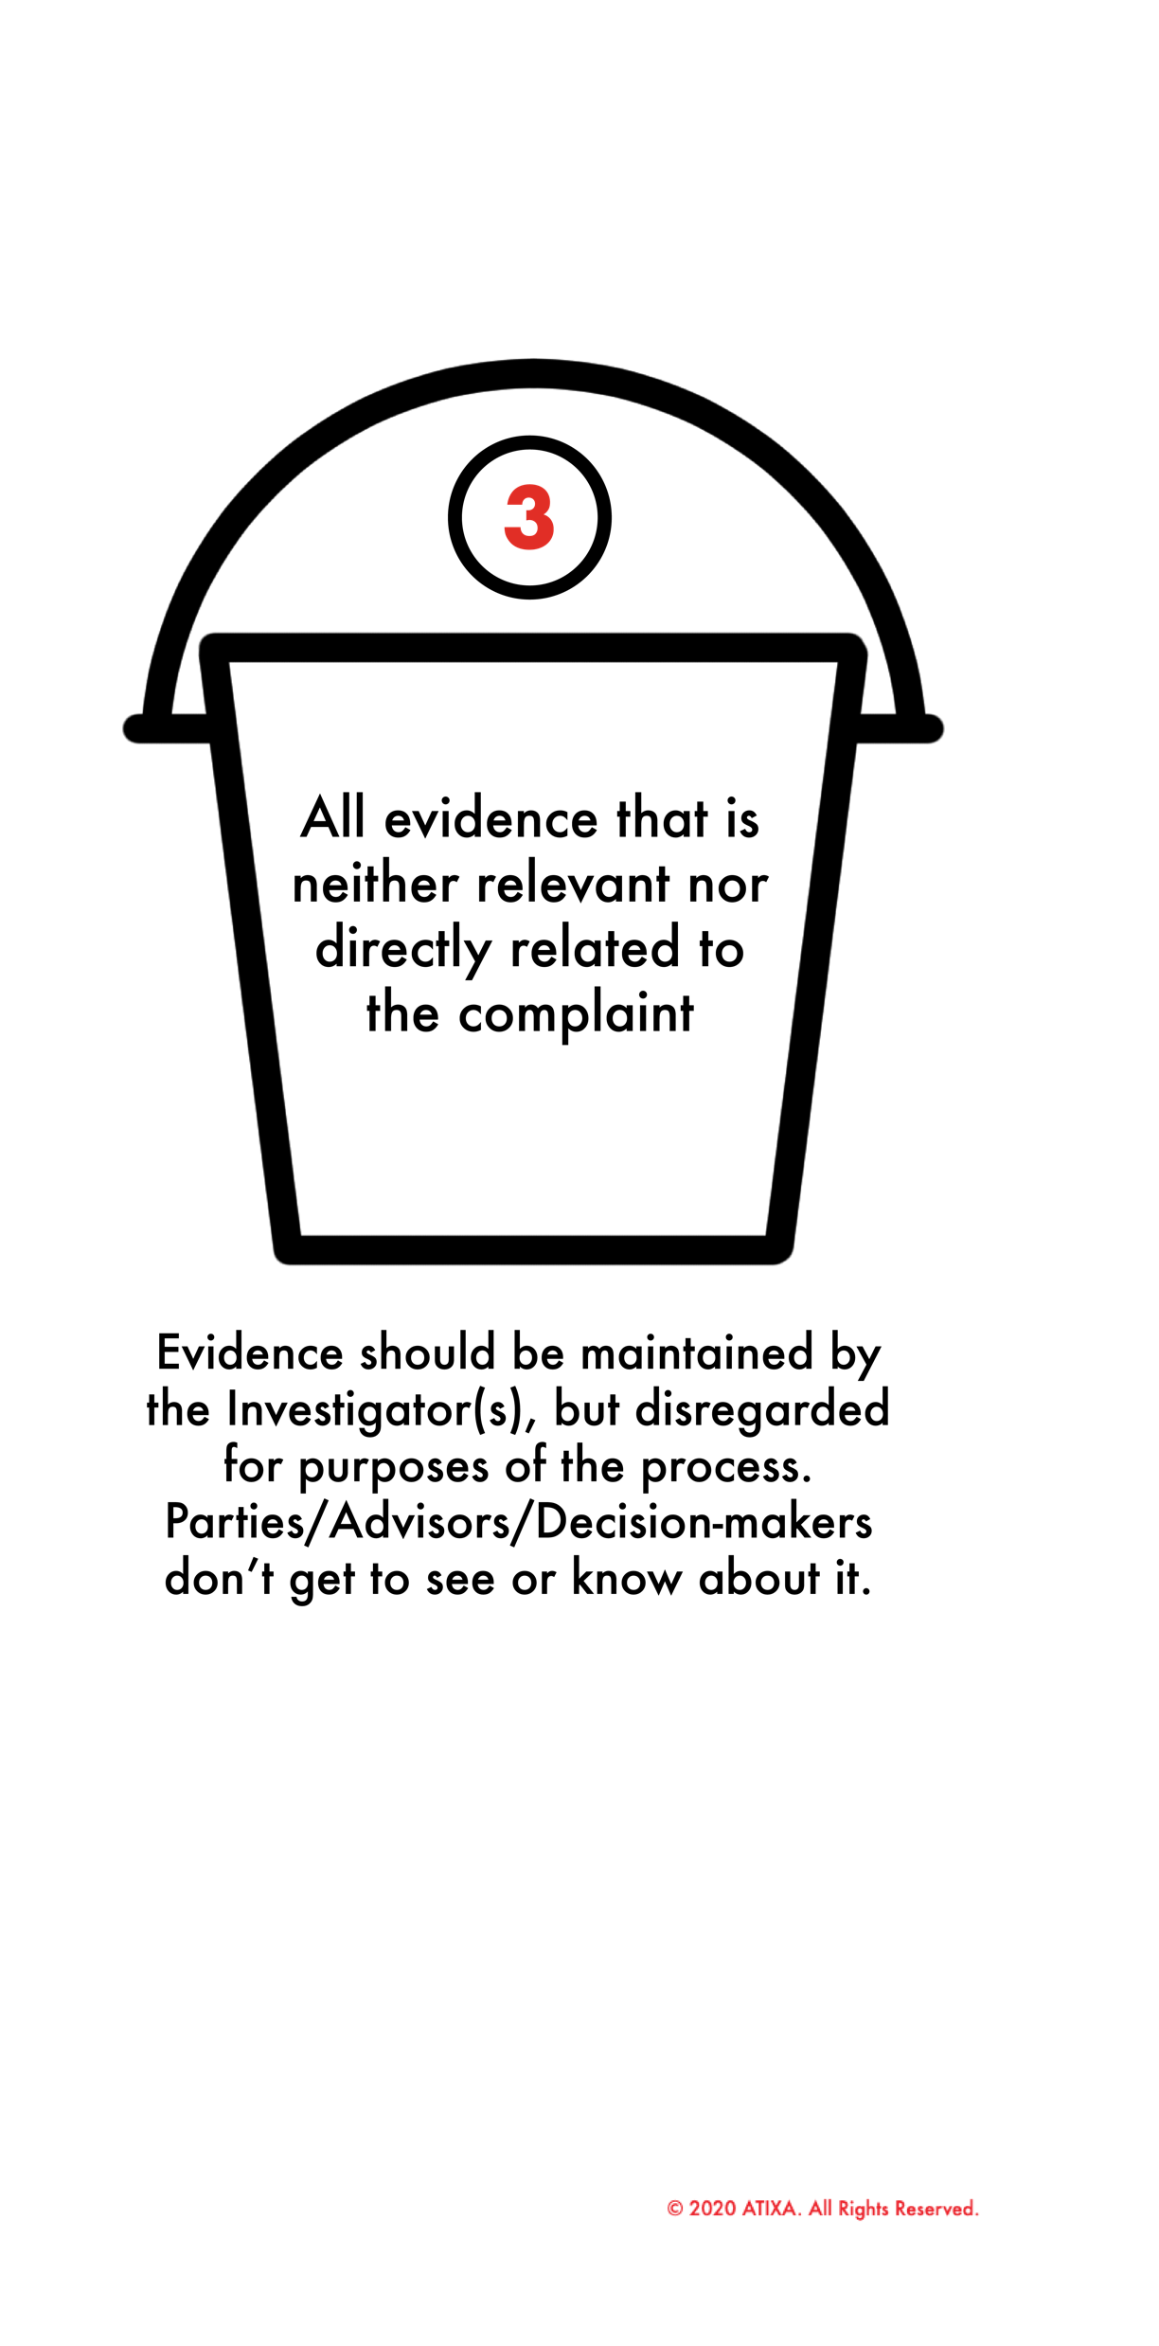
Three Buckets of Evidence

Slide 48
Other evidence may be directly-related
Evidence is directly related when it is connected to the complaint but is neither inculpatory (tending to prove a violation) nor exculpatory (tending to disprove a violation) and will not be relied upon by the investigation report.
This evidence comes to the Decision-maker(s) pre-hearing, in Bucket #1 (the investigation report) or in Bucket #2, the evidence file of what is considered directly-related.
  How will you want investigators to address records that combine elements of both relevant and directly-related evidence?
While the investigator has initially sifted the evidence into these buckets, the Chair/Decision-maker makes the final allocation of what evidence will be relied upon and what will not.

Slide 49
relevance
If the investigator indicates an opinion on credibility, outcome, whether policy was violated, how evidence should be weighed, etc., that opinion or recommendation is not binding on the decision-maker.
The decision-maker may consider it, but has to be objective and independent, and is free to accept or reject any recommendation of the investigator (or ask them not to make one)
  Should a Chair/Decision-maker ask for it or ask the investigator to clarify their recommendations?

Slide 50
Understanding Evidence
Decision-maker may consider and assign weight to different types of evidence, when relevant and credible:
  Documentary evidence (e.g. supportive writings or documents).
  Electronic evidence (e.g. photos, text messages, and videos).
  Real evidence (i.e. physical objects).
  Direct or testimonial evidence (e.g. personal observation or experience).
  Circumstantial evidence (i.e. not eyewitness, but compelling).
  Hearsay evidence (e.g. statement made outside the hearing but presented as important information).
  Character evidence (subject to a relevance determination, but often not probative of the underlying allegation).
Decision-makers should typically disregard:
  Impact statements (typically only relevant in sanctioning).

Slide 51
Specific evidence issues under the Title IX REgulations
Evidence of the Complainant’s prior sexual behavior or predisposition is explicitly and categorically not relevant except for two limited exceptions:
  Offered to prove that someone other than the Respondent committed the conduct alleged, or
  Concerns specific incidents of the Complainant’s sexual behavior with respect to the Respondent and is offered to prove consent
Even if admitted/introduced by the Complainant.
Does not apply to Respondent’s prior sexual behavior or predisposition.

Slide 52
Additional evidence restrictions in title ix regulations
Additional permissions required for:
Records made or maintained by a:
  Physician
  Psychiatrist
  Psychologist
Questions or evidence that seek disclosure of information protected under a legally recognized privilege must not be asked without permission.
  This is complex in practice because you won’t know to ask for permission unless you ask about the records first.

Slide 53
Additional evidence considerations in hearings
In court, we often see issues of “admissibility” which means the question of whether evidence can be seen, heard, and/or considered by Decision-makers
In the Title IX hearing, we are often going to see Bucket #1 and #2 evidence “admitted” in the sense that it is not excluded and/or Decision-makers are not shielded from hearing/knowing it.
Some evidence can be excluded, or witnesses can be directed to answer certain questions.
However, the Decision-makers and/or Chair need to determine whether the evidence can and will be relied upon if it is introduced, and there will be a decent amount of trying to “unhear” what is introduced, because even though you know it, you can’t consider it.

Slide 54
Relevance exercise

Slide 55
relevant or directly related?
The Complainant writes in her online written formal complaint form narrative that she has been experiencing significant mental health issues since being sexually assaulted, including PTSD (self-diagnosis). Respondent brings this up at the hearing, to argue that one of the reasons Complainant likely misperceived the incident as non-consensual is because she has a self-admitted history of serious mental health concerns.
  RELEVANT? DIRECTLY RELATED? NEITHER? WHICH AND WHY?
Complainant states in her opening statement at the hearing that she did not consent to sex with Respondent. She adds that one of the reasons why she did not consent and would not have consented is because prior to the incident, she was a virgin and had never had sex before.
  RELEVANT? DIRECTLY RELATED? NEITHER? WHICH AND WHY?

Slide 56
Questioning & Cross-Examination
The live hearing requirement for higher education allows the parties to ask (direct and) cross-examination questions of the other party and all witnesses through their advisor.
  Advisor of choice or an advisor provided by the institution, at no cost to the parties.
Such cross-examination must be conducted directly, orally, and in real time by the party’s advisor and never by a party personally.
Permit relevant questions and follow-up questions, including those challenging credibility.
Managing advisors to ensure decorum and civility.

Slide 57
Questioning & Cross-Examination
If the advisor seeks to ask a question that is potentially answered in the investigation report, that question should typically be permitted, if relevant.
If the question has already been answered by a witness or party at the hearing, the decision-maker or Chair may deny the question as “irrelevant because it has already been answered,” or may ask the advisor why posing the question again is expected to lead to additional relevant evidence.

Slide 58
Questioning & Cross-Examination
If a party or witness does not submit to cross-examination at the hearing, the decision-maker(s) must not rely on any statement of that party or witness (from the investigation or hearing) in reaching a determination regarding responsibility.
  This means that a party or witness must answer all relevant cross-examination questions that are posed. One refusal will trigger the prohibition that the decision-maker may not rely on any statements.
  First question to ask each party and all witnesses: “Do you intend to answer all questions directed to you today?”
The decision-maker(s) cannot draw an inference about the determination regarding responsibility based solely on a party’s or witness’s absence from the live hearing or refusal to answer cross-examination or other questions.
  What is an inference and how does it work?

Slide 59
What is Credibility?
  Accuracy and reliability of information.
  Ultimately the decision-maker’s role to determine the credibility of testimony and evidence, and hence its reliability.
  “Credible” is not synonymous with “truthful.”
  Memory errors, evasion, misleading may impact credibility.
  Primary factors: corroboration and consistency.
  Avoid too much focus on irrelevant inconsistencies.
  Source + content + plausibility.
  Credibility assessment may not be based on a person’s status as a Complainant, Respondent, or Witness.
“Sexual assault” means an offense classified as a forcible or non-forcible sex offense under the uniform crime reporting system of the FBI.”

Slide 60
Credibility
  Inherent plausibility
    “Does this make sense?”
    Be careful of bias influencing sense of “logical.”
  Motive to falsify
    Do they have a reason to lie?
  Corroboration
    Aligned testimony and/or physical evidence.
  Past record
    Is there a history of similar behavior?
  Demeanor
    Do they seem to be lying or telling the truth?
Enforcement Guidance on Vicarious Employer Liability for Unlawful Harassment by Supervisors
EEOC (1999)
“Sexual assault” means an offense classified as a forcible or non-forcible sex offense under the uniform crime reporting system of the FBI.”

Slide 61
Factors to Consider for Credibility
Corroborating evidence
Strongest indicator of credibility.
Independent, objective authentication.
  Party says they went to dinner, provides receipt.
  Party describes text conversation, provides screenshots.
Corroboration of central vs. environmental facts.
Not simply alignment with friendly witnesses.

Slide 62
Factors to Consider for Credibility
Corroborating evidence
Can include contemporaneous witness accounts.
  More “separate” the witness, greater the credibility boost.
Outcry witnesses.
  Does what party said then line up with what they say now?
Pay attention to allegiances.
  Friends, roommates, teammates, group membership.
  This can work both directions (ex. honest roommate).

Slide 63
Factors to Consider for Credibility
Inherent plausibility
Does what the party described make sense?
  Consideration of environmental factors, trauma, relationships.
Is it believable on its face?
“Plausibility” is a function of “likeliness.”
  Would a reasonable person in the same scenario do the same things? Why or why not?
  Are there more likely alternatives based on the evidence?

Slide 64
Factors to Consider for Credibility
Inherent plausibility
Is the party’s statement consistent with the evidence?
Is their physical location or proximity reasonable?
  Could they have heard what they said they heard?
  Were there other impediments? (darkness, obstructions).
How good is their memory?
  Temporal proximity based on age of allegations.
  “I think,” “I’m pretty sure,” “It would make sense”

Slide 65
Triangulating Credibility
One of the least used and least understood methods of assessing credibility is the triangulation method, which is rooted in abductive reasoning.
Analysis of credibility often ignores this approach because it is less dispositive than corroboration, but it can still be enough to meet the standard of proof.
Triangulation is simply being faced with two plausible explanations (B & C) and deciding which is the more plausible (likely) based on the fact that you know A & D to be true. Based on what you know about A & D, B is more likely than C.

Slide 66
Triangulating Credibility
It’s called triangulation because ABC forms a more coherent triangle than ABD, based on knowing all four data points. It’s more of a stretch to draw the line from A-to-D than A-to-C.
Triangulation has more utility when the standard of proof is preponderance, as opposed to clear and convincing evidence.
Triangulation is the formal way of processing what leads you to determine why something is inherently plausible.
When you determine inherent plausibility, it is because you are comparing, and deciding that B is more likely than C as an explanation or a fact to have occurred.

Slide 67
Factors to Consider for Credibility
Motive to falsify
Does the party have a reason to lie?
What’s at stake if the allegations are true?
  Think academic or career implications.
  Also personal or relationship consequences.
What if the allegations are false?
  Other pressures on the reporting party – failing grades, dramatic changes in social/personal life, other academic implications.
Reliance on written document during testimony.

Slide 68
Factors to Consider for Credibility
Past record
Is there evidence or records of past misconduct?
Are there determinations of responsibility for substantially similar misconduct?
Check record for past allegations.
  Even if found “not responsible,” may evidence pattern or proclivity.
Written/verbal statements, pre-existing relationship.

Slide 69
Factors to Consider for Credibility
Demeanor
Is the party uncomfortable, uncooperative, resistant?
Certain lines of questioning – agitated, argumentative.
BE VERY CAREFUL
  Humans are excellent at picking up non-verbal cues.
  Human are terrible at spotting liars (roughly equivalent to polygraph).
Look for indications of discomfort or resistance.
Make a note to dive deeper, discover source

Slide 70
Credibility assessments in investigation reports
Under the 2020 regs, investigators may or may not assess credibility with or without rendering conclusions or making findings related to credibility but will help to roadmap where decision-makers should look for information critical to a determination.
Language in an investigation report may look like this:
  “Decision-makers will want to carefully review Mary’s testimony as to whether the conduct was welcome, in light of the testimony of W1.”
  “Decision-makers may wish to focus on reconciling the testimony offered by Joe and by Witness 2 with respect to who engaged in the conduct first.”

Slide 71
Credibility in the hearing
Distinguish performance/presentation skills from believability.
  Make sure key witnesses will be present.
  Make sure evidence has been verified.
If any evidence/testimony must be subject to credibility assessment, and the evidence isn’t available or the witness/party does not participate, it may violate due process to consider that evidence/testimony and give it weight.
2020 regs are quite clear such evidence may not be considered if it relates to a statement previously made. Other evidence can be considered.
What will the effect of that be on the process/decision?

Slide 72
Credibility DETERMINATIONS post-hearing
The decision-maker determines the greater weight of credibility on each key point in which credibility is at issue.
First, narrow to the contested facts, and then make a credibility analysis (by the standard of proof) for each.
Then, weight the overall credibility based on the sum total of each contested fact.
Credibility exists on a 100 point scale.
When you write the final determination letter, focus on what facts, opinion, and/or circumstantial evidence supports your conclusion. Offer a cogent and detailed rationale.

Slide 73
Making a decision
Deliberations
Analyzing Information and Making Findings
Sanctioning
Written Determination

Slide 74
Overview of the deliberation process
Only decision-makers attend the deliberations.
  Parties, witnesses, advisors, and others excused.
  If Title IX Coordinator is present, they do not participate and only serve as a resource to the decision-makers.
  ATIXA recommends they not participate. Same with legal counsel.
Do not record; recommend against taking notes (the Chair may)
Parse the policy again; remind yourselves of the elements that compose each and every allegation.
Assess credibility of evidence and assess statements as factual, opinion-based, or circumstantial.
Determine whether it is more likely than not that policy has been violated or determine whether highly probable if C&C standard applies.

Slide 75
Deliberations
General Information
Anticipate that the panel/decision-maker must concretely articulate the rationale for and evidence supporting its conclusions.
With a panel, the Chair must be a voting member.
Typically, there is no specific order in which allegations must be addressed. When in doubt, start with the most serious.
Chair should ensure that all viewpoints are heard.
Neutralize any power imbalances among panel members, particularly based upon their position at the institution.
Ensure an impartial decision that is free of substantive bias.
Withhold judgment until all the evidence has been considered.

Slide 76
deliberation
Foundation for Decisions
Decisions must be based only upon the facts, opinions, and circumstances provided in the investigation report or presented at the hearing.
Do not turn to any outside “evidence.”
Assess each element in the policy (e.g. intent, sexual contact, voluntary, etc.), separate it out and determine if you have evidence that supports that a violation of that element is proven. Assess evidentiary weight. Measure with the following questions:
  Is the question answered with fact(s)?
  Is the question answered with opinion(s)?
  Is the question answered with circumstantial evidence?

Slide 77
Deliberations
Findings, Impact Information, and Sanctions
Separate the ”Finding” from the “Sanction.”
  Do not use impact-based rationales for findings (e.g.: intent; impact on the Complainant; impact on the Respondent, etc.)
  Use impact-based rationales for sanctions only.
Complainant and Respondent should share impact statement(s) only if and after the Respondent is found in violation.
Understand that the question of whether someone violated the policy should be distinct from factors that aggravate or mitigate the severity of the violation.
Be careful about not heightening the evidentiary standard for a finding because the sanctions may be more severe.

Slide 78
Sanctioning in Sexual Misconduct Cases
Title IX and case law require:
  Decision-maker should also decide sanction if credibility will influence the sanction
  Not act unreasonably to bring an end to the discriminatory conduct (Stop)
  Not act unreasonably to prevent the future reoccurrence of the discriminatory conduct (Prevent)
  Restore the Complainant as best you can to their pre-deprivation status (Remedy)
This may create a clash if the other sanctions only focus on educational and developmental aspects.
Sanctions for serious sexual misconduct should not be developmental as their primary purpose; they are intended to protect the Complainant and the community.

Slide 79
Written determinations
Decision-maker or Chair issues a written determination regarding responsibility that includes the following:
  Sections of the policy alleged to have been violated
  A description of the procedural steps taken from the receipt of the formal complaint through the determination, including any notifications to the parties, interviews with parties and witnesses, site visits, methods used to gather other evidence, and hearings held
  Statement of and rationale for the result as to each specific allegation
    Should include findings of fact supporting the determination and conclusions regarding the application of the policy to the facts
  Sanctions imposed on Respondent
  Any remedies provided to the Complainant designed to restore or preserve access to the education program or activity
  Procedures and bases for any appeal

Slide 80
Written determinations: Logistics
The decision-maker should author the written determination.
  May follow a template provided by the Title IX Coordinator.
The written determination should be provided to the parties simultaneously.
  Follows existing VAWA/Clery requirements for higher education institutions, but now extends both to reach sexual harassment cases as well as applying to all K-12 determinations.
The determination becomes final either on the date that the recipient provides the parties with the written determination of the result of the appeal, or if an appeal is not filed, the date on which an appeal would no longer be considered timely.
FERPA cannot be construed to conflict with or prevent compliance with Title IX.
Will this letter be reviewed by the Coordinator and/or legal counsel?

Slide 81
Appeals
The appeal decision-maker may be an individual or a panel.
  Cannot be the Title IX Coordinator.
  Cannot be the investigator or decision-maker in the original grievance process.
  Recipient may run a pool of decision-makers who sometimes serve as hearing or appeal decision-makers
  Recipient may have dedicated appeal decision-makers.
When an appeal is filed, must notify the other party and implement appeal procedures equally for all parties.
Give the parties a reasonable, equal opportunity to submit a written statement in support of, or challenging, the outcome.
The Chair may be called on by the appeal decision-maker to inform the appeals process. Likely a paper exchange. Not in-person.

Slide 82
Appeals: The Process
Request for Appeal
Accepted
Decision Stands
Remand
Denied
Decision Stands
Sanction Adjusted
New Investigation
New Hearing
Sanctions-Only Hearing

Slide 83
Record-keeping and documentation

Slide 84
Record-keeping and documentation
Certain records must be created, retained, and available to the parties for at least seven years:
  Sexual harassment investigation including any responsibility determination, any disciplinary sanctions imposed, and any remedies implemented
  Any appeal and related result(s)
  Any informal resolution implemented
  Any supportive measures implemented
  For each formal complaint, must document the basis for why the institutional response was not deliberately indifferent
For each conclusion, must document the rationale for its determination
Must document measures taken to preserve/restore access to education programs/activity

Slide 85

QUESTIONS?

Slide 86
Contact Information
Brett A. Sokolow
Brett.Sokolow@atixa.org
Belinda Guthrie
Belinda.Guthrie@tngconsulting.com

Slide 87
LIMITED LICENSE AND COPYRIGHT. By purchasing, and/or receiving, and/or using ATIXA materials, you agree to accept this limited license and become a licensee of proprietary and copyrighted ATIXA-owned materials. The licensee accepts all terms and conditions of this license, and agrees to abide by all provisions. No other rights are provided, and all other rights are reserved. These materials are proprietary and are licensed to the licensee only, for its use. This license permits the licensee to use the materials personally and/or internally to the licensee’s organization for training purposes, only. These materials may be used to train Title IX personnel, and thus are subject to 34 CFR Part 106.45(b)(10), requiring all training materials to be posted publicly on a website. No public display, sharing, or publication of these materials by a licensee/purchaser is permitted by ATIXA. You are not authorized to copy or adapt these materials without explicit written permission from ATIXA. No one may remove this license language from any version of ATIXA materials. Licensees will receive a link to their materials from ATIXA. That link, and that link only, may be posted to the licensee’s website for purposes of permitting public access of the materials for review/inspection, only. Should any licensee post or permit someone to post these materials to a public website outside of the authorized materials link, ATIXA will send a letter instructing the licensee to immediately remove the content from the public website upon penalty of copyright violation. These materials may not be used for any commercial purpose except by ATIXA.

