Slide 1

Supporting Title IX Respondents at Boston University
Dori Hutchinson, Sc.D, CPRP, CFRP
Executive Director/Director of Services
Larry Kohn, MS
Director of Development
Center for Psychiatric Rehabilitation
Boston University

Slide 2
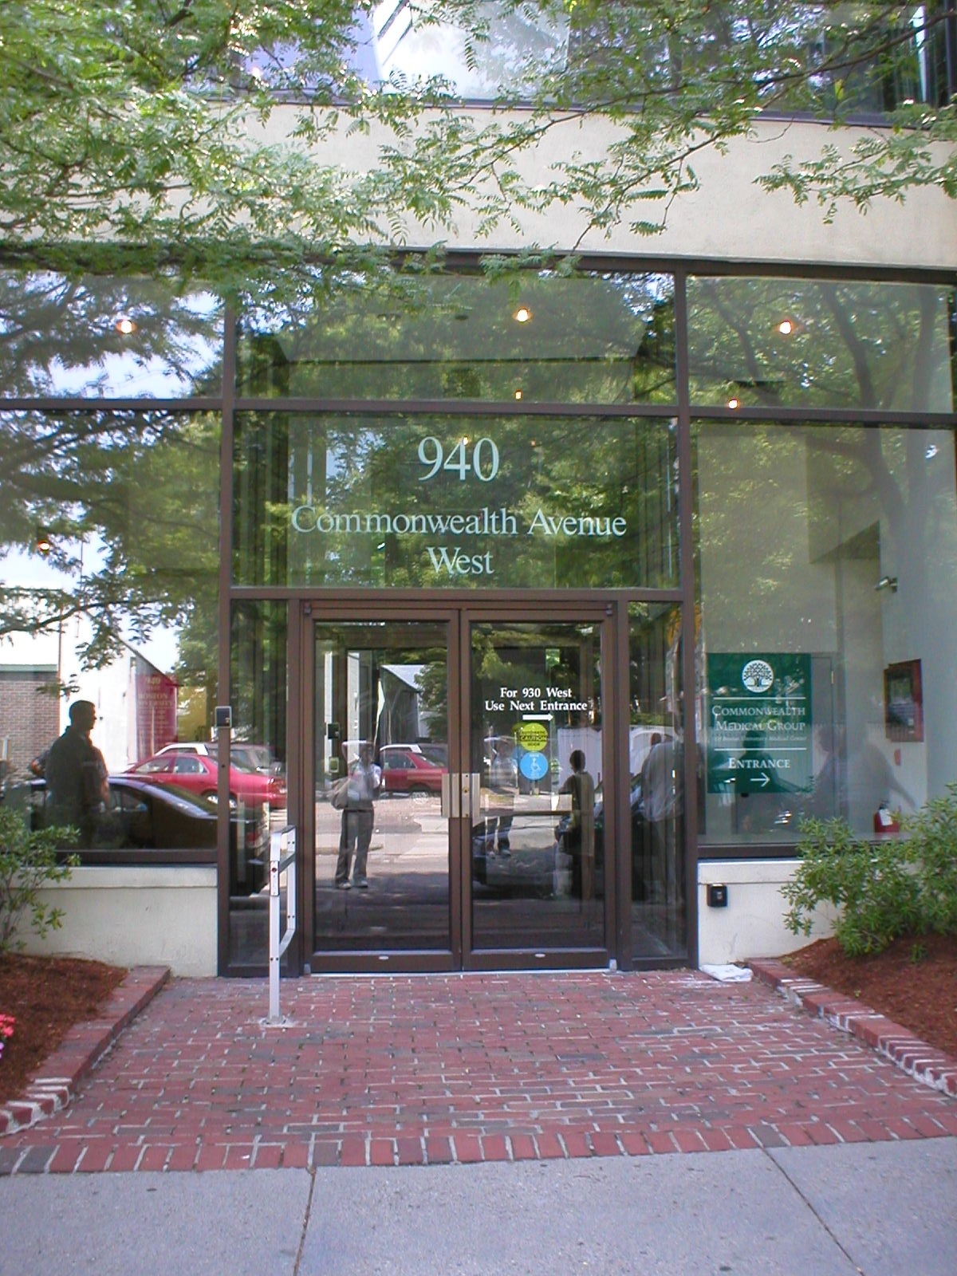
Center for Psychiatric Rehabilitation
Funded as a NIMH/NIDLRR/SAMHSA National Research, Training and Service Center in Psychiatric Rehabilitation since 1979 By Dr. William Anthony.
Strong focus on education, employment and wellness for individuals who live with mental health conditions, as well as shifting systems of care and provider training.
WHO in Psychiatric Rehabilitation and our work globally.
Affiliated with Sargent College/OT Department faculty appointments.
The difference between Treatment and Psychiatric Rehabilitation.

Slide 3
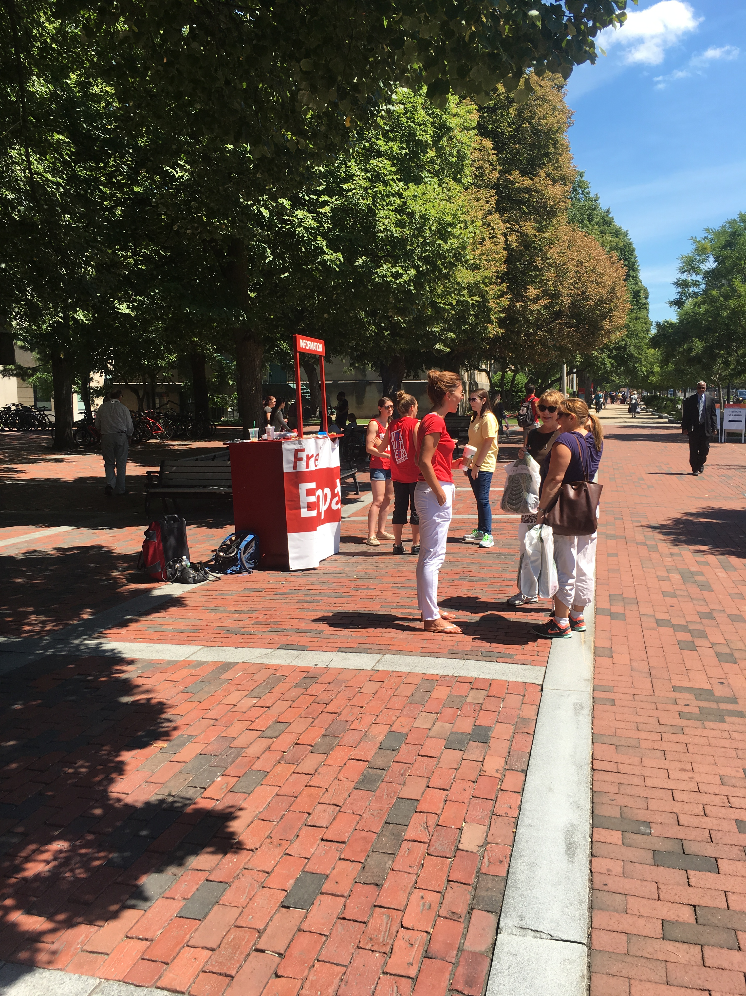
RECOVERY AND RESILIENCY SERVICES FOR BU
LEADBU Seminars (in person and online) for credit for BU and LEAD Espaniol!
Peer Academic Supports for Success Program.
National Depression Screening Day for both campuses-Since 2008.
Wellbeing Project: Terriers Thrive Together Week (the month of October)
Training for students, RA’s, staff and faculty to respond to distress and build resiliency.
Collaboration with the NEWBURY center.
The NITEO program.
Supportive Coaching for title IX respondents on campus.-Healthy Relationships Class as prevention may be implemented.
Facilitated Groups for faculty, staff and students after suicide for healing, Advising with Empathy, etc..
Faculty advisors for ACTIVE MINDS.

Slide 4

Orienting to Our Role in the Process
How Students learn about us and get to us.
Who we are at the University and who we are not.
What we can provide to the student.
How/when we can provide support to the student.
This Photo by Unknown Author is licensed under CC BY-SA

Slide 5

Listening
Leaving our personal biases at the door. It is not an easy place to ”sit” with Title IX complaints.
Focusing on the student and their distress in the moment.
Physical body language and use of office space to create a space of safety and support.

Slide 6

Acknowledging Negative Realities
The importance of sitting in the muck with the respondent.
They have to go through the process.
Our role is not to fix, advise, but to respond, support, teach coping skills, and coach.
We highlight strengths to the students that they possess as a connection to their resiliency during this time of adversity.

Slide 7

Sharing Our Belief The Student Can Survive the Process-no matter the outcome.
Validating the student as a person whose feelings are valid.

Slide 8

Wellbeing Coaching for Respondents
Bio rhythms-sleep, exercise, food as coping tools
Substance use/misuse
Academic structure/responsibilities
Social connections and social fallout
Mental Health needs
Distress tolerance/suicidal thoughts
Telling their families/cultural issues
Campus resources

Slide 9

Our Doors are Always Open (even in COVID)
Recovery from this experience, has no timeline even for Respondents.
Our Relationships with respondents are unconditional.
We welcome students back.
Students who were found “non-guilty”, are often traumatized by the whole process-socially, academically, emotionally and need continued counseling to make sense of their experience and continue to learn and grow.

