Slide 1
Intro to Sexual Misconduct, Prevention, Resources, and Trauma Response
Nathan Brewer, PhD, LICSW
(he, him, his)
Director, SARP

Slide 2
Sexual Violence
Sexual contact without consent
Rape,
Sexual Assault
Intimate Partner Violence
Power and control by intimate
Stalking
Pattern of behavior leading to
fear or emotional distress
Physical, Digital
Domestic Violence
Parental & sibling abuse
Sexual Harassment
Unwanted sexual attention: advances, requests, jokes
Verbal, Physical, Digital
Physical, Psychological, Sexual, Academic, Digital
Physical, Psychological, Sexual,
Financial
Cultural-based
Often related to IPV
Can happen as part of IPV
Violence Types
Notes:
-Domestic violence: family/parental violence
-ACEs: experiencing or witnessing violence, suicide in family, substance abuse, MH problems, or parental imprisonment

Slide 3
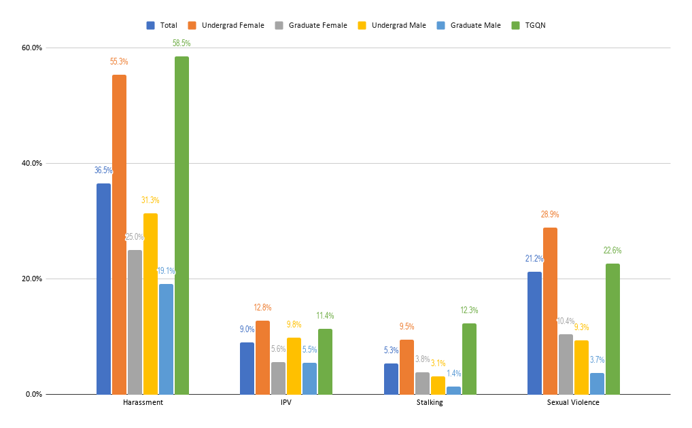
(BU Climate Survey Results, 2020)

Slide 4
Assigned Sex
Determination: Genitalia, Chromosomes
Designations: Male, Female, Intersex: ~1% Births
Gender
Gender Identity
Internal sense of being male, female, neither, both, or another gender
Gender Expression
Physical manifestation of one’s identity; Masculinity, femininity, other
~350 BU Students

Slide 5
Cisgender
When assigned sex is the same as gender identity
Transgender
When assigned sex is not the same as gender identity
0.5% Gen. pop (Flores, Herman, Gates, & Brown, 2016)
3.2% College students (American College Health Association, 2019)
~1,120 BU Student

Slide 6
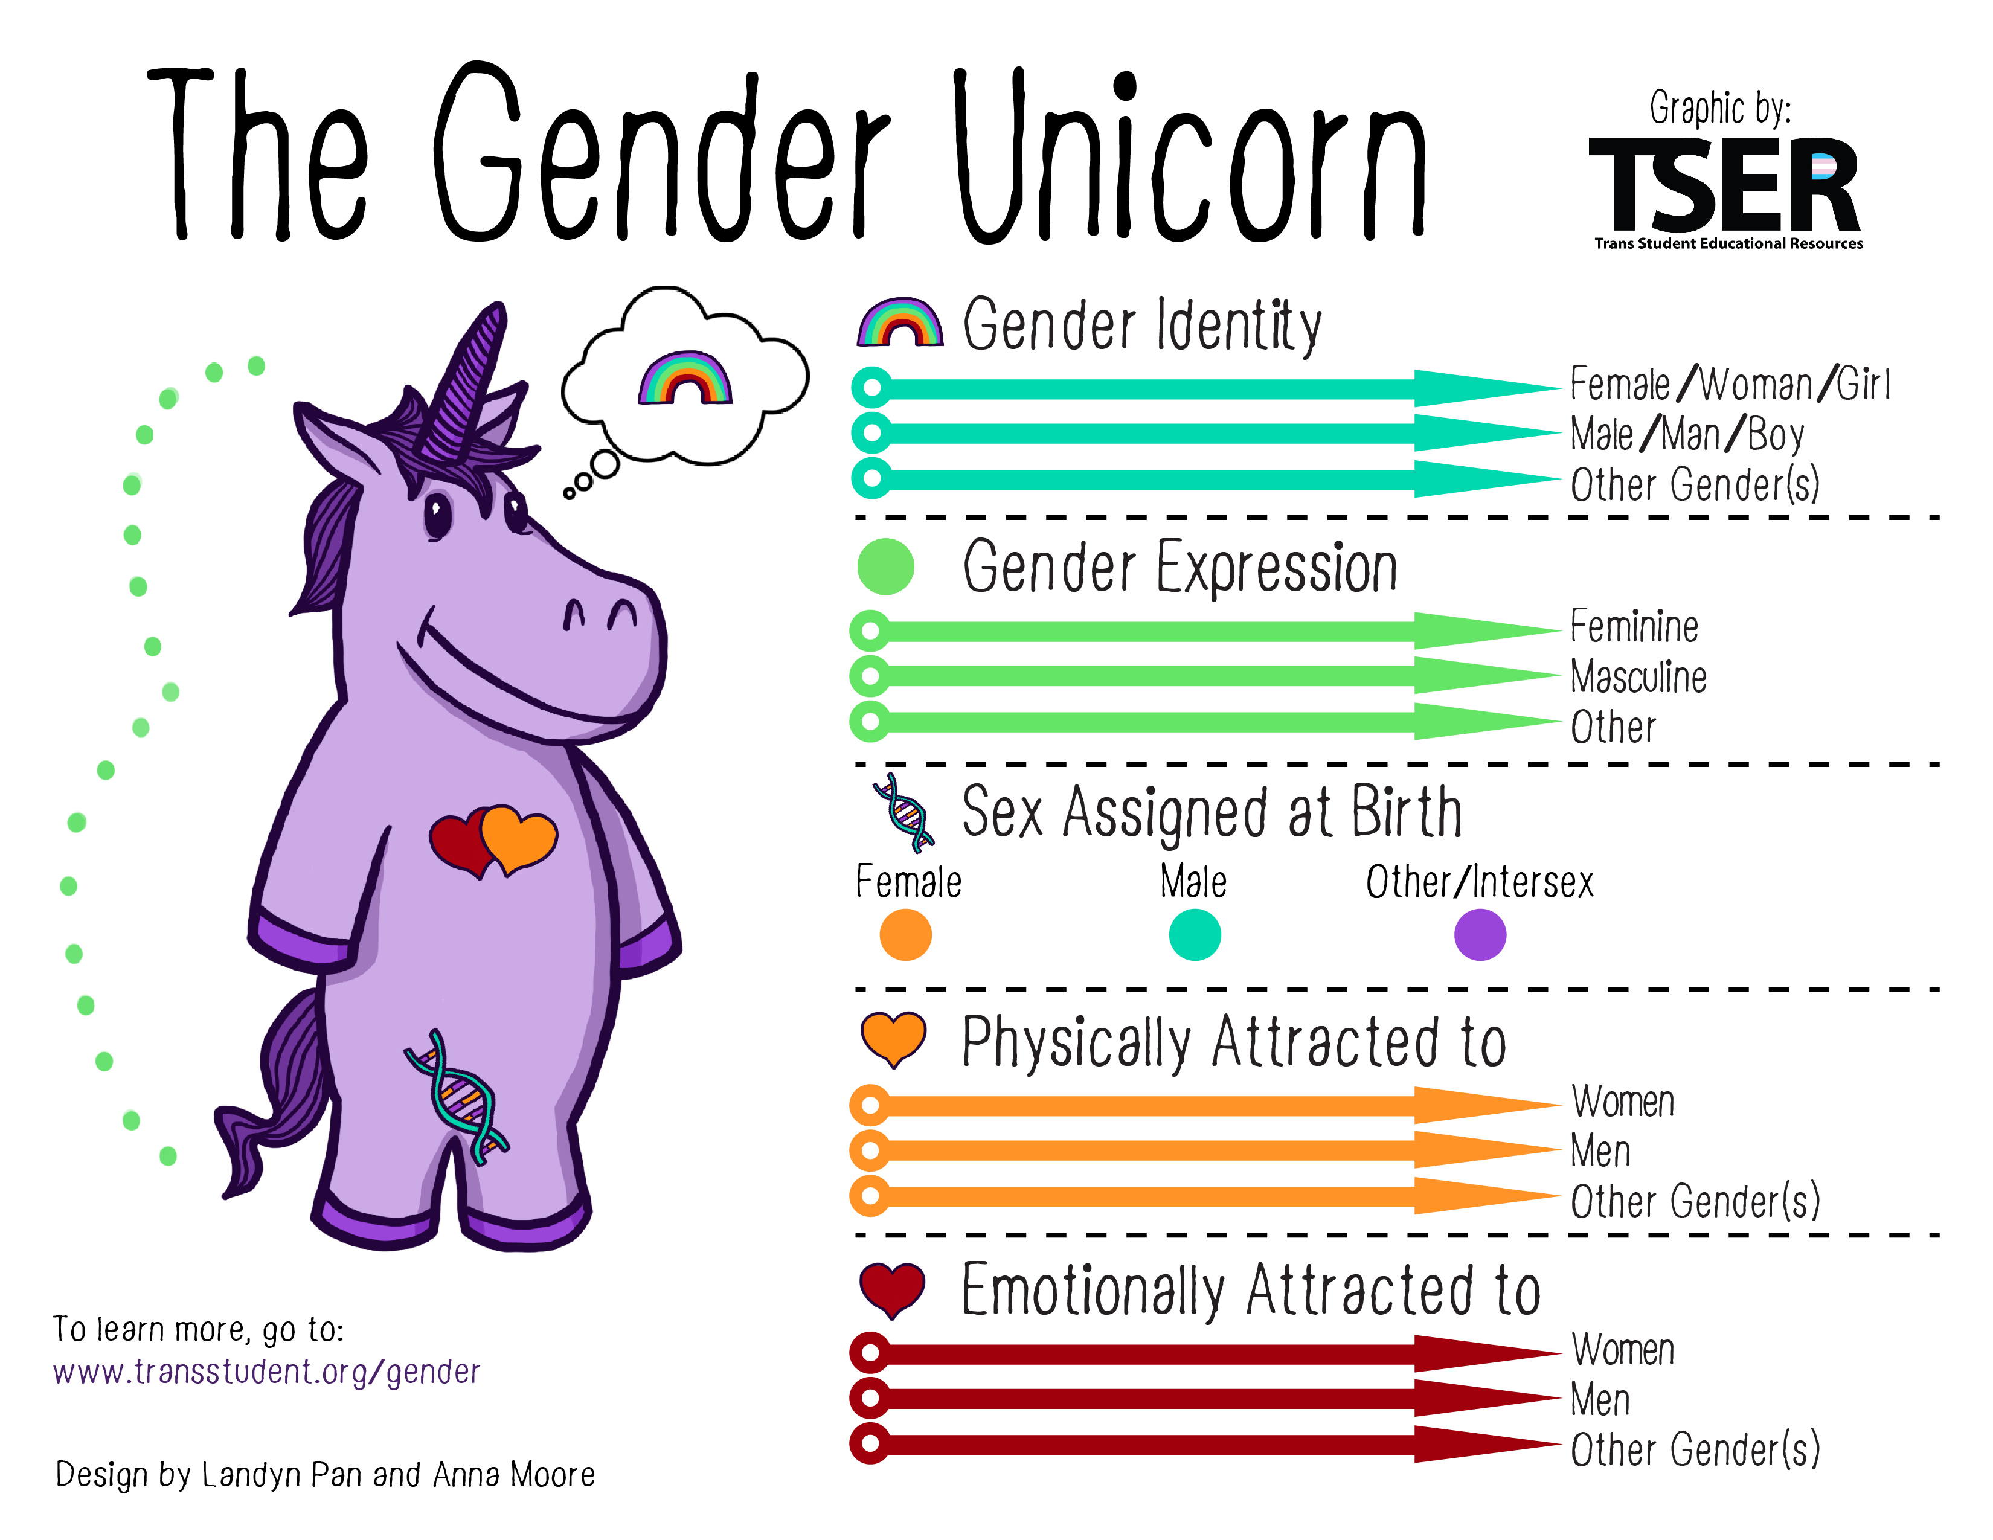

Slide 8
Prevention
9 Principles of Prevention
4. Sufficient Dosage
5. Appropriately Timed
7. Well-Trained Staff
Participants need to be exposed to enough of the activity for it to have an effect.
Program activities should happen at a time (developmentally) that can have maximum impact in a participant's life.
Programs need to be implemented by staff members who are sensitive, competent, and have received sufficient training, support, and supervision. Follow up (booster) training and technical assistance to staff are critical.
9. Outcome Evaluation
A systematic outcome evaluation is necessary to determine whether a program or strategy worked.
1. Theory Driven
Preventive strategies should have scientific or logical rationale.
2. Comprehensive
Programs should be tailored to fit within cultural beliefs and practices of specific groups, as well as local community norms.
8. Positive Relationships
Programs should foster strong, stable, positive relationships.
Strategies should include multiple components and affect multiple settings to address a wide range of risk and protective factors of the target problem.
3. Socio-Culturally Relevant
6. Varied Methods
Strategies should include multiple teaching methods, including some type of active, skills-based component.

Slide 9
Prevention
Levels of Prevention
Other Concepts
Secondary Prevention: ex. Criminal Complaint
Tertiary Prevention: ex. SARP Counseling
Primordial Prevention: ex. BU Values
Primary Prevention: ex. SUSIBU
Addresses underlying risk factors
Targeted efforts before violence occurs
Address immediate impact of violence
Address long-term impact of violence
Awareness
Risk Reduction

Slide 10
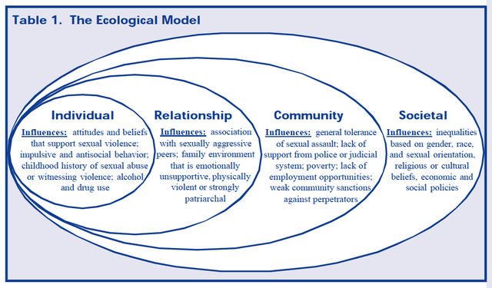
Prevention

Slide 11
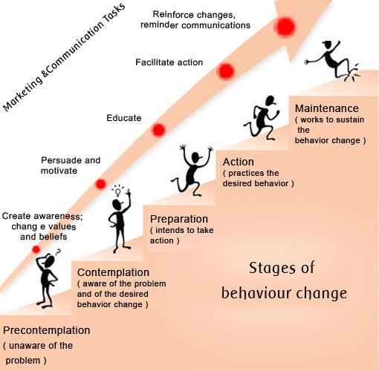
Prevention

Slide 12
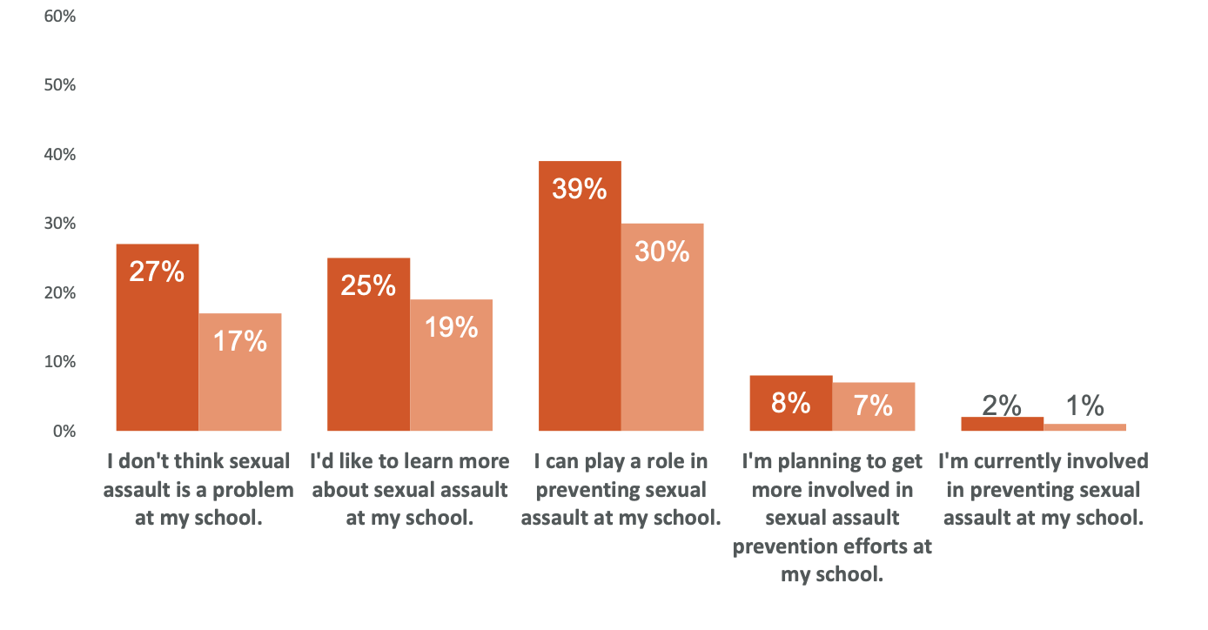
Prevention
Preparation
Precontemplation
Contemplation
Action
Maintenance

Slide 13
SARP
Eligibility
Prevention
SARP Ambassadors
Awareness Events and Trainings
BU Student
Experienced trauma at BU (or one year before)
Response
24/7 Crisis Line
Advocacy and Accompaniment
Individual and Group Counseling

Slide 14
Resources: On-Campus
Advocacy, Counseling
Counseling
BM, CPR, Danielson Institute, CARD.
Medical
SHS
Reporting
EOO/TIX, OJA, BUPD
Academic, Financial
USC, Financial Aid
Housing
ORL
SARP

Slide 15
Resources: Student Groups
Primary
SARP Ambassadors
Others
CGSA
Queer Activist Collective (Q)
FemCo
It’s on Us
16,000 Strong
Panhellenic & Interfraternity Council Sexual Violence Committee
HeForShe

Slide 16
Resources: Off-Campus
Sexual Violence
Domestic Violence
Casa Myrna
Specialized
The Network/La Red
ATASK
Saheli
Boston Area Rape Crisis Center
SafeLink (MA Hotline)
RAINN (SV Hotline)
National DV Hotline
Victim Rights Law Center
NoMoreDirectory.org
BIDMC: SANE

Slide 17
Trainings: On-Campus
SARP
SUSIBU
SUSIBU2
Yes! Sex Positivity and Consent
This Dating Life
Interrupt!
Others
WiseGuys Allies
Professional Boundaries (EOO)
Healthy Relationships (CPR)

Slide 18
What is trauma?
A reaction to at least one difficult event that overwhelms an individual’s ability to cope (SAMHSA, 2014)
Interaction of:
  Nature of the event(s)
  Individual’s response to those event(s)

Slide 19
What is trauma?
Type I Trauma: “Simple” Trauma
Single, discreet event
Type II/III Trauma: “Complex” Trauma
Multiple and/or prolonged events
Perpetrator is someone known, trusted, loved
Happens early in development (i.e., childhood)
Insidious Trauma: Oppression
Effects are similar to Type I-III Traumas
Collective & Generational Trauma
Related to collective events (e.g., Marathon Bombing)
Related to group history (e.g., Holocaust)
(Herman 1997; Solomon & Heide 1999, Terr, 1991; Van der Kolk 2005, 2014)

Slide 20
How does trauma affect us?
Physical
Caused by event, immediate response, long-term response
Psychological: Echoes of FFFF
ASD, PTSD
Emotional
Interpersonal
Trust, Relationships, Sex
Spiritual / Existential
Depression, Anxiety
Loss of meaning, Sense of Self, Direction

Slide 21
How does trauma affect us?
Thinking brain (cortex): complex, very slow, conscious
Action brain (amygdala): simple, very quick, unconscious
Fight, Flight, Freeze, Fawn (4 F’s)
Memory making (hippocampus): disrupted by 4 F’s

Slide 22
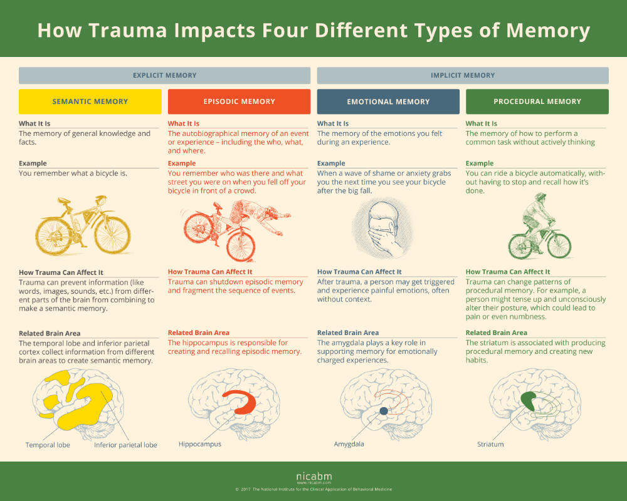
NICABM
(2017)

Slide 23
How will trauma present to you?
  No “right” way to present
  Timing
    Immediately
    Increase in symptoms
    Decrease in functioning
    At a time they can cope with the trauma of disclosing/reporting

Slide 24
How will trauma present to you?
  Memory
    Semantic and episodic memory might be disrupted
  Emotions
    Tearful, numb or blank, anxious or fidgety, laughing or smiling
  Behaviors
    Turn to substances, risky behaviors, or completely withdraw

Slide 25
How to respond?
  Survivor need:
    To be heard, respected, and believed
    A chance to re-establish a sense of personal control and safety
    Information to make timely and informed decisions

Slide 26
How to respond?
DO
DON’T
Stay calm
Talk in a soft, respectful voice
Explain your role, confidentiality
Listen without judgement
Remind them they aren’t alone
Encourage them to talk with someone they trust
Take care of yourself!
Touch the survivor
Ask too many invasive questions
Tell the survivor what they “MUST” do
Reveal case information outside the scope of your position
Allow disclosure without discussing limits of confidentiality
Do the work alone or in isolation

Slide 27
Thank you!
Questions?
nbrewer@bu.edu

