Slide 1
Understanding Expectations for
Title IX Team Members
Equal Opportunity Office
August 19, 2021

Slide 2

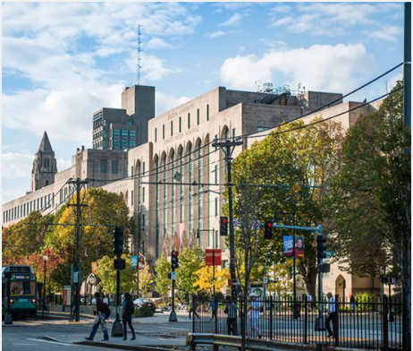
Title IX Team
Notes:
Welcome! I became TIXC 7 weeks ago. Since that time, I have had the pleasure of working with so many of you
Super impressed by your knowledge, skill and dedication
I look forward to meeting you all and working with you.
I believe together we can improve BU’s community by providing more care and connection to resources to help our students, faculty and staff become more successful here.
Thank you, this stuff is HARD

Slide 3
University Title IX Coordinator
The Title IX Coordinator acts with independence and authority free from bias and conflicts of interest.
Charged with primary oversight of the Boston University’s compliance with Title IX, including education, monitoring and addressing complaints.
Jessica Nagle
University Title IX Coordinator
nagle@bu.edu

Slide 4
Deputy Title IX Coordinator
List of Deputies is being finalized
More than 50 professional staff members designated by respective deans
Local resources
Trained in responding to disclosures of sexual misconduct
Provide information and referrals

Slide 5
Notice to a Deputy?
What do Deputies do? A Deputy is a facilitator or resource. A Deputy is not a decision-maker by law.
What is “actual knowledge?”
Has the authority to institute corrective measures and must report incidents to the Title IX Coordinator.

Slide 6
Responsible Employees
Employees with responsibility for others (i.e., “responsible employees”):
  Must report information incidents to the Title IX Coordinator
  May not promise confidentiality

Slide 7
What Does Resource Mean?
You are not a decision maker, not a fixer
You are a resource to help people report, obtain supportive measures to restore access to their living, learning and working environment
Provide care and connection to referrals

Slide 8
What is the Expectation?
  Explain:
    Reporting options and the effects of each option
    Counseling services available on campus and through local community-based rape crisis or domestic violence centers
    Medical and health services available on- and off-campus
    Available school- or work-based supportive measures related to academic and residence life, and employment
    Explain BU’s disciplinary process
    Provide information on how the legal process is carried out through local law enforcement agencies
    Notify the reporting party of their rights and BU’s responsibilities in obtaining a criminal protection order, BU No Contact Directive, BU No Trespass Order, and other lawful orders from law enforcement or BU

Slide 9
What Does Private Mean?
Are Deputy TIXC conversations confidential?
No.
Deputies are private resources. They will keep your information as private as possible, only sharing it on a need-to-know basis.

Slide 10

BU’s Procedural
Process

Slide 11
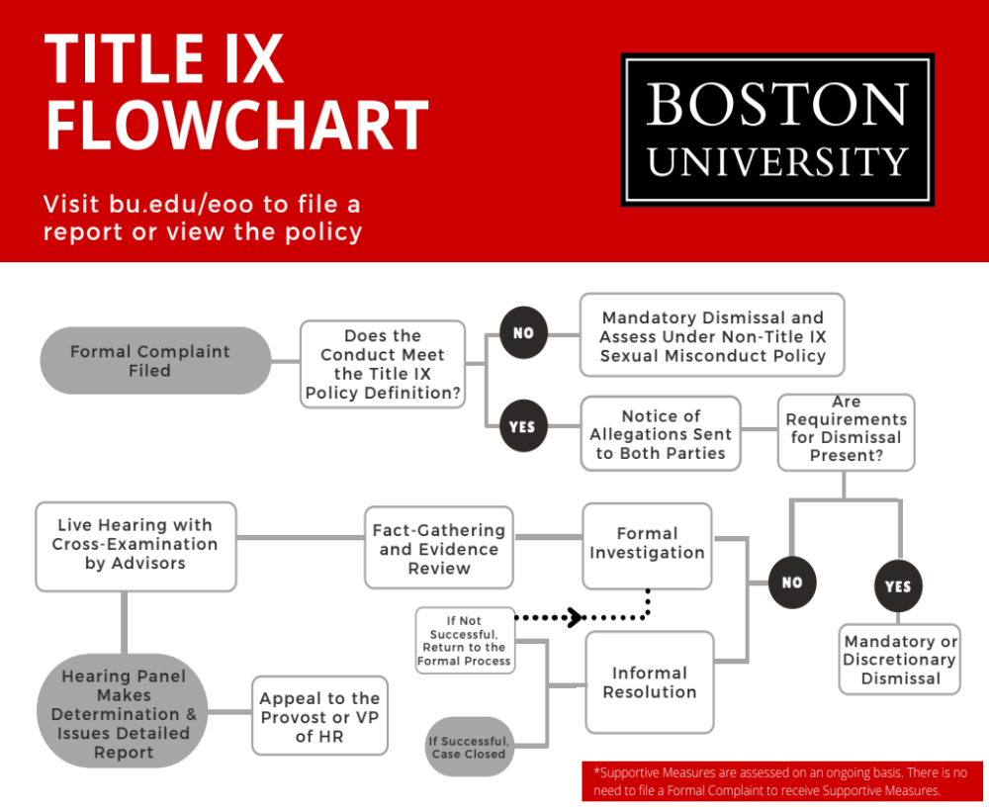
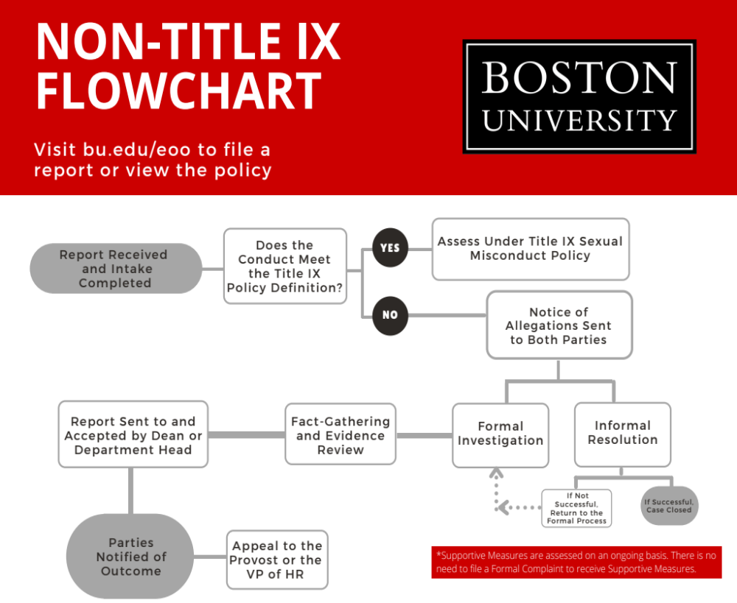

Slide 12
Case Scenarios
During Dean T’s and Deputy S’s weekly one on one, the Dean says:
  I keep hearing there are concerns regarding the sexually natured remarks in the science club. What is going on?
  I want you to decide what should happen and deal with it.

Slide 13
Confidential Resource Providers (CRPs)
Free
Resource for any BU community member (student or employee).
  Denita Johnson | denita@bu.edu
  Assistant Dean for Field Education
  Sonia Mee | smee@bu.edu
  Assistant Director, Online Programs

Slide 14
CRPs Explain:
Reporting options and the effects of each option
Counseling services available on campus and through local community-based rape crisis or domestic violence centers
Medical and health services available on- and off-campus
Available school- or work-based supportive measures related to academic and residence life, and employment
Explain BU’s disciplinary process
Provide information on how the legal process is carried out through local law enforcement agencies
Notify the reporting party of their rights and BU’s responsibilities in obtaining a criminal protection order, BU No Contact Directive, BU No Trespass Order, and other lawful orders from law enforcement or BU

Slide 15
CRP Designation
Not a counselor or therapist
BU will not discipline or penalize the CRP for representing the interest of the reporting party
Notice to CRP of an alleged sexual misconduct or a CRP shall NOT Be considered actual or constructive notice to BU

Slide 16
What’s the Difference Between a
Deputy & CRP?
Deputies are private
CRPs are confidential
Individuals should be referred to a CRP if they want:
  want to speak to a University staff member
  learn more about their options and the effects of each option

Slide 17
CRPs, SARP, FSAO, SHS, BM
Are my conversations confidential?
Yes.
Confidential staff will keep conversations confidential and are not required to disclose information to the Title IX Coordinator.
May report incidents without any identifying information to the University Title IX Coordinator to help the University understand the existence and extent of the problem (Title IX) or to BUPD with the consent of the individual.

Slide 18

What Are Our Values of Our Title IX Team?

Slide 19
How will we work together?
Teams Channel
Resources, flowcharts, brochures, and information to support you
Beginning August 26, open office hours every Thursday through Zoom from 1pm-2pm
Will have 4 more trainings this year
  Review upcoming policy and procedures revisions
  Learn from our experts on how to understand trauma, how to provide support, referrals and best practices for success

Slide 20
Changing state and federal laws

Slide 21
What is Title IX?
No person in the United States shall, on the basis of sex, be excluded from participation in, be denied the benefits of, or be subjected to discrimination under any education program or activity receiving Federal financial assistance.
On May 6, 2020, Dept of Education (DE) Final Title IX regulations.

Slide 22
What is Covered by Title IX?
Sexual Violence
Sexual Harassment
Gender/Sex Based Discrimination
Sexual Orientation Discrimination
Pregnant Students
Pregnant Students
Dating and Domestic Violence
Retaliation
Stalking
Failure to provide Equal Opportunity

Slide 23
What’s New Under Title IX?
Formal process - the right to a hearing and to cross-examination
Informal process
Right to an advisor, BU will provide one a hearing advisor if necessary
EOO BIT Team will conduct emergency removal only for employees
Both parties may appeal
A new definition of sexual harassment
Sexual Misconduct Policy being revised

Slide 24
BIT Key Functions
Provide threat assessments and early intervention before a crisis arises.
Identify employees whose behaviors are distressed, disruptive, and/or dysregulated
Discuss/assess situations brought to its attention by any campus community member seeking guidance on concerning behaviors that might lead to aggression or self-harm.
Centralize the process of collecting and assessing “red flags”
Develop a coordinated plan to help employees in crisis, mitigate risk, facilitate early intervention, and protect and maintain campus safety.
Coordinate follow-up with the employee

Slide 25
Who Serves on BIT?
Individuals from diverse areas within the University:
Dean of Students
Talent Management & Human Resources
Police Chief
Police Detective Lieutenants
Social Worker
University Title IX Coordinator
** OJA or the Dean of Students manages and responds to any concern regarding students.
Notes:
BIT membership is based on skill, training and speciality not by person

Slide 26
EOO BIT Team
The EOO BIT Team convenes specifically for employees involved or participating in our Sexual Misconduct process or procedures.
Any concerns regarding employees that are not associated or involved in our sexual misconduct processes should be reported to Human Resources, not the EOO.
** OJA or the Dean of Students manages and responds to any concern regarding students.

Slide 27
Refer to BIT?
If you have concerns about any employee, report them to your HRBP.
If the employee is someone you know to be involved in BU’s Sexual Misconduct procedures, report it to TIXC.
Urgent, immediate threat, call BUPD.

Slide 28
An Act relative to Sexual Violence on Higher Education Campuses
August 1, 2021
All new students and employees must be trained within 45 days of their matriculation or employment. This training must subject matter is outlined (explanation of civil rights laws today)
Annual Report no later than December 1
  # of allegations of sexual misconduct reported to BU
  # of allegations by community members against another community member
  # community members found responsible
  # of disciplinary sanctions imposed by BU on those found responsible

Slide 29
How to provide care?

Slide 30
How Do I Support the Person Making the Disclosure?
Time: Be present, listen take your time, do not multi-task
Care: Listen without judgement, avoid questions that imply fault, and respect personal boundaries
Interrupt: Let the person know you MUST make a report as soon as possible as a responsible employee
Connect: Refer the individual to on and off campus counseling, medical and legal advocacy partners
Report: Submit and complete the Incident Report Form, bu.edu/eoo

Slide 31
Kindly Interrupt
Thank you for coming to talk to me. I get the sense that you are about to share sensitive information with me. Depending on what you share, I may have to report this to our University Title IX Coordinator. I will maintain your privacy as much as possible and if the TIXC needs to know they will do the same. I want you to be fully informed before you share with me.
I can explain the reporting options available to you, explain policies, procedures and assess whether supportive measures are appropriate. I will also refer you to medical, counseling or legal support. I am here to support and help you.

Slide 32
Equity in Disclosures
Provide equitable services to every individual
Ensure your tone and response is the same whether you are working with a complainant or respondent
Practice equitable touchpoints or check ins with both parties
Every community member and person is entitled to care and connection

Slide 33

Resources

Slide 34
Private University Resources
(Must Report to the TIXC)
Deputy Title IX Coordinators
BUPD
Dean of Students
Judicial Affairs
EOO

Slide 35
University Confidential Resources
Student Health Services
617-353-3575 | bu.edu/shs
SHS is an integrated health center that offers high-quality integrated clinical services and prevention strategies specific to our college population, and engages educational services and advocacy.
The Center for Psychiatric Rehabilitation
617-353-3549 | cpr.bu.edu
The Center for Psychiatric Rehabilitation is dedicated to improving the lives of persons who have psychiatric disabilities. The Center specializes in wellness, recovery, support, and advocacy for individuals alleged to have caused harm.
Sexual Assault Resource & Prevention Center (SARP)
617-353-7277 | bu.edu/shs/sarp
SARP provides counseling and advocacy to students who have experienced trauma.
Behavioral Medicine
617-353-3569 | bu.edu/shs/behavioral-medicine/
Behavioral Medicine offers a range of mental health services to BU students to keep the BU community healthy by providing assessment, diagnosis and therapy, and psychiatry for a variety of mental health issues.
Faculty, Staff, Assistance Office (FSAO)
617-353-5381 | bu.edu/fsao
FSAO provides free and confidential support, problem-solving, or coaching to address work and personal challenges for BU employees or their families.

Slide 36
Confidential Community Providers
Beth Israel Deaconess Center
617-667-8141 | bidmc.org/centers-and-departments/social-work/center-for-violence-prevention-and-recovery/sexual-assault
Boston Medical Center
617-638-8000 | bmc.org
To locate a SANE nurse, visit the Boston Region Designated Hospitals website at: https://www.mass.gov/ma-sexual-assault-nurse-examiner-sane-program.
Legal Services/Advocacy
Victim Rights Law Center
617-399-6720 | victimrights.org
International Resource
No More Directory | Violence & Sexual Assault
nomoredirectory.org
Sexual Violence
Boston Area Rape Crisis Center (BARCC)
800-841-8371 | barcc.org
National Sexual Assault Hotline
800-656-4673
RAINN
800-656-HOPE | rainn.org
Casa MYRNA: SAFElink Domestic Violence Hotline
877-785-2020 | casamyrna.org/get-support/safelink/
BMC Domestic Violence Program
617.414.5457 | bmc.org/programs/domestic-violence-program
National Domestic Violence Hotline
800-799-7233 | thehotline.org
Network LA ReD | LGBTQ Domestic Violence Hotline
800-832-1901 | tnlr.org
Asian Task Force Against Domestic Violence
617-338-2355 | atask.org
Saheli (South Asian and Arab women)
866-472-4354 | saheliboston.org

Slide 37
Identify Behavior: Case Scenarios

Slide 38
Scenario 1
Resident Assistant Ky likes to socialize with residents.
Ky likes to host parties and is the “hugger” of the dorm.
You witness a student push Ky away in attempt to avoid the hug.
Ky does not seem to get the message and continues to try to hug the student.
What do you do?

Slide 39
Examples of Sexual Harassment
Sexual innuendo, propositions, sexual attention, or suggestive comments/gestures
Physical contact of a sexual nature, such as touching, hugging, kissing, patting, pinching
Sex-based humor, slurs, insults, derogatory language, gestures
Unwelcome attention, such as inappropriate flirting, repetitive compliments about clothing/physical attributes
Display or creation of emails, texts, websites of a sexual nature
Notes:
Humor is problematic
It’s NOT the intent that matters it’s the impact

Slide 40

Scenario 2
Supervisor Sam overhears an employee saying they received nude photos of a colleague.
What do you do?

Slide 41
Retaliation
Illegal
Policy violation
Quells reporting
Examples: schedule change, demotion, removing access to the lab
Notes:
Lets talk about retaliation. Any action that may quell reporting might be retaliatory
We want to be careful not to share information with others or it could open our colleagues up to charges of retaliation.
We only share infor with those with a business legitimate need to know or an educational need to know. And when we share info, we limit the info, only sharing high level info

Slide 42
Reporting Options

Slide 43
1: Law Enforcement
BUPD/Public Safety, local law enforcement
By choosing to report sexual misconduct to the police, individuals are not required to go forward with the case.
They can change their mind.
The statute of limitations on rape in Massachusetts is 15 years.
Notes:
Erin Starts

Slide 44
Protective Order Process
  Violating a Court Issued Protective Order is a criminal offense.
  Only a judge can grant, change, or deny a request.
  BUPD can provide information to individuals who wish to obtain a protective order. Call BUPD.
  If someone has already obtained an order ask them to provide a copy of the court order to BUPD. BUPD will conduct individualized safety planning.

Slide 45
Option 2: Report to the University
Individuals may choose to report to the Title IX Coordinator or their designee. The University has three potential responses:
Supportive Measures
  Provided upon notice, prior to and after the filing of a formal complaint, or when no formal complaint is filed to preserve or restore access to the University.
Formal Process
  The University will investigate the allegation and adjudicate by the preponderance of the evidence.
Informal Process
  Individuals may agree to resolve concerns with the assistance of a neutral facilitator (except if Title IX allegations by a student against a University employee or sexual violence).

Slide 46
Supportive Measures
Restore or preserve equal access, to provide a safe environment, and to prevent additional acts of misconduct
A person is entitled to a supportive measure once BU has notice of an incident, no need to report
The University will keep confidential any accommodations or supportive measures unless maintaining confidentiality would impair the University’s ability to provide such measures.

Slide 47
Examples of Supportive Measures
Access to counseling, tutoring, other academic support
Course-related adjustments
Moving Complainant’s or Respondent’s residence
Reassigning Respondent to another section if enrolled in same course/lab/section as Complainant
Adjusting Complainant’s or Respondent’s work schedule (including leaves of absence), assignment, or location of employment
Issuing administrative No Contact Directive or BU No Trespass Order
Protective orders

Slide 48
Protective Orders
Civil Order
Can we be enforced anywhere in the U.S.
Violations of a civil order result in criminal consequences
Abuse Prevention Order - 209A
Family, dating, former partners, roommates, a child in common
Abuse: "attempting to cause or causing physical harm...or placing another in fear of physical harm..."
Can be filed against family, parents, dating partner
Notes:
Erin Starts

Slide 49
Protective Orders/Process
Harassment Prevention Order - 258E
No relationship type required
Domestic Violence, Stalking, Sexual Violence, Harassment
Harassment: "(i) three or more acts...to cause fear, (ii) involuntary"
Can be filed against anyone who is a threat (i.e., stranger)

Slide 50
University Actions
No Contact Directive (NCD) issued by EOO or OJA
  No communication between the parties
  Failure to adhere results in administrative action
No Trespass Order from BUPD
  Bar someone from BU property who has no reason to be here or is a threat to an individual or the community
  Criminal consequence

Slide 51

Case Scenario
Student A mentions they missed class because they were in court obtaining a protective order.
What should you do?

Slide 52
Reporting Tips From the Field: Carian Diaz
Identify the problem and form your thesis statement.
Write in the third person.
Identify individuals involved
Use the first and last name
Label parties by the role and the affiliation (i.e., complainant, respondent, witness, student, professor)
Always submit a report even if the identity of a party is anonymous or unknown.
Do not delay reporting, can update information as it becomes known
Provide all requested and required information.
Any doubt? Report it.

Slide 53
When Do We Share Info?
Only share information on a need to know basis or if there is a legitimate business need
Only share details that are necessary
Sharing information can open you or your colleagues up to retaliation

Slide 54
Next Meeting
How to Identify Potential Sexual Misconduct
How to Respond to a Disclosure
How to Report Report
How to Advise and Provide Resources
Next Steps:
Learn how trauma impacts the brain, sexual misconduct prevention and awareness, the role drugs and alcohol play in affecting the ability to consent, bystander intervention, and risk-reduction strategies
Learn how law enforcement works
Share and post materials within respective areas
How to host awareness and education events within respective areas

Slide 55

Any Questions?

