Slide 1
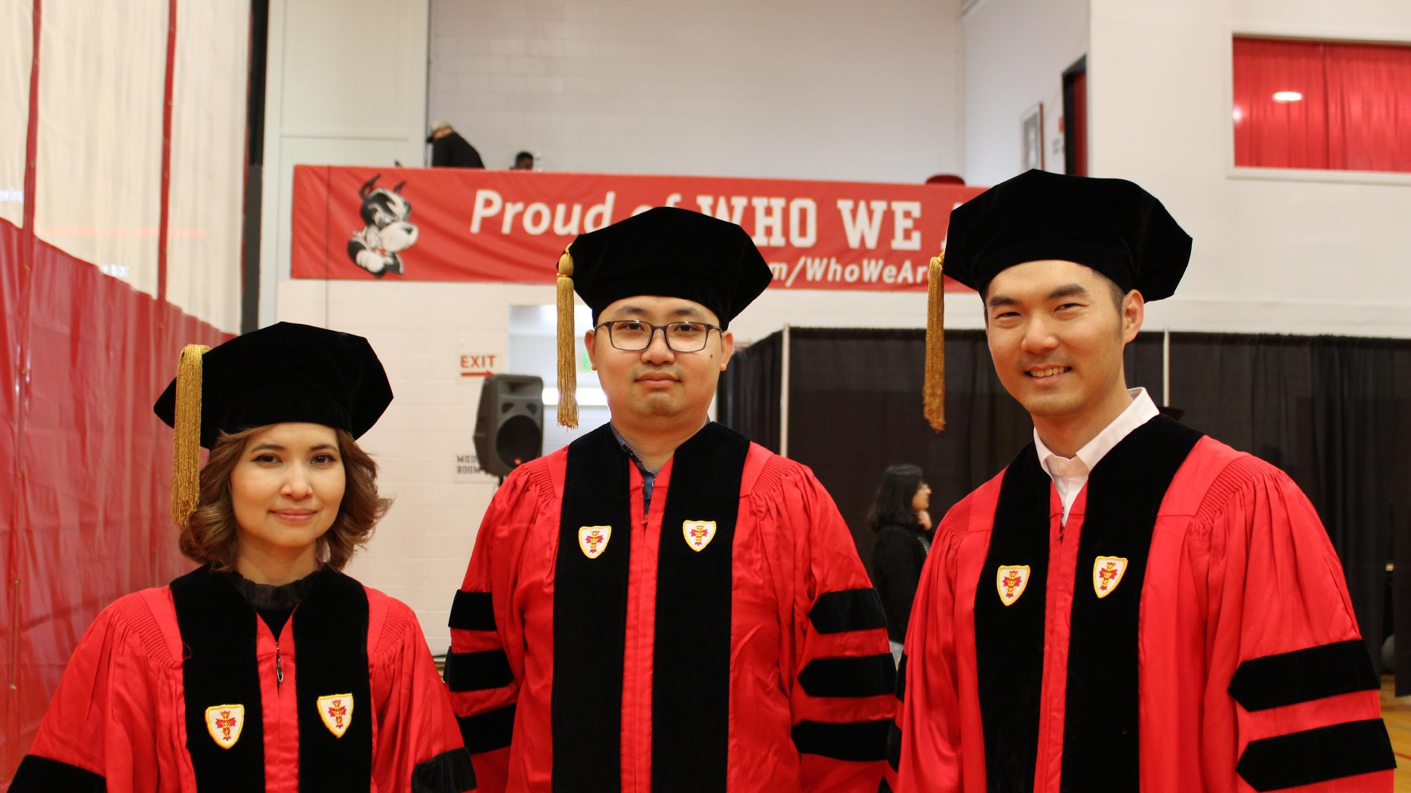

Slide 2
PhD Orientation
Fall 2024
College of Engineering
Division of Material Science & Engineering

Slide 3
Agenda
Welcome and Program Overview Professor Basu, Associate Division Head
Resources Elizabeth Flagg, Division Director
MSE Graduate Student Association & Peer Mentoring MSE GSA Team
College of Engineering
Division of Material Science & Engineering

Slide 4
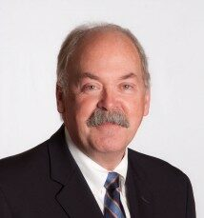
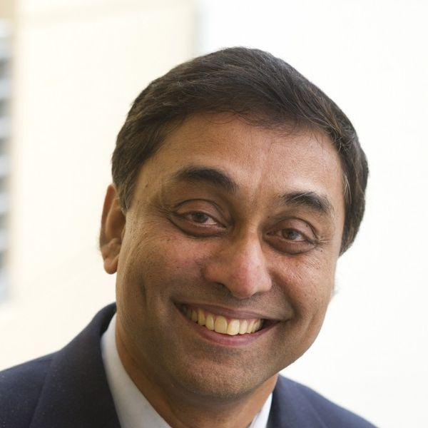
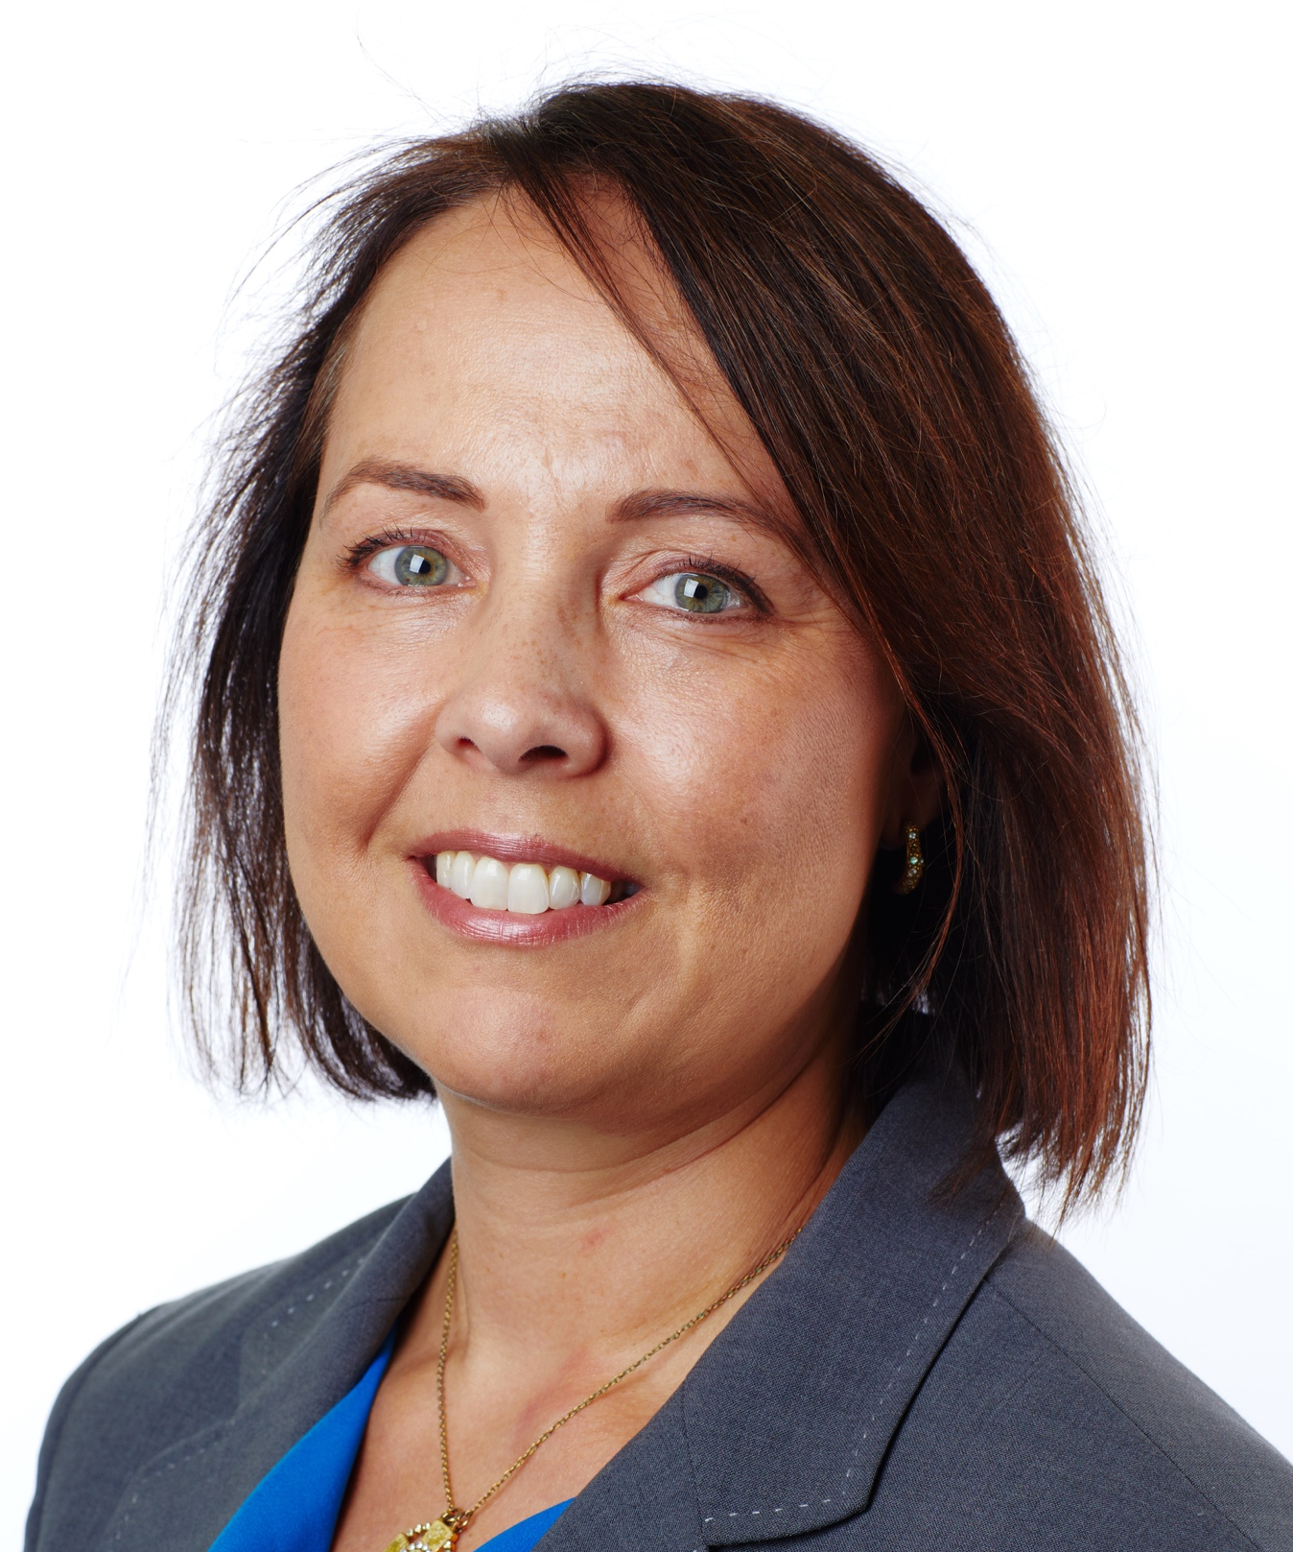
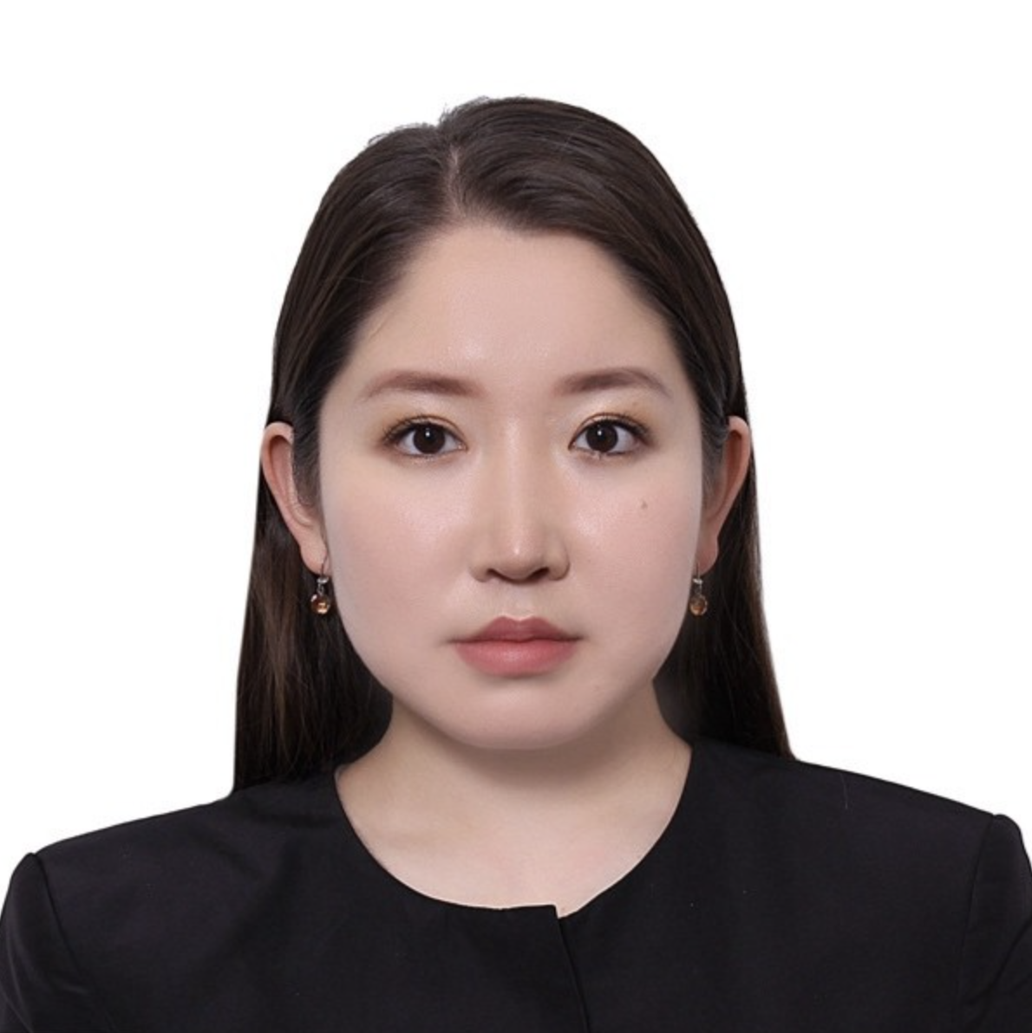
MSE Team
David J. Bishop
Soumendra Basu
Division Head
Associate Division Head
Division Head
Associate Division Head
Elizabeth Flagg
Bulgamaa Batdelger
Lea Sabra
Division Director
Graduate Programs Manager
Communications Manager

Slide 5
Points of Contact
Academic Issues
Non-Academic Issues
Academic Advisor
Graduate Programs Manager
Division Director
Associate Division Head
Graduate Programs Manager
Division Director
College of Engineering
Division of Material Science & Engineering

Slide 6
Advisor Roles:
Academic Advisor vs. Research Advisor
Academic Advisor
Fall 2024 & Spring 2025
Helps with course selection and general advising.
Research Advisor
Summer 2025 (or earlier), until graduation
Directs research
Helps with course selection and general advising.
College of Engineering
Division of Material Science & Engineering

Slide 7
PhD Programs
Post-bachelors PhD:
Minimum 64 credits, including MS requirements:
4 Core Courses (16 credits)
2 Concentration Courses from one area (8 credits)
Biomaterials
Materials for Energy & Environment
Electronic/Photonic Materials
Nanomaterials
Electives/Research (Remaining credits)
MS 539 Intro to Materials Science & Engineering is recommenced for students without an MSE background.
Only one 400-level course, with advisor approval, if needed as a pre-requisite for another course in the program.
Apply to graduate with MS after passing Prospectus Defense.
Only courses with grades of B- or better count.
Cumulative GPA of at least 3.0 on courses used for graduation is required to graduate.
College of Engineering
Division of Material Science & Engineering

Slide 8
PhD Programs
Post-masters PhD:
Minimum 32 credits applicable to the degree, all of which must be at the 500 level or higher.
There are no structured course requirements, HOWEVER:
The MS core + concentration structure is STRONGLY RECOMMENDED
CORE: needed to pass qualifying examination
CONCENTRATION: for research
MS 539: Introduction to Materials Science and Engineering
Recommended for students without an MSE undergraduate or masters degree
A minimum of 16 credits of research/dissertation coursework is required.
Only courses with grades of B- or better count.
Cumulative GPA of at least 3.0 on courses used for graduation is required to graduate.
College of Engineering
Division of Material Science & Engineering

Slide 9
PhD Qualifying Examinations
Qualifying Exam Section | Course | Next Offering
Section 1 (typical option) | MS 577 Electrical, Optical, and Magnetic Properties of Materials OR | Fall
Section 1 (students with a physics background may take this option) | PY 543 Introduction to Solid State Physics (instructor approval required) | Spring
Section 2 | MS 503 Kinetic Processes in Materials | Spring
Section 3 | MS 505 Thermodynamics and Statistical Mechanics | Fall
College of Engineering
Division of Material Science & Engineering

Slide 10
PhD Qualifying Examinations
Exam format
Written and oral exam
Oral exam based on written section
Final result is based on both of the above
Possible outcomes
Pass
Partial Pass: retake section(s) of exam (1st attempt only)
Fail: retake entire exam (1st attempt only)
Fail: removed from PhD program
Schedule
January, before Semester Start
May, usually the week after Commencement
College of Engineering
Division of Material Science & Engineering

Slide 11
Math Requirement
Post-BS PhD students:
Complete with grade B+ or better one of:
ENG ME 512 Engineering Analysis
ENG EK 501 Mathematical Methods I
ENG MS/EC 574 Physics of Semiconductor Materials
ENG MS 508 Computation Methods in Materials Science
ENG MS/ME 527 Transport Phenomena in Materials Processing
Other graduate level courses can be petitioned for approval of MSE Graduate Committee BEFORE taking course
Post-MS PhD students:
Complete Post BS requirement OR
Submit evidence of successful completion B+ or better of equivalent course as approved by the MSE Graduate Committee
College of Engineering
Division of Material Science & Engineering

Slide 12
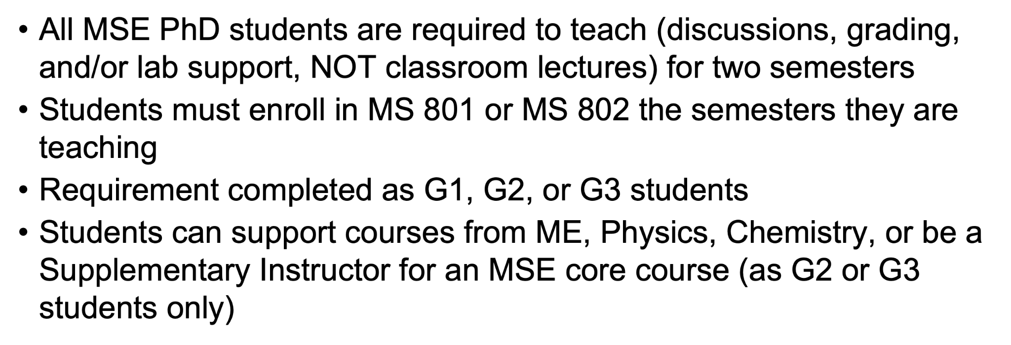
Teaching Requirement
College of Engineering
Division of Material Science & Engineering

Slide 13
Timeline
Candidacy Within 2 years of matriculation | Prospectus Within 2 years of passing Subject Qualifying exam | Dissertation Within 5 years of attaining Candidacy
Subject Qualifying Exam Must pass within 2 years of matriculating Offered in May between Commencement & Memorial Day weekend and in January before classes start Maximum of 2 attempts Math Requirement Stipend Increase, 10% | Advanced RCR Requirement Prospectus Defense Post-bachelors PhD students should apply to receive their Masters degree | Meet with Dissertation Committee annually to report progress Defend dissertation Deposit approved dissertation to library
College of Engineering
Division of Material Science & Engineering

Slide 14
Research Advisor & Doctoral Research Fellow Positions
Matriculating students are (mostly) on MSE support for Fall ‘23 and Spring ‘24
Doctoral Research Fellow (or RA) positions begin Summer ‘24
Finding a Research Advisor
Some students enter the program with a specific research advisor and project in mind. No rotation is needed for such students
Others will use the first two semesters to find research advisors through lab rotations.
On finding a faculty supervisor in Fall or Spring, register for MS900 research .
Students with no advisor commitment after the first rotation must complete at least one more rotation during spring semester
Inability to secure a research advisor by April 30, 2025 constitutes not making sufficient progress as graduate student
College of Engineering
Division of Material Science & Engineering

Slide 15
PhD Funding Model
1st Year | Candidacy Rate
$13,791.67/semester | $15,170/semester
Fall/Spring Service Stipend Graduate Teaching Fellowship Doctoral Research Fellowship | 10% raise over base.
Fall/Spring Non-Service Stipend Dean’s Fellowship Distinguished MSE Fellowship | Must pass both: PhD Qualifying Exam Math Requirement
Summer Service Stipend Doctoral Research Fellowship | Service Stipend Doctoral Research Fellowship Other Fellowship (NSF, etc)
* See MSE PhD Handbook, PhD Funding Information for further information.
College of Engineering
Division of Material Science & Engineering

Slide 16
External Funding Bonus
Application Period: 7/1 – 9/30
For a multi-year award, the student must apply each year.
Up to $3,000 per year.
Must have an NSF, NIH, or HHMI individual predoctoral fellowship for which the student wrote a scientific grant that was subjected to rigorous review.
Other sources of funding will be considered.
Must maintain Satisfactory Academic Progress.
College of Engineering
Division of Material Science & Engineering

Slide 17
MSE PhD Travel Award
Students who have passed the PhD qualifying exam are eligible for a $500 Student Travel Award. The advisor must submit a nomination to the Associate Head, Professor Soumendra Basu, including:
a copy of the paper abstract, and
evidence that the paper is included in the conference/meeting program (e.g., web site containing the program or a page showing where the paper is scheduled in the program).
On completion of travel, the student will submit receipts for reimbursement.
College of Engineering
Division of Material Science & Engineering

Slide 18
BU Advanced Conduct of Research (RCR) Requirement
The RCR program educates students in core norms, principles, regulations, and rules governing the ethical practice of research.
College of Engineering doctoral candidates must complete the RCR requirement prior to scheduling the PhD Prospectus Defense.
Students will complete the RCR-specific CITI training and the RCR Course. The RCR course is a 1 credit, non-tuition bearing course (ENG EK 800) open to all PhD students and postdoctoral scholars. This 10-week course will meet once weekly for 50-minute sessions.
College of Engineering
Division of Material Science & Engineering

Slide 19
Supplemental Instruction (SI) in MSE Core Courses
What is SI?
Supplemental Instruction (SI) is an academic support program in MSE. Peer SI leaders are trained to engage students in group activities outside class hours to help them reinforce course concepts, prepare for exams, and cultivate strong study skills.
Why SI?
Get help with CORE MSE courses.
Peer-facilitated study sessions
Learn and share study skills
It's Free!
College of Engineering
Division of Material Science & Engineering

Slide 20
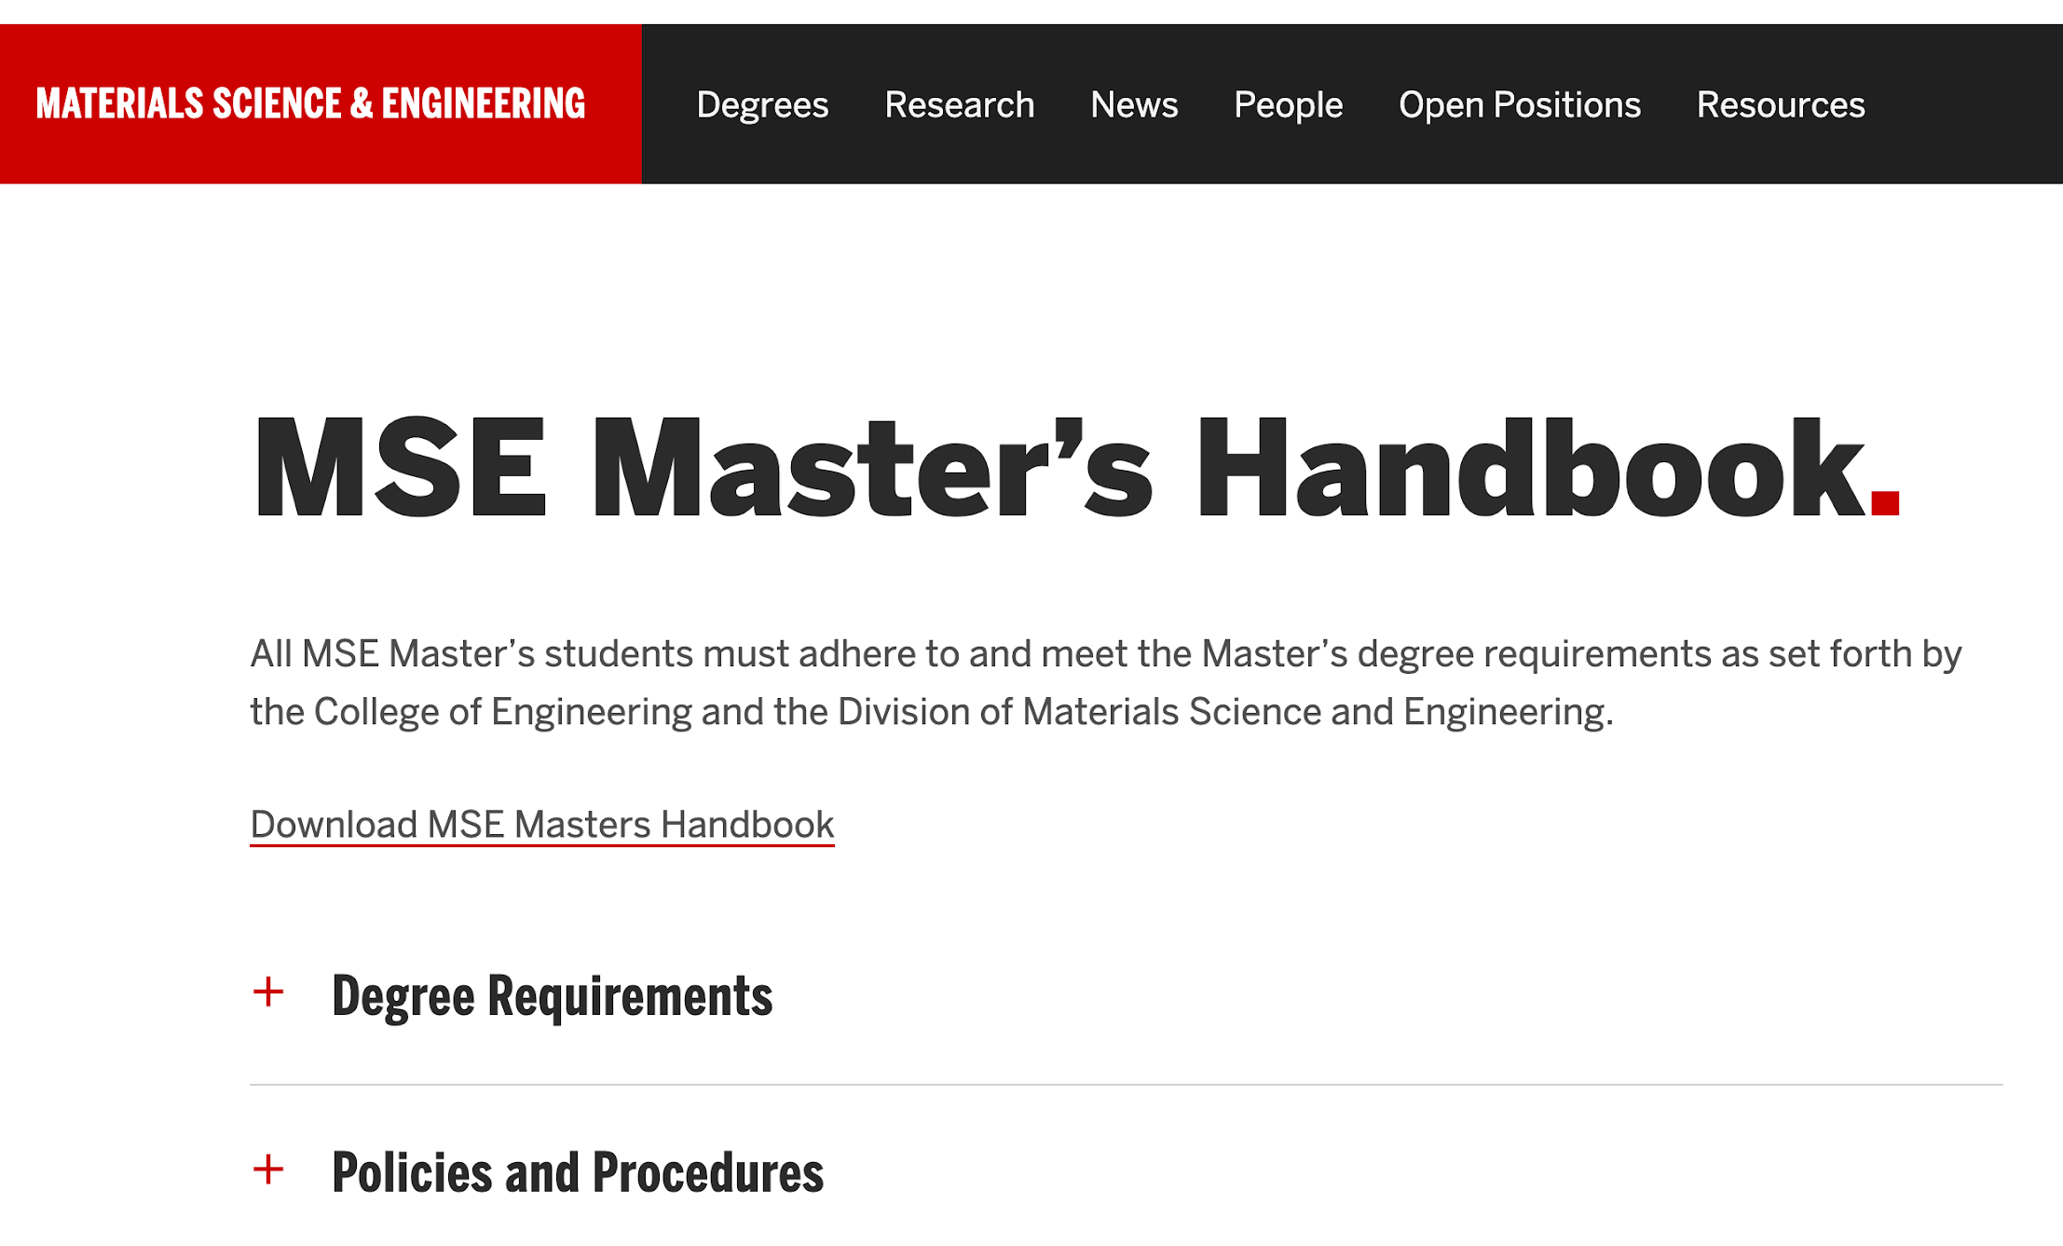
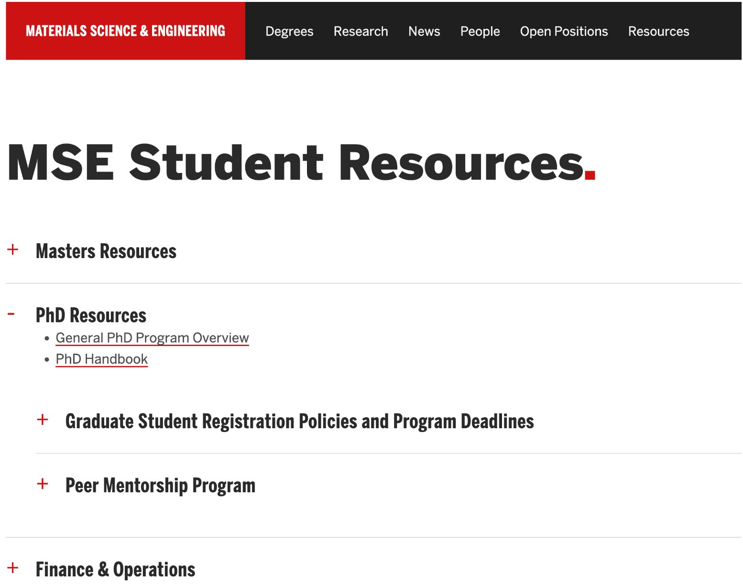
Guidance & Resources
Guidance
Academic Conduct Code
College of Engineering Graduate Bulletin
MSE Masters Handbook
MSE PhD Handbook

Slide 21
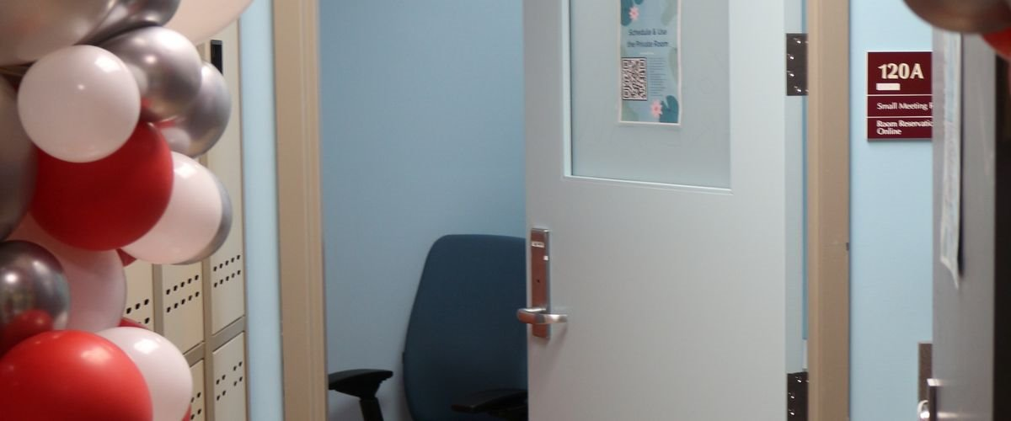
Guidance & Resources
Division Resources
MSE Student Lounge & 1st Year PhD Desks, 15 Saint Mary’s Street Rm 122
MSE Conference Room, 15 Saint Mary’s Street Rm 121
Division Wellbeing Room
Card Access is moving to a new system, new info coming.
University Resources
Newbury Center (First-Gen)
BU Out List (for LGBTQIA+ faculty, staff, students and BU community)
Howard Thurman Center for Common Ground
Student Health Services
Educational Resource Center

Slide 22
Guidance & Resources
Fall Events:
Peer mentoring kickoff, 9/25
MSE GSA SolClarity Lab Tour, 9/26
Materials Day, 10/10-10/11
Thanksgiving Lunch, 11/15
MSE GSA Networking Event 11/18
MRS Fall Reception 12/3
MSE Tea & Coffee Wednesdays 2-3, EMB 121
College of Engineering
Division of Material Science & Engineering

Slide 23
Group Affiliations
MSE GSA (MSE Graduate Student Association)
Join ASM & MRS for FREE (after reimbursement)!
SAGE (Student Association of Graduate Engineers)
GWISE (Graduate Women in Science and Engineering)
oSTEM (Out in STEM)
NSBE (National Society of Black Engineers)
SHPE (Society of Hispanic Professional Engineers)

Slide 24
MSE T-Shirt

Slide 25
MSE Graduate Student Association & Peer Mentoring
2023-2024 Eboard
President: Emily Ghosh
Vice President: Savannah Schisler
Treasurer: Chloe Kekedjian
Secretary: Anubhav Wadehra
Peer Mentorship: Matt Geib, Jairaj Narendran

Slide 26
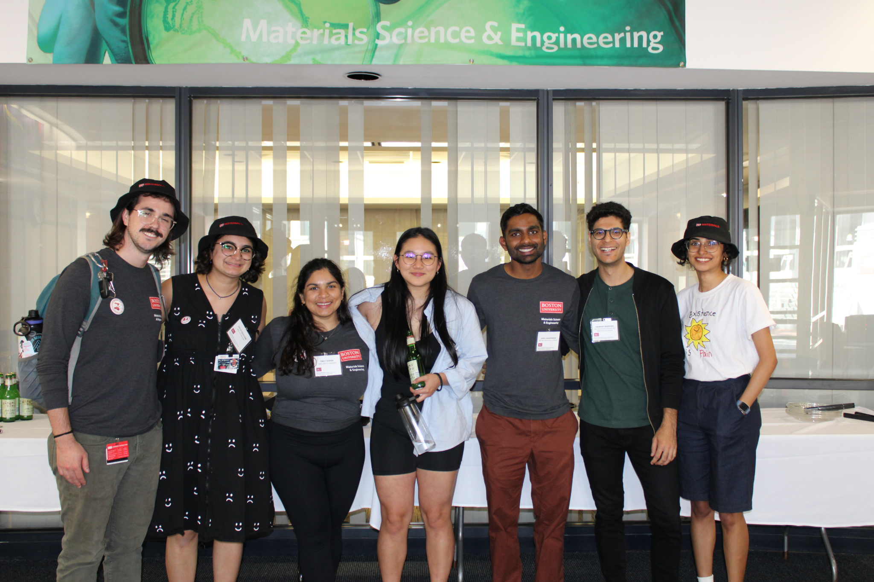
Who is MSE-GSA?
We are the Materials Science & Engineering Graduate Student Association
We seek to build a stronger sense of community
Provides professional development, networking, and social events for graduate students interested in materials science & engineering
We are materials researchers & students (YOU!)

Slide 27
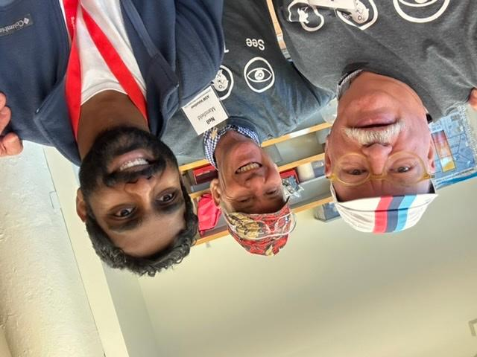
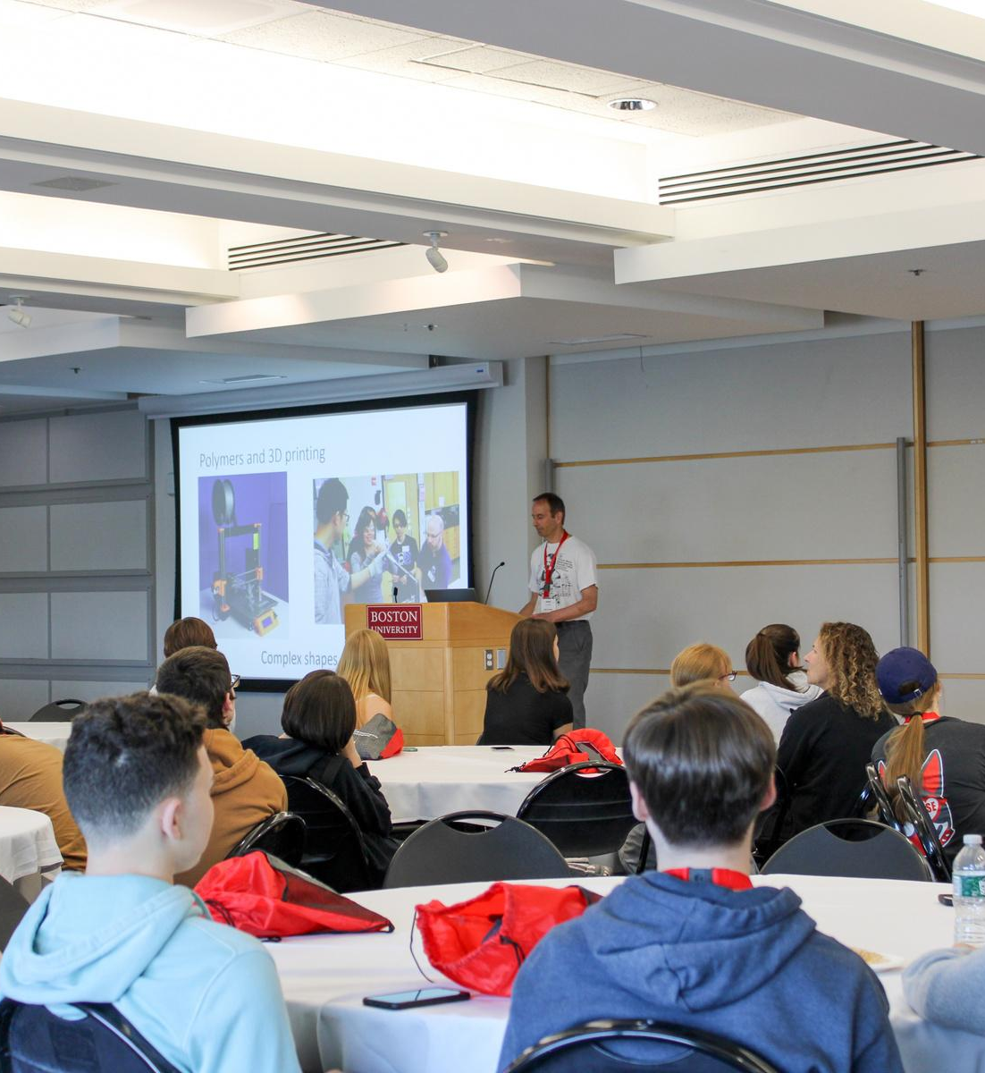
MSE Graduate Student Association
Professional Development
Networking
Social Events

Slide 28
MRS & ASM
Joint student chapter of MRS and ASM International
BU Materials Division students also get FREE MRS and ASM memberships (requires reimbursement form)
Conferences, Talks, Networking
2024 Materials Advantage Chapter of Excellence Award Winner

Slide 29
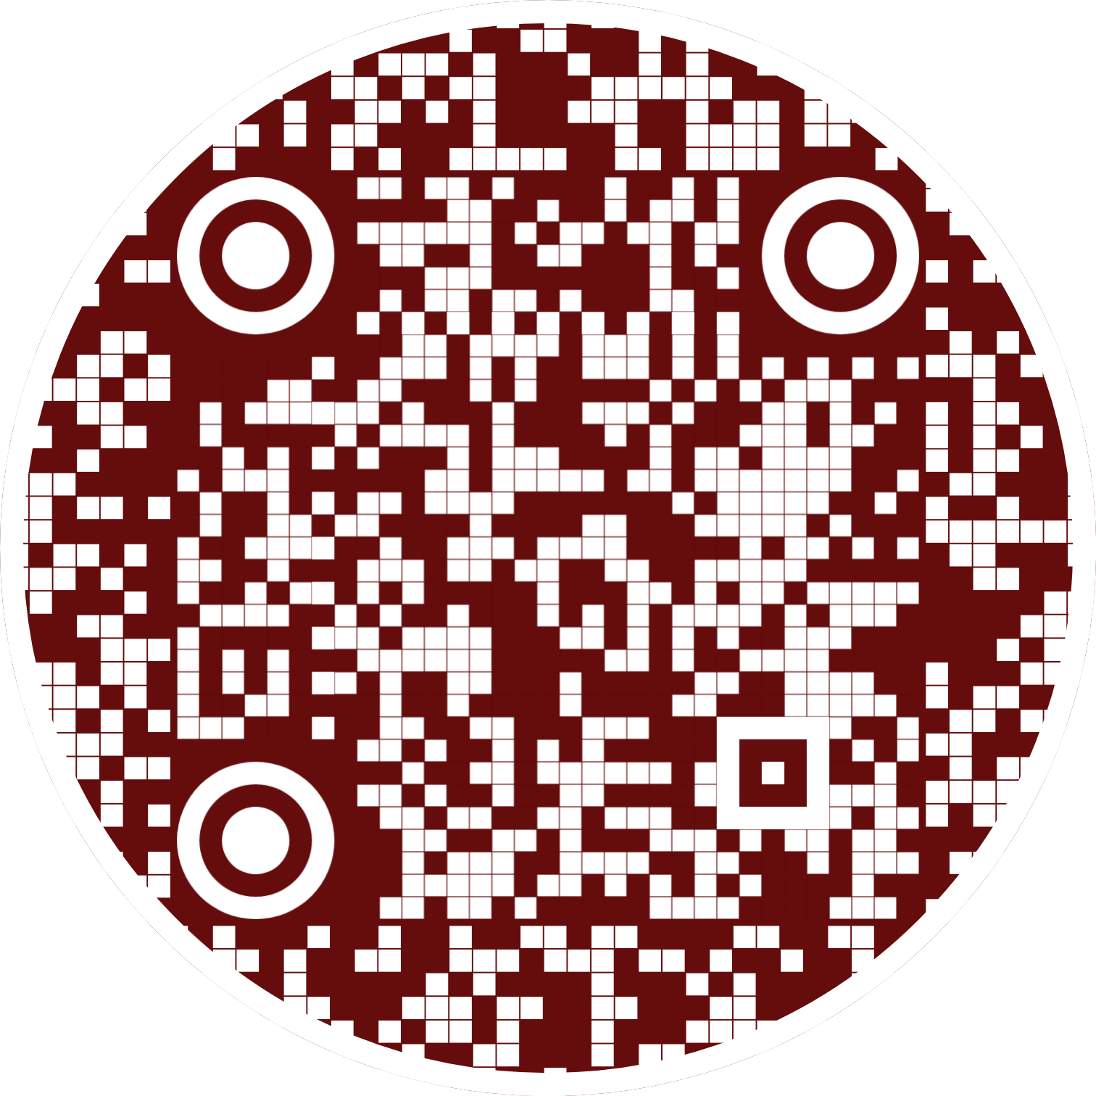
Join us!
Scan the QR code to check out our website, follow us on Instagram, nominate yourself for an Eboard position, and more!
Email: msegsa@bu.edu

Slide 30
Peer Mentoring
Interested in being mentored by a seasoned MSE grad student during your first year?
The MSE Peer Mentorship Program is a student-led initiative with the goal of helping incoming MSE students ease into their grad program and fostering a sense of community within MSE. Senior grad students mentor new students, providing information on a variety of different things such as finding a research lab, learning about available resources at BU, getting to know the Boston area, and more!
Questions? See the MSE Student Resources Page or contact the program Co-Directors:
Jairaj Narendran, jairajn@bu.edu MSE 3rd Year PhD student
Matt Geib, geib@bu.edu
MSE 3rd Year PhD student
College of Engineering
Division of Material Science & Engineering

Slide 31
Welcome to BU MSE!
College of Engineering
Division of Material Science & Engineering

