Slide 1
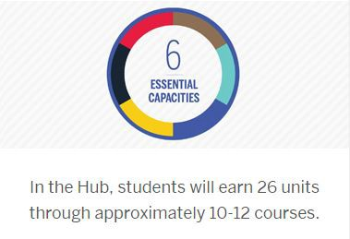
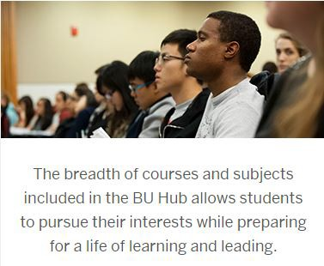


Overview
All students must fulfill 26 Hub requirements spread across the 6 capacities on the Hub.
In general, a 4-credit course can fulfill up to 2 Hub requirements, plus a requirement from the ‘Intellectual Toolkit’ capacity.
The Hub has been integrated into much of the required ENG curriculum. Currently, 18 of the 26 requirements will be filled by required ENG courses, leaving 8 Hub requirements (circled in red on the 4th slide) to be completed outside of the required curriculum. These 8 requirements will be completed through the four Hub Electives identified on the program planning sheets.
Faculty Hub Orientation, Fall 2018

Slide 2
BU Hub – 26 Requirements
PHILOSOPHICAL, AESTHETIC, AND HISTORICAL INTERPRETATION
Philosophical Inquiry and
Life’s Meanings (PLM) 1 REQUIREMENT
Aesthetic Exploration (AEX) 1 REQUIREMENT
Historical Consciousness (HCO) 1 REQUIREMENT
SCIENTIFIC AND SOCIAL INQUIRY
Scientific Inquiry I (SI1) 1 REQUIREMENT Social Inquiry I (SO1) 1 REQUIREMENT Scientific Inquiry II (SI2) or
Social Inquiry II (SO2) 1 REQUIREMENT
QUANTITATIVE REASONING
Quantitative Reasoning I (QR1) 1 REQUIREMENT
Quantitative Reasoning II (QR2) 1 REQUIREMENT
6
ESSENTIAL CAPACITIES
DIVERSITY, CIVIC ENGAGEMENT,
AND GLOBAL CITIZENSHIP
The Individual in Community (IIC) 1 REQUIREMENT
Global Citizenship and Intercultural Literacy (GCI) 2 REQUIREMENTS
Ethical Reasoning (ETR) 1 REQUIREMENT
COMMUNICATION
First-Year Writing Seminar (FYW) 1 REQUIREMENT Writing, Research, and Inquiry (WRI) 1 REQUIREMENT Writing-Intensive Course (WIN) 2 REQUIREMENTS
Oral and/or Signed Communication (OSC) 1 REQUIREMENT
Digital/Multimedia Expression (DME) 1 REQUIREMENT
INTELLECTUAL TOOLKIT
Critical Thinking (CRT) 2 REQUIREMENTS
Research and Information Literacy (RIL) 2 REQUIREMENTS Teamwork/Collaboration (TWC) 2 REQUIREMENTS Creativity/Innovation (CRI) 2 REQUIREMENTS

Slide 3
How ENG Requirements Fulfill BU Hub Requirements
PHILOSOPHICAL, AESTHETIC, AND HISTORICAL INTERPRETATION
Philosophical Inquiry and
Life’s Meanings (PLM) 1 REQUIREMENT
Aesthetic Exploration (AEX) 1 REQUIREMENT
Historical Consciousness (HCO) 1 REQUIREMENT
SCIENTIFIC AND SOCIAL INQUIRY
Social Inquiry I (SO1) 1 REQUIREMENT
Scientific Inquiry I (SI1) 1 REQUIREMENT
  PY211 Physics I
  CH101 Chemistry I
  CH102 Chemistry II
  CH131 General Chemistry
Scientific Inquiry II (SI2) 1 REQUIREMENT
  PY212 Physics II
  BI315 Systems Physiology
  PY313 Waves in Modern Physics
  MA124 Calculus II
QUANTITATIVE REASONING
Quantitative Reasoning I (QR1) 1 REQUIREMENT
  PY211 Physics I
  EK125 Intro to Programming
  CH101 Chemistry I
  CH102 Chemistry II
  CH131 General Chemistry
Quantitative Reasoning II (QR2) 1 REQUIREMENT
  MA123 Calculus I
  MA124 Calculus II
  MA225 Multivariate Calculus
  PY212 Physics II
  EK 381 Prob, Stats, & Data Sci
DIVERSITY, CIVIC ENGAGEMENT,
AND GLOBAL CITIZENSHIP
The Individual in Community (IIC) 1 REQUIREMENT
Global Citizenship and Intercultural Literacy (GCI) 2 REQUIREMENTS
Ethical Reasoning (ETR) 1 REQUIREMENT
6
ESSENTIAL CAPACITIES
INTELLECTUAL TOOLKIT
Critical Thinking (CRT) 2 REQUIREMENTS
  PY211 Physics I
  PY212 Physics II
  EK301 Eng Mechanics
  EK381 Prob, Stats, & Data Sci
  MA124 Calculus II
  MA225 Multivariate Calculus
  MA226 Differential Equations
  BI315 Systems Physiology
Research and Information Literacy (RIL) 2 REQUIREMENTS
  WR15x Writing, Research, & Inquiry
  Senior Design
Teamwork/Collaboration (TWC) 2 REQUIREMENTS
  EK210 Intro ENG Design
  PY211 Physics I
  PY212 Physics II
  BI315 Systems Physiology
Creativity/Innovation (CRI) 2 REQUIREMENTS
  EK122 Programming for Engineers
  EK301 Eng Mechanics
COMMUNICATION
First-Year Writing Seminar (FYW) 1 REQUIREMENT – WR120 Writing Seminar
Writing, Research, and Inquiry (WRI) 1 REQUIREMENT –WR15x Writing & Research
Oral and/or Signed Communication (OSC) 1 REQUIREMENT – Senior Design
Digital/Multimedia Expression (DME) 1 REQUIREMENT – Senior Design
Writing-Intensive Course (WIN) 2 REQUIREMENTS
  BI315 Systems Physiology (BME)
  ME310 Measurement & Instrumentation (ME)
  Senior Design

Slide 4
How ENG Requirements Fulfill BU Hub Requirements
PHILOSOPHICAL, AESTHETIC, AND HISTORICAL INTERPRETATION
Philosophical Inquiry and
Life’s Meanings (PLM) 1 REQUIREMENT
Aesthetic Exploration (AEX) 1 REQUIREMENT
Historical Consciousness (HCO) 1 REQUIREMENT
SCIENTIFIC AND SOCIAL INQUIRY
Social Inquiry I (SO1) 1 REQUIREMENT
Scientific Inquiry I (SI1) 1 REQUIREMENT
  PY211 Physics I
  CH101 Chemistry I
  CH102 Chemistry II
  CH131 General Chemistry
Scientific Inquiry II (SI2) 1 REQUIREMENT
  PY212 Physics II
  BI315 Systems Physiology
  PY313 Waves in Modern Physics
  MA124 Calculus II
QUANTITATIVE REASONING
Quantitative Reasoning I (QR1) 1 REQUIREMENT
  PY211 Physics I
  EK125 Intro to Programming
  CH101 Chemistry I
  CH102 Chemistry II
  CH131 General Chemistry
Quantitative Reasoning II (QR2) 1 REQUIREMENT
  MA123 Calculus I
  MA124 Calculus II
  MA225 Multivariate Calculus
  PY212 Physics II
  EK 381 Prob, Stats, & Data Sci
DIVERSITY, CIVIC ENGAGEMENT,
AND GLOBAL CITIZENSHIP
The Individual in Community (IIC) 1 REQUIREMENT
Global Citizenship and Intercultural Literacy (GCI) 2 REQUIREMENTS
Ethical Reasoning (ETR) 1 REQUIREMENT
6
ESSENTIAL CAPACITIES
INTELLECTUAL TOOLKIT
Critical Thinking (CRT) 2 REQUIREMENTS
  PY211 Physics I
  PY212 Physics II
  EK301 Eng Mechanics
  EK381 Prob, Stats, & Data Sci
  MA124 Calculus II
  MA225 Multivariate Calculus
  MA226 Differential Equations
  BI315 Systems Physiology
Research and Information Literacy (RIL) 2 REQUIREMENTS
  WR15x Writing, Research, & Inquiry
  Senior Design
Teamwork/Collaboration (TWC) 2 REQUIREMENTS
  EK210 Intro ENG Design
  PY211 Physics I
  PY212 Physics II
  BI315 Systems Physiology
Creativity/Innovation (CRI) 2 REQUIREMENTS
  EK122 Programming for Engineers
  EK301 Eng Mechanics
COMMUNICATION
First-Year Writing Seminar (FYW) 1 REQUIREMENT – WR120 Writing Seminar
Writing, Research, and Inquiry (WRI) 1 REQUIREMENT –WR15x Writing & Research
Oral and/or Signed Communication (OSC) 1 REQUIREMENT – Senior Design
Digital/Multimedia Expression (DME) 1 REQUIREMENT – Senior Design
Writing-Intensive Course (WIN) 2 REQUIREMENTS
  BI315 Systems Physiology (BME)
  ME310 Measurement & Instrumentation (ME)
  Senior Design

Slide 5
Hub Electives
All program planning sheets include four Hub Electives
Students who start at BU as freshmen must satisfy the remaining 8 hub requirements (PLM, AEX, HCO, SO1/2, IIC, 2X GCI, ETR) via these electives
You can search for courses by School/College, number of credits and/or specific Hub units via (www.bu.edu/phpbin/course-search/)

Slide 6
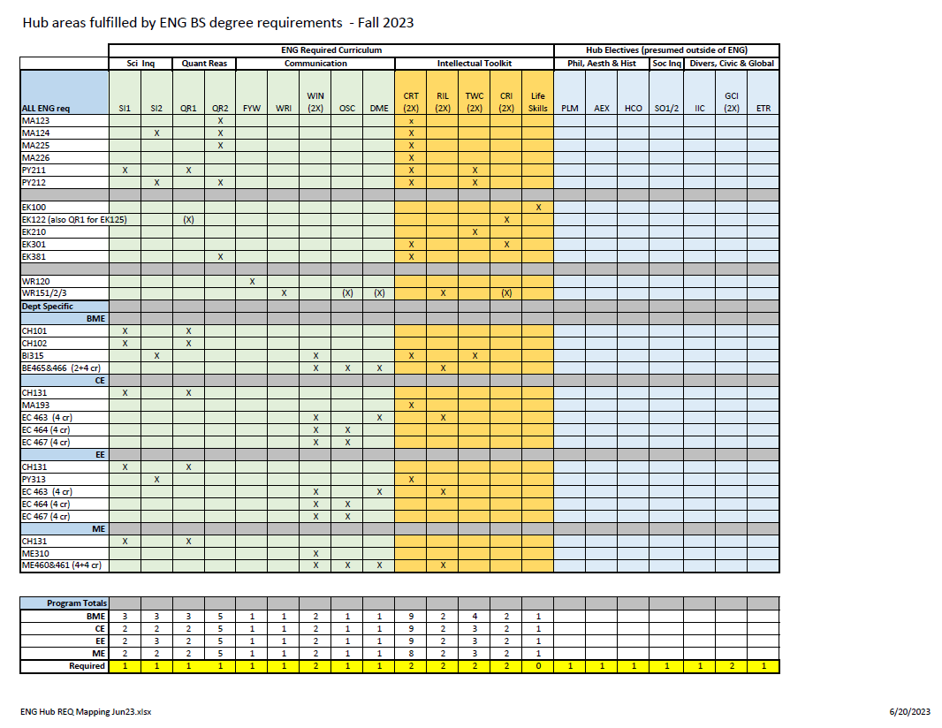

Slide 7
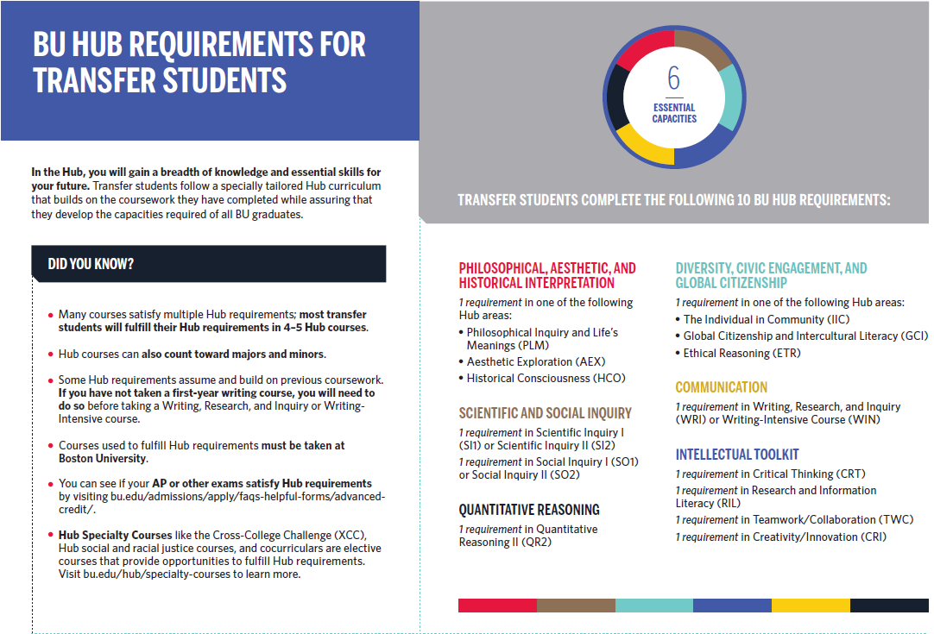

Transfer Students Have a Reduced Hub Requirement

Slide 8
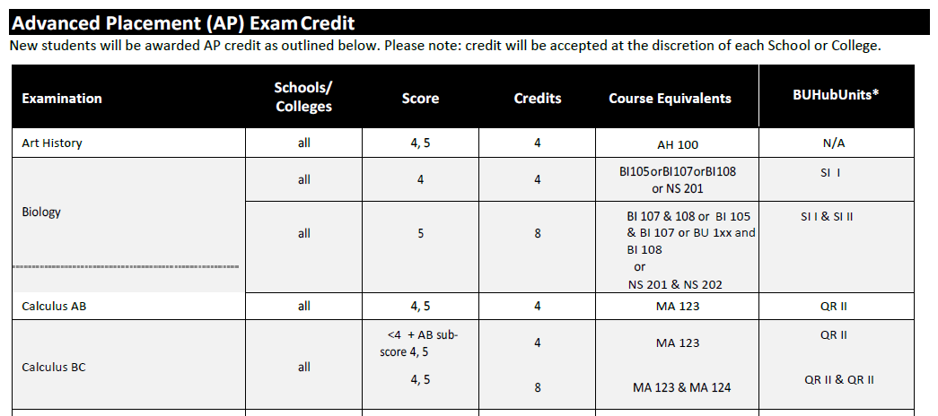
AP Courses & Hub Units
General Rule:
If AP credit awarded for a course that contains more than one Hub unit, only the primary unit is counted.
Advanced Placement Credit Guide, see link for official credit
https://www.bu.edu/admissions/files/2018/06/Advanced-Credit-Guide.pdf
Example of the Advanced Placement Credit Guide. Use the link to view the entire document.

