Slide 1
Computer Engineering (CE) Research Areas & Groups
Rabia Tugce Yazicigil
Department of Electrical &
Computer Engineering
Boston University
Notes:
Good morning everyone. We are excited to welcome you to Boston University for your Open House visit. I will give you an overview of some of the exciting CE research directions in the department.

Slide 2
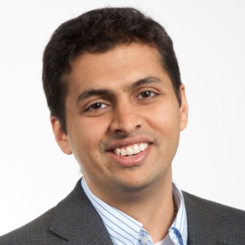
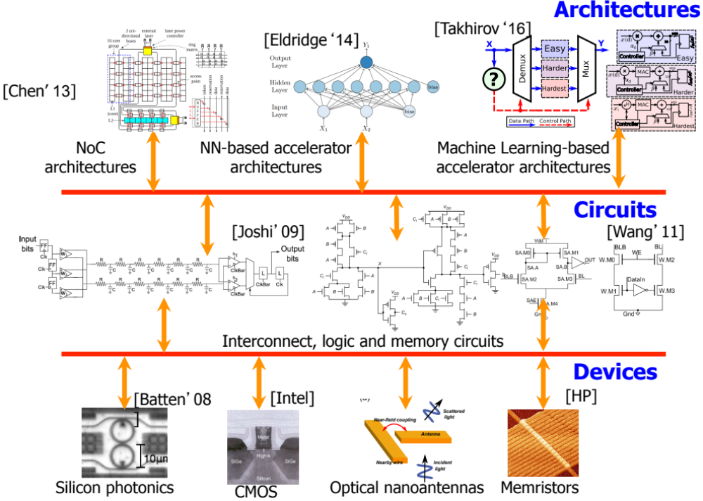
Integrated Circuits and Systems Group: Playing Field
Prof. Ajay Joshi
Notes:
The Integrated Circuits and Systems Group led by Prof. Joshi focuses on developing novel architectures and circuits to design low power, high performance, and robust VLSI systems.

Slide 3
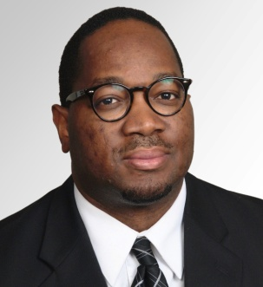

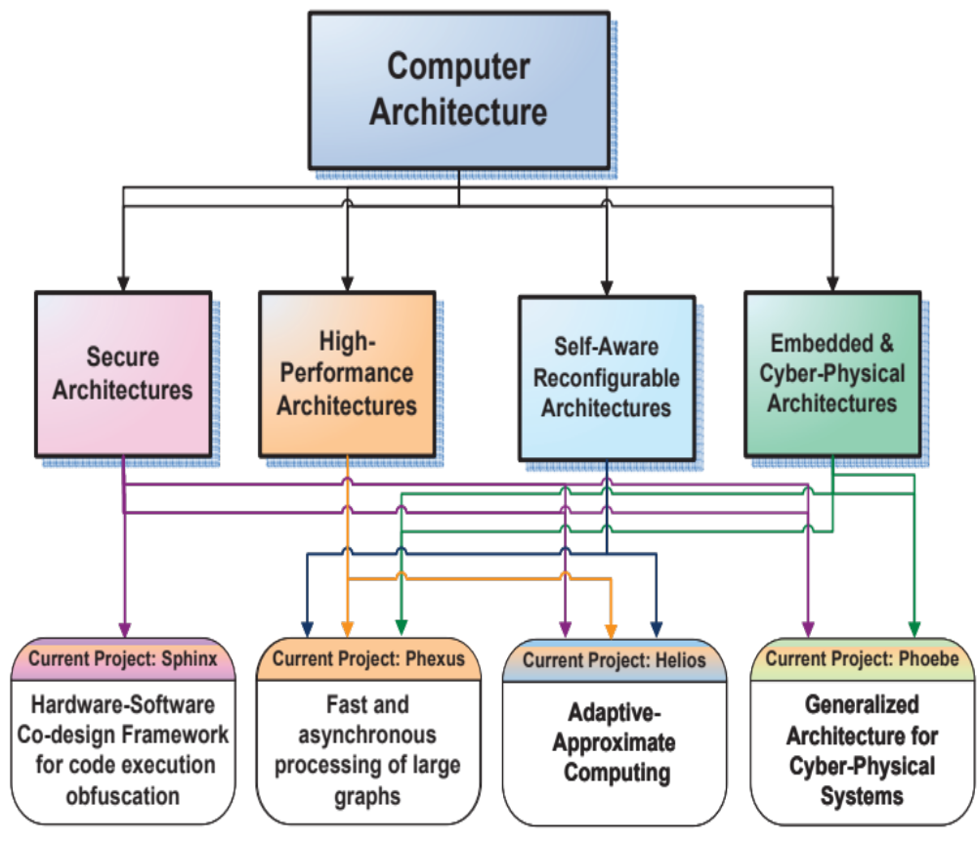
Who we are and what we do:
The research efforts of ASCA Lab focus primarily on the exploration of novel concepts in computer architecture:
Emerging micro-architecture design techniques
Intelligent network-on-chip designs
Secure architecture and embedded systems
Artificial neural network accelerator design
Approximate computing
Notes:
The laboratory explores different sub-domains of computer architecture. Our current set of active research projects are:
- Sphinx: Hardware-Software Co-design Framework for Binary Code Diversification Based
- Hermes: Multi-Tenant Secure Computer Architecture
- Helios: Adaptive-Approximate Computing Architecture
- Coeus: Reconfigurable Architecture Design for Deep Learning Acceleration
- Plexus Architecture: High-Performance Graph Processing Architecture Design
- Resilient and Fault-Tolerant Interconnect Network-on-Chip Design
- Cyborg: CPS Design Approach to Human-Prosthesis Systems

Slide 4
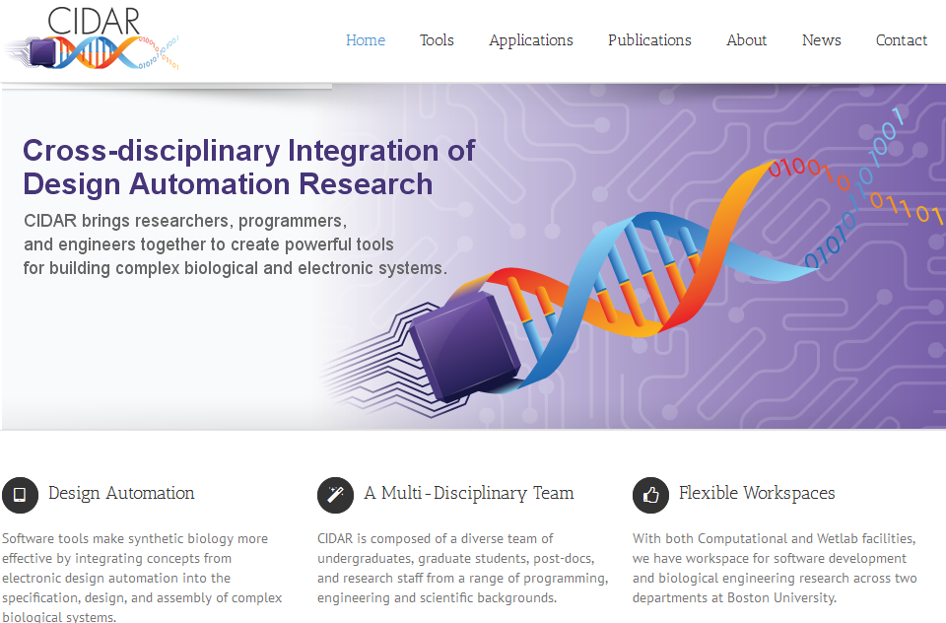
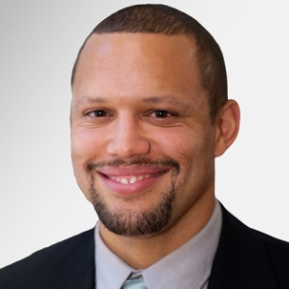

www.cidarlab.org

Slide 5
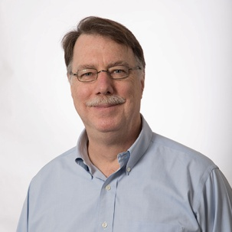
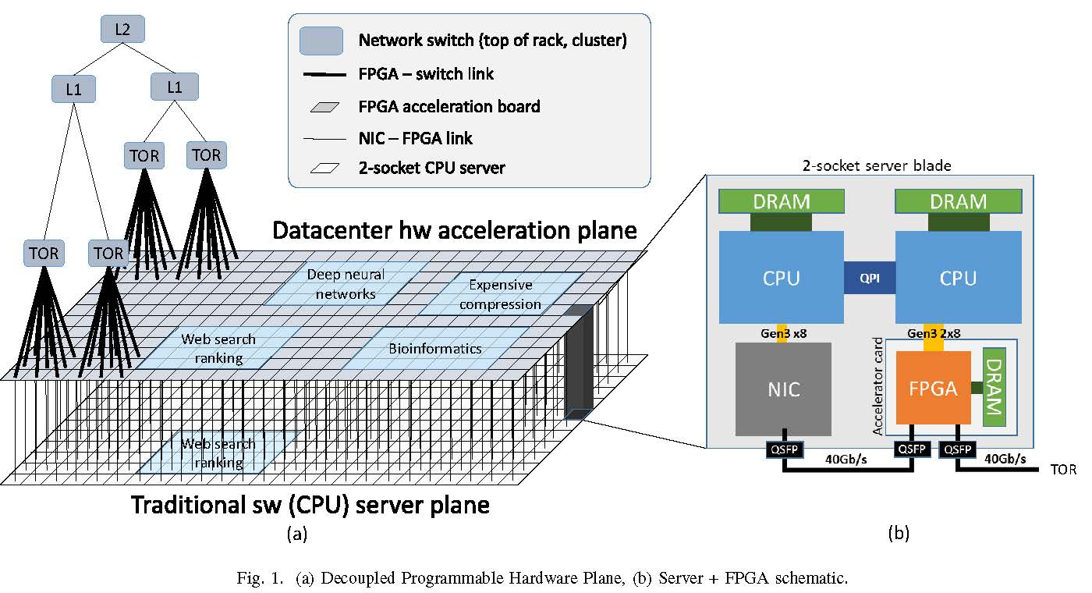
CAAD Lab – M. Herbordt, PI
Current RAs/PhD Students
Jiayi Sheng
Ethan Yang
Ahmed Sanaullah
Qingqing Xiong
Primary Projects, Funding, & Collaborators
Coherent Bump-in-the-Wire Cloud Accelerators DCA/Red Hat
w/ Prof. Krieger
FPGA-centric HPC clusters NSF, w/ UFl & Pitt.
HW Accelerated HPC w/ MPI NSF, w/ Auburn U
HPC in the Cloud Microsoft
Dark Matter Detection NSF, w/ Wellesley
Coherent Bump-in-the-Wire
Cloud Accelerators
FPGA is in path between node and network
Currently used for encryption
New use: High Performance Computing
Goal: Develop complete infrastructure from hardware design through operating system
Notes:
Here’s Catapult 2: Note that the FPGA is directly in the communication path.

Slide 6
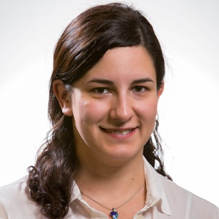

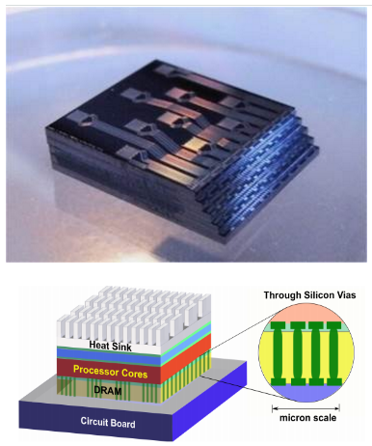
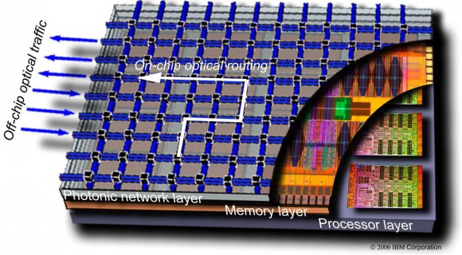
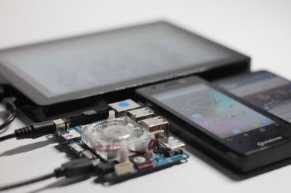
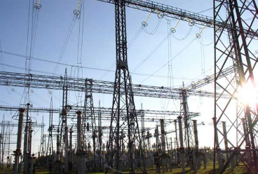
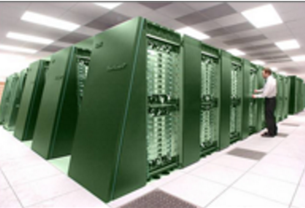
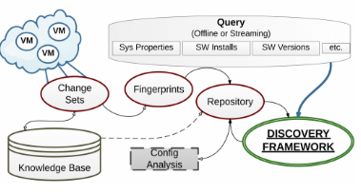
Performance and Energy Aware
Computing Laboratory – Prof. Ayse K. Coskun
Photonic
Layer
Memory
Layer
Processor
Layer
3D Stacked Systems for Low-Power High-Performance Computing
Energy-Efficient
Mobile Computing
Data Centers in the
Smart Grid
Analysis & Management
of HPC Systems
Efficient (Big Data) Analytics for the Cloud
www.bu.edu/peaclab
Notes:
Overview:
Broad research theme is energy efficiency: from small scale embedded systems to large scale systems w. thousands of computers
Energy efficient computing: requires an understanding of the interplay of performance, power, temperature (and possibly other constraints such as reliability and security)
PeacLab’s research projects are in the intersection of design automation, computer architecture, and systems. All projects involve coding and systems development; some projects interact with device technology/circuits, others have a strong analytical/mathematical component.
Interdisciplinary projects that synthesize knowledge from different fields to solve new problems using innovative approaches
About current projects:
3D stacking: looking into designing models and new architectures for emerging heterogeneous systems, e.g., 3D stacking of CPU with DRAM and with Silicon Photonic networks
Mobile computing: Investigating new management challenges in cutting edge mobile devices in presence of emerging apps such as machine learning, complex image processing, etc.
Bottom part is on large scale systems. (a) Smart grid looks into integrating data centers, which are major energy consumers, into new power markets enabled by the smart grid. (b) In HPC, our aim is to design tools and methods that help design of future HPC systems that are more energy efficient, robust, and secure. (c) Cloud analytics: solving complex analytics problems (i.e., find vulnerable software) in presence of thousands of machines.

Slide 7
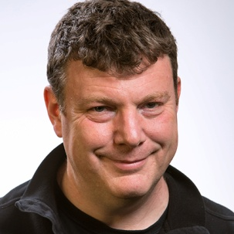
The Massachusetts Open Cloud (MOC)
Future of all computing in the cloud, but today hidden inside massive proprietary companies:
  Makes academic research and innovation by other companies difficult
MOC is the worlds first Open Cloud:
  Collaboration with NU, UMass, MIT, Harvard, led by BU
  Funded by Commonwealth, NSF, USAF, Intel, Lenovo, Brocade, Two Sigma, CISCO
  Red Hat’s first research lab RHET Lab@BU just announced
Its your cloud, get involved, huge variety of research projects:
  OS research, distributed file systems, analytics on cloud meta data, security, middleware, FPGAs, GPUs, convergence Cloud/HPC, ….

Slide 8
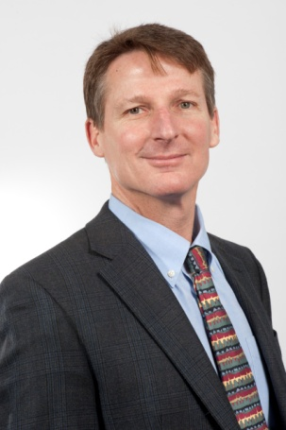
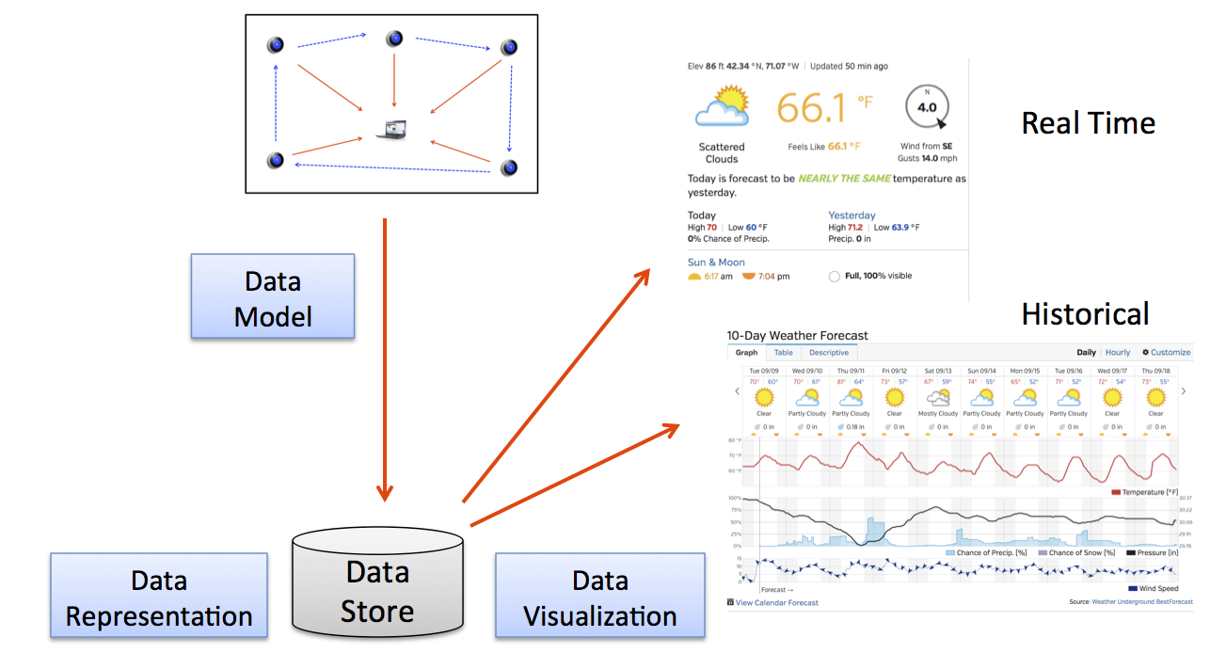
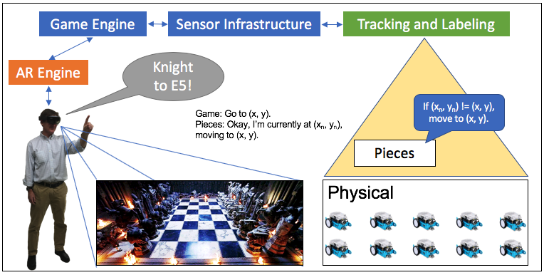
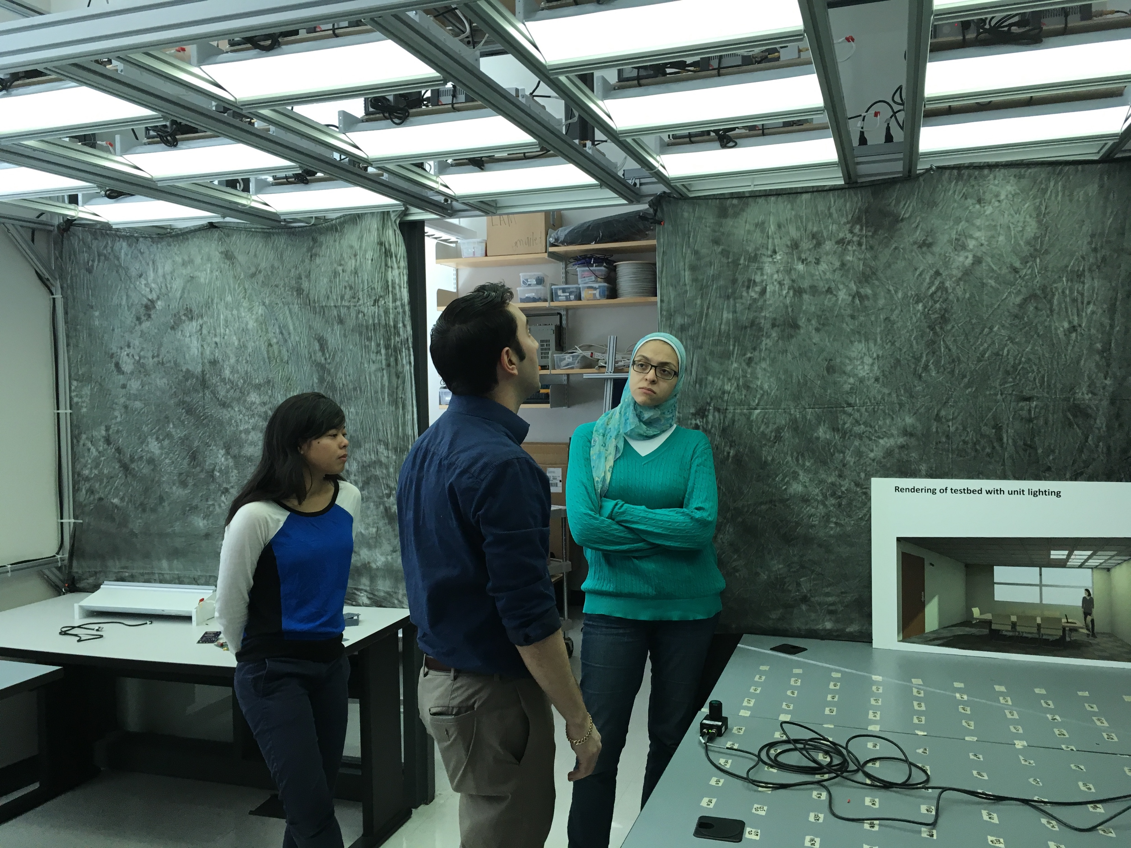
IoT workflow: instrumentation to analysis
Instrumentation, technology, processes to collect, analyze and report on the environment
Novel positioning and tracking for labeling, mapping, and association with physical objects
Funding: ARPA-E,
NSF CNS, NSF ERC
Notes:
Reporting and labeling where you are present
Environmental use cases
Walk around and get health info for a garden, a tree, current CO2 or NO2 or particulate levels
Count how many people are waiting in line
Report traffic per hour
Energy/building management
Get temp in space
Find efficiency reported or status of device

Slide 9
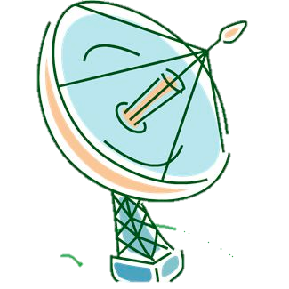
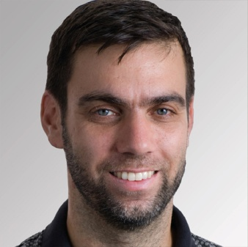
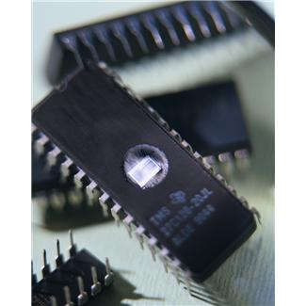
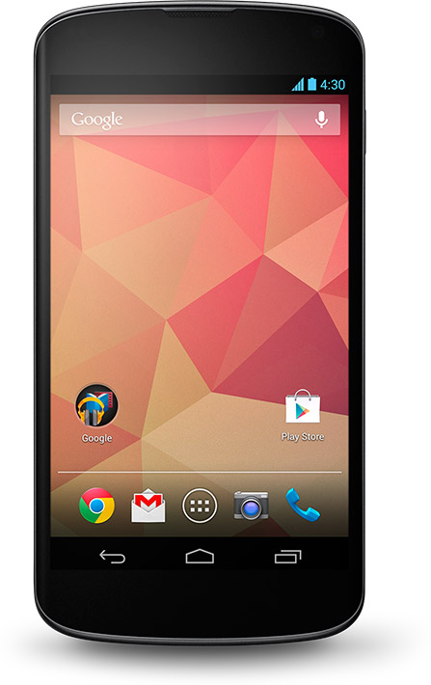

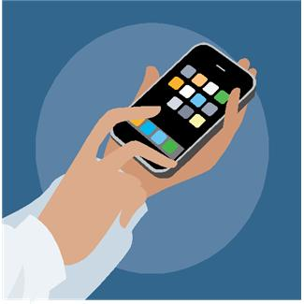
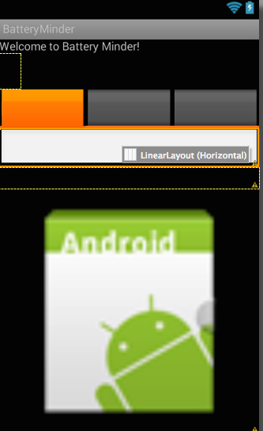
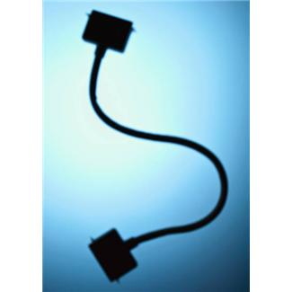

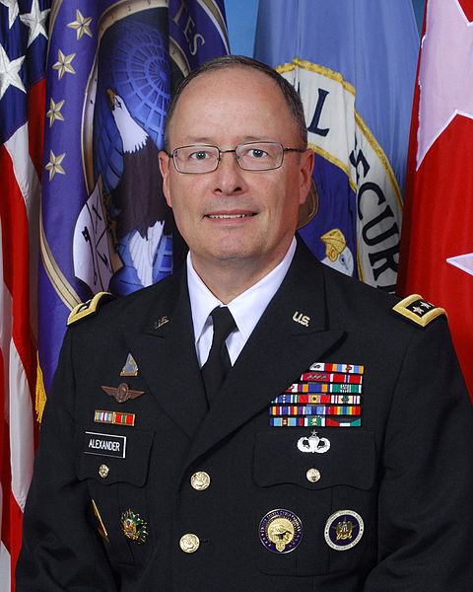
Prof. Ari Trachtenberg
Laboratory of Networking and Information Systems
nislab.bu.edu
agps₇
baseband
processor₆
os₄
memory/
SIM₂
apps₄
adapters₈
Interface₃
picture from google.com
sensors₁
Attack SurfaceS
laws₅

Slide 10
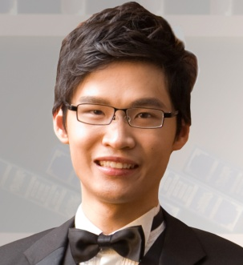
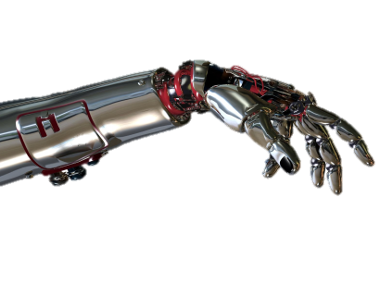


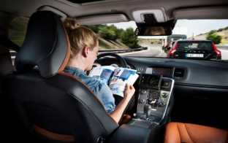
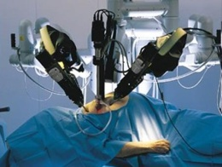
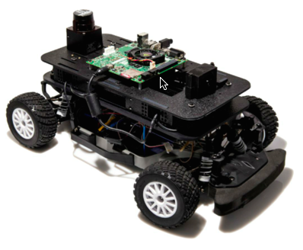



Dependable Computing Lab
PI: Prof. Wenchao Li http://sites.bu.edu/depend
Computational Proof Methods + Machine Learning
Synthesis & Verification of Human-in-the-Loop Controllers
Safe Artificial Intelligence
Extensible and Adaptive Embedded Software
Mining & Understanding Software Repositories
Ontology
Runtime monitoring
System I.D.
Program transformation
deep learning
graph kernels
Mini self-driving car
Mission: Make intelligent systems safe, reliable and secure.
Notes:
Li’s lab develops computational proof methods and machine learning techniques to aid the construction of safe, reliable and secure systems.
On the theory side, they investigate the interplay between deductive reasoning and inductive learning, and develop computational tools to automate them.
On the application side, they focus on human-centered systems and applications run the gamut from tele-surguery robots, through programmer’s assistant, to self-driving cars.
The slide shows some of the active projects in the lab.

Slide 11
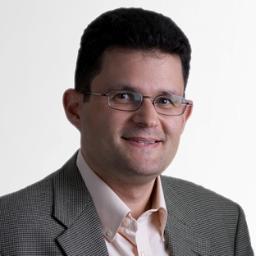
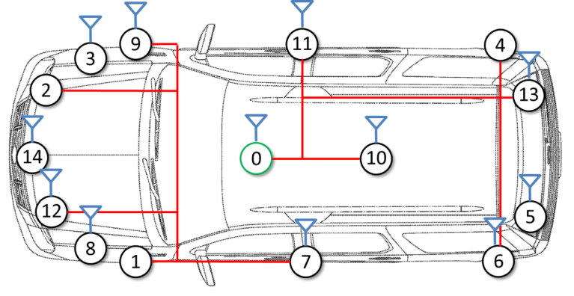


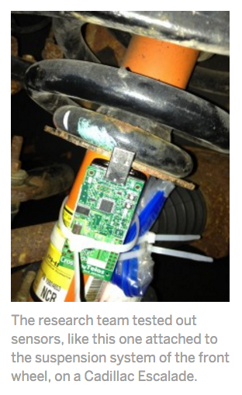
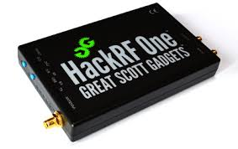


David Starobinski: Research Interests
IoT/Automotive Security
Blockchain and Crypto-currencies
Software-defined Radios
Notes:
Automotive security: intra and inter-vehicular (connected vehicles) – collaboration with industry
Blockchain: network economics, game theory, data dissemination and synchronization
Software-defined radios: Pen-testing of IoT devices, agile spectrum access

Slide 12
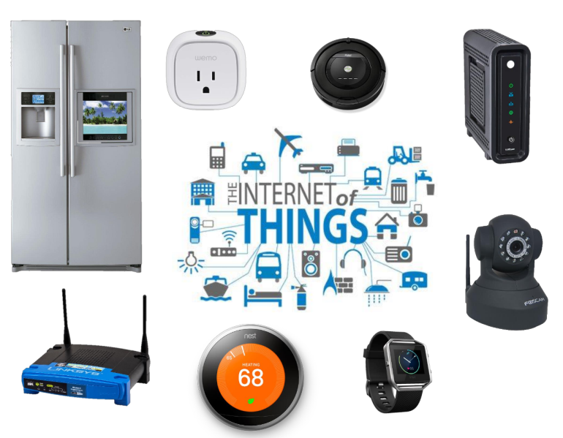
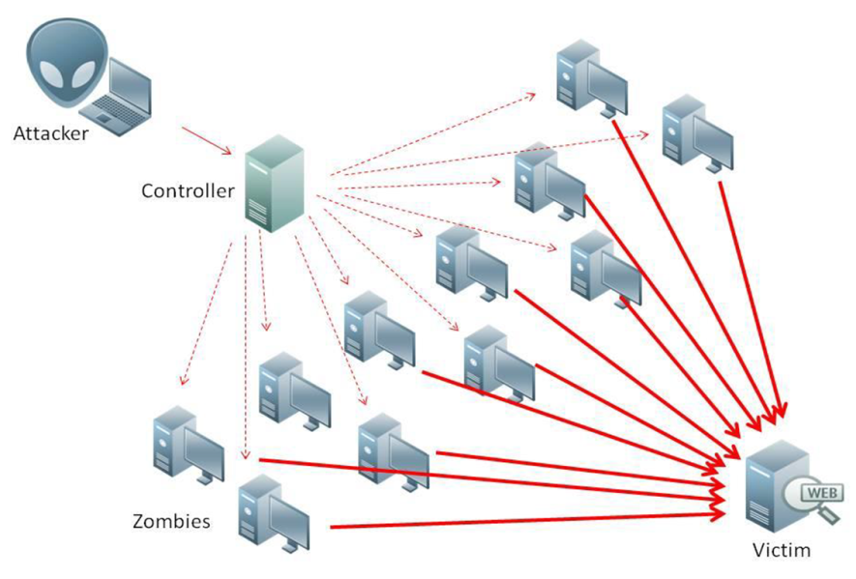
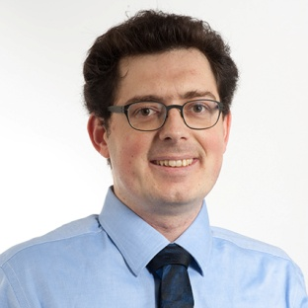

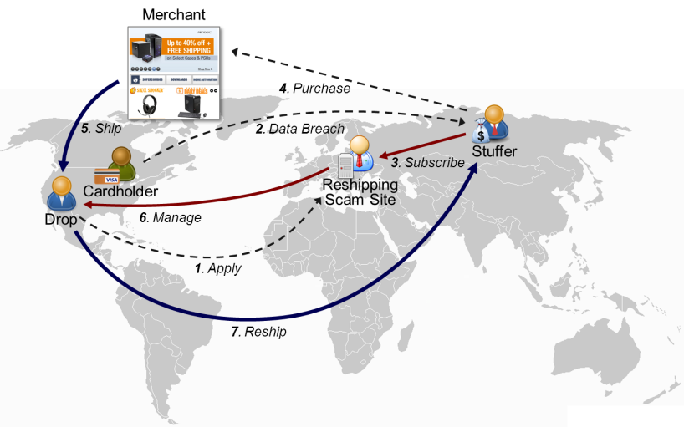
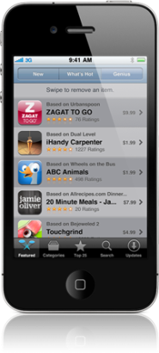
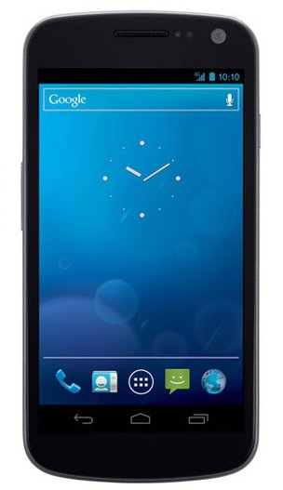
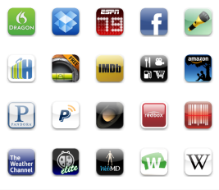
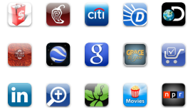
BU Secure Systems Lab, Prof. Egele
The Internet of Things (IoT) is
everywhere and insecure
Sept. 21st, 500,000 hacked IoT devices
flood Twitter, Spotify, AirBnB, & more
Billions of mobile devices,
millions of apps … trouble awaits
Hackers have sophisticated
business models too!

Slide 13
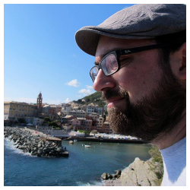
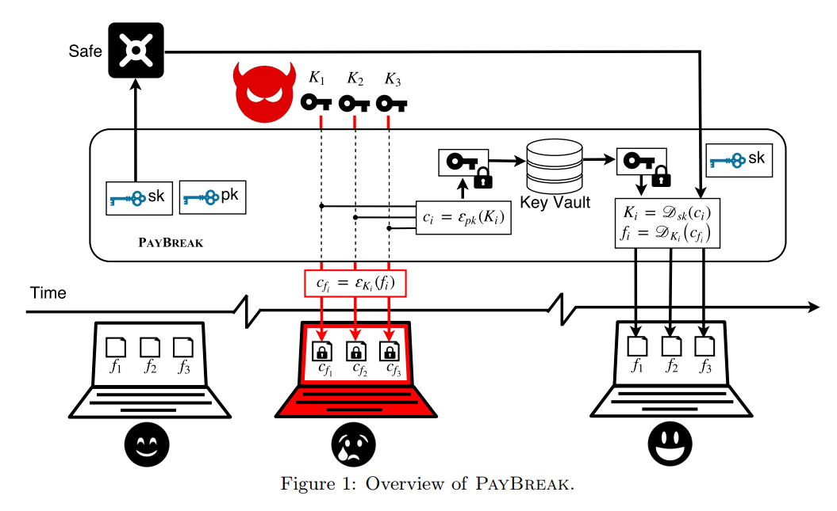
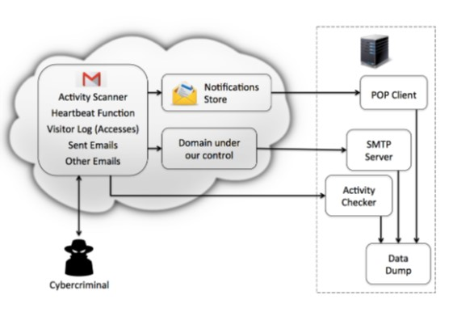
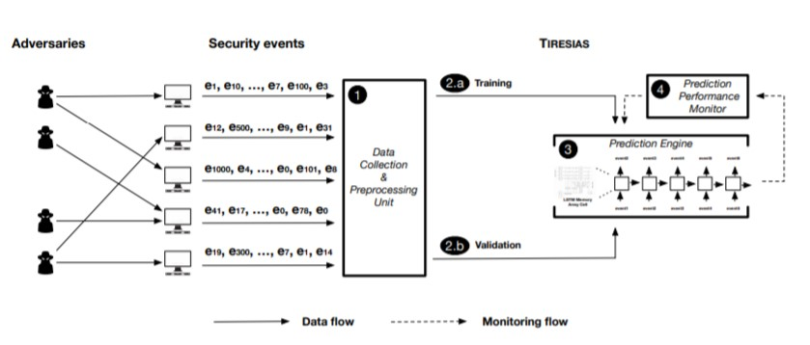
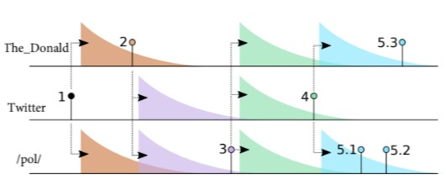
Data-Driven Security, Prof. Stringhini
Malware
Cybercrime
Predictive analytics for security
Disinformation

Slide 14

Prof. Rabia Tugce Yazicigil
Wireless Integrated Systems and Extreme Circuits Laboratory
Notes:
To tackle these main challenges of IoT such as security and data processing, my research approach is to develop tightly-coupled system solutions derived at the intersection of electronics, security, signal processing, and communications. These solutions would not be possible through isolated investigation. I focus on cross-layer optimization of these fundamental subjects together for energy efficiency and higher performance

Slide 15





Secure
Wireless Communications
Spectrum-Aware
Wireless Communications
m < N₀
R. T. Yazicigil et al., “Taking Compressive Sensing to the Hardware Level: Breaking Fundamental Radio-Frequency Hardware Trade-offs,” March 2019, IEEE Signal Processing Magazine.
R. T. Yazicigil et al., “Ultra-Fast Bit-Level Frequency-Hopping Transmitter for Securing Low-Power Wireless Devices”, RFIC, June 2018.
Notes:
In today’s talk, I would like to discuss two of my key contributions to enable secure wireless communications and to handle the wireless data traffic growth while achieving spectrum-aware wireless communications. In my group, we will continue exploring new opportunities in this space and

Slide 16




Secure Package-Less THz ID
Embedded
Secure Drug Delivery
Source:DuoSkin
Ingestible Micro-Bio-Electronic
Devices
Mimee, Nadeau, Science 2018
Notes:
And we will also broaden to new applications

Slide 17

Extreme signal processing,
sensing & communications inside living cells
Notes:
My longer-term goal is to impact IoT of humans. One future direction under this umbrella is enabling extreme signal processing, sensing and communications inside living cells. I imagine this project will enable understanding of disease development at the single-cell level and also the development of better strategies for medical diagnostics and treatments such as single-cell targeted drug delivery.

Slide 18











