Slide 1
Electro-Physics Research
Notes:
Prof. Dal Negro works on theoretical and computational EM in nanophotonics, and nanofabrication.
Prof. Bigio develops optical spectroscopic and imaging technologies for biomedical applications, including detection of cancer and imaging of physiological dynamics, like neuronal activation patterns.

Slide 2
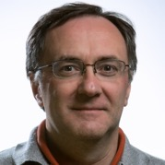
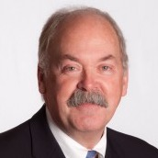
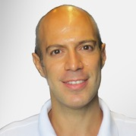

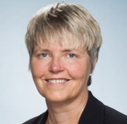
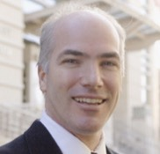
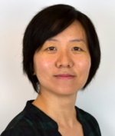


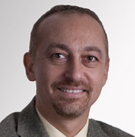
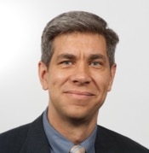
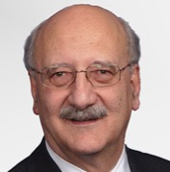
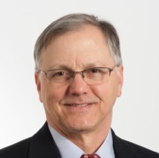
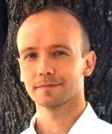
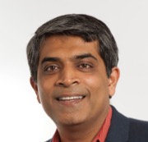
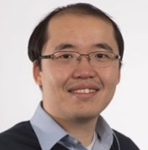
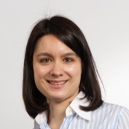
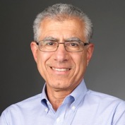
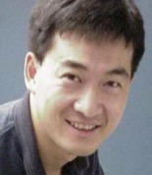

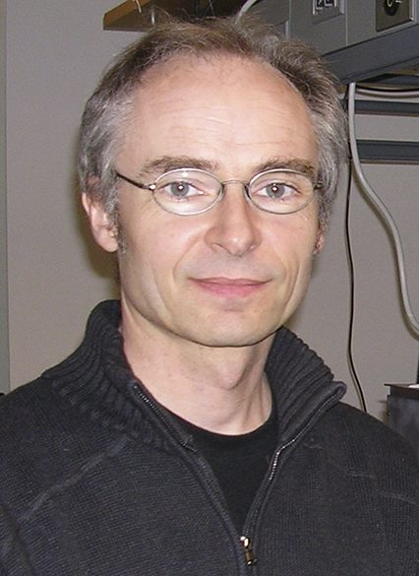
EP Faculty
HIRING
HIRING
HIRING
HIRING
Bellotti
Bishop
Dal Negro
Kotiuga
Popovic
Swan
Bifano
Yang
HIRING
HIRING
Lee
Paiella
Mazumder
Unlu
Semeter
Pavlidis
Horenstein
Sushkov
HIRING
HIRING
HIRING
HIRING
HIRING
Ramachandran
Sergienko
Tian
Sander
Bigio
Cheng
Zhang
Sharifzadeh
HIRING
Mertz
Notes:
25 faculty

Slide 3
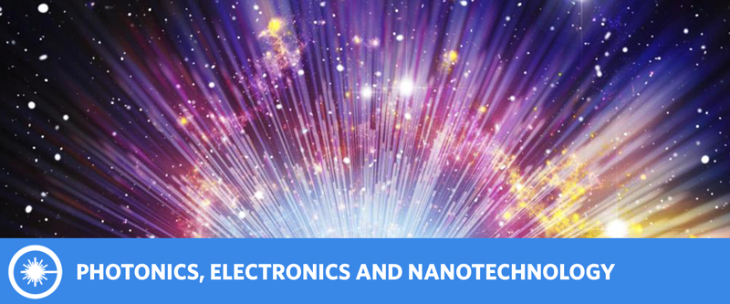
Research Areas in EP
Photons are the most sensitive fine-toothed probes into the world around us, from radio astronomy to microscopic biological imaging and semiconductor chip fabrication.
Integration of novel materials at nanoscales and of innovative design concepts empower the next-generation of light sources, smart lighting detectors and sensors, biodetection, and on-chip communication.
Notes:
Photons, the fleeting particles of light, are the communicators of the universe. They let us still see the remnants of the Big Bang, and are instrumental in carrying the information load of the internet at blazing speeds. They are also our most sensitive fine-toothed probes in both space and time into the world around us, from radio astronomy to microscopic biological imaging and semiconductor chip fabrication. Integration of novel materials at nanoscales and of innovative design concepts into optoelectronic devices and optical systems enables photonic technologies that empower the next-generation of light sources, smart lighting detectors and sensors, biodetection, and on-chip communication.

Slide 4
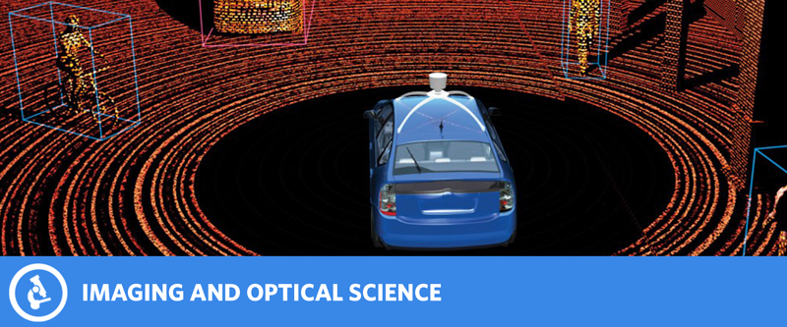
Research Areas in EP
Today’s novel light-sensing modalities help us discover new biological phenomena, empower vision for driverless cars, and facilitate recognition of human activities without violating individuals’ privacy.
Tomorrow’s technology will allow us to “see” through walls and measure heart-rate without contact.
Integration of novel sensing materials, optoelectronic devices and computational algorithms.
Notes:
Today, novel light-sensing modalities help us discover new biological phenomena, empower vision for driverless cars, and facilitate recognition of human activities without violating individuals’ privacy. Tomorrow’s technology will allow us to “see” through walls and measure heart-rate without contact. These advances are made possible by integrating novel sensing materials, optoelectronic devices and computational algorithms.

Slide 5

Research Areas in EP
Gain a deep understanding of and interaction with biological systems that has evaded humanity for centuries
Better insight into the human brain, design of artificial neural systems inspired by modern neuroscience, development of new biomaterials and biosensors, and delivery of smart healthcare.
Notes:
While a deep understanding of and interaction with biological systems has evaded humanity for centuries, the modern tools and methods of Electrical and Computer Engineering (ECE) seem to be on the cusp of a breakthrough. Today’s Bio-ECE techniques strive to gain better insight into the human brain, design artificial neural systems inspired by modern neuroscience, develop new biomaterials and biosensors, and deliver smart healthcare.

Slide 6
Applied electromagnetics and energy
Computational Electro-Physics
Lasers
Bio-Photonics
Nonlinear and ultrafast optics
Space science & technology
Fiber and guided wave optics
Quantum Optics
Integrated and silicon photonics
Imaging, sensing, microscopy & spectroscopy
Optoelectronic materials & devices
Nanophotonics, plasmonics and metamaterials

Slide 7
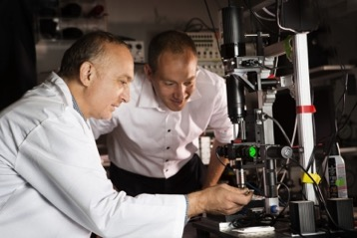
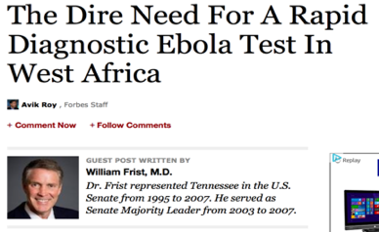


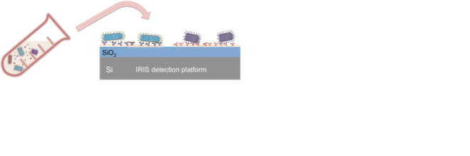
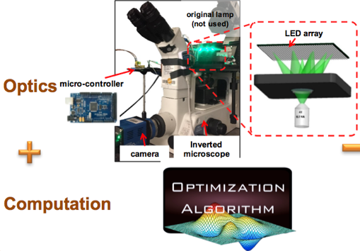
Optical detection of individual viral pathogens
Bio-Photonics
Unlu
Bigio
Tian
Computational imaging
Optical cancer detection, neuron activation, and tissue profiling
Notes:
Prof. Bigio develops optical spectroscopic and imaging technologies for biomedical applications, including detection of cancer and imaging of physiological dynamics, like neuronal activation patterns.

Slide 8

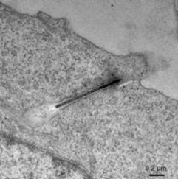
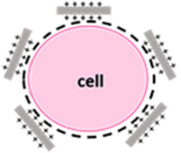
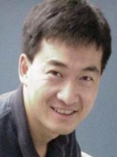
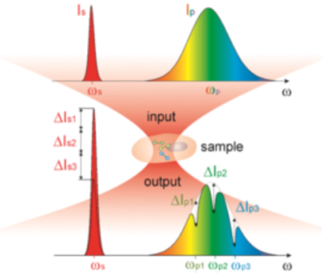
Active nano-biomaterial modulating neuronal activities
Bio-Photonics
Yang
Cheng
Label-free molecular spectroscopic imaging
(from Maxwell’s equations to clinic)

Slide 9
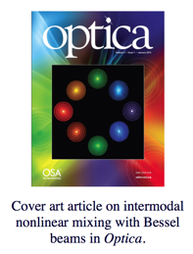

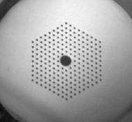

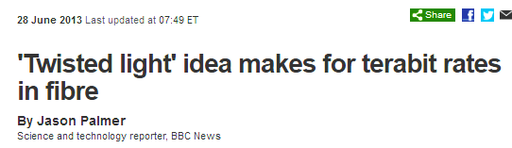
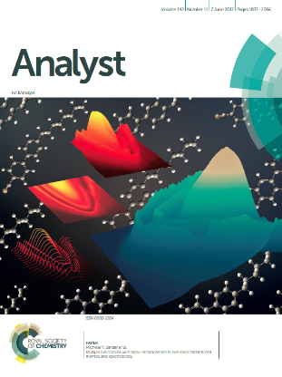
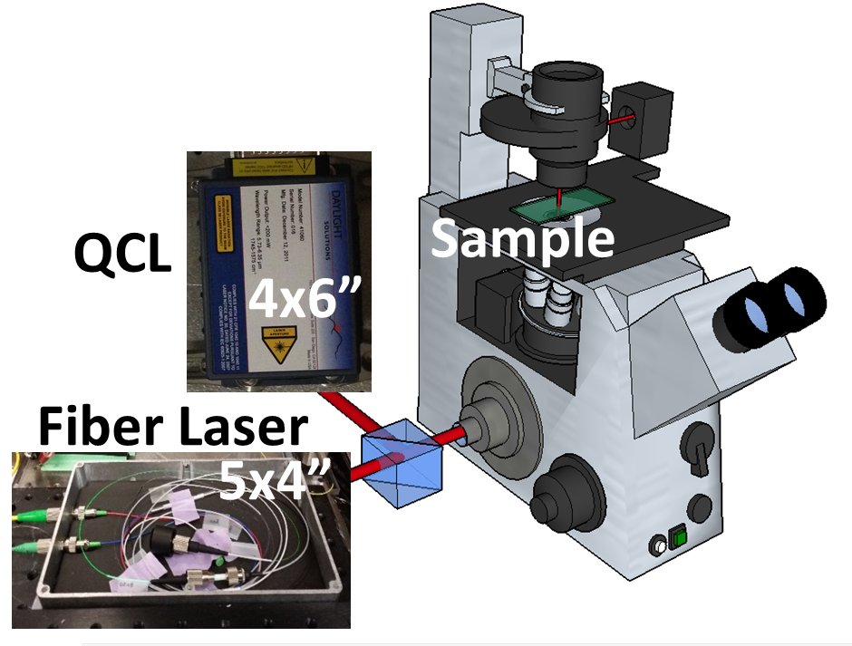
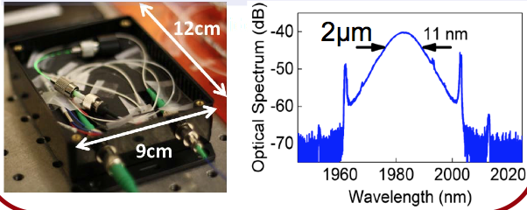
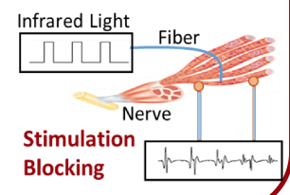
Nanostructured optical fiber and nonlinear optics
Fiber and guided wave optics
Ramachandran
Lasers
Nonlinear and ultrafast optics
Bio-Photonics
Ultrafast lasers, laser-matter interaction, imaging & spectroscopy, nerve stimulation
Sander

Slide 10
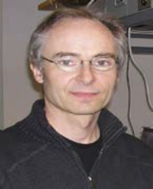
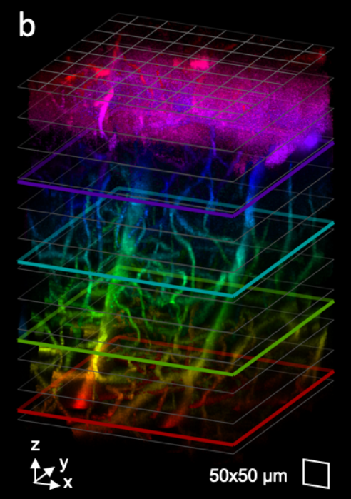
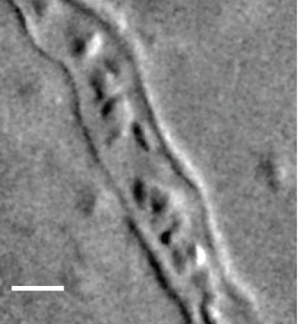
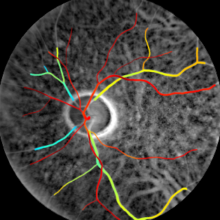
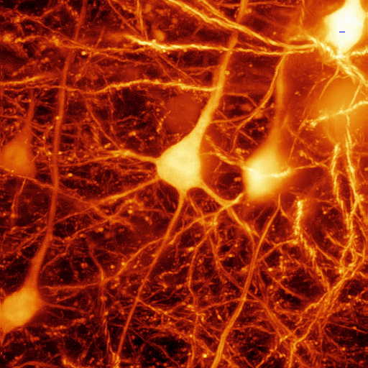
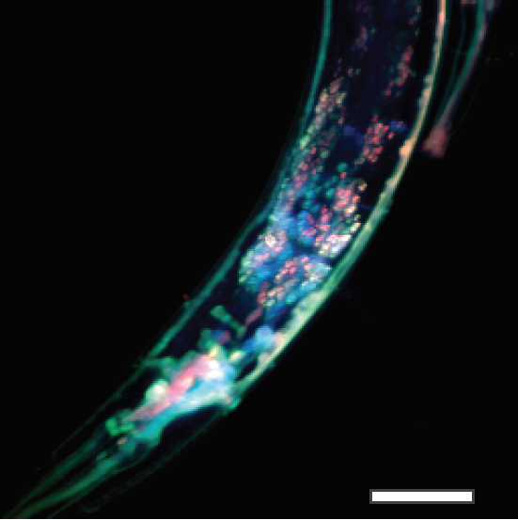

Mertz
Development of novel optical microscopy techniques
Imaging, sensing, microscopy & spectroscopy
Cheng
Dal Negro
Sander
Swan
Unlu
Tian

Slide 11
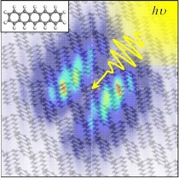

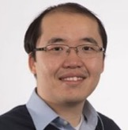
Computational Electro-Physics
Sharifzadeh
Computational materials science of optoelectronic materials
Numerical methods,
magnetics
Bellotti
Kotiuga
Computational electronics
Dal Negro
Tian
Popovic

Slide 12
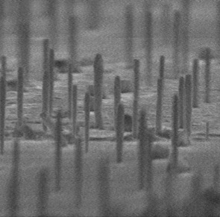
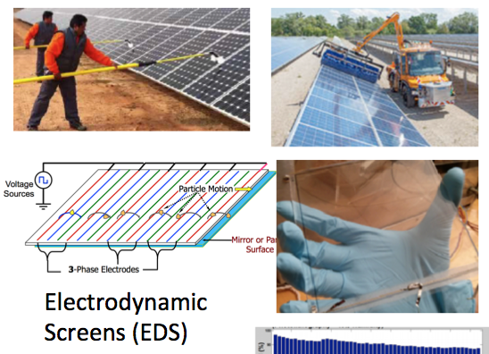
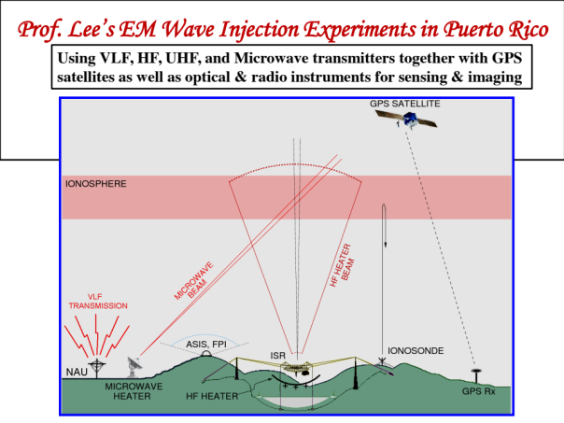
Applied electromagnetics and energy
Yang
Nanowire architectures for photonics and solar energy application
Mazumder
Horenstein
Lee
Electromagnetic Wave Propagation Injection Experiments in Puerto Rico
Sustainable solar energy conversion

Slide 13
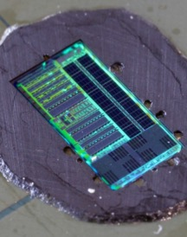
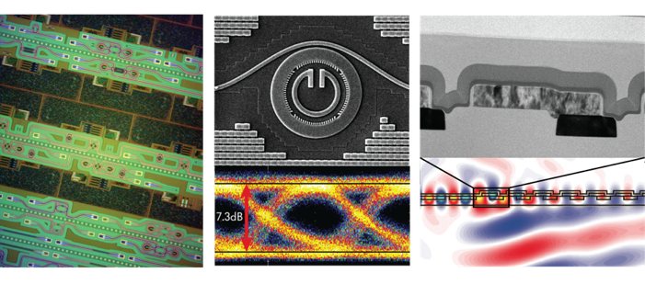
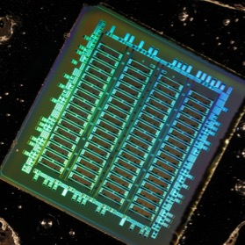
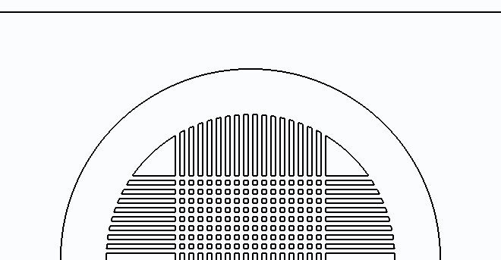
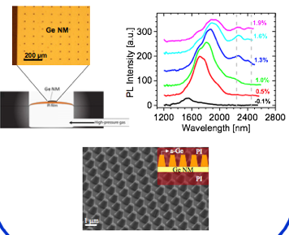


Popovic
Silicon photonics; photonic/acoustic/mechanical devices & systems on chip
Nonlinear and ultrafast optics
Integrated and silicon photonics
Paiella
Optoelectronic materials & devices
THz photonics, plasmon-enhanced optoelectronics, Group-IV semiconductor lasers

Slide 14








Nanoscale (2D) materials, devices & spectroscopy
Swan
Swan
graphene
MoS2
h-BN
Graphene MEMS device
Device development for plasmonics, metamaterials and optics of complex media
Dal Negro
Optoelectronic materials & devices
Nanophotonics, plasmonics and metamaterials
Notes:
Luca: materials and device development for plasmonics and polaritonics, metamaterials and optics of complex media. Examples are random lasers, novel plasmonic materials, light localization in aperiodic photonic media, and fractional (anomalous) photon transport in metamaterials.

Slide 15



Quantum communication and measurement
Sergienko
Quantum Optics
Spins in diamond: using tools of quantum science for nanoscale precision measurements
Ramachandran
Popovic
Sushkov

Slide 16

Understanding optical properties
of nanomaterials
Yang
MEMS and Metamaterials
engineering&applications from energy to health care to homeland security.
Zhang
MEMS (2D materials, Fab-on-a-Chip…)
Optoelectronic materials & devices
Bishop
Nanophotonics, plasmonics and metamaterials

Slide 17

Optical, radar and magnetic sensing of the space environment
Semeter
Space science & technology
Search for dark matter using NMR
Sushkov

Slide 18





3-photon image of
Mouse brain slice
http://www.bu.edu/neurophotonics/
Affiliated EP faculty:
100 μm
Bigio
Cheng
Ramachandran
Sander
Tian
Mertz
http://www.bu.edu/nano-bu/

Slide 19


$20M NSF Engineering Research Center on Cellular Metamaterials
Bishop
(Director)
Bifano

