Slide 1
Preventing Contamination in Cell Culture and in the CO₂ Incubator
Gary Schoedler
Product Specialist – Northeast Region

Slide 2
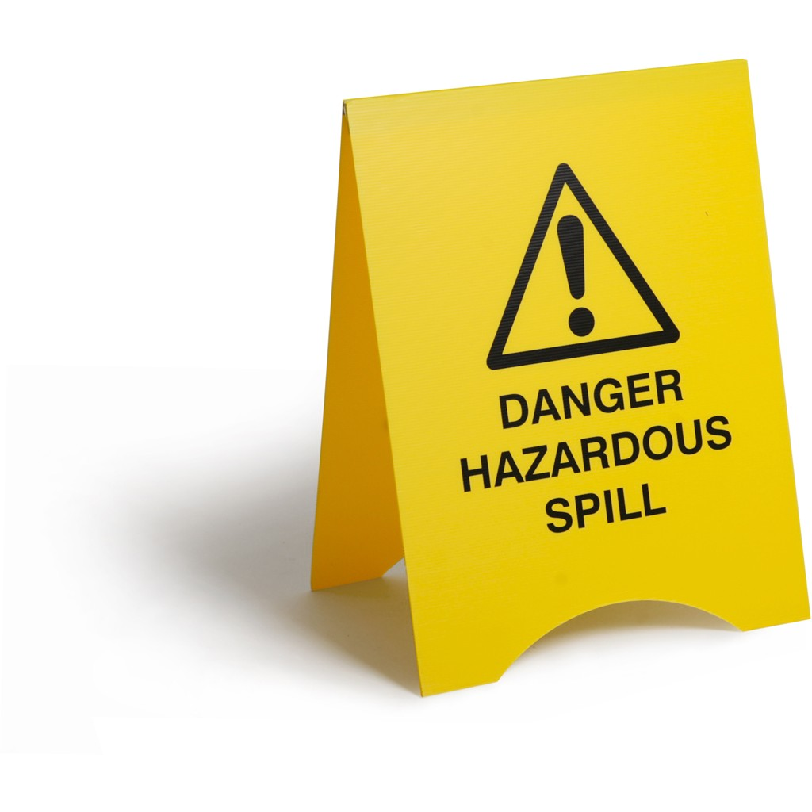

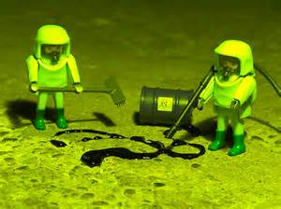
But How Can I Reduce Contamination?

Slide 3

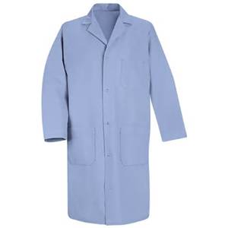
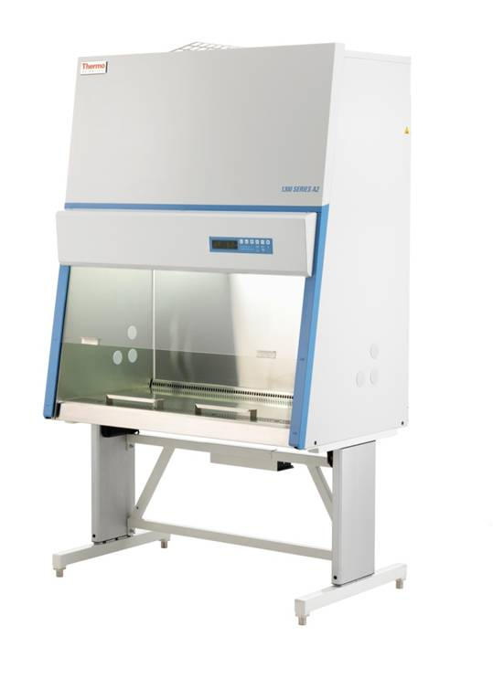

Don’t Relax Your Aseptic Technique!
Wash hands, wear lab coats and gloves
Work with only one cell type at once
Clean spills immediately)
Remove clutter from the BSC
Avoid touching door handles, phones, calculators, etc.
Change your gloves
Keep individual records of all your work

Slide 4
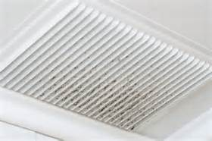
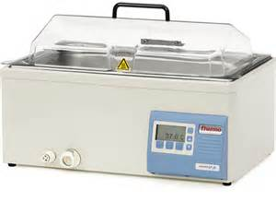
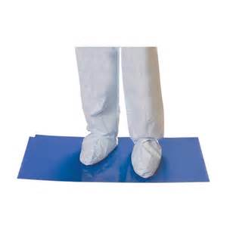
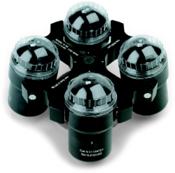
Clean the Lab 1-2 Times Per Month (Minimum)
How often are you cleaning your lab?
Install contamination control mats
Centrifuge, including buckets
Do you have an air duct blowing into the tissue culture lab?
Corners and under equipment
Lab sink (wipe around daily)
Water bath (including the rim and under the lid)
Calculator, telephone, microscopes

Slide 5
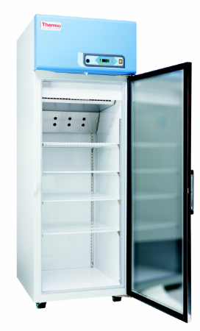
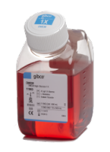
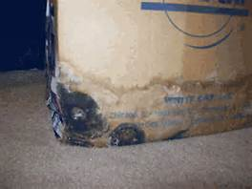
Reduce Growth in Refrigerated Storage
Do not share media and reagents with others
Eliminate cardboard storage in fridge or cold room (mold)
Discard old bottles of Media

Slide 6
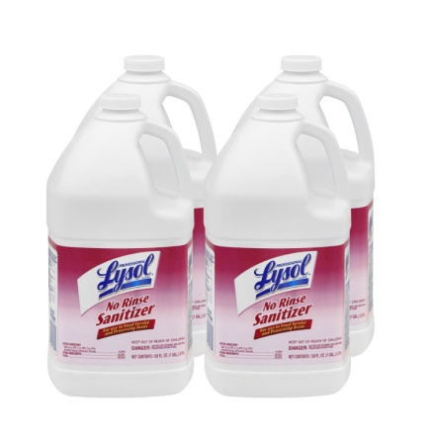
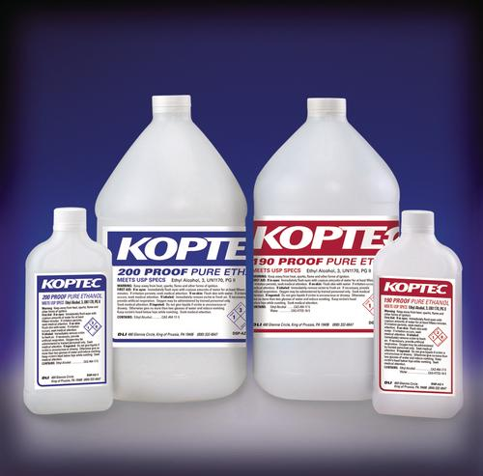
Use of disinfectants
Chlorine derivatives are very aggressive and can corrode stainless steel and copper
Many disinfectants are available, but not all are safe for your cells. Some disinfectants contain volatile organic chemicals, which can affect cell growth by inducing expressions of stress responses
DO NOT use disinfectants that contain chlorine derivatives with oxidizing properties. Examples of such derivatives include: Hypochlorite, Chlorite, Chlorate and Perchlorate
We recommend using only 70% ethanol or a quaternary ammonium containing disinfectant such as Lysol No Rinse

Slide 7
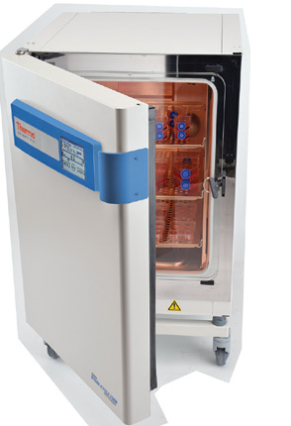
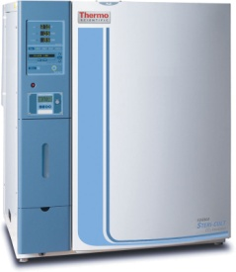
What About the CO₂ Incubator?
Use an incubator with a design that helps prevent contamination
They come from YOU – normal flora on hands, breath, hair
Start with a clean, sterile incubator
All contaminants in a cell culture incubator come from outside
As soon as you open the door, the incubator interior is at risk

Slide 8
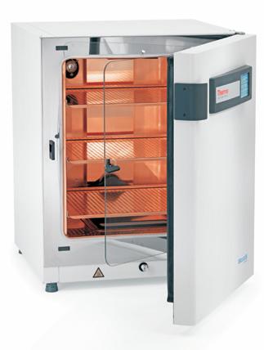
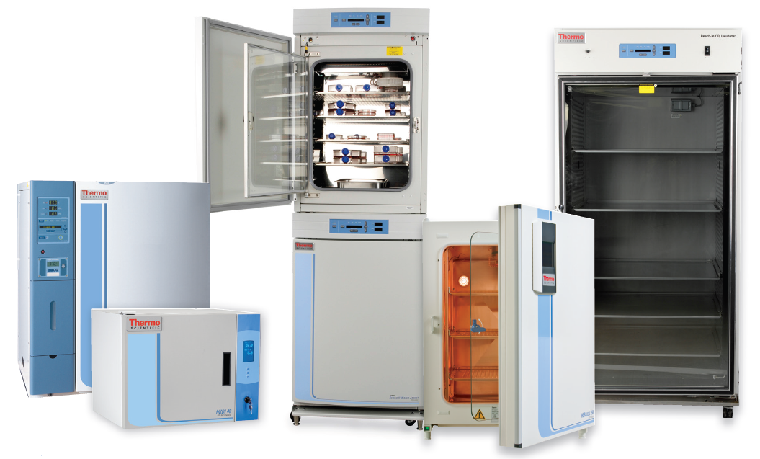
Proper Procedure for cleaning & Disinfection CO₂ Incubator

Slide 9
Proper Procedure for cleaning & Disinfection CO₂ Incubator
Move all cultures to a different incubator
Turn off the incubator and the gas supply
Remove all shelves, shelf supports and brackets, side ducts, top & bottom ducts, and the water pan
Autoclave removable parts (except sensors) if desired
Remove & clean blower cover & blower wheel if needed, according to manufacturer’s directions
Remove Sensors if needed, handling carefully. Do not autoclave sensors. Do not wipe or spray sensors, but instead gently rinse with distilled water
Clean all internal surfaces & parts, inner glass door and door gasket with mild soapy water using a clean lint free cloth. Rinse twice using clean distilled water. Wipe dry using clean, lint free cloth
Wipe the interior of the incubator, including glass door and gasket, with 70% ethanol
Wipe the shelves, supports, ducts and water pan with 70% ethanol and replace them in the incubator
Turn on the incubator heat (But not the CO₂ gas) and let the unit air dry completely
If available, run the automated decontamination cycle
Fill water reservoir with sterile distilled water
When the set temperature is reached, turn on the CO₂ gas
When the incubator has reached the set conditions, return cultures to the chamber

Slide 10
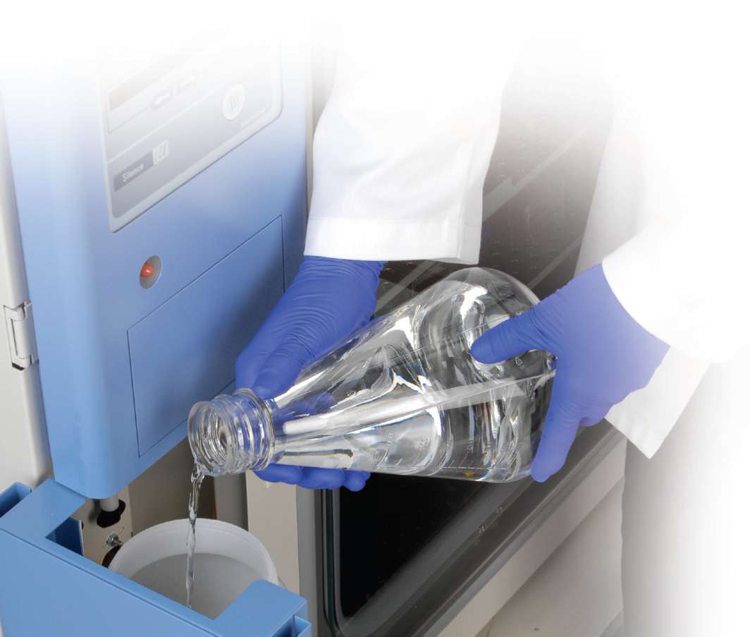
What type of water should I use?
You should only use sterile, distilled water in your CO2 incubator that has a pH between 7 and 9
Water used in the CO2 incubator must contain some inorganic ions. A resistivity of 50 K-1 MΩ-cm (conductivity of 1-20 μS/cm) is recommended
  High purity water with low ionic strength is very aggressive to metals and glass over time. Water with a resistivity approaching or equal to 18.2 MΩ-cm contains very few ions.
  Deionized (DI), reverse osmosis (RO), or ultrapure Type 1 water can be very aggressive, corroding incubator components
  Newer laboratories may only have access to DI or Type 1 water, or sterile distilled pre-bottled water. In this case, check that the resistance is 50K - 1 MΩ-cm, with pH 7-9. If your water falls outside these parameters, one option is to add a sterile solution of weak sodium bicarbonate to raise the pH and add ions.

Slide 11
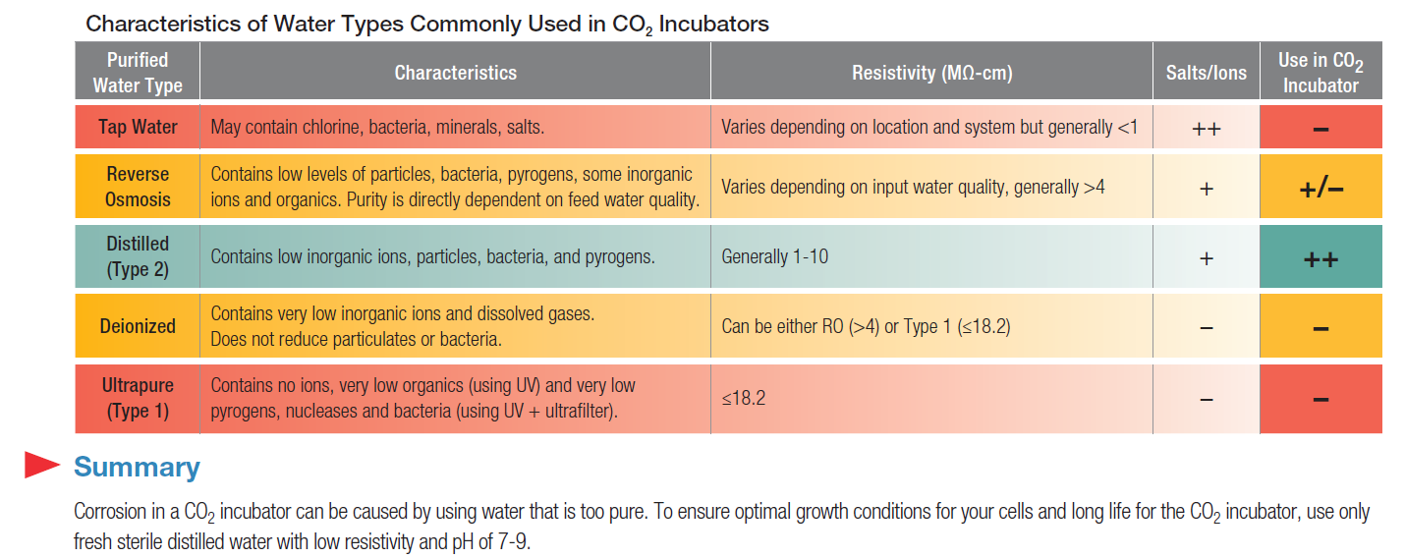
Characteristics of Water Types Commonly used

Slide 12
Clean the Incubator Exterior
Use a lint-free cloth dampened in mild soapy water to clean the exterior, especially door handles
Do not use any liquids (Including spray cleaners) on touch sensitive buttons or display. Instead, clean these with a dry microfiber cloth
Wipe the surfaces (except display) twice using a clean cloth dampened in clean water
Wipe dry using a clean cloth

Slide 13
Complete Contamination Control
100% solid copper kills contamination on contact
Steri-Run, high temperature cycle for on-demand disinfection
HEPA filtration cleans air of microbes and particles
Protecting cells in all directions – Air and Surfaces

Slide 14
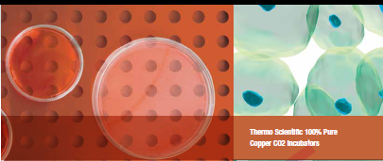
Antimicrobial Copper Incubators
Top Five Reasons Why Your Next Incubator Should Be Copper!
  100% Pure Antimicrobial Copper is Proven Effective Against Contamination
  Easy to Maintain
  Always working
  Improves with time
  Safe for cells
We like the Heracell copper because we just don’t experience any problems, from entry level to post-docs with 20-30 papers, none of our team has any contamination problems at
all. It’s just so easy.
– Lab Manager with 11 years experience
with Heracell® copper incubators

Slide 15
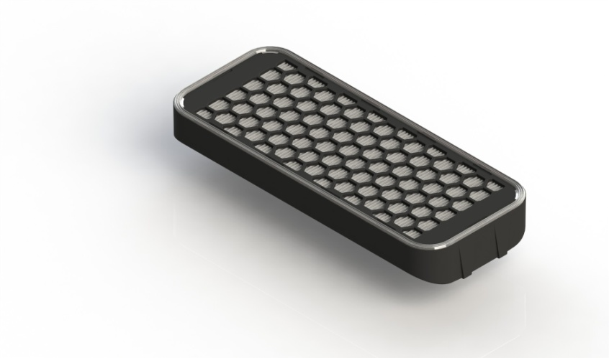
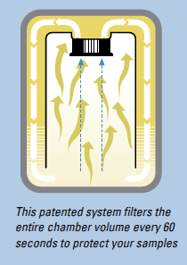
Thermo Scientific HEPA Filtration System
Thermo Scientific patented system filters the entire chamber volume every 60 seconds
Message Center alert informs you when to replace the filter
Circulating fan speeds recovery and provides uniform conditions
Our HEPA filters snap in and out easily - no tools required
Provides Class 100 (ISO-5) air quality

Slide 16
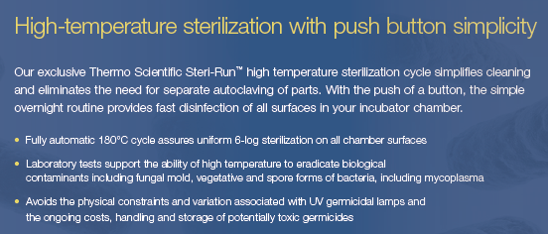
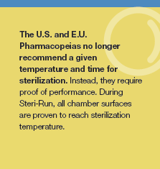

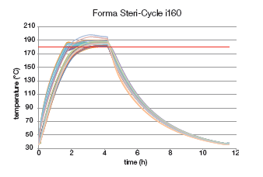

Dry Heat Sterilization
White paper:
“Efficient Heat Sterilization
in CO₂ Incubators”
Notes:
On the Forma steri-cult and steri-cycle there is a 140 degree high heat sterilization cycle. The time is 120 minutes, which is proven by independent tests to be almost triple the time required to kill Bacillus subtilis bacterial spores, which are very difficult to kill. Anyway, the Forma 140 degree sterilization is proven in multiple experiments using approved test organisms recommended by the US pharmacopeia and others. These are tests done by independent test labs, not by Thermo Scientifc.

Slide 17
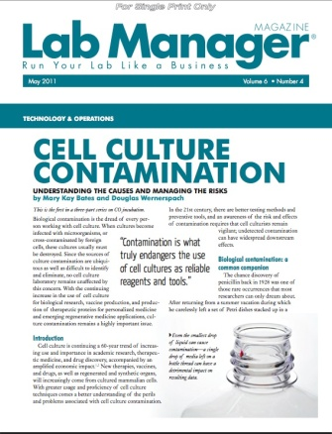
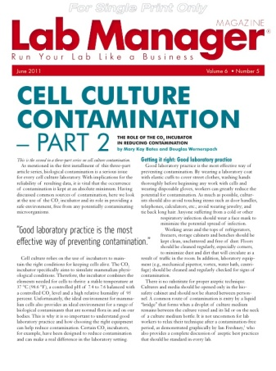
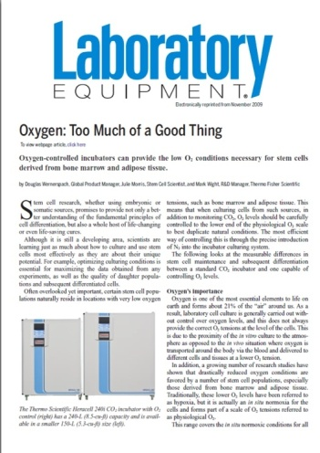
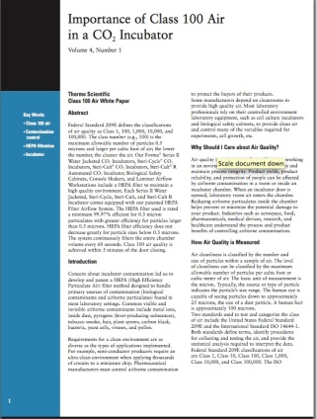
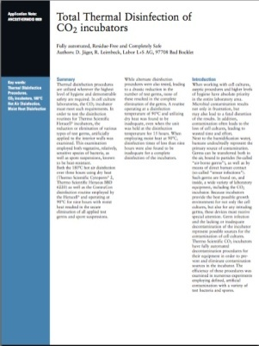

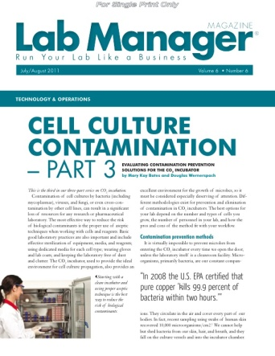
Thermo Scientific Provides Tools You Can Use!
At Thermo, we are committed to providing the best customer experience before and after the sale
Expertise and history continue to drive innovation
Visit our website, www.thermoscientific.com/co2incubators
  Information about new and existing features
  Interesting articles building on new discoveries
  Helpful Application Notes
  Informative Smart Notes
  And more!
Have a question? Contact us!

