Slide 1
Spring Laboratory Safety Coordinator Meeting
April 2017

Slide 2
Agenda
Welcome and Introductions: Joe Barbercheck
BioRAFT: Connie Gath
Research Safety Incidents report: Samantha Beglinger
Office of Research Integrity / Animal Welfare Program: Heather Tobin
Industrial Hygiene: Wayne Mackenzie
Environmental Management: Steve Monstur
Thank You and Raffle: Tanya Cafarella

Slide 3
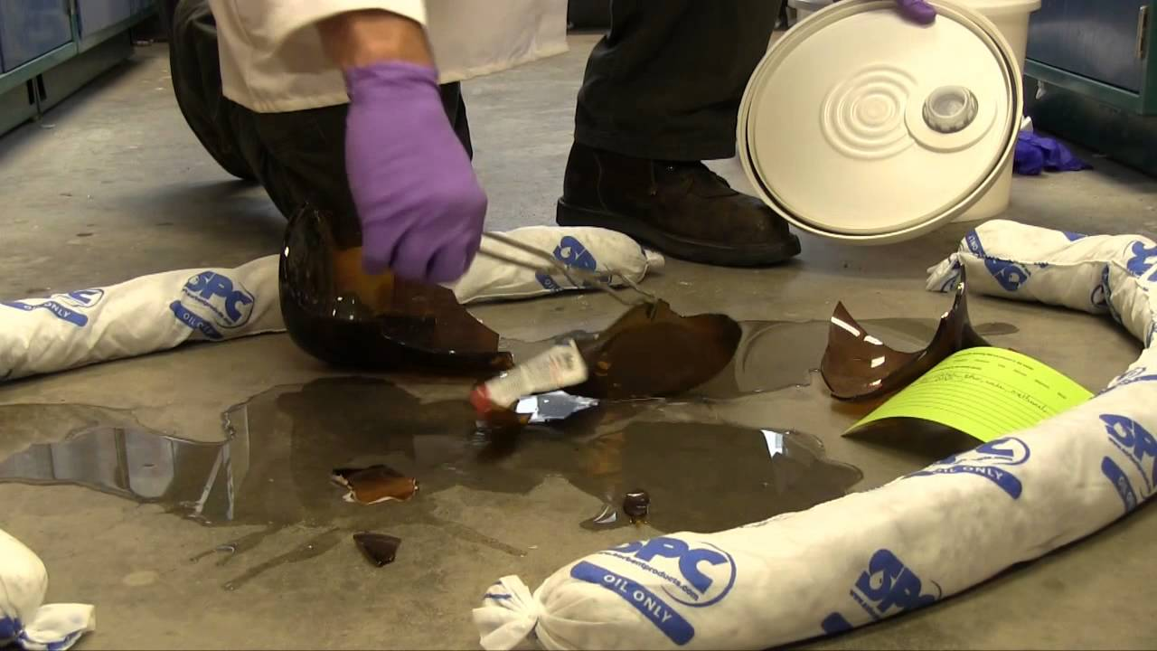
Safe Chemical Handling and Reporting Spills

Slide 4
Recent Lab Incidents
Xylene solution spill from a waste drum in 609 Albany St. (J Building)
Chemical spill in elevator of 24 Cummington
Chemical spill in hallway of 590 Comm Ave

Slide 5
Xylene Spill in J Building
A researcher was pouring xylene waste into a waste drum and had not noticed the drum was full
The researcher continued to fill the drum as xylene/formalin waste poured out from overflow holes in the drum
By the time the researcher noticed, about a gallon of waste had leaked out onto the spill deck

Slide 6
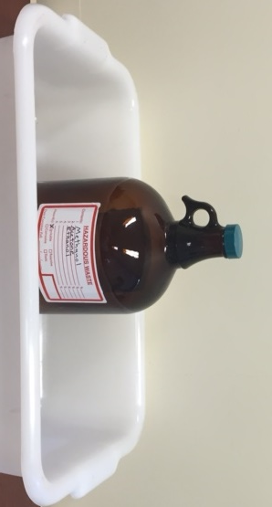
Filling Waste Containers
Waste drums and waste containers should be filled to a maximum of 75% of the volume of the container to limit overflow and spills
Secondary containers for waste containers should hold 110% of the total volume of the waste container
Try to schedule waste pickups so they align with the volume of waste generated

Slide 7
Large Solvent Bottle Transport Incidents
Both CRC incidents involved 4 liter solvent bottles being carried by hand
In 24 Cummington, a researcher was carrying two solvent bottles by hand when he accidentally knocked one of them against the elevator door
In 590, a researcher dropped a bottle of THF while attempting to unlock the door to his lab

Slide 8
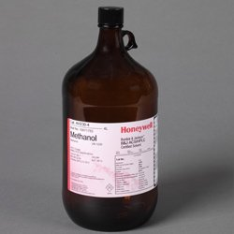
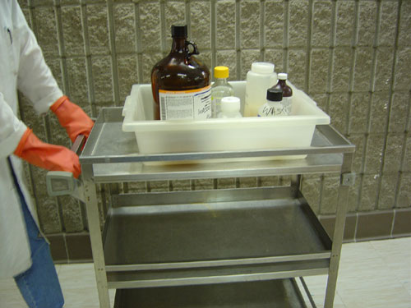
So…if you can’t carry them by hand, what are you supposed to do?
The little hand ring on 4L bottles is meant for use while pouring, not for carrying
Use a cart with a lip to transport chemicals between the lab and other locations

Slide 9
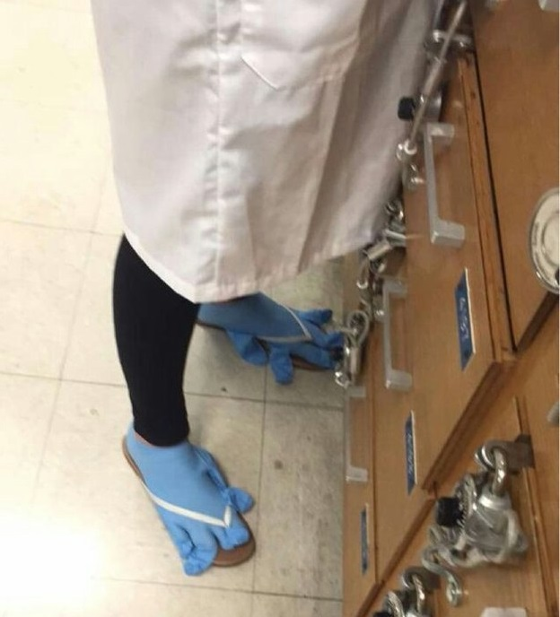
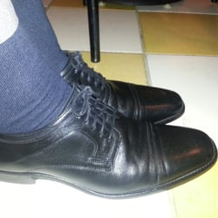
Other Safe Practices
NO
Appropriate PPE should be worn even when transporting chemicals from one place to another
Do not use gloved hands on elevator buttons, door handles, etc.
Ask for help if you’re concerned about moving chemicals alone
Make multiple trips if you need to (don’t be a hero)
YES

Slide 10

If a spill does happen?
Call EHS during business hours or Facilities Emergency Line/Control Desk during off hours right away
Contain the spill if possible
If safe to do so and you are comfortable, place absorbent padding or material
Block off the spill area with signage, etc.
If necessary, evacuate the lab or area the spill occurred
For serious injuries or emergencies, call BUPD (617-353-2121)
Observe and familiarize yourself with spill kit locations in hallways, etc

Slide 11
Office of Research Integrity
Heather Tobin, ALM, RLAT, CVT

Slide 12

What do we do?
Ensure researchers are compliant with laws and regulations that govern academic and medical research
  Boston University,
  Massachusetts State Laws,
  Animal Welfare Act and Regulations,
  PHS Policy,
  NIH Guidelines,
  and many others

Slide 13
Who’s in our office?
Michelle Auerbach, Executive Director, Research Integrity
Lillian Campbell, Administrative Coordinator, Research Integrity
Conflict of Interest (COI)/Export Control Program
  Heather Skinner, Assistant Director, COI & Export Control Officer
  Victoria Carlo-Carson, Sr. Compliance Specialist, COI & Export Control
  Sarah Porter, Sr. Compliance Specialist, COI & Export Control
Safety Committees Program (SCP)
  Sajal Ghosh, Sr. Compliance Specialist, SCP
  Cassie Williams, Sr. Compliance Specialist, SCP
  Ashley Gibson, Compliance Specialist, SCP & AWP
  Uditi Kapoor, Graduate Student Worker, SCP & AWP

Slide 14

Who’s in our office?
Animal Welfare Program (AWP)
  Michele Fahey, Assistant Director, AWP
  Lindsay Andrews, Sr. Compliance Specialist, AWP
  Heather Tobin, Sr. Compliance Specialist, AWP
  Ashley Gibson, Compliance Specialist, SCP & AWP
  Danny Lee, Graduate Student Worker, AWP
  Uditi Kapoor, Graduate Student Worker, SCP & AWP

Slide 15
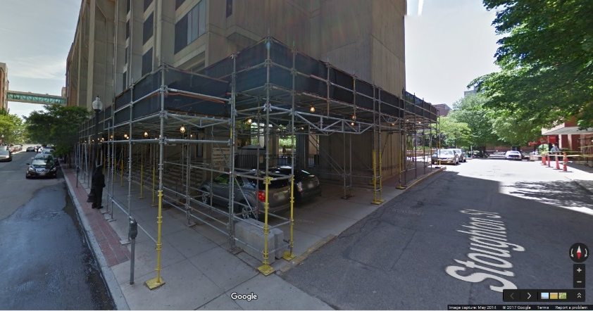
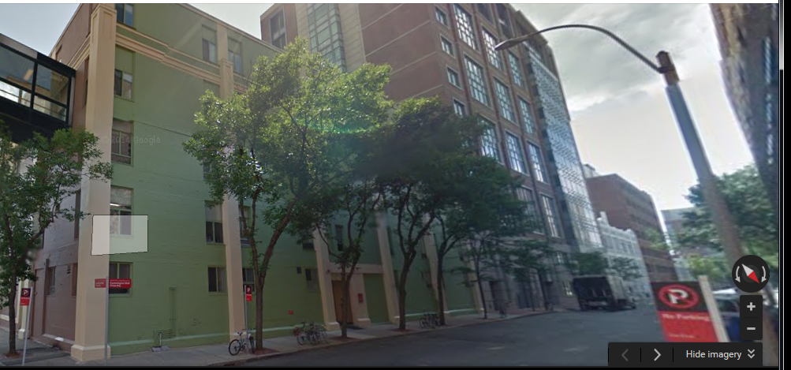
Where are we?
Solomon Carter Fuller Mental Health Center (85 E. Newton Street)
8th floor (Suite 810)
2 Cummington Mall
410S

Slide 16
What’s new within the AWP?
Successful AAALAC site visit!
  “Well maintained facilities with animals well taken care of”
  “Active involvement of the IACUC; well documented minutes with good semi-annual documentation”
  “Well written SOPs”
  “Strong administrative financial support (CILSE)”
  “Aquatics Center well maintained”
Continued Full Accreditation was recommended to the AAALAC Council.

Slide 17

What’s new within the AWP?
Semi-Annual IACUC inspections
  BUMC – Will begin in May
  CRC – Currently ongoing (except CILSE)
  NEIDL – Completed April 13th, 2017

Slide 18

How can AWP help you?
Aid you in better understanding the laws, regulations, guidelines and standards regarding animal welfare and the IACUC.
Assist with effective communication between you and the IACUC.
Appreciate your responsibilities to the compliance process.

Slide 19

Do not hesitate to contact us if you have any questions or concerns. We are here to help!

Slide 20
Eyewash & Safety Showers
Laboratory Safety Coordinators Meeting
April 24 & 26, 2017

Slide 21
Proposal on inspection frequency
Eyewash & Safety Shower Inspections

Slide 22
Problem Statement
BU inspects some eyewashes and safety showers more often than required by regulation and standards
  ANSI requires weekly activation and annual inspection of plumbed emergency eyewash and shower equipment.
  OSHA requires eyewash for formaldehyde, BBP, injurious corrosive materials – no testing/inspection frequency.
  527 CMR 1.00 Massachusetts Comprehensive Fire Safety Code (adopts NFPA 1 with amendments) requires newly constructed or renovated university labs wherein corrosives or flammable liquids are handled or where open flame devices are used, to be equipped with one or more Emergency Wash Systems that are tested every 6 months.

Slide 23
Background
Requirements for eyewash & safety shower are found in:
  Chemical Hygiene Plan, Section 7.0 SOPs, Laboratory Safety Equipment
  BMC Policy 06.25.000, Emergency Eyewash and Safety Showers
  BU Policy 2.3.10, Emergency Eyewash and Safety Shower Equipment
All based on CMR regulation with extra requirement for flammables & fire hazard (not just corrosives, skin/eye contact hazard), inspection frequency of 6 months.

Slide 24
Opportunity
Change to annual testing for eyewash & safety showers installed in labs constructed or last renovated before December 31, 2014.
Advantages:
  Free up labor hours of testing an unknown number of units
  Focus attention on other efforts such as Bioraft, IH qualitative risk assessments
Disadvantages:
  Fewer inspections of critical safety equipment
  Difficult to determine what labs are pre/post 2015 cutoff
  May not result in significant reduction in testing LOE

Slide 25
Recommendation
Maintain status quo with respect to eyewash and safety shower inspections – keep at 6 months.
  Additional inspections could identify problem sooner
  Avoid complexity of maintaining two different procedures
  Avoid regulatory violations

Slide 26
Weekly activation
Eyewash & Safety Shower Inspections

Slide 27
Weekly Activation
Required by ANSI Z358.1-2014
Responsibility of PI or Academic Department
Ensures emergency equipment operates and keeps lines clear of sediment that could clog heads and/or cause further eye injury
Documentation of weekly activation
Report issues to DSA or IH

Slide 28
Focus Areas
Bucket and tubing available if needed
Keep area clear of obstructions
Threads of plastic heads can get stripped
Contact DSA/IH Department (8-8830) with questions or concerns

Slide 29
Hazardous Waste
Lab Safety Coordinators Presentation

Slide 30
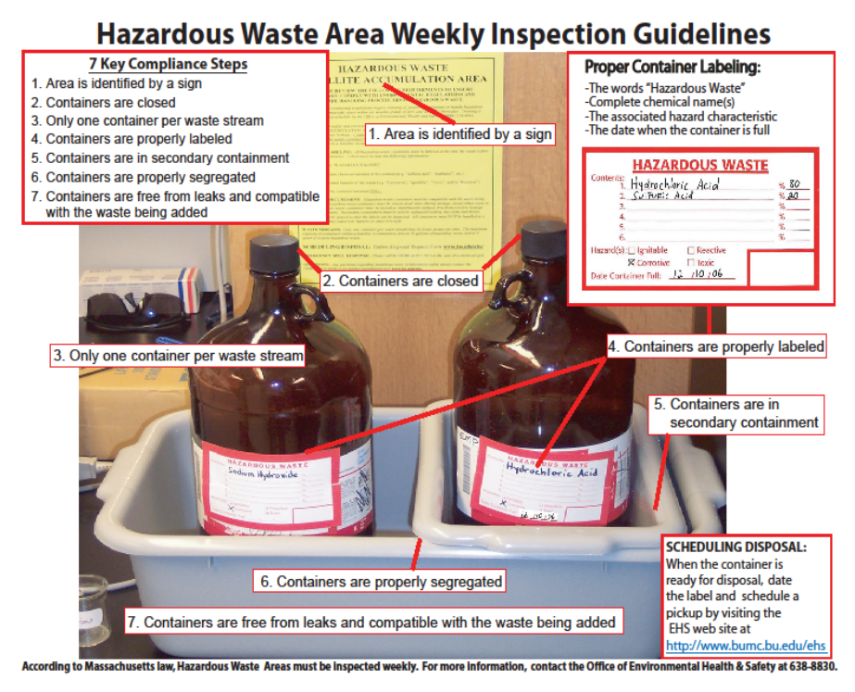
Chemical wastes almost never belong in a sink or in the trash. When in doubt, collect it. Never hesitate to make a phone call (3-4094 or 8-8830) to ask a question.
Most Common Violations:
1. No hazard box checked
2. Abbreviations used
3. Not tightly closed
4. Not in secondary containment
5. Date > 3 days old

Slide 31
Updated Resources
Hazardous Waste Management Guide
  Everything you need to know, including lists of chemicals.
  Currently in PDF form, but web version has been created, will be rolled out with new EHS site.
New Sign/Poster
  Quick reference and designation sign
  Available on website
  Laminated copies available today
bu.edu/ehs

Slide 32
Updated Regulations
EPA recently passed updated hazardous waste regulations
Requiring ‘at the point of generation’ waste determinations:
  Made by researchers who generate the waste
  Documented: Is it a hazardous waste? Why?
Implementation date up to Massachusetts, likely next spring
BU working with EPA, other colleges and universities, to determine best practice

Slide 33
Updated Inspections
Outside Regulators: BU is overdue for a regulatory inspection. It’s not ‘if’ they’re coming, it is ‘when’.
Internal Inspections: EHS is working on a system to score, rank and report hazardous waste compliance in individual laboratories.
  Dedicated inspections of every lab twice per year
  Scoring, ranking, and reporting of worst laboratories

Slide 34
Questions?

Slide 35
THANK YOU
RAFFLE

