Slide 1
LABORATORY SAFETY COORDINATOR MEETING
FALL 2017

Slide 2
AGENDA
Welcome and Introductions- Tanya and Ron
Recent Laboratory Incident Report- Sonya
Risk Assessment- John
ORC & EHS websites overview- Sam
BioRAFT Updates and Tutorial- Sony and Connie
Raffle- Tanya

Slide 3
Recent Laboratory Incidents

Slide 4
Background of the Quarterly LSC Incident Report
The Laboratory Safety Committee (LSC) at BU provides guidance and administrative oversight of environmental health and safety in the academic research and teaching laboratories.
Each quarter a report is provided to the LSC. The report provides an accounting for laboratory inspections for a period of a quarter regarding inspection deficiencies, based on nine categories by-campus. In addition the report contains information on laboratory incidents such as injury/exposure and chemical spill data.
The value-added addresses the much needed work and oversight in the form of committee action; in the form of policy, plans, and guidance material and the direction of focus for BU’s Laboratory Safety Committee.

Slide 5
Reportable Incidents
This past quarter (Jul.-Sept.) there were 11 incidents
  1-mouse bite
  2 –needle stick (clean needles),
  2 finger laceration-incident review
  chemical splash-incident review
  Inhalation exposure
  Odor
  Skin allergen
  Bio-spill
  Chemical reaction – incident review

Slide 6
Qiagen Kit mixed with Bleach
A researcher added about 1 mL of bleach to Qiagen Kit waste
Though there was no visible reaction, these kits contain a chemical (guanidinium thiocyanate) that may produce hazardous gases when combined with bleach and/or strong acids
Many labs use kits/products for DNA and RNA extraction methods that contain guanidium thiocyanate
While this chemical is low hazard on it’s own, it’s important to remember that mixing low hazard chemicals can produce high hazard by-products and gases (think bleach mixed with ammonia)
Always read the SDS sheet for a chemical/user guide for a kit. There is a section for incompatible chemicals in SDS sheets.

Slide 7
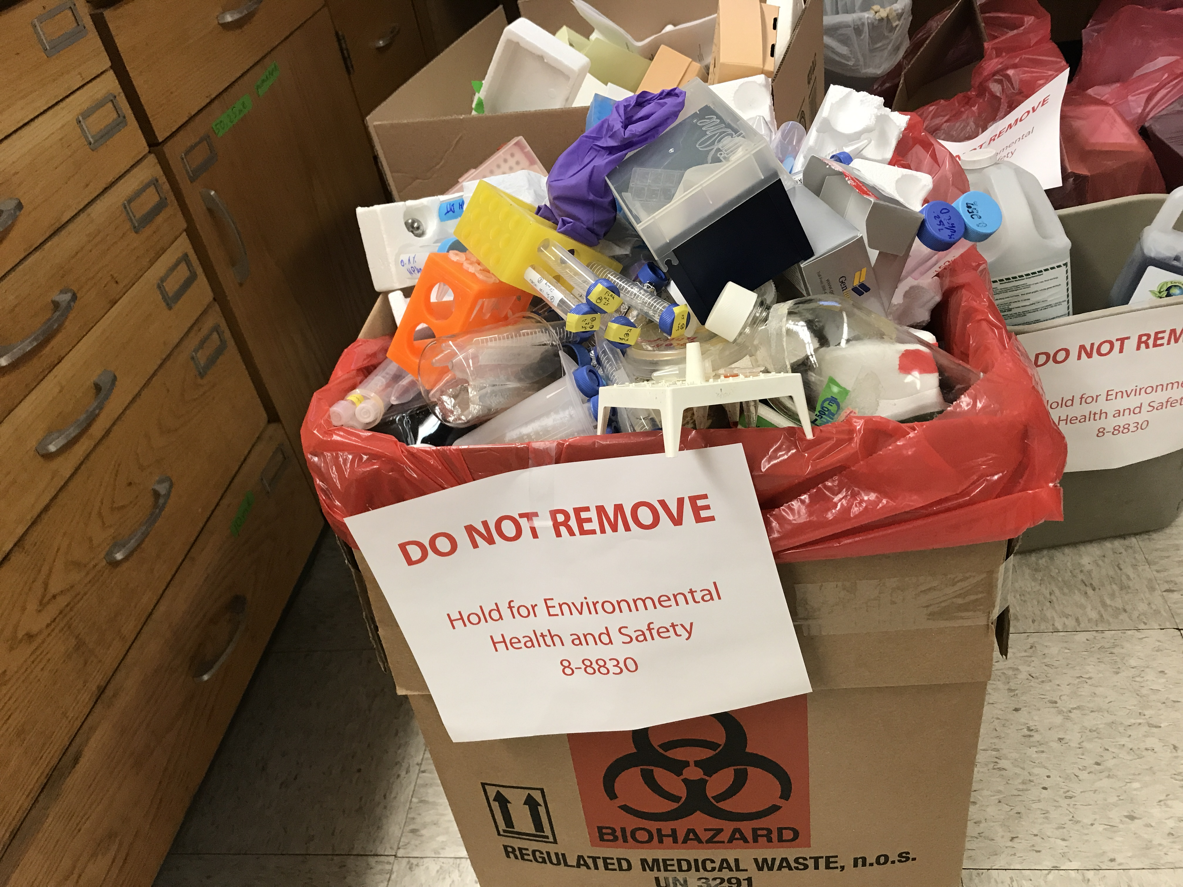
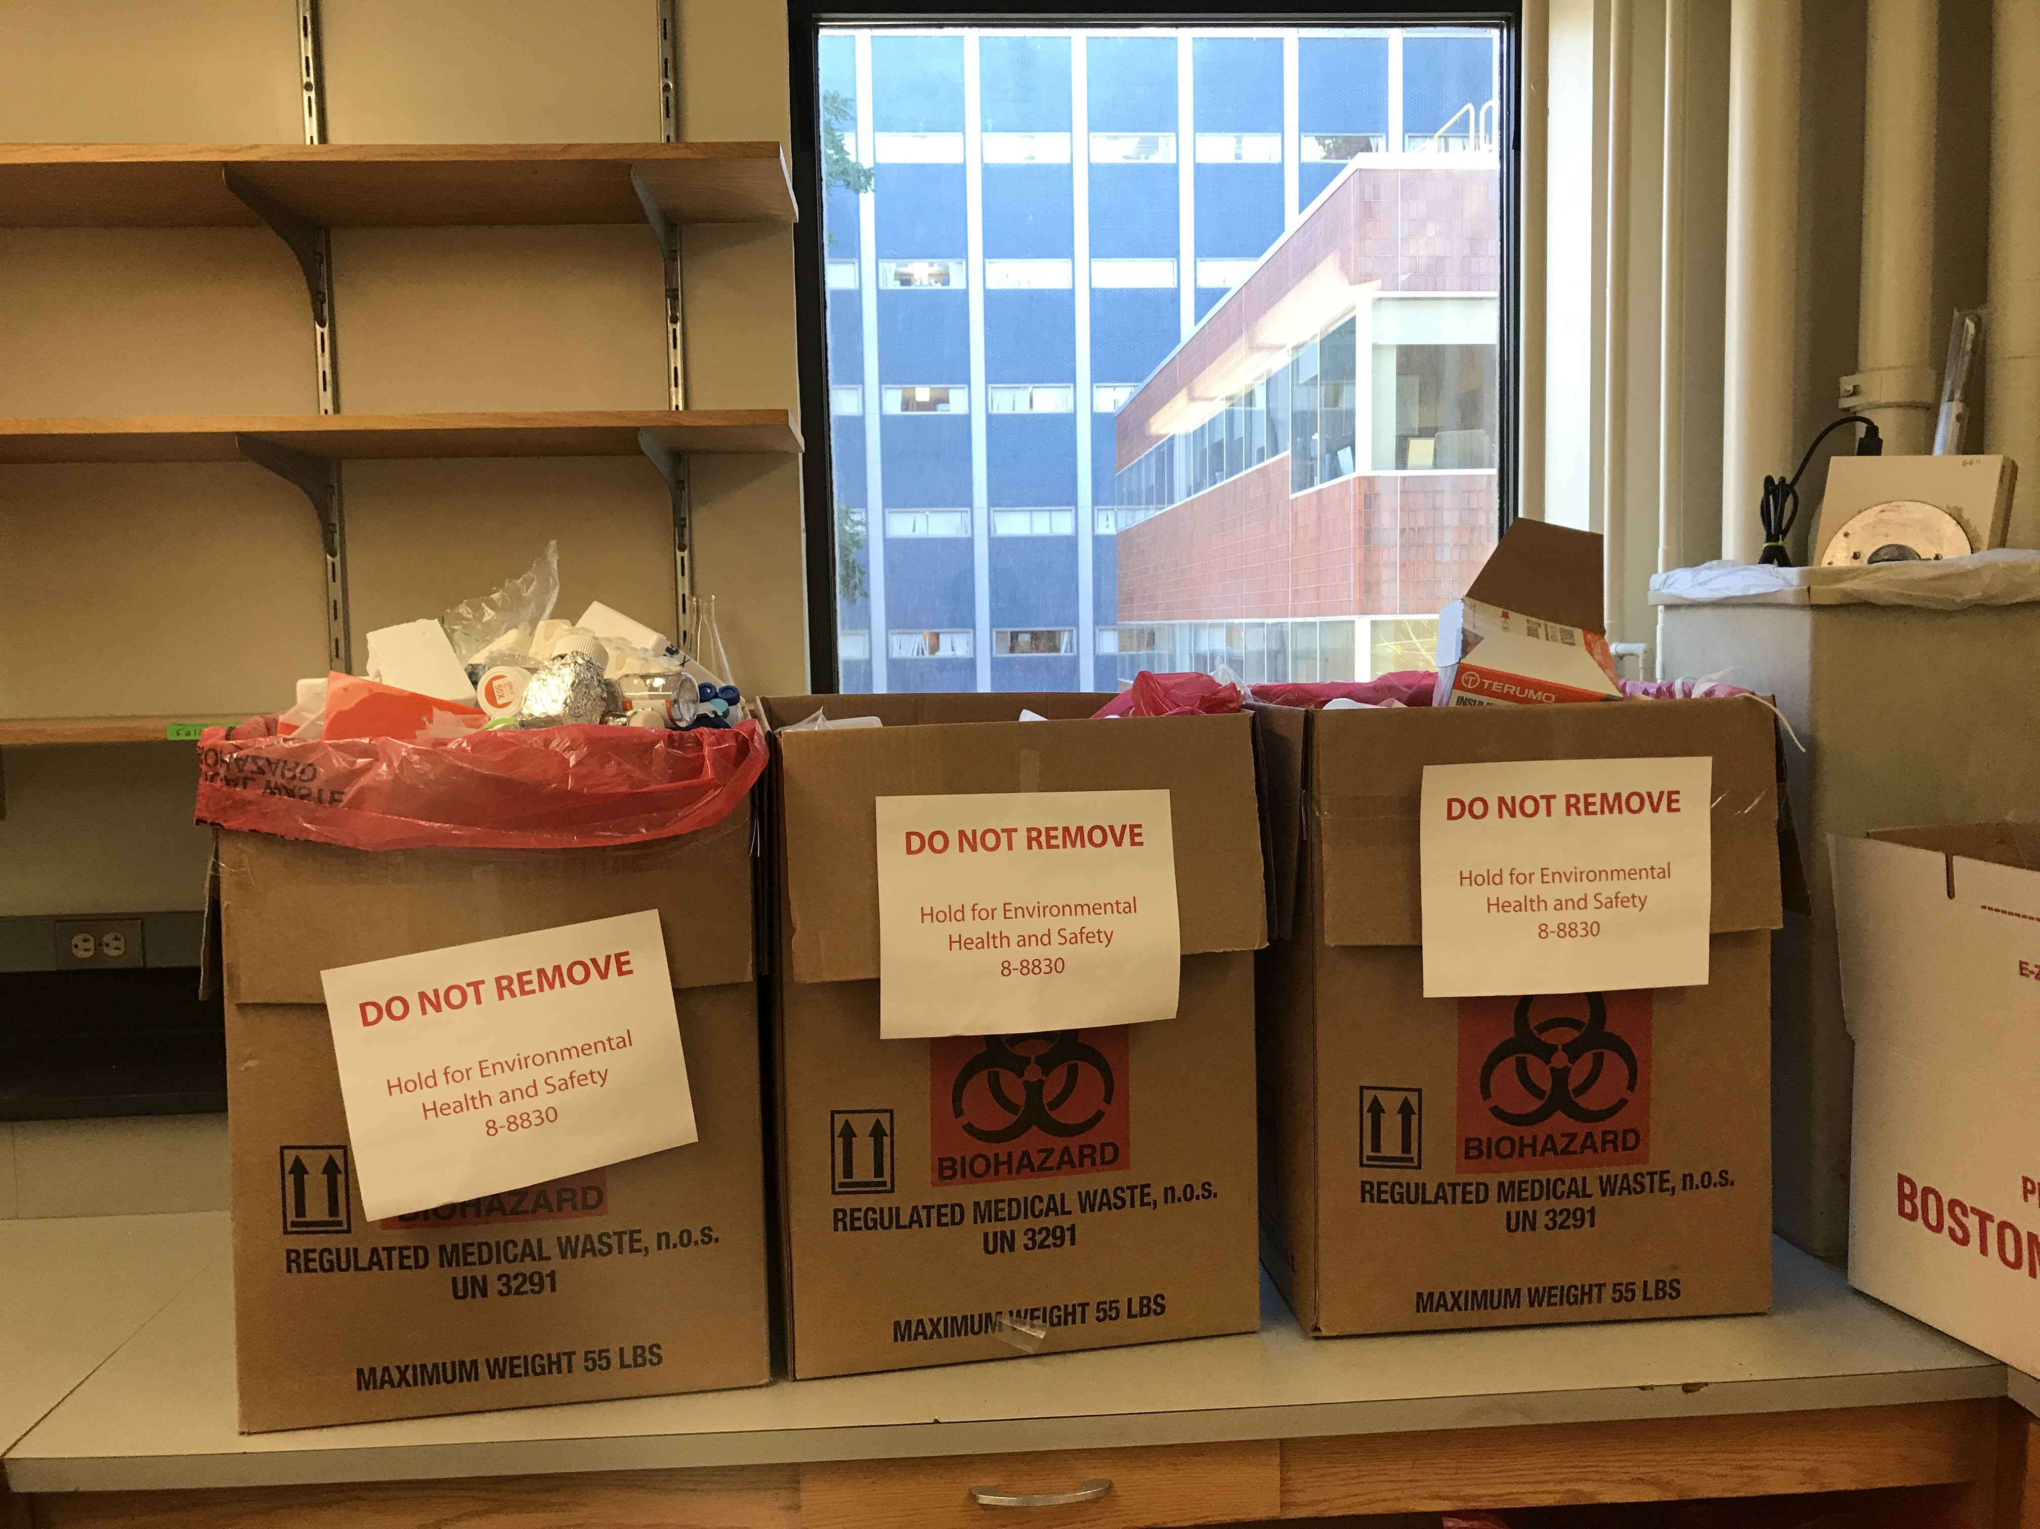
Incident- Near miss: Improper Hazardous Chemical Disposal
Near miss: Personnel discovered that cardboard biological waste boxes were being used to collect non-biological wastes. Inspection of the contents of the boxes revealed that a jar of sodium metal had been placed inside.
Sodium metal reacts explosively with water. If this biological waste box had been closed and sent out for disposal, it would have been shredded and cooked in an autoclave. During this process it would have certainly contacted water, likely causing an explosion at the waste treatment facility and endangering the safety of those who work there.
Root Cause: Failure to follow procedure
Steps to prevent occurrence: Institutional policy change

Slide 8
Incident- Chemical Splash
A graduate student was doing chemical reaction in a horizontal sash (sliding door) fume hood, since the components of the reaction were combustible, irritating, reactive and caustic, they were wearing gloves, a lab coat and googles.
Heating the mixture, caused some hot vapor to dissolve through and burst out. About 5-10mL of reaction mixture splashed up to their chin, lips and neck.
Root Cause: Poor understanding of the procedure
Steps to prevent occurrence: Follow an SOP for the experiment exactly. Usually the reaction mixture is regulated by cooling through a condenser. The student decided not to use the condenser because the student believed that the heating temperature was below the boiling point of the chemical mixture.

Slide 9
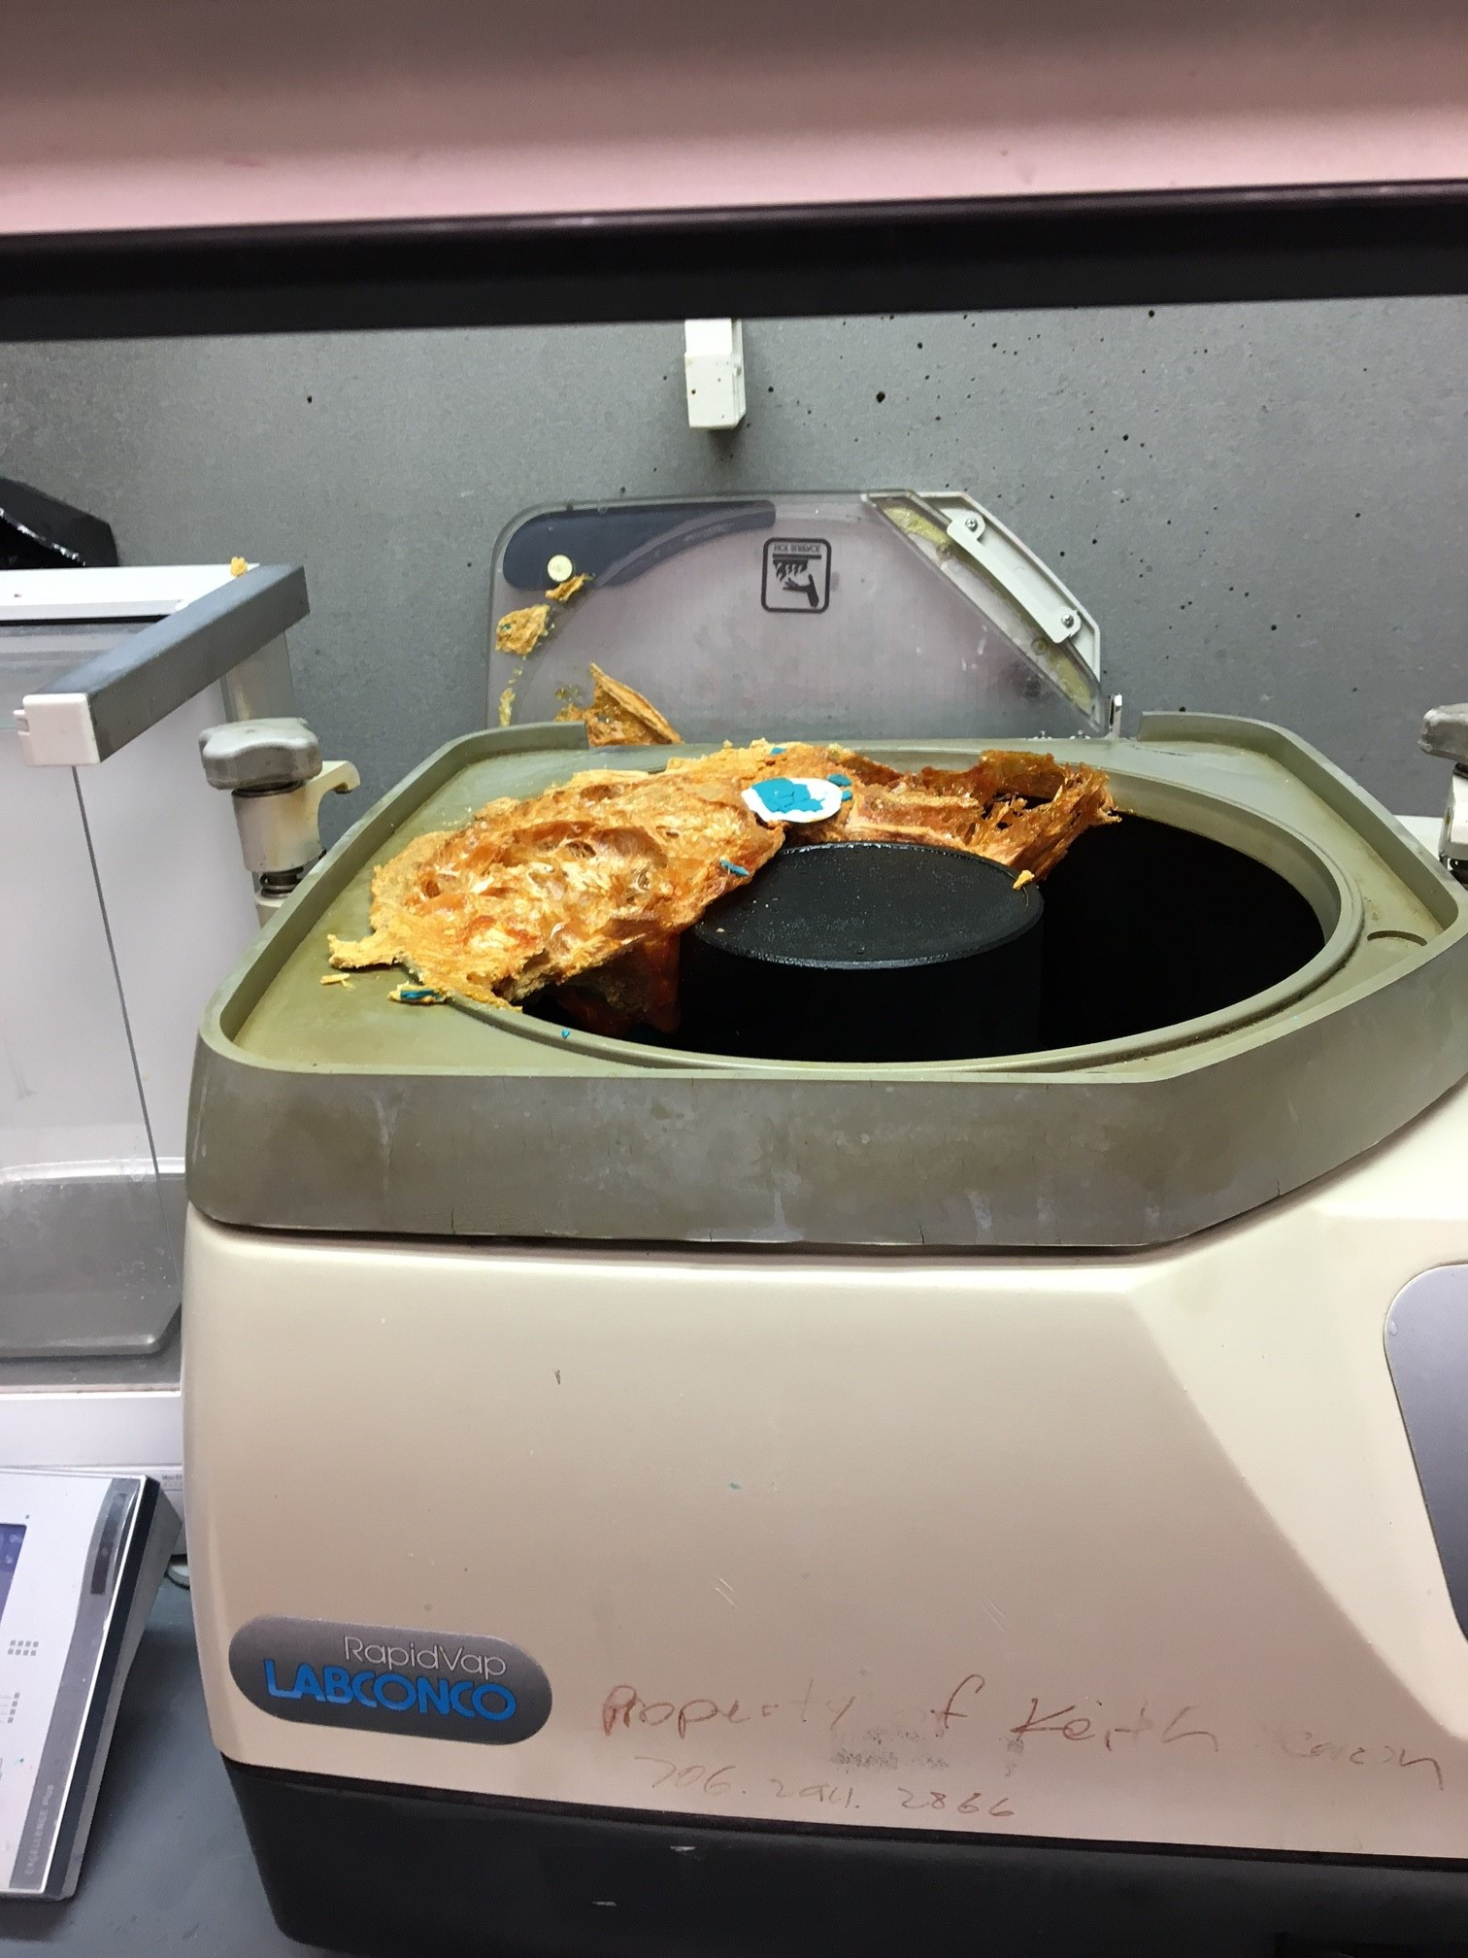
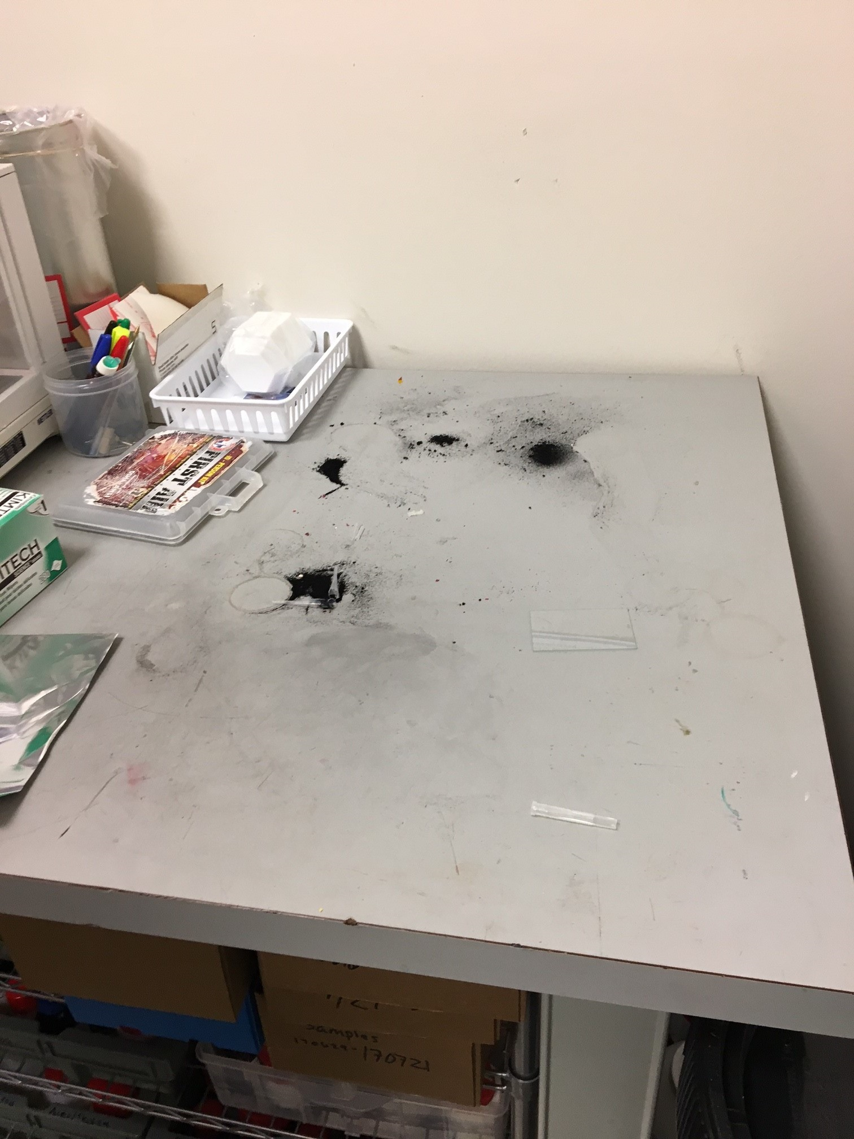
Incident- Chemical Reaction
Staff noticed white smoke coming from a heater, that was located on a table next to the fume hood. Immediately turned on the emergency exhaust in the fume hood, opened the fume hood sash completely to vent and disconnect the heater from power. All personnel immediately evacuated the lab and followed best safety practices.
The department administrator called Facilities Emergency Desk to report a small explosion inside lab
Members provided an extended chemical inventory for the entire lab, as well as a separate list of the chemicals used during the experiment in the heater.
Determined that a thermally driven free radical auto-polymerization most likely the source of the incident
Route Cause: Inadequate procedure
Steps to prevent occurrence:
  The lab is looking for alternative methods to dissolve the solid (e.g. lower the heating temperature to 40-45C, no heating, use mixer and sonication)
  Place equipment generating toxic fumes in fume hood
  Revise and communicate new SOP

Slide 10
Risk Assessment
Goal: Prevention of Incidents

Slide 11
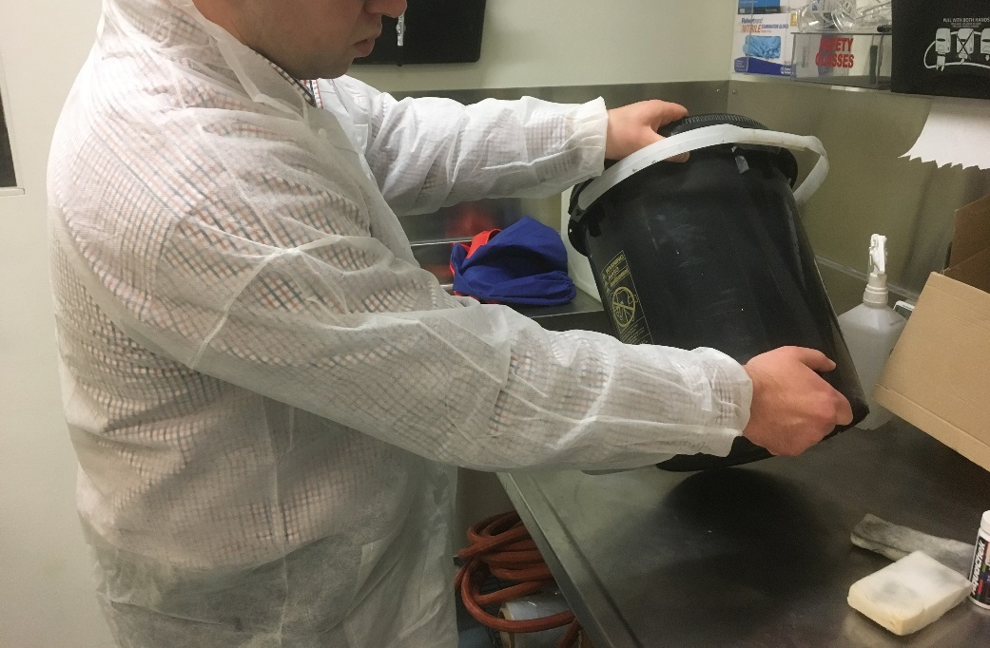
First Aid Injury Summary:
On September 14, a Lab Technician injured the right hand while emptying the contents of a 4-gallon bucket of disinfectant solution into a sink. The Technician held the top of the bucket with the left hand and the bottom of the bucket with the right hand. The bucket slipped into the sink and pinned the right hand between the bucket and the sink.
4 gal water ~ 33 lbs

Slide 12
Root Cause
  No procedure in place for emptying bucket
  Resulted in hand in “line of fire”
What went right…
  Technician reported incident immediately to Supervisor
  Evaluated by ROHP, returned to full duty same day
4 gal water ~ 33 lbs

Slide 13
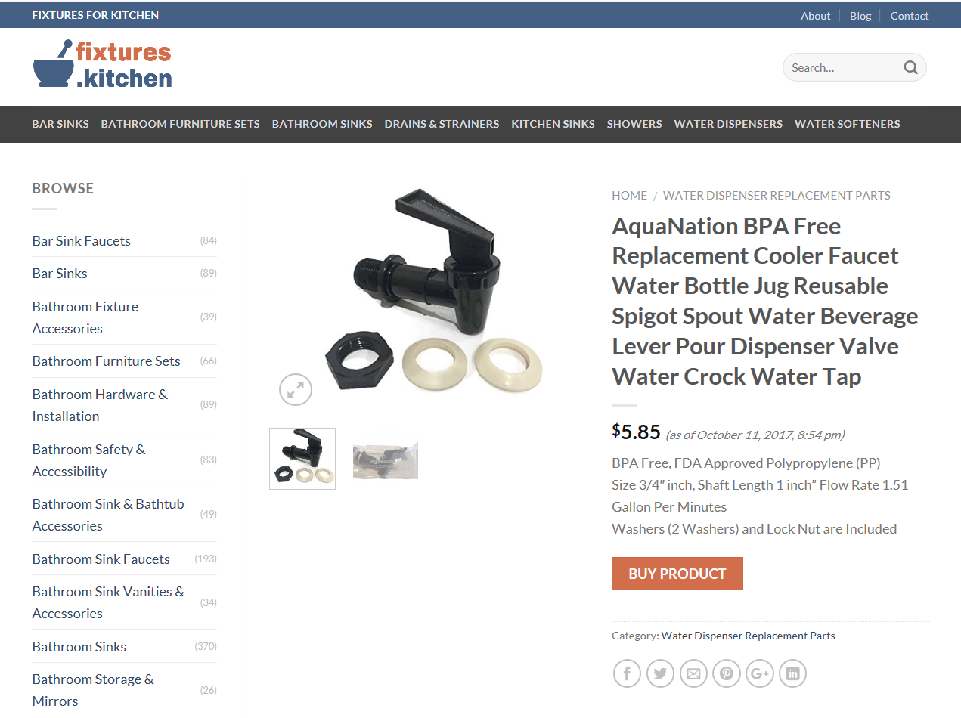
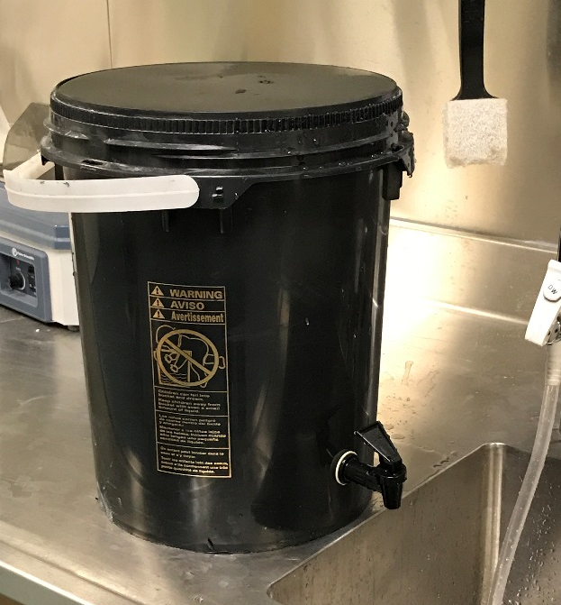
Our $6 Improvement
Opportunity for improvement…
  Develop better method for emptying bucket to eliminate hands in danger area
Eliminated tipping the bucket by installing a spigot in < 30 minutes

Slide 14
Take Away Points
  Periodically review routine and non-routine tasks
  Challenge “we have always done it this way” rationale
  Create teams to solve problems, involve persons closest to operation for best outcomes

Slide 15
Environmental Health & Safety Website
Navigating the new EHS website

Slide 16
Why do we have a new website?
Part of a larger University wide initiative to be ADA compliant
Improved/streamlined menu options
Updated forms and documents
Consistent design for all departments/university

Slide 17
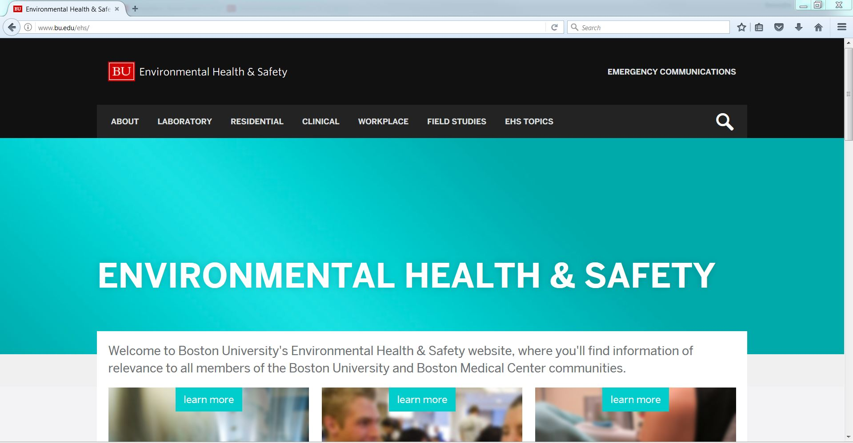
EHS Homepage: www.bu.edu/ehs

Slide 18
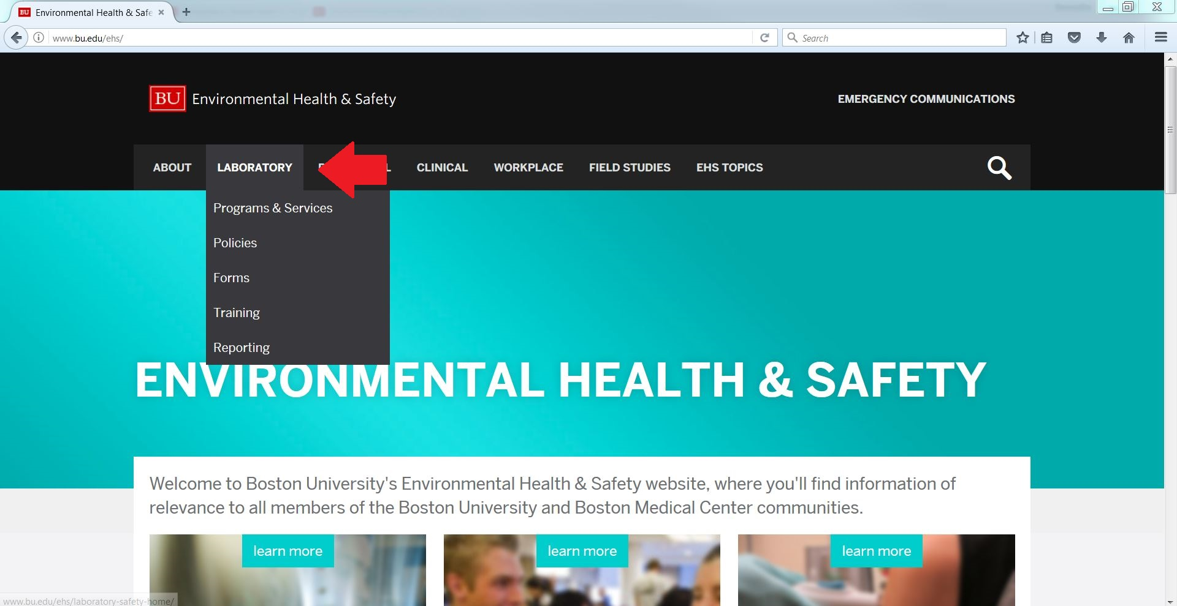
Navigating Laboratory Options

Slide 19
Navigating Laboratory Options
There are five different pages under Laboratory Safety menu
  Programs & Services: links and resources for various programs relevant to Lab Safety
  Policies: Guidance documents and plans
  Forms: relevant Lab Safety forms
  Training: link to specific training page. All Lab Safety training is now in BioRAFT
  Reporting: resource for variety of reporting, including near-miss and misconduct reporting

Slide 20
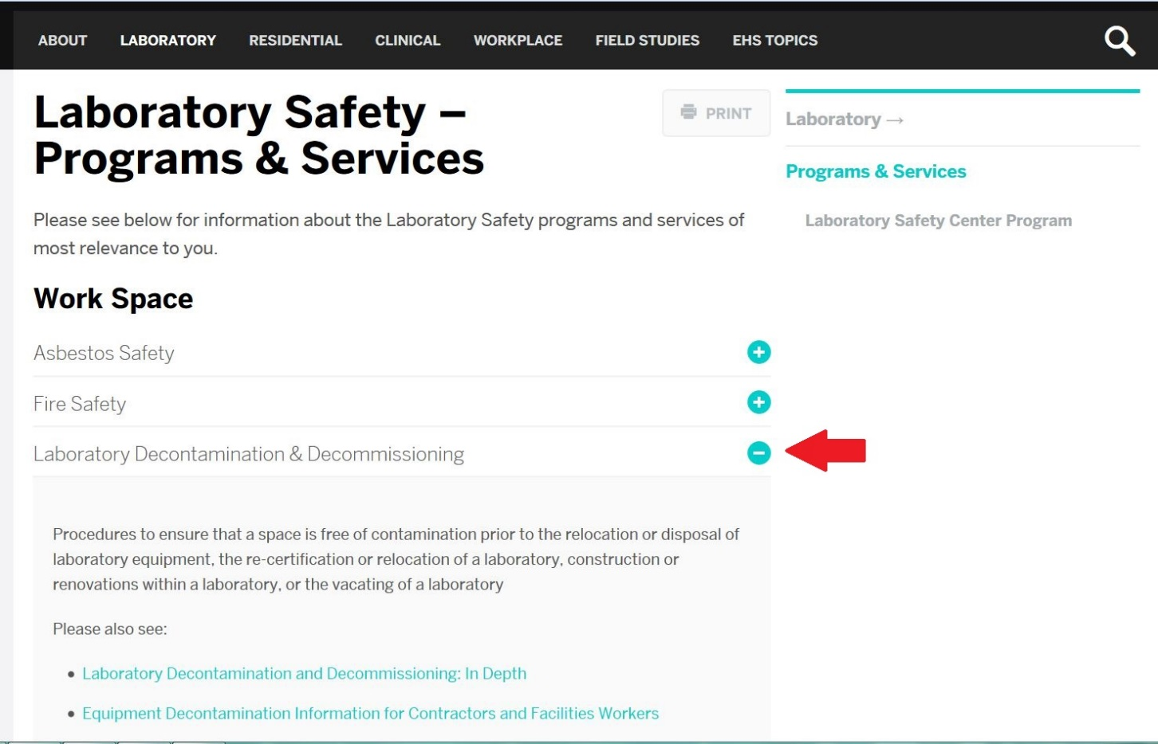
Navigating the website – Programs & Services
Click the plus sign for drop down menu options

Slide 21
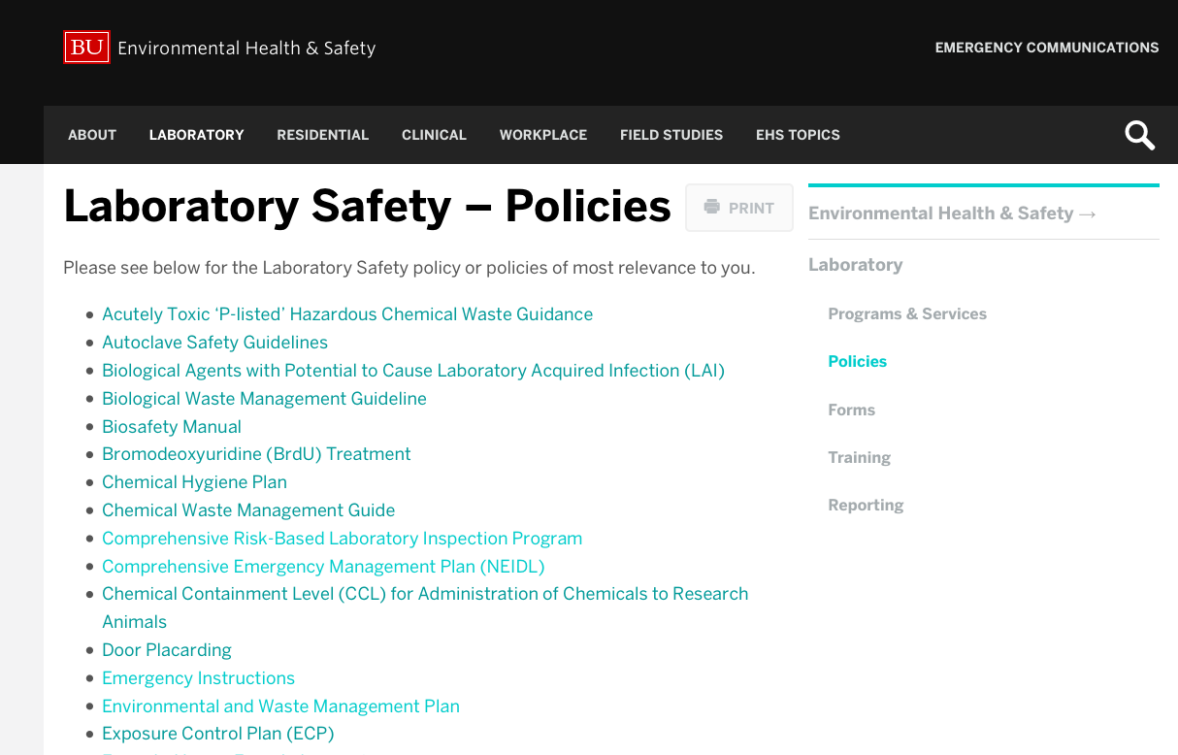
Navigating the website -- Policies

Slide 22
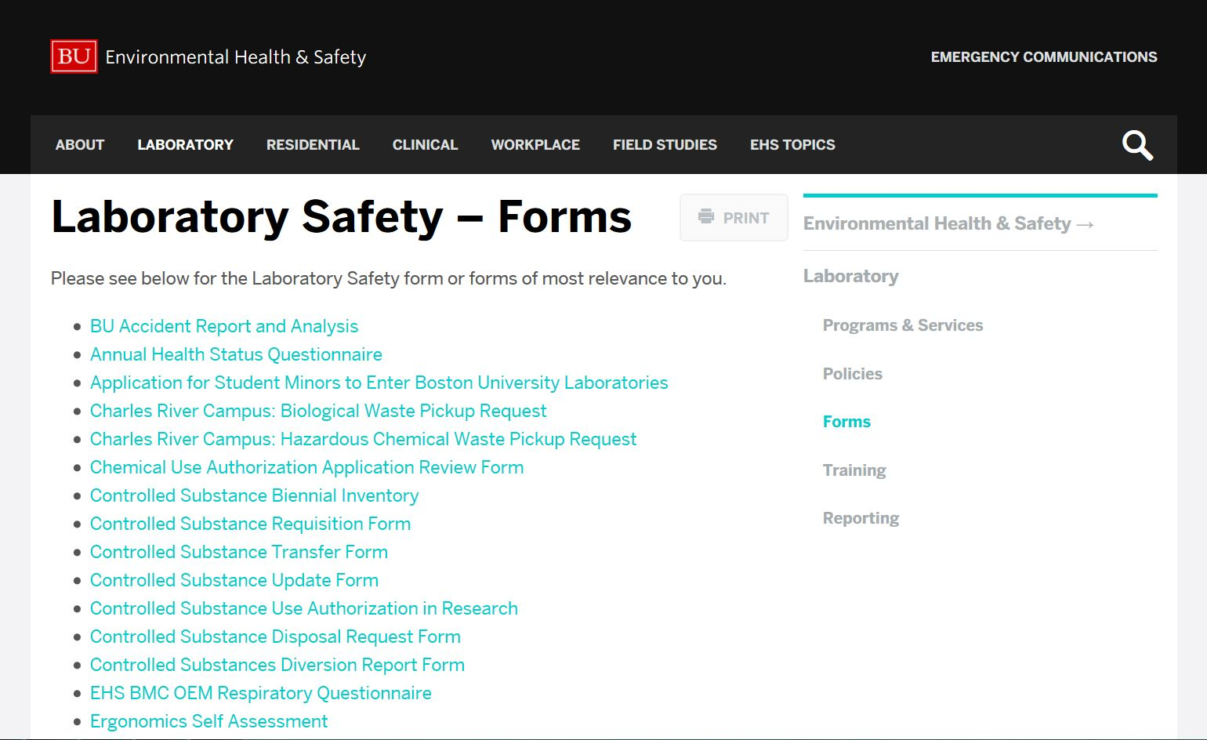
Navigating the website - Forms

Slide 23
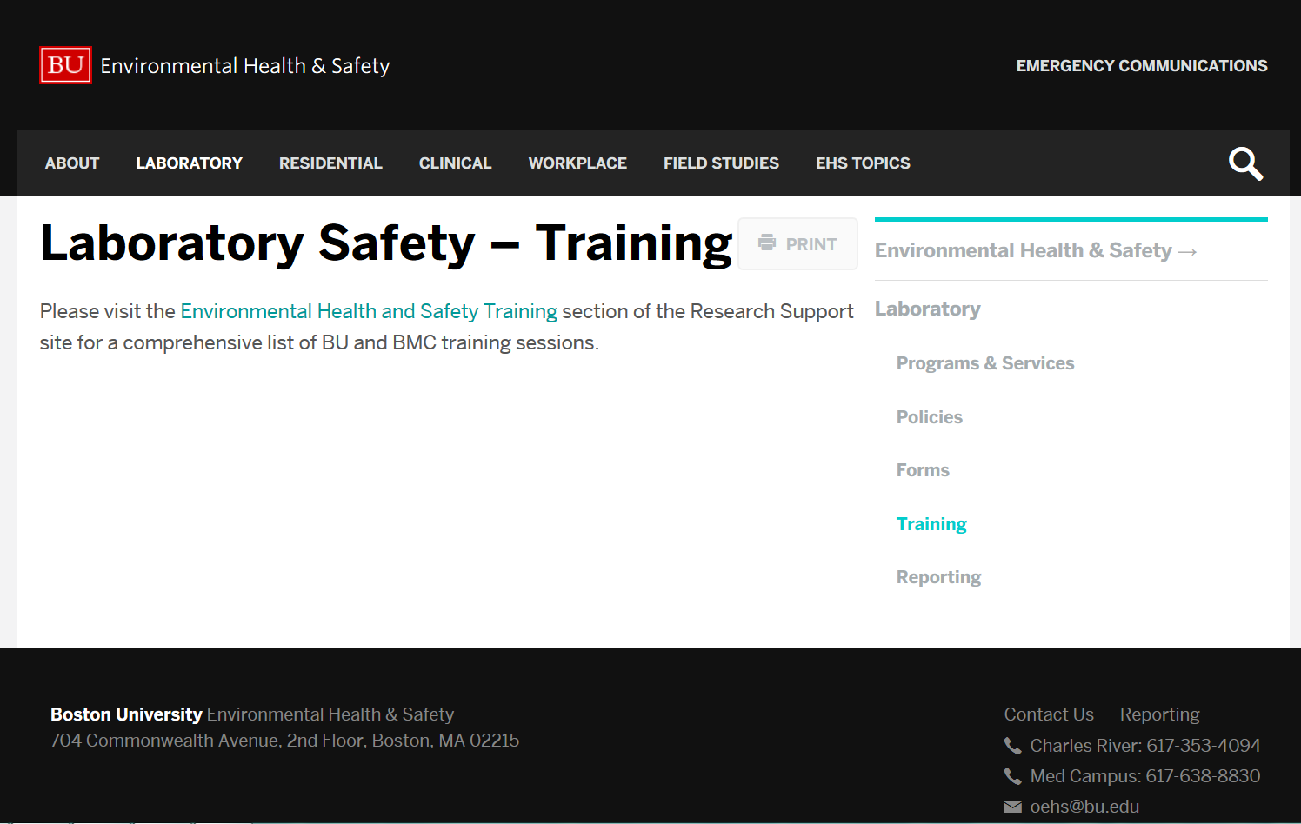
Training
Currently, this page directs users to the Research Support Website.
All training related to Lab Safety can be found in BioRAFT.
Training is located at bu.bioraft.com

Slide 24
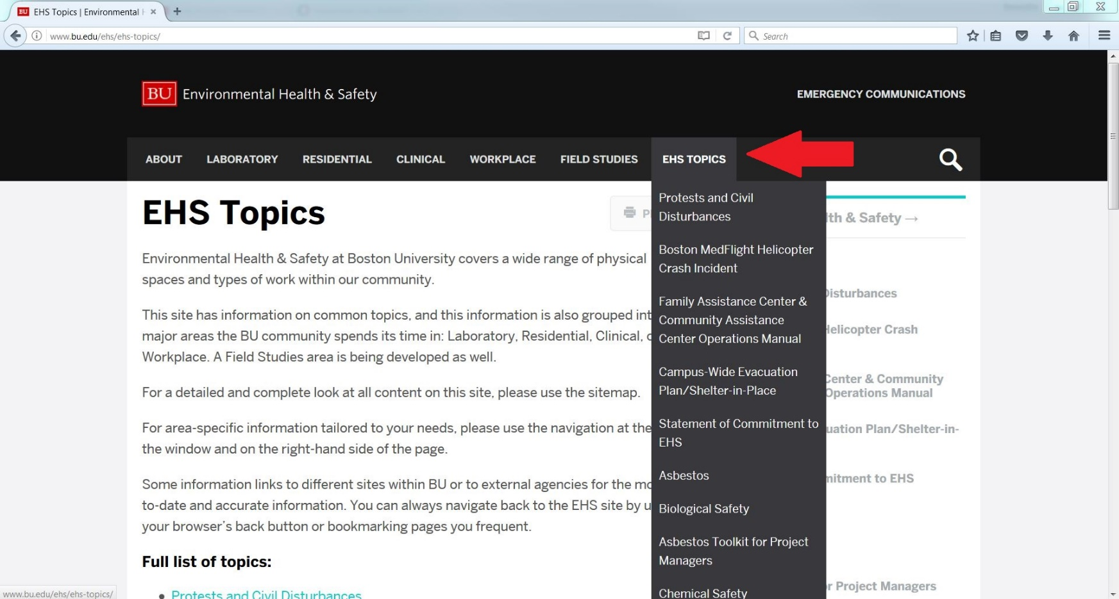
Other options for navigation – EHS Topics

Slide 25
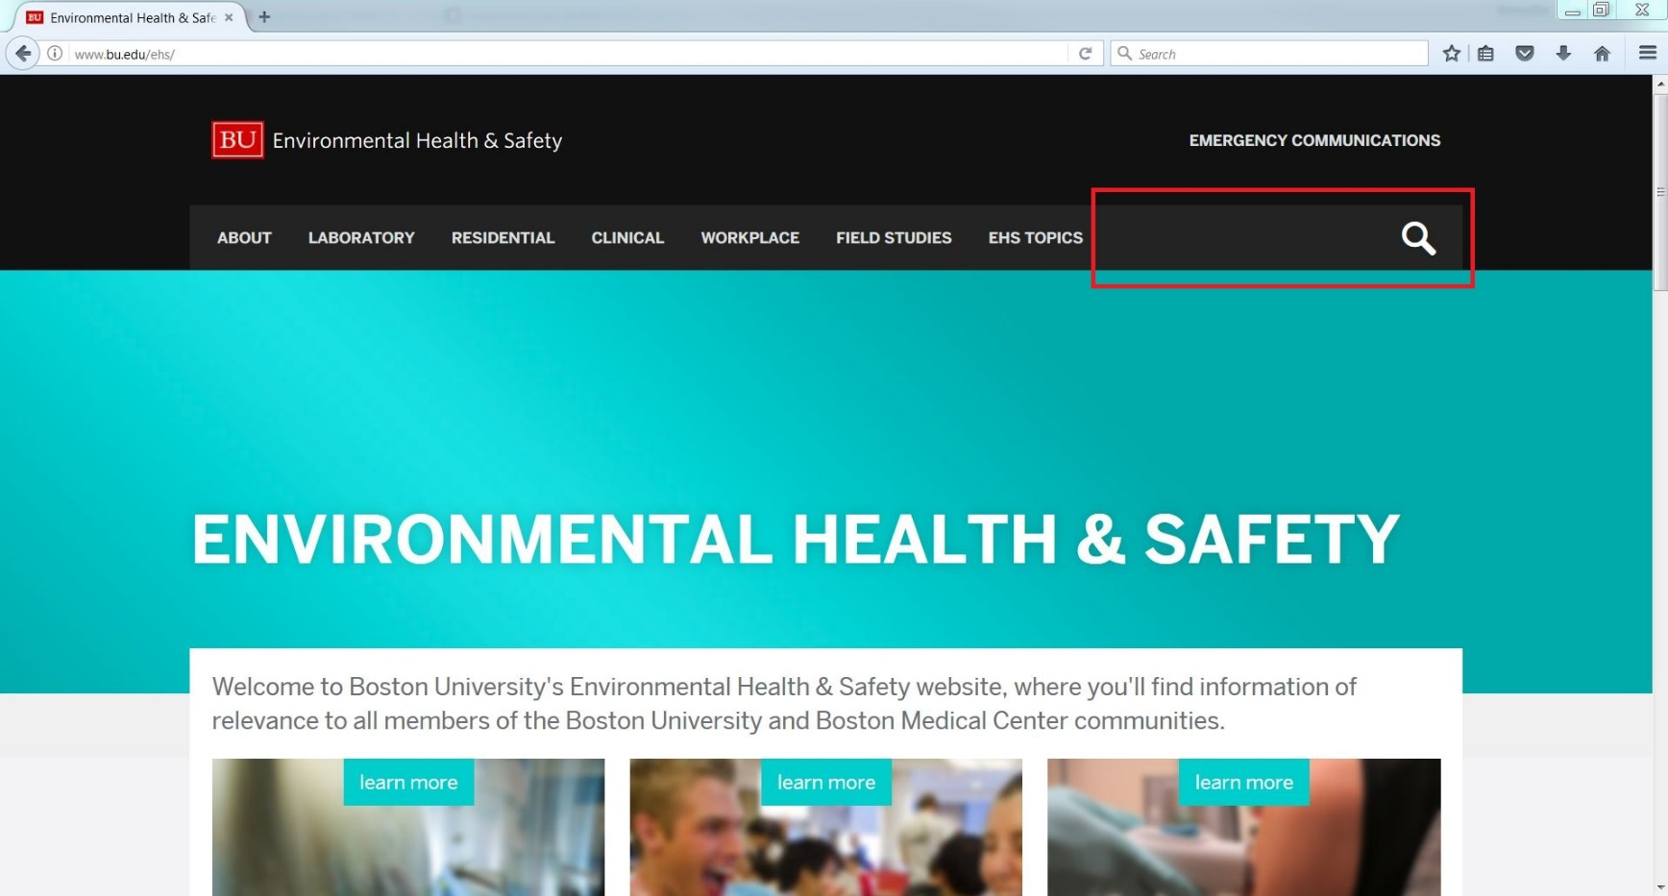
Other options for navigation - Search

Slide 26
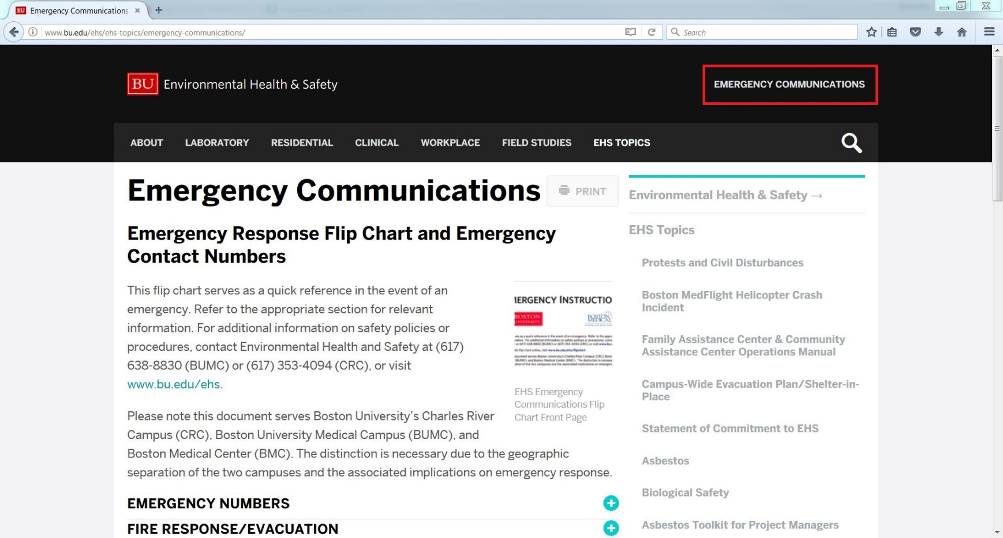
Emergency Communication

Slide 27
A Couple More Things!
If you had bookmarked forms from the old website, update the bookmarks using the new website.
All new forms are HTML, so most can be filled in online directly.
If you’re still not sure where to look or can’t find a form, don’t hesitate to contact our office directly!

Slide 28

Questions?

Slide 29
BioRAFT
Live Demonstration and Update

