Slide 1
Chapter 9:
Economic Fluctuations and Macroeconomic Theory

Slide 2
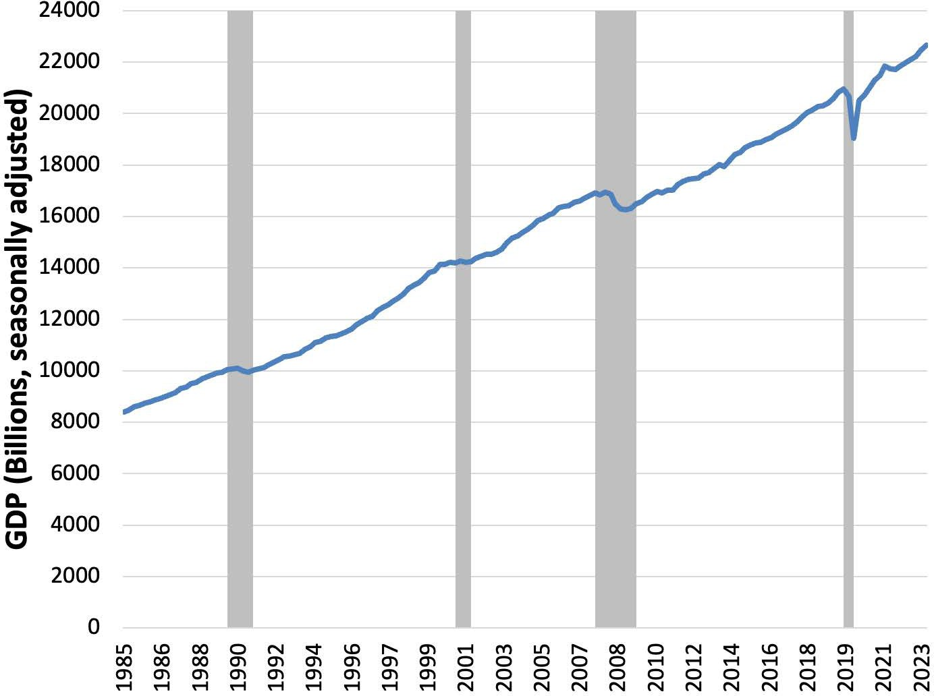
Notes:
Figure 9.1

Slide 3
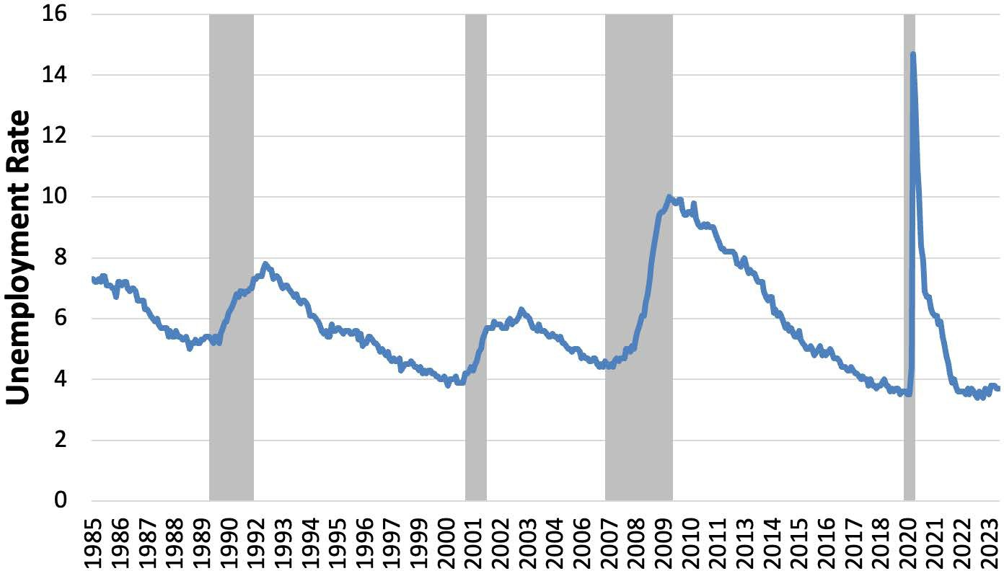
Notes:
Figure 9.2

Slide 4
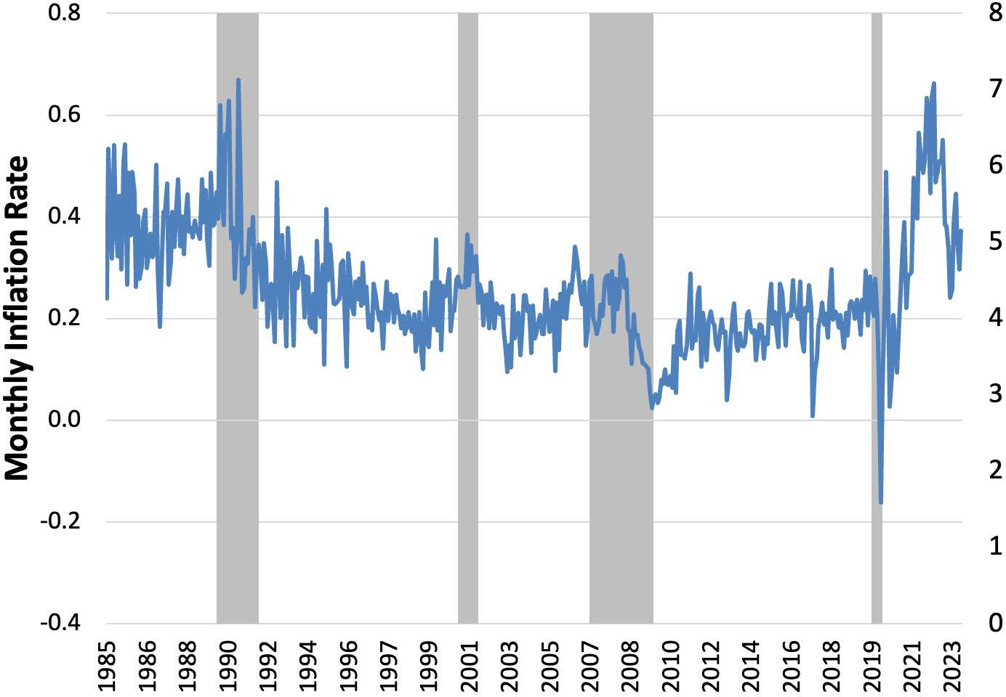
Notes:
Figure 9.3

Slide 5
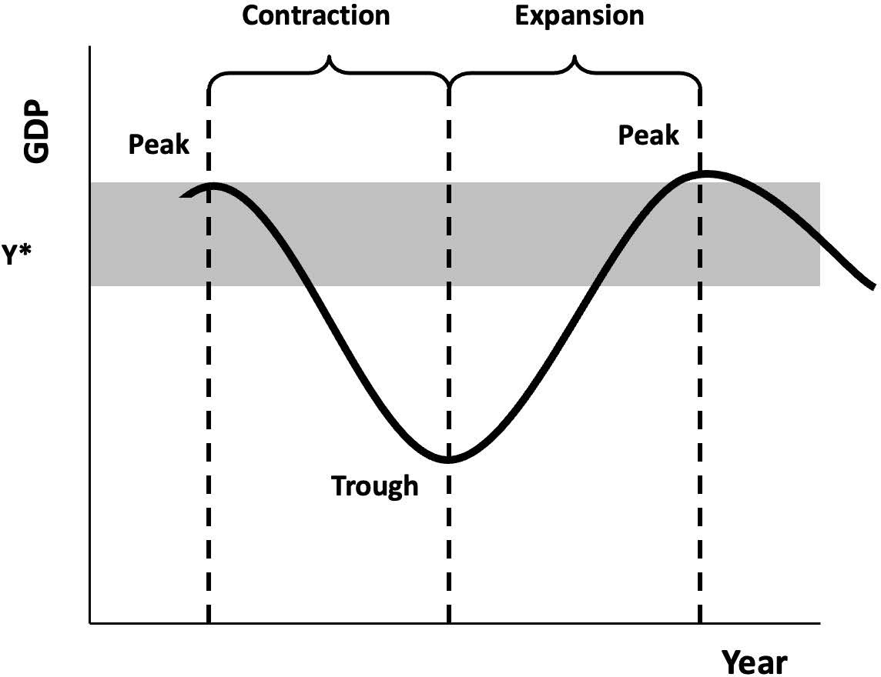
Notes:
Figure 9.4

Slide 6
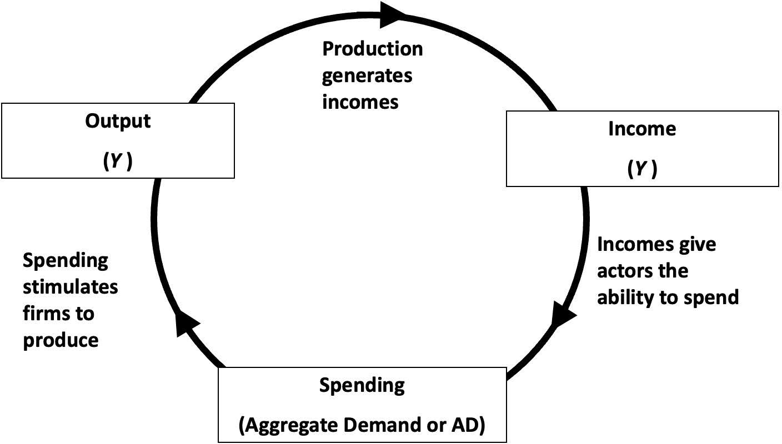
Notes:
Figure 9.5

Slide 7
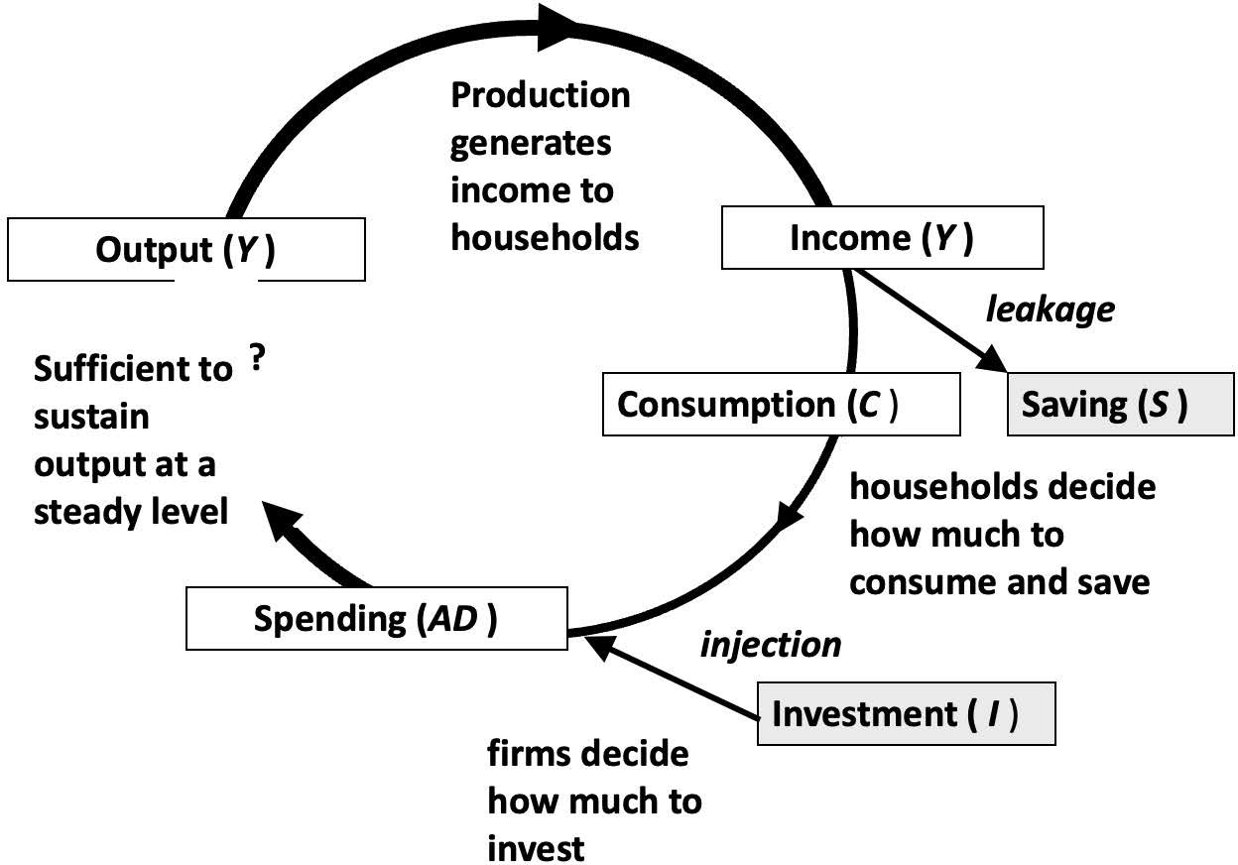
Notes:
Figure 9.6

Slide 8
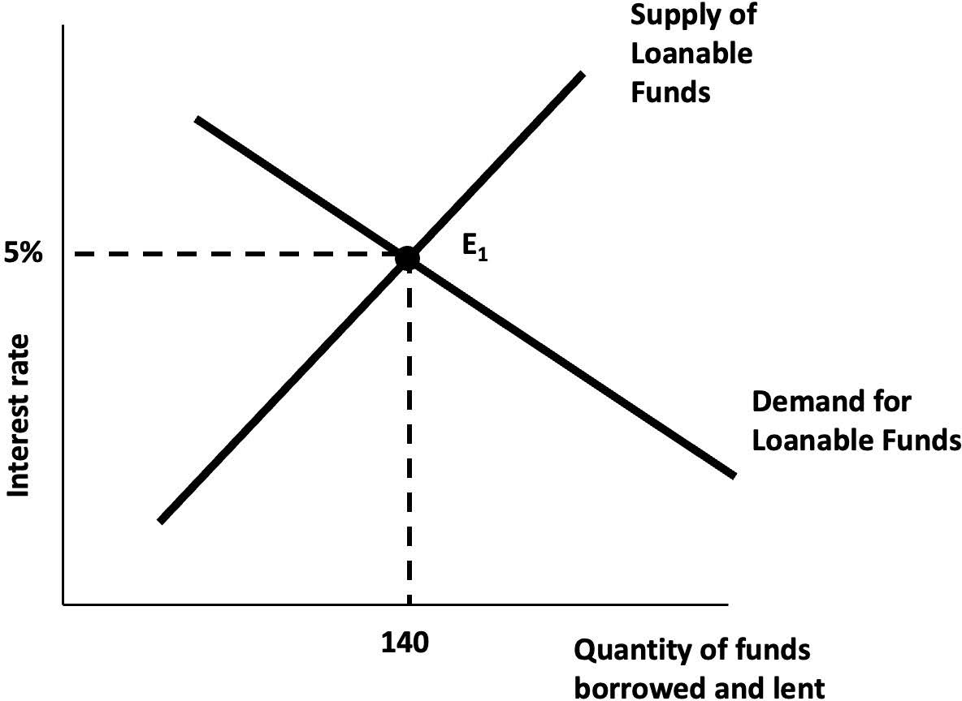
Notes:
Figure 9.7

Slide 9
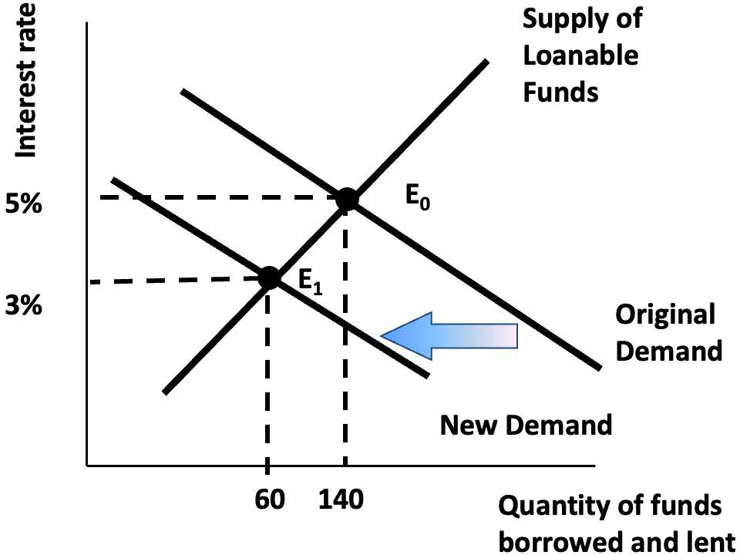
Notes:
Figure 9.8

Slide 10
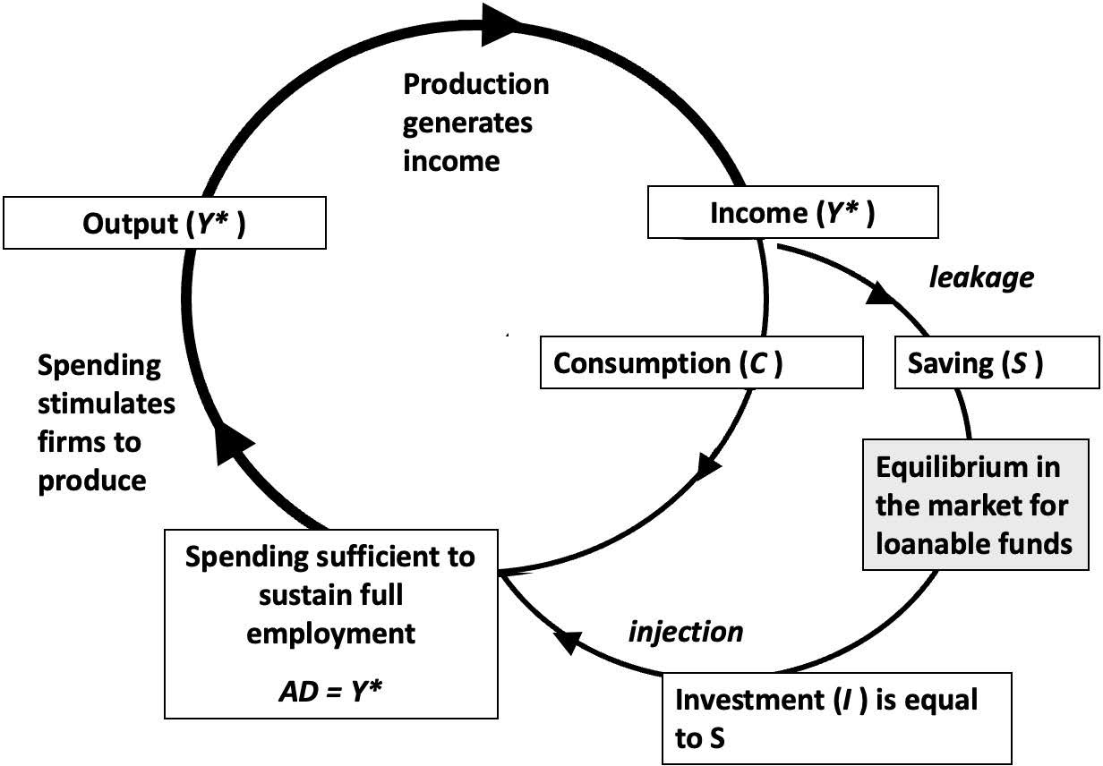
Notes:
Figure 9.9

Slide 11
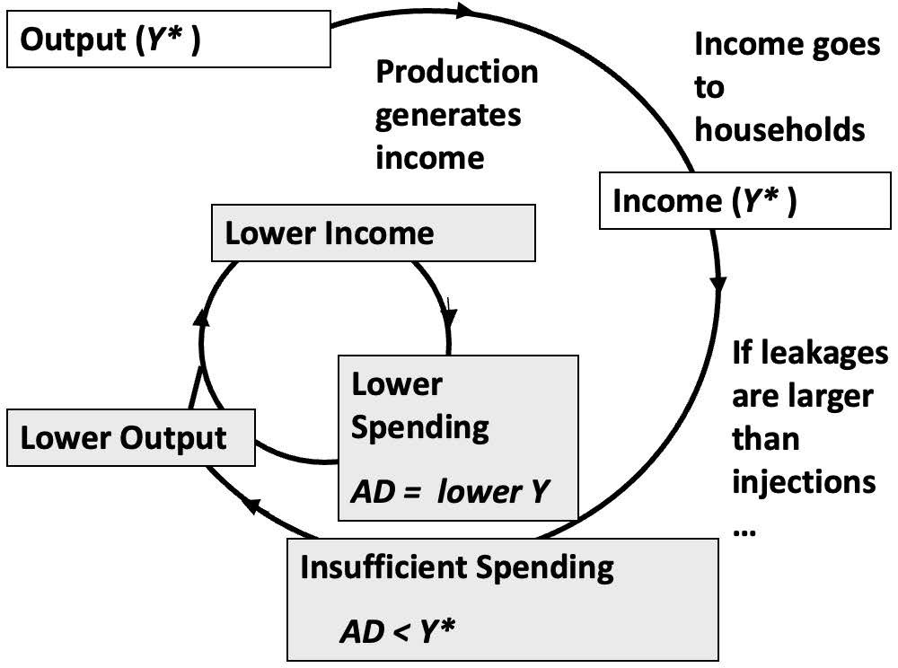
Notes:
Figure 9.10

Slide 12
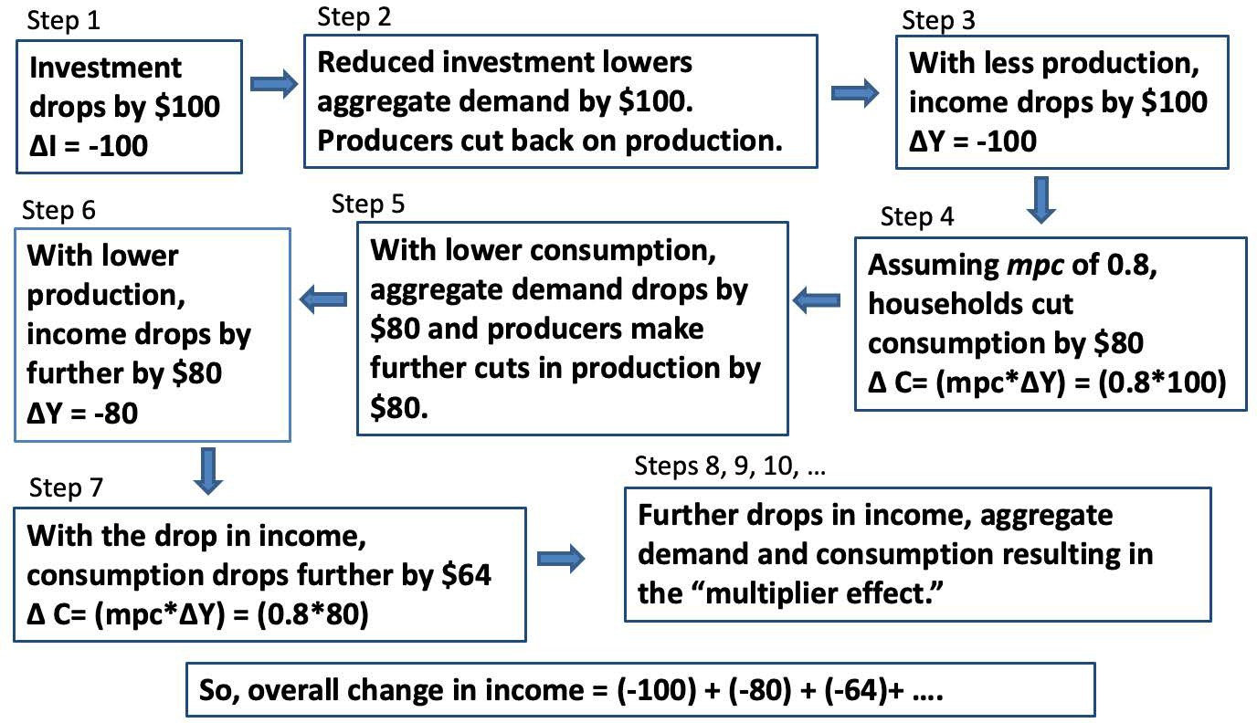
Notes:
Figure 9.11

