Slide 1
Chapter 8:
Macroeconomic Measurement

Slide 2
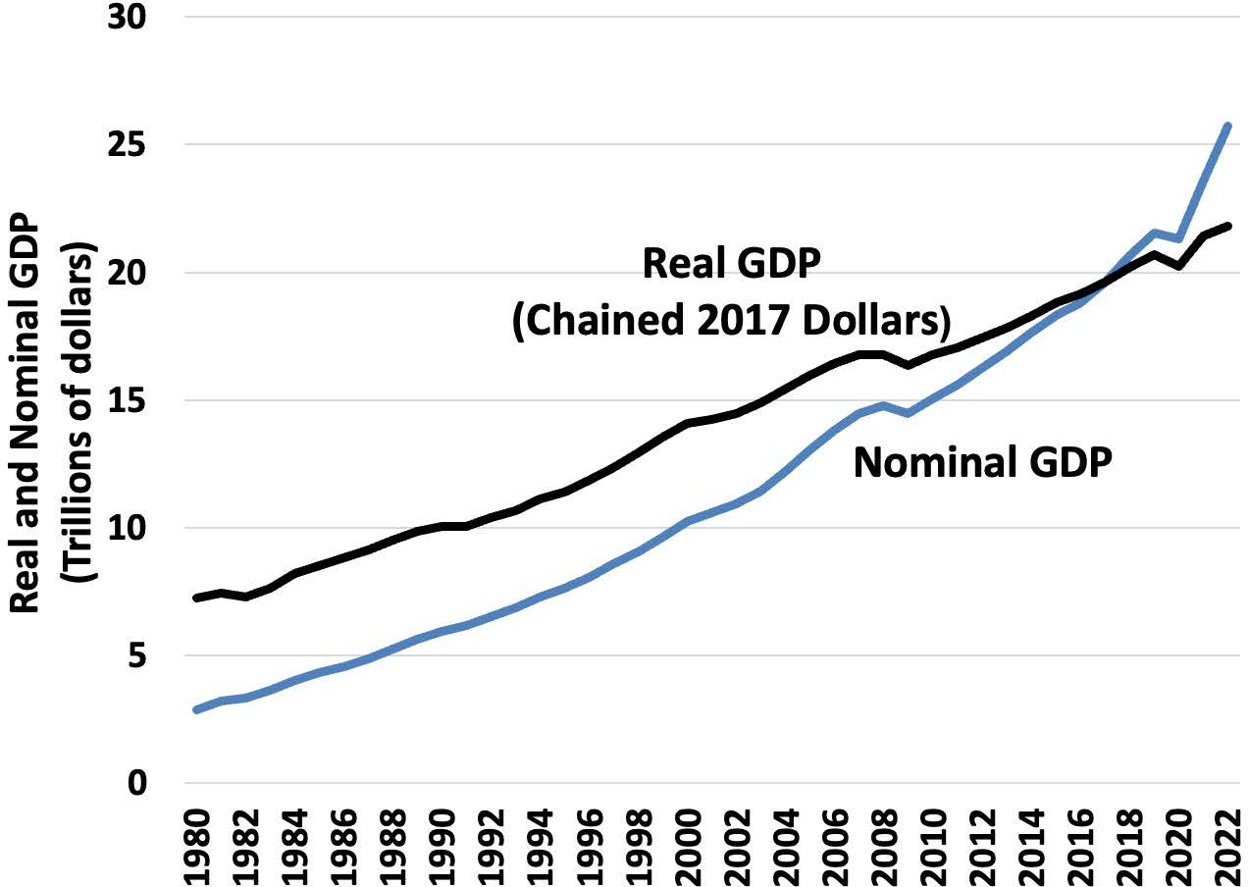
Notes:
Figure 8.1

Slide 3
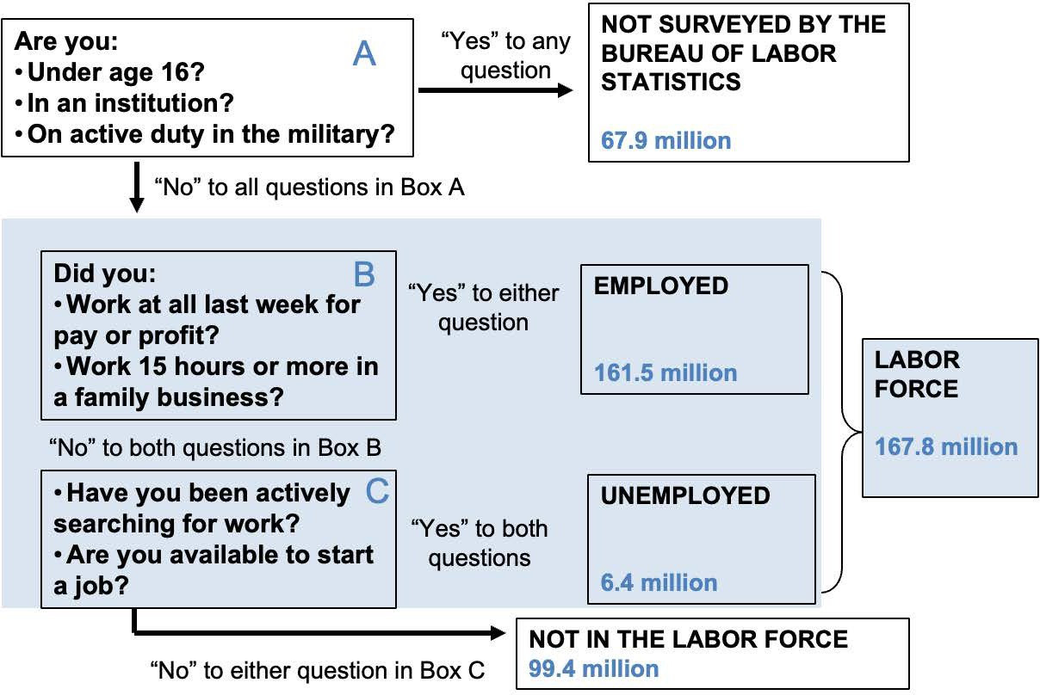
Notes:
Figure 8.2

Slide 4
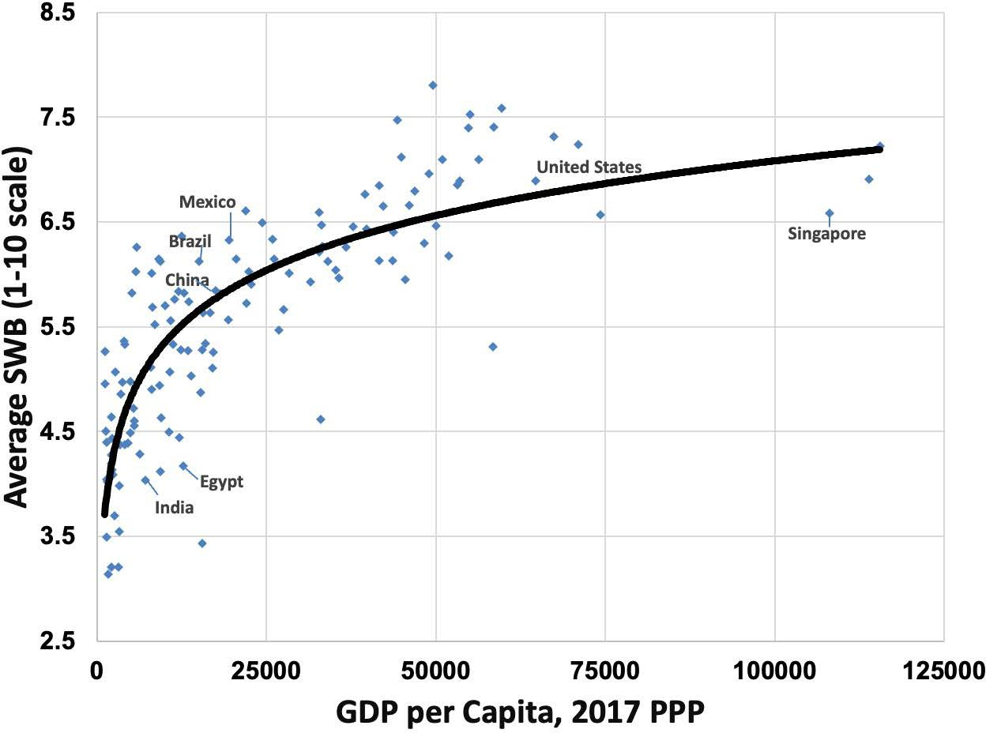
Notes:
Figure 8.3

Slide 5
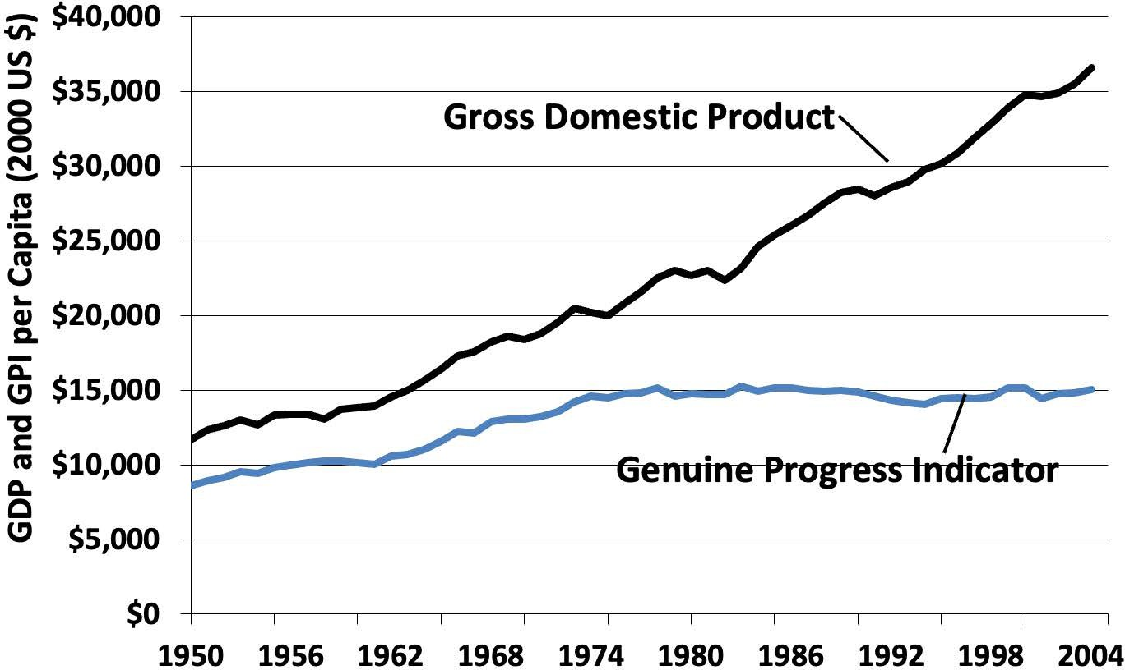
Notes:
Figure 8.4

Slide 6
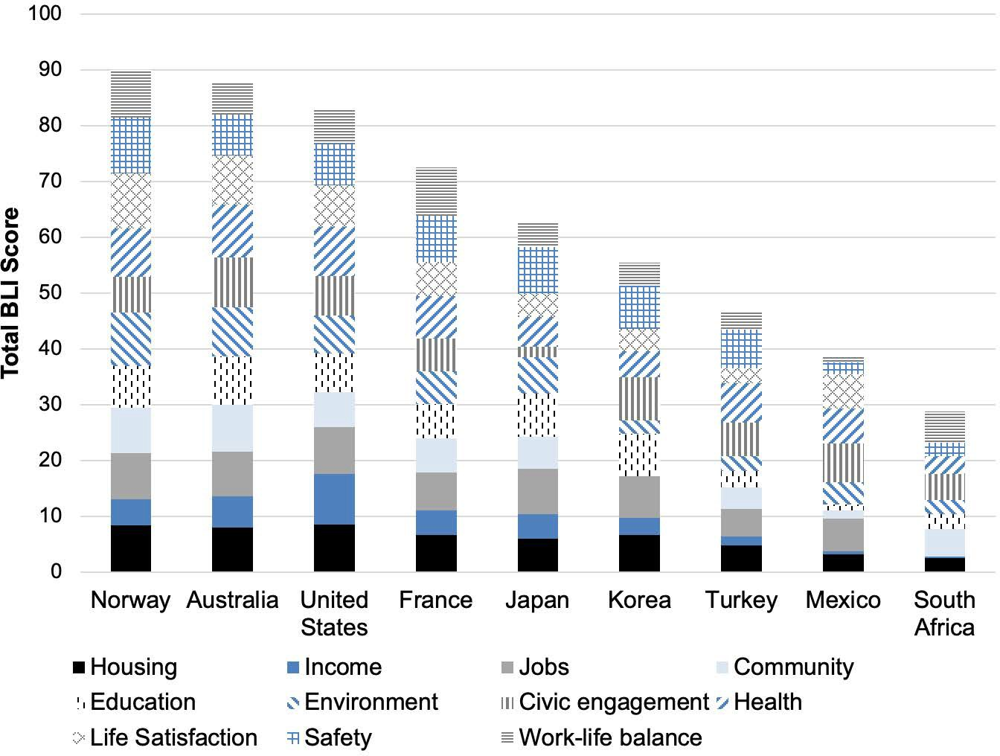
Notes:
Figure 8.5

Slide 7
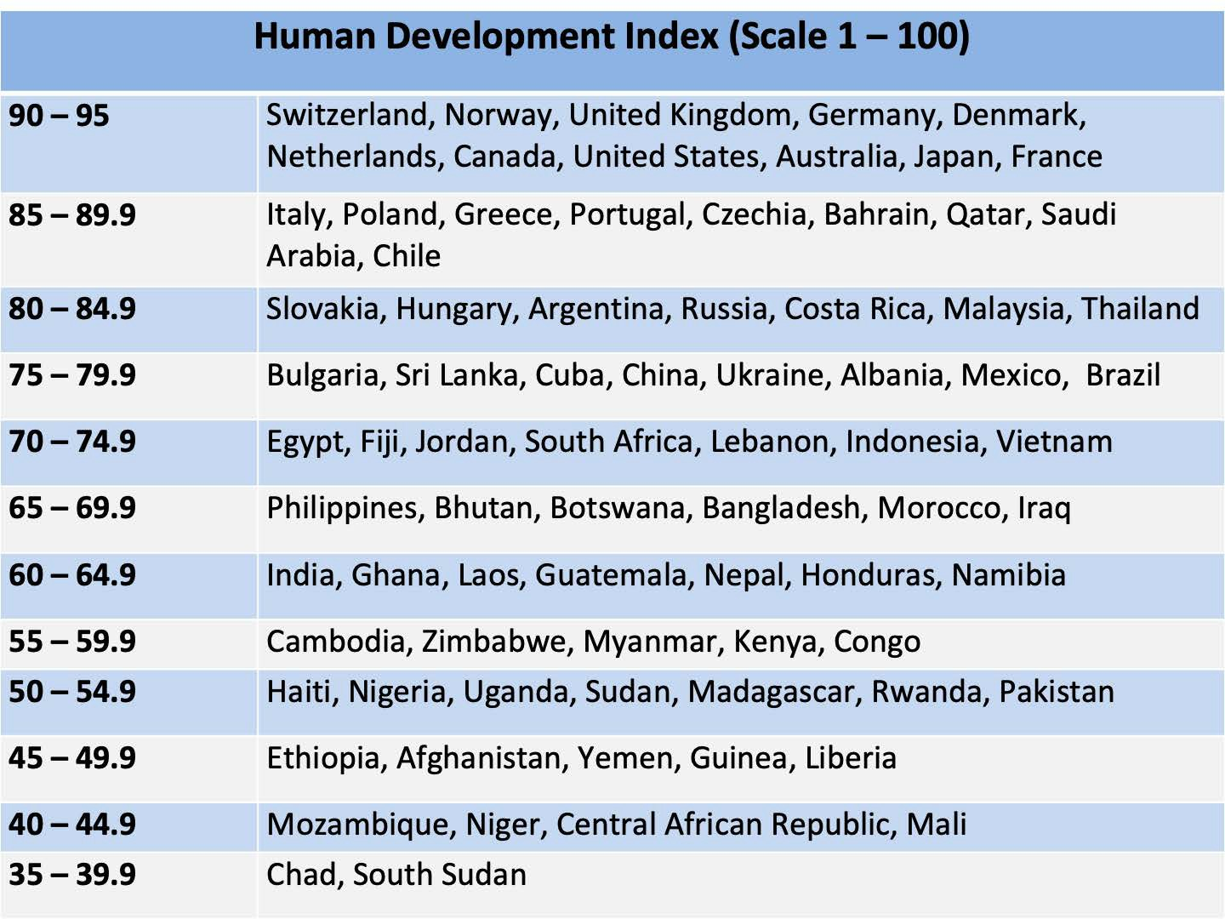
Notes:
Figure 8.6

Slide 8
Table 8.1 Gross Domestic Product, Spending Approach, 2022
Sector and type of spending | Spending by sector (trillions of dollars) | Spending by type (trillions of dollars)
Household and institutions spending (personal consumption expenditures) | 17.51
Durable goods |  | 2.12
Nondurable goods |  | 3.87
Services |  | 11.51
Business spending (gross private domestic investment) | 4.75
Fixed investment |  | 4.59
Change in private inventories |  | 0.15
Government spending (government consumption expenditures and gross investment) | 4.44
Federal |  | 1.63
State and local |  | 2.81
Net foreign sector spending (net exports of goods and services) | 0.97
Exports |  | 2.99
Less: Imports |  | 3.96
Total: Gross domestic product | 25.74
Notes:
Table 8.1 Gross Domestic Product, Spending Approach, 2022

