Slide 1
Chapter 7:
Markets for Labor

Slide 2
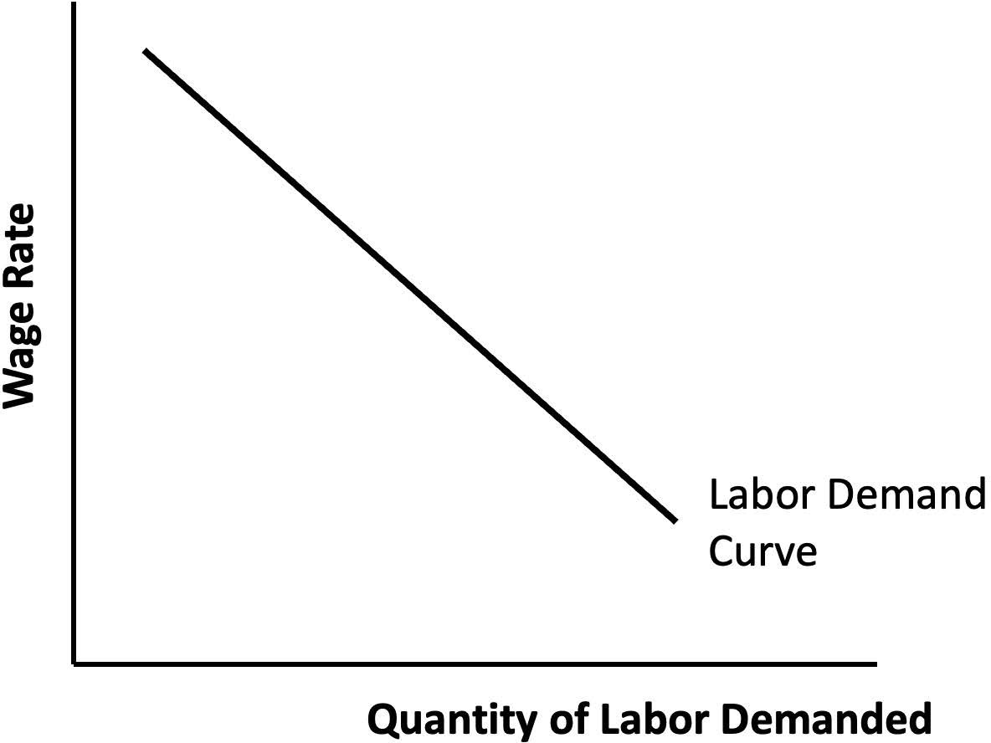
Notes:
Figure 7.1

Slide 3
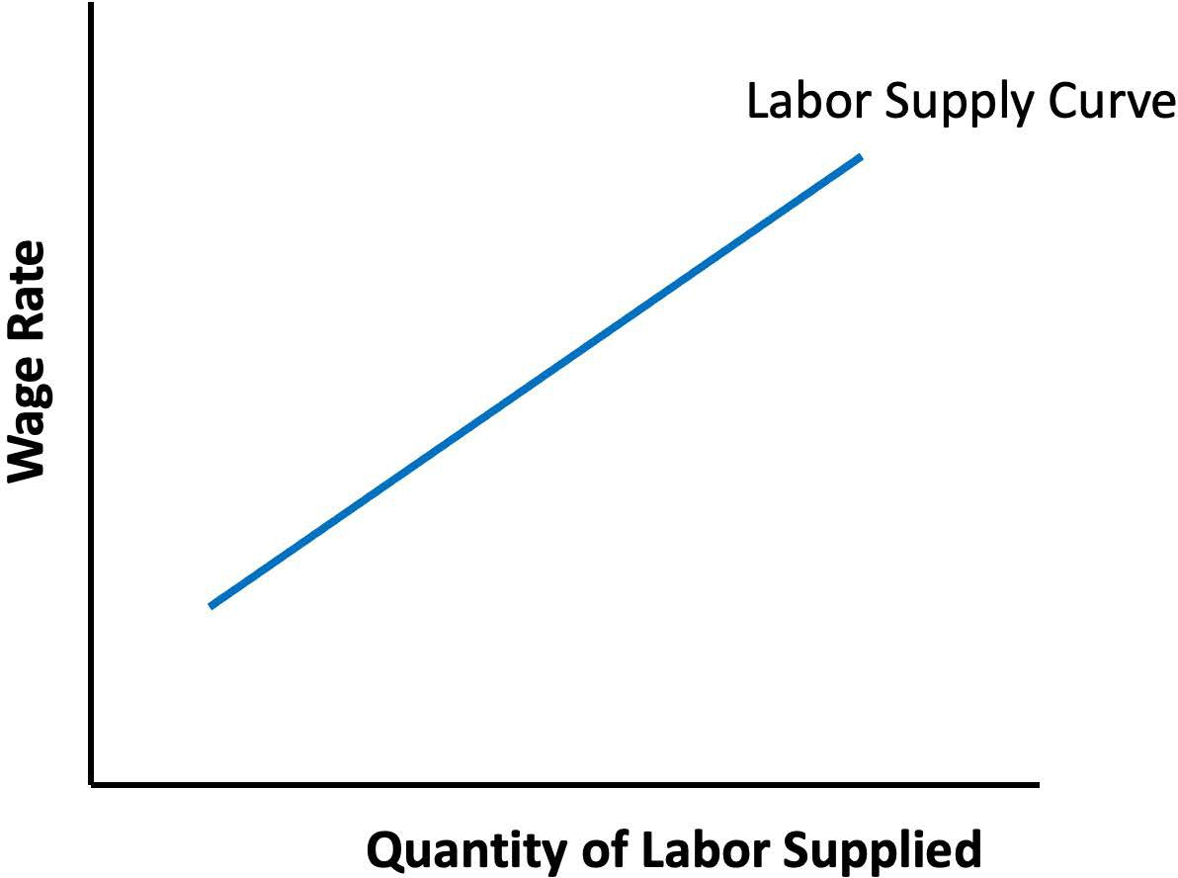
Notes:
Figure 7.2

Slide 4
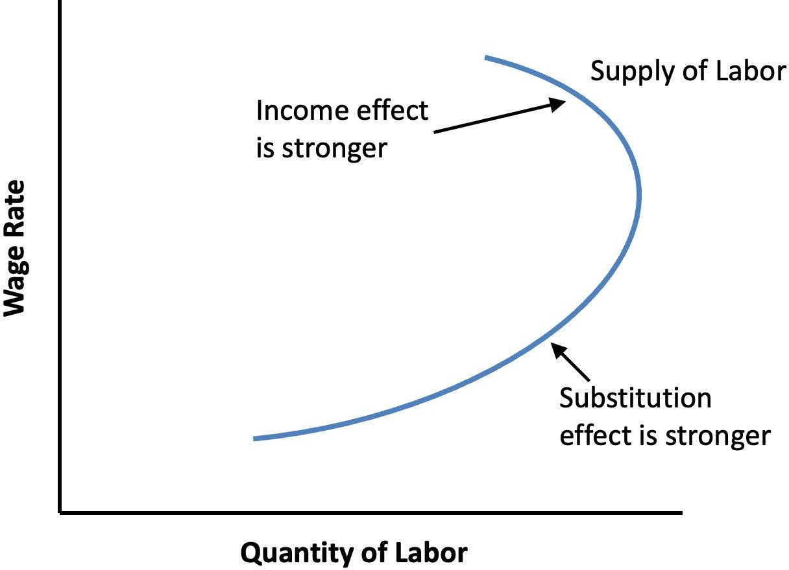
Notes:
Figure 7.3

Slide 5
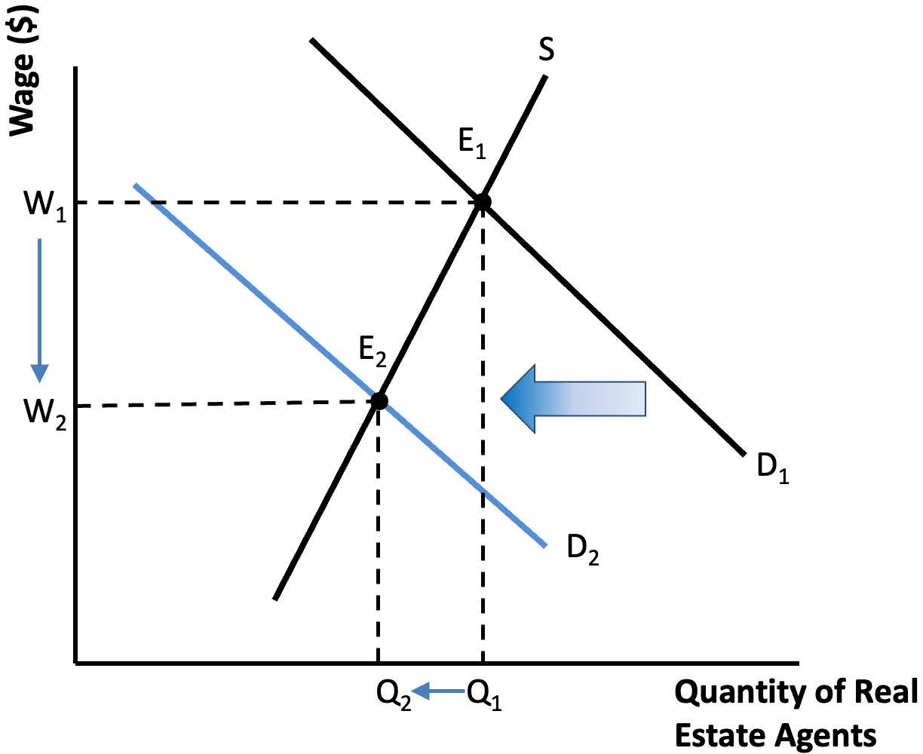
Notes:
Figure 7.4

Slide 6
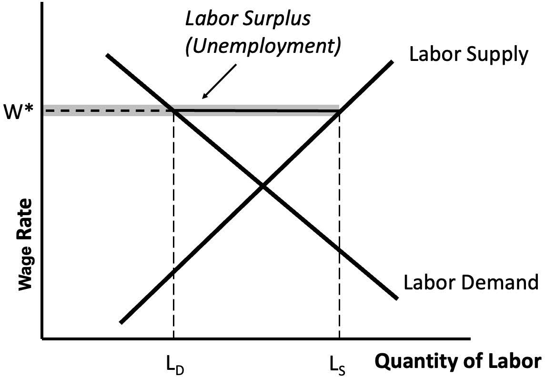
Notes:
Figure 7.5

Slide 7
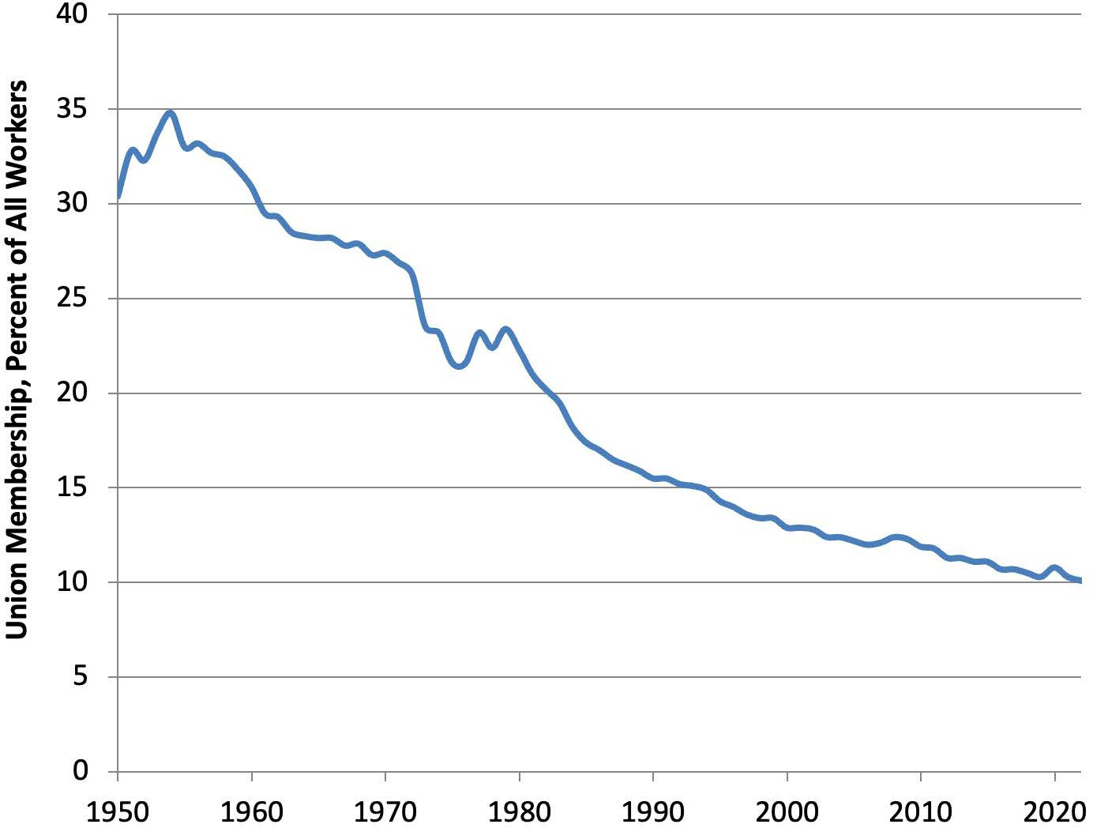
Notes:
Figure 7.6

Slide 8
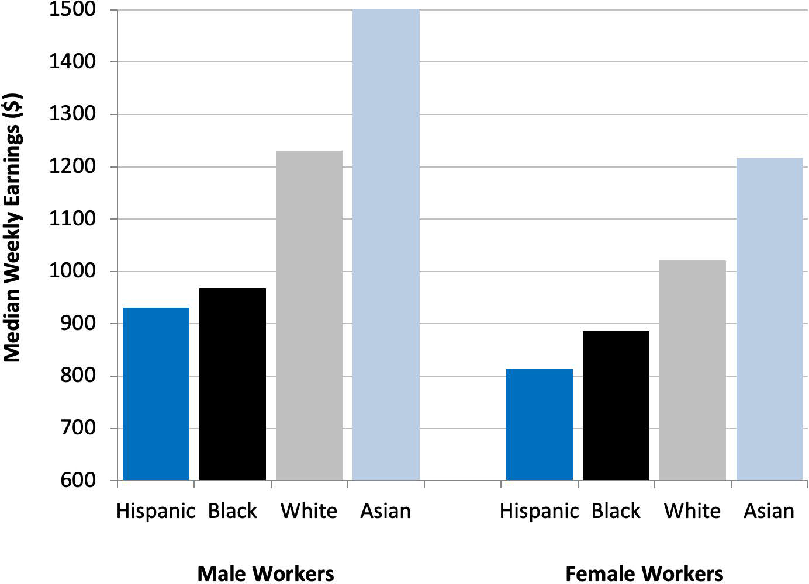
Notes:
Figure 7.7

Slide 9
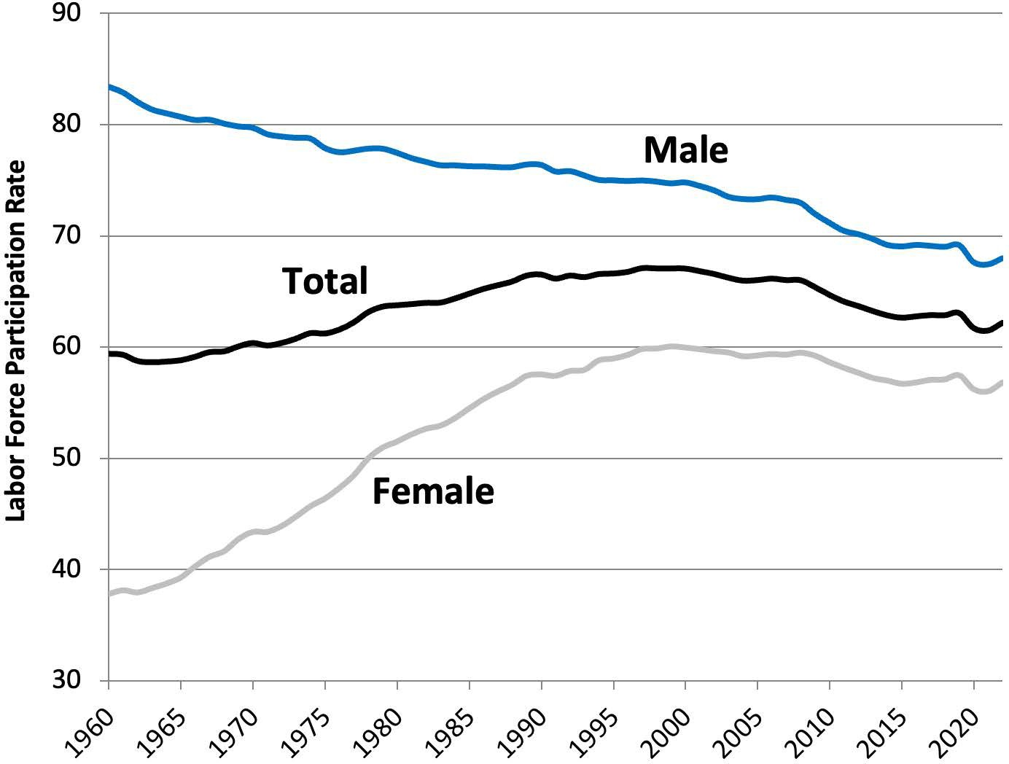
Notes:
Figure 7.8

Slide 10
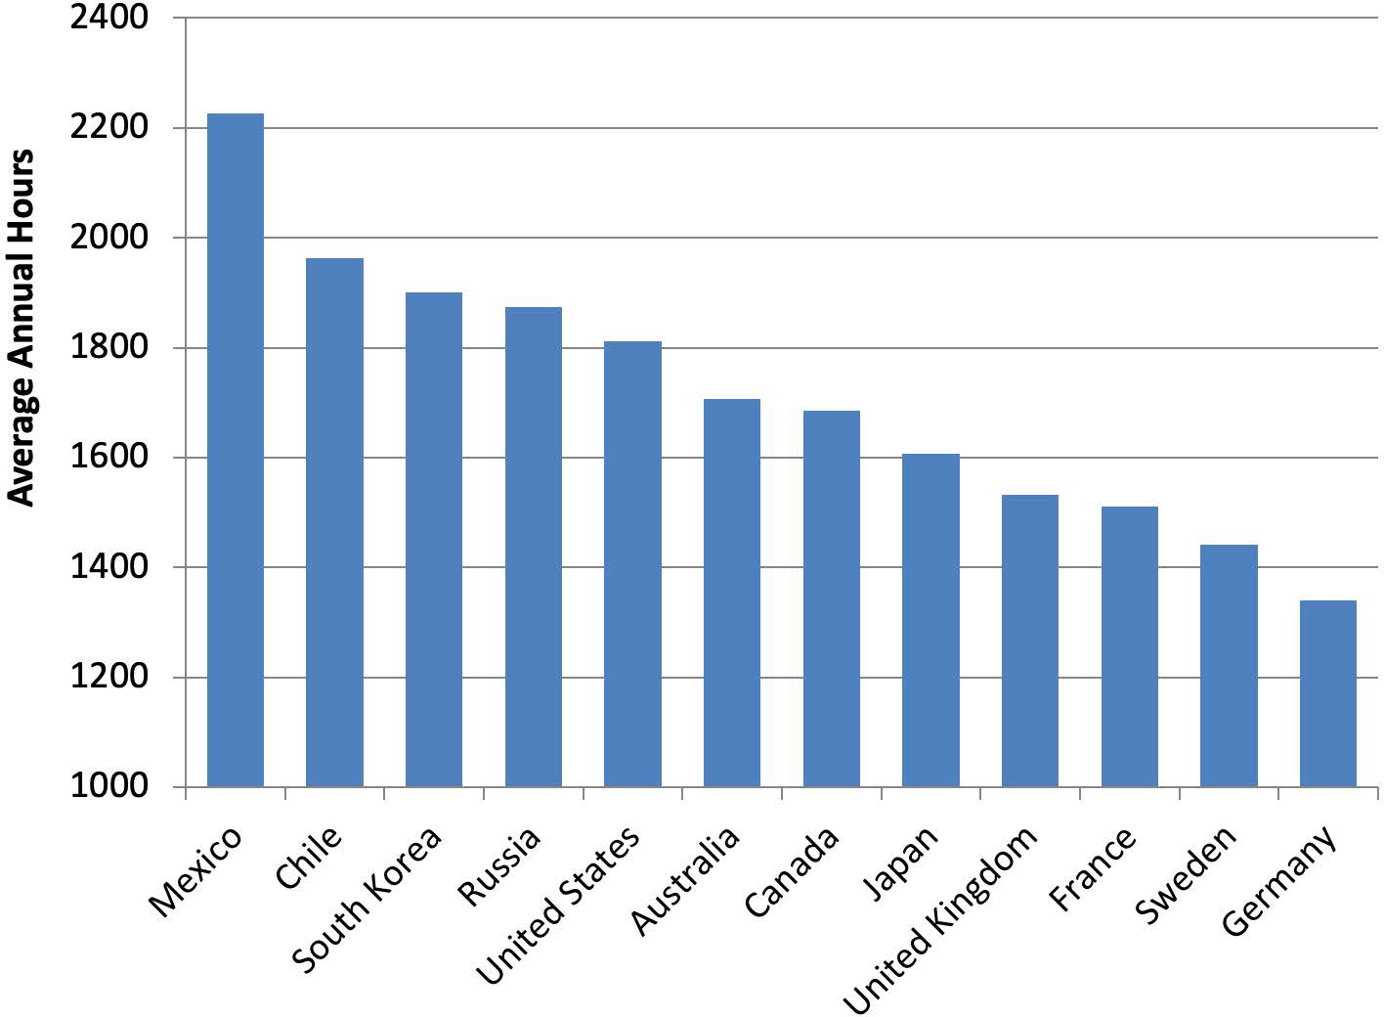
Notes:
Figure 7.9

Slide 11
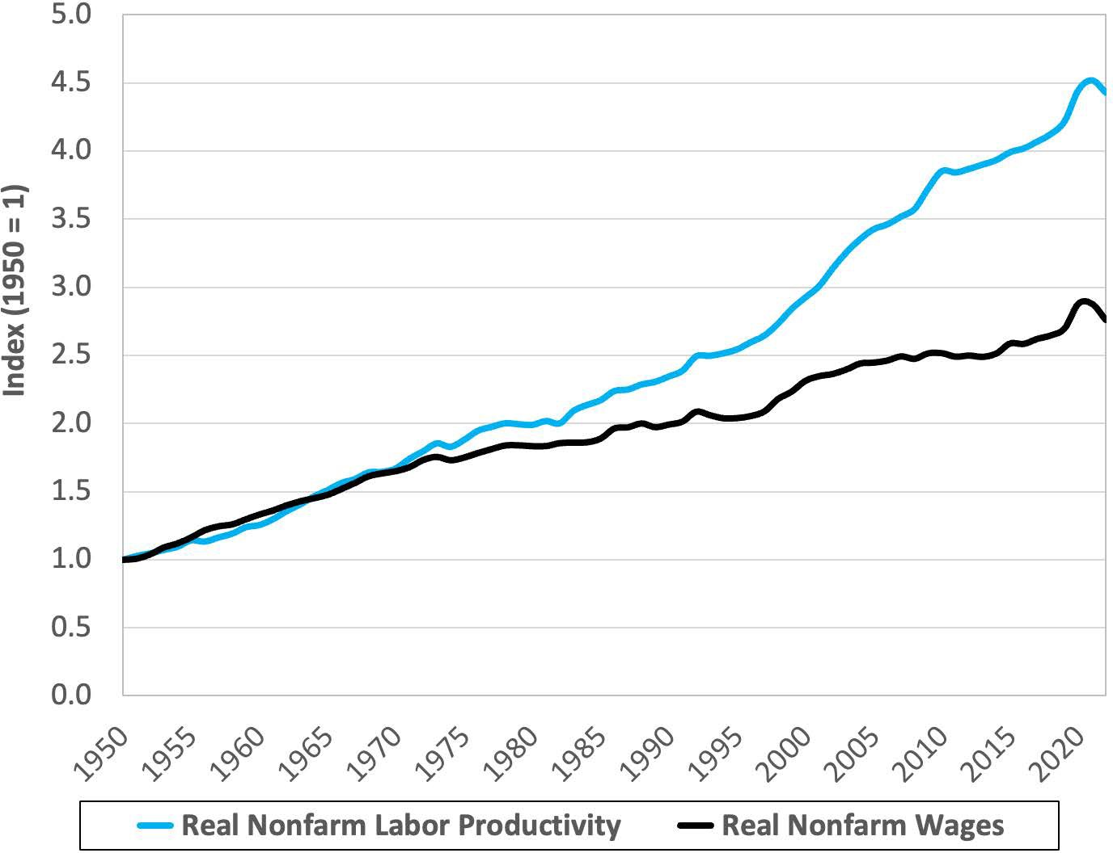
Notes:
Figure 7.10

Slide 12
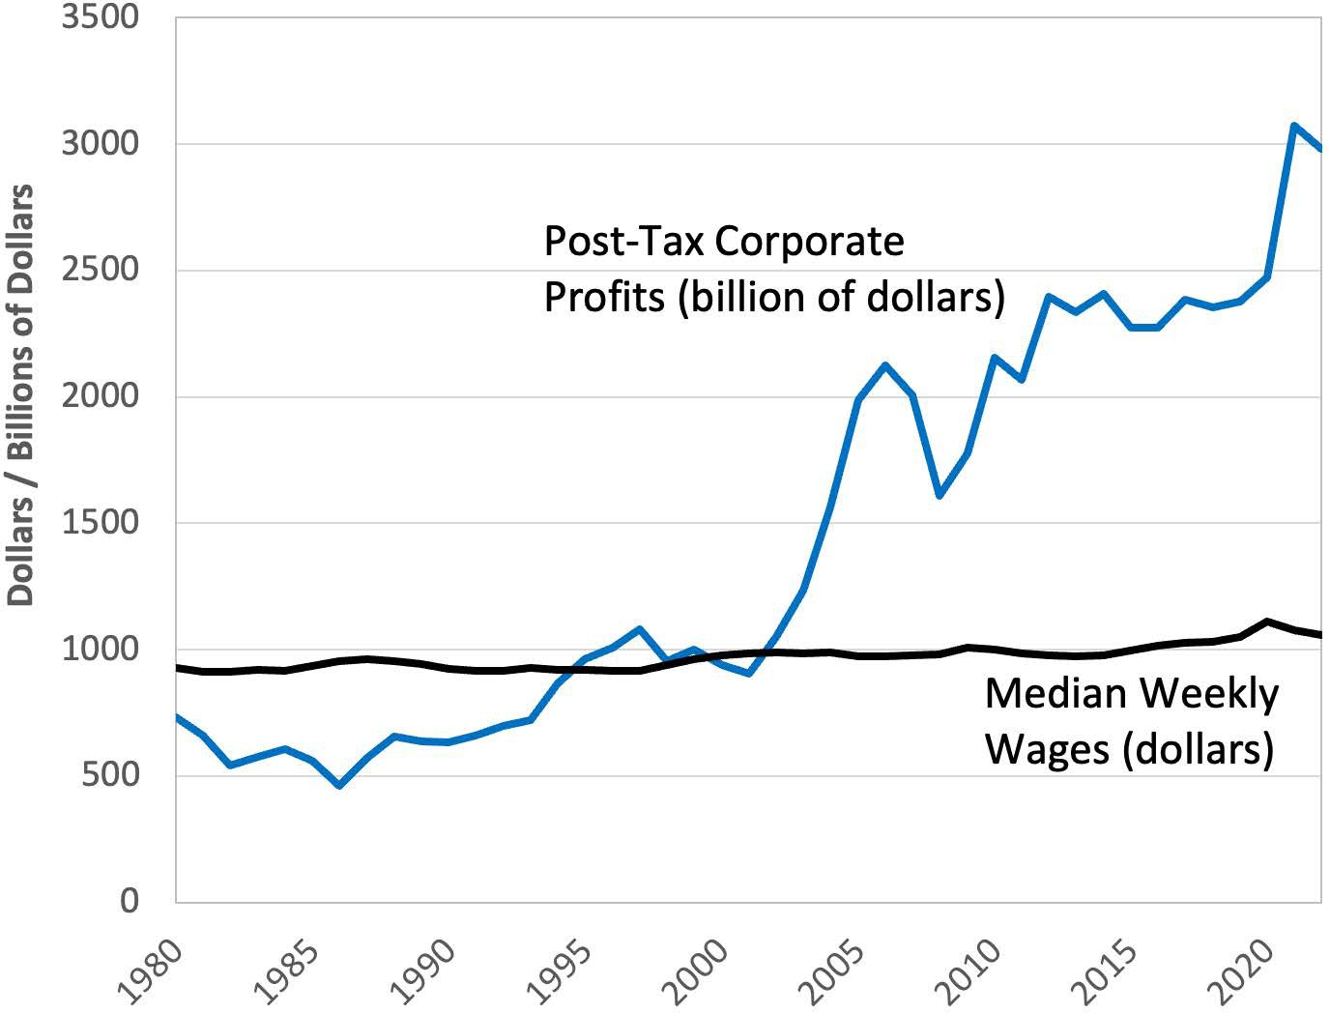
Notes:
Figure 7.11

