Slide 1
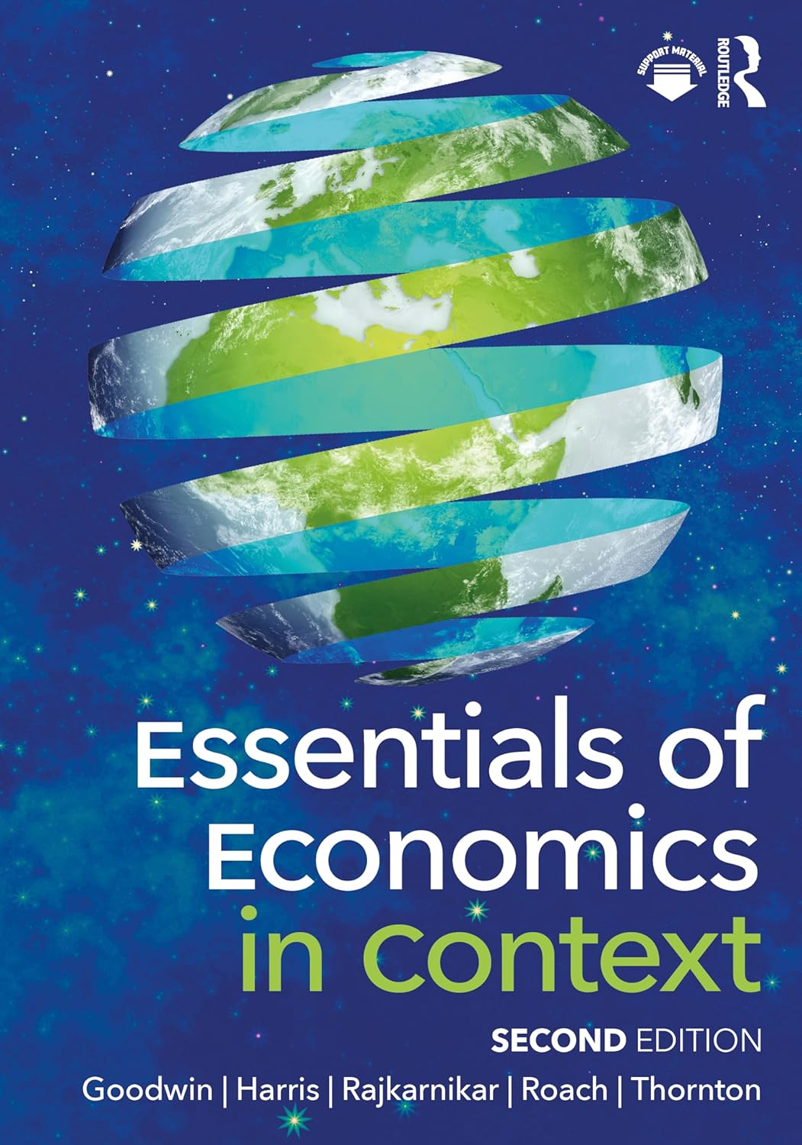
Chapter 6:
Market Structure

Slide 2
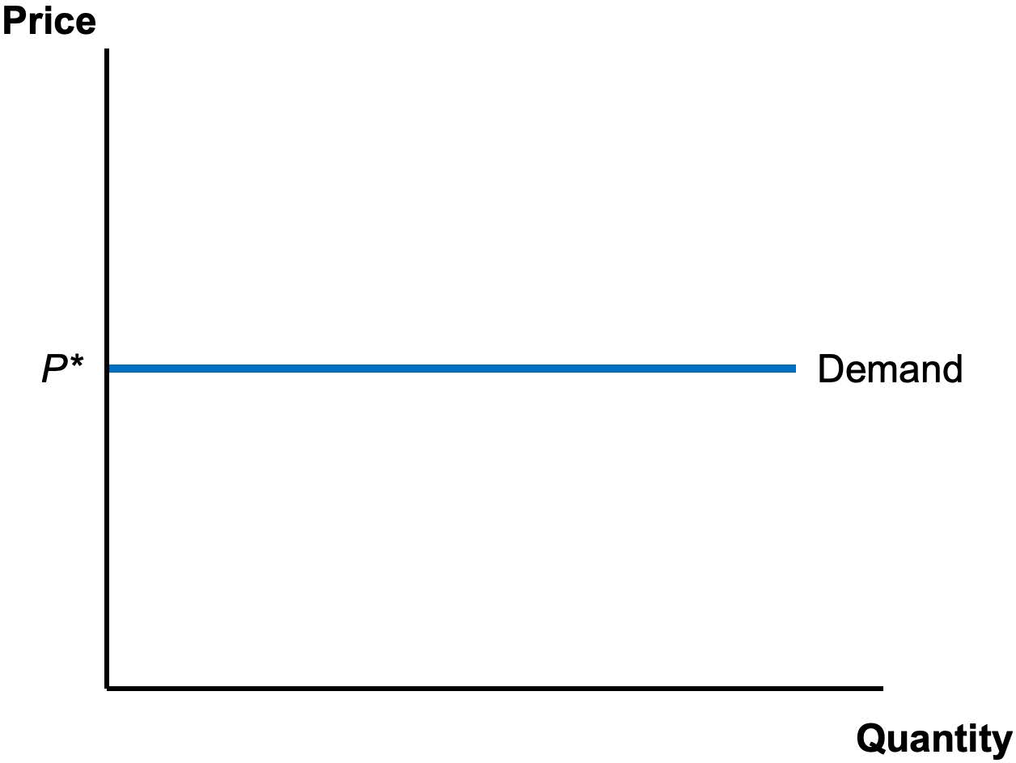
Notes:
Figure 6.1

Slide 3
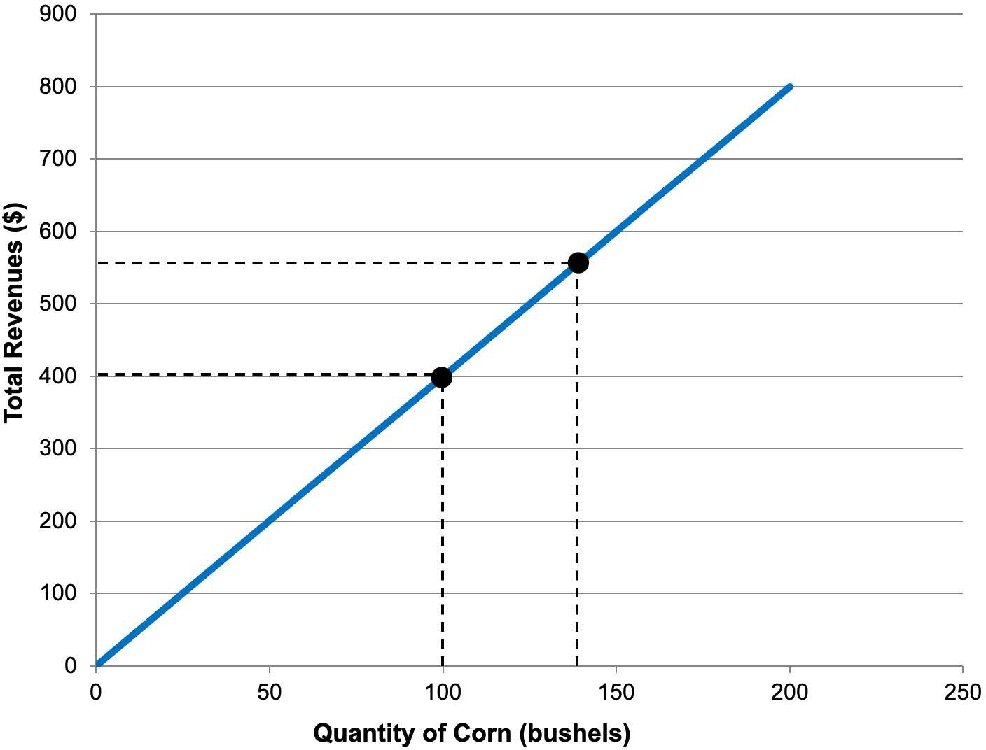
Notes:
Figure 6.2

Slide 4
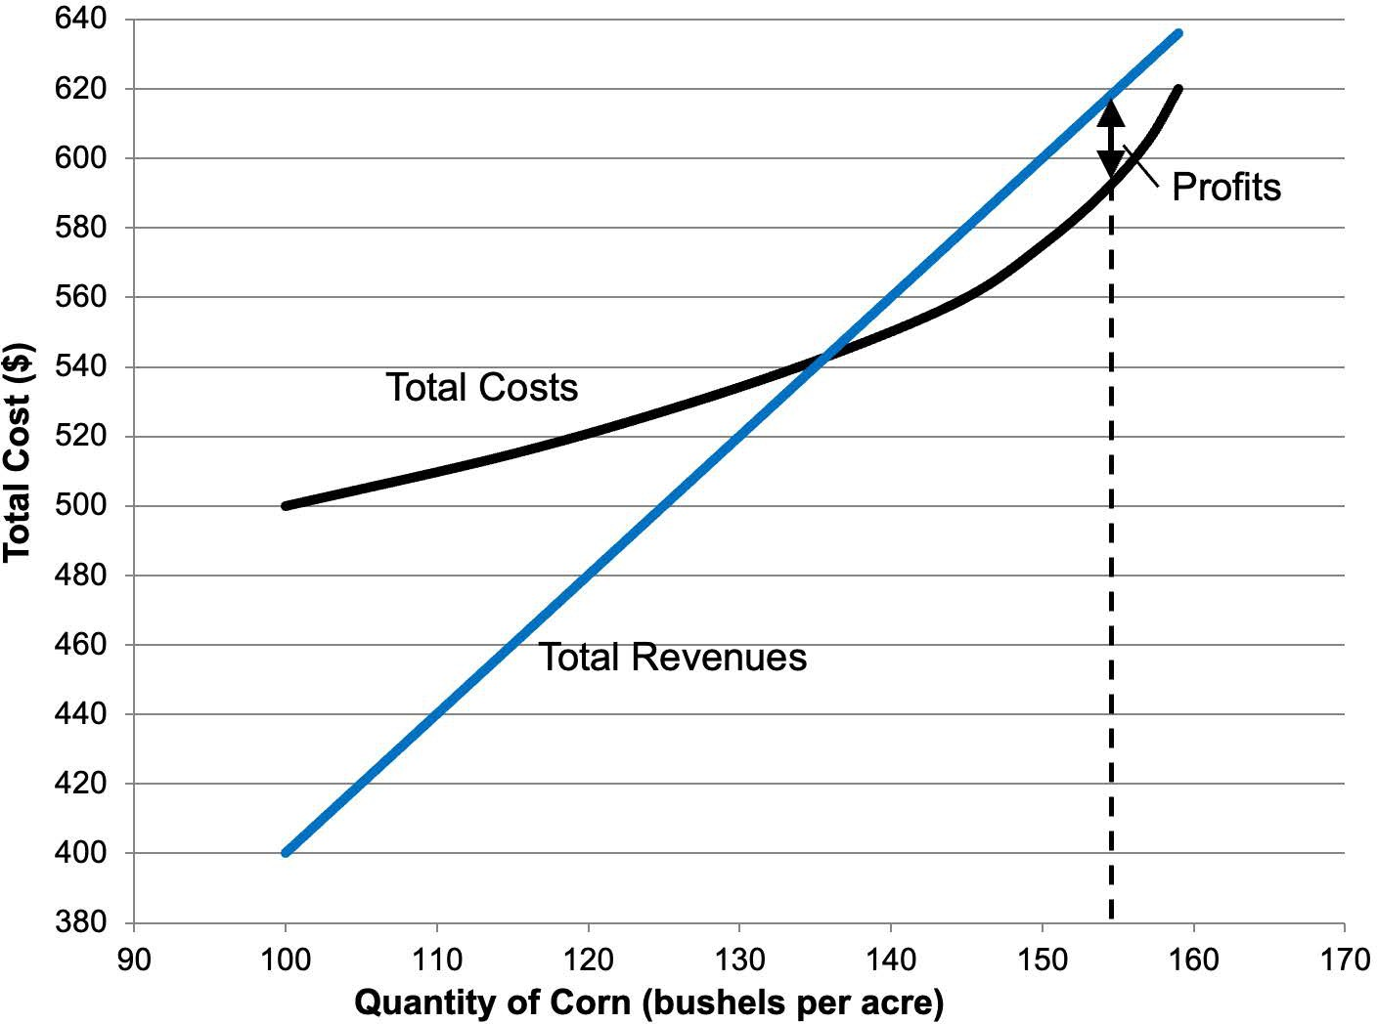
Notes:
Figure 6.3

Slide 5
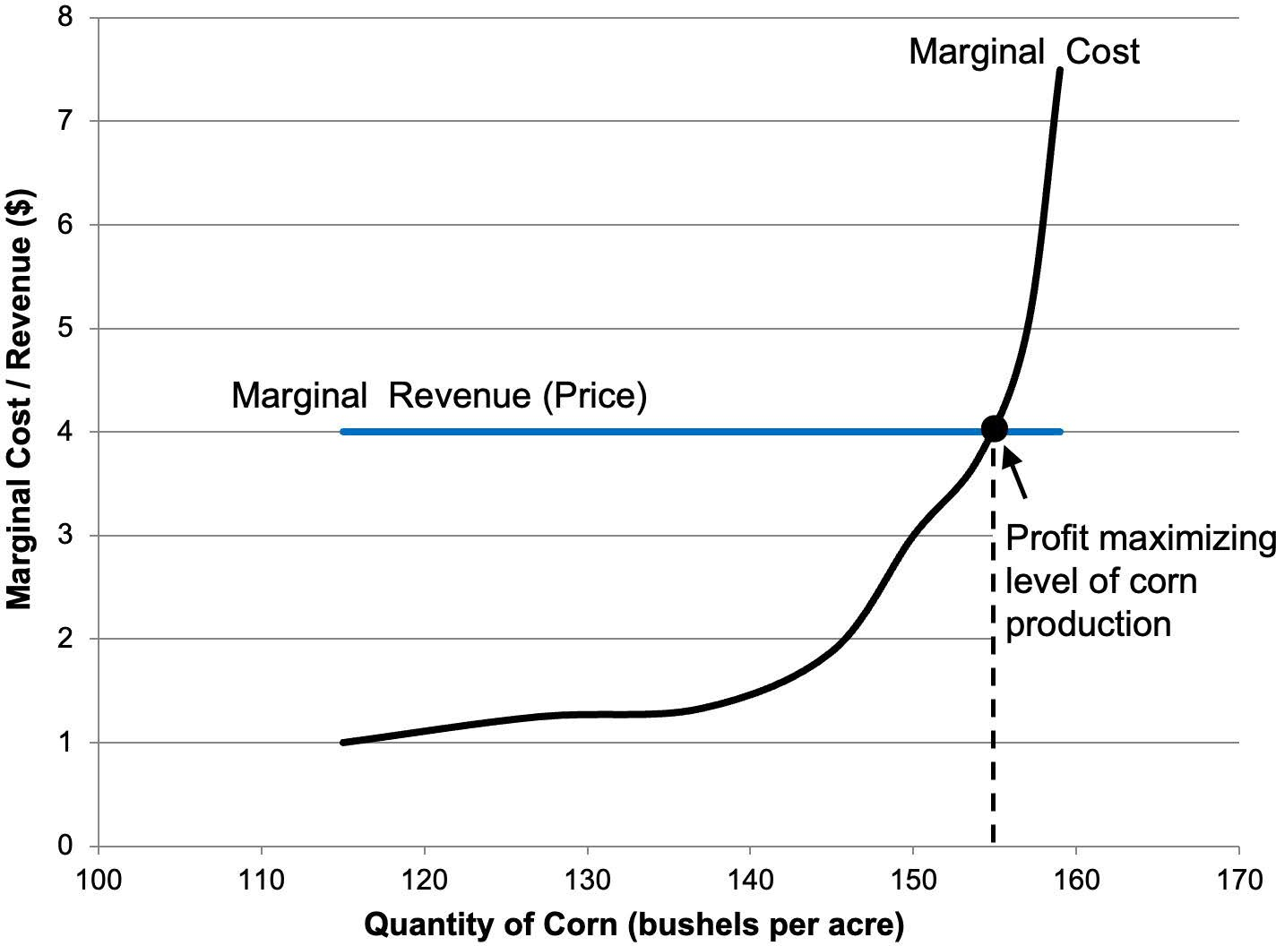
Notes:
Figure 6.4

Slide 6
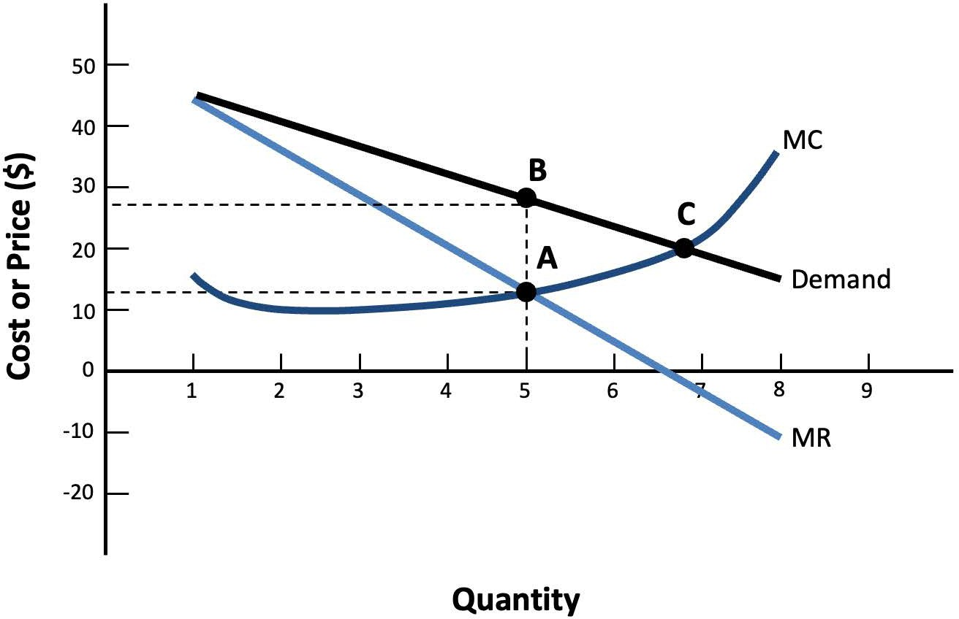
Notes:
Figure 6.5

Slide 7
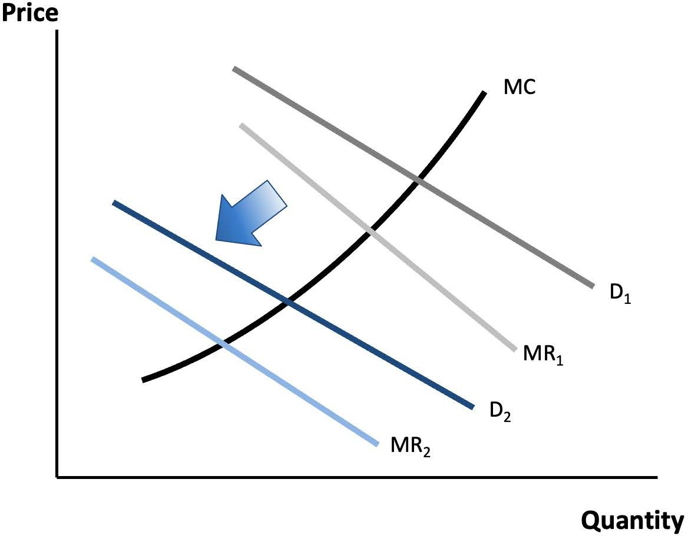
Notes:
Figure 6.6

Slide 8
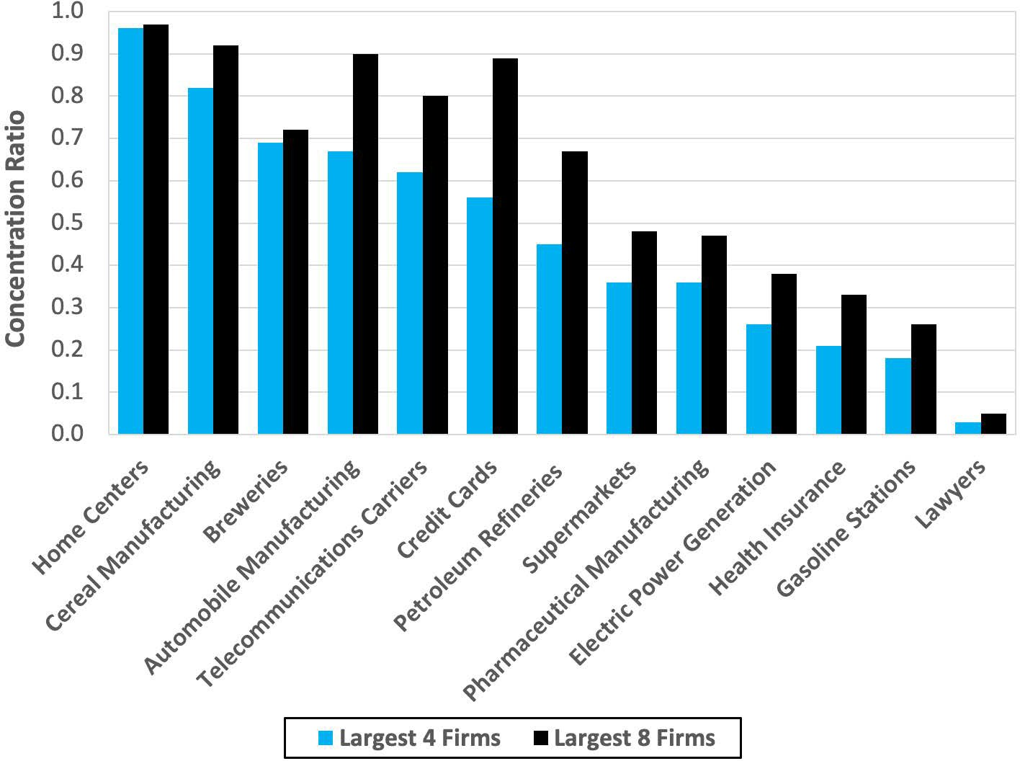
Notes:
Figure 6.7

Slide 9
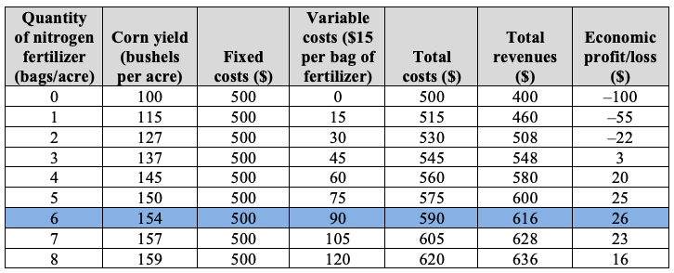
Table 6.1 Profit Maximization, Based on Analysis of Total Costs and Total Revenues

Slide 10
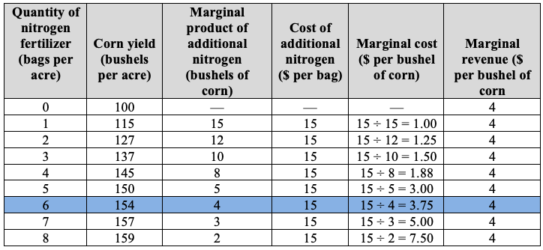
Table 6.2 Profit Maximization, Based on Analysis of Marginal Costs and Marginal Revenues

Slide 11
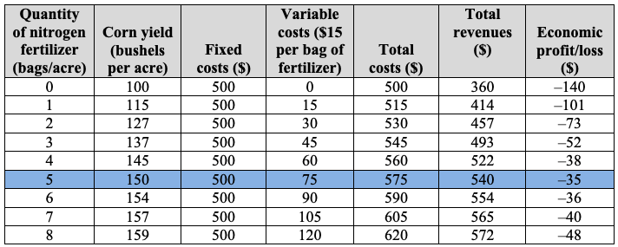
Table 6.3 Impact of a Decrease in Corn Prices

Slide 12
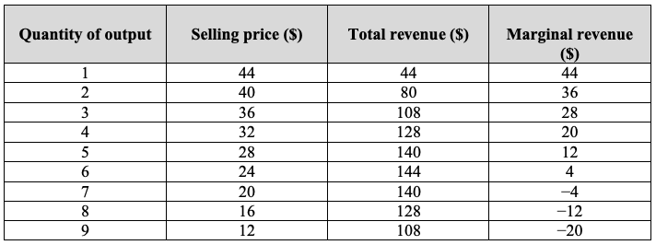
Table 6.4 Total and Marginal Revenue for a Monopolist

