Slide 1
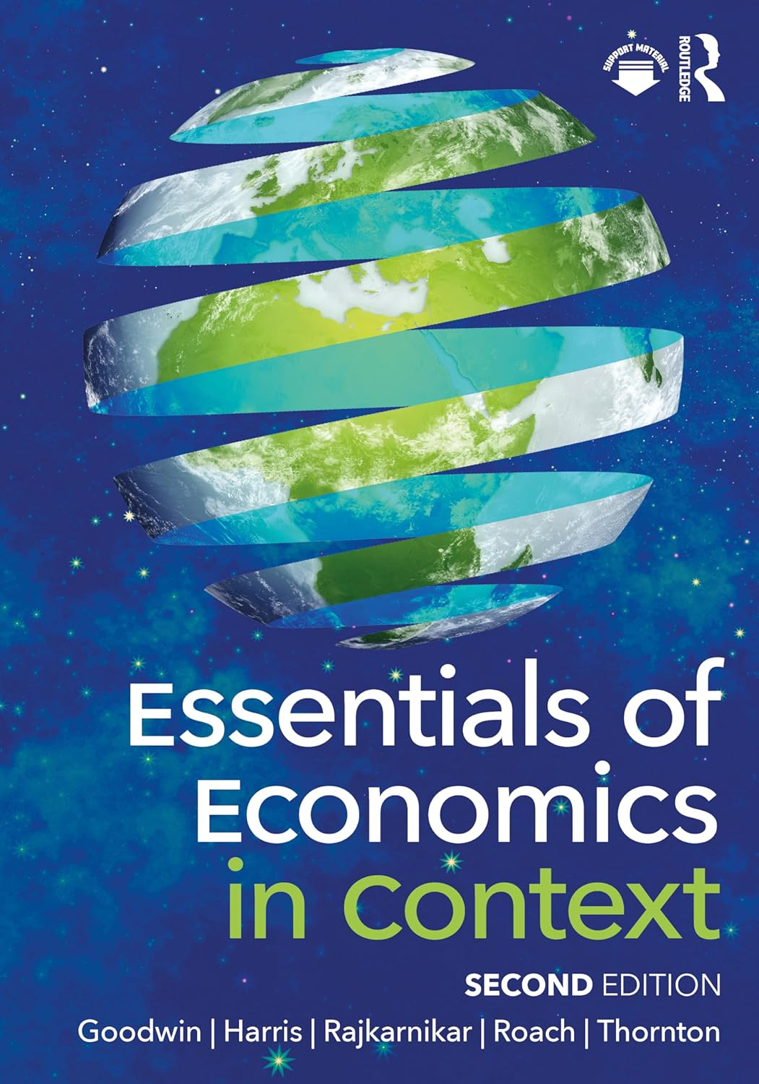
Chapter 5:
Production

Slide 2
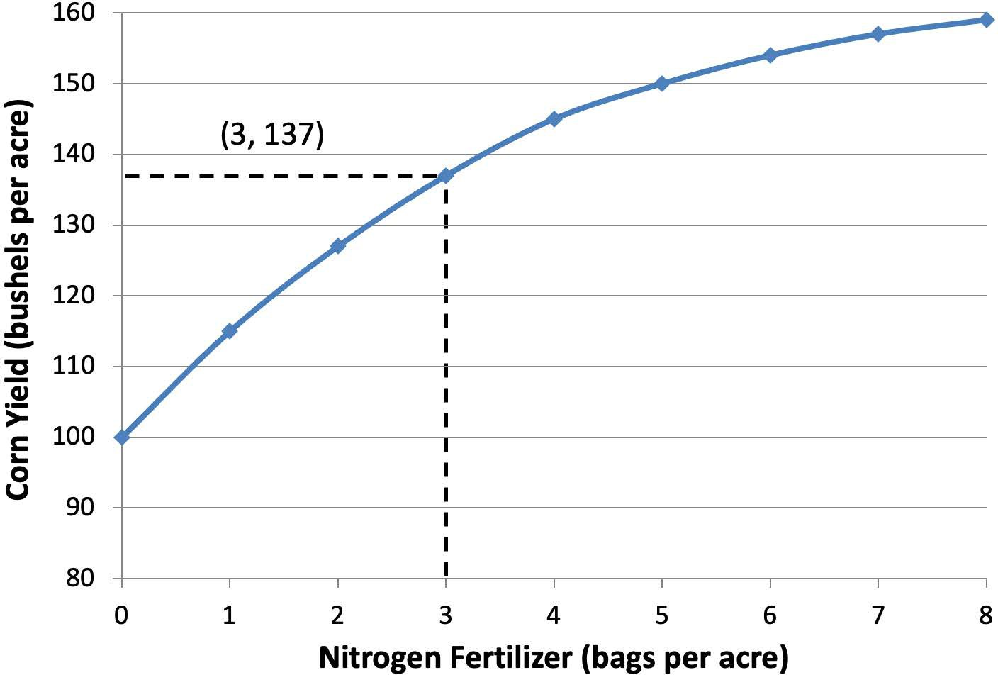
Notes:
Figure 5.1

Slide 3
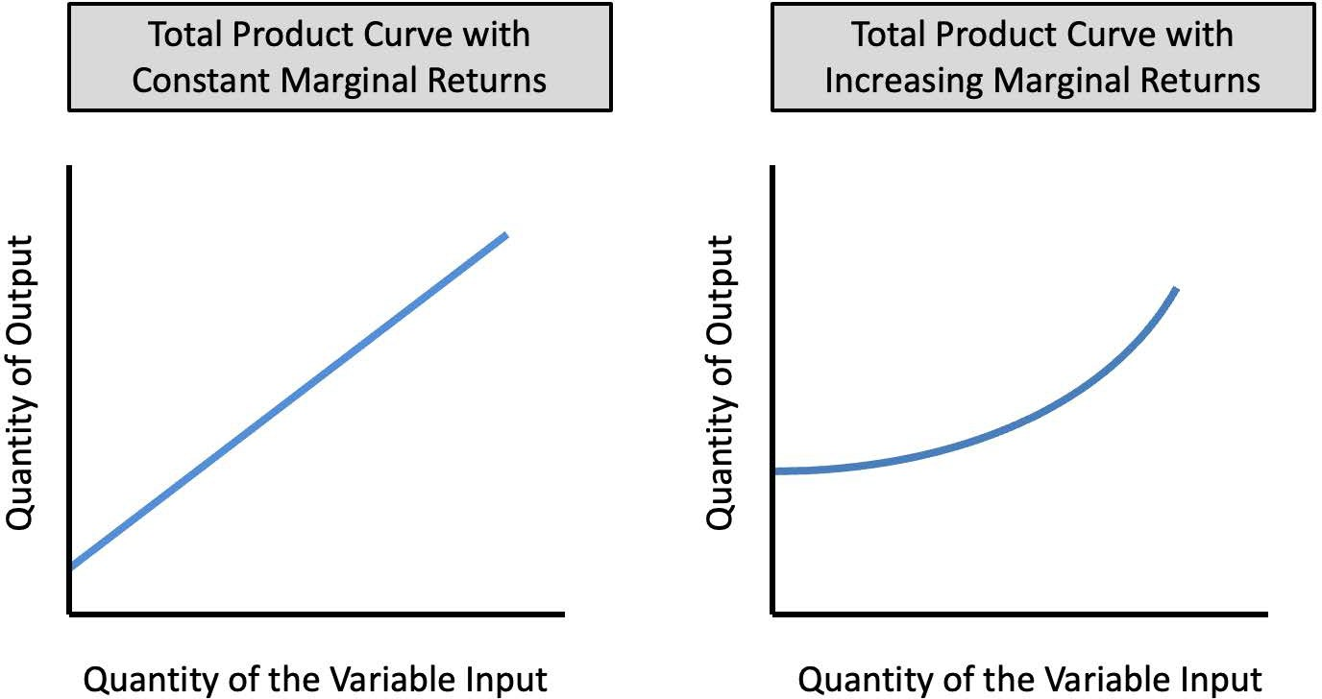
Notes:
Figure 5.2

Slide 4
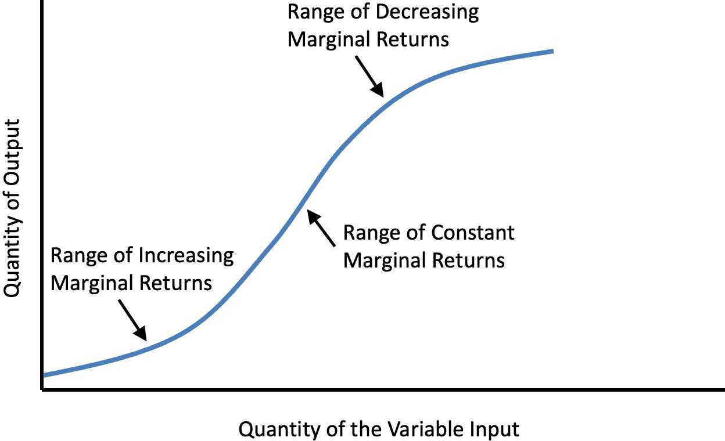
Notes:
Figure 5.3

Slide 5
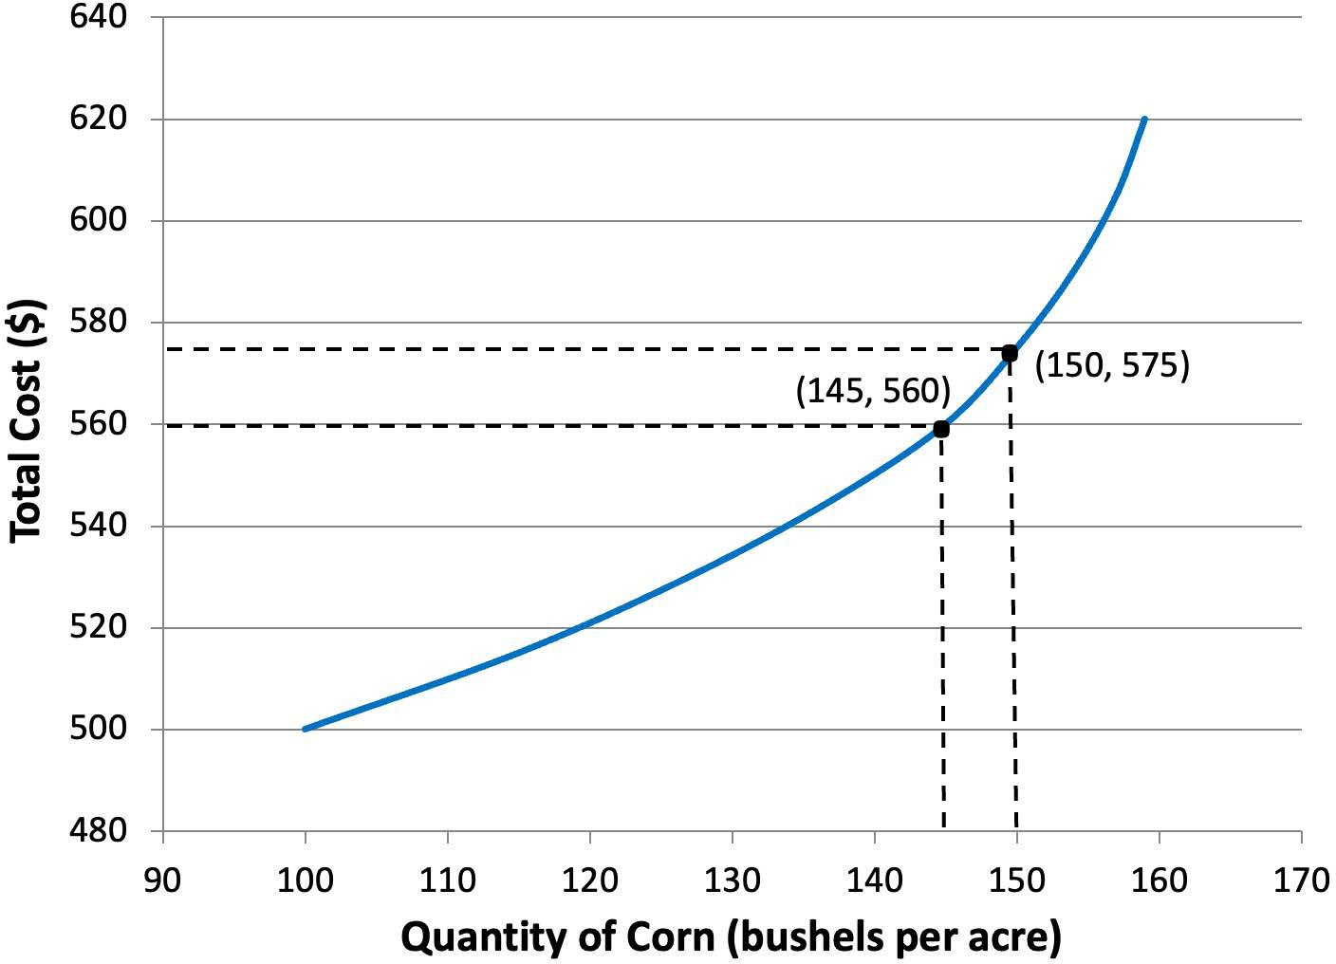
Notes:
Figure 5.4

Slide 6
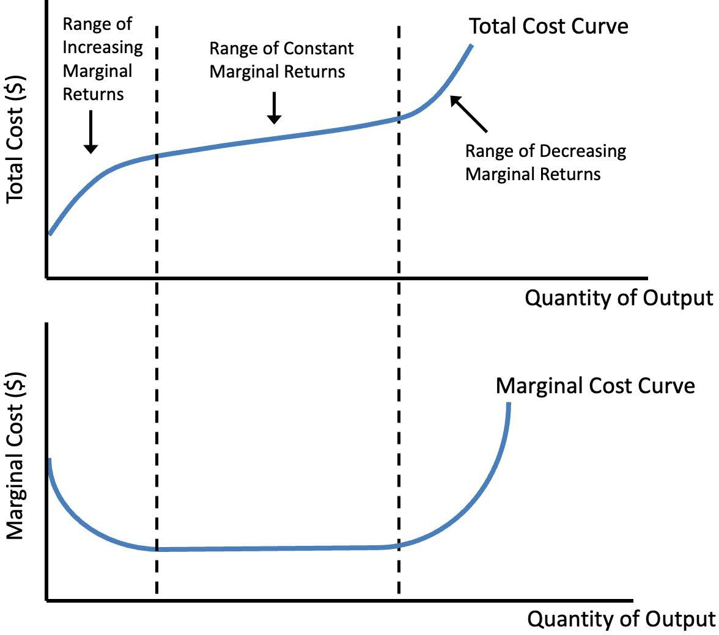
Notes:
Figure 5.5

Slide 7
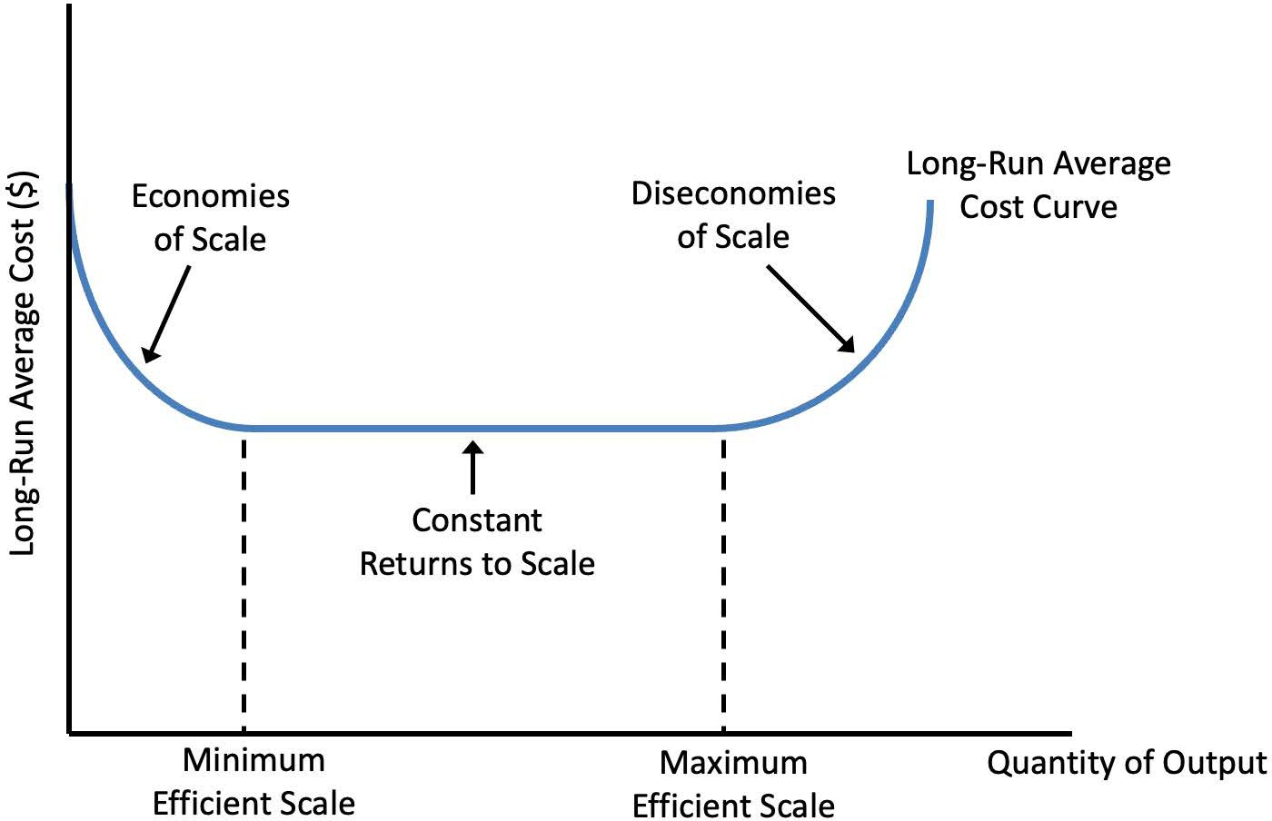
Notes:
Figure 5.6

Slide 8
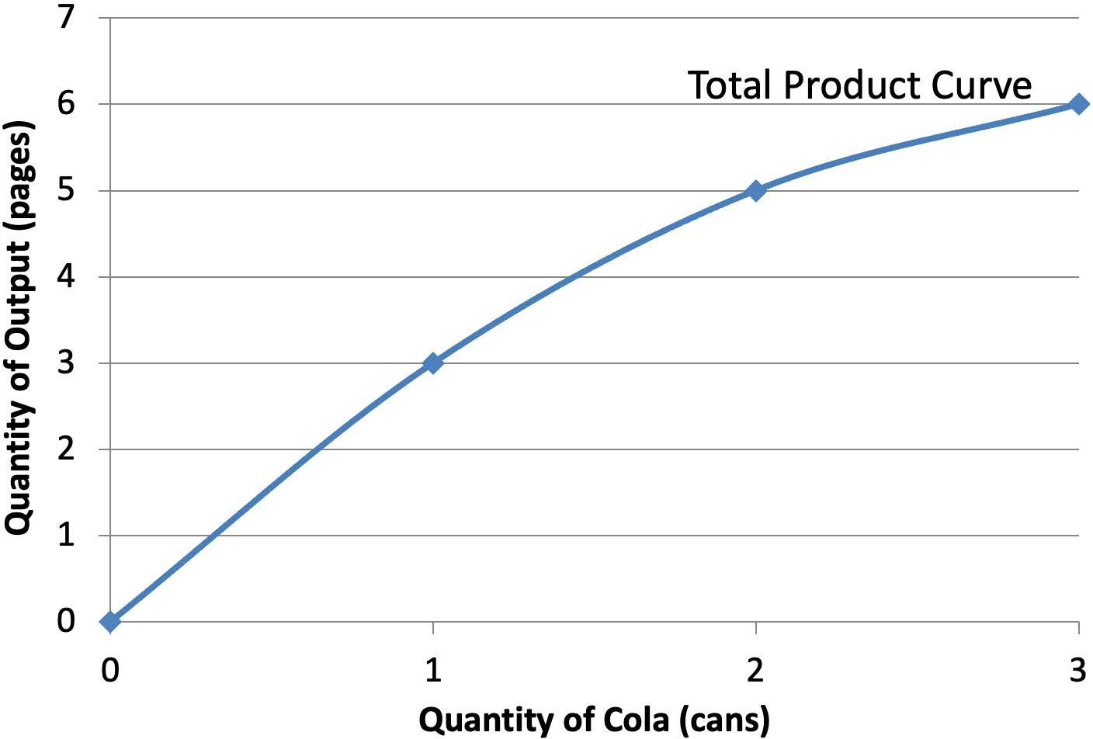
Notes:
Figure for Exercise 5. Note: No caption. (Unchanged from first edition)

Slide 9
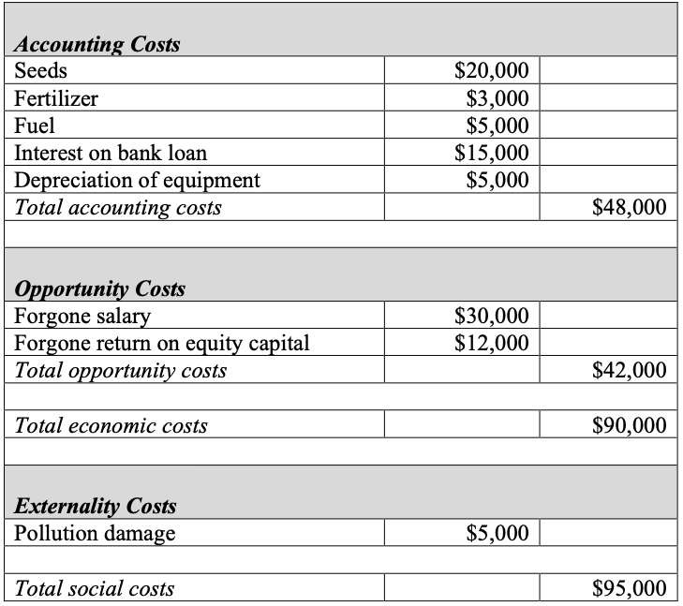
Table 5.1 Gail’s Cost of Farming
Notes:
Table 5.1 Gail’s Cost of Farming

Slide 10
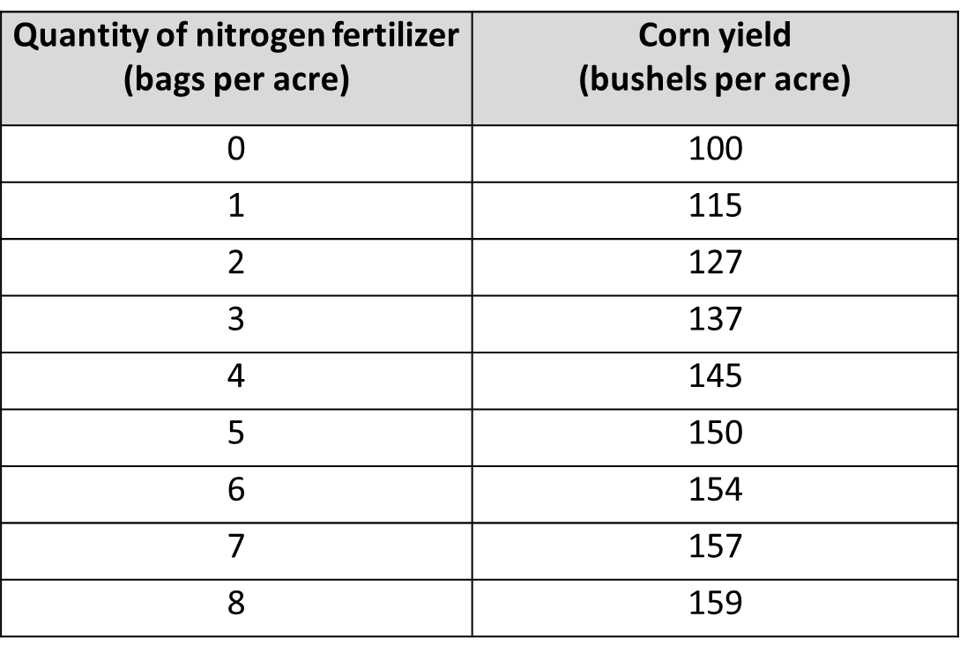
Table 5.2 Corn Production Function
Notes:
Table 5.2 Corn Production Function

Slide 11
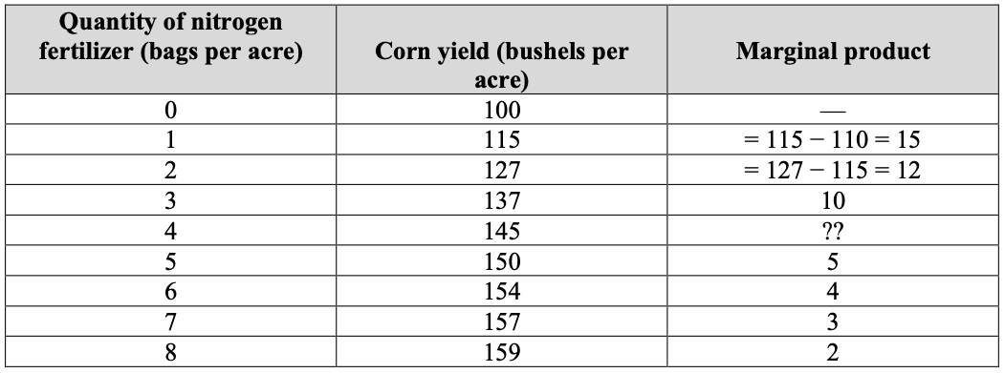
Table 5.3 Calculating Marginal Product
Notes:
Table 5.3 Calculating Marginal Product

Slide 12
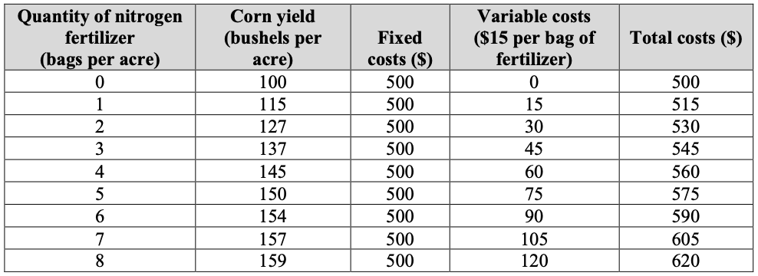
Table 5.4 Cost of Corn Production
Notes:
Table 5.4 Cost of Corn Production

Slide 13
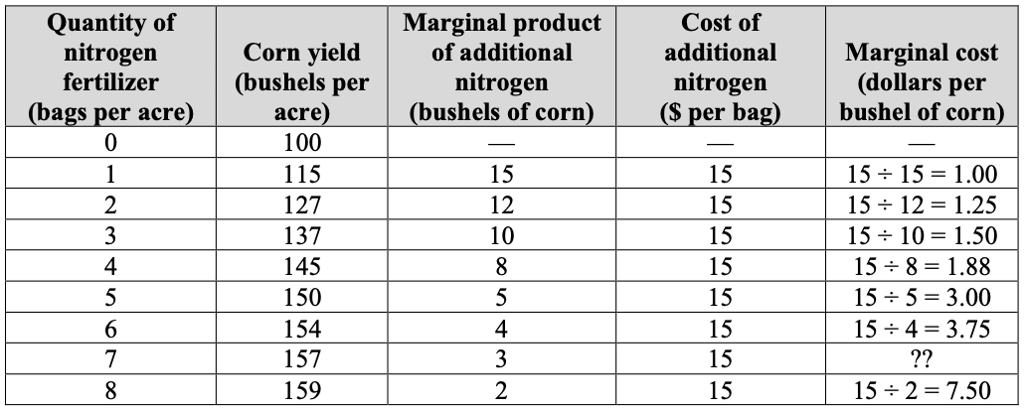
Table 5.5 Marginal Cost of Corn Production

