Slide 1
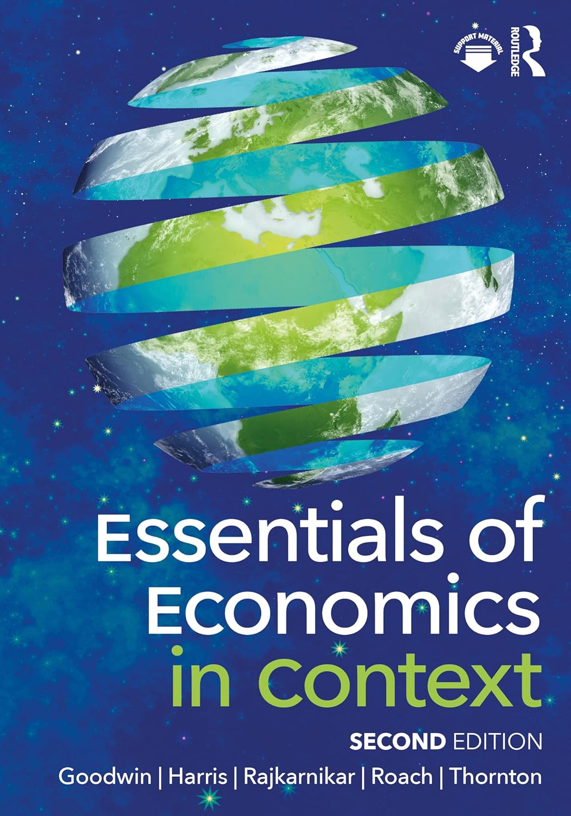
Chapter 4:
Consumption and Decision Making

Slide 2
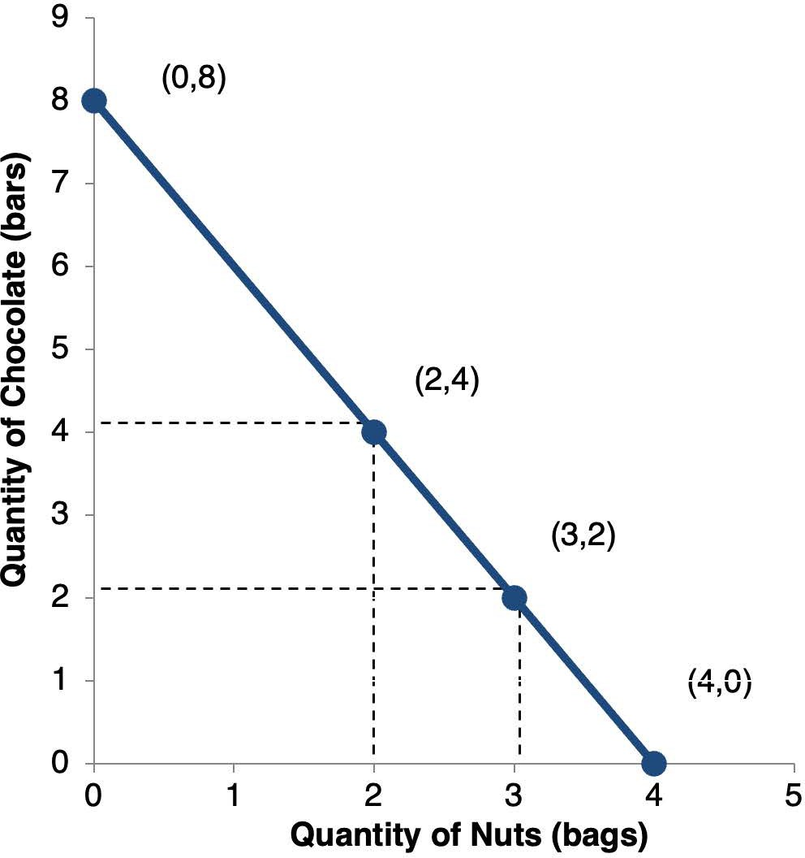
Notes:
Figure 4.1

Slide 3
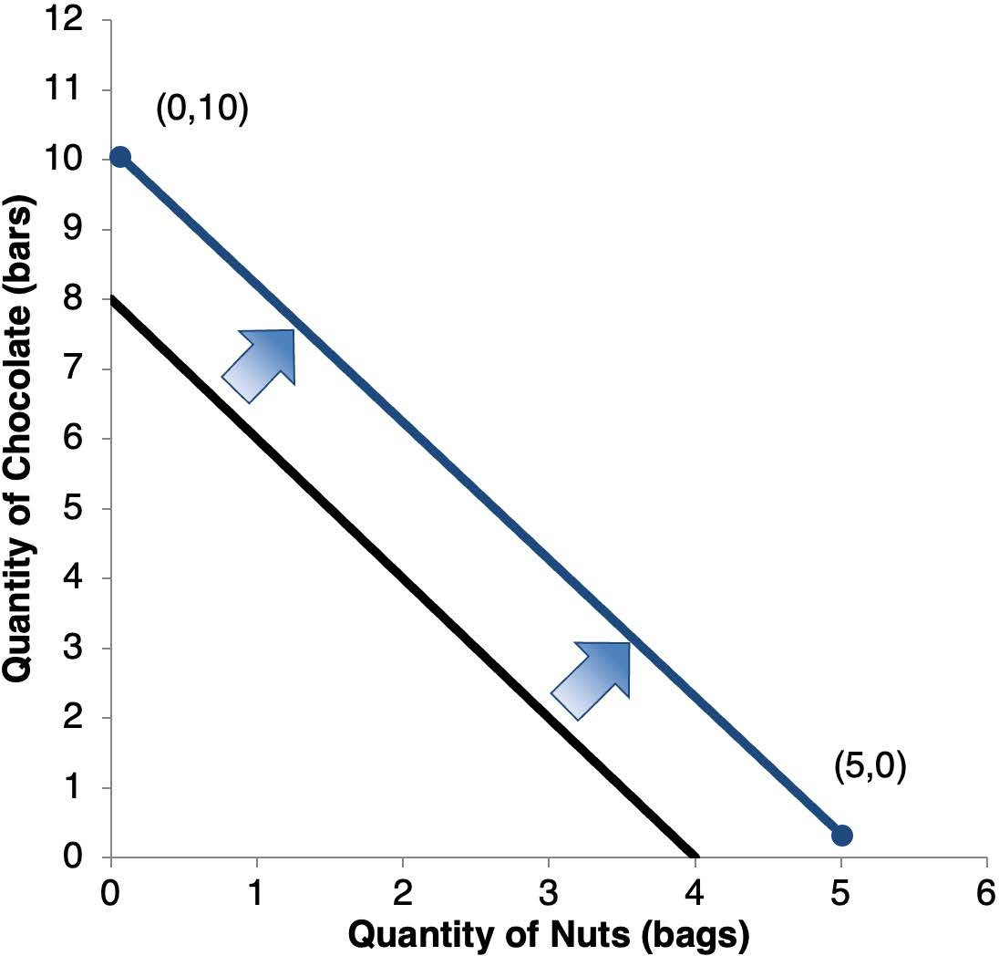
Notes:
Figure 4.2

Slide 4
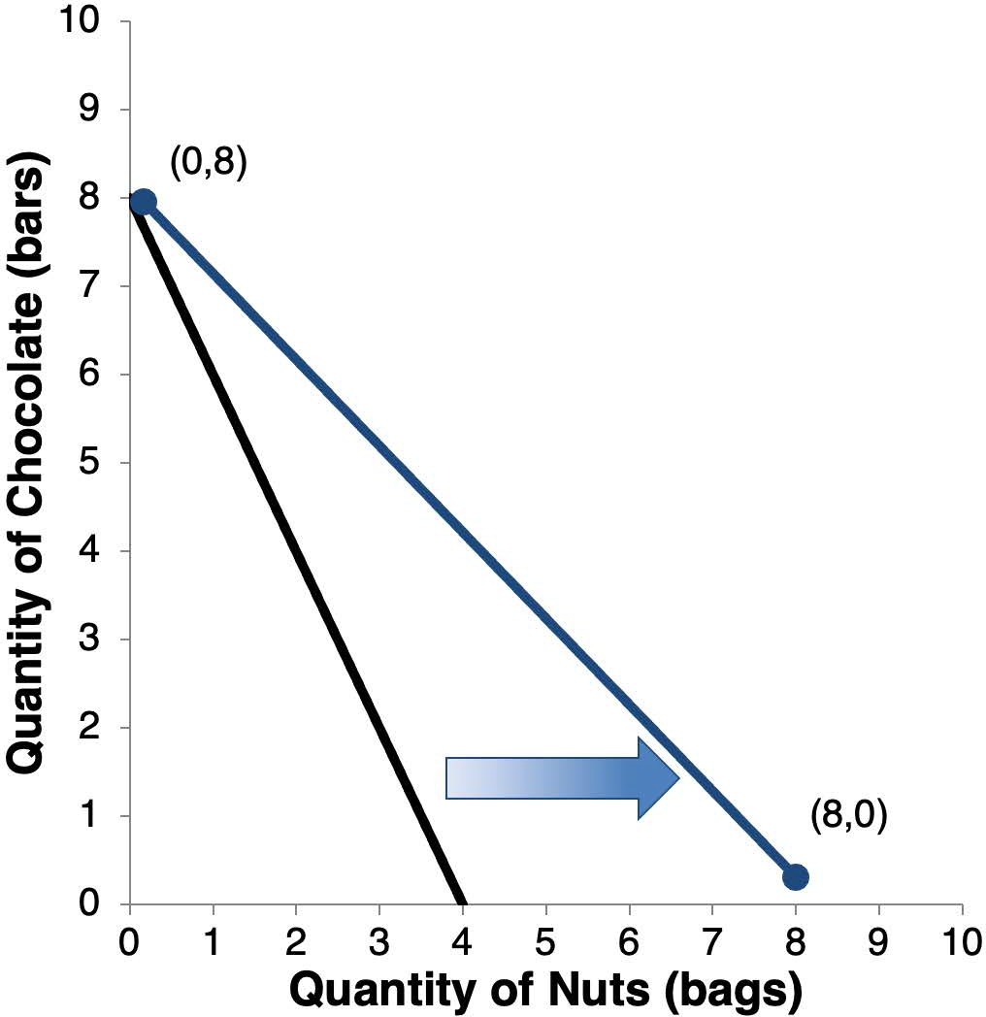
Notes:
Figure 4.3

Slide 5
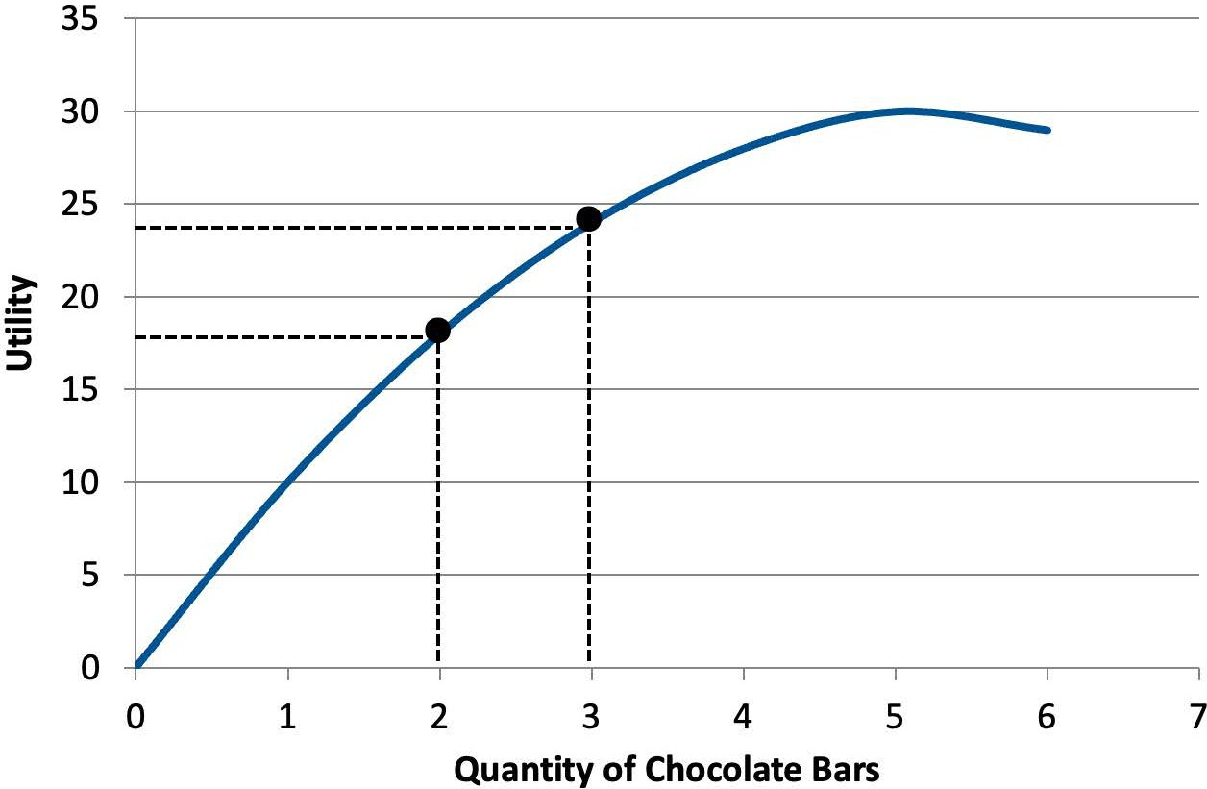
Notes:
Figure 4.4

Slide 6
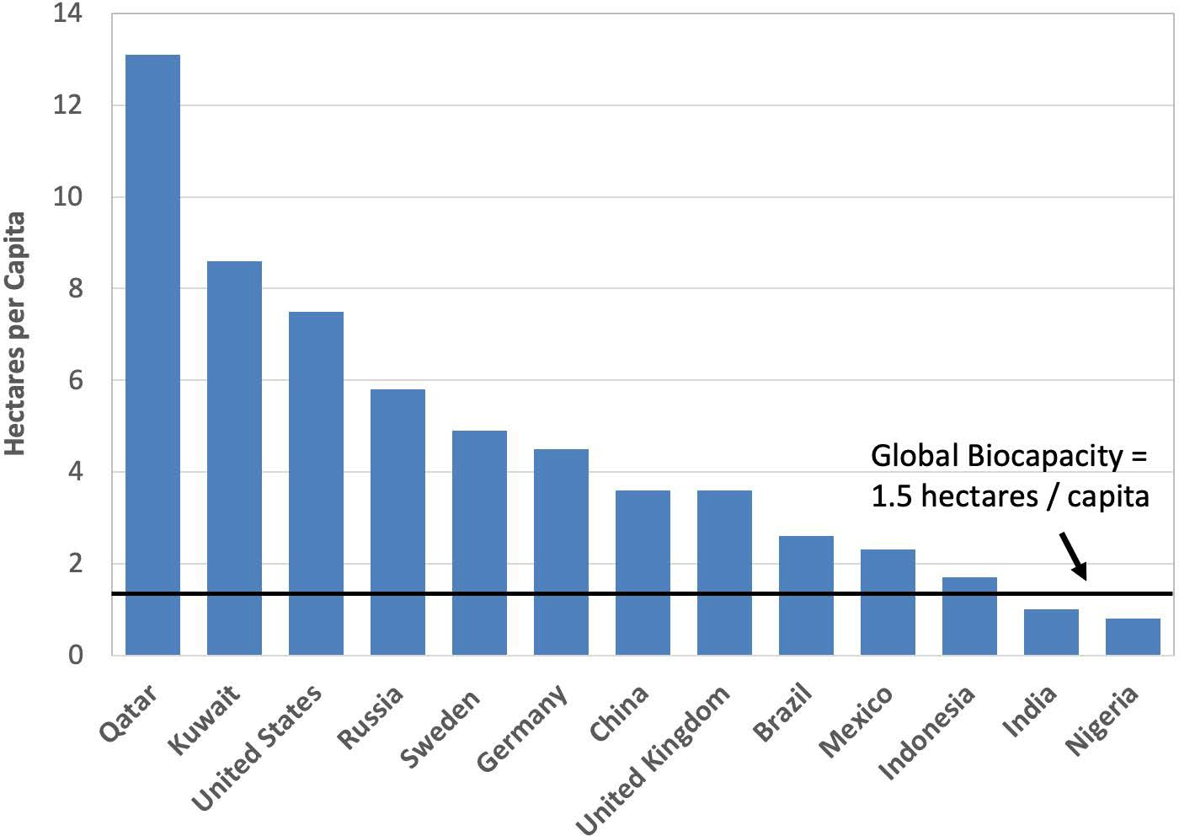
Notes:
Figure 4.5

Slide 7
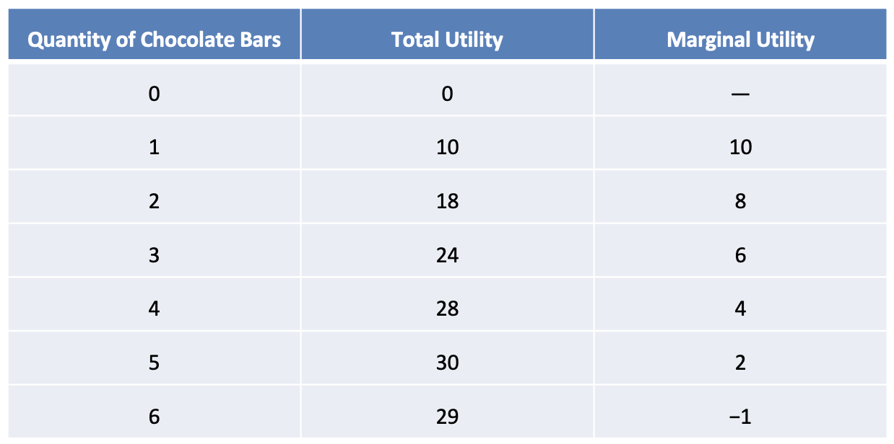
Table 4.1 Quong’s Utility from Consuming Chocolate Bars

