Slide 1
Chapter 3:
Supply and Demand

Slide 2
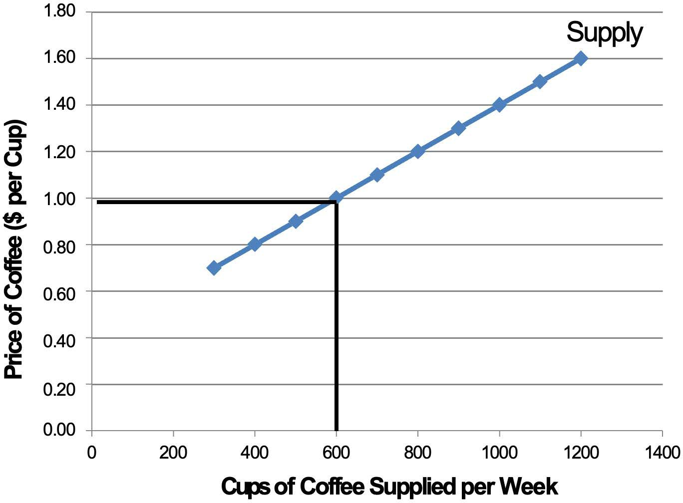
Notes:
Figure 3.1

Slide 3
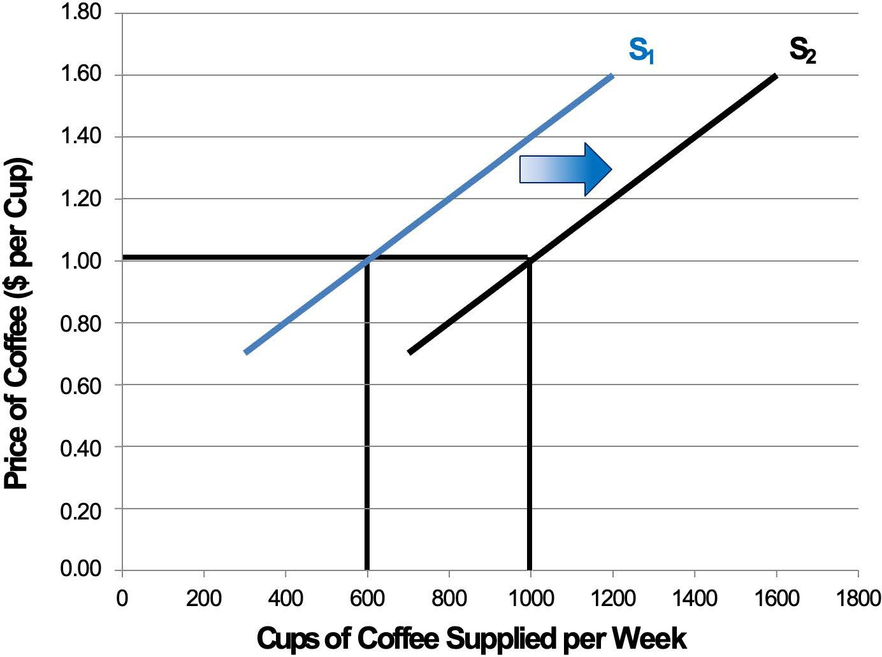
Notes:
Figure 3.2

Slide 4
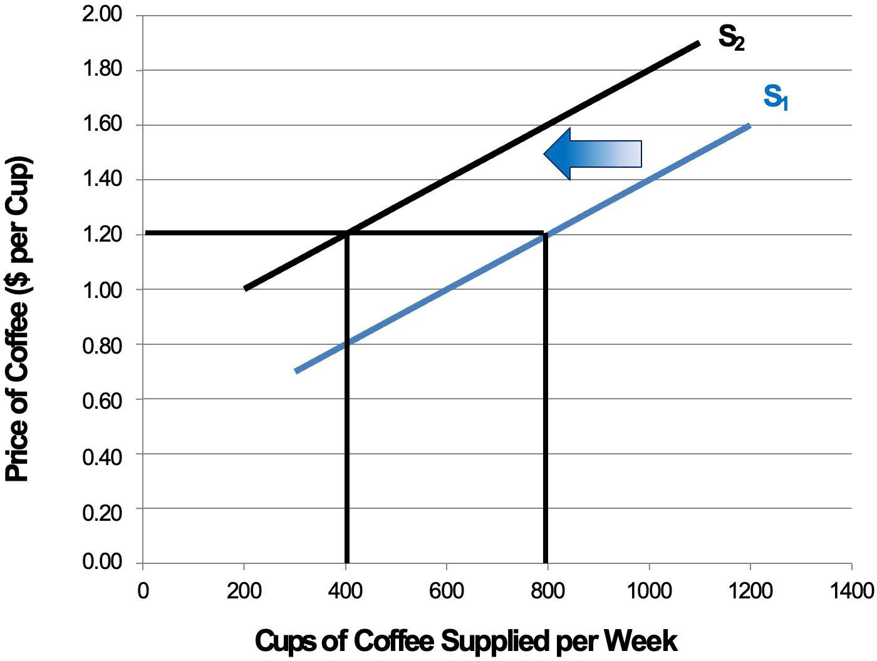
Notes:
Figure 3.3

Slide 5
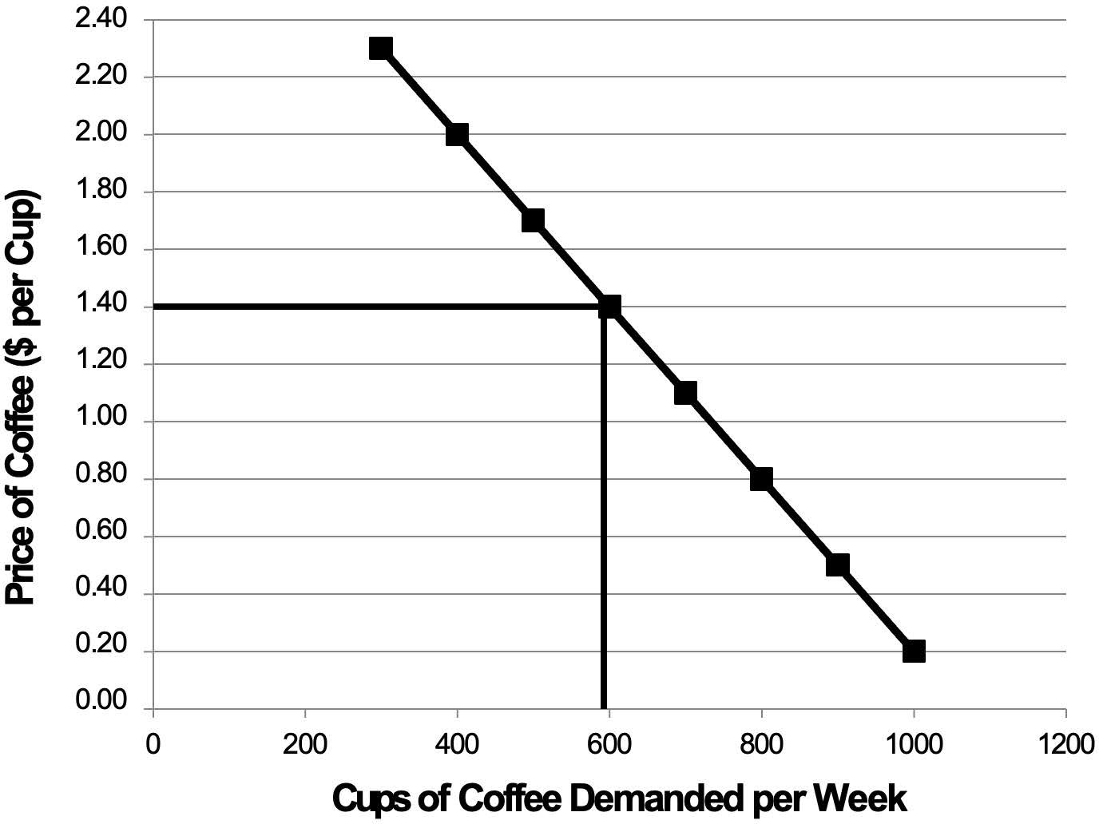
Notes:
Figure 3.4

Slide 6
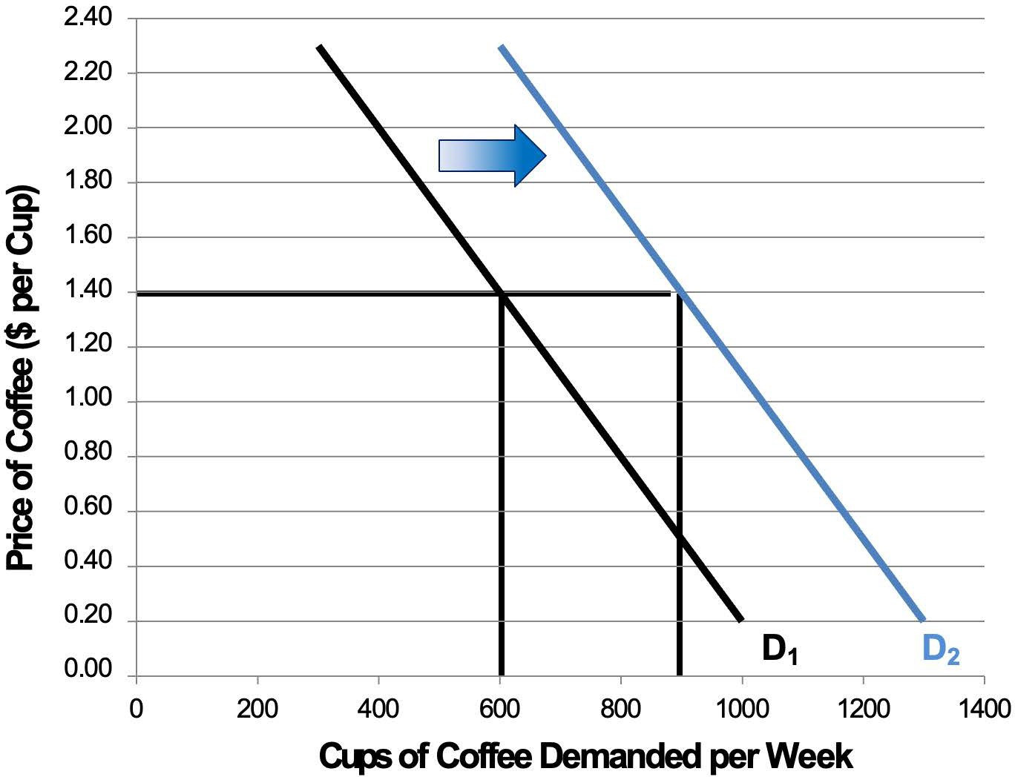
Notes:
Figure 3.5

Slide 7
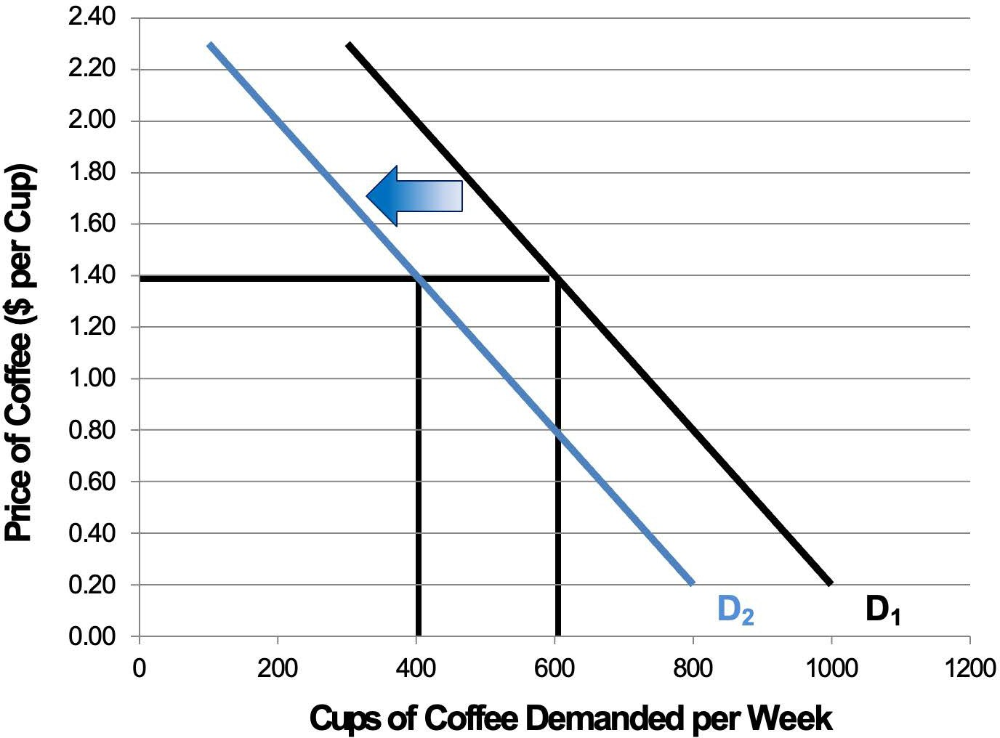
Notes:
Figure 3.6

Slide 8
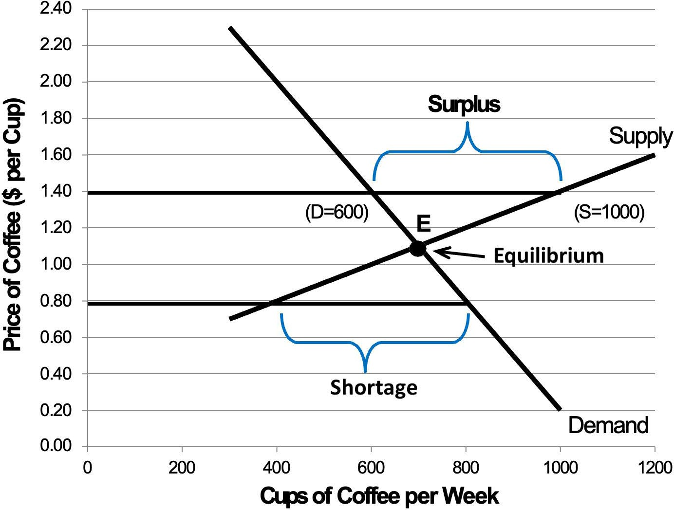
Notes:
Figure 3.7

Slide 9
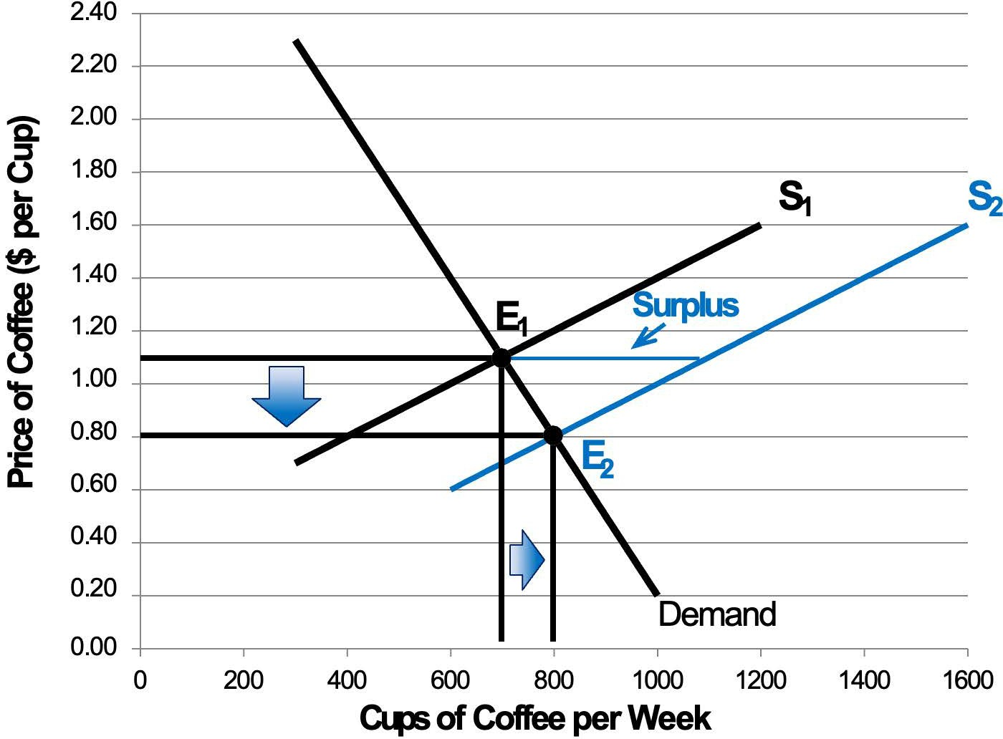
Notes:
Figure 3.8

Slide 10
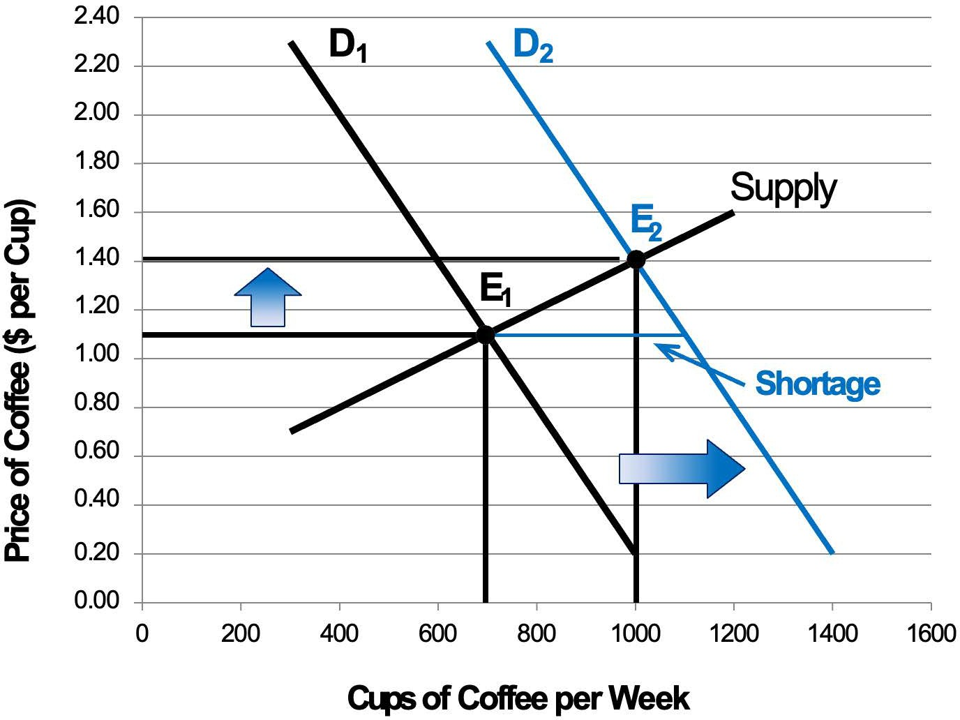
Notes:
Figure 3.9

Slide 11
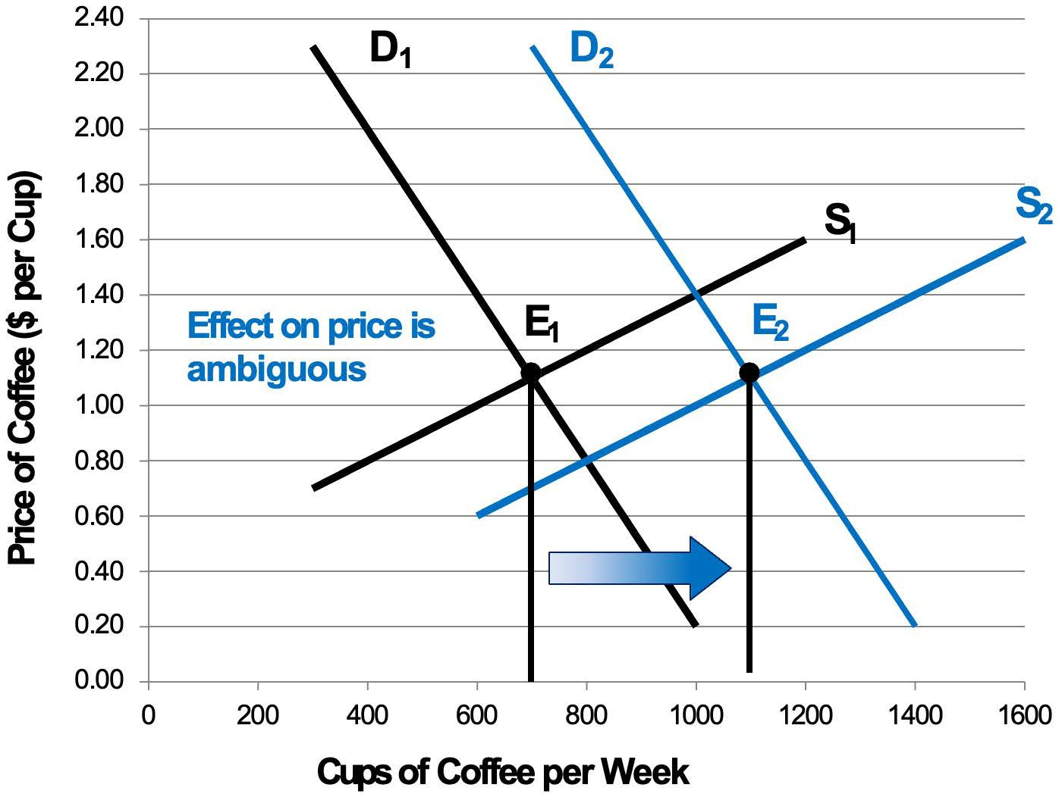
Notes:
Figure 3.10

Slide 12
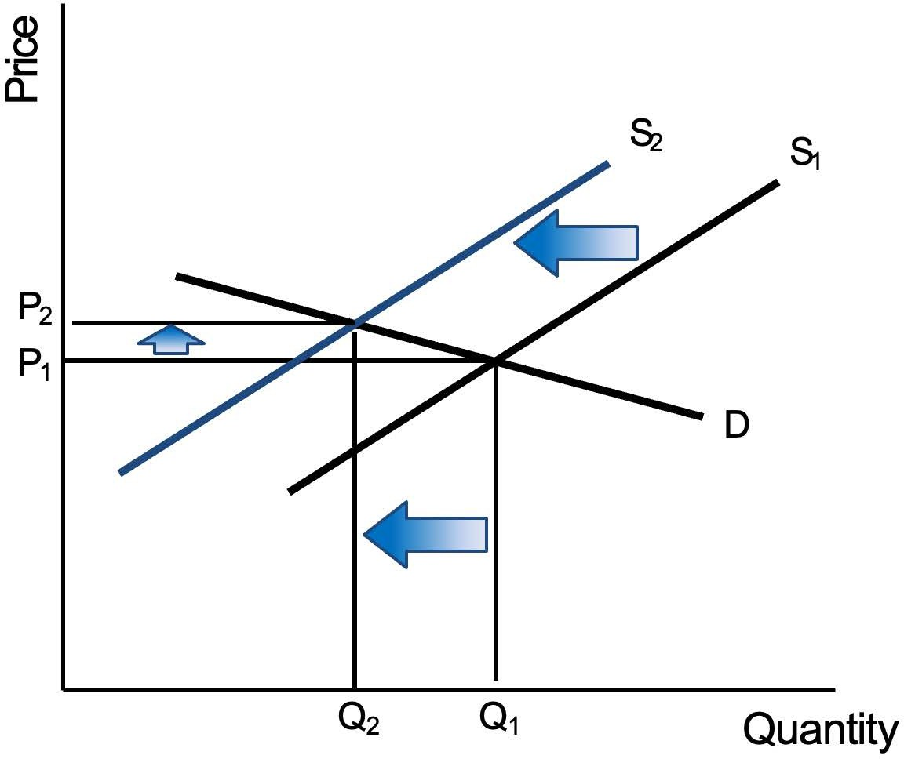
Notes:
Figure 3.11a

Slide 13
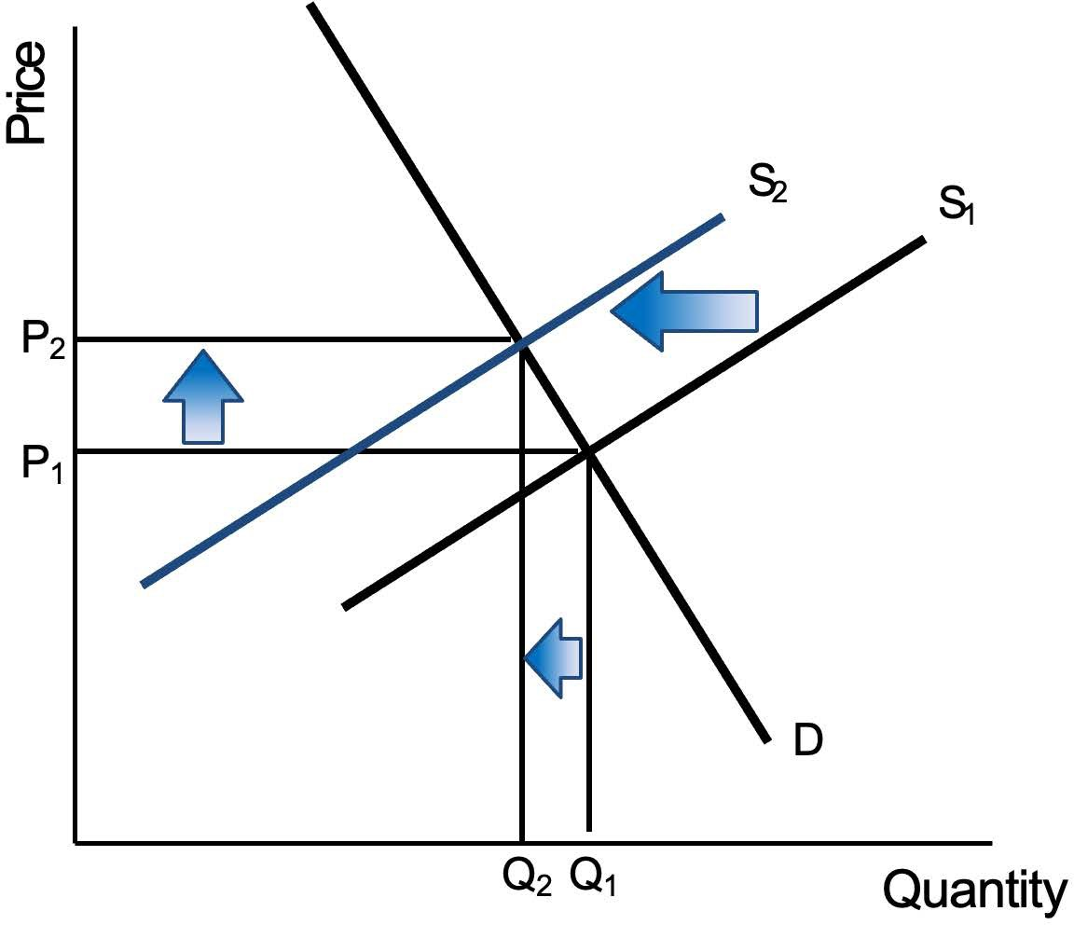
Notes:
Figure 3.11b

Slide 14
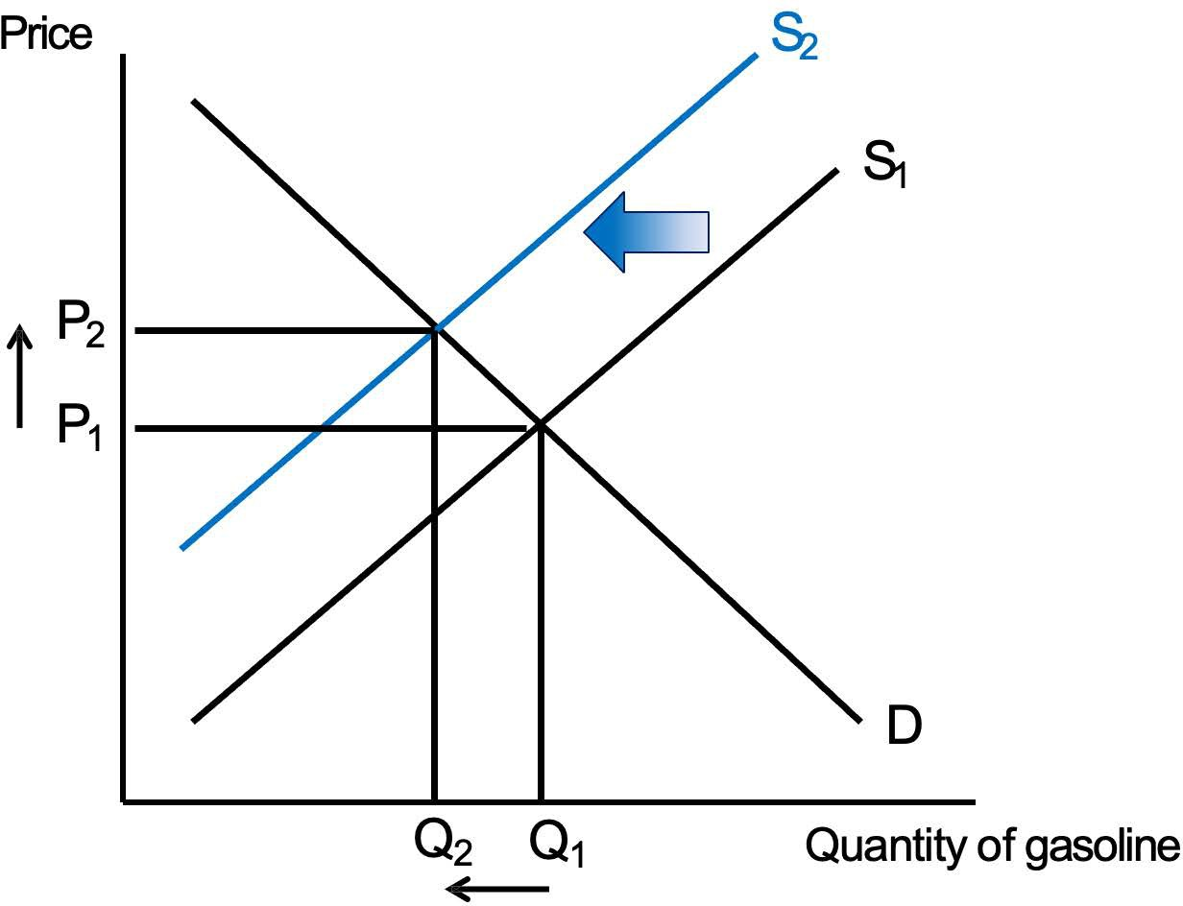
Notes:
Figure for Exercise 5. Note: No caption (Unchanged)

Slide 15
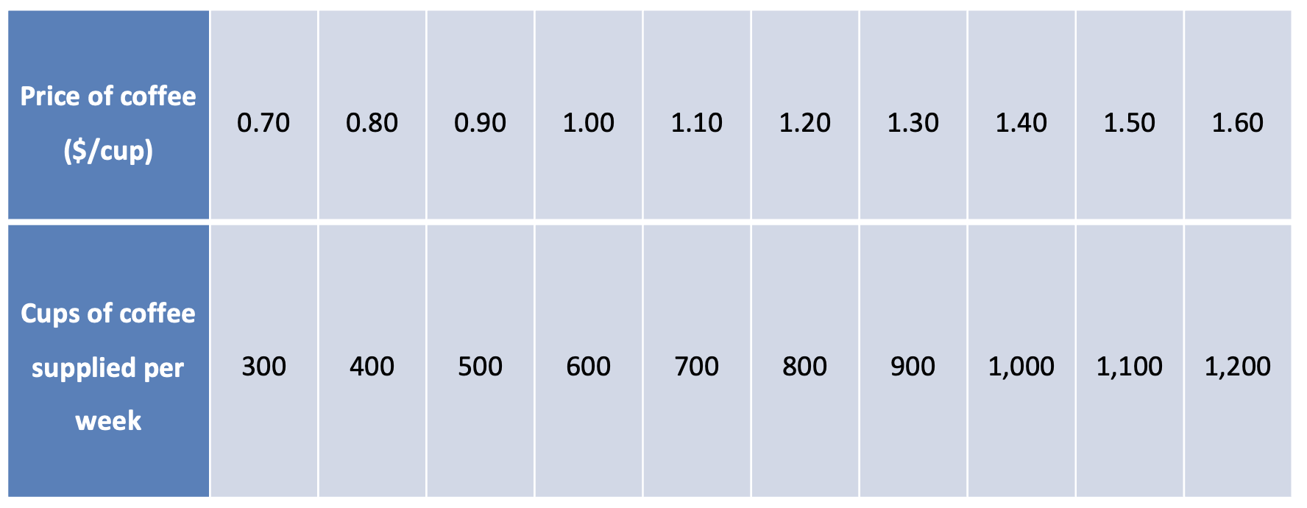
Table 3.1 Supply Schedule for Cups of Coffee
Notes:
Table 3.1 Supply Schedule for Cups of Coffee

Slide 16
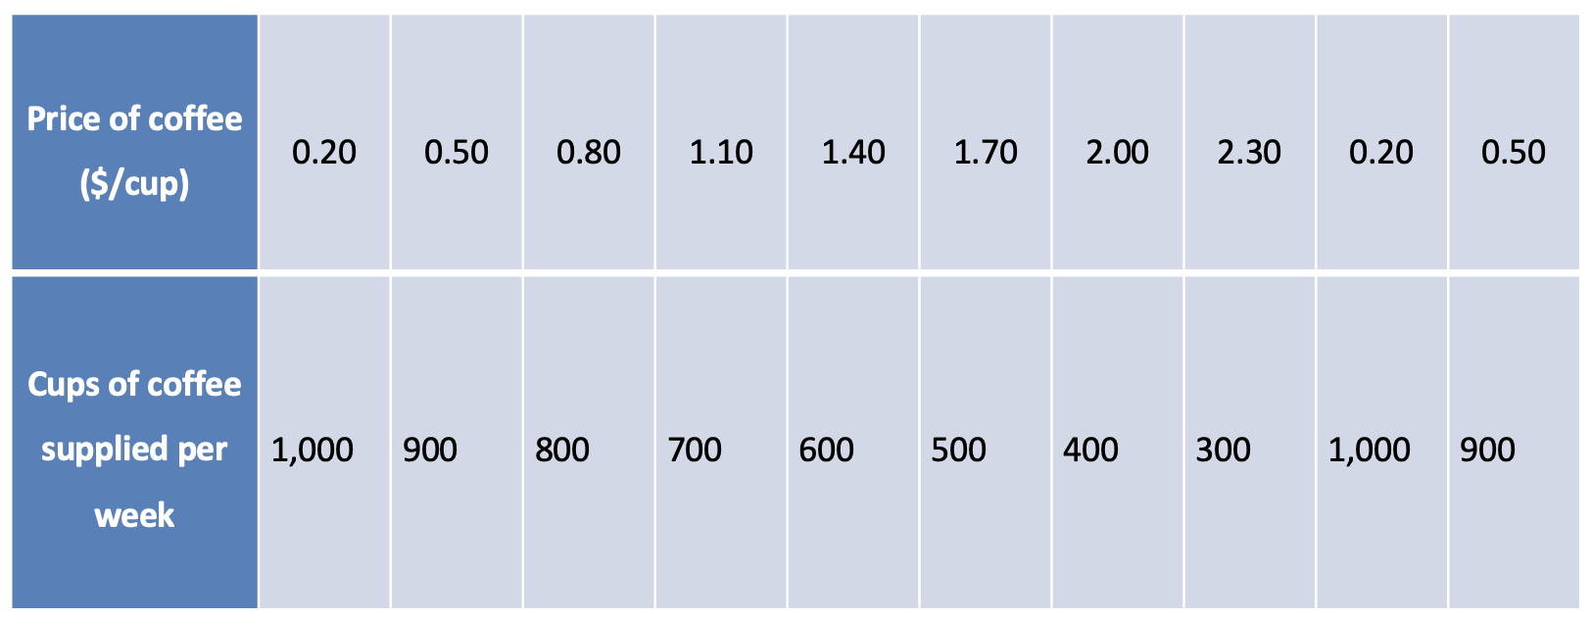
Table 3.2 Demand Schedule for Cups of Coffee
Notes:
Table 3.2 Demand Schedule for Cups of Coffee

Slide 17
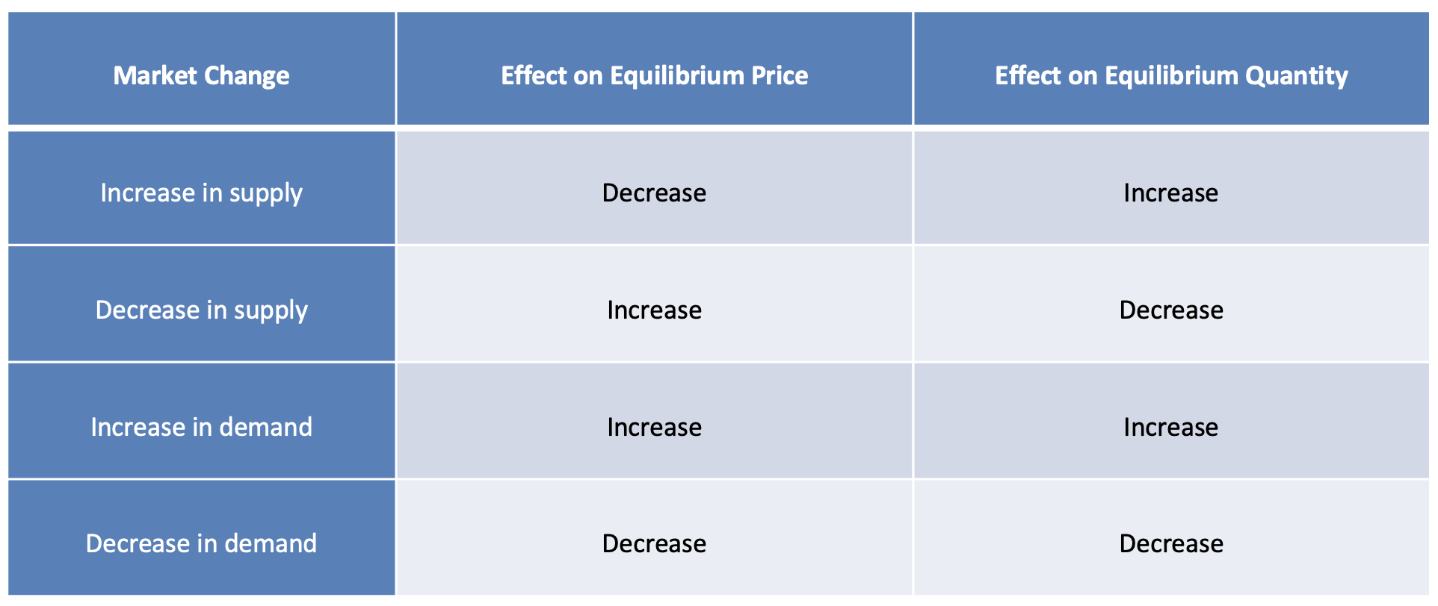
Table 3.3 Summary of the Market Effects of Shifts in Supply or Demand
Notes:
Table 3.3 Summary of the Market Effects of Shifts in Supply or Demand

Slide 18
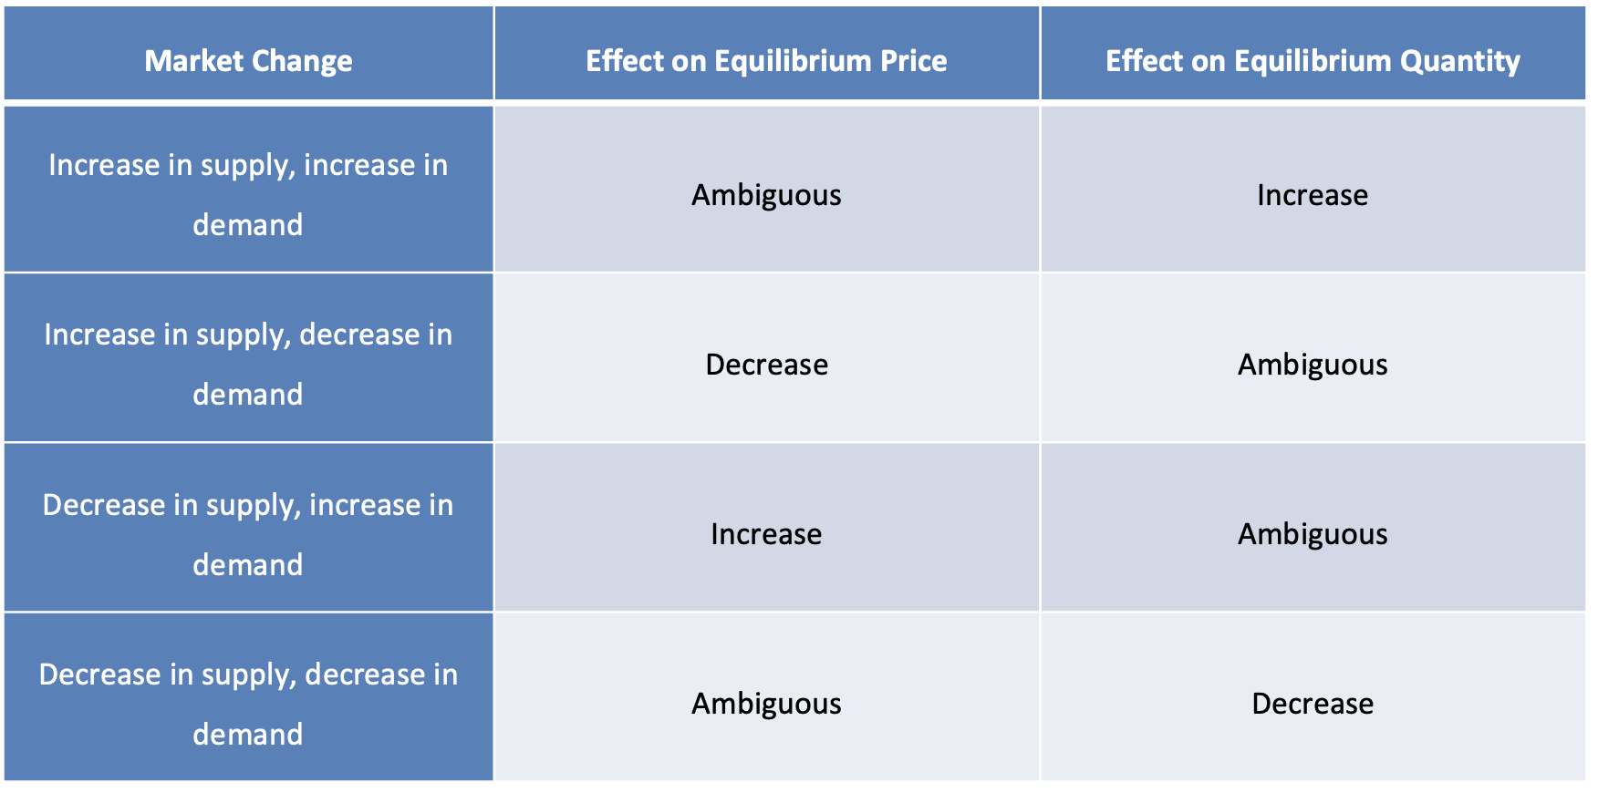
Table 3.4 Summary of the Market Effects when Both Supply and Demand Shift
Notes:
Table 3.4 Summary of the Market Effects when Both Supply and Demand Shift

