Slide 1
Chapter 2:
Foundations of Economic Analysis

Slide 2
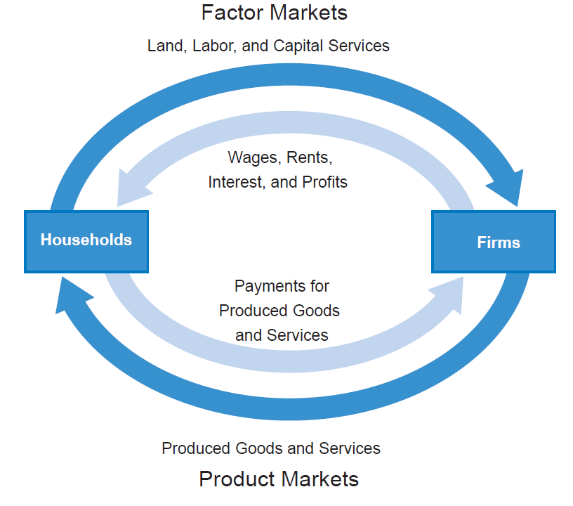
Land, Labor, and Capital Services
Wages, Rents, Interest, and Profits
Payments for Produced Goods and Services
Produced Goods and Services
Notes:
Figure 2.1 (former Figure 2.3)

Slide 3
Environmental Context
Social Context
Economic Activity
Core Sphere
Business Sphere
Natural Inputs (Natural resources and environmental services)
Outputs (pollution and wastes)
Public Purpose Sphere
Notes:
Figure 2.2 (former Figure 2.4)

Slide 4
Notes:
Figure 2.3 (Updated)

Slide 5
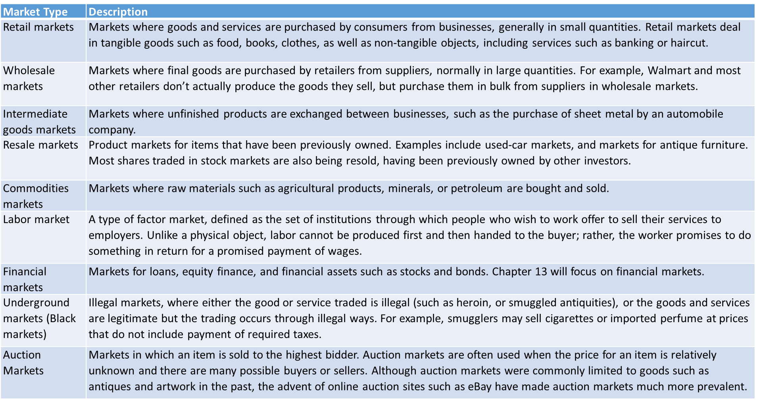
Table 2.1 Different Types of Markets
Notes:
Table 2.1

