Slide 1
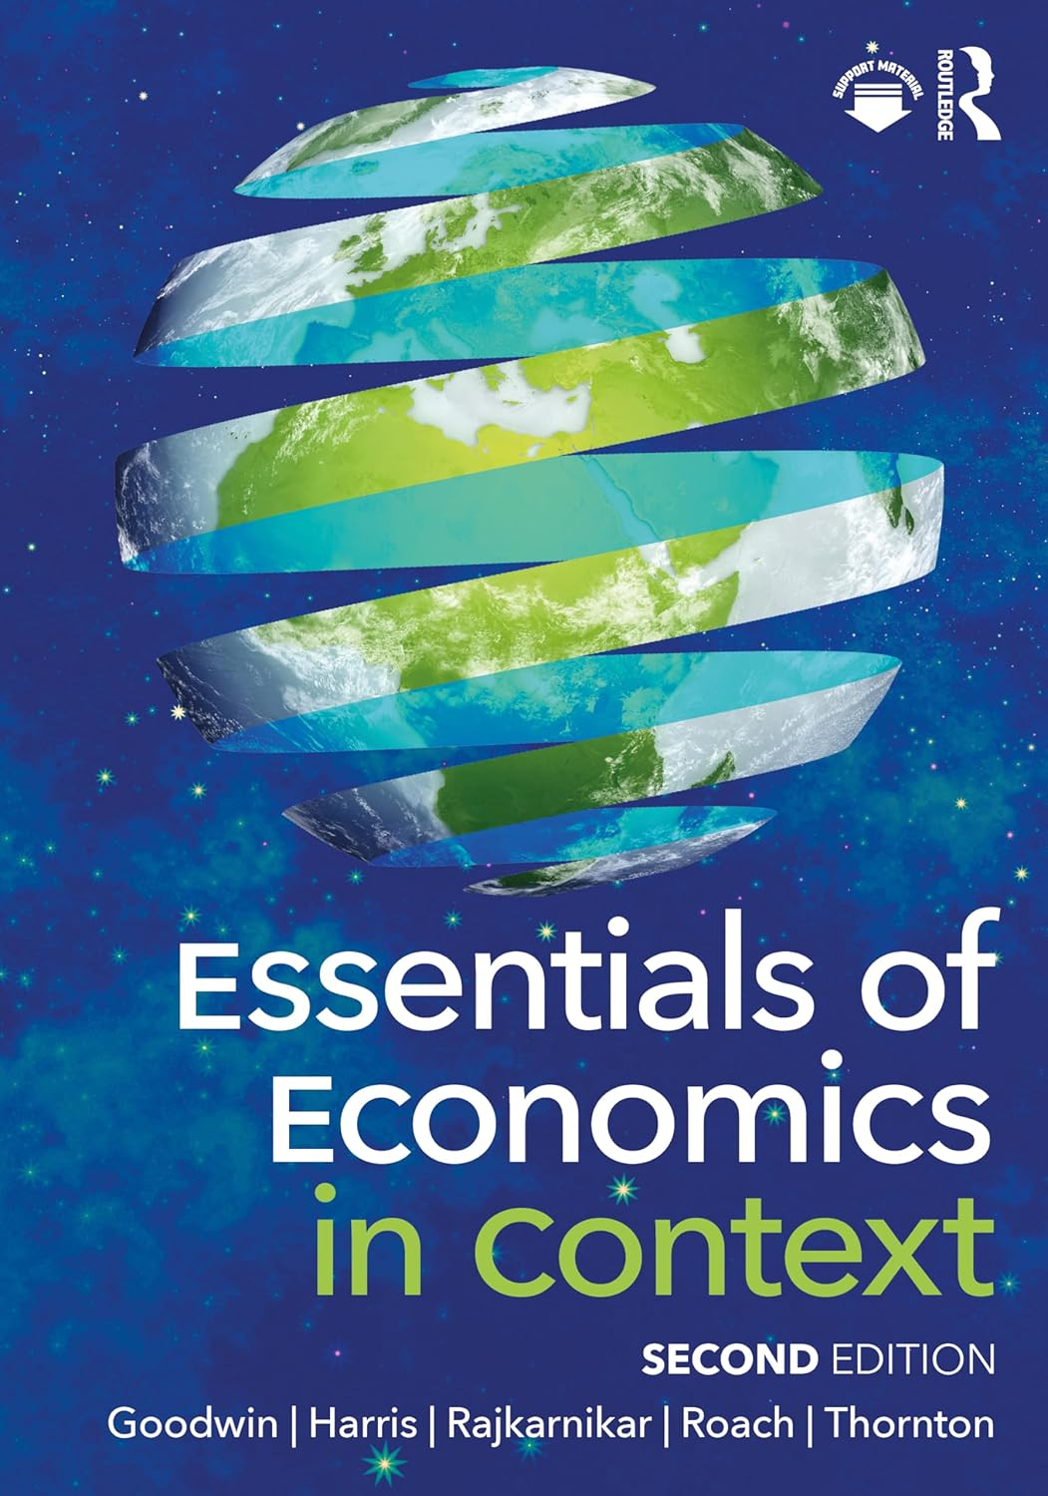
Chapter 16:
Economics of the Environment

Slide 2
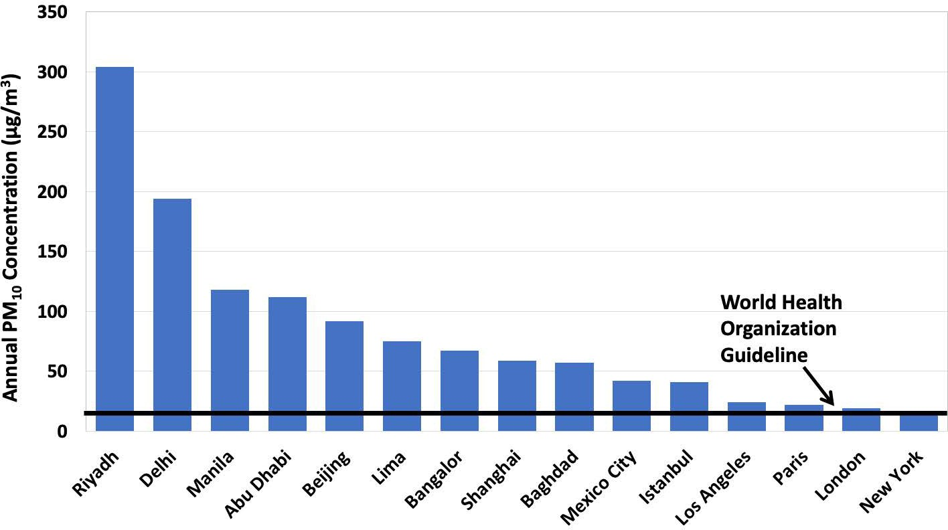
Notes:
Figure 16.1

Slide 3
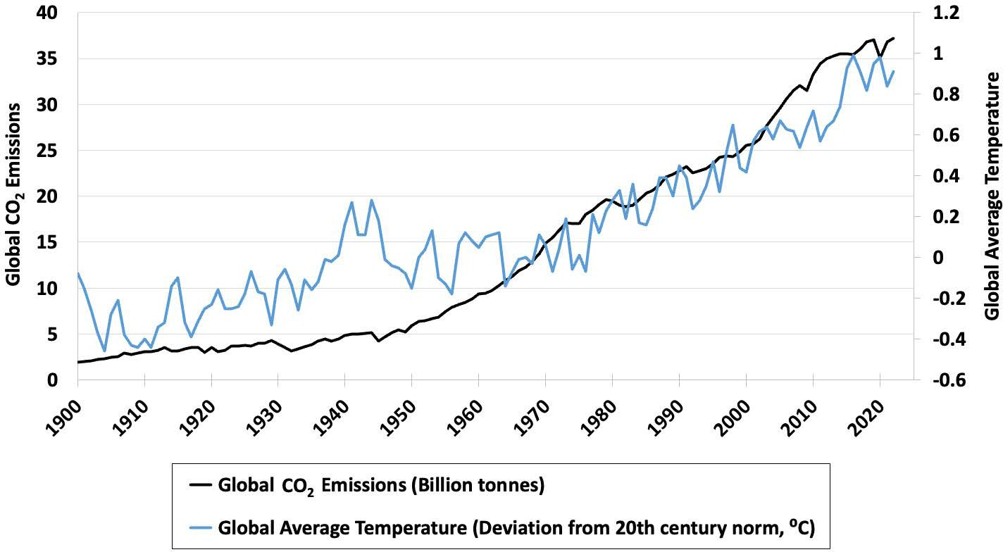
Notes:
Figure 16.2

Slide 4
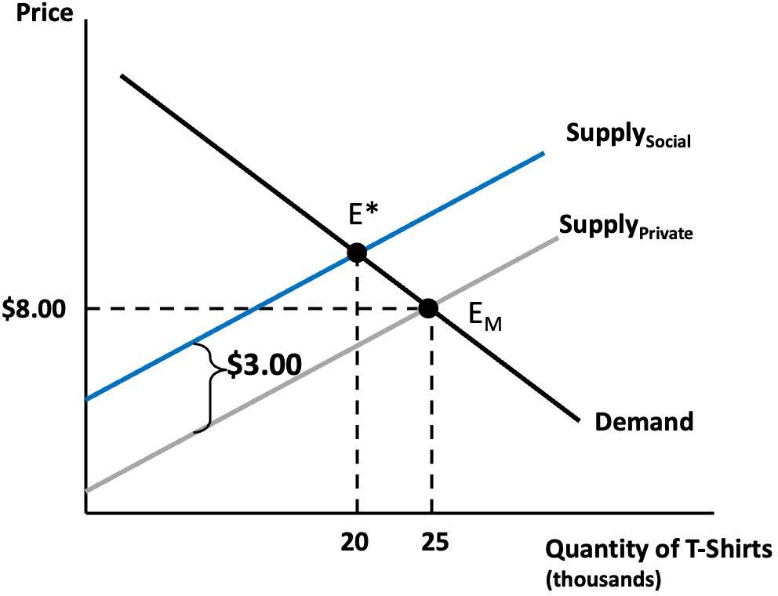
Notes:
Figure 16.3

Slide 5
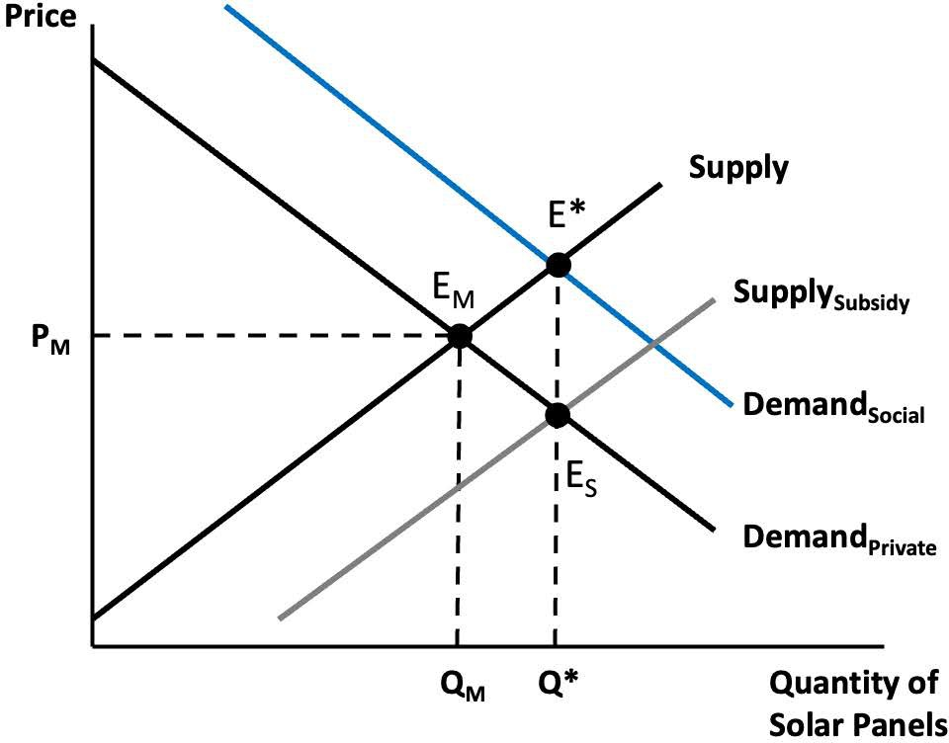
Notes:
Figure 16.4

Slide 6
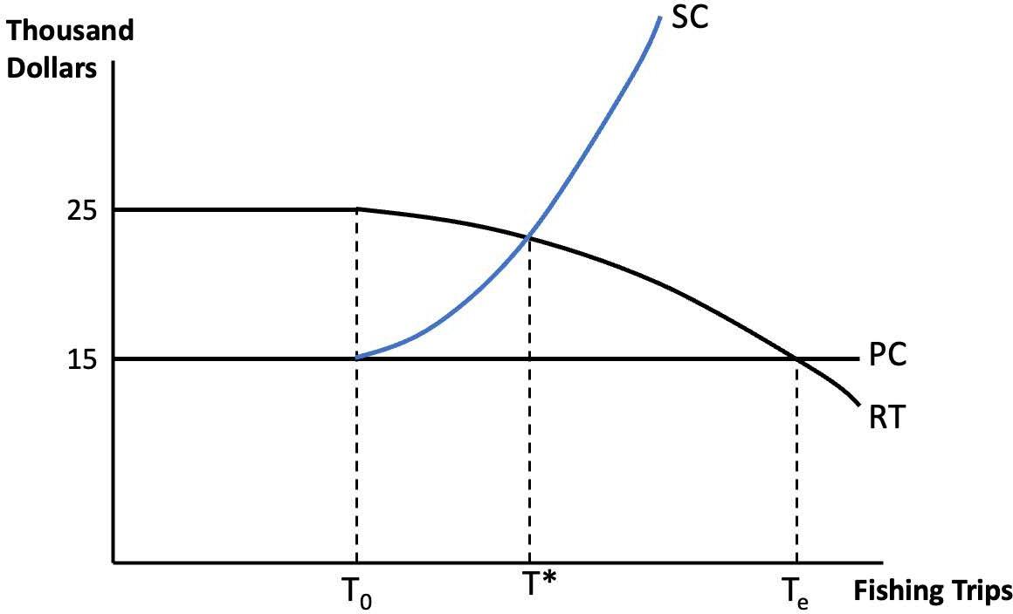
Notes:
Figure 16.5

Slide 7
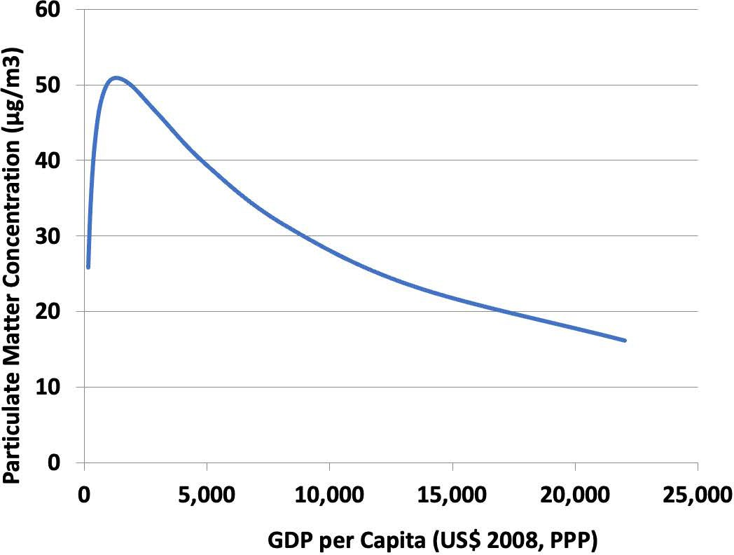
Notes:
Figure 16.6

Slide 8
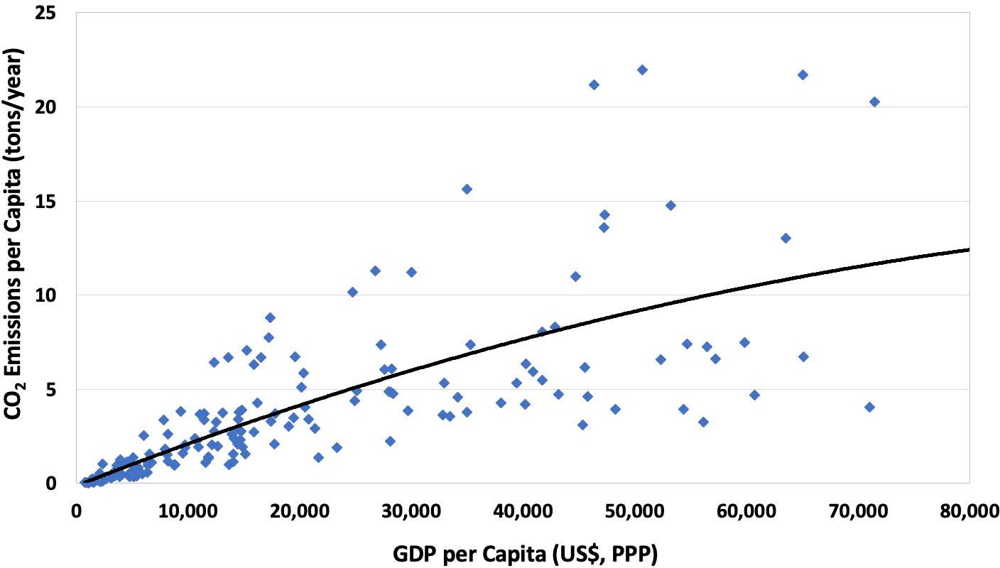
Notes:
Figure 16.7

Slide 9
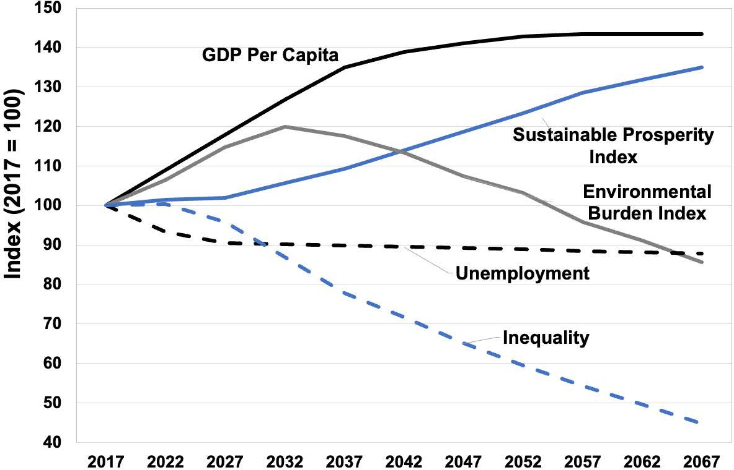
Notes:
Figure 16.8

Slide 10
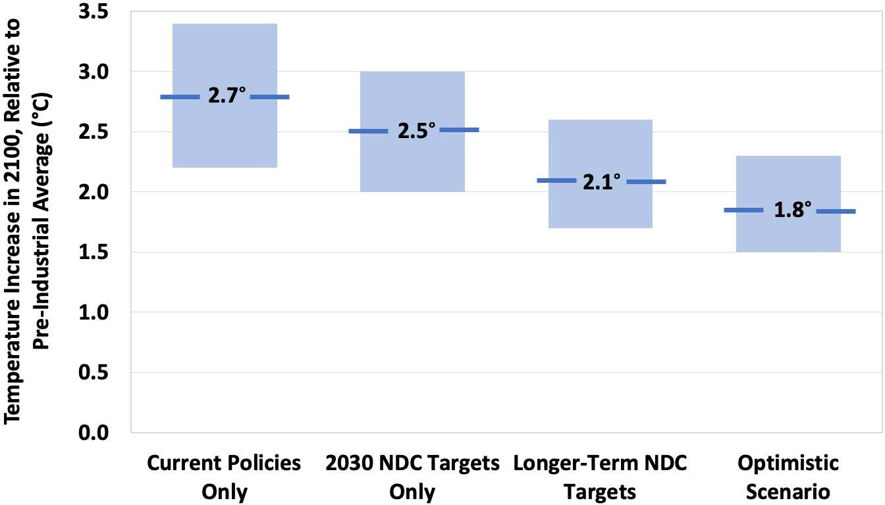
Notes:
Figure 16.9

Slide 11
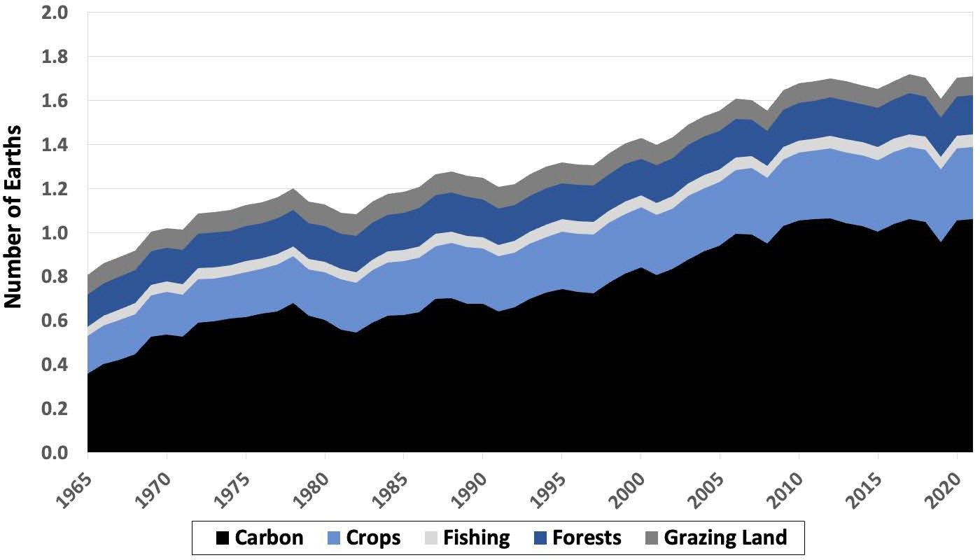
Notes:
Figure 16.10

