Slide 1
Chapter 15:
How Economies Grow and Develop

Slide 2
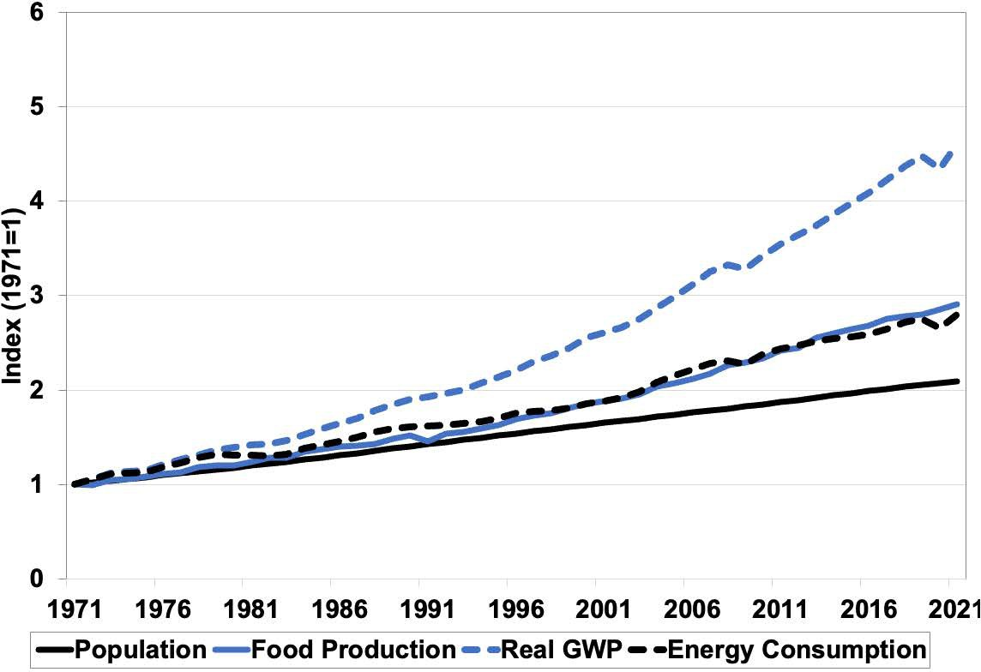
Notes:
Figure 15.1

Slide 3
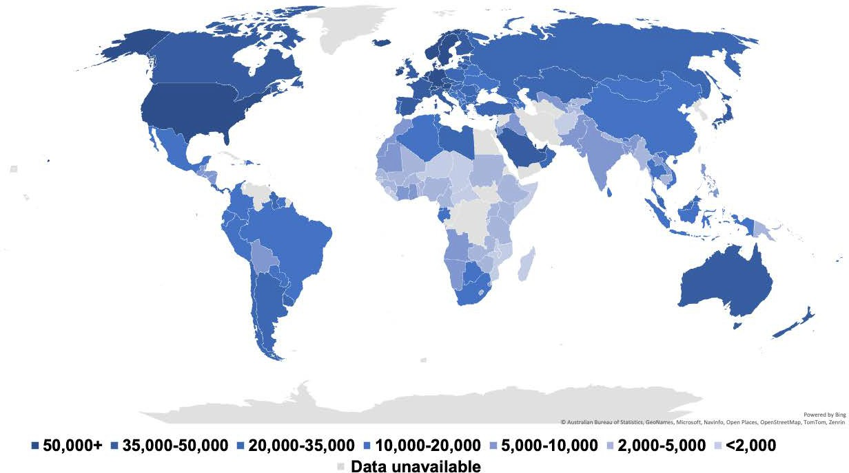
Notes:
Figure 15.2

Slide 4
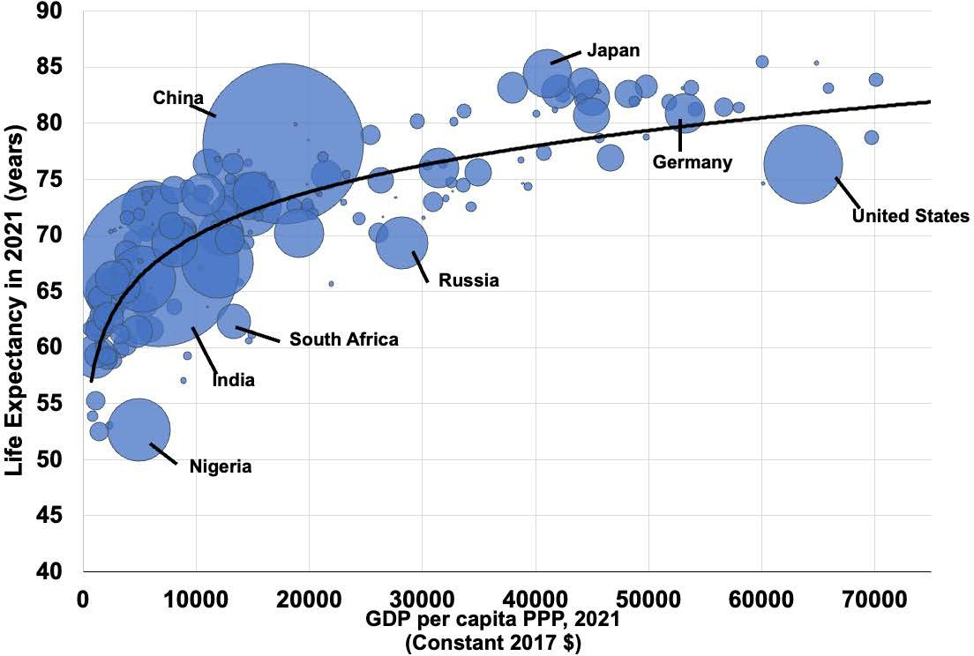
Notes:
Figure 15.3

Slide 5
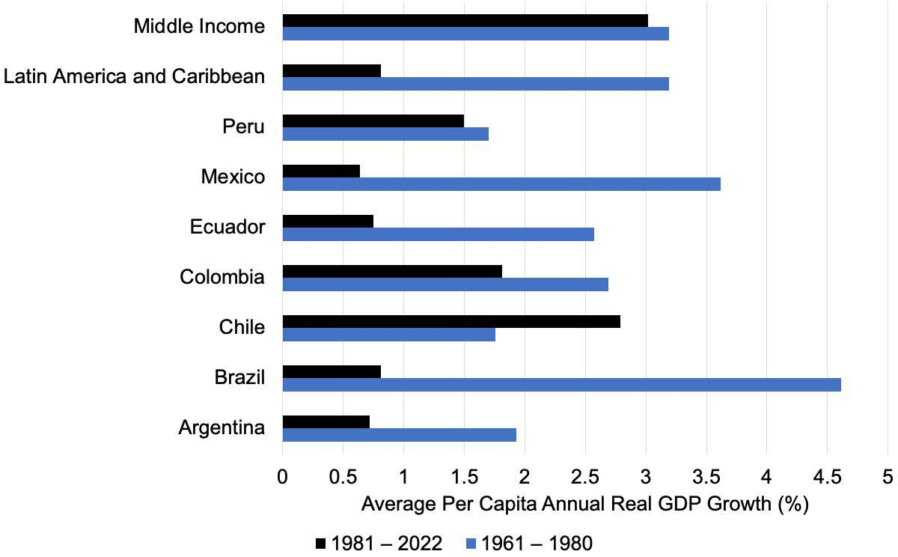
Notes:
Figure 15.4

Slide 6
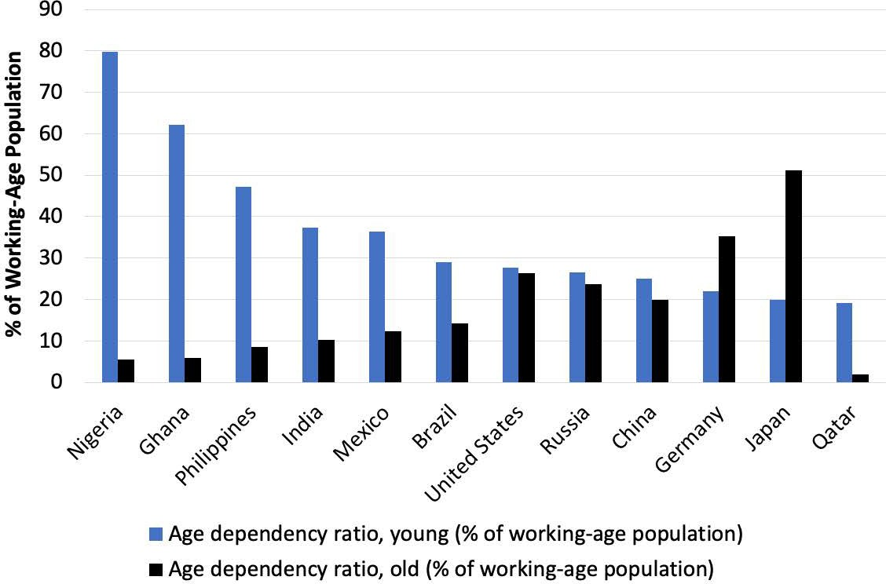
Notes:
Figure 15.5

Slide 7
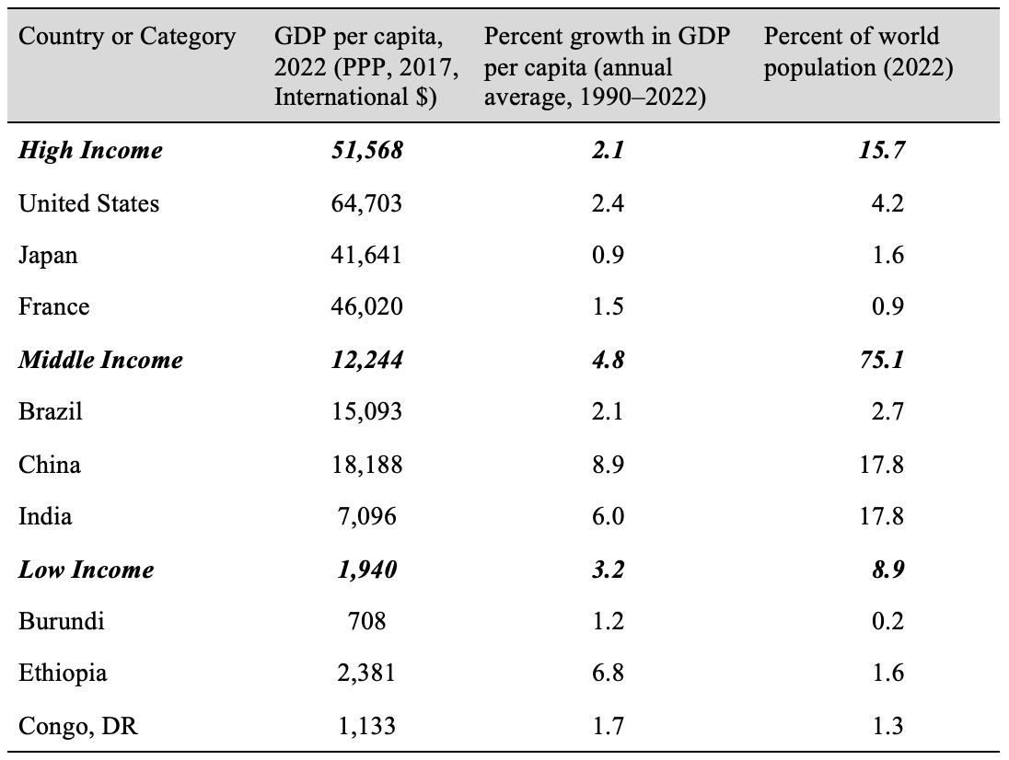
Table 15.1 Income, Growth, and Population Comparison Selected Countries and Country Groups

Slide 8
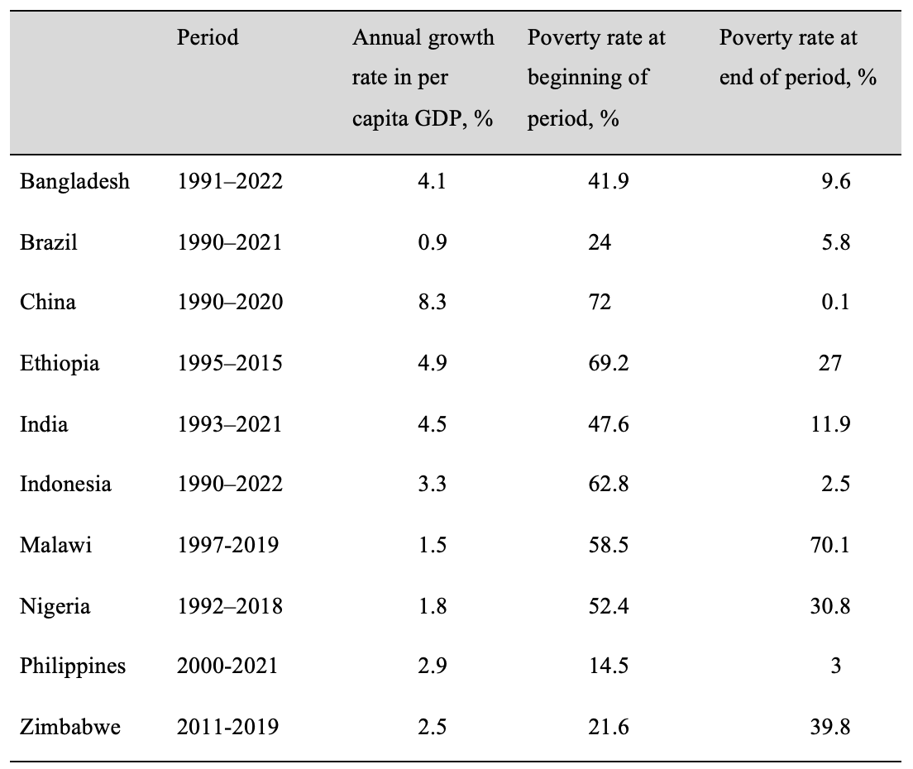
Table 15.2 Growth Rates and Changes in Poverty Rates, Select Countries
Notes:
Table 15.2

Slide 9
Table 15.3 Population in Multidimensional Poverty and Income Poverty
Notes:
Table 15.3

