Slide 1
Chapter 14:
Economic Inequality

Slide 2
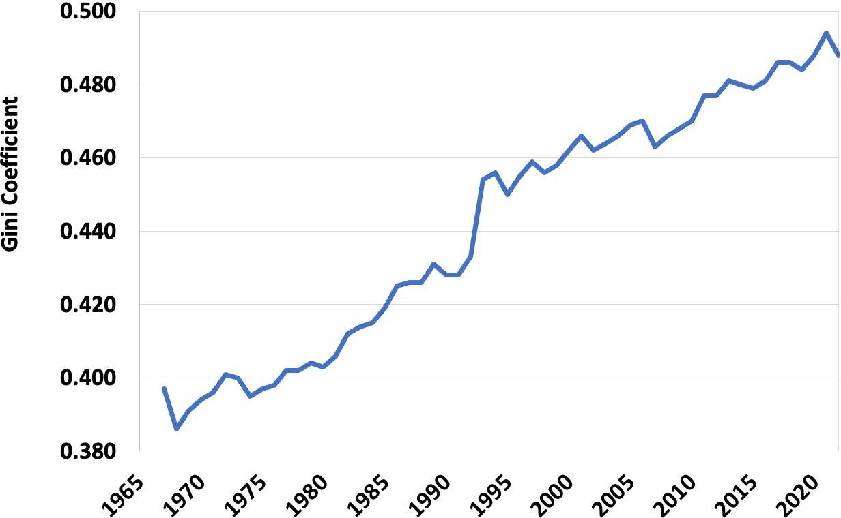
Notes:
Figure 14.1

Slide 3
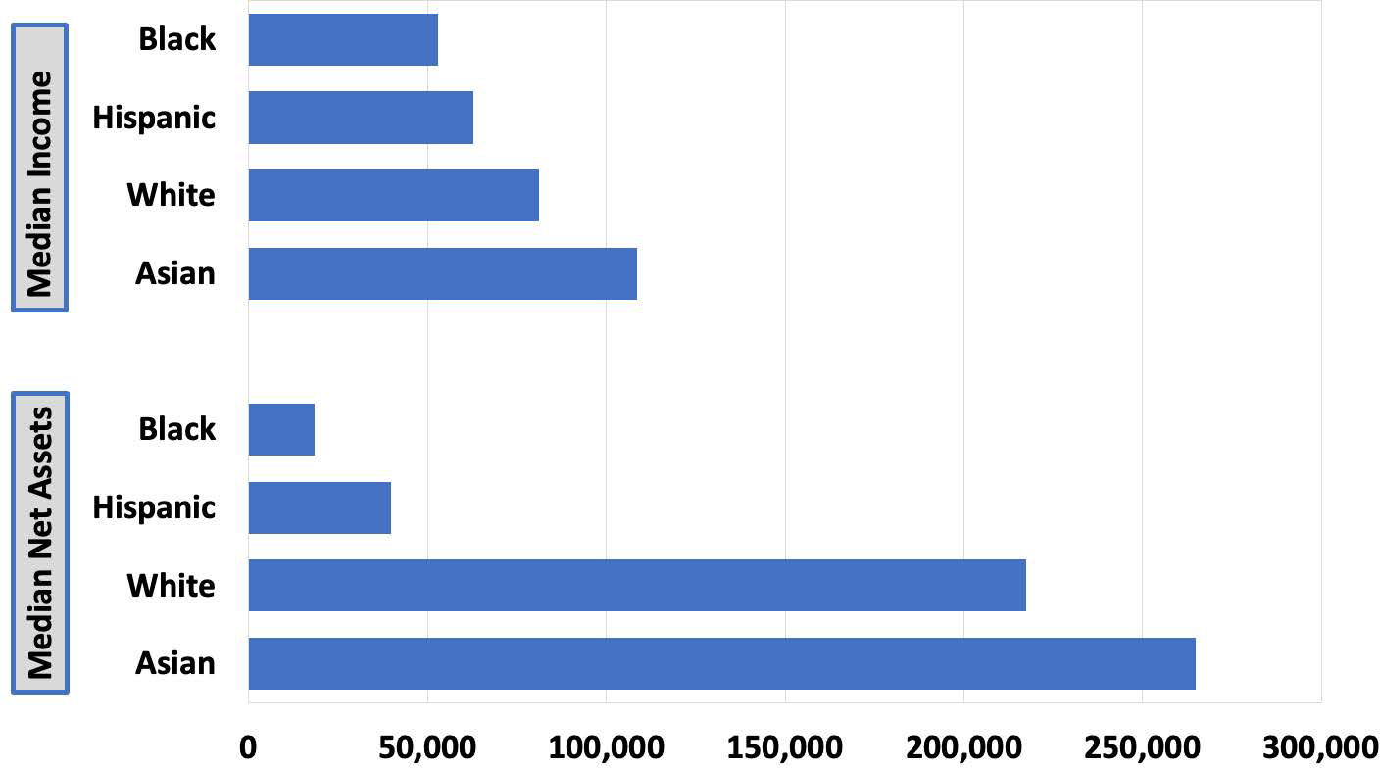
Notes:
Figure 14.2

Slide 4
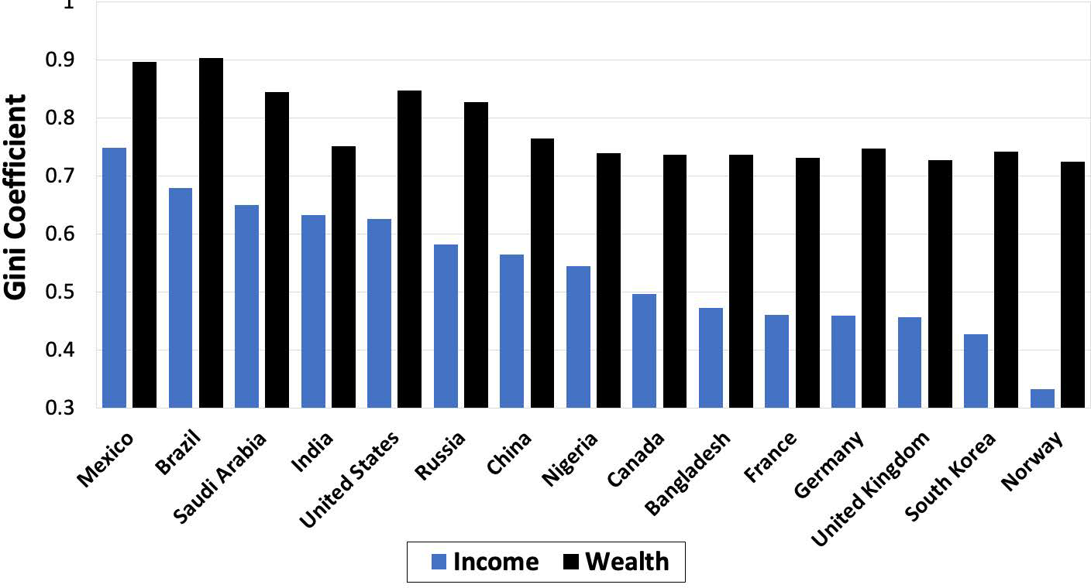
Notes:
Figure 14.3

Slide 5
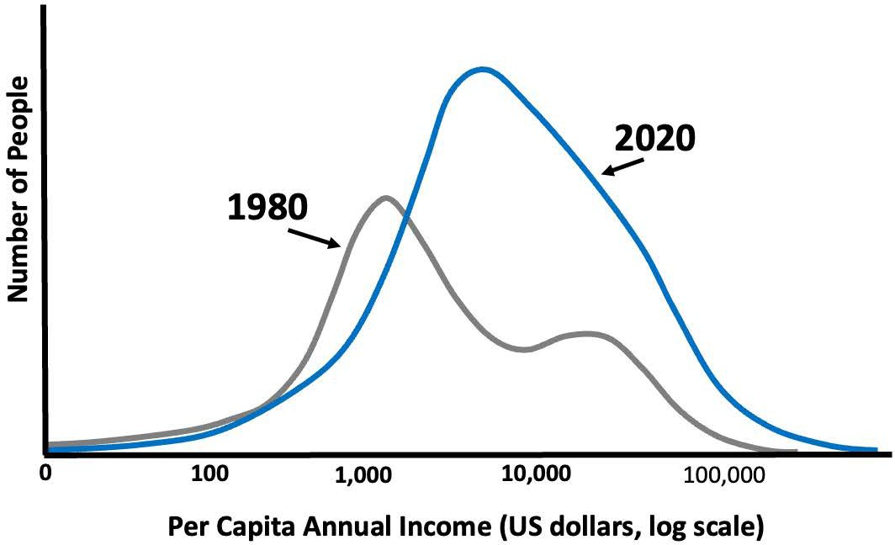
Notes:
Figure 14.4

Slide 6
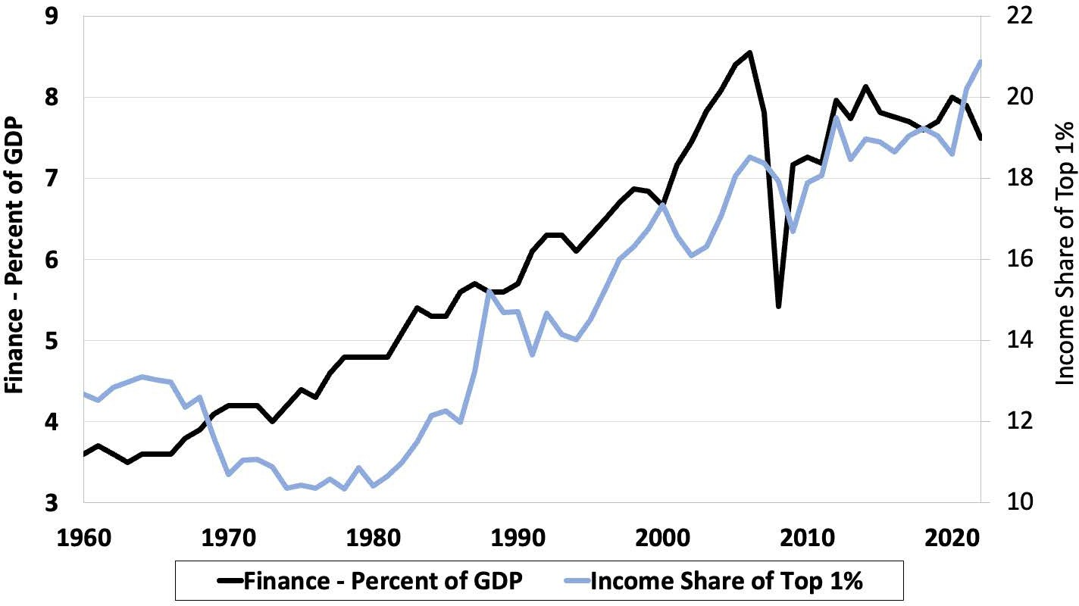
Notes:
Figure 14.5

Slide 7
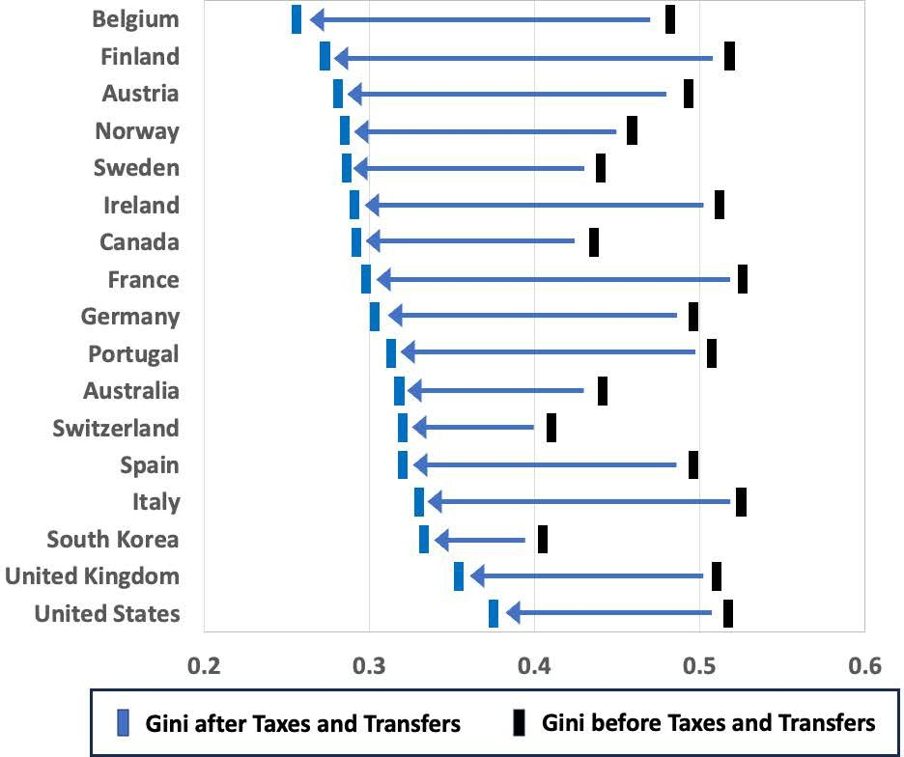
Notes:
Figure 14.6

Slide 8
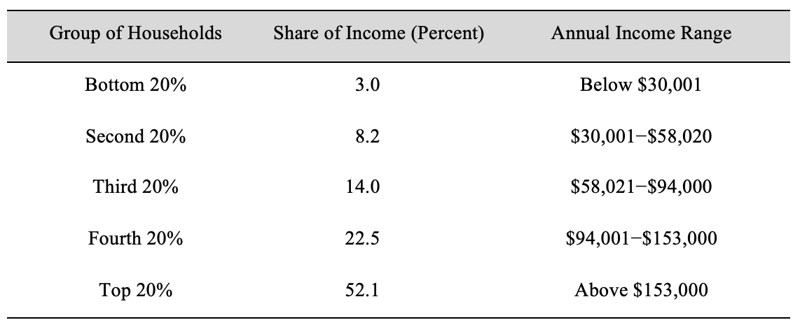
Table 14.1 Household Income Distribution in the United States, 2022
Notes:
Table 14.1

