Slide 1
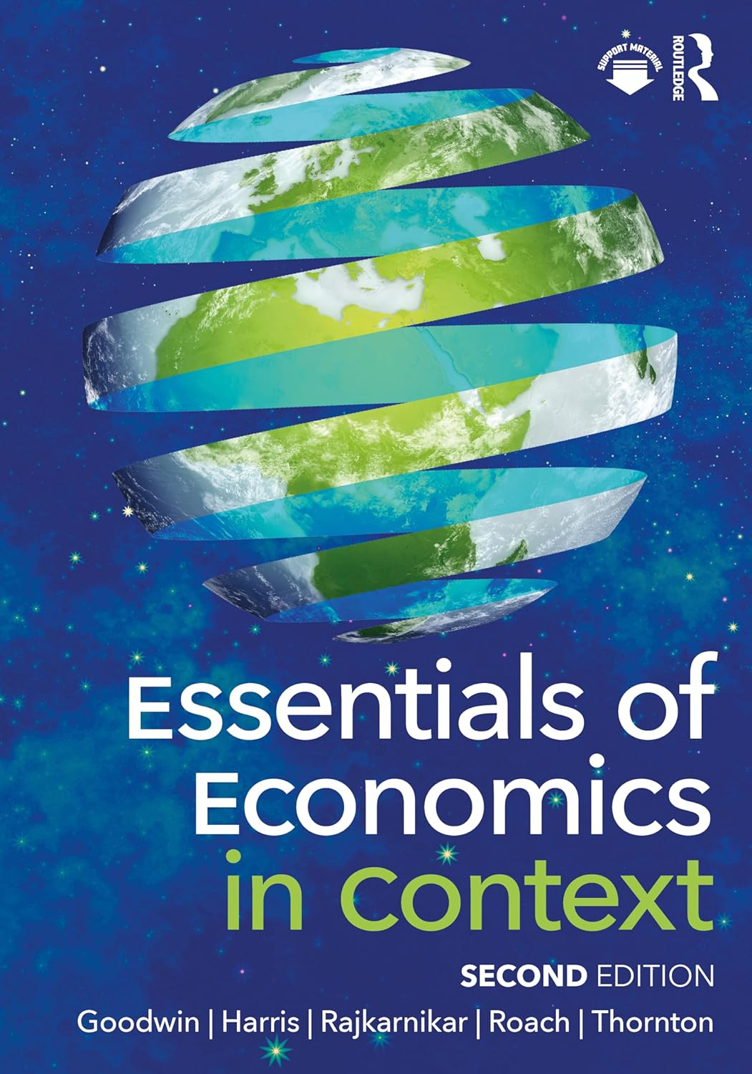
Chapter 13:
The Global Economy and Policy

Slide 2
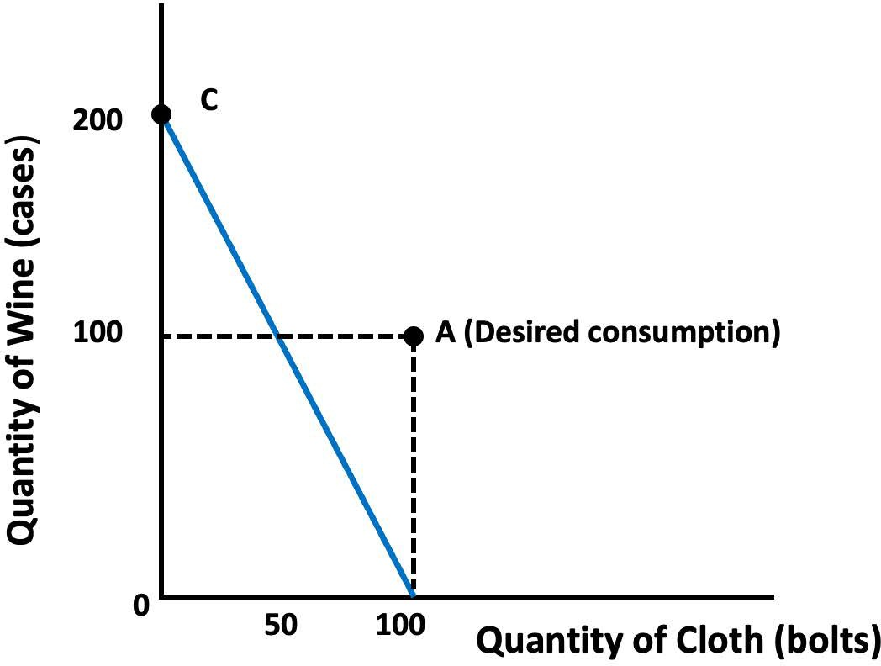
Notes:
Figure 13.1

Slide 3
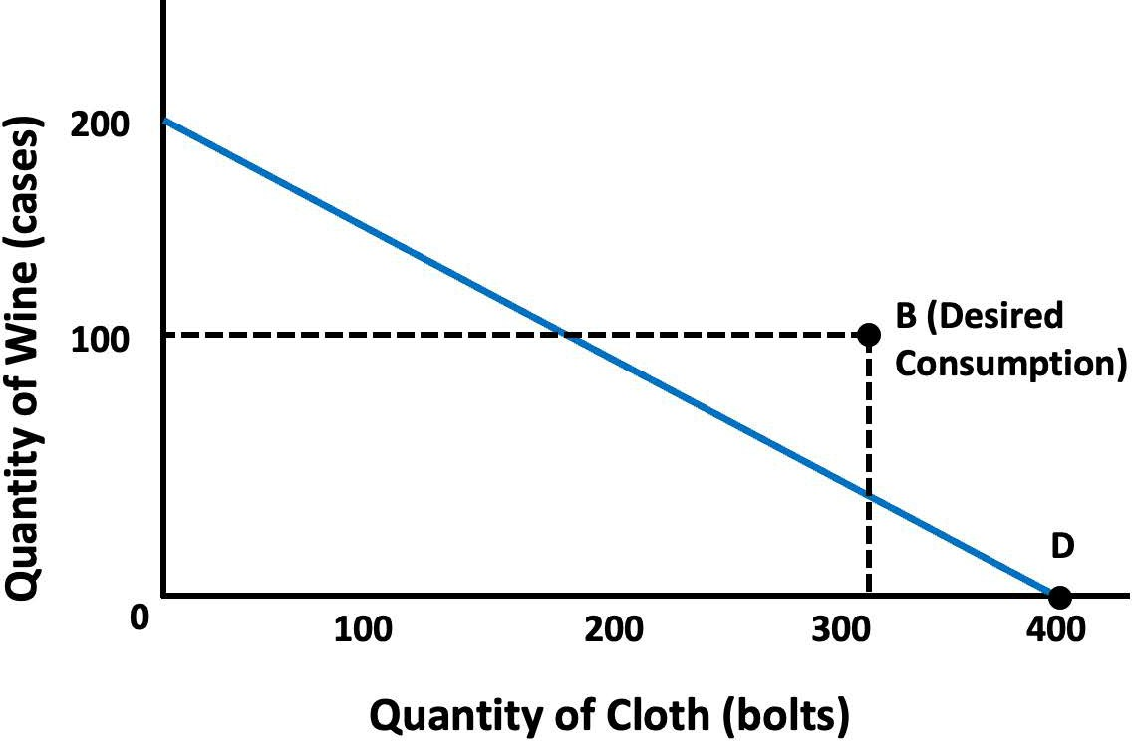
Notes:
Figure 13.2

Slide 4
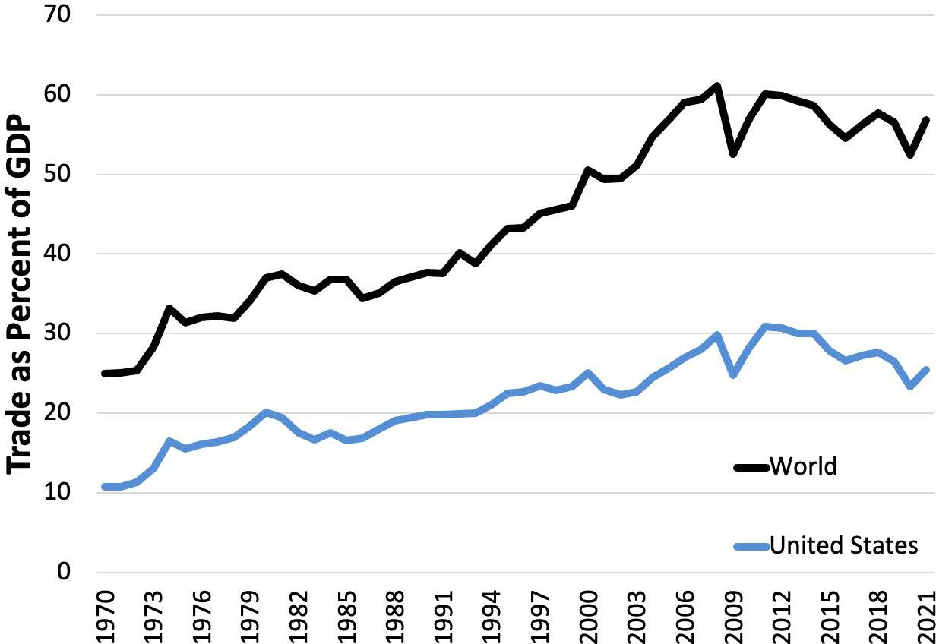
Notes:
Figure 13.3

Slide 5
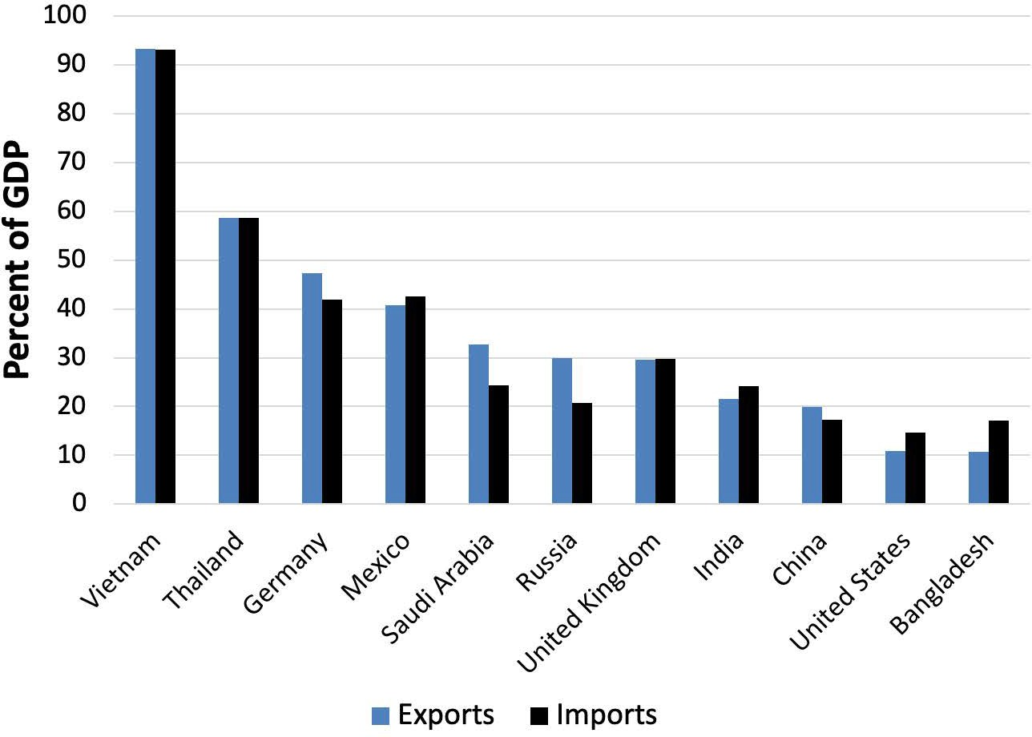
Notes:
Figure 13.4

Slide 6
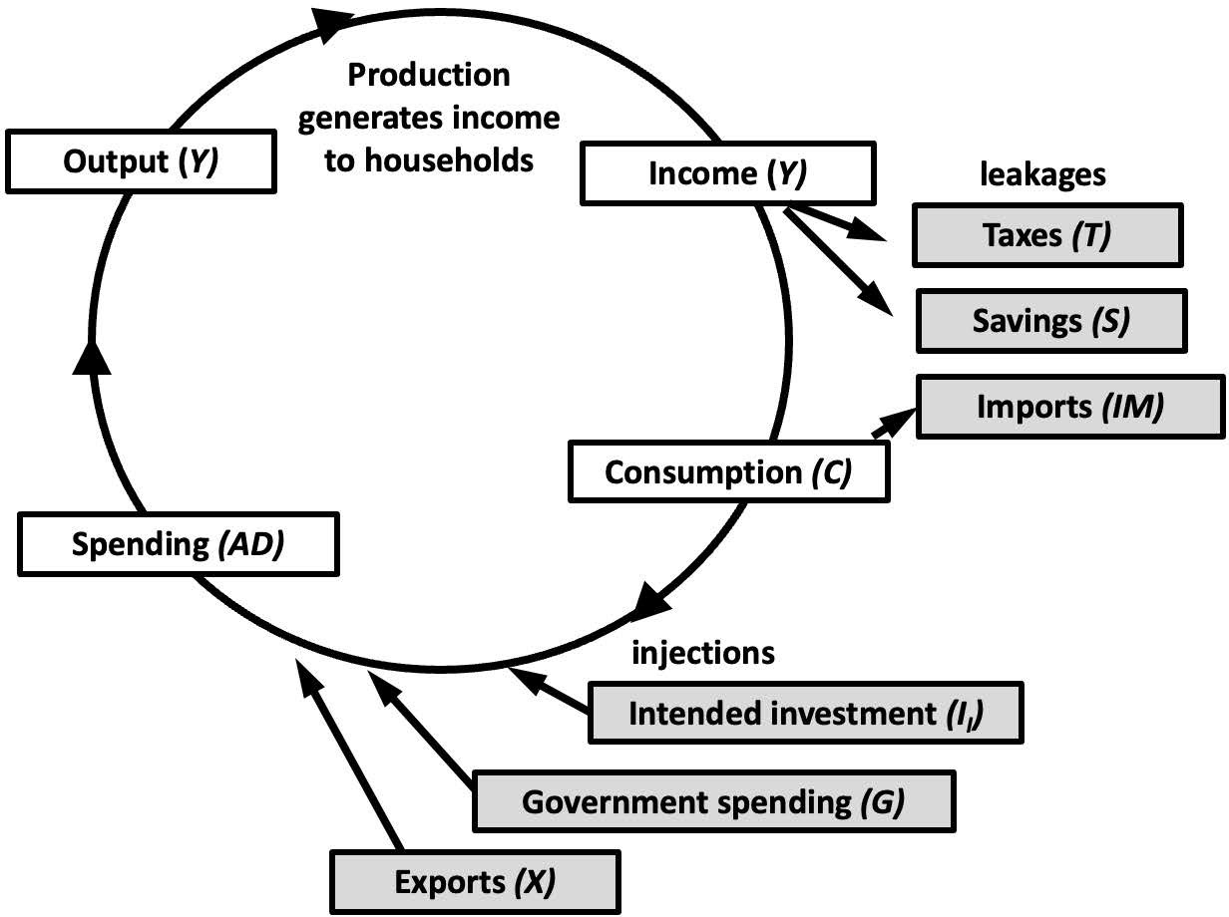
Notes:
Figure 13.5

Slide 7
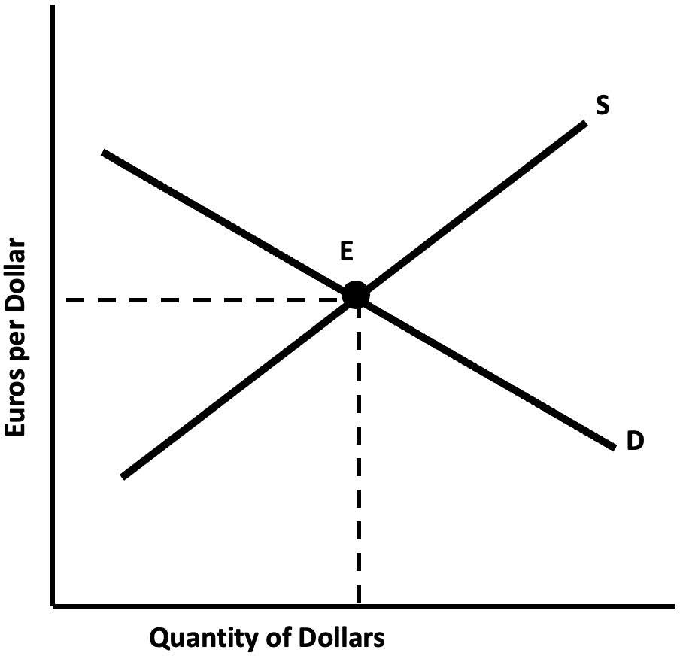
Notes:
Figure 13.6

Slide 8
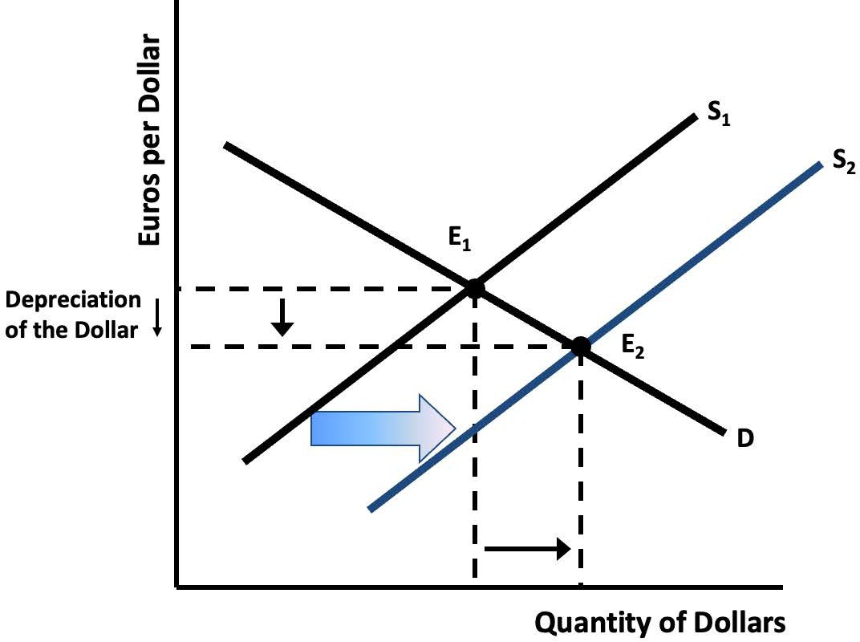
Notes:
Figure 13.7

Slide 9
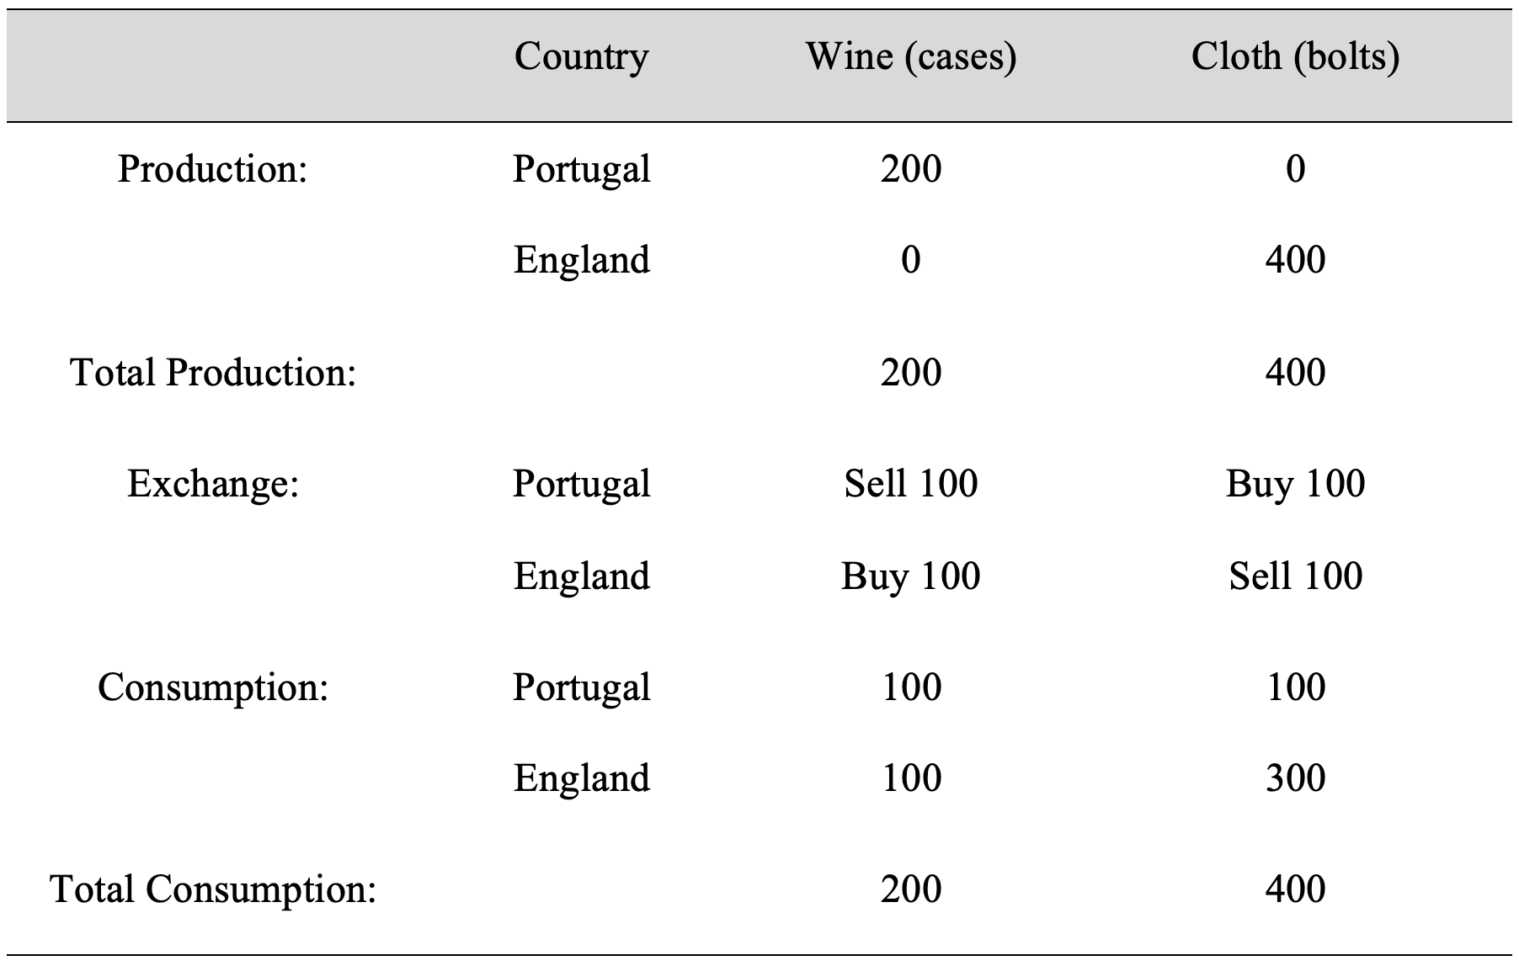
Table 13.1: Production, Exchange, and Consumption of Wine and Cloth
Notes:
Table 13.1

Slide 10
Table 13.2: Opportunity Cost and Comparative Advantage

Slide 11
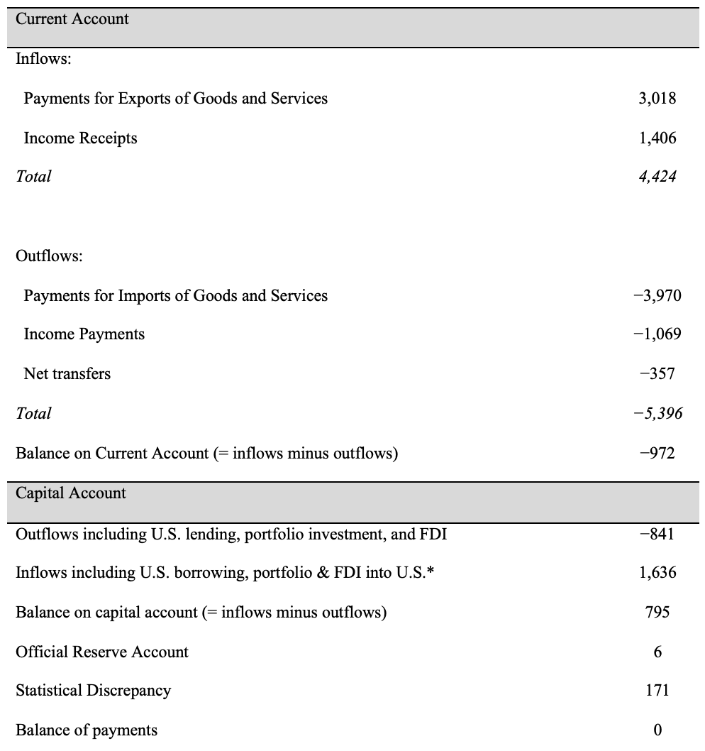
Table 13.3 U.S. Balance of Payments Account (2022), Billions of Dollars

