Slide 1
Chapter 12:
Aggregate Supply, Aggregate Demand, and Inflation: Putting it All Together

Slide 2
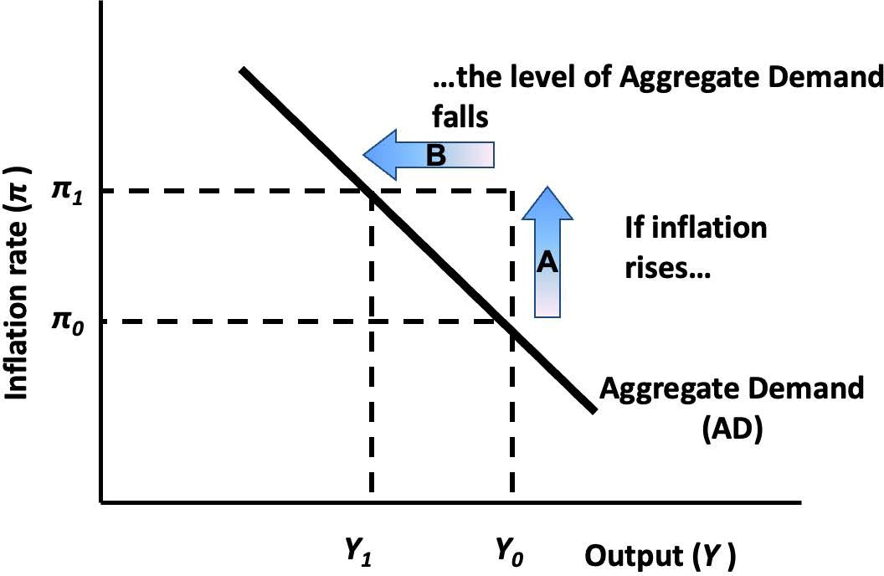
Notes:
Figure 12.1

Slide 3
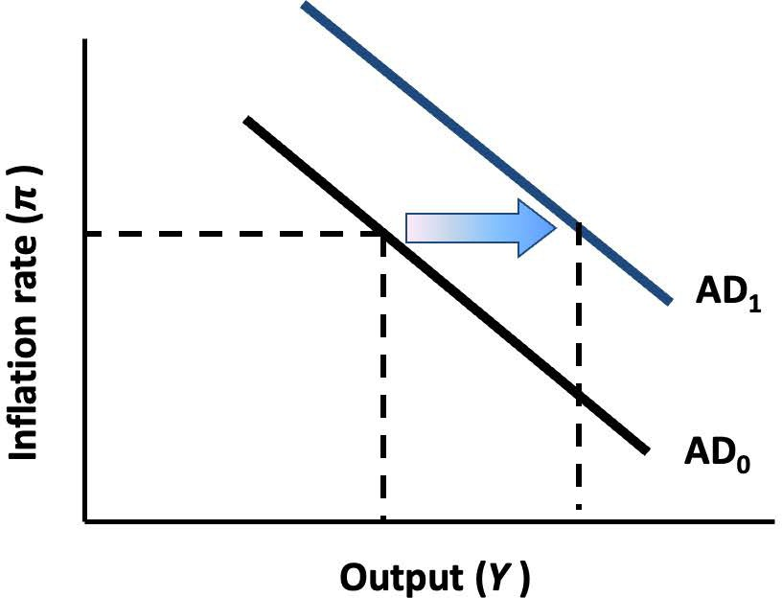
Notes:
Figure 12.2

Slide 4
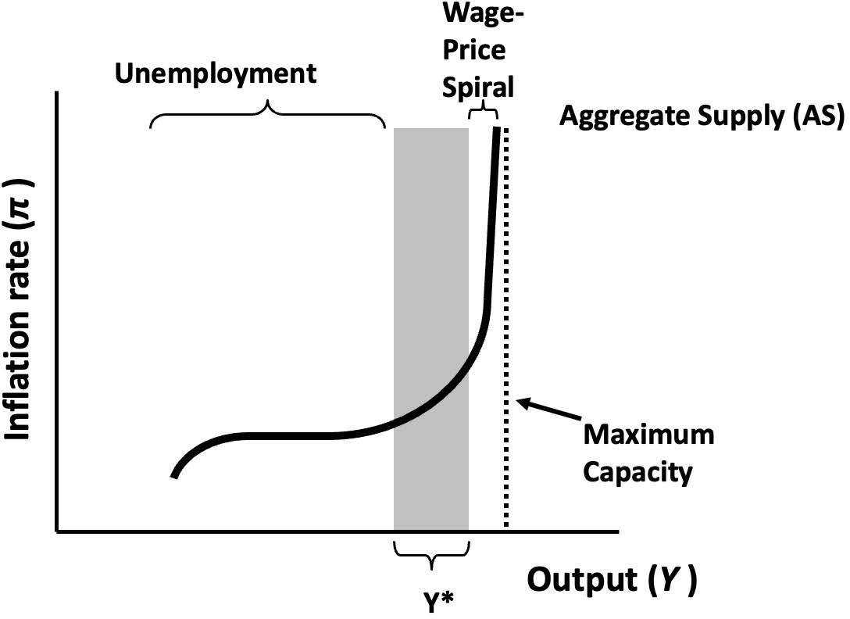
Notes:
Figure 12.3

Slide 5
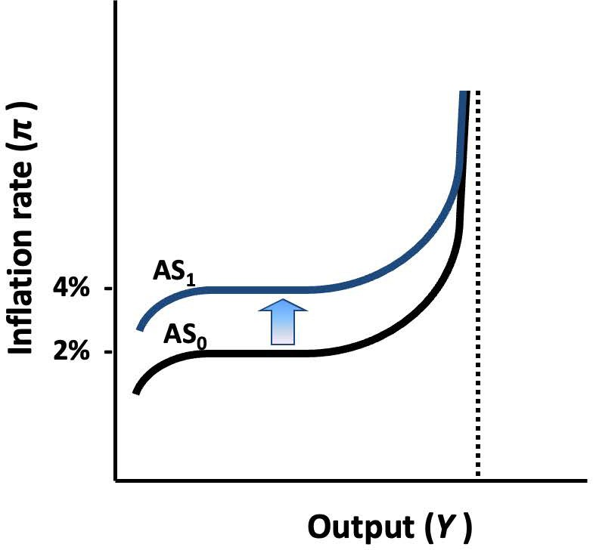
Notes:
Figure 12.4

Slide 6
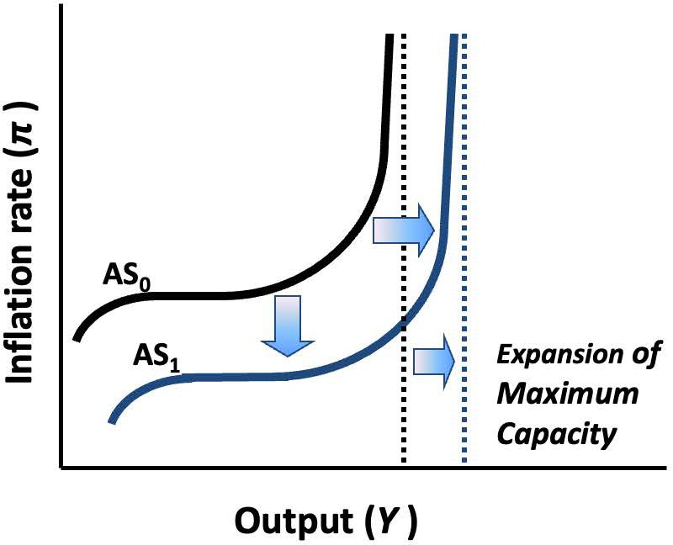
Notes:
Figure 12.5

Slide 7
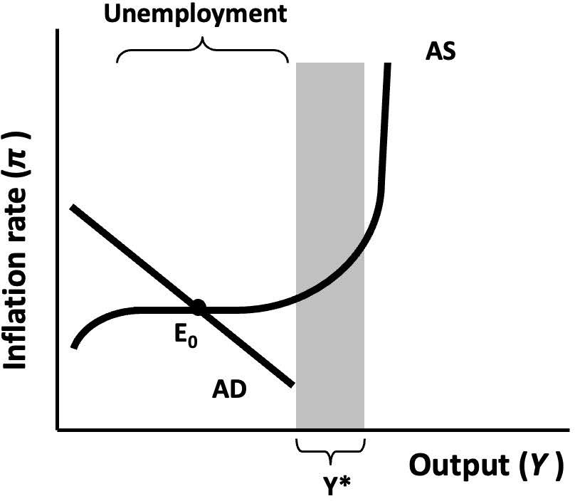
Notes:
Figure 12.6

Slide 8
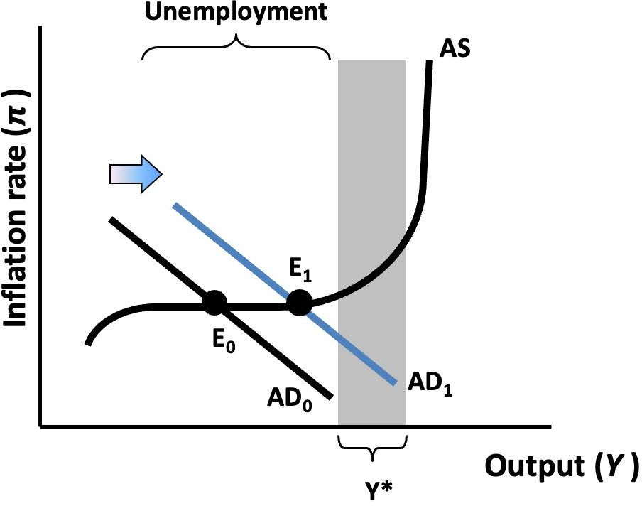
Notes:
Figure 12.7

Slide 9
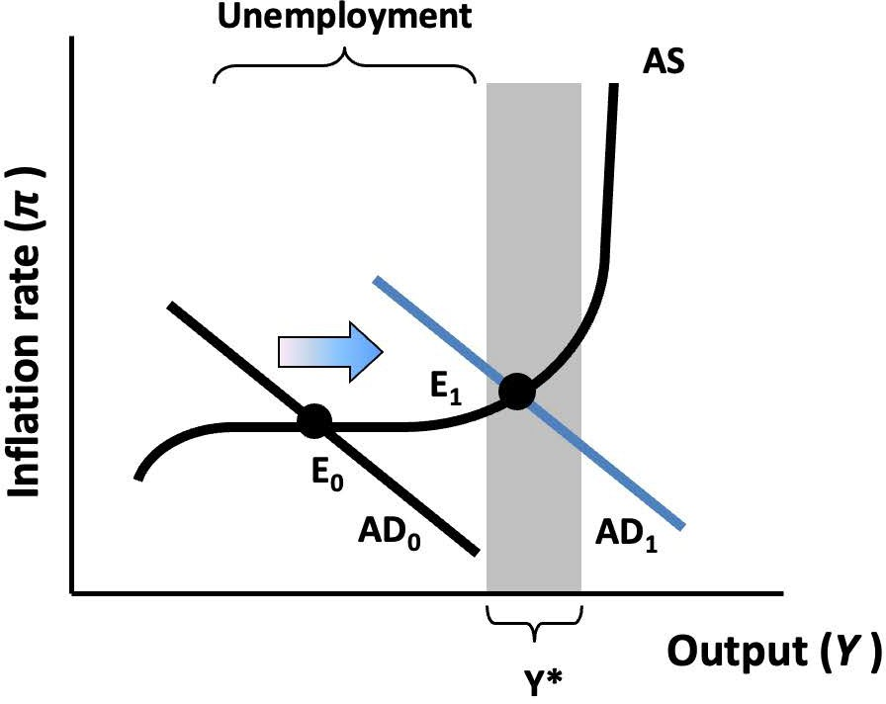
Notes:
Figure 12.8

Slide 10
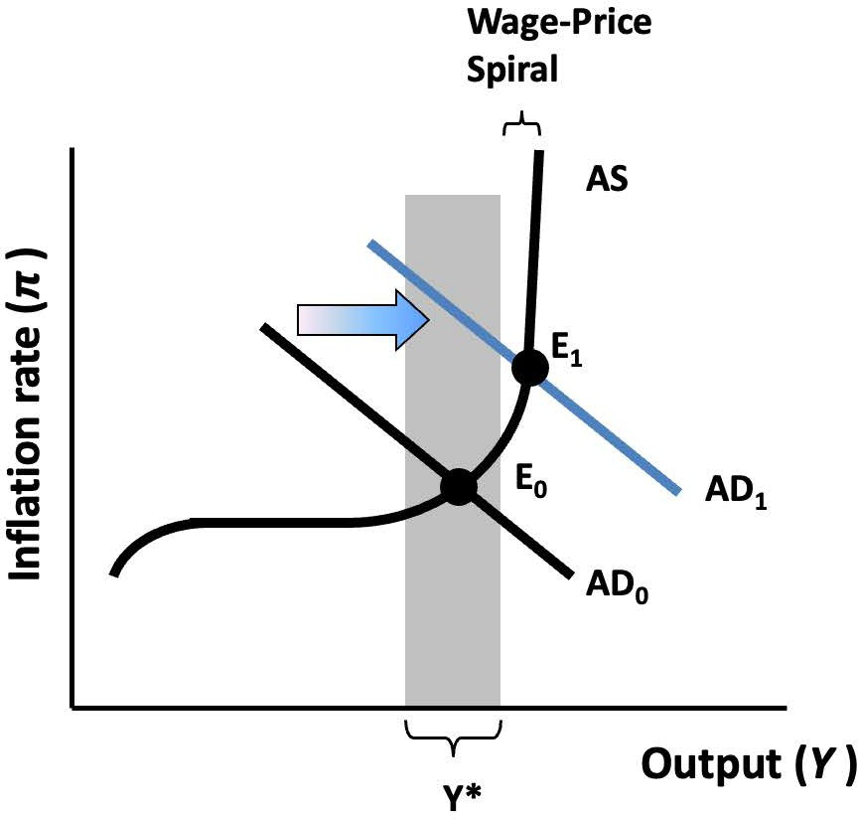
Notes:
Figure 12.9

Slide 11
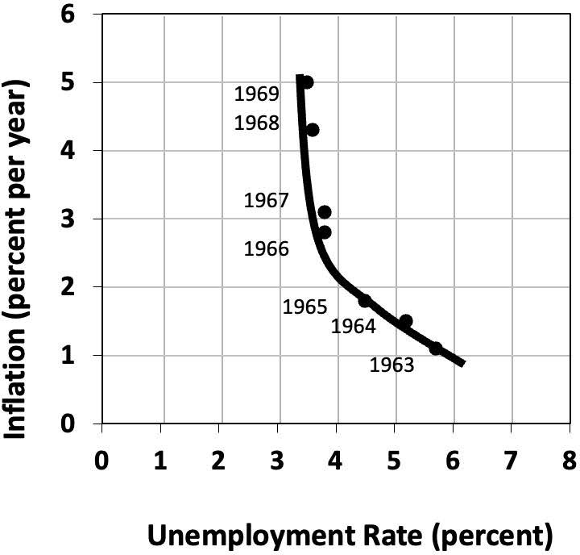
Notes:
Figure 12.10

Slide 12
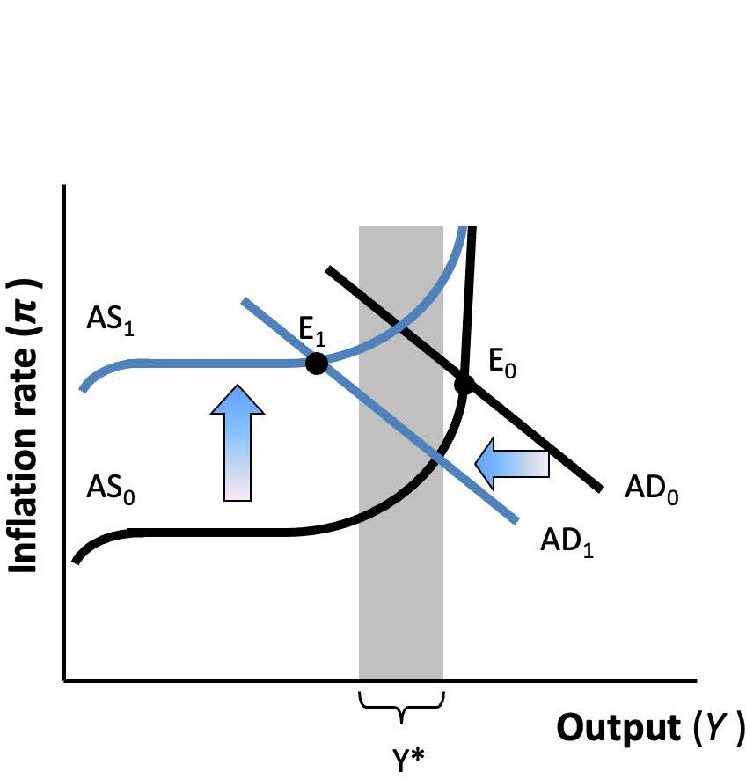
Notes:
Figure 12.11

Slide 13
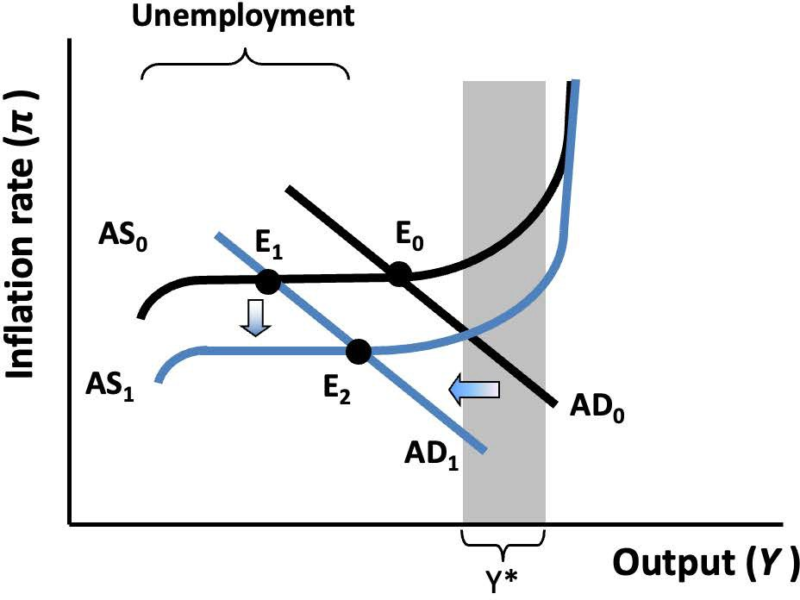
Notes:
Figure 12.12

Slide 14
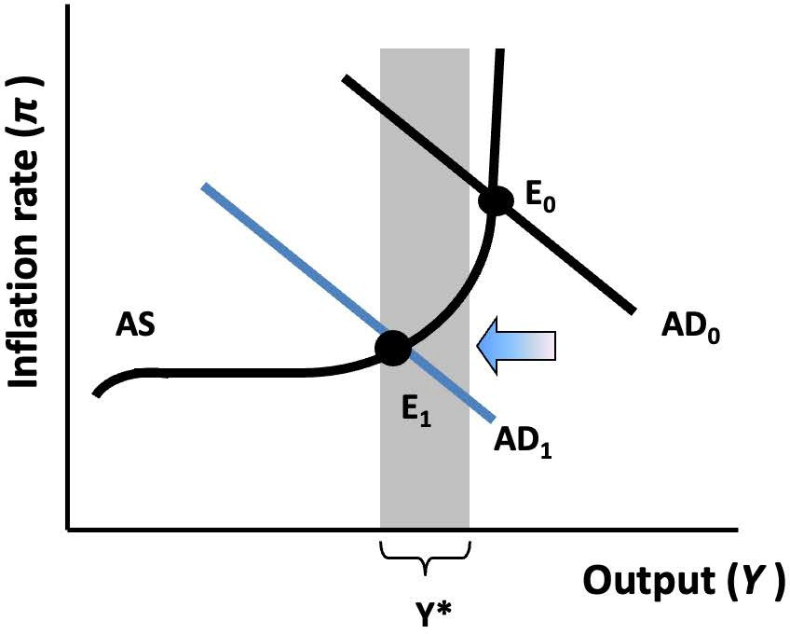
Notes:
Figure 12.13

Slide 15
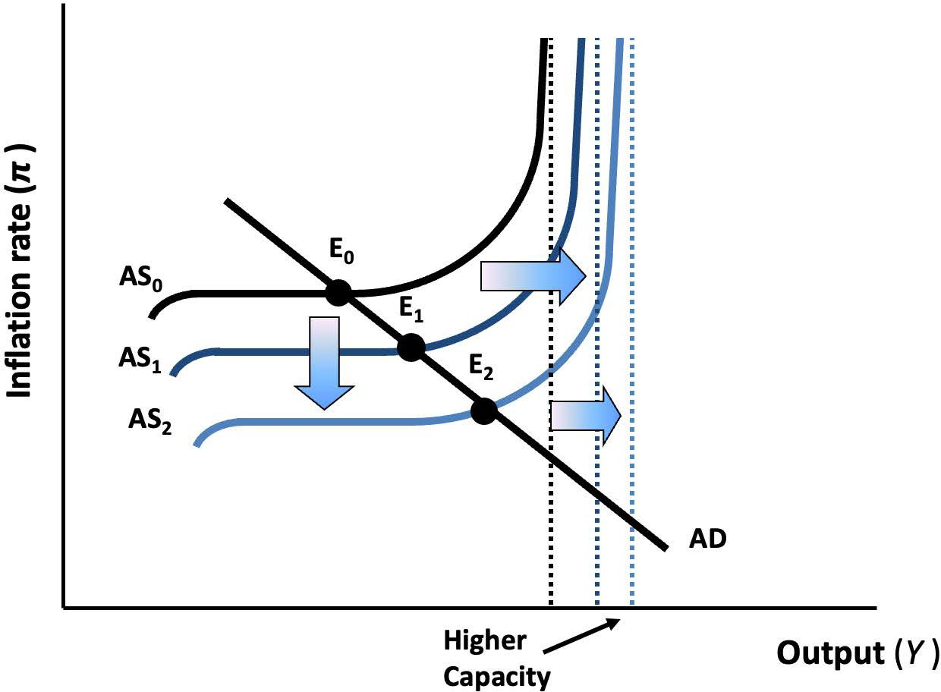
Notes:
Figure 12.14

Slide 16
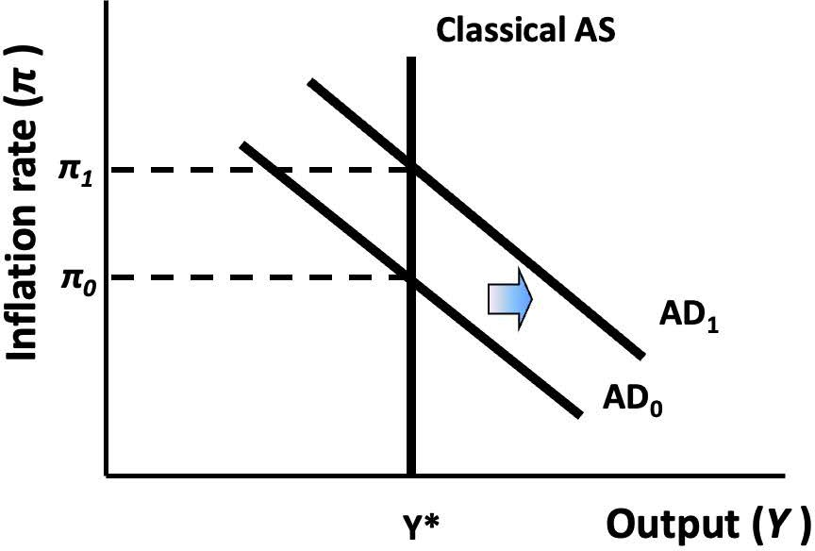
Notes:
Figure 12.15

