Slide 1
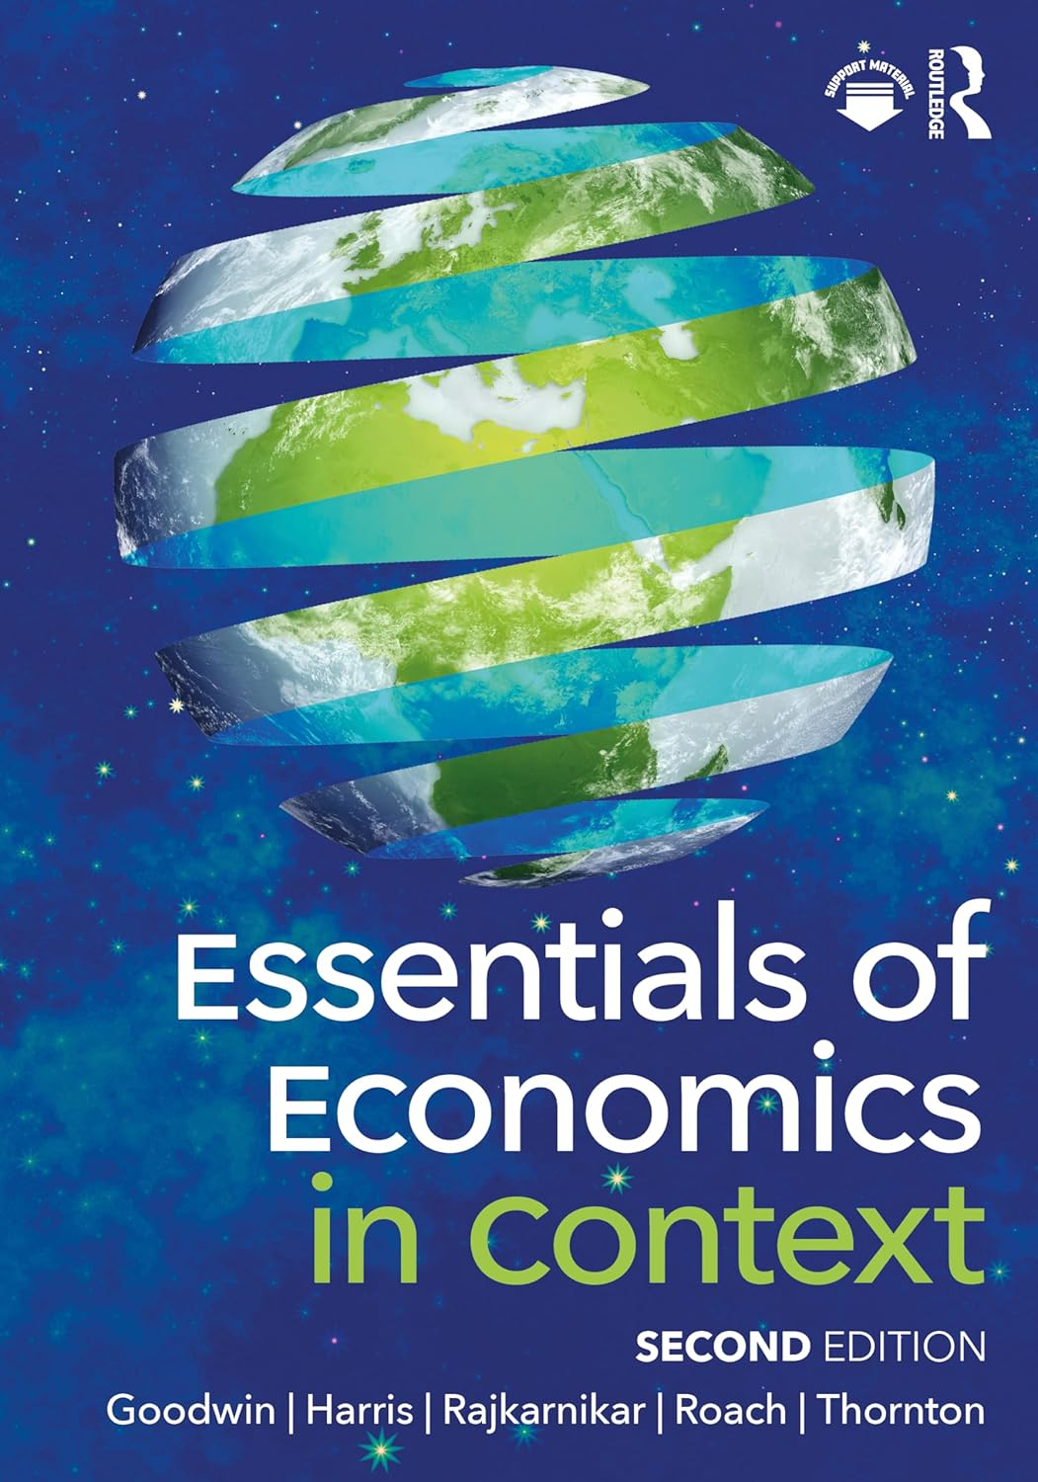
Chapter 11:
Money and Monetary Policy

Slide 2
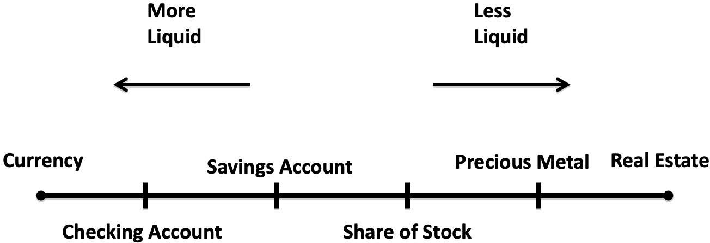
Notes:
Figure 11.1

Slide 3
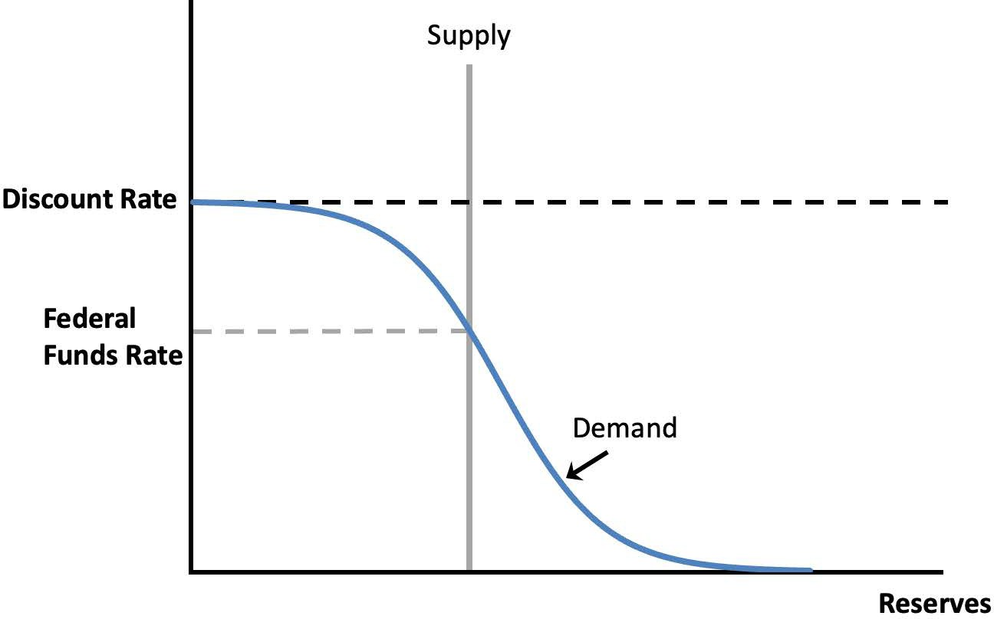
Notes:
Figure 11.2a

Slide 4
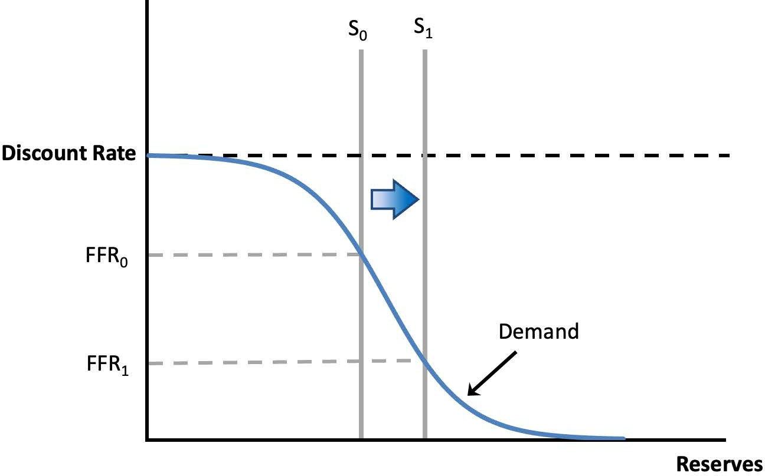
Notes:
Figure 11.2b

Slide 5
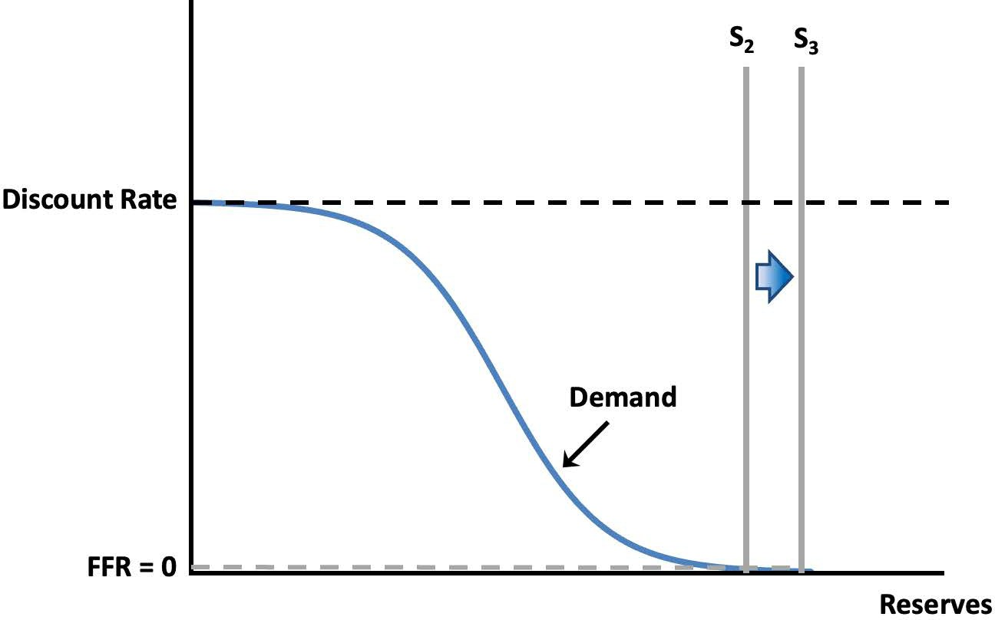
Notes:
Figure 11.3

Slide 6
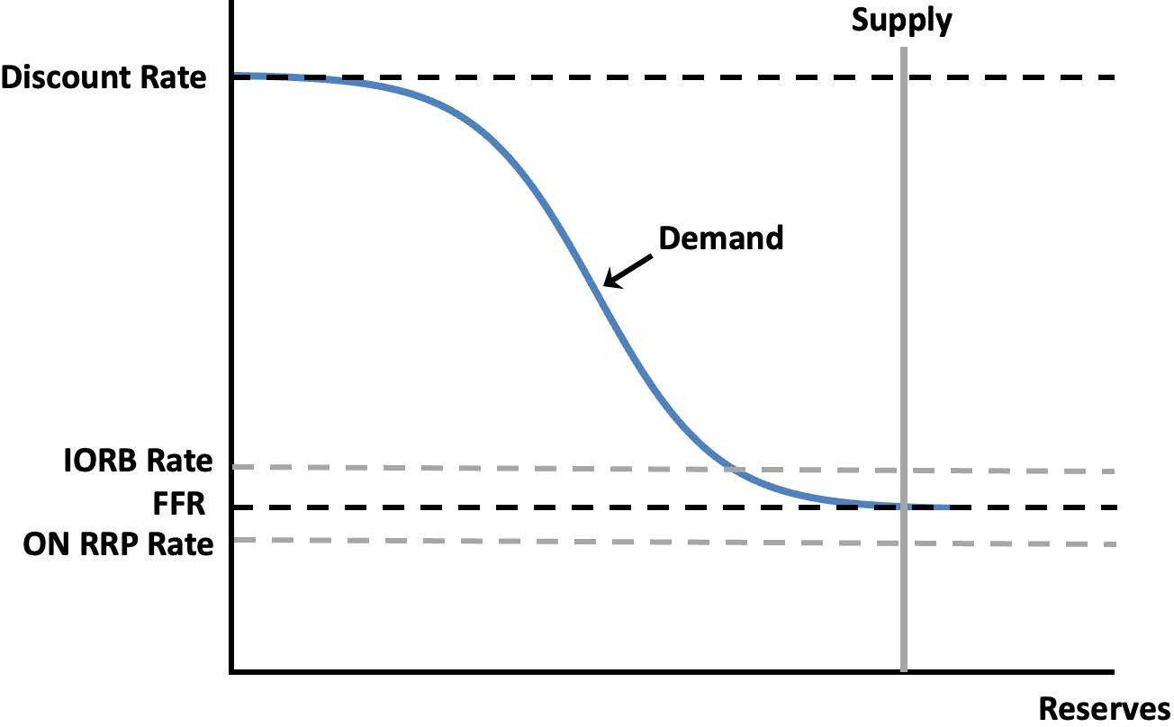
Notes:
Figure 11.3

Slide 7
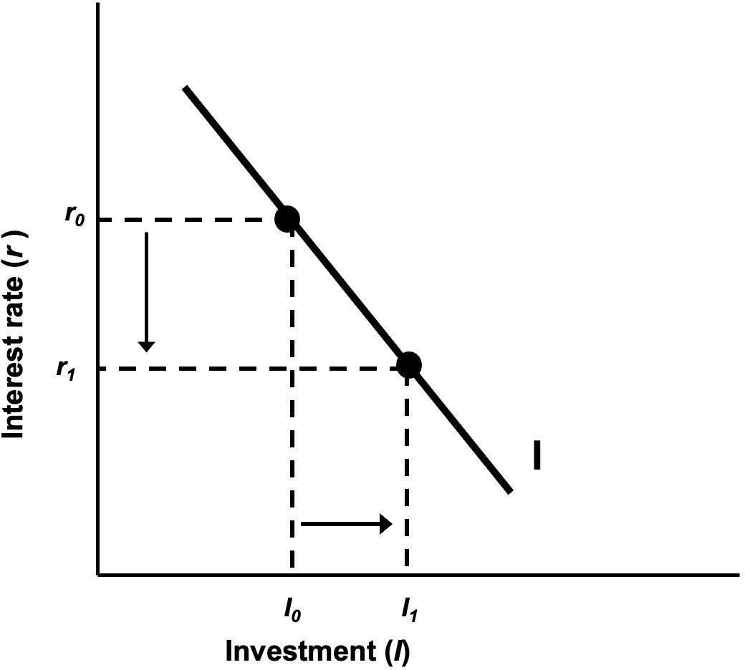
Notes:
Figure 11.4

Slide 8
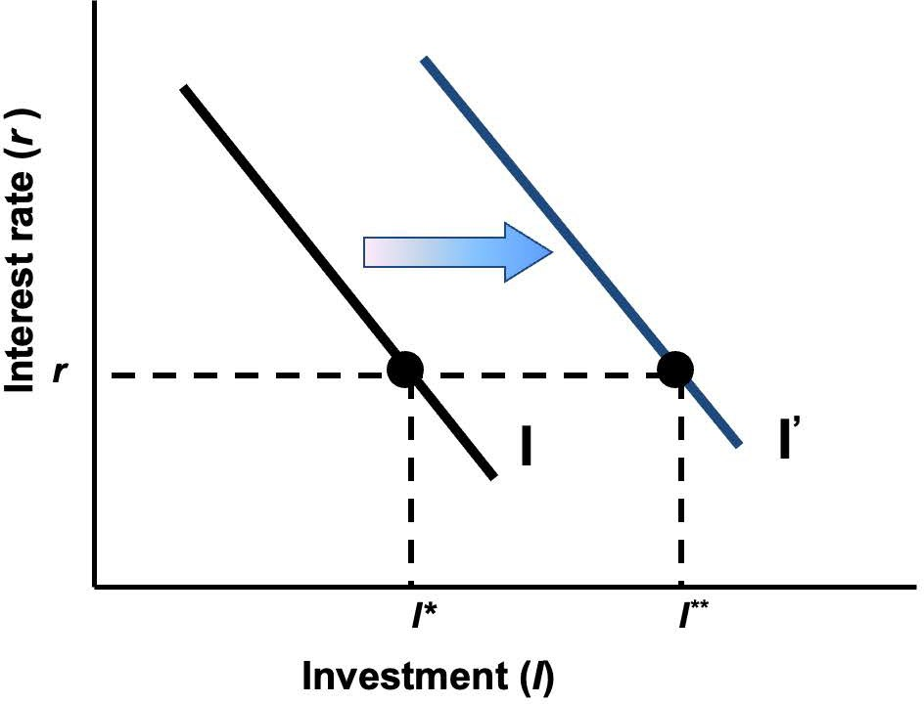
Notes:
Figure 11.5

Slide 9
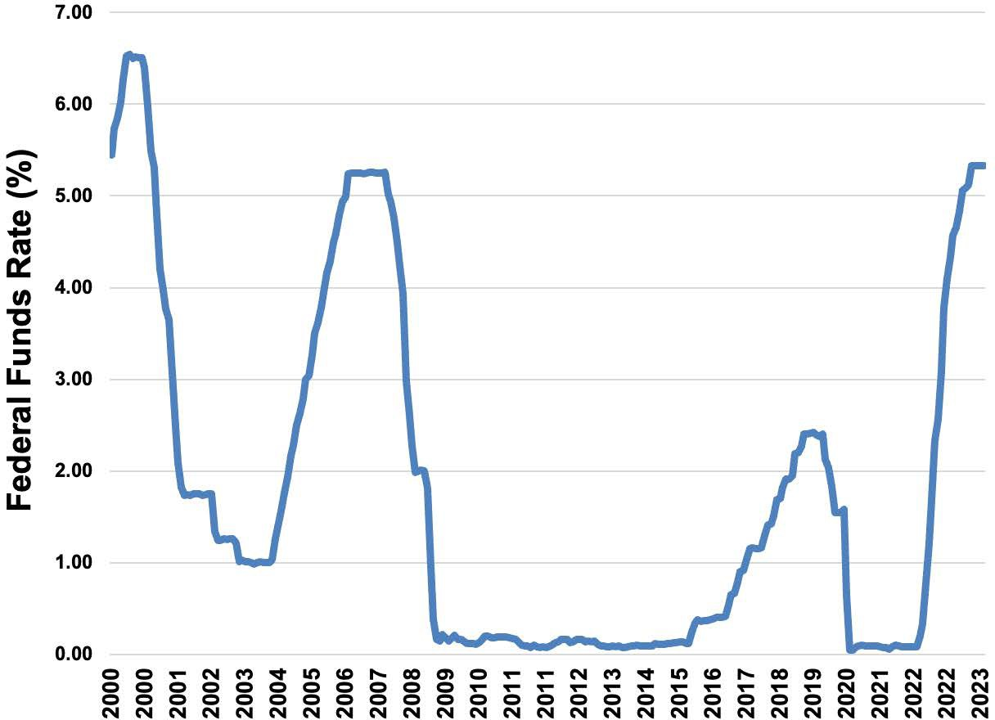
Notes:
Figure 11.6

Slide 10
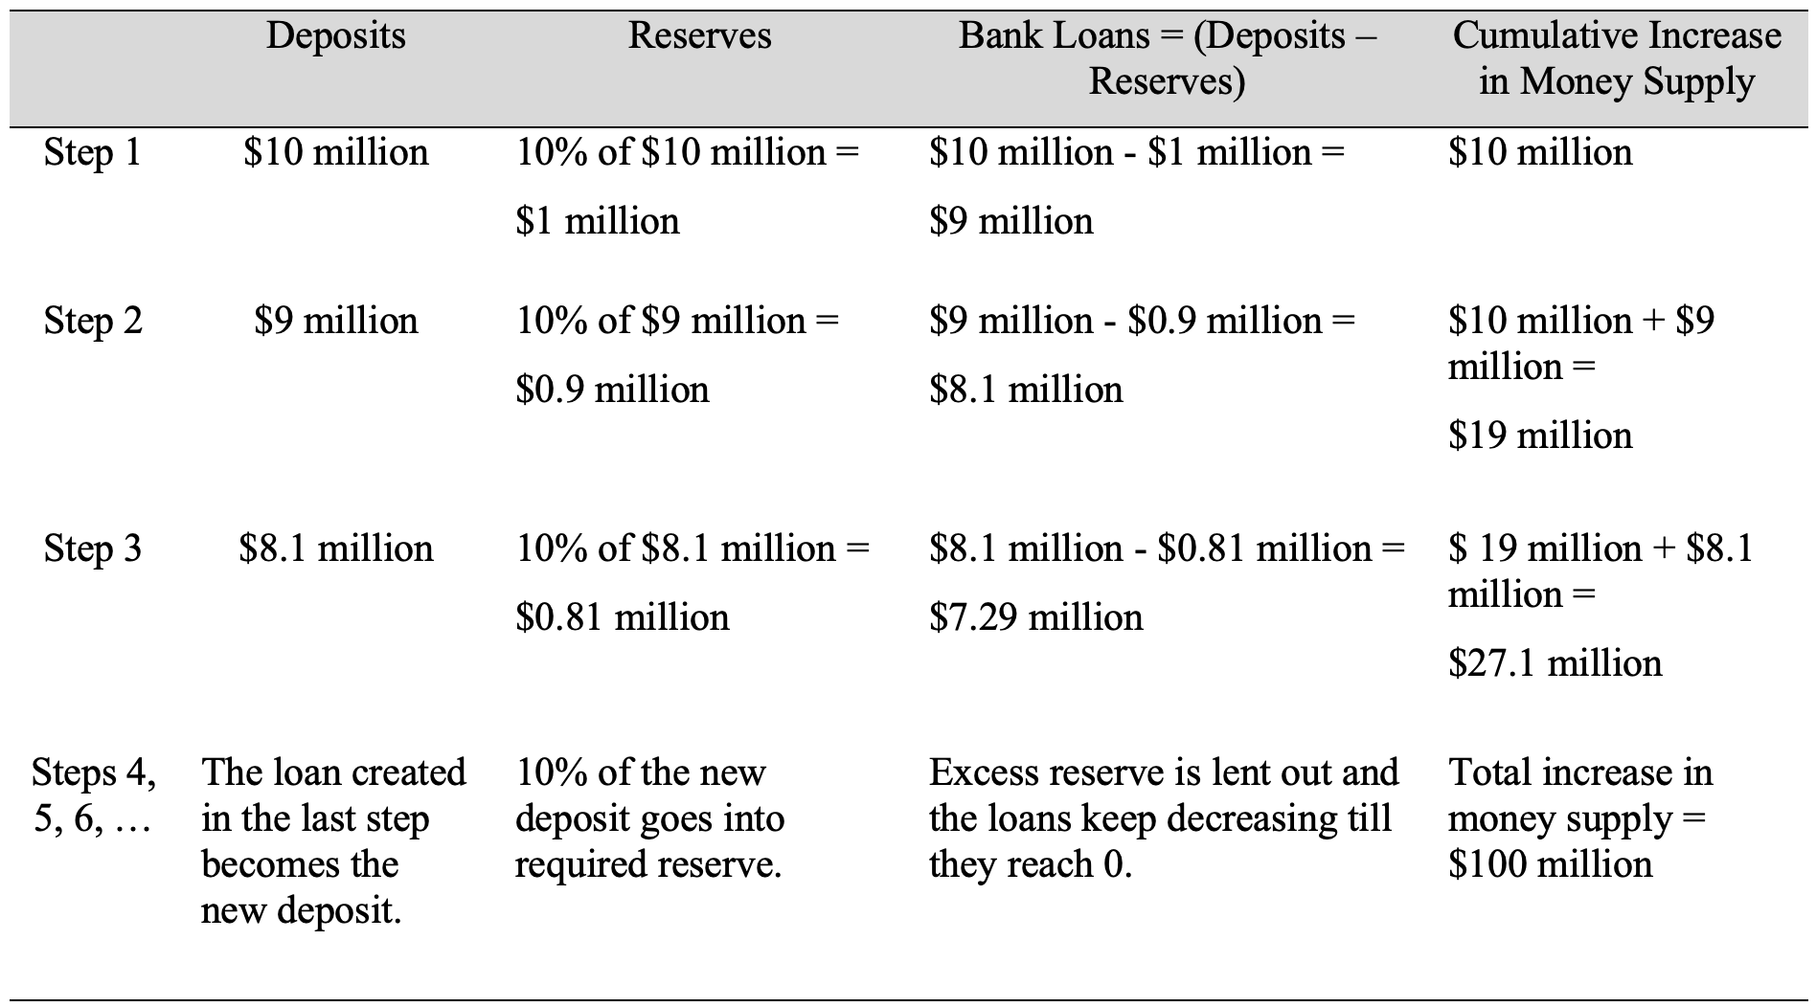
Table 11.1 The Money Multiplier Effect
Notes:
Table 11.1

