Slide 1
Chapter 10:
Fiscal Policy

Slide 2
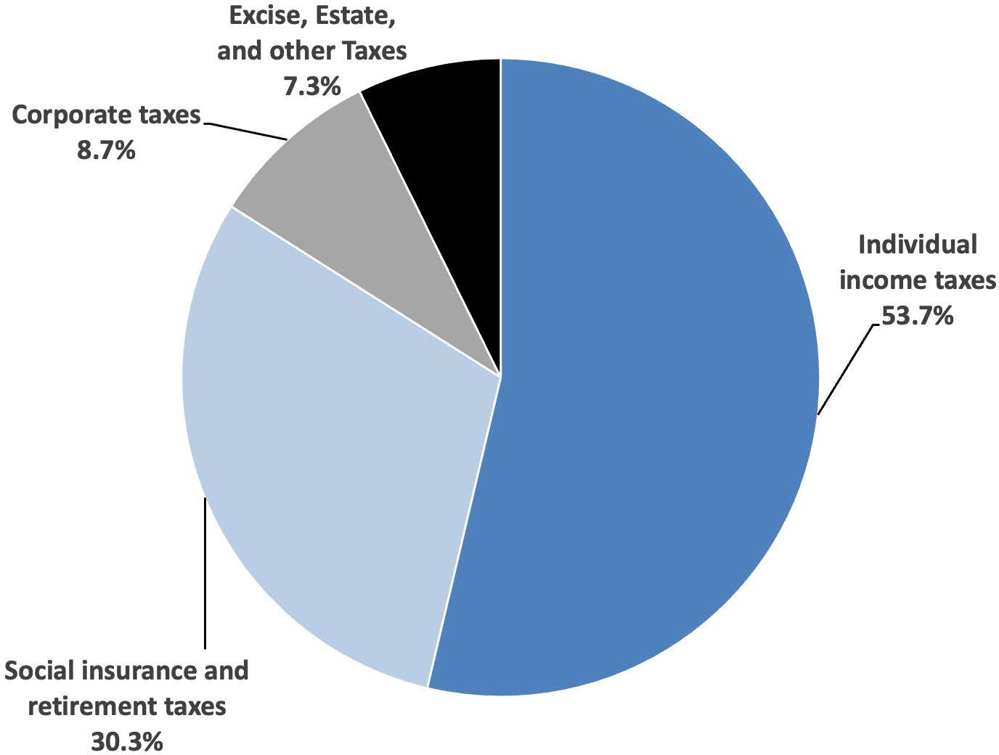
Notes:
Figure 10.1a

Slide 3
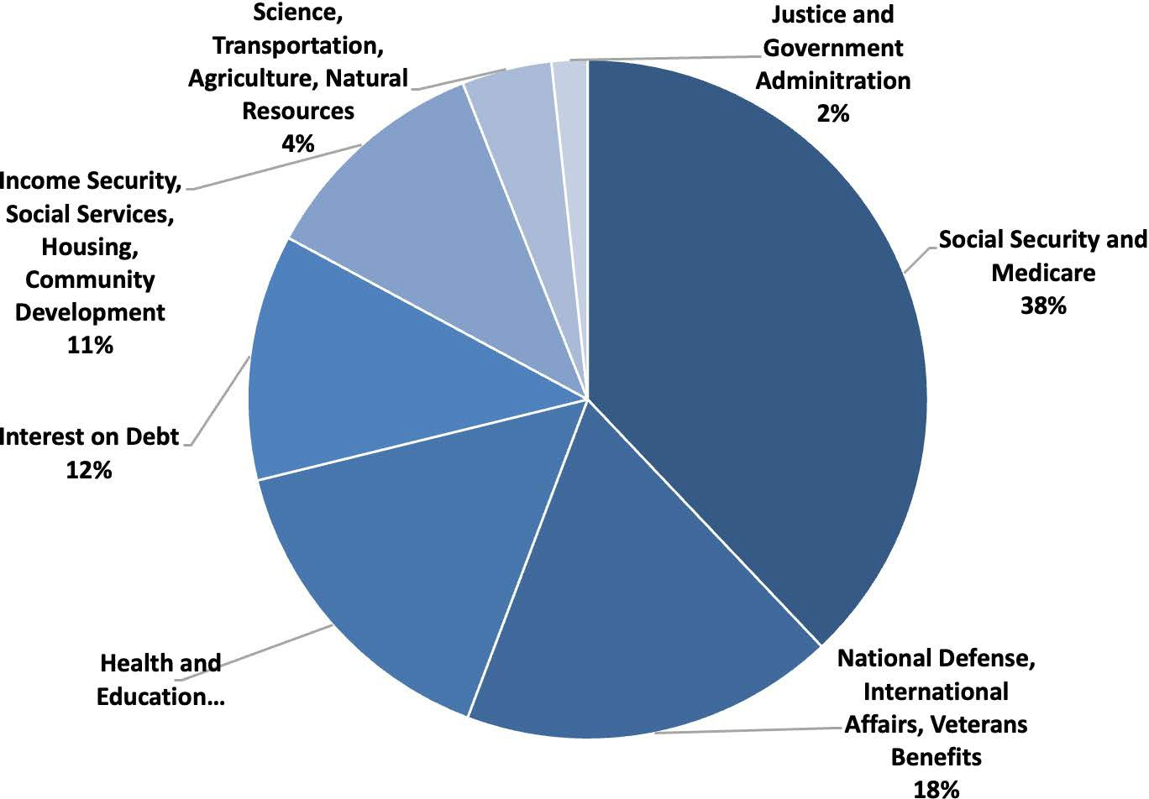
Notes:
Figure 10.1b

Slide 4
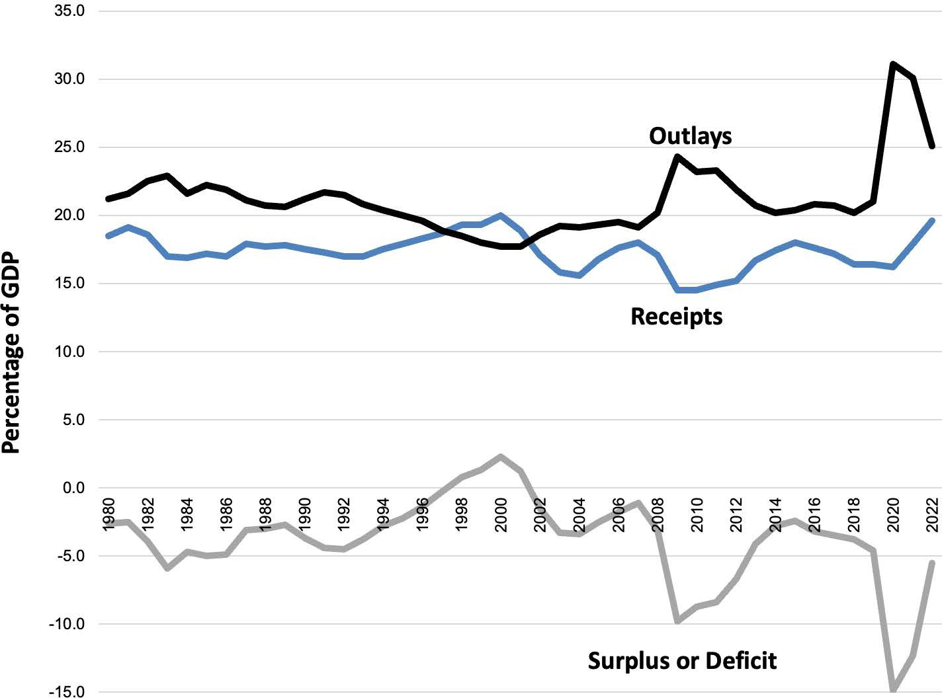
Notes:
Figure 10.2

Slide 5
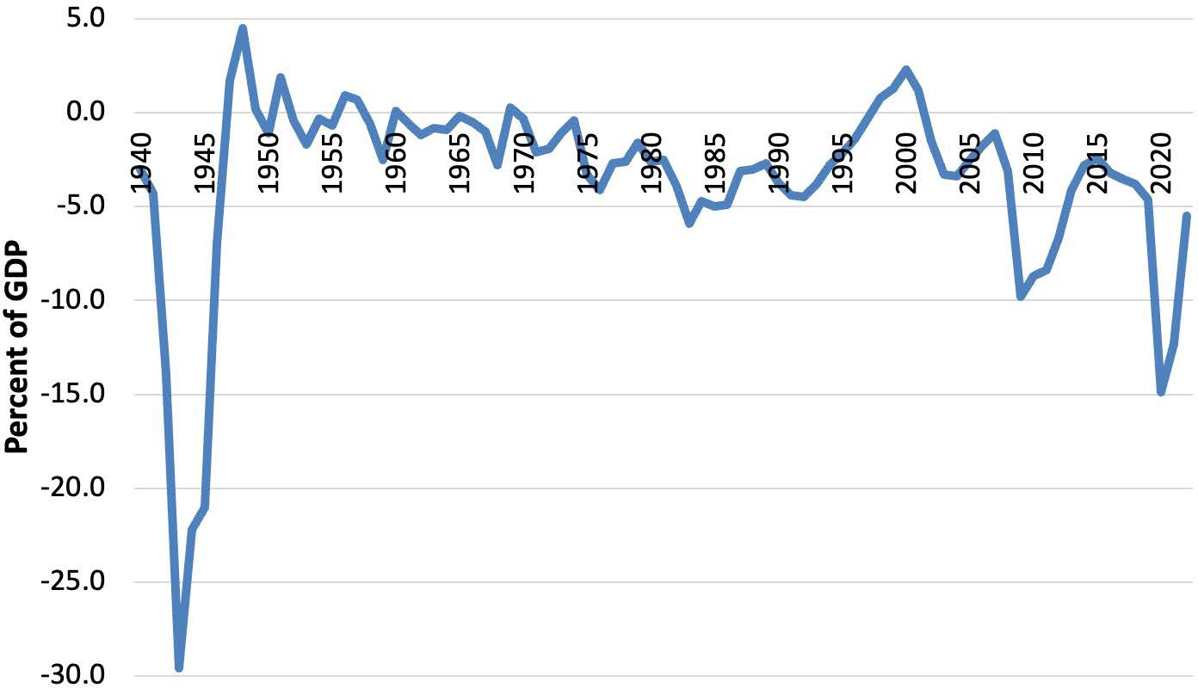
Notes:
Figure 10.3

Slide 6
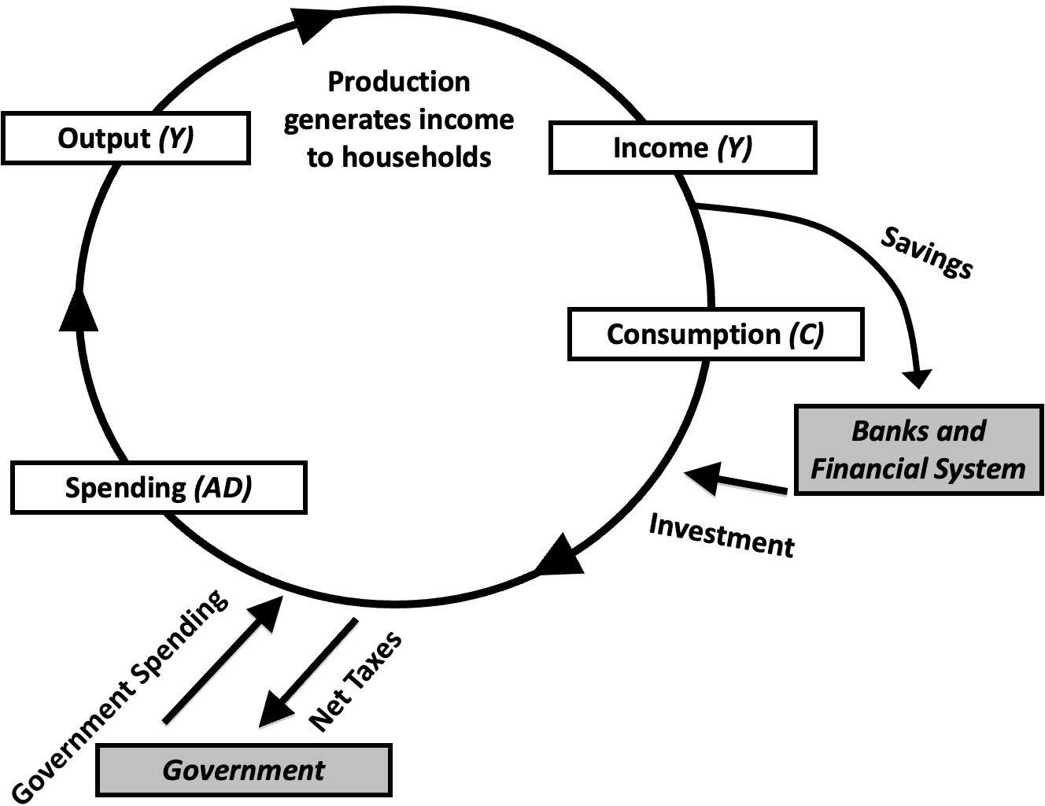
Notes:
Figure 10.4

Slide 7
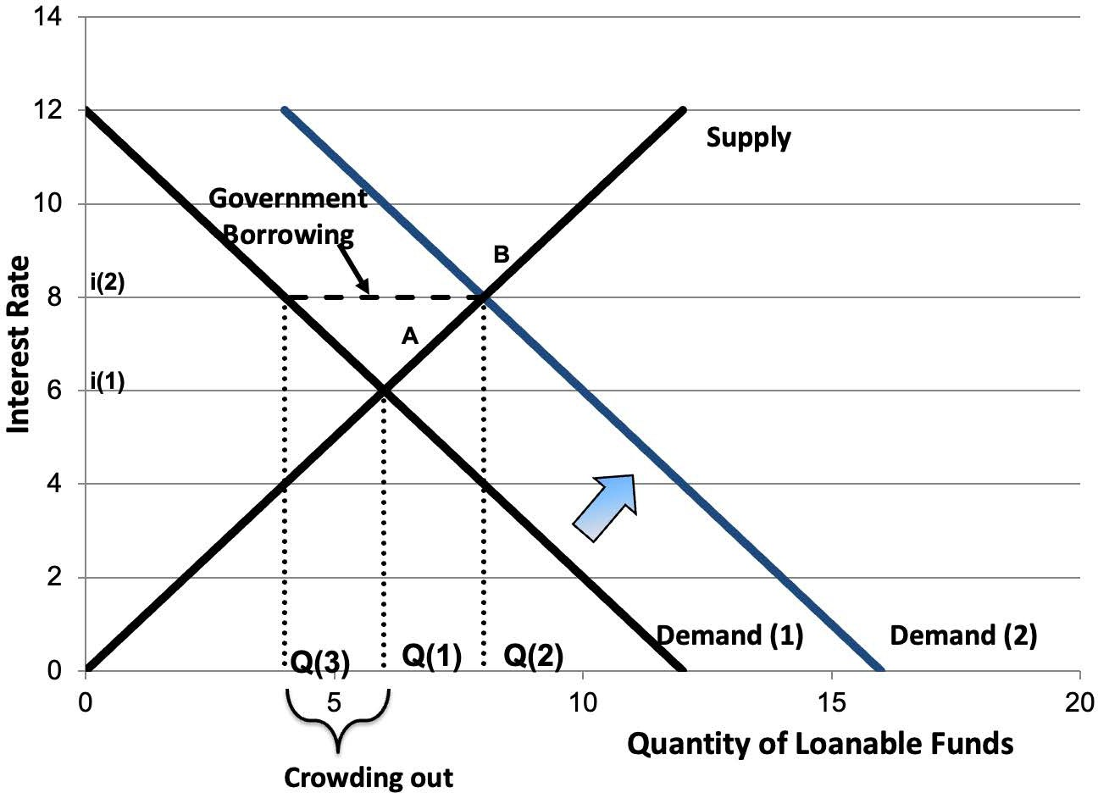
Notes:
Figure 10.5

Slide 8
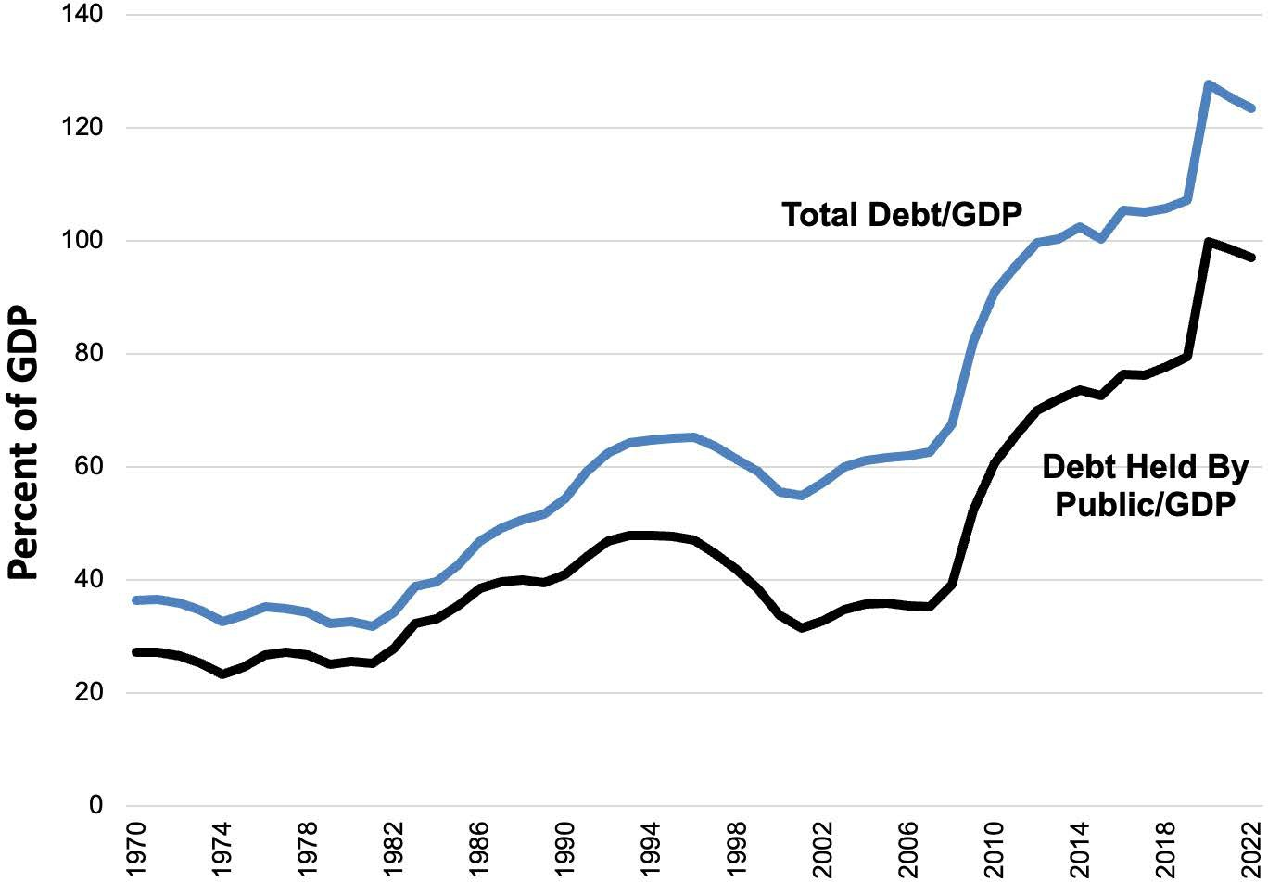
Notes:
Figure 10.6

Slide 9
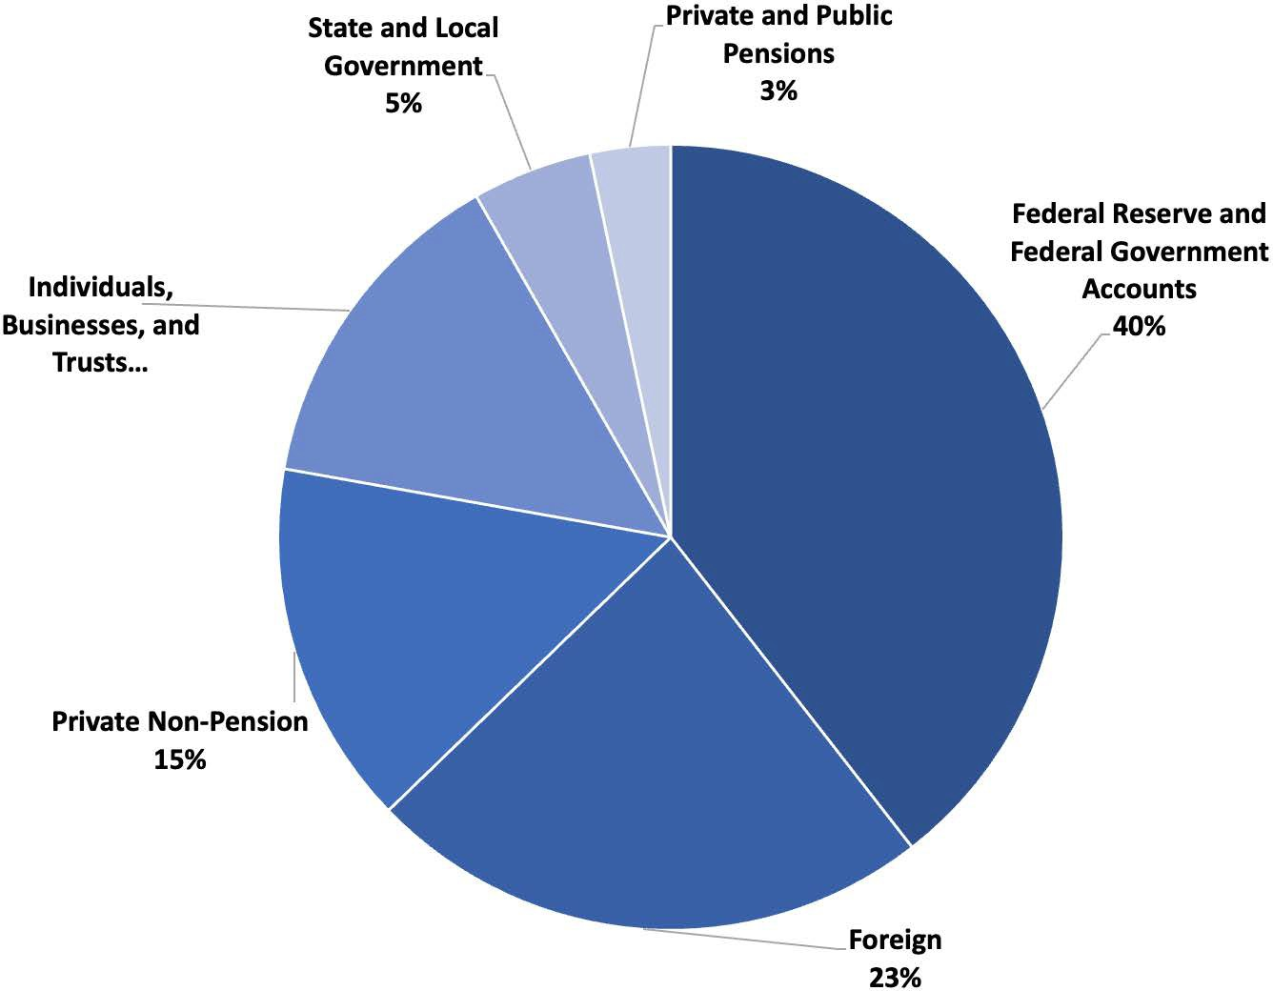
Notes:
Figure 10.7

Slide 10
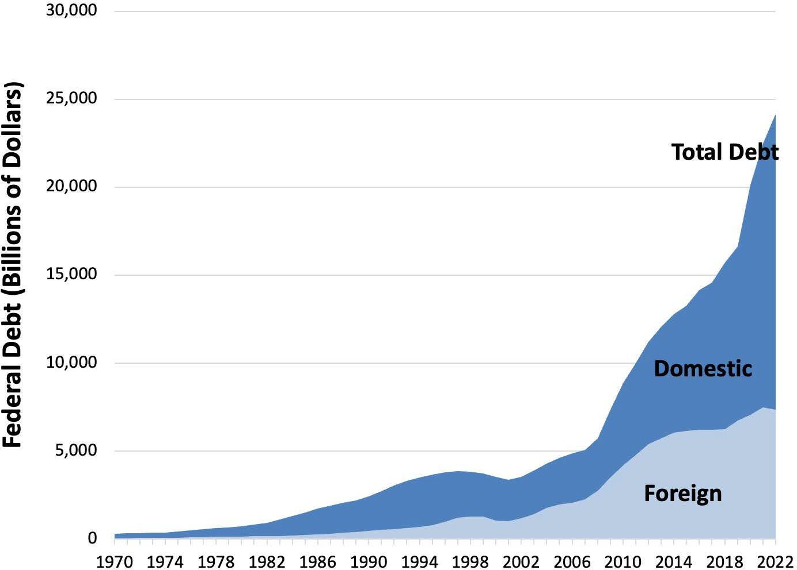
Notes:
Figure 10.8

Slide 11
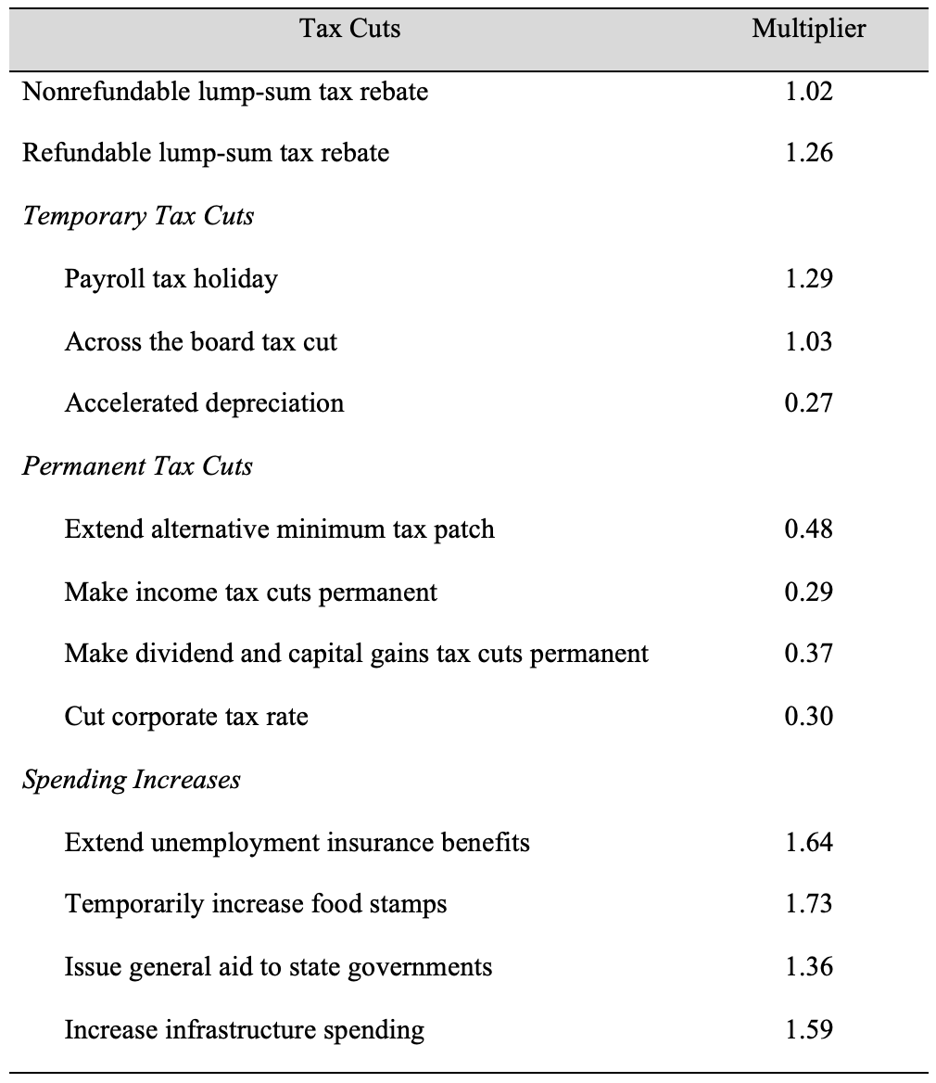
Table 10.1 Different Multiplier Effects
Notes:
Table 10.1

