Slide 1
Chapter 1:
Economic Activity in Context

Slide 2
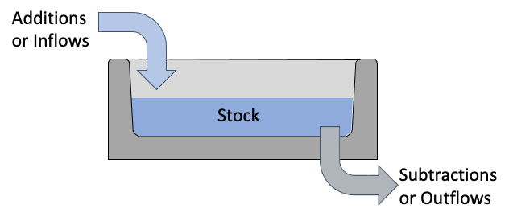
Notes:
Figure 1.1

Slide 3
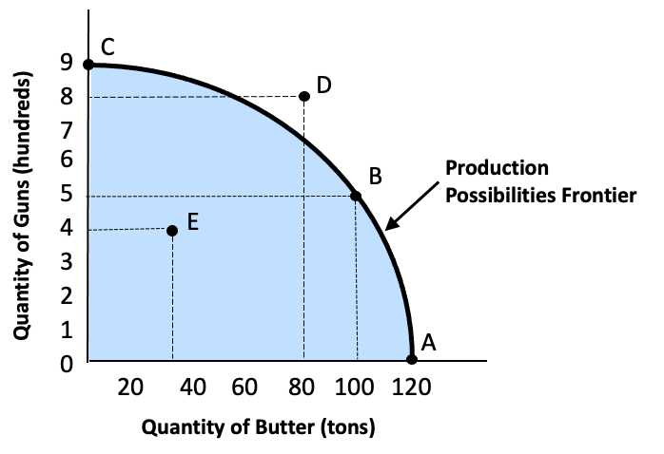
Notes:
Figure 1.2

Slide 4
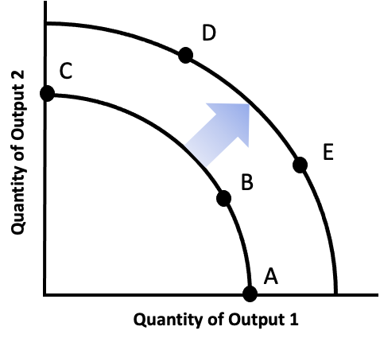
Notes:
Figure 1.3

Slide 5
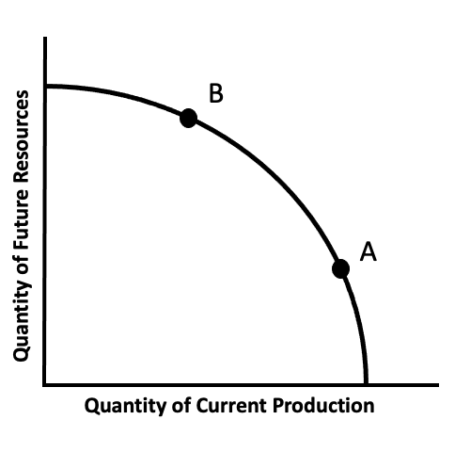
Notes:
Figure 1.4

Slide 6
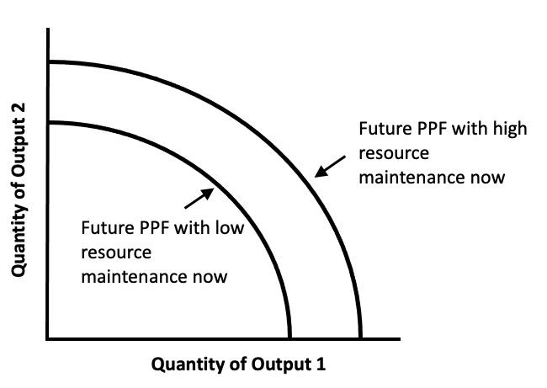
Notes:
Figure 1.5

Slide 7
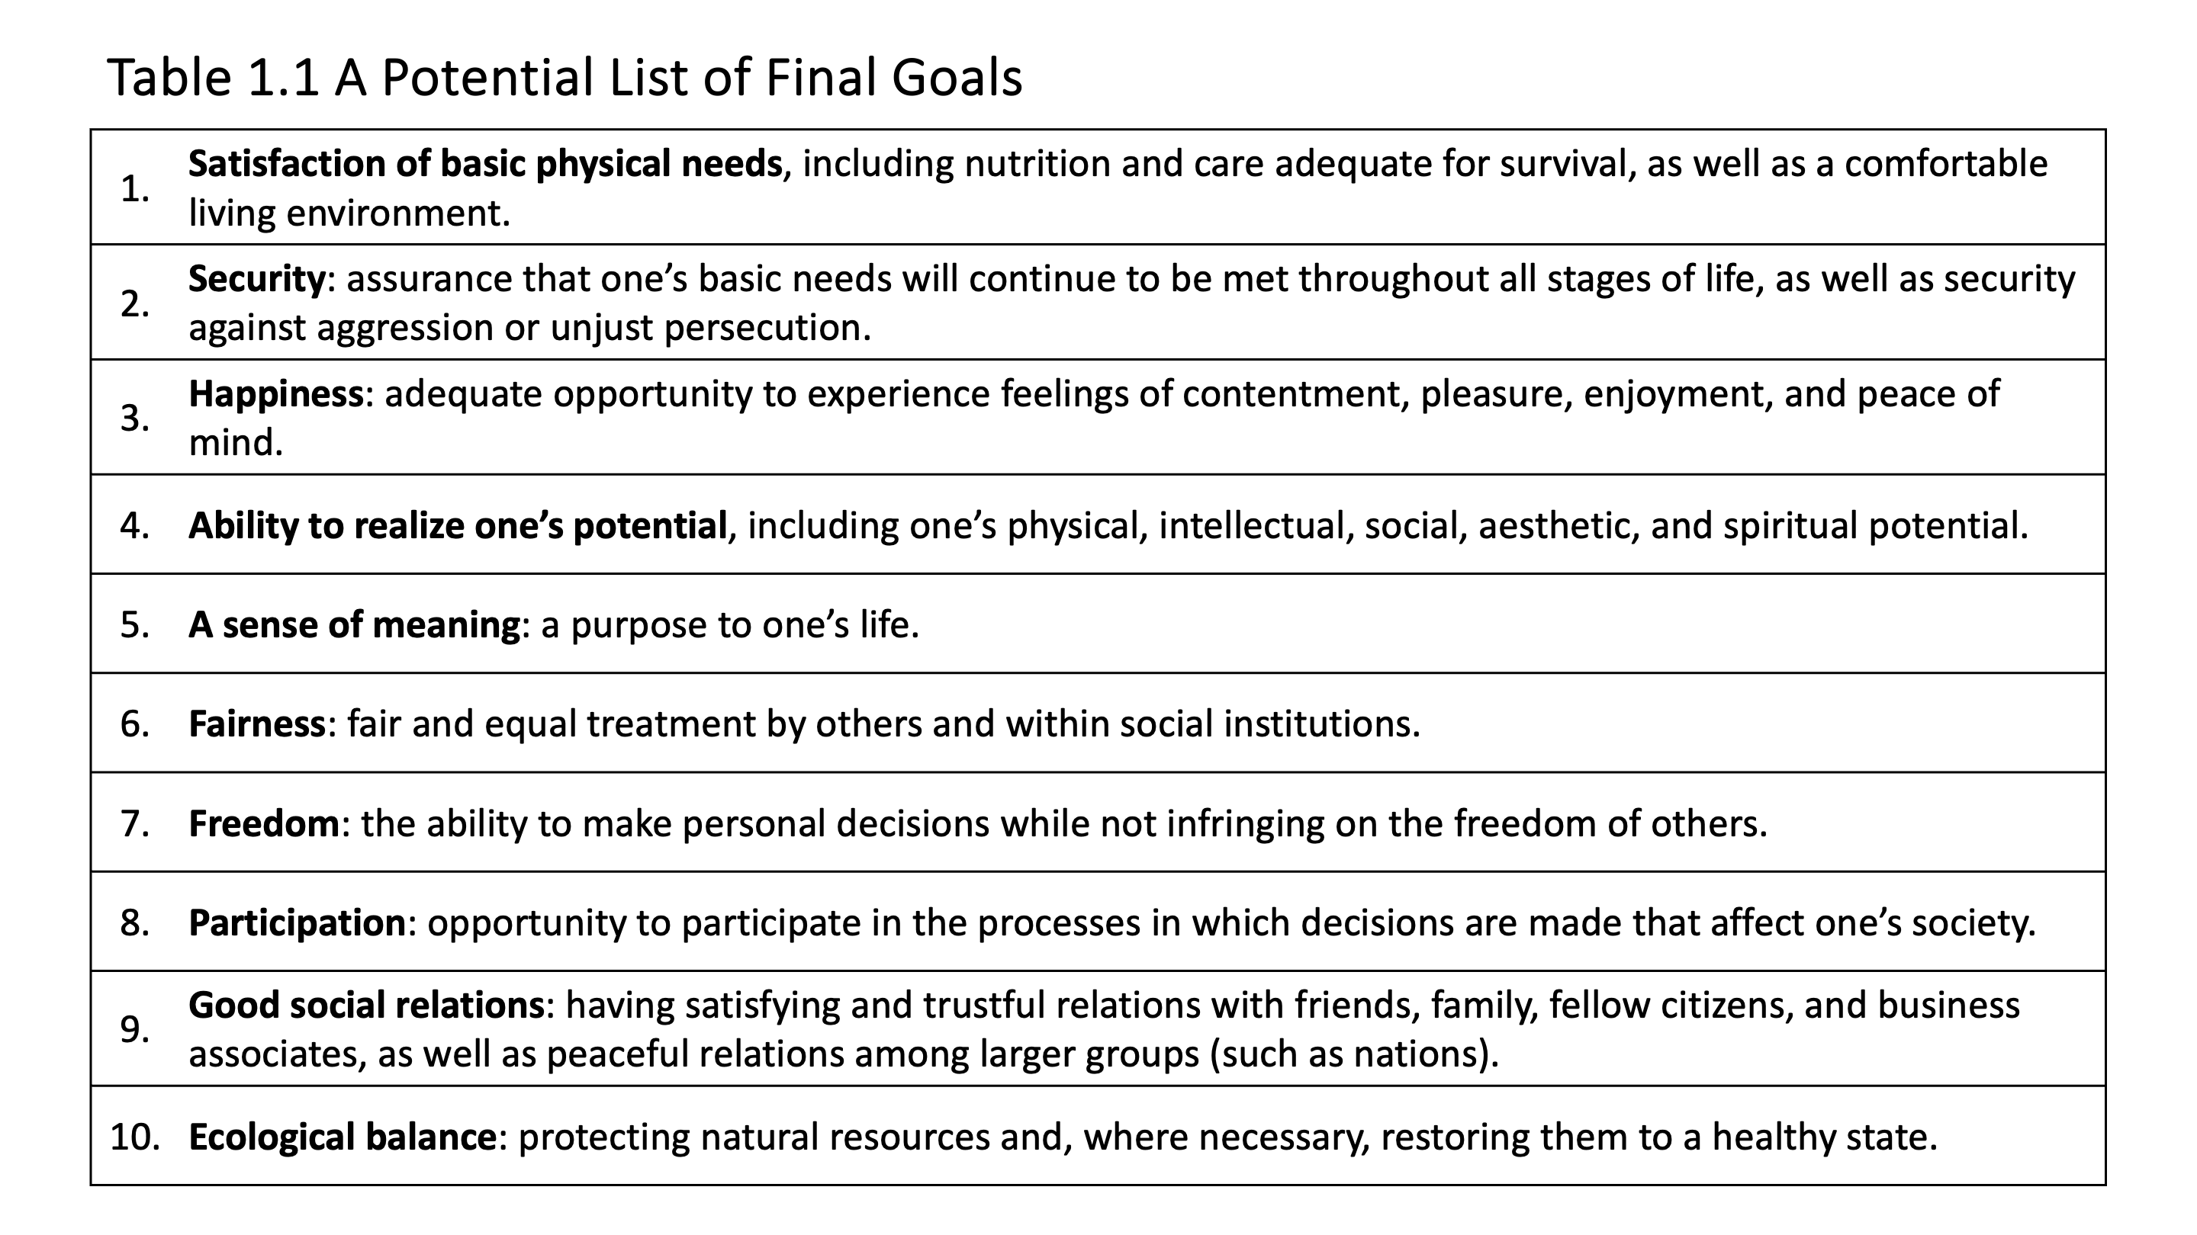
Notes:
Table 1.1

