Slide 1
Chapter 0:
Economics and Well-Being

Slide 2
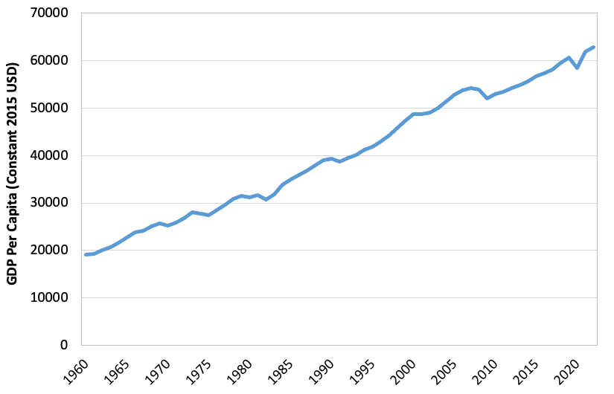
Notes:
Figure 0.1

Slide 3
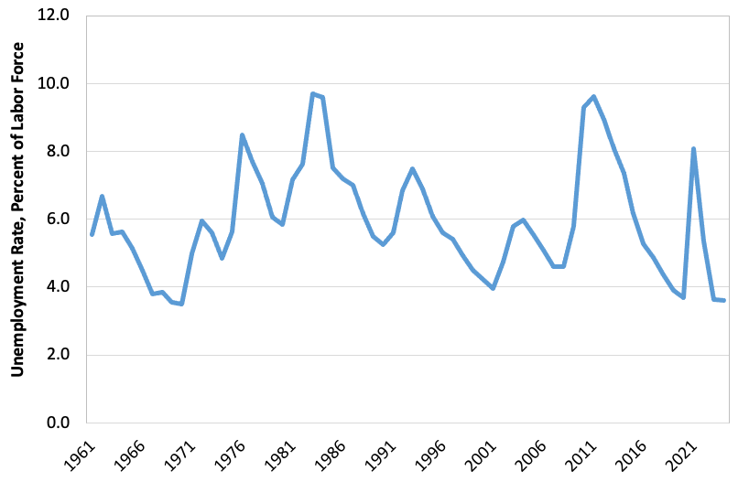
Notes:
Figure 0.2

Slide 4
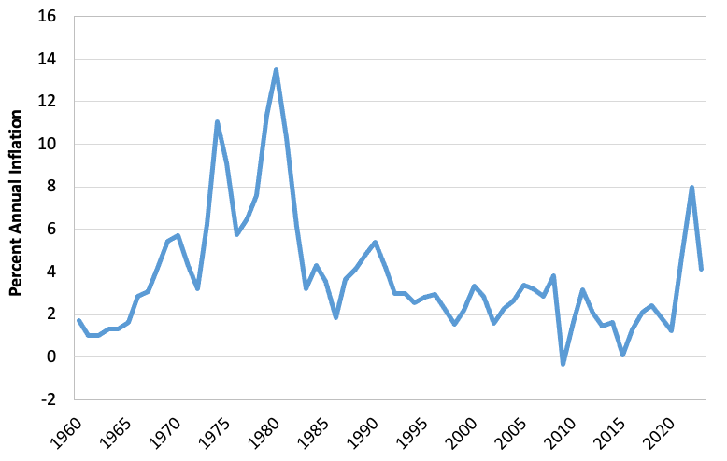
Notes:
Figure 0.3

Slide 5
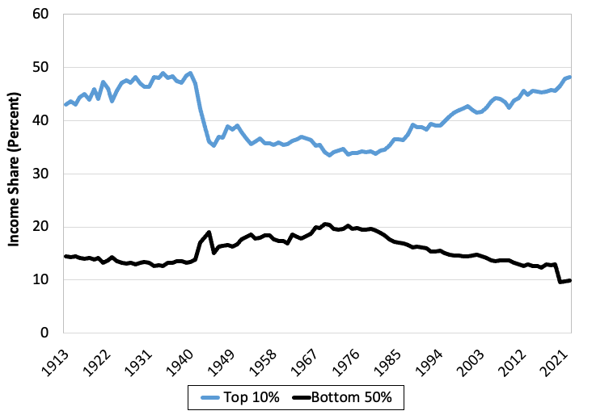
Notes:
Figure 0.4

Slide 6
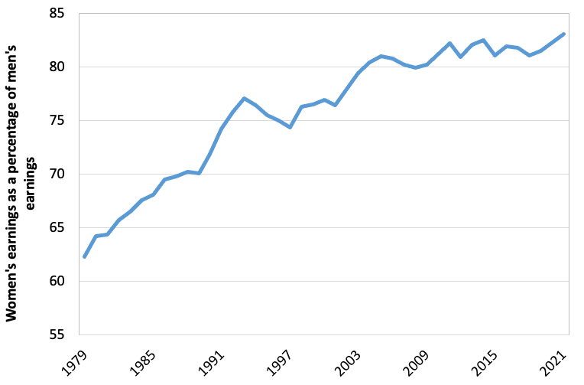
Notes:
Figure 0.5

Slide 7
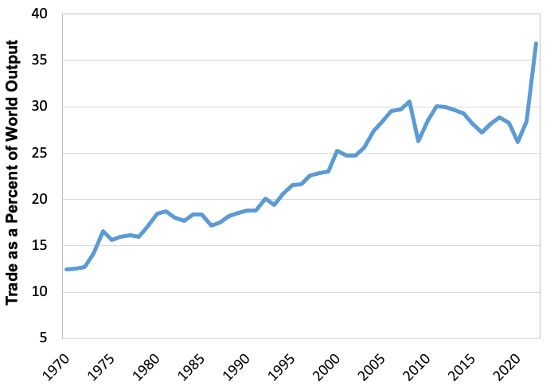
Notes:
Figure 0.6

Slide 8
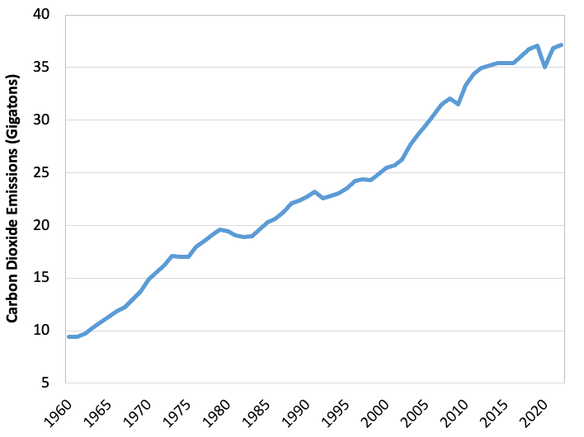
Notes:
Figure 0.7

Slide 9
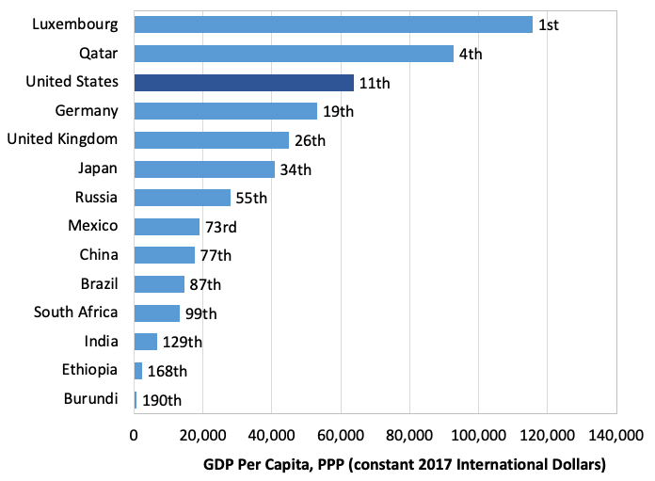
Notes:
Figure 0.8

Slide 10
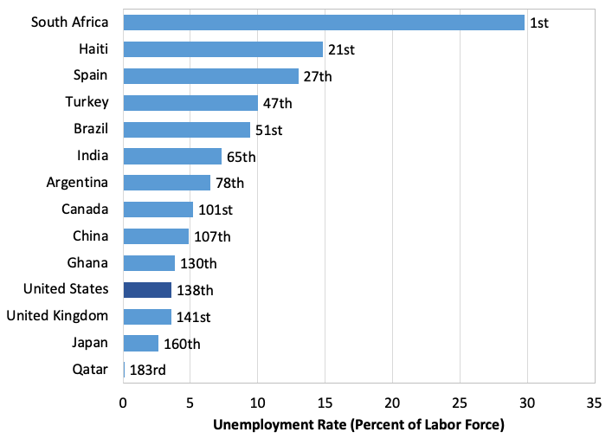
Notes:
Figure 0.9

Slide 11
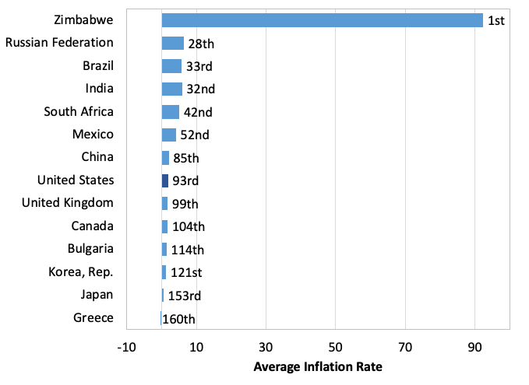
Notes:
Figure 0.10

Slide 12
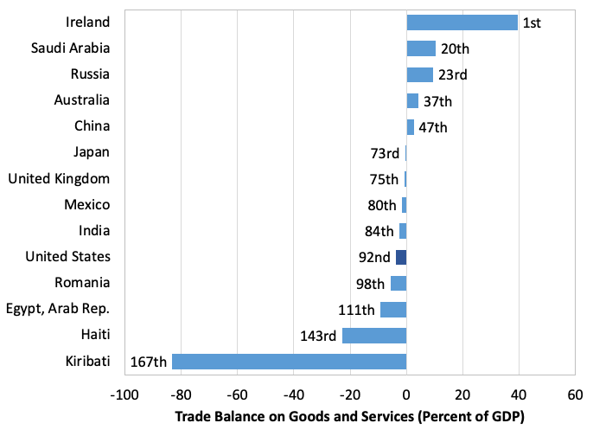
Notes:
Figure 0.11

Slide 13
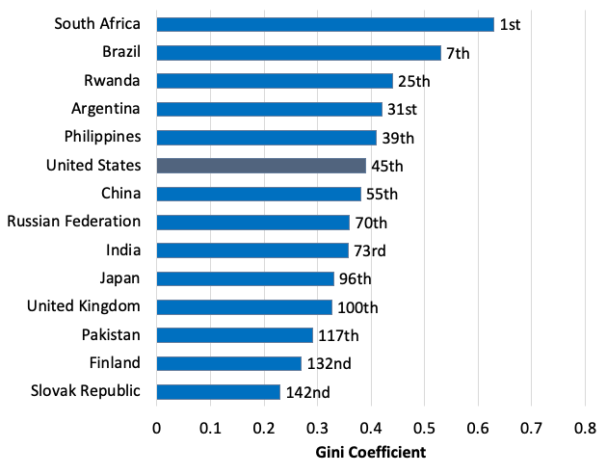
Notes:
Figure 0.12

Slide 14
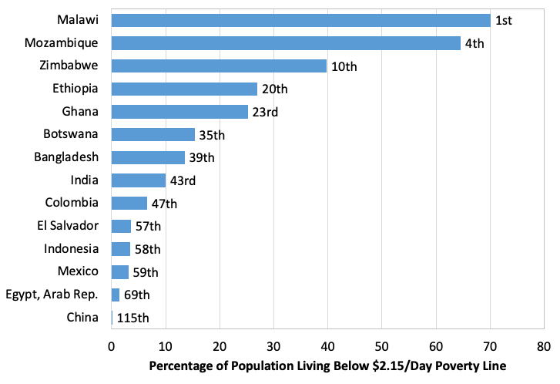
Notes:
Figure 0.13

Slide 15
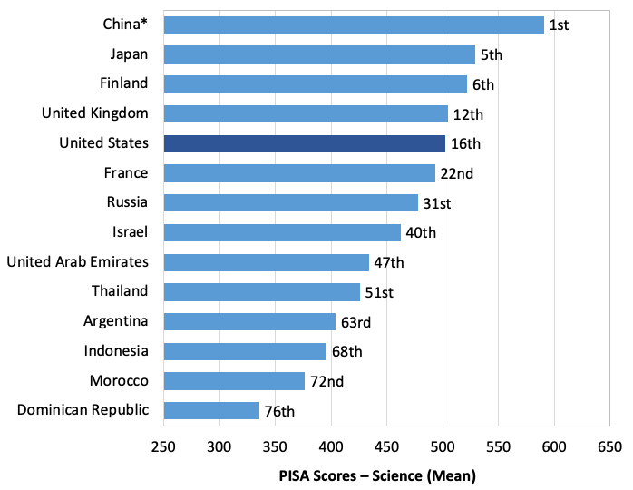
Notes:
Figure 0.14

Slide 16
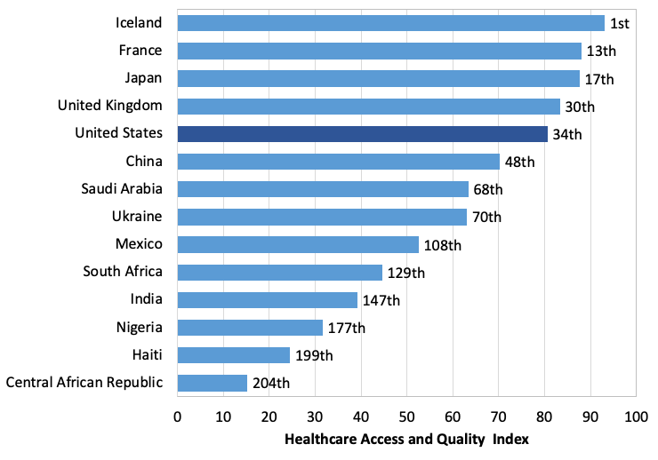
Notes:
Figure 0.15

Slide 17
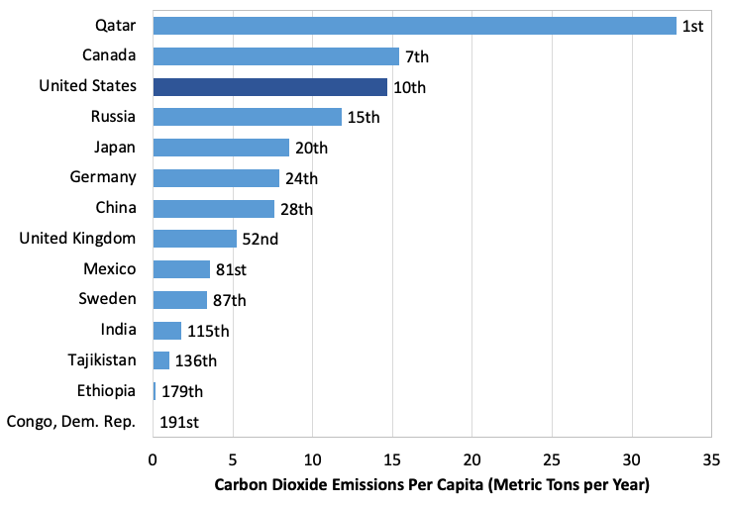
Notes:
Figure 0.16

