Slide 1
After COP28:
The Bumpy Road to Net Zero
by Jonathan Harris and Anne-Marie Codur
jonathan.harris@tufts.edu
amcodur@ume.org
13th Annual U.S. Society for Ecological Economics Conference, June 6─9, 2024
© Global Development and Environment Institute
Tufts University https://sites.tufts.edu/gdae
Boston University Global Development Policy Center
Economics in Context Initiative https://www.bu.edu/eci/

Slide 2
Hottest Year in Recorded History
2023 was the hottest year in recorded history., continuing and accelerating a steady trend of increasing global temperatures since the 1960s
Record high temperatures were recorded on land, in the oceans, and in Antarctica.
Global concentrations of major greenhouse gases carbon dioxide, methane and nitrous oxide climbed to their highest levels ever. Huge losses of ice were recorded in Greenland and from glaciers worldwide.

Slide 3
Record Weather and Climate Disasters
The United States experienced 28 weather and climate disasters in 2023, surpassing the previous record of 22 in 2020, with a price tag of at least $92.9 billion.
Worldwide, extreme weather events included intensified hurricanes, unprecedented wildfires, and deadly flooding in Greece, Turkey, Bulgaria, Libya, and elsewhere.

Slide 4
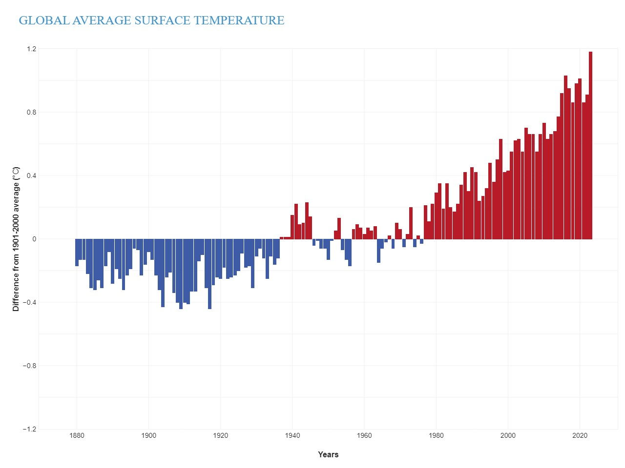
Global Average Surface Temperature, 1880-2023
Source: National Oceanic and Atmospheric Administration (NOAA), Climate Change: Global Temperature https://www.climate.gov/news-features/understanding-climate/climate-change-global-temperature

Slide 5
COP28 objectives and stock take
2023 United Nations climate conference COP28: Dubai, United Arab Emirates.
Aim to advance objectives set at the Paris Conference of 2015 (COP21), which were strengthened at the 2021 COP26 conference in Glasgow, UK.
Goal of holding global temperature increase to no more than 1.5°C above pre-industrial levels—a level that was closely approached in 2023.
Global Stock Take (GST): global emissions continue to rise by 1.5% a year; need to reduce by 7% annually to 2030 for goal of 1.5°C.

Slide 6
COP28 specific goals
Net Zero Emissions by 2050.
Tripling the global capacity of renewable energy
Doubling the annual rate of energy efficiency improvement before 2030.
Rapidly phasing down “unabated” coal use.
Near-zero global methane emissions by 2030.

Slide 7
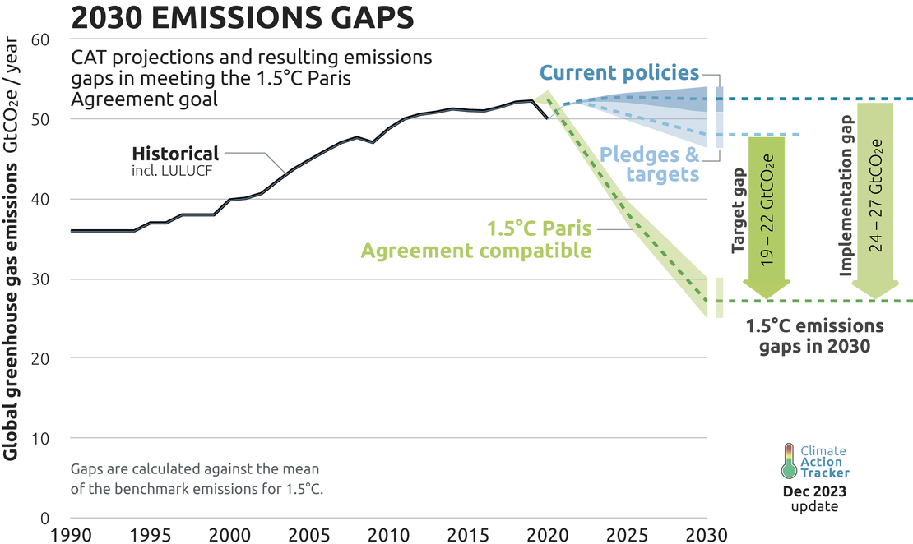
Pledges, Targets, and Emissions Gaps
Source: Climate Action Tracker, CAT Emissions Gap https://climateactiontracker.org/global/cat-emissions-gaps/

Slide 8
Agriculture, Forests, and Natural Systems
Emirates Declaration on Sustainable Agriculture, Resilient Food Systems and Climate Action:
Include emissions from agriculture and farming in national climate action plans.
Shift to sustainably produced and low-emission agricultural systems.
But specific plans to transform world agriculture from a net emitter to a net absorber of carbon—theoretically possible given the great carbon absorption capacities of soils—were lacking.

Slide 9
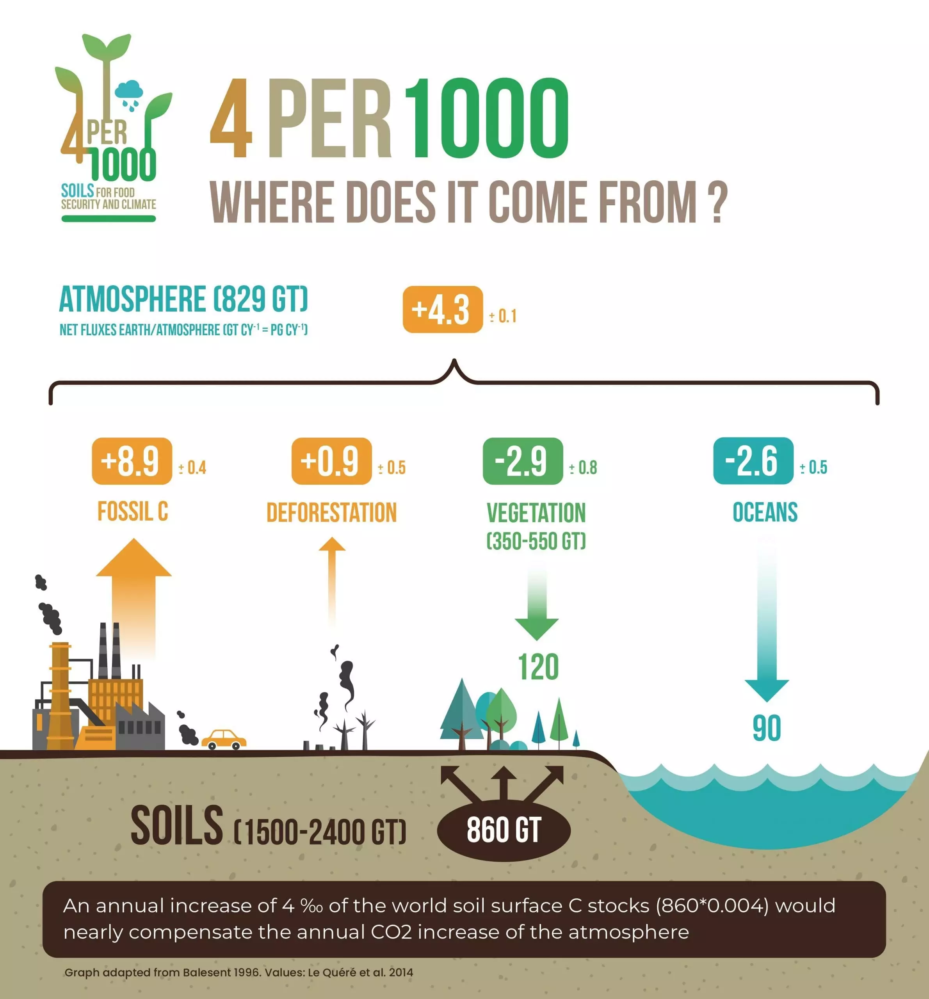
World Soils Potential Carbon Absorption:
860Gt x 0.004 = 3.4 Gt C/yr
International 4 per 1000 initiative https://4p1000.org/

Slide 10
Forests and Wetlands
A “flurry of positive and important steps on forests, ranging from enhanced commitments to ending deforestation in the tropics to new financial support for forest action in developing countries.” (World Resources Institute)
Brazil proposed creation of a global Tropical Forest Forever fund, with $250 billion annually directed toward area-based payments for forest conservation, and a $200 million initiative to restore degraded areas in the Amazon forest by 2030.
$5.7 billion, or 47% of $12 billion Global Forest Finance Pledge agreed at COP26 in 2021, has already been directed toward forest-related programs in developing countries

Slide 11
World Forests Potential Carbon Absorption:
Up to 5 GtC/yr
Halt deforestation: 1.1 GtC/y
Remove CO₂ by restoring forest capacity over next 50 years:
  Allow current second growth forests to reach maturity: 2 GtC/y
  Restore degraded forests: 1 GtC/y
  Reforest recently deforested lands: 1 GtC/y
  (William Moomaw, Meeting the Paris Goals: Clean Energy, Forests, and Soils, https://sites.tufts.edu/gdae/conferences/)

Slide 12
Climate Finance
COP28 saw more than $80 billion in climate finance commitments from countries, development banks, private sources, and philanthropists.
Agreement to implement a Loss and Damage Fund, for countries most vulnerable to the effects of extreme weather events, including droughts, flooding, and rising seas.
$800 million raised for Loss and Damage Fund, with the most substantial contributions from the United Arab Emirates and Germany. But annual damages from climate disasters in vulnerable countries are in the range of $800 billion annually.

Slide 13
Expansion of Renewable Energy
Very rapid expansion of renewable energy in China, Europe, and the United States. Record-breaking solar output, with “over 440 gigawatts of renewable energy added in 2023, more than the entire installed power capacity of Germany and Spain together.
China, Europe and the US each set solar installation records for a single year, according to the International Renewable Energy Agency (IEA).
Almost 3,700 GW of new renewable capacity will come online over the 2023‑2028 period, driven by supportive policies in more than 130 countries (IEA).

Slide 14
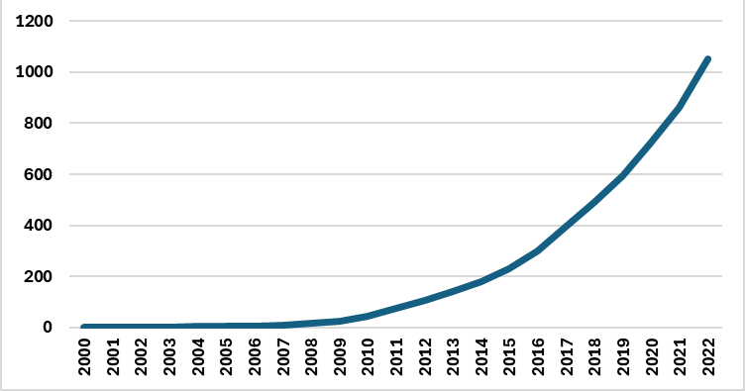
Global Solar PV Capacity, GW 2000-2022
Source: Data from International Renewable Energy Agency, 2023.

Slide 15
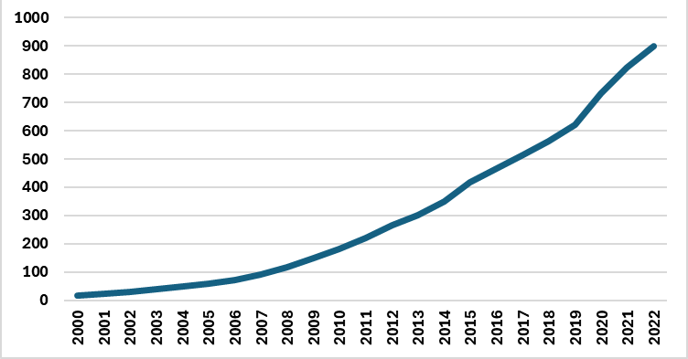
Global Wind Capacity, GW, 2000-2022
Source: Data from International Renewable Energy Agency, 2023.

Slide 16
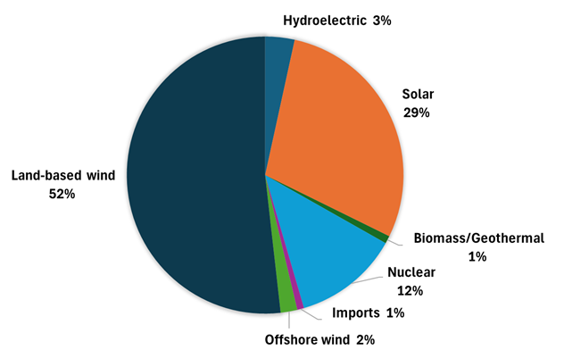
. Generation for U.S. Electric Grid in 2035 Without Fossil Fuels
Source: National Renewable Energy Laboratory, 2022.

Slide 17
Carbon Dioxide Emissions from Energy Consumption in the United States, 1975-2023
More than 17% decline in U.S. since 2007 (EIA).
In the EU, GHG emissions decline was 30% between 1990 and 2021.

Slide 18
The Not-So-Good News
Global greenhouse emissions continue to increase.
China increased emissions by 10% between 2019 and 2023. China has six times as many coal plants under construction as the rest of the world combined. India’s emissions are also rapidly growing.
Global emissions fell sharply during the 2020 pandemic, but have since bounced back, although the rate of increase has slowed.
Clean energy growth has limited the rise in global emissions, with 2023 registering an increase of 1.1%. (IEA)
Other studies present lower estimate of only 0.1% for the 2023 increase. (Nature Reviews Earth & Environment: “Global carbon emissions in 2023.”)

Slide 19
Methane: Problem and Opportunity
A major medium-term benefit could come from reduction of methane emissions. But major policy action is needed to achieve COP28’s stated goal of near-zero methane emissions by 2030.
The U.S. Environmental Protection Agency methane reduction plan includes methane emissions fees and technical assistance to accelerate the transition to no- and low- emitting oil and gas technologies.
These and similar plans in other countries represent a start on harvesting the “low-hanging fruit” of unnecessary methane leaks and flaring, but much more needs to be done.

Slide 20
Changing the Framework
Perhaps the greatest achievement leading up to and following COP28 was to establish a more ambitious framework for climate action, reflected in national policies.
The United States Inflation Reduction Act includes unprecedented incentives for a transition to renewable energy. State and local net zero action in the U.S., and acceptance of net zero as a policy goal in many countries and industries, is a major turnaround.
In early 2024, California hit a new record of generating 100% of its power from renewable sources for 30 days of a 38-day period in March and April. California is ahead of many other regions, but the trend is clearly toward rapid expansion of renewables.

Slide 21
Major Barriers Remain
Political opposition to climate policies, such as resistance by European farmers to agricultural emissions reduction plans, and broader opposition by the fossil fuel industry and other vested interests, are significant.
The urgent need for rapid grid expansion to accommodate wind and solar has also engendered opposition. Grid upgrading requires major investment that may be difficult to mobilize.
But the goal of net zero is now on the agenda, and progress will be measured at the next international conferences, COP29 in Baku, Azerbaijan in 2024, and COP30 in Brazil in 2025.

