Slide 1


Chapter Nine:
Markets for Labor

Slide 2
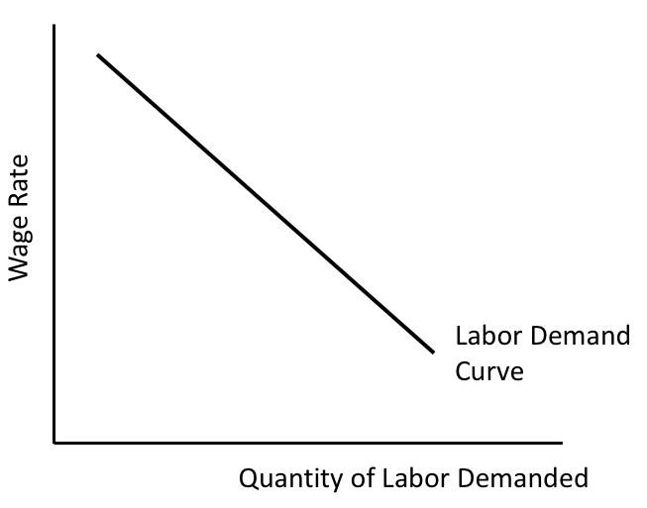
Figure 9.1 An Individual Firm’s Labor
Demand Curve

Slide 3
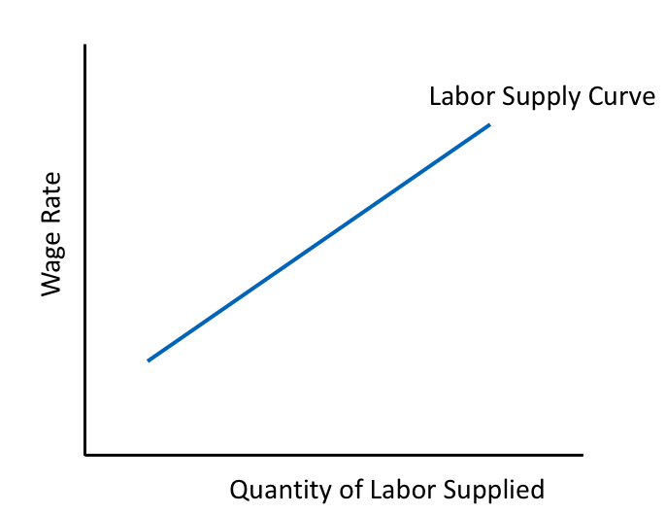
Figure 9.2 Upward-Sloping Labor Supply Curve

Slide 4
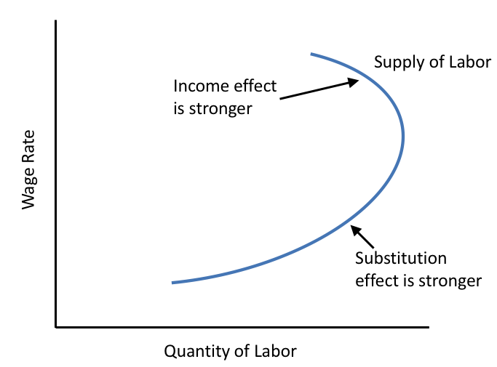
Figure 9.3 Backward-Bending Individual Labor Supply Curve

Slide 5
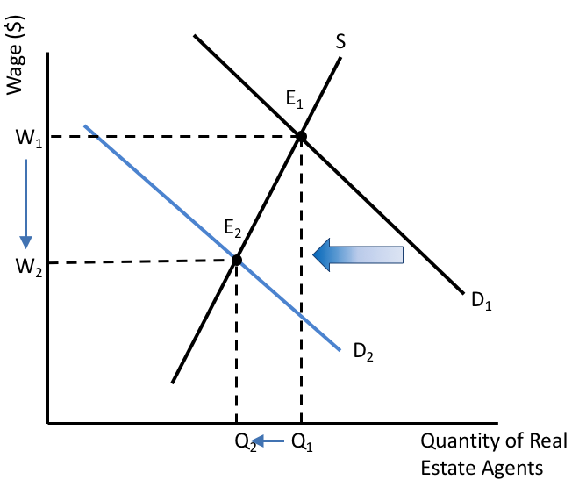
Figure 9.4 The Labor Market for Real Estate Agents

Slide 6
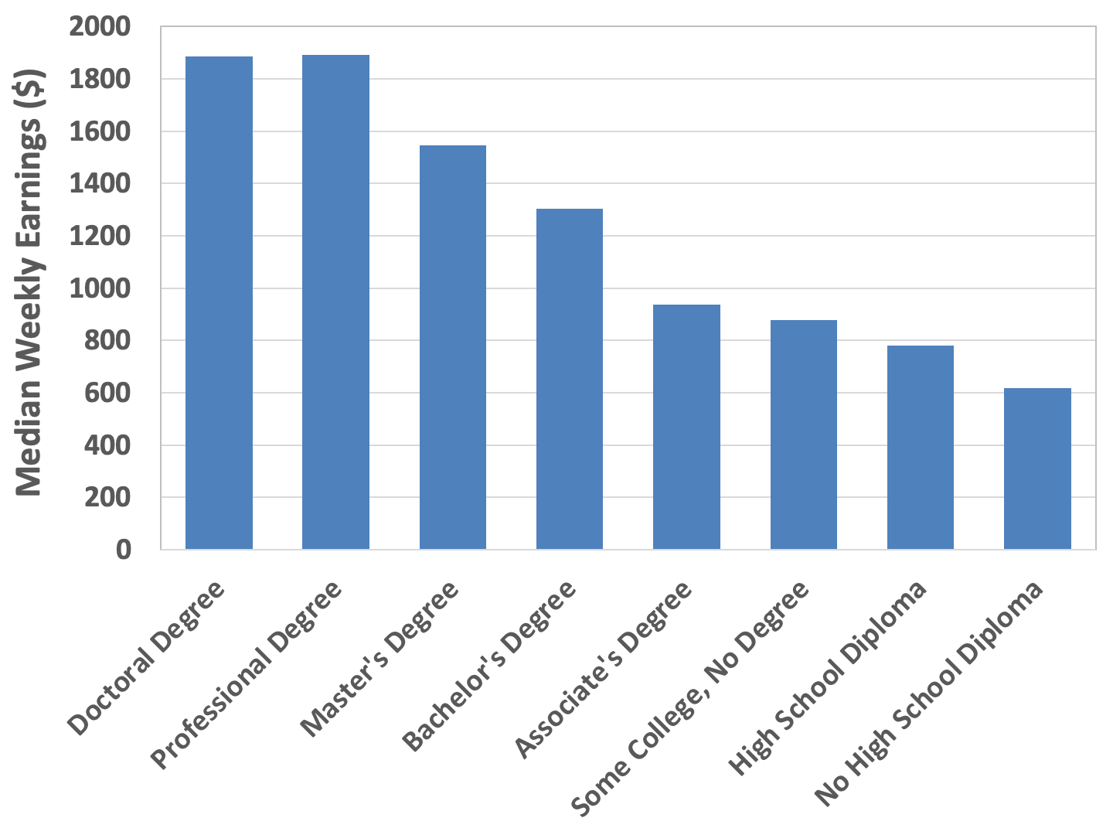
Figure 9.5 Median Weekly Earnings of U.S. Workers, by Educational Attainment, 2021
Source: U.S. Bureau of Labor Statistics, 2021a.

Slide 7
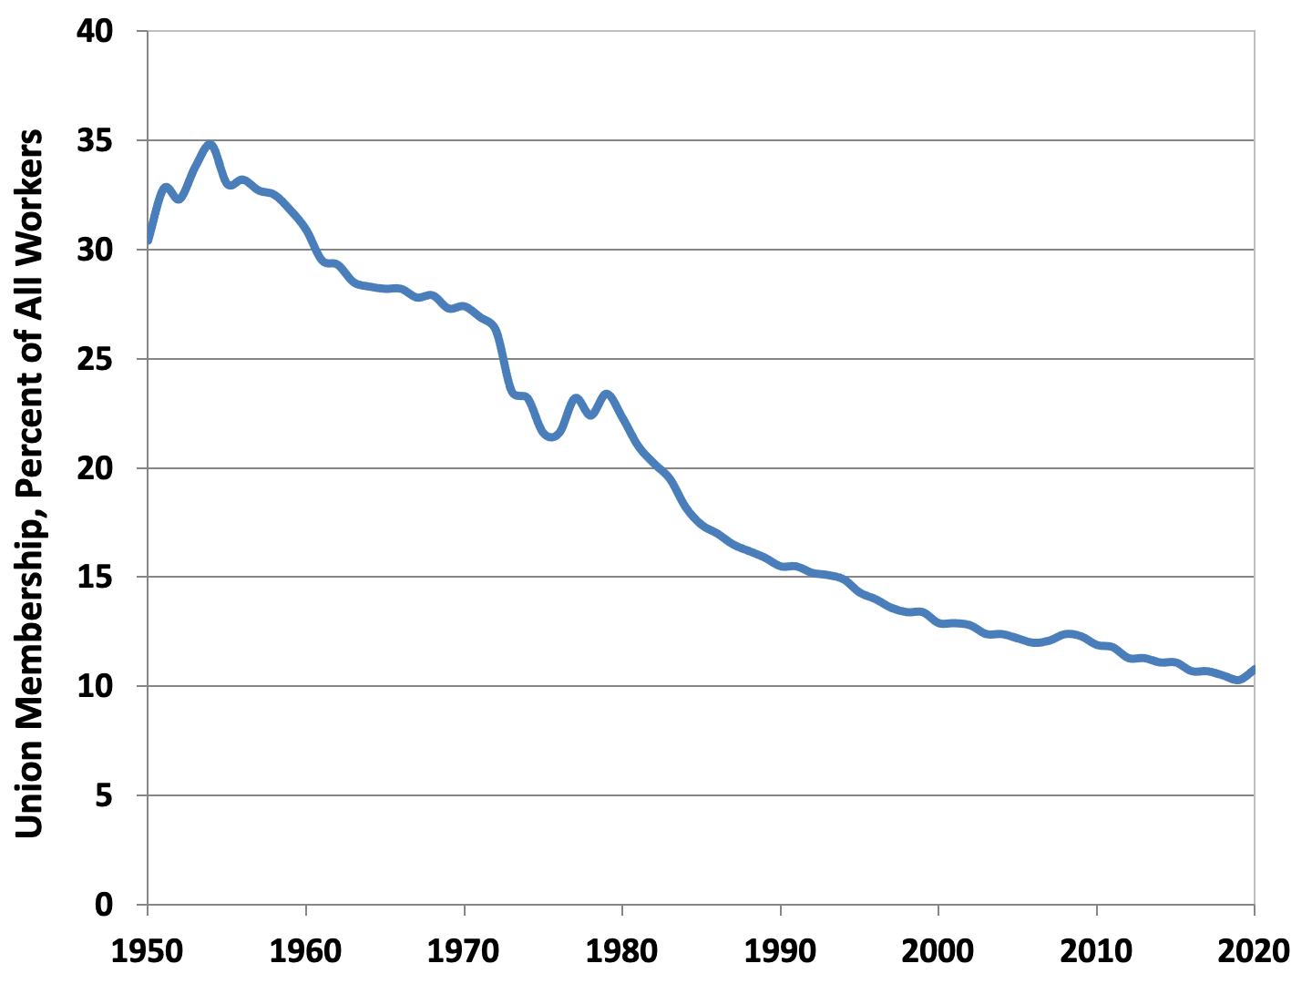
Figure 9.6 Union Membership in the United States,
1950-2020
Source: U.S. Bureau of Labor Statistics, 2021b.

Slide 8
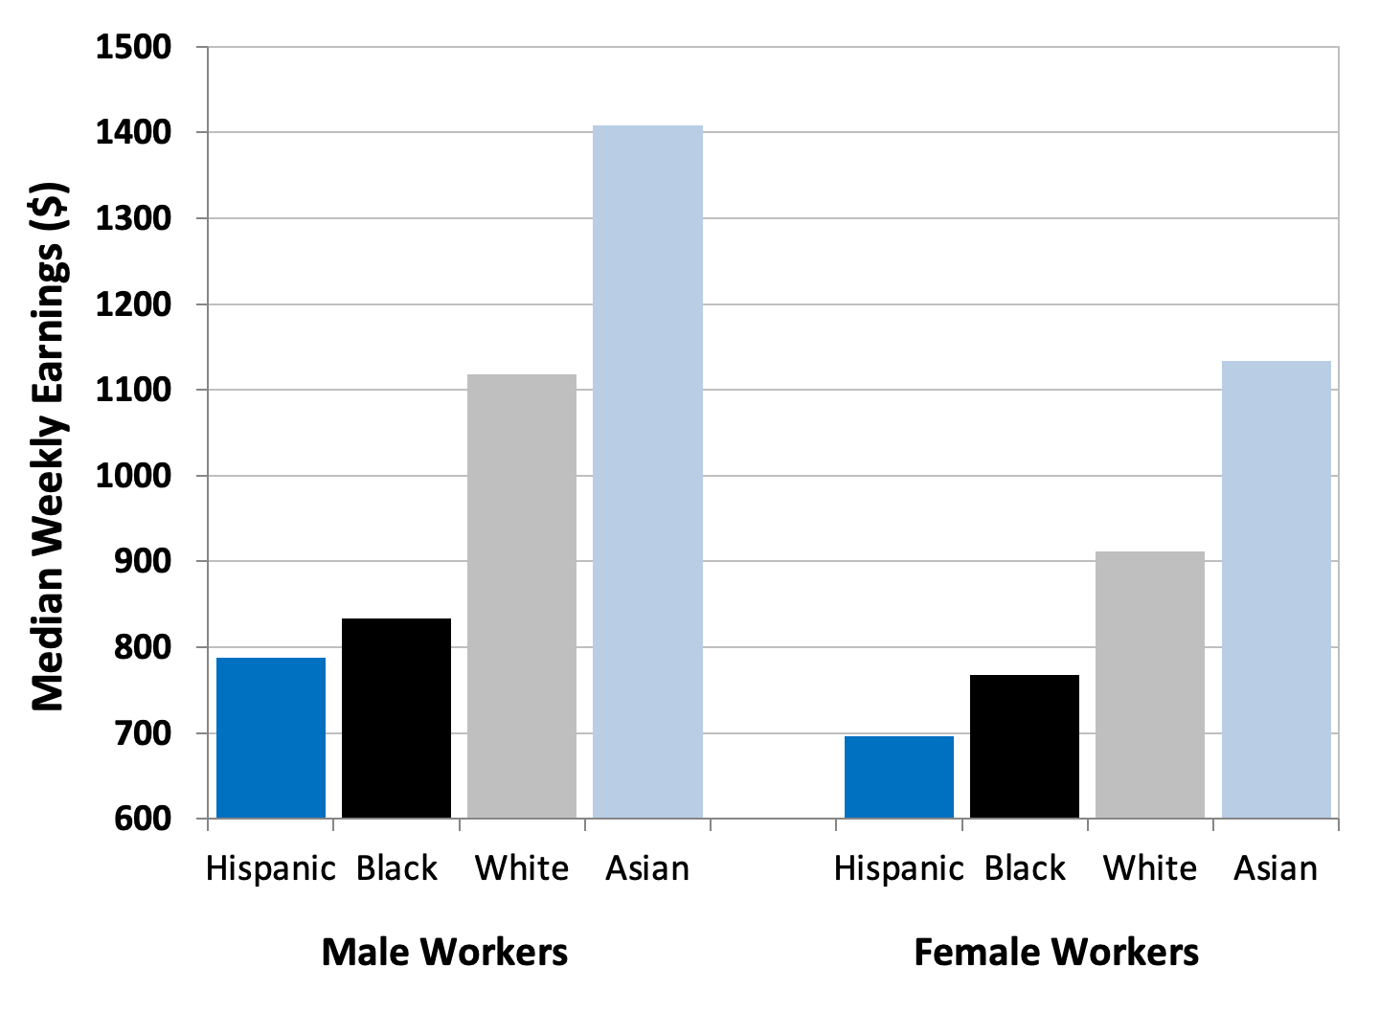
Figure 9.7 Median Weekly Earnings, Select Groups of U.S. Workers, Age 25 and Over, 2021
Source: U.S. Bureau of Labor Statistics, 2021d.

Slide 9
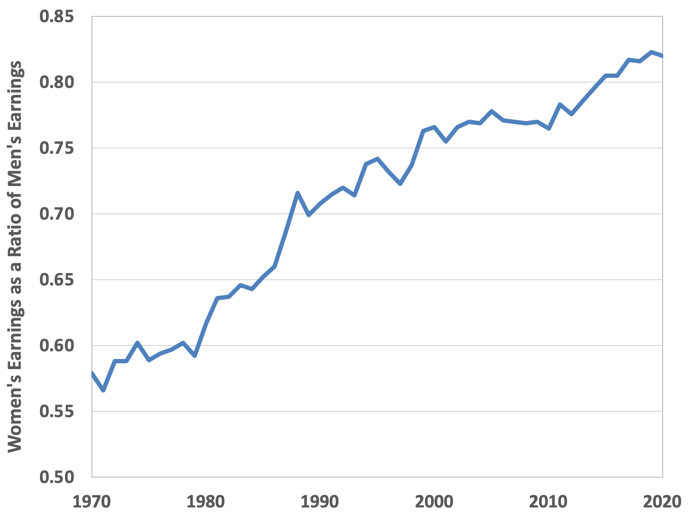
Figure 9.8: The Gender Pay Gap in the United States, 1970-2020
Source: U.S. Census Bureau, 2022.

Slide 10
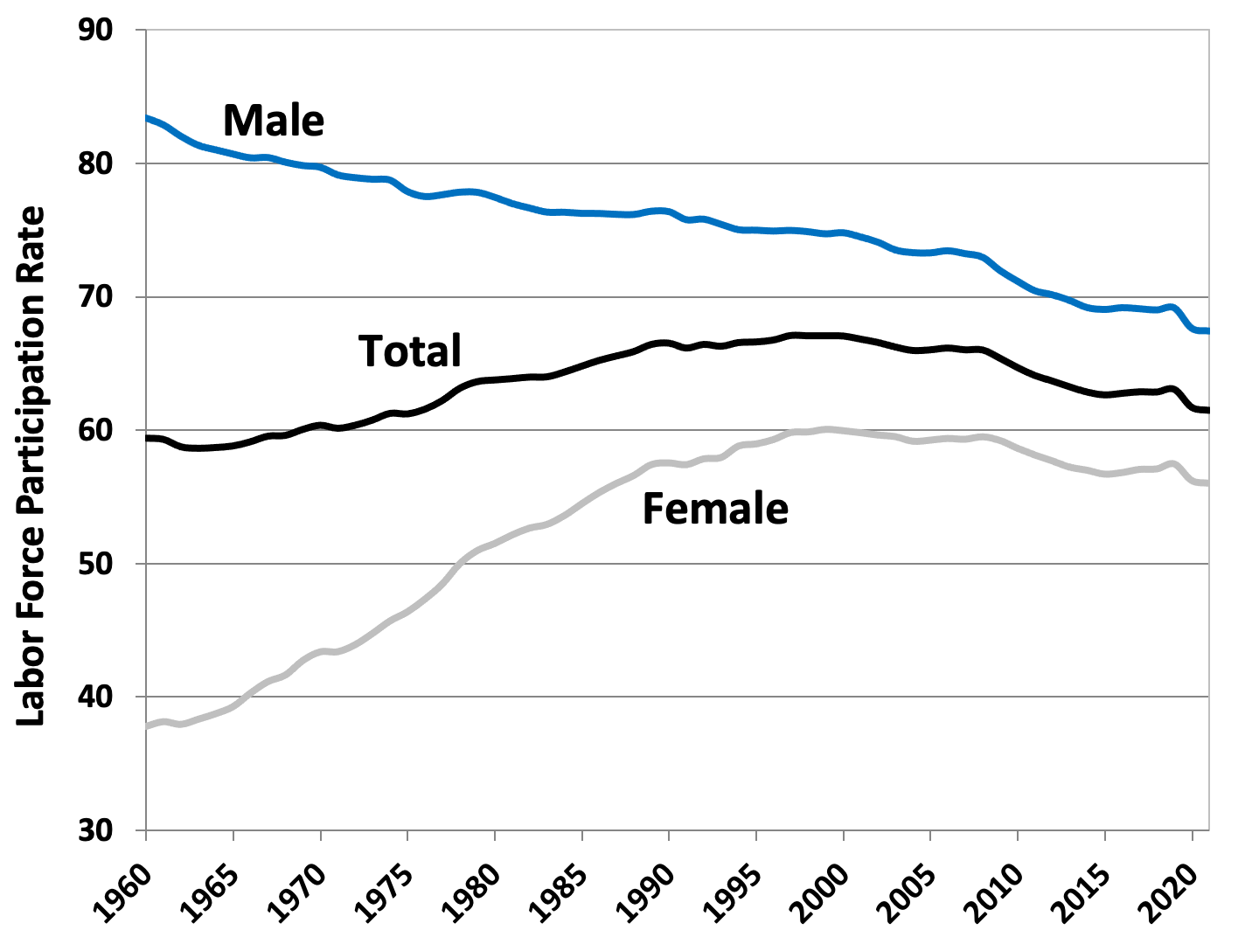
Figure 9.9 Labor Force Participation Rates in the United States, 1960-2021
Source: U.S. Bureau of Labor Statistics, 2021e.

Slide 11
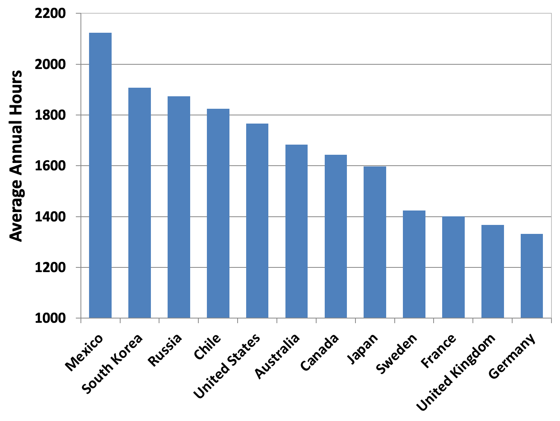
Figure 9.10: Average Annual Hours Worked, Select Countries, 2020
Source: OECD, OECD. Data, “Hours Worked.”

Slide 12
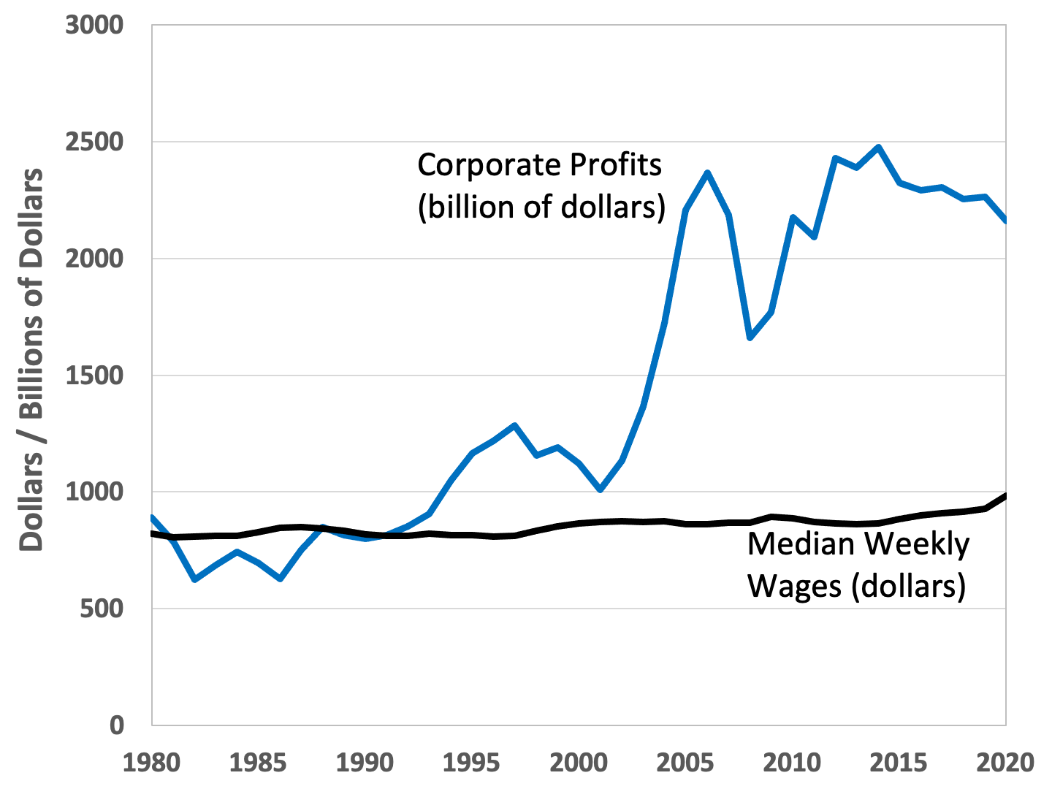
Figure 9.11 Real Median Weekly Wages Versus Real Corporate Profits, United States, 1980-2020
Source: Federal Reserve Bank of St. Louis, Federal Reserve Economic Data.

Slide 13
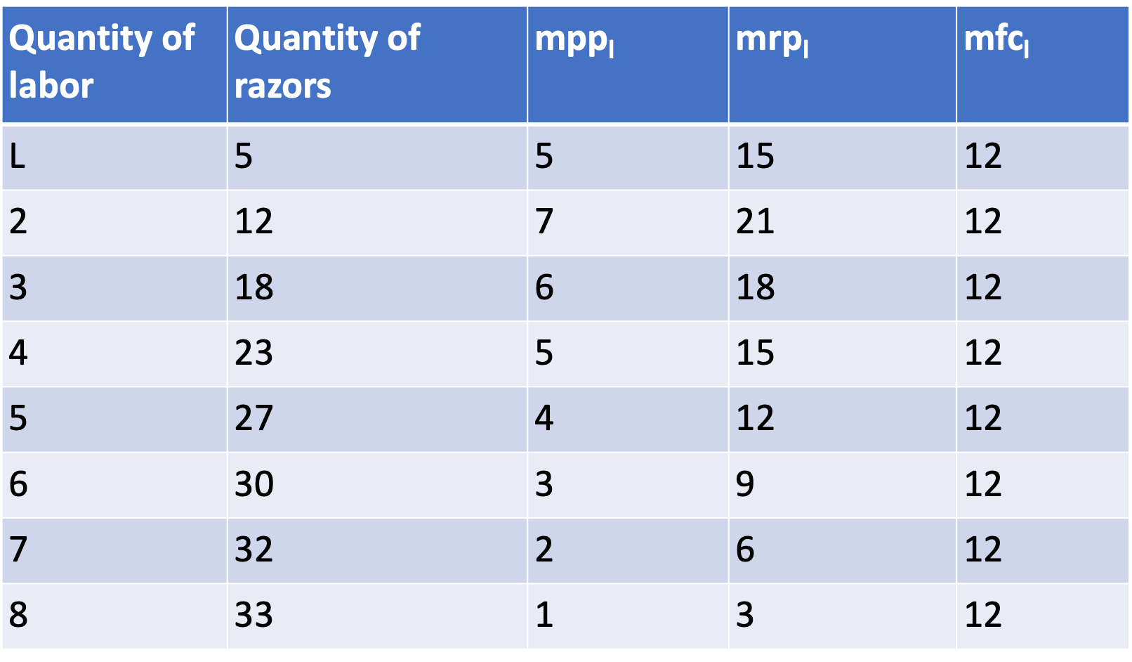
Table 9.1: Labor Analysis of Hypothetical Razor Firm

Slide 14
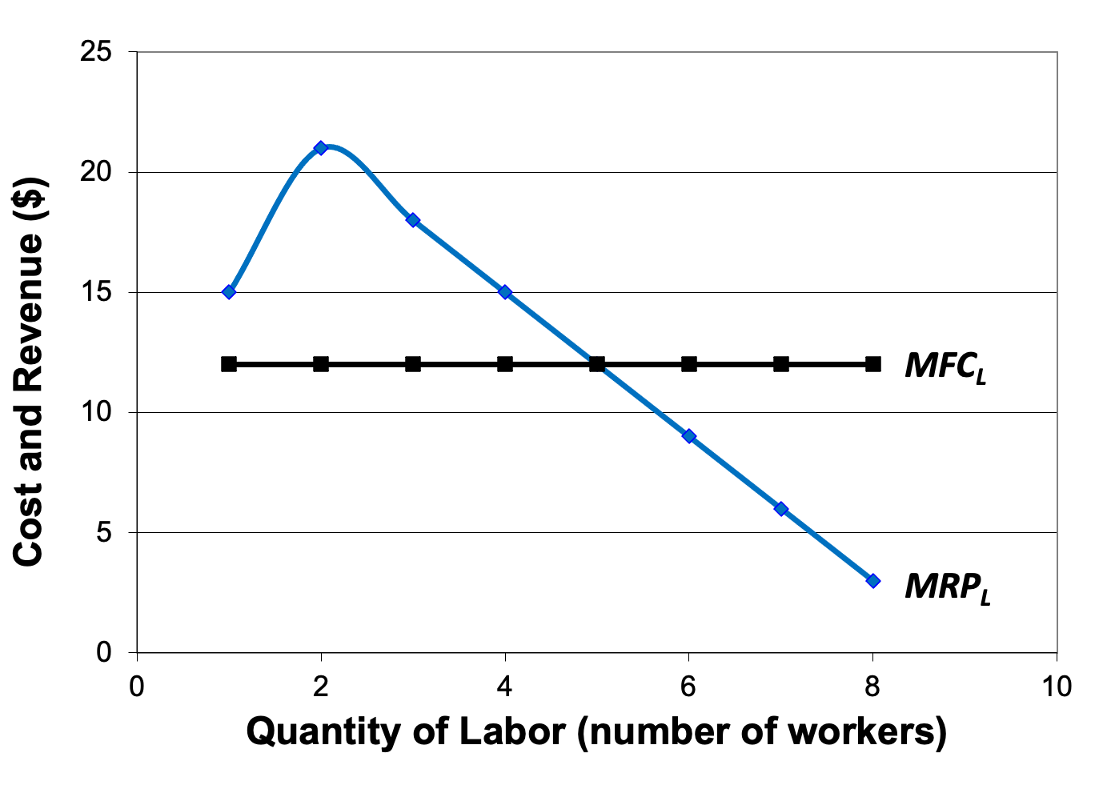
Figure 9.12 Marginal Revenue Product of Labor and Marginal Factor Cost of Labor

