Slide 1
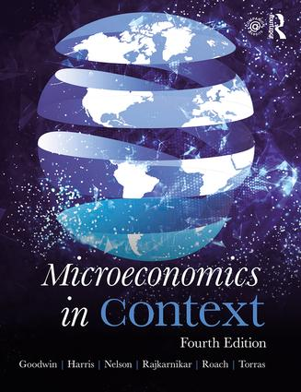
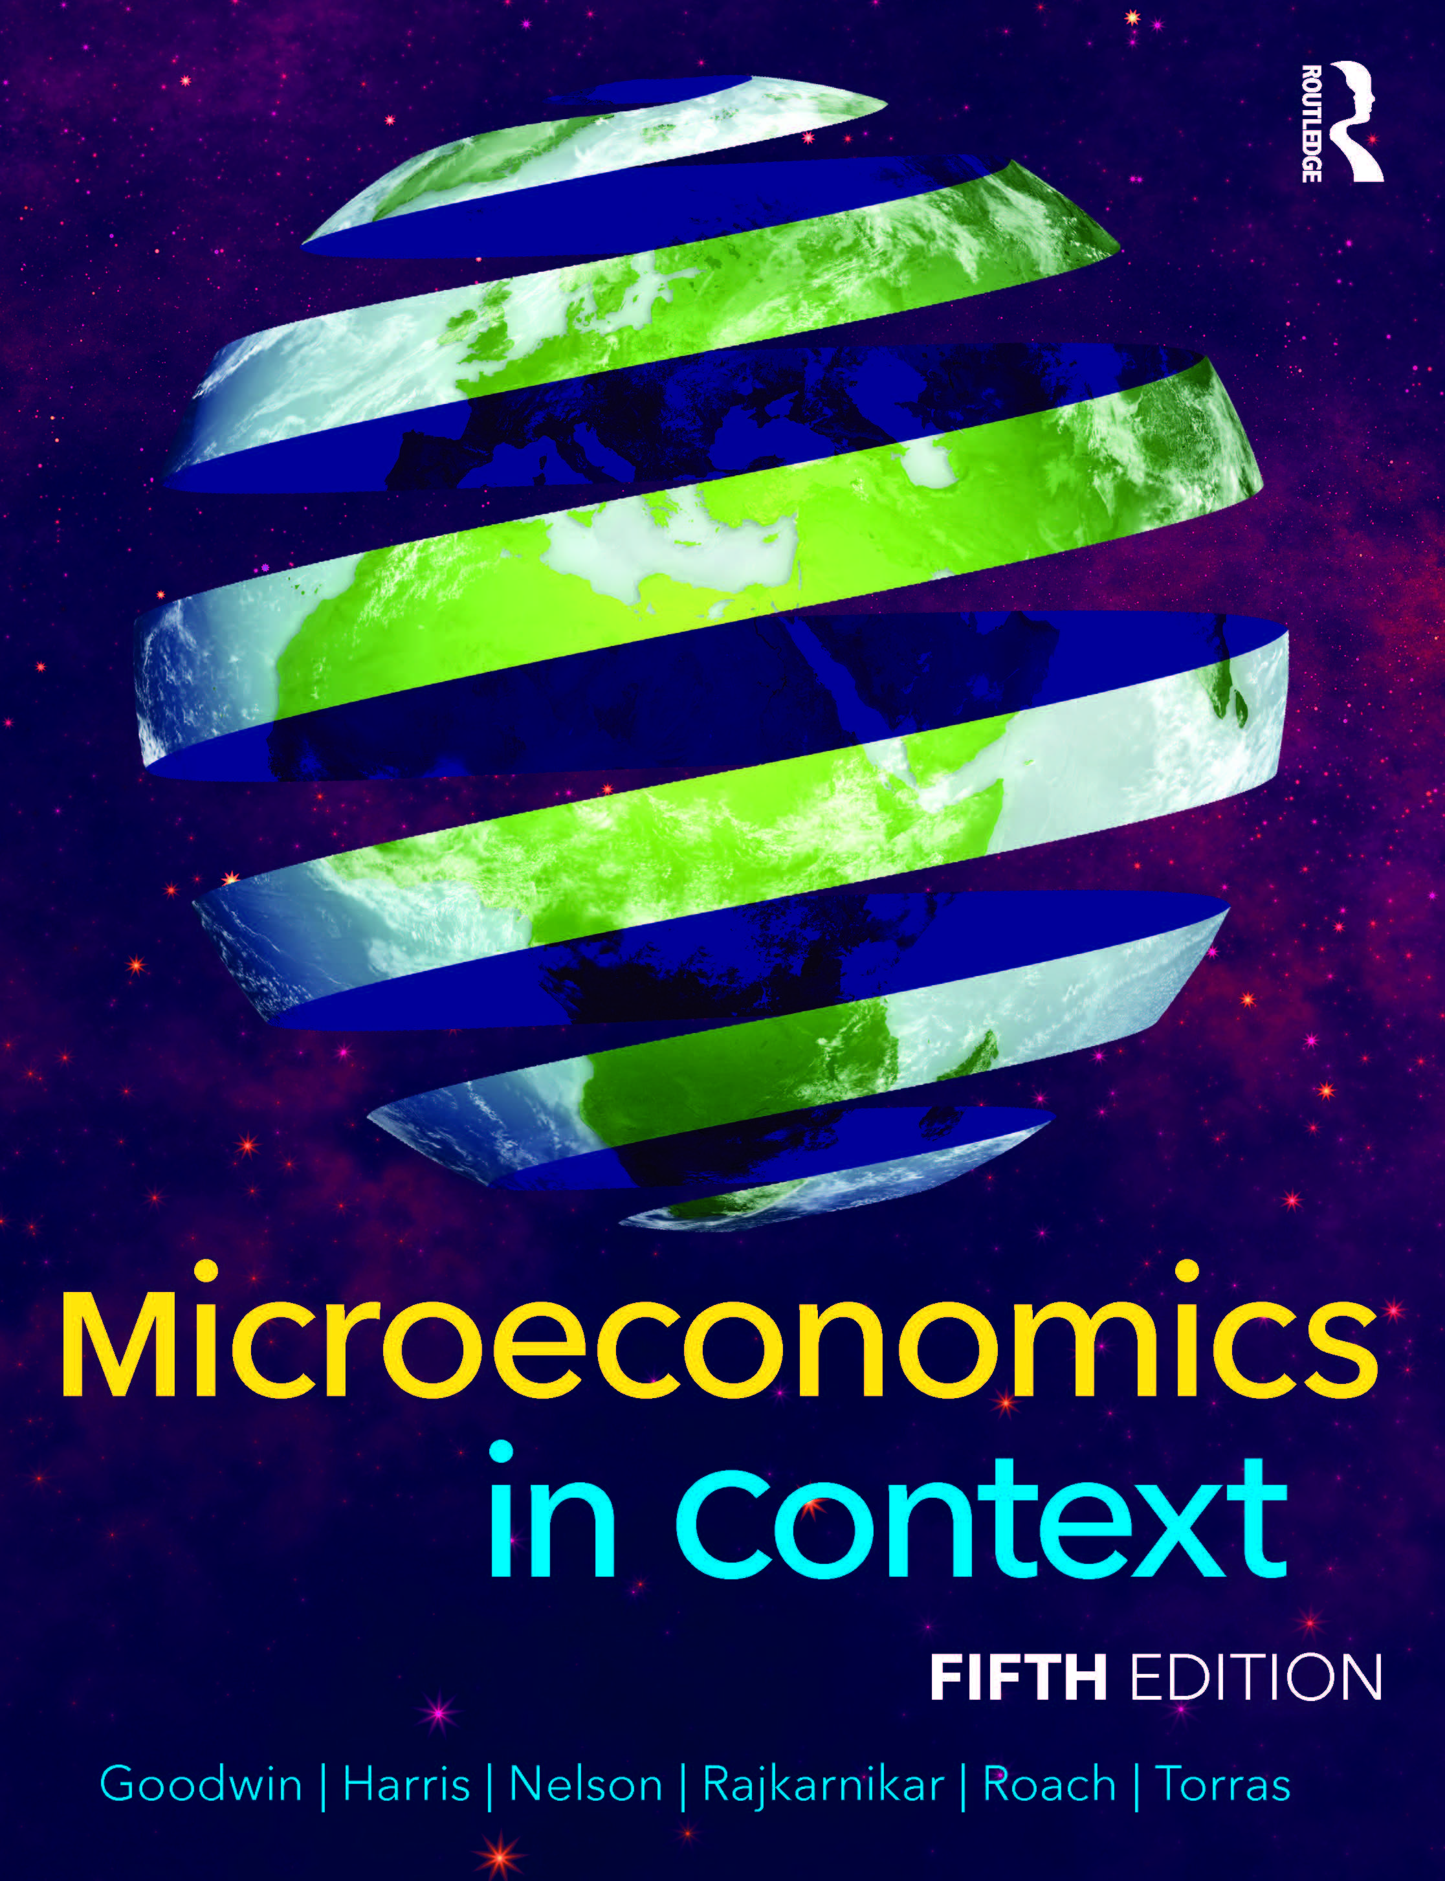
Chapter Eight:
Consumption and the Consumer Society

Slide 2
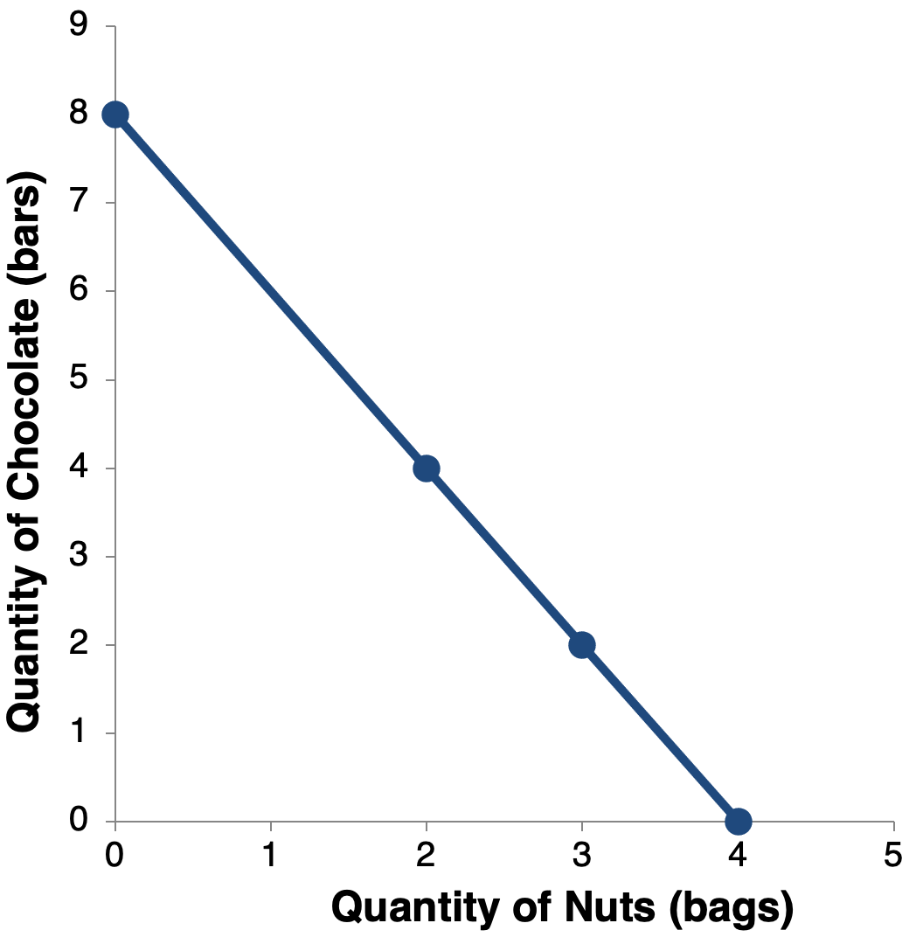
Figure 8.1 The Budget Line

Slide 3
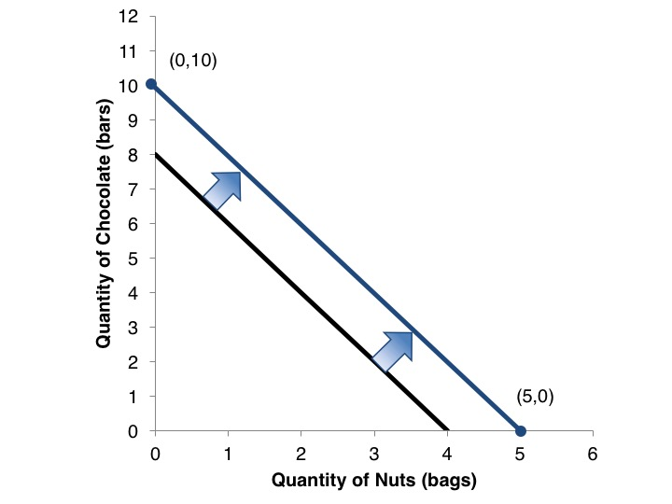
Figure 8.2 Effect of an Increase in Income

Slide 4
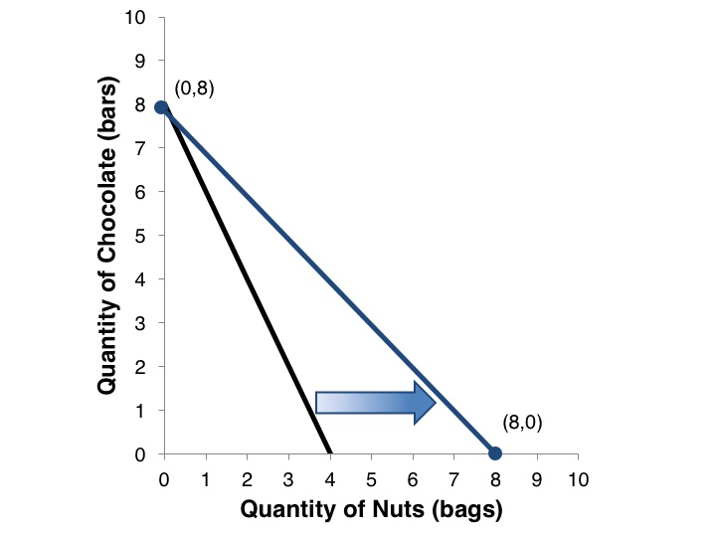
Figure 8.3 Effect of a Fall in the Price of One Good

Slide 5
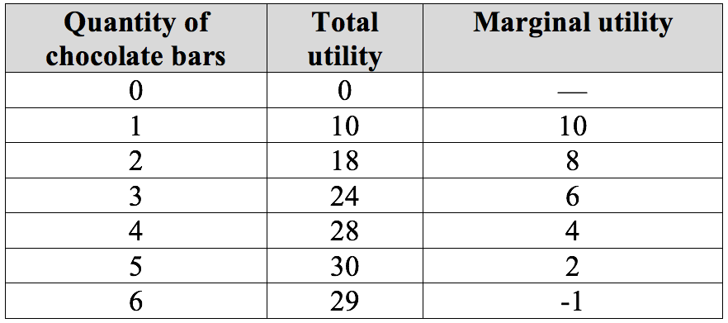
Table 8.1 Quong’s Utility from Consuming Chocolate Bars

Slide 6
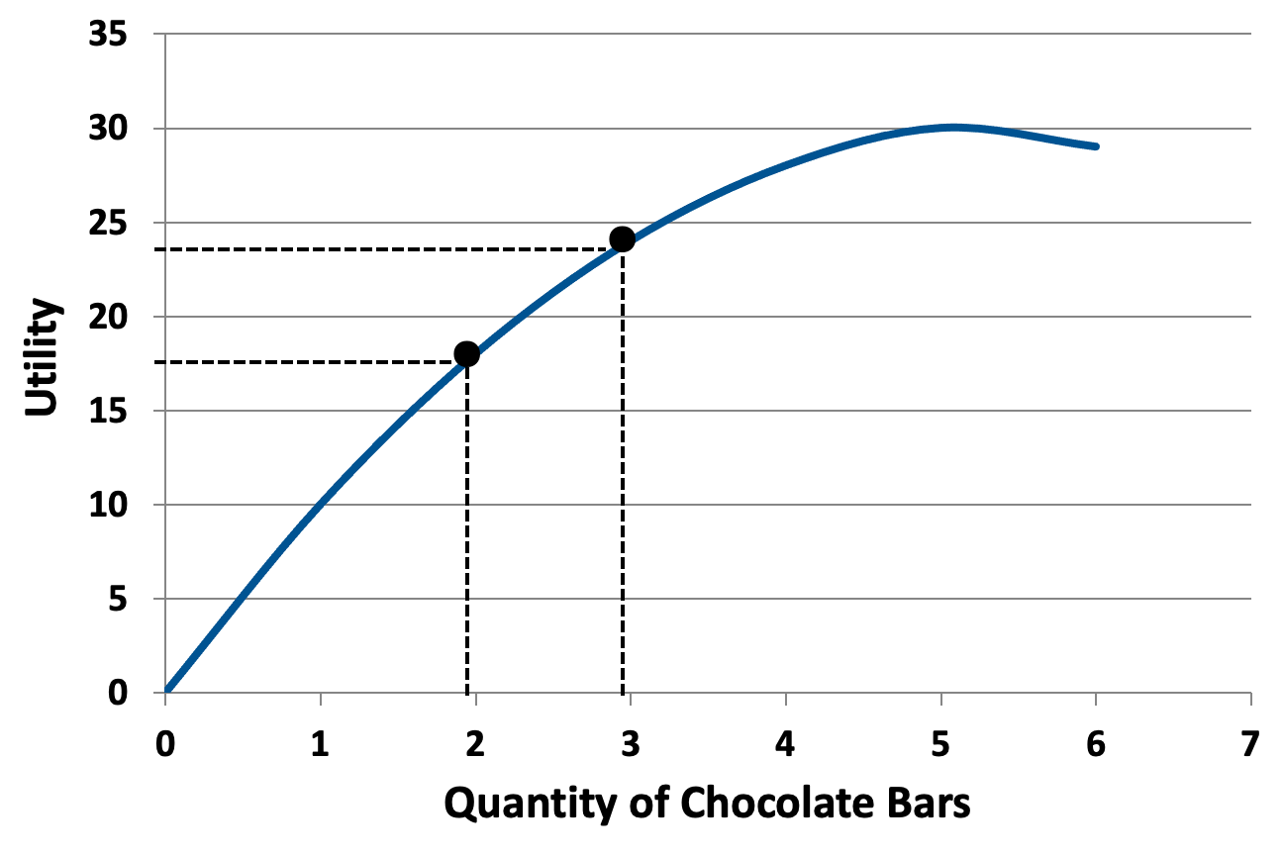
Figure 8.4 Quong’s Utility Function for Chocolate Bars

Slide 7
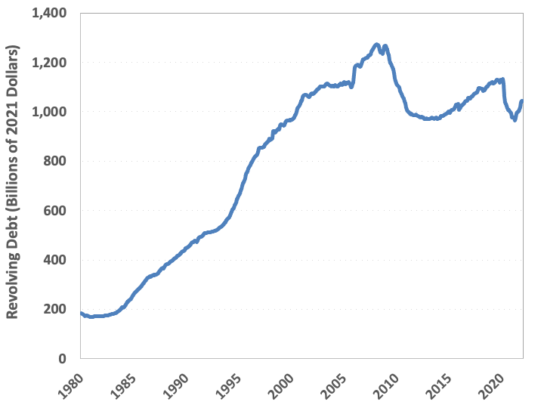
Figure 8.5 Revolving Debt in the United States, 1968-2022, Adjusted for Inflation
Sources: Federal Reserve Bank of St. Louis, Federal Reserve Economic Data (FRED).

Slide 8
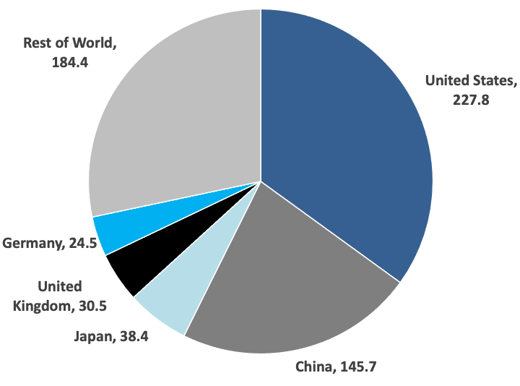
Figure 8.6 Advertising Expenditures, by Country/Region, 2020
Source: Advertising Age, 2021.

Slide 9
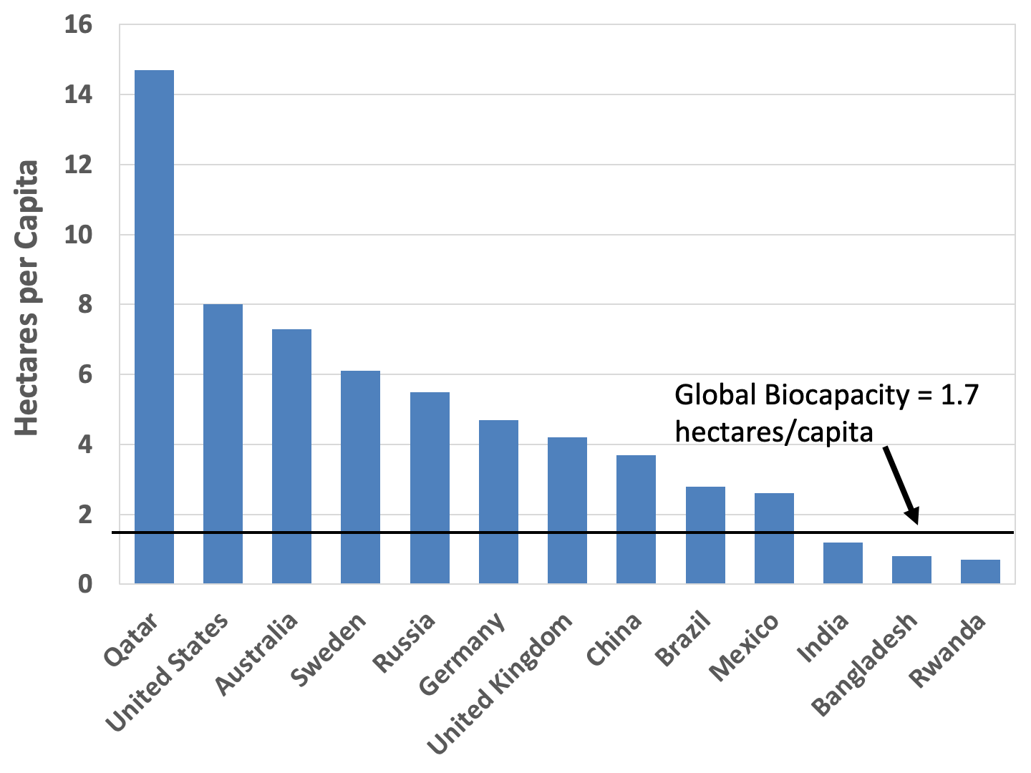
Figure 8.7 Ecological Footprint per Capita, Select Countries, 2017
Source: Global Footprint Network, 2021.

Slide 10
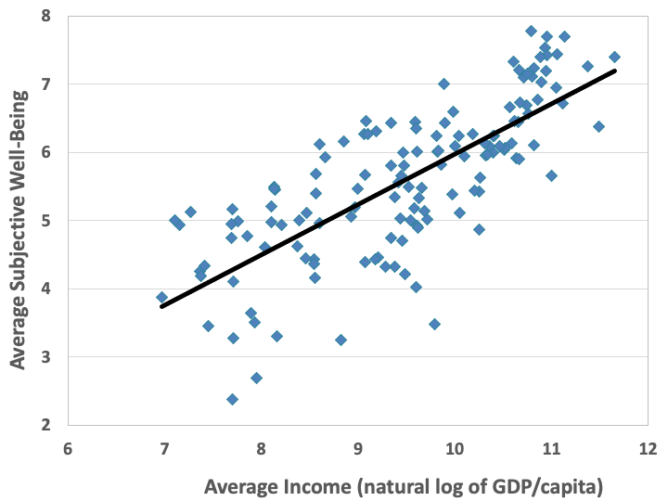
Figure 8.8 The Relationship Between Average Income and Average Subjective Well-Being Across Countries, 2019
Source: Helliwell et al., 2021.

Slide 11
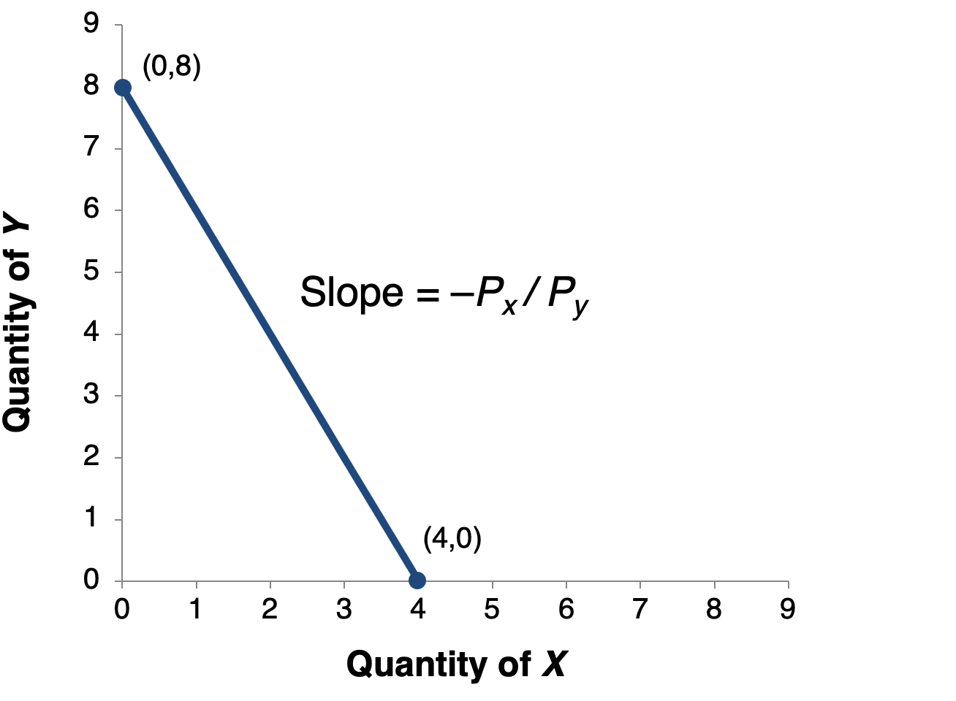
Figure 8.9 The Budget Line and Its Slope

Slide 12
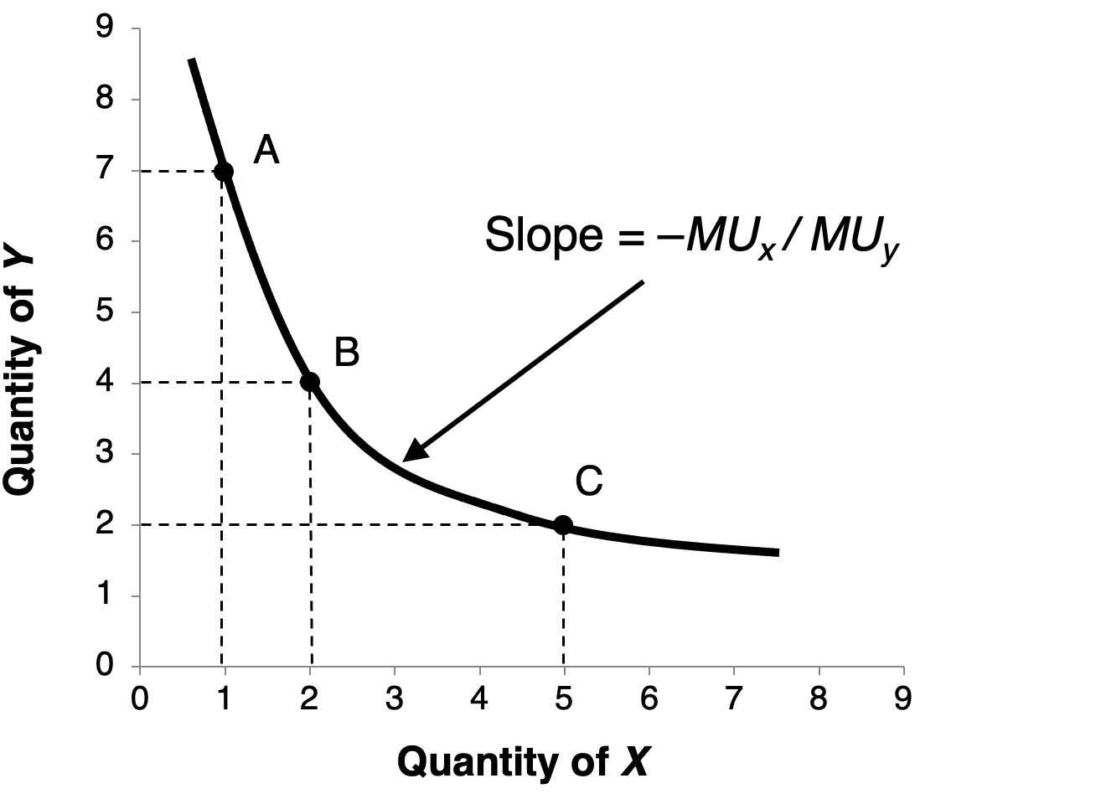
Figure 8.10 An Indifference Curve

Slide 13
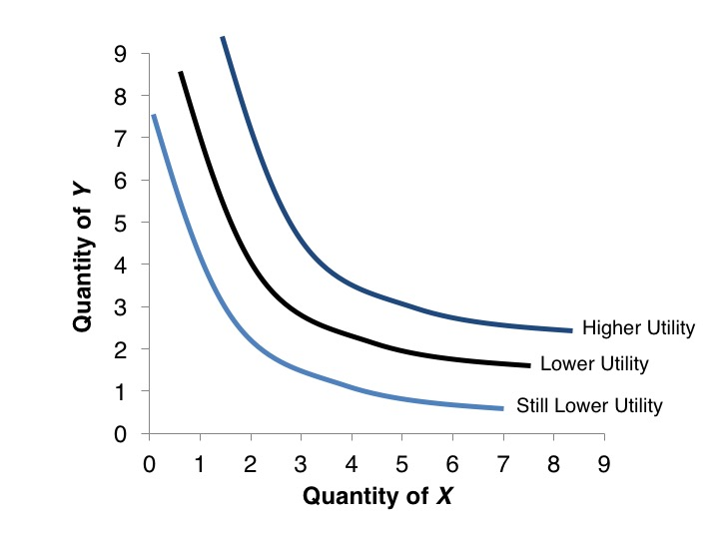
Figure 8.11 Different Levels of Utility

Slide 14
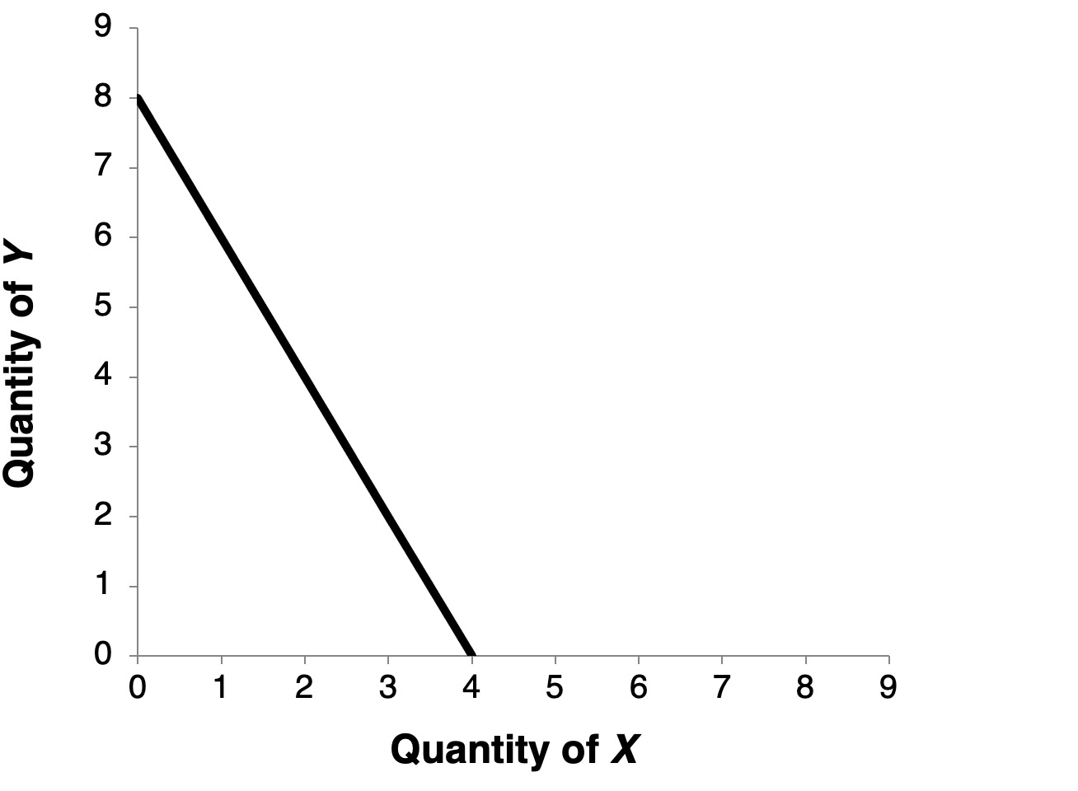
Figure 8.12 Utility Maximization

Slide 15
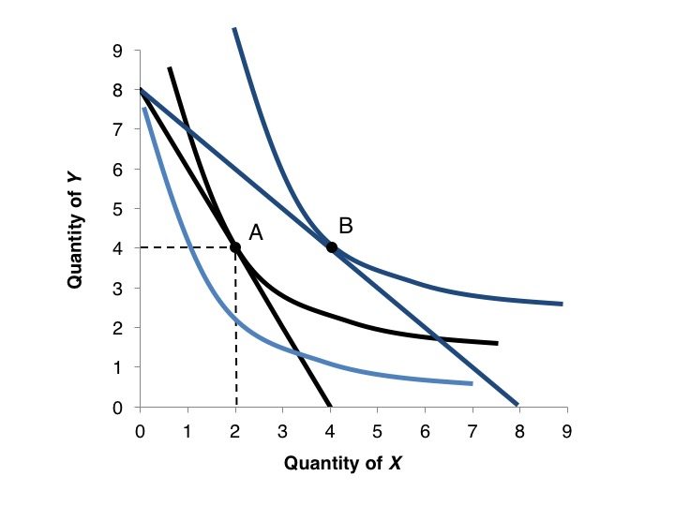
Figure 8.13 Response to a Change in Price

