Slide 1
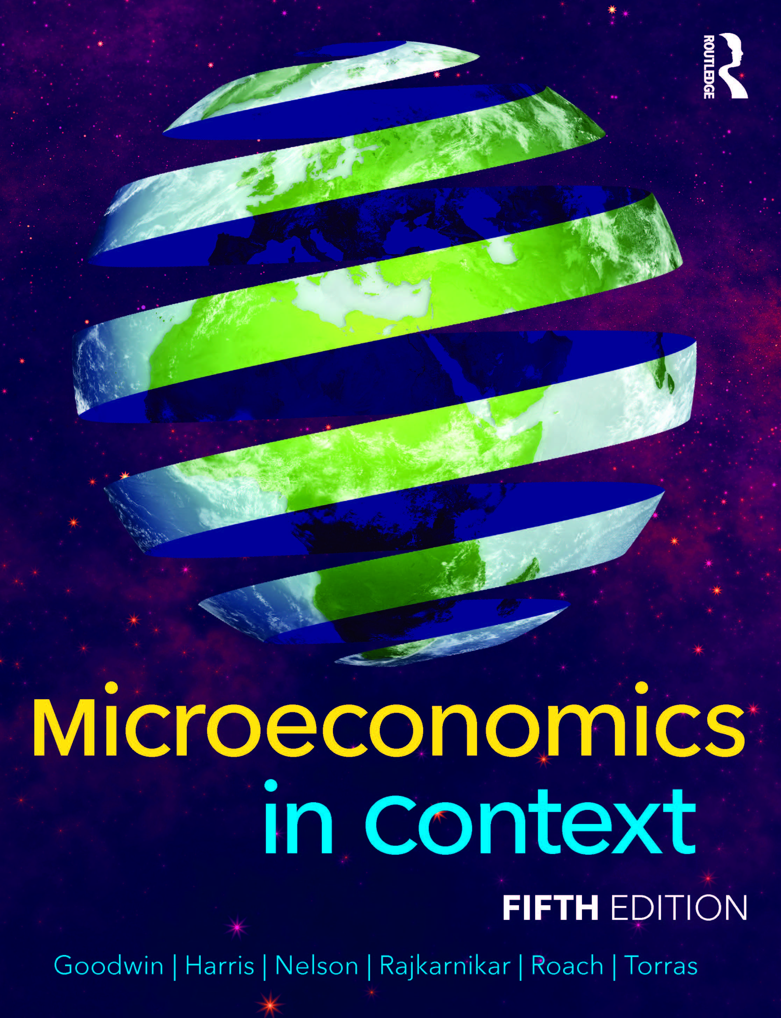
Chapter Six:
International Trade and Trade Policy

Slide 2
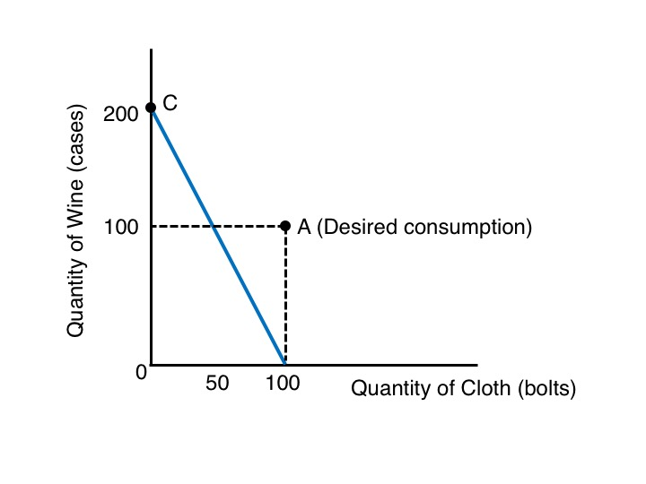
Figure 6.1 Portugal’s Production-Possibilities Frontier

Slide 3
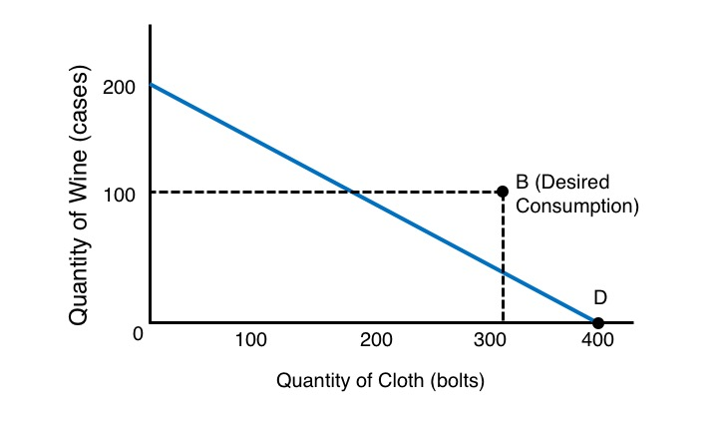
Figure 6.2 England’s Production-Possibilities Frontier

Slide 4
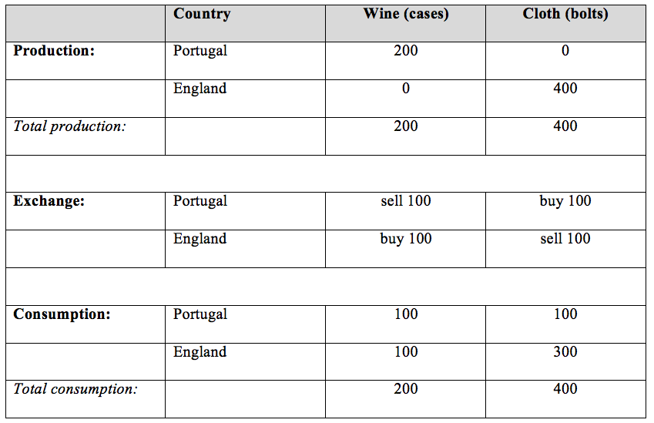
Table 6.1 Production, Exchange, and Consumption of
Wine and Cloth

Slide 5
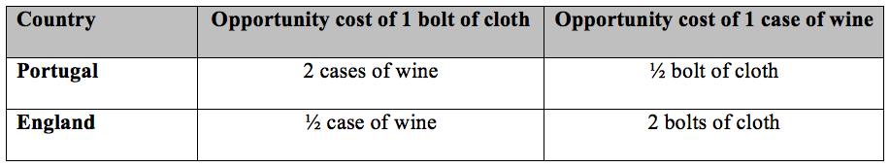
Table 6.2 Opportunity Cost and Comparative Advantage

Slide 6
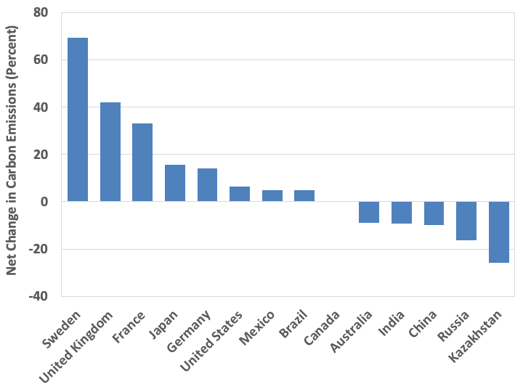
Figure 6.3: Net Change in Carbon Dioxide Emissions when Accounting for Trade, 2018
Source: Ritchie, 2019.

Slide 7
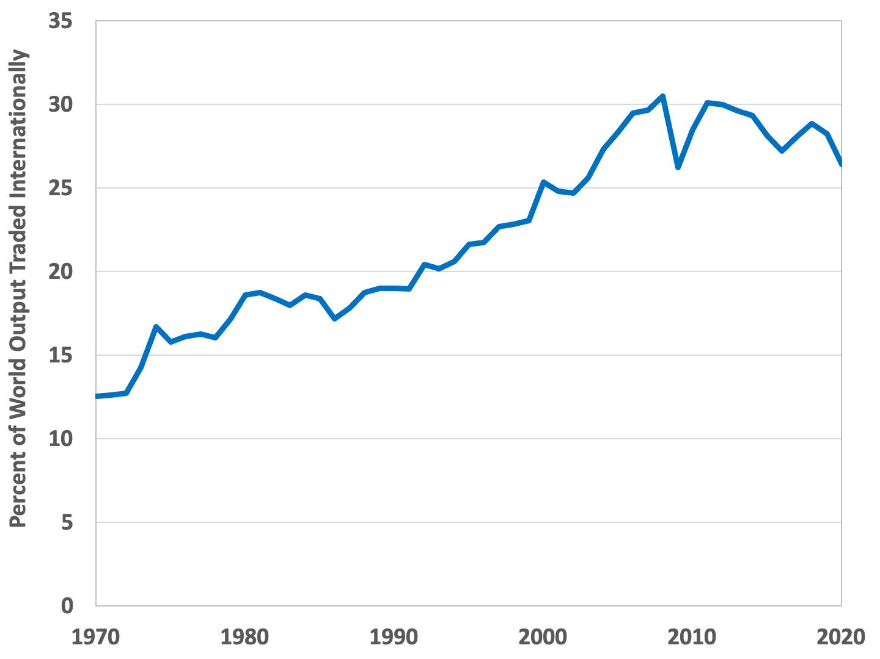
Figure 6.4 Percentage of World Economic Output Traded Internationally, 1970-2020
Source: World Bank, World Development Indicators online database.

Slide 8
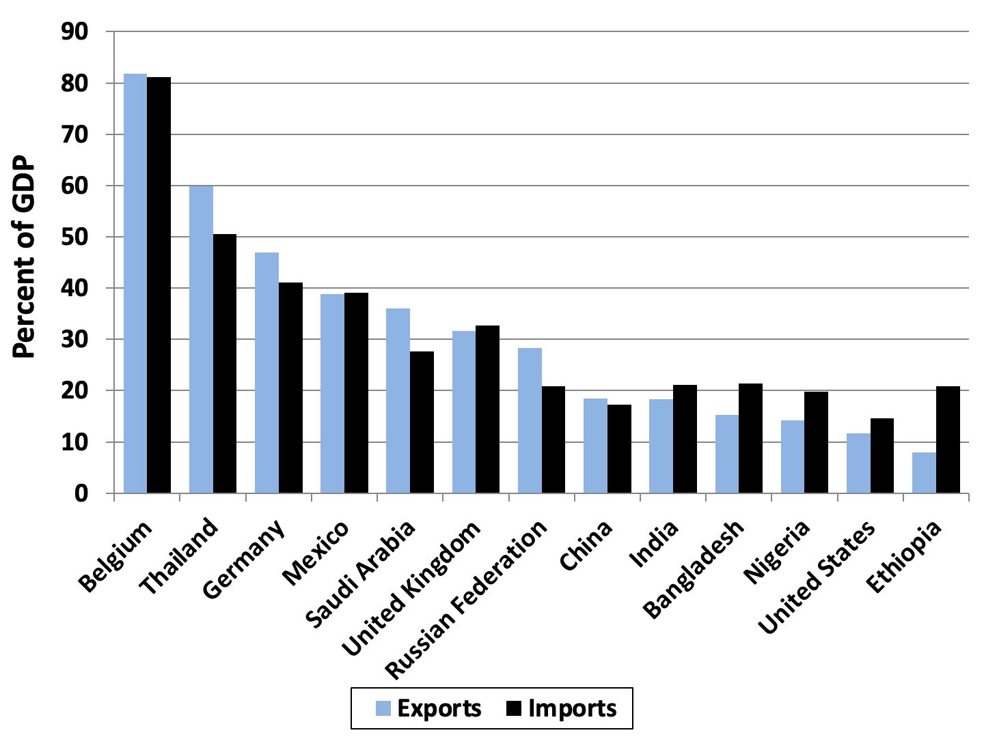
Figure 6.5 Exports and Imports as a Percentage of GDP, Select Countries, 2019
Source: World Bank, World Development Indicators online database.

Slide 9
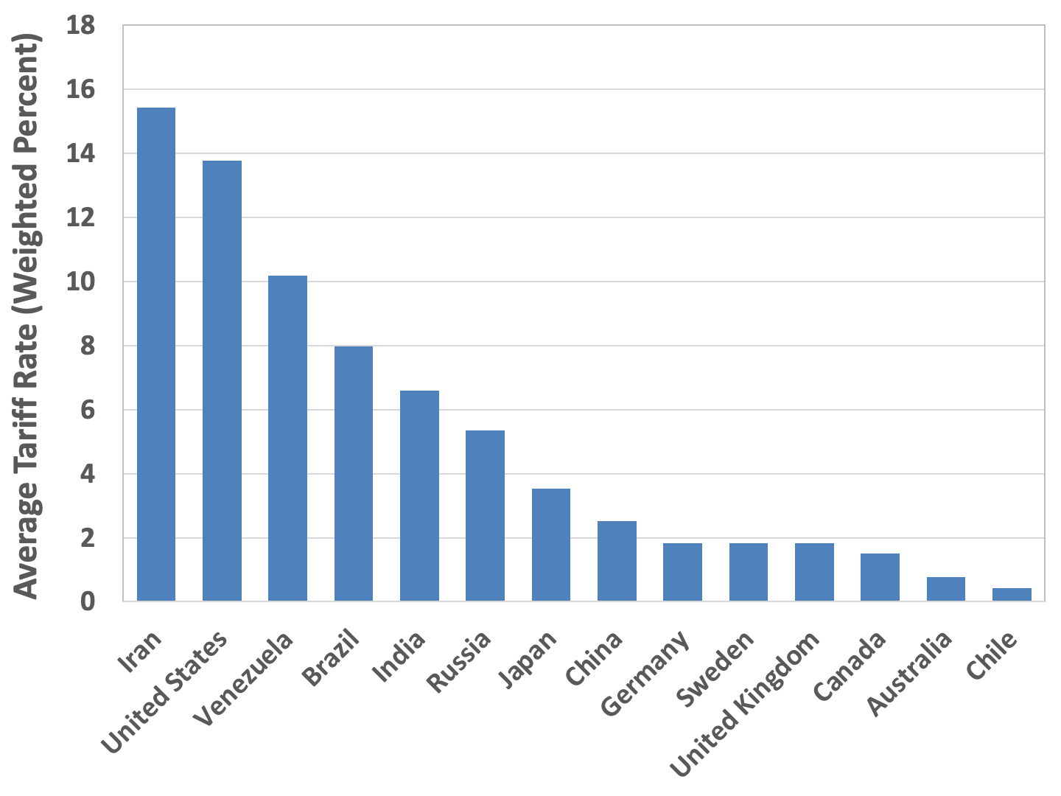
Figure 6.6 Average Tariff Rates, Select Countries, 2019
Source: World Bank, World Development Indicators online database.
Note: Average tariff calculated as a weighted average based on all products.

Slide 10
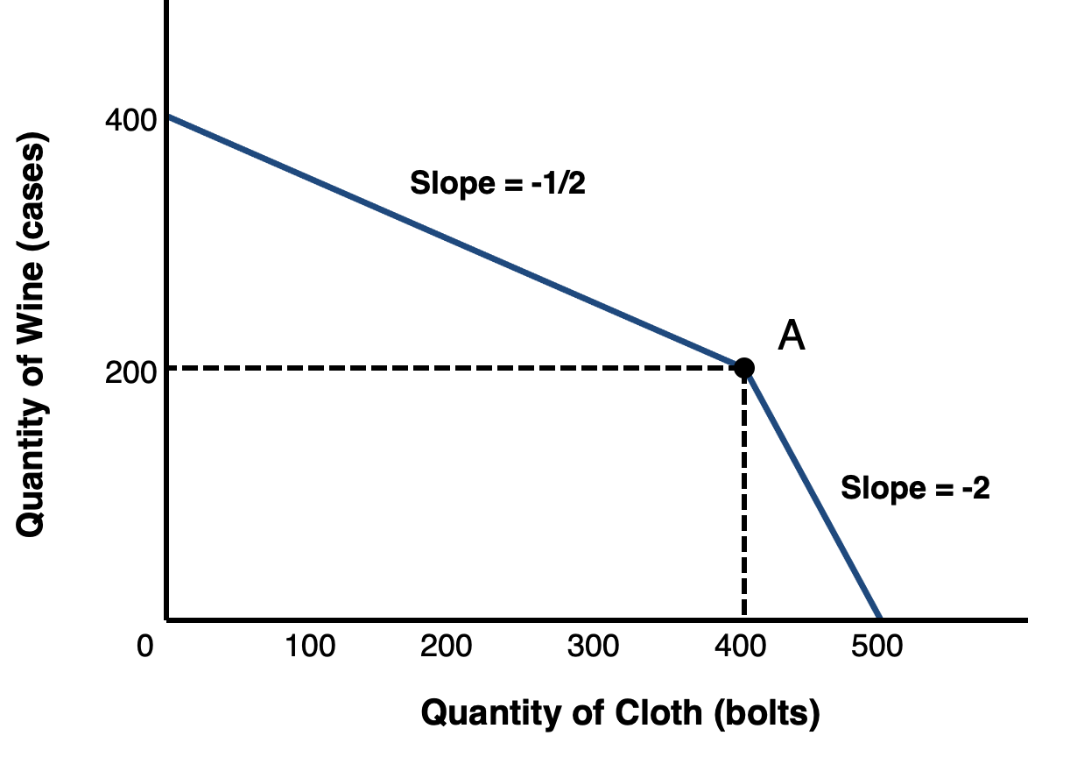
Figure 6.7 Joint Production-Possibilities Frontier for England and Portugal

Slide 11
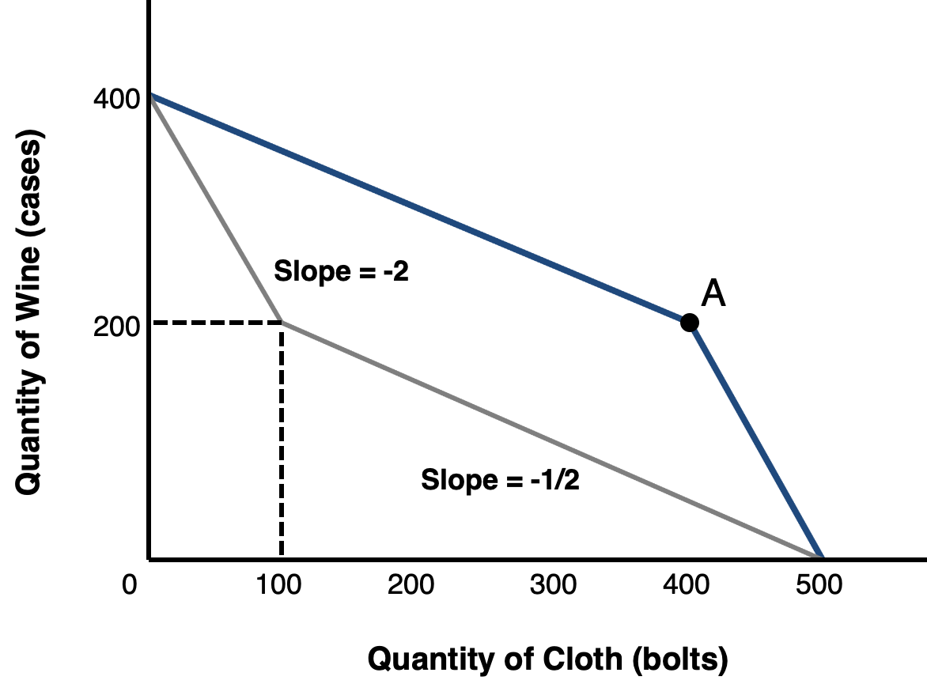
Figure 6.8 Efficient and Inefficient Joint Production-Possibilities Frontiers

