Slide 1


Chapter Five:
Welfare Analysis

Slide 2
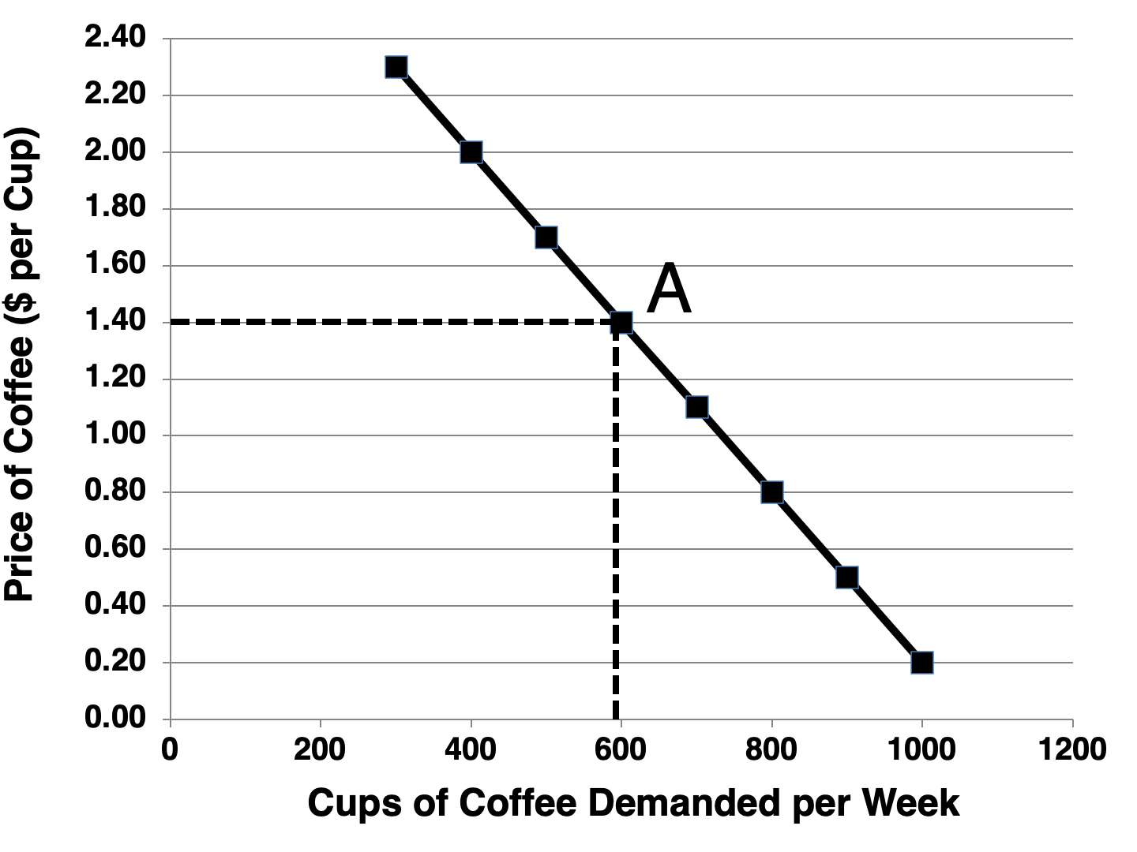
Figure 5.1 Demand Curve for Cups of Coffee

Slide 3
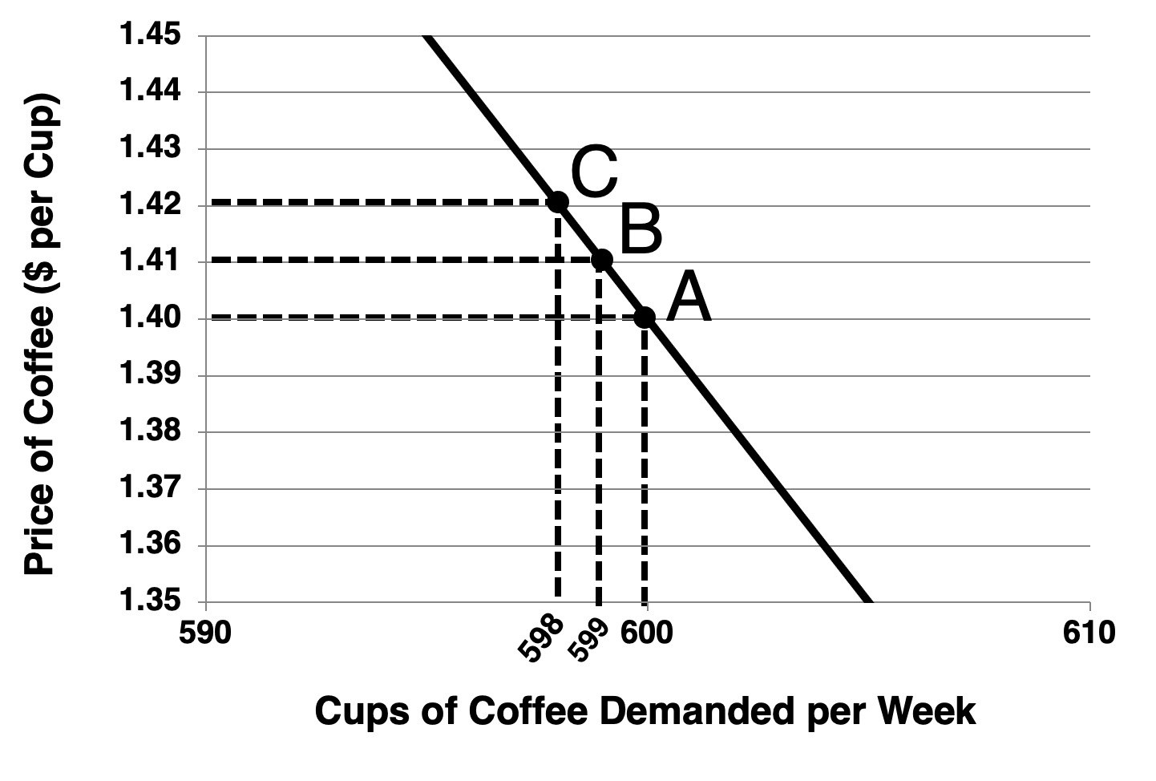
Figure 5.2 Detailed Demand Curve for Cups of Coffee

Slide 4
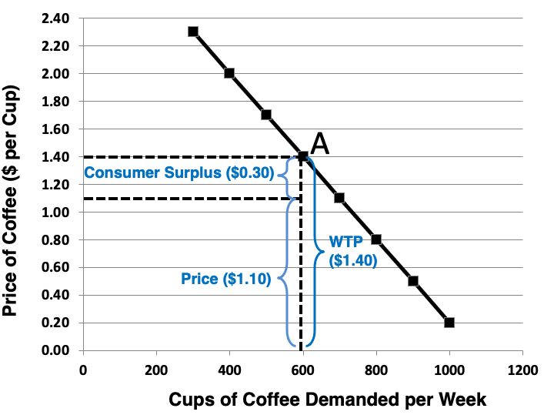
Figure 5.3 Consumer Surplus and a Demand Curve

Slide 5
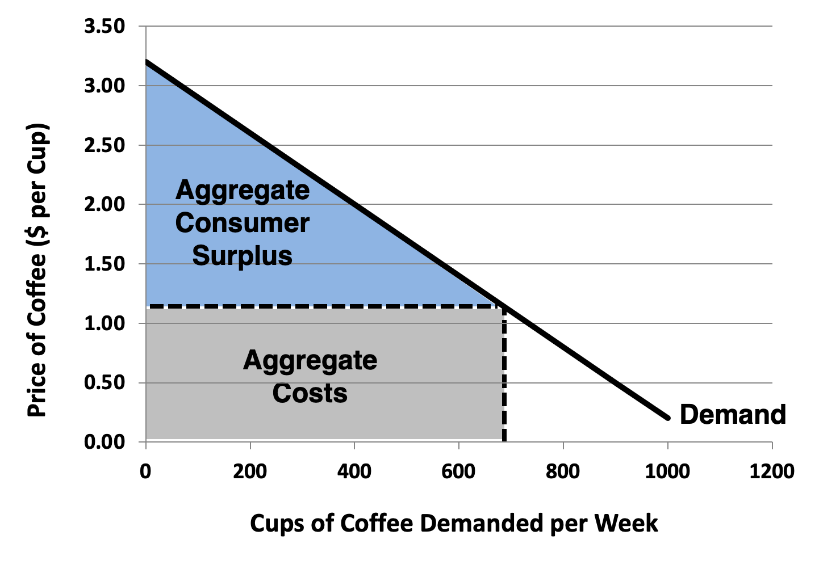
Figure 5.4 Market Consumer Surplus

Slide 6
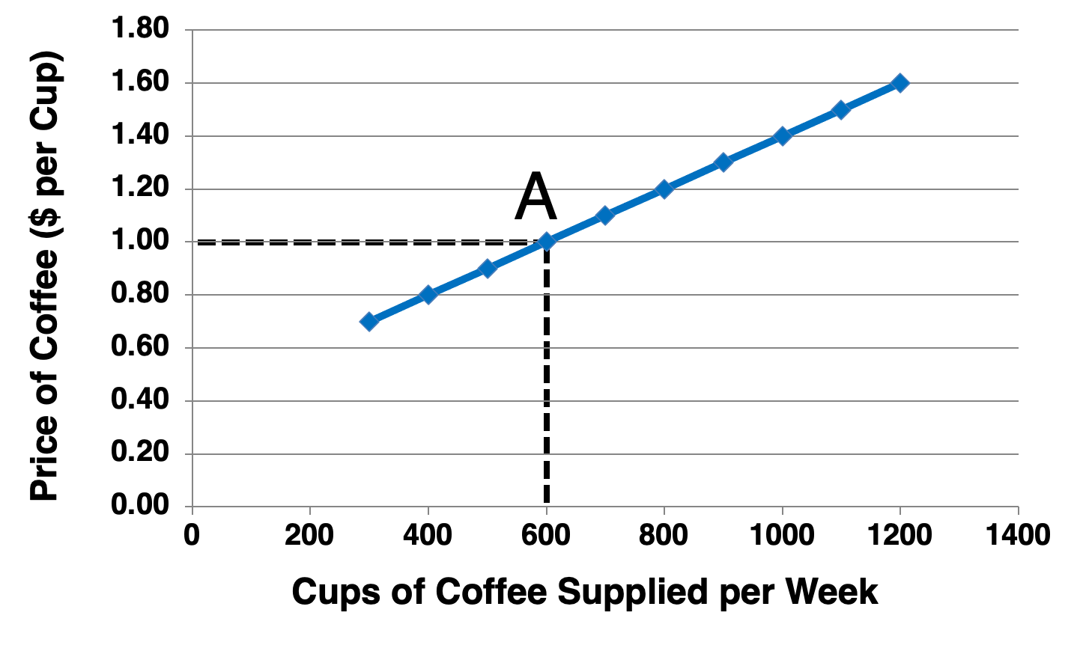
Figure 5.5 Supply Curve for Cups of Coffee
Figure 5.5 Supply Curve for Cups of Coffee

Slide 7
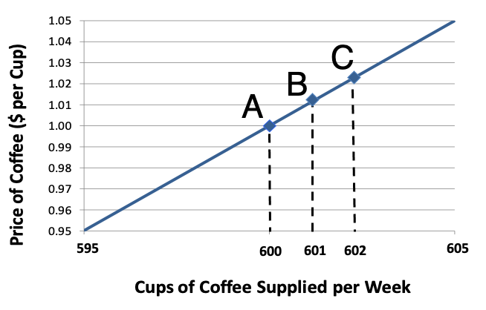
Figure 5.6 Detailed Supply Curve for Cups of Coffee

Slide 8
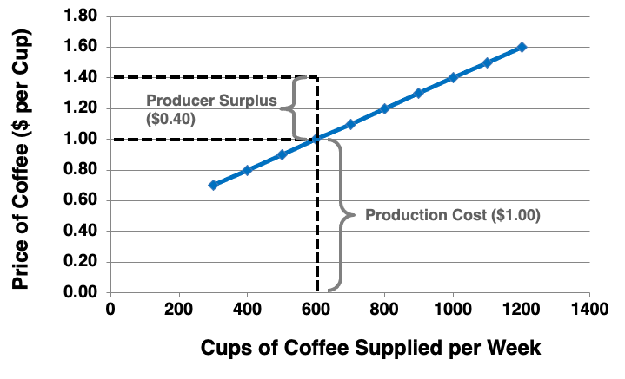
Figure 5.7 Producer Surplus and a Supply Curve

Slide 9
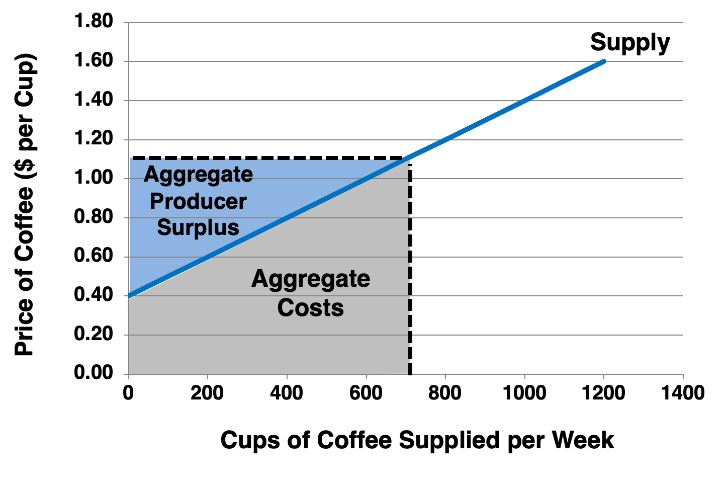
Figure 5.8 Market Producer Surplus

Slide 10
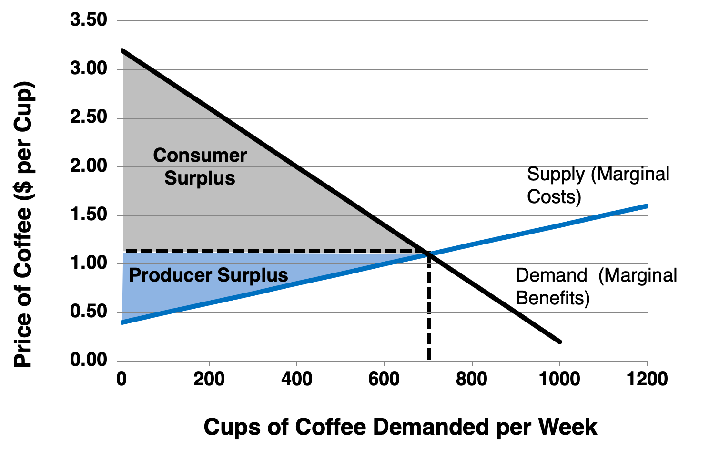
Figure 5.9 Social Welfare at Market Equilibrium

Slide 11
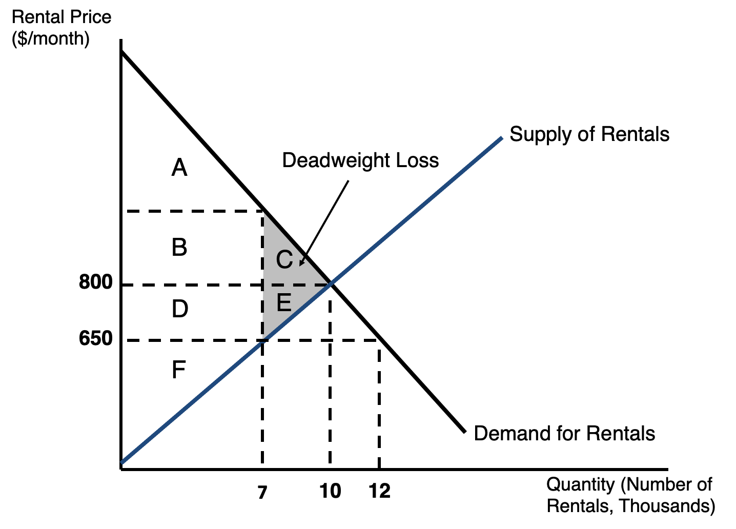
Figure 5.10 Welfare Analysis of a Price Ceiling

Slide 12
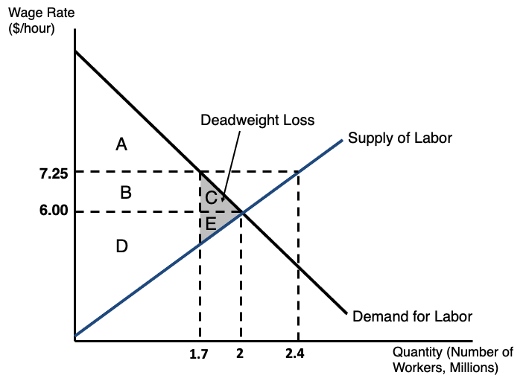
Figure 5.11 Welfare Analysis of a Price Floor

