Slide 1

Chapter Four:
Elasticity

Slide 2
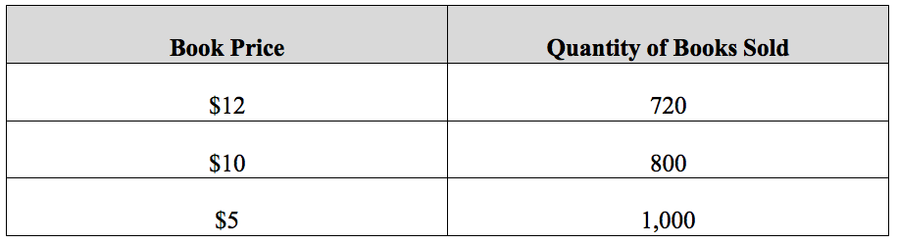
Table 4.1 Relationship Between Price and Quantity Demanded for Braeburn’s Poetry Book

Slide 3
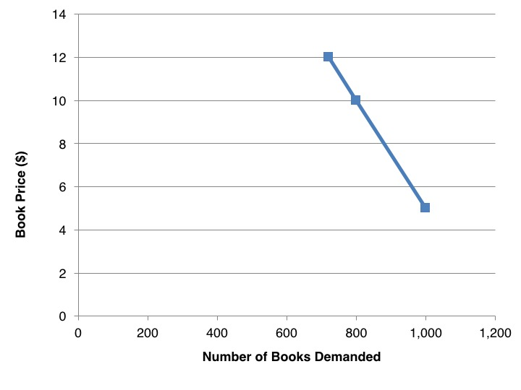
Figure 4.1 Demand Curve for Braeburn’s Poetry Book

Slide 4
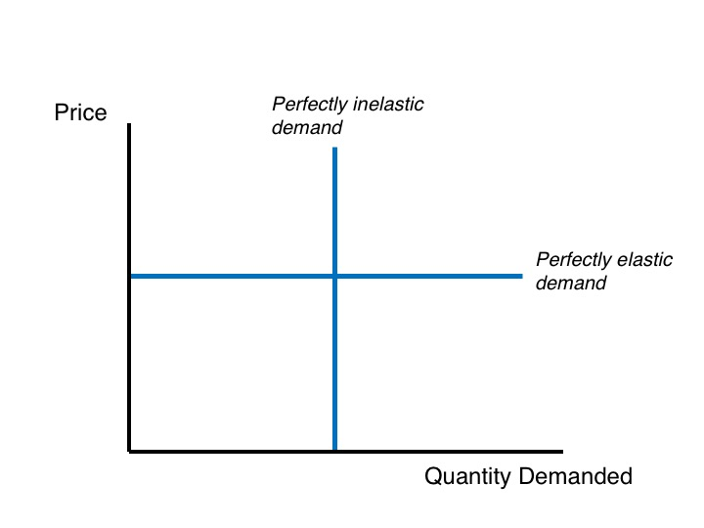
Figure 4.2 Perfectly Inelastic and Perfectly Elastic Demand Curves

Slide 5
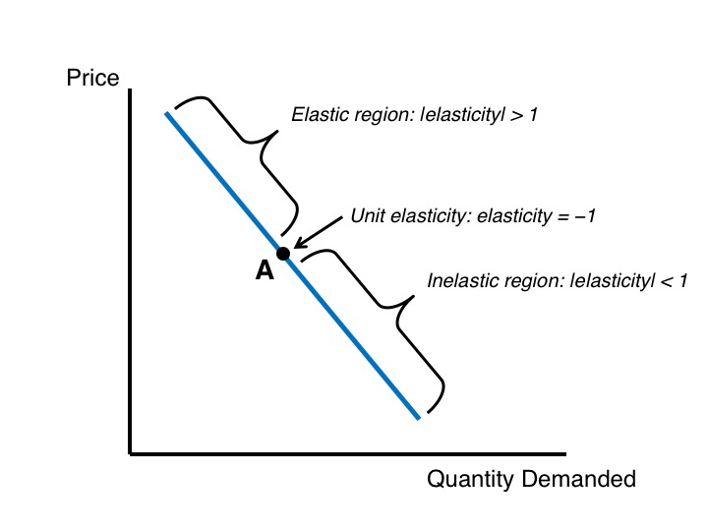
Figure 4.3 Elasticity Varies Along a Straight-Line Demand Curve

Slide 6
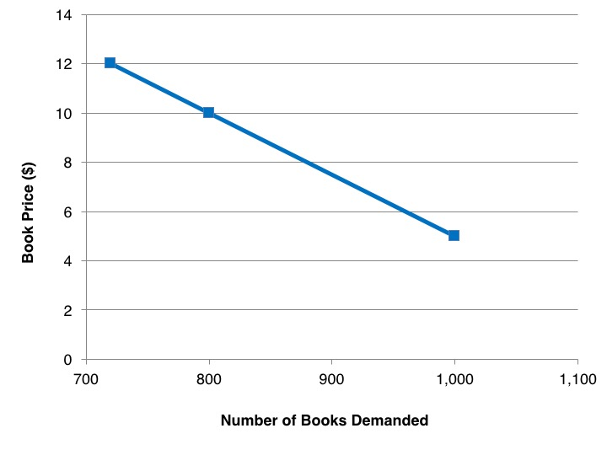
Figure 4.4 Changing the x-Axis Scale of Braeburn’s Demand Curve

Slide 7
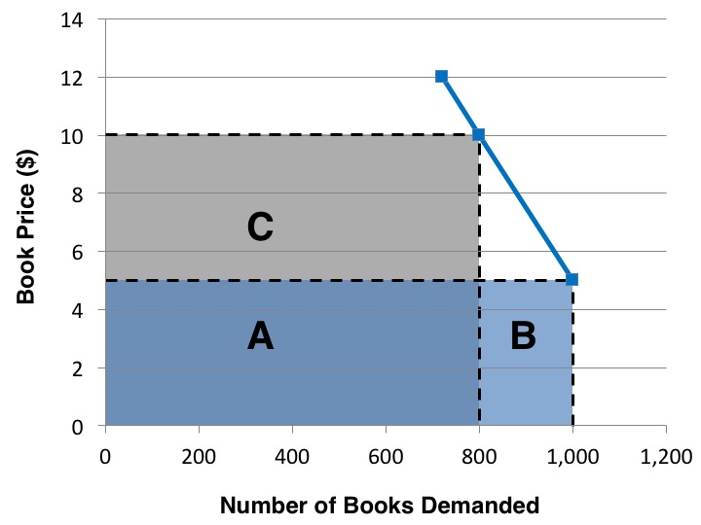
Figure 4.5 Braeburn’s Book Revenues

Slide 8
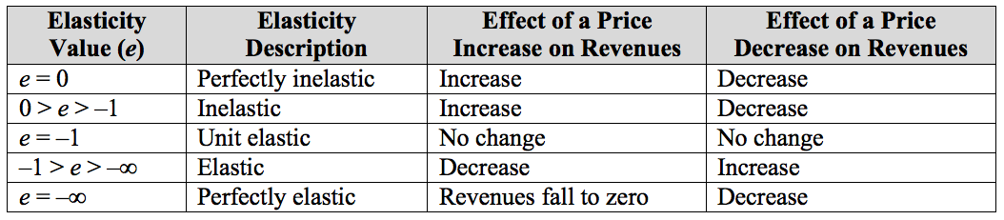
Table 4.2 Effects of Price Changes on Revenues

Slide 9
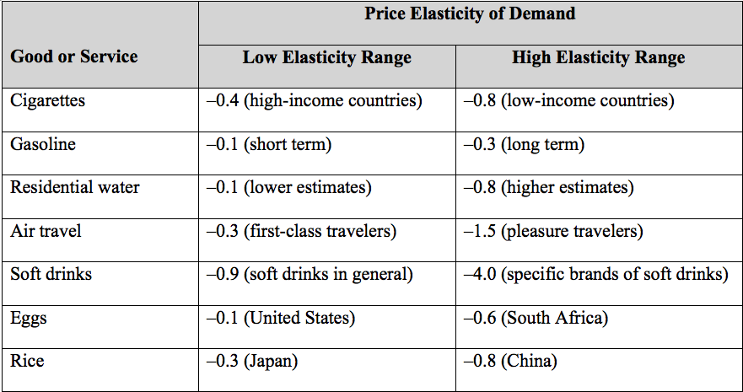
Table 4.3 Some Estimated Price Elasticities of Demand
Sources: Perucic, 2012; Dalhuisen et al., 2003; https://en.wikipedia.org/wiki/Price_elasticity_of_demand.

Slide 10
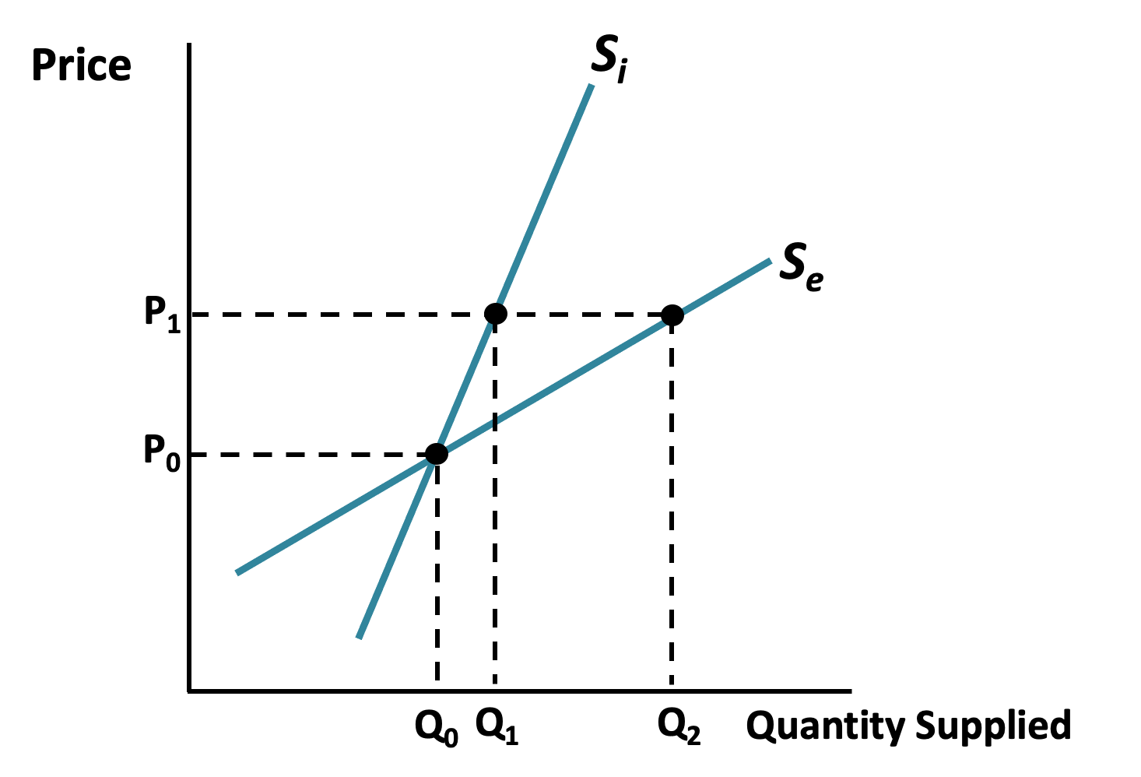
Figure 4.6: The Price Elasticity of Supply

Slide 11
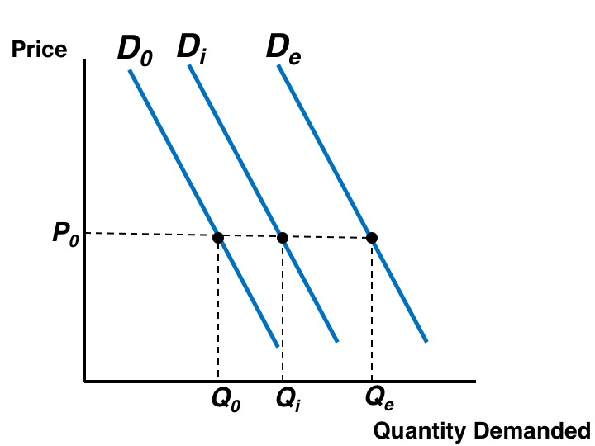
Figure 4.7 The Income Elasticity of Demand

