Slide 1


Chapter Seventeen:
Markets with Market Power

Slide 2
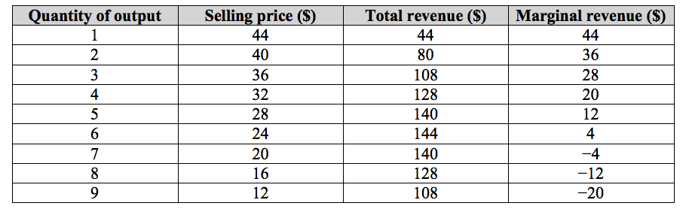
Table 17.1 Total and Marginal Revenue for a Monopolist

Slide 3
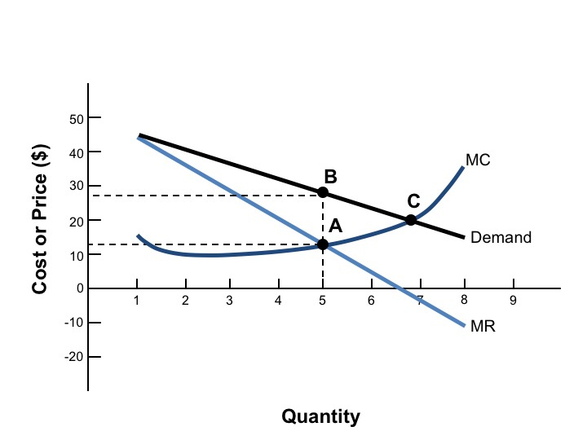
Figure 17.1 Monopoly Profit Maximization

Slide 4
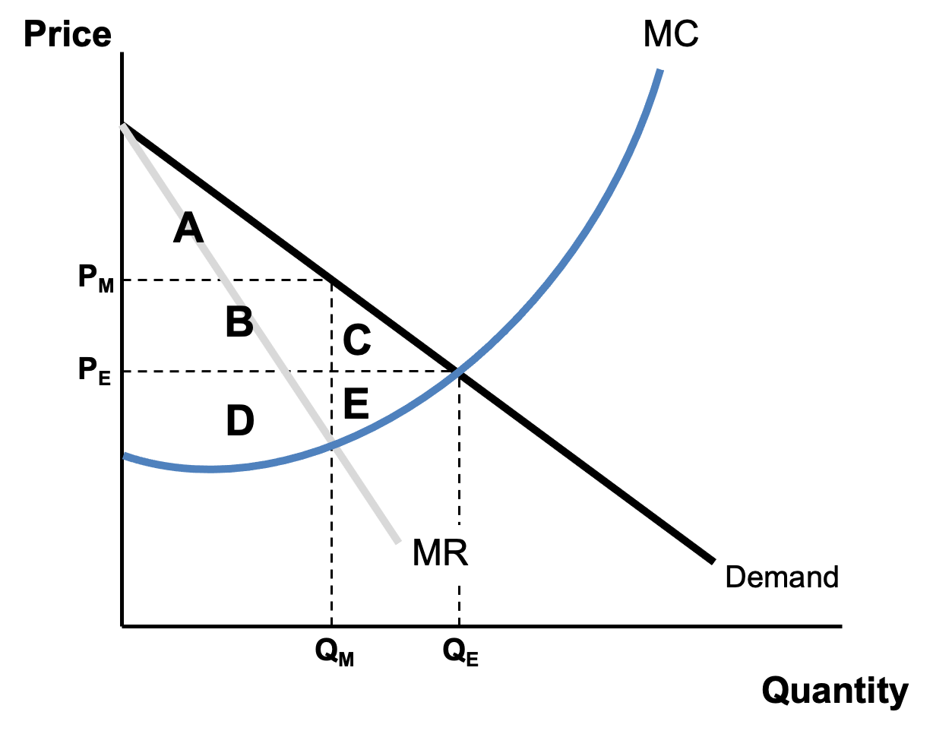
Figure 17.2 Welfare Analysis of Monopoly

Slide 5
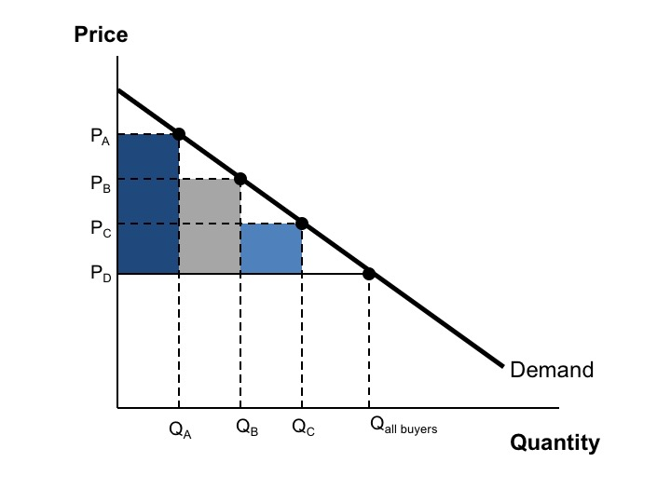
Figure 17.3 Price Discrimination

Slide 6
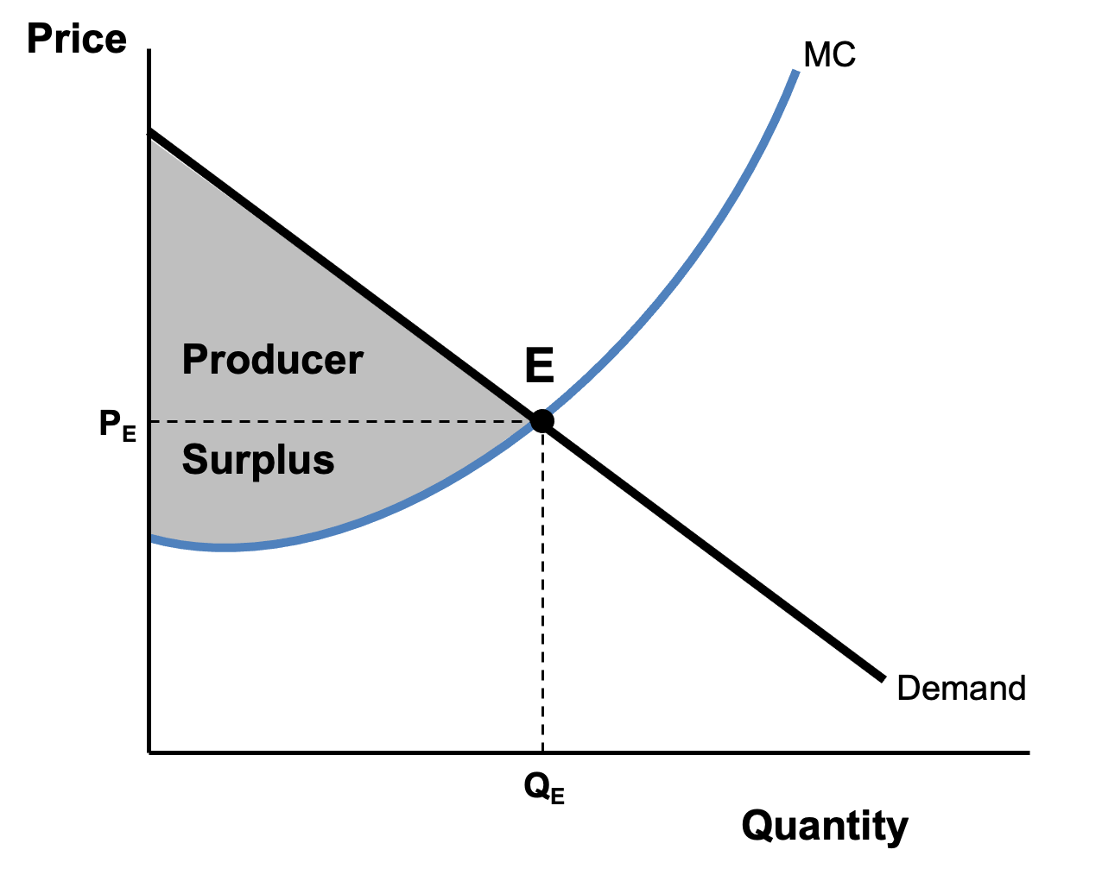
Figure 17.4 A Perfectly Price-Discriminating Monopolist

Slide 7
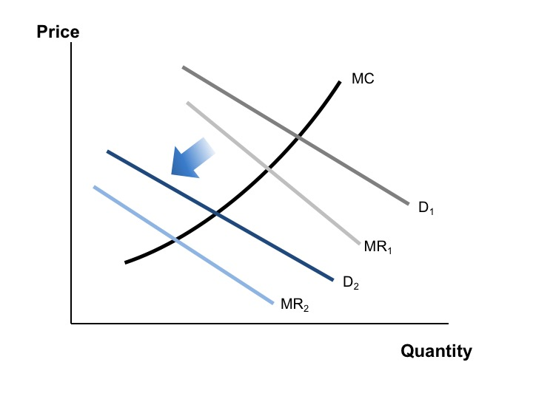
Figure 17.5 The Effect of Firm Entry on the Demand Curve for a Monopolistically Competitive Firm

Slide 8
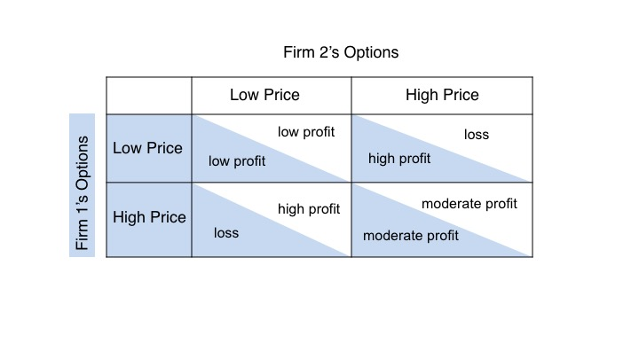
Figure 17.6 A Payoff Matrix

Slide 9
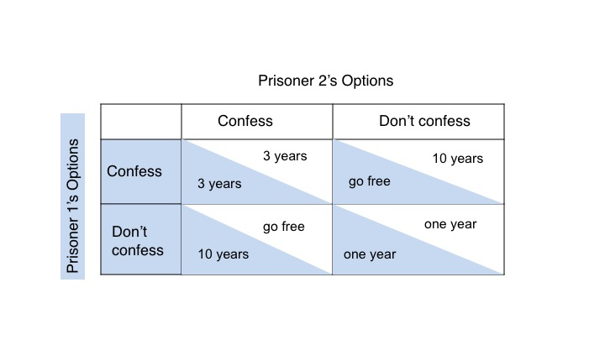
Figure 17.7 The Prisoner’s Dilemma

Slide 10
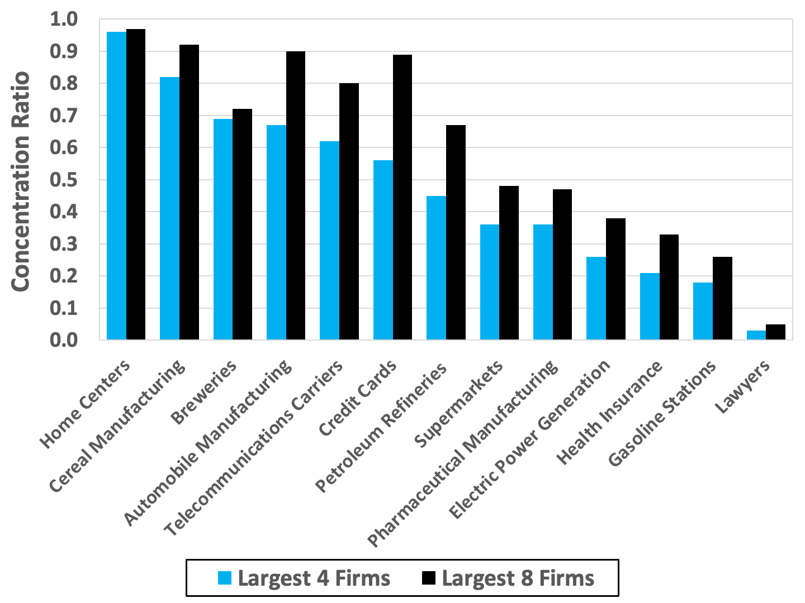
Figure 17.8 Concentration Ratios for Select Industries,
United States 2017
Source: U.S. Census Bureau, 2017 Economic Census.
Note: Manufacturing concentration ratios based on value-added. All other concentration ratios based on revenues.

Slide 11
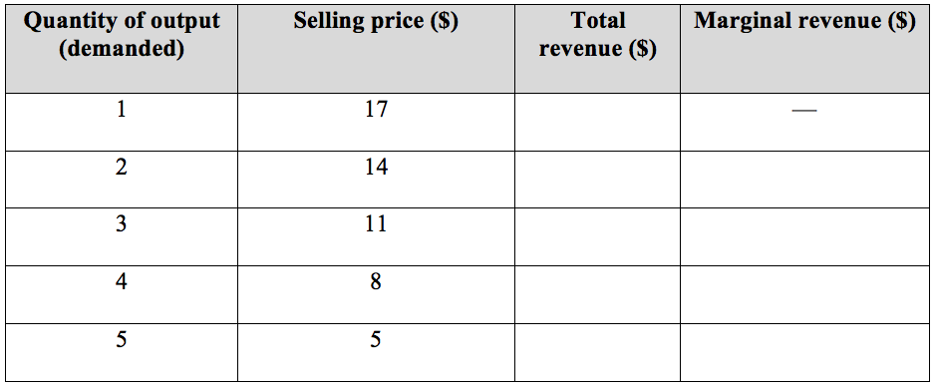
Chapter 17 Exercise 1

Slide 12
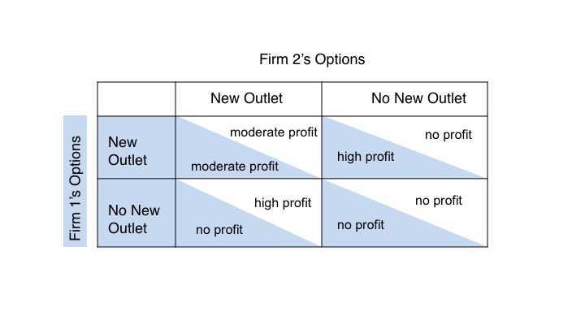
Chapter 17 Exercise 2

Slide 13
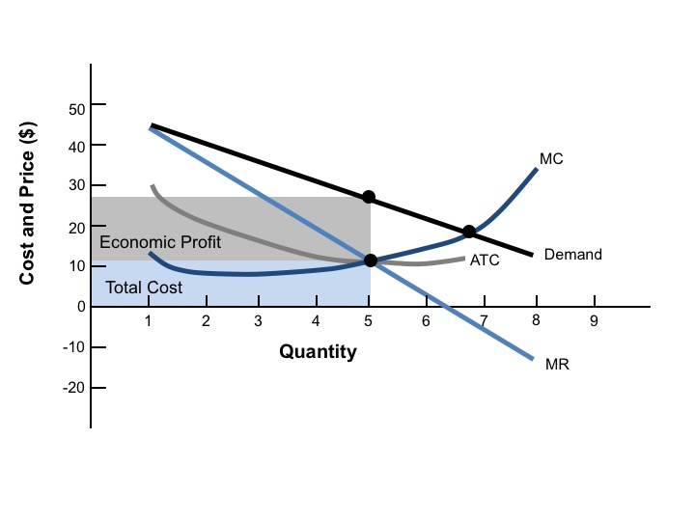
Figure 17.9 Monopoly Profits

Slide 14
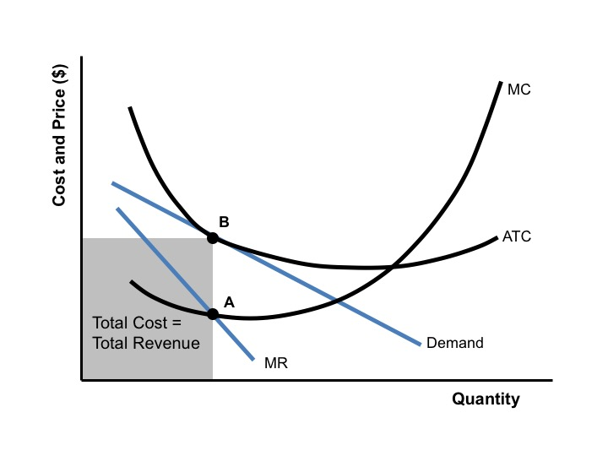
Figure 17.10 Zero Economic Profits for a Monopolistically Competitive Firm

