Slide 1

Chapter Thirteen:
Common Property Resources and Public Goods

Slide 2
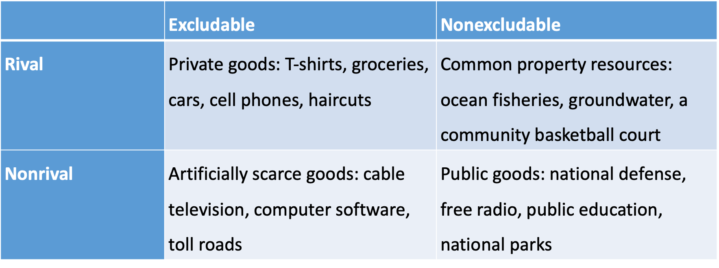
Table 13.1 Classification of Different Types of Goods

Slide 3
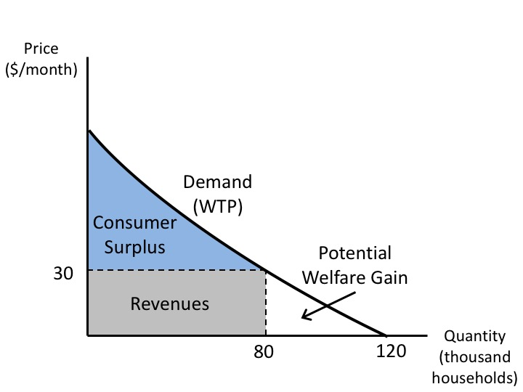
Figure 13.1 The Market for an Artificially Scarce Good (Cable Television)

Slide 4
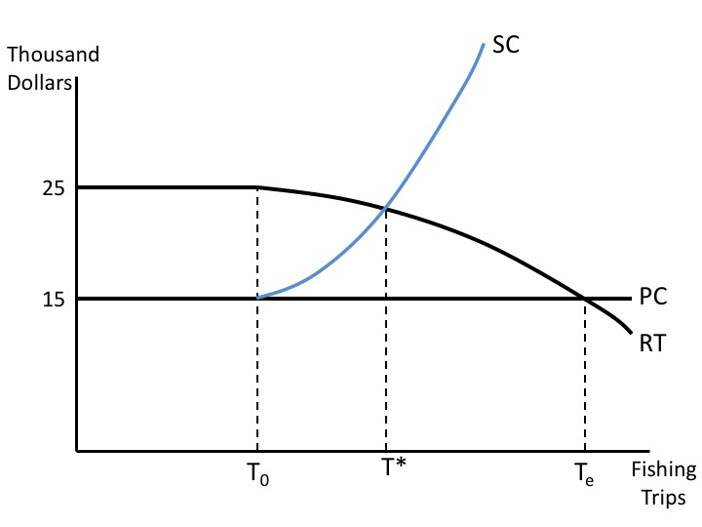
Figure 13.2 Common Property Model of a Fishery

Slide 5
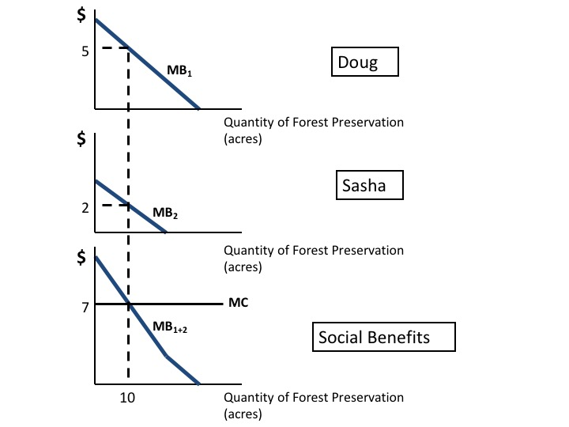
Figure 13.3 The Benefits of Public Goods

Slide 6
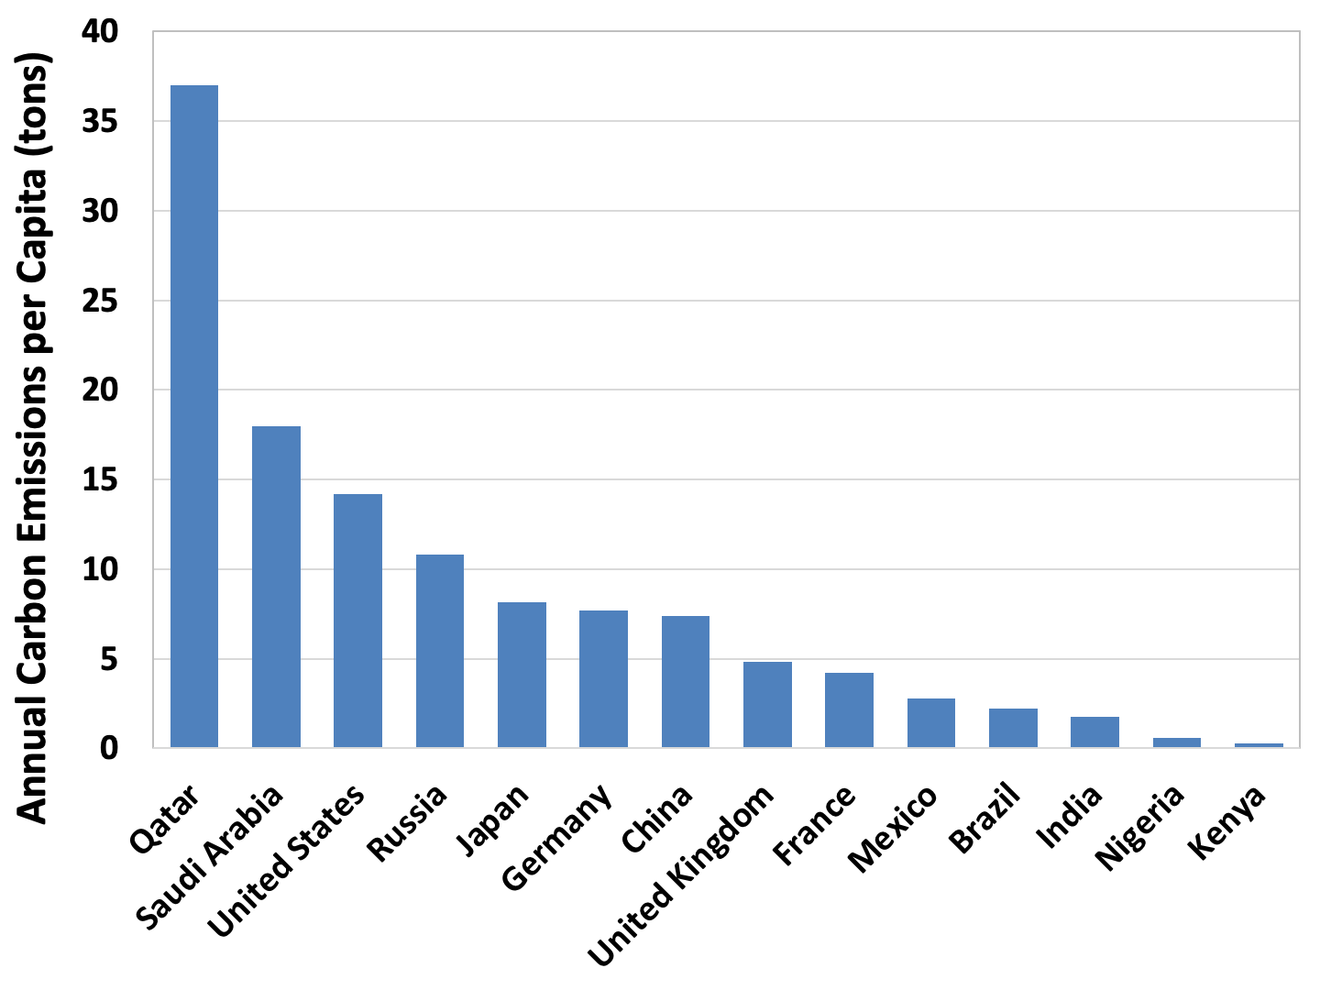
Figure 13.4 Carbon Emissions per Capita, 2020, Select Countries
Source: Global Carbon Atlas, http://www.globalcarbonatlas.org/en/CO2-emissions.

Slide 7
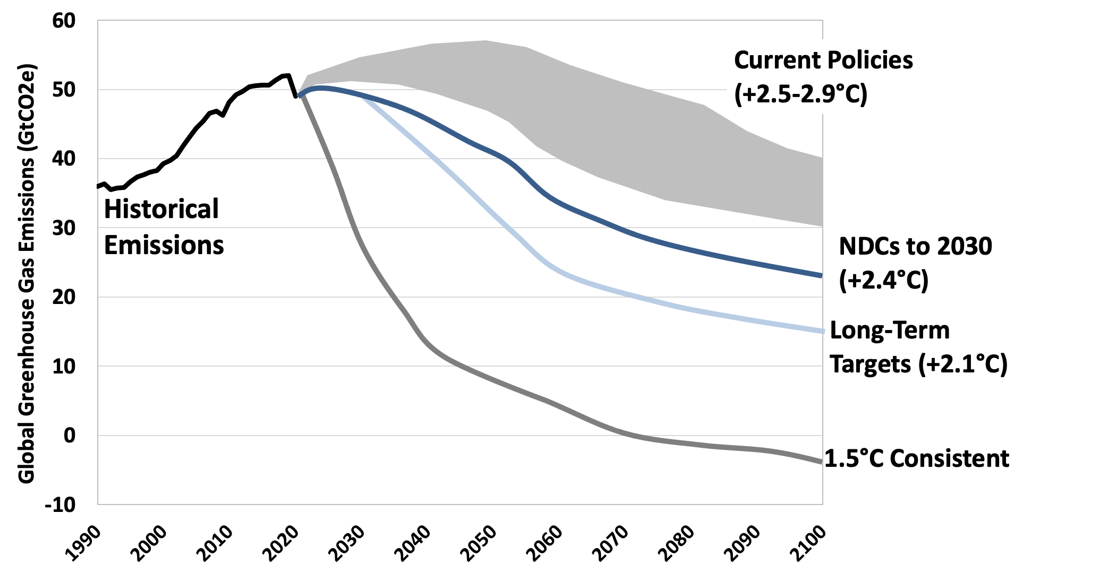
Figure 13.5 Global Greenhouse Gas Emissions and Temperature Increase Under Alternative Scenarios
Source: Climate Action Tracker, https://climateactiontracker.org/global/temperatures/.
Note: Emissions data include carbon dioxide and other greenhouse gases converted to carbon dioxide equivalents

Slide 8
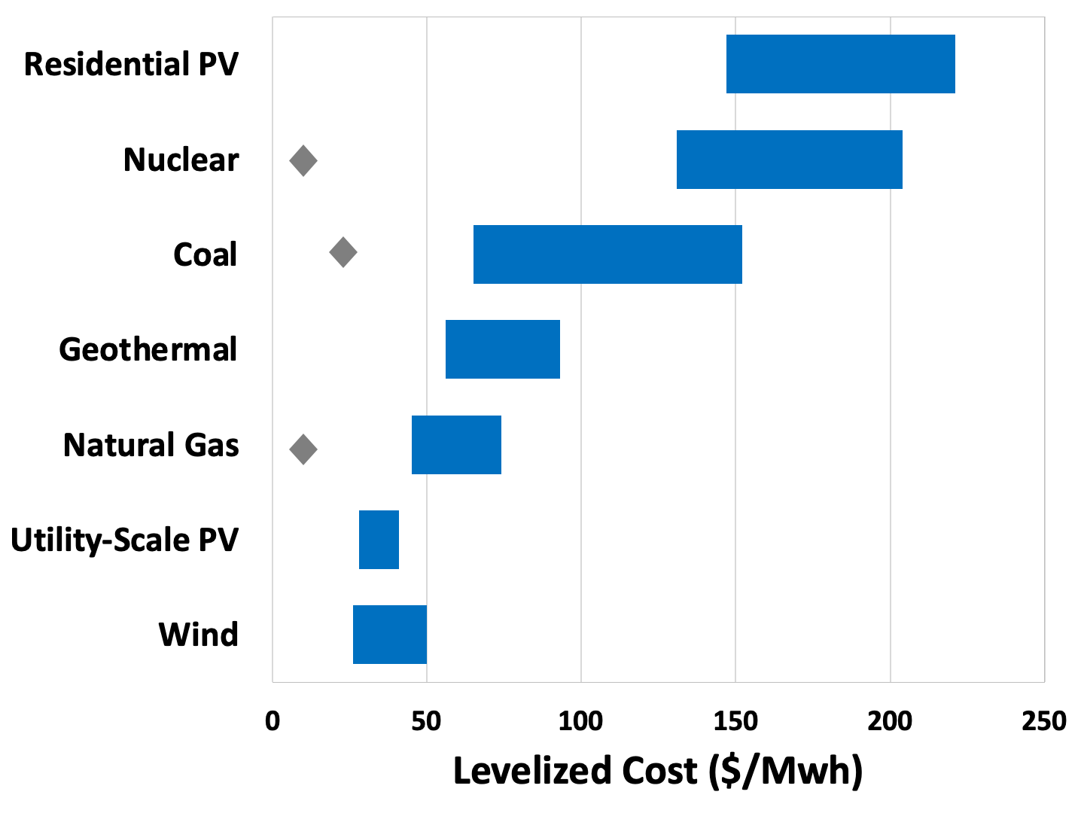
Figure 13.6 Cost Comparison of Electricity Generation from Different Energy Sources, 2021
Source: Lazard, 2021.

