Slide 1

Chapter Twelve:
The Economics of the Environment

Slide 2
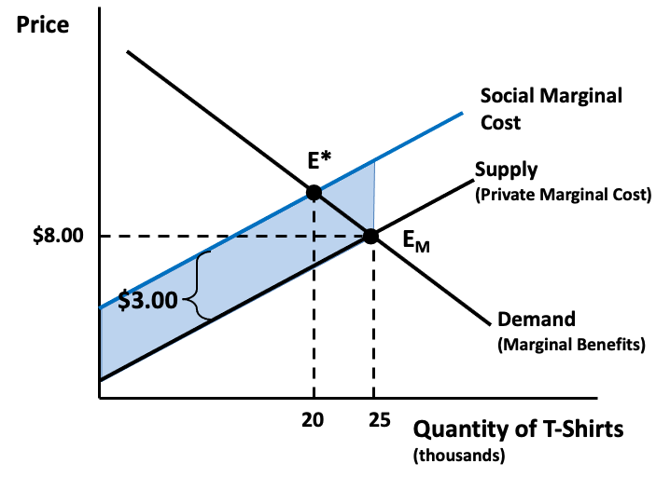
Figure 12.1 The Negative Externalities of T-Shirt Production

Slide 3
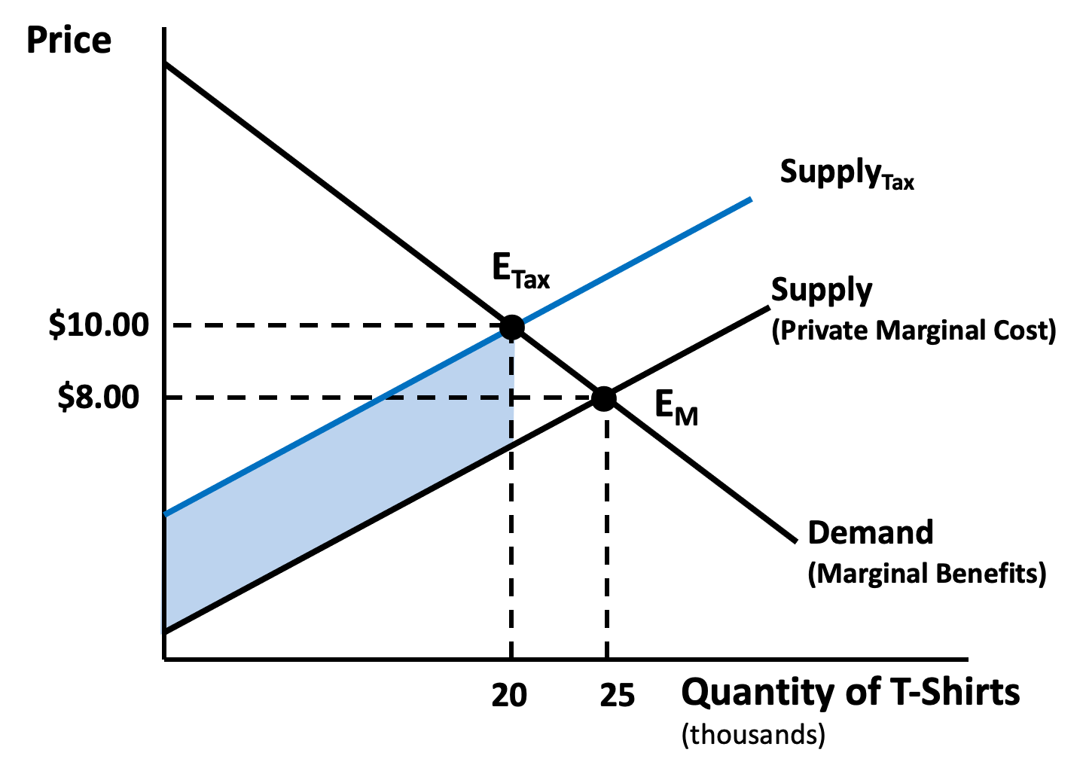
Figure 12.2 Internalizing a Negative Externality with a Pigovian Tax

Slide 4
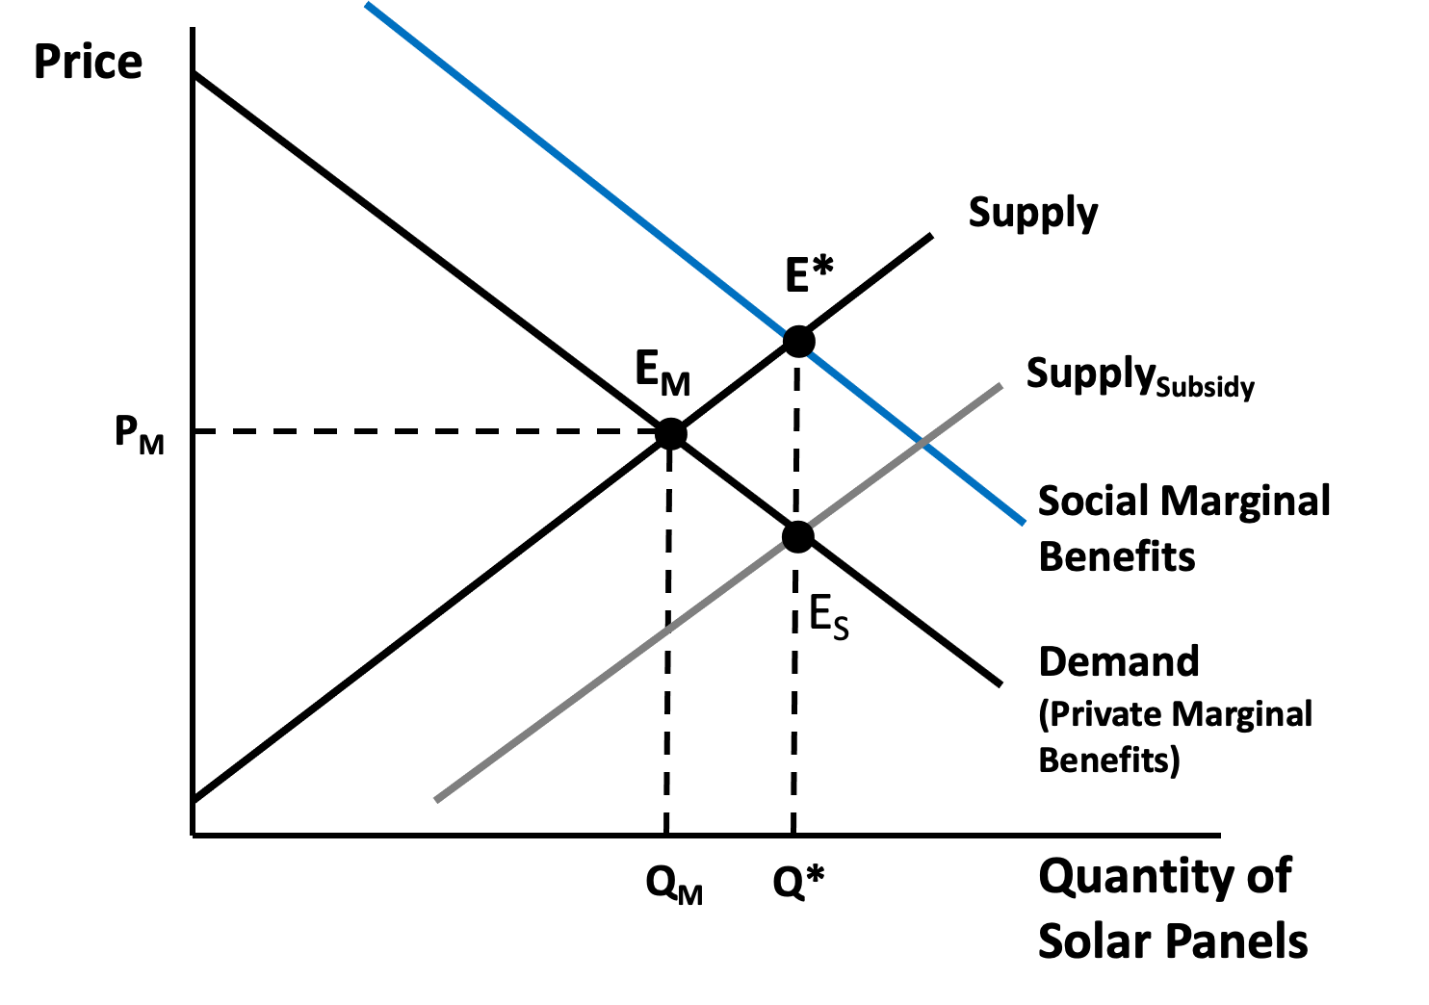
Figure 12.3 Analysis of a Positive Externality

Slide 5
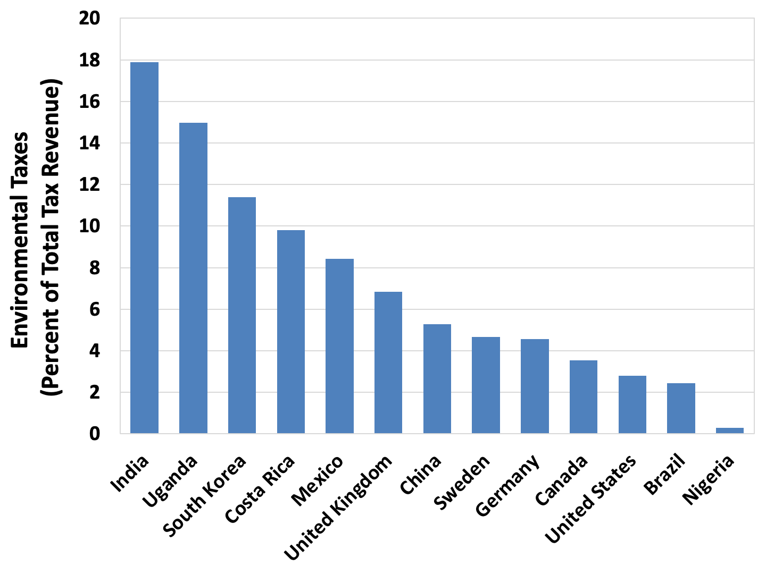
Figure 12.4 Environmental Taxes as a Percentage of Total Tax Revenue, Select Countries, 2019
Source: OECD, Environmental Taxation, http://www.oecd.org/env/toolsevaluation/environmentaltaxation.htm.

Slide 6
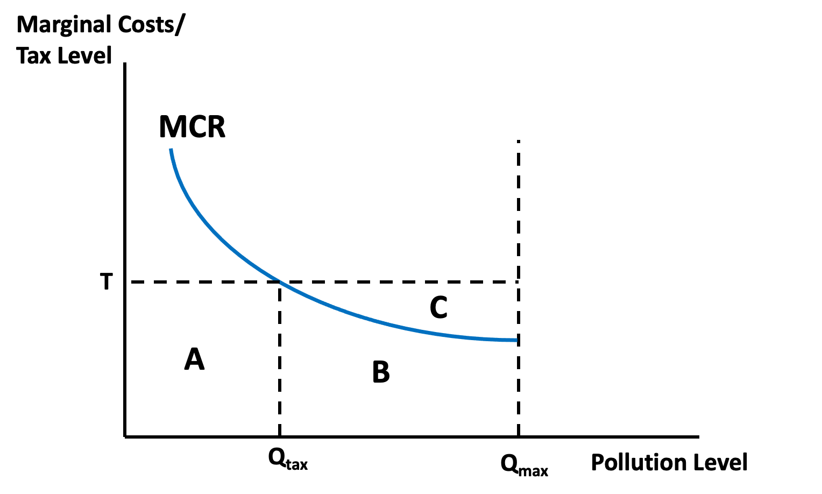
Figure 12.5 A Firm’s Response to a Pollution Tax

Slide 7
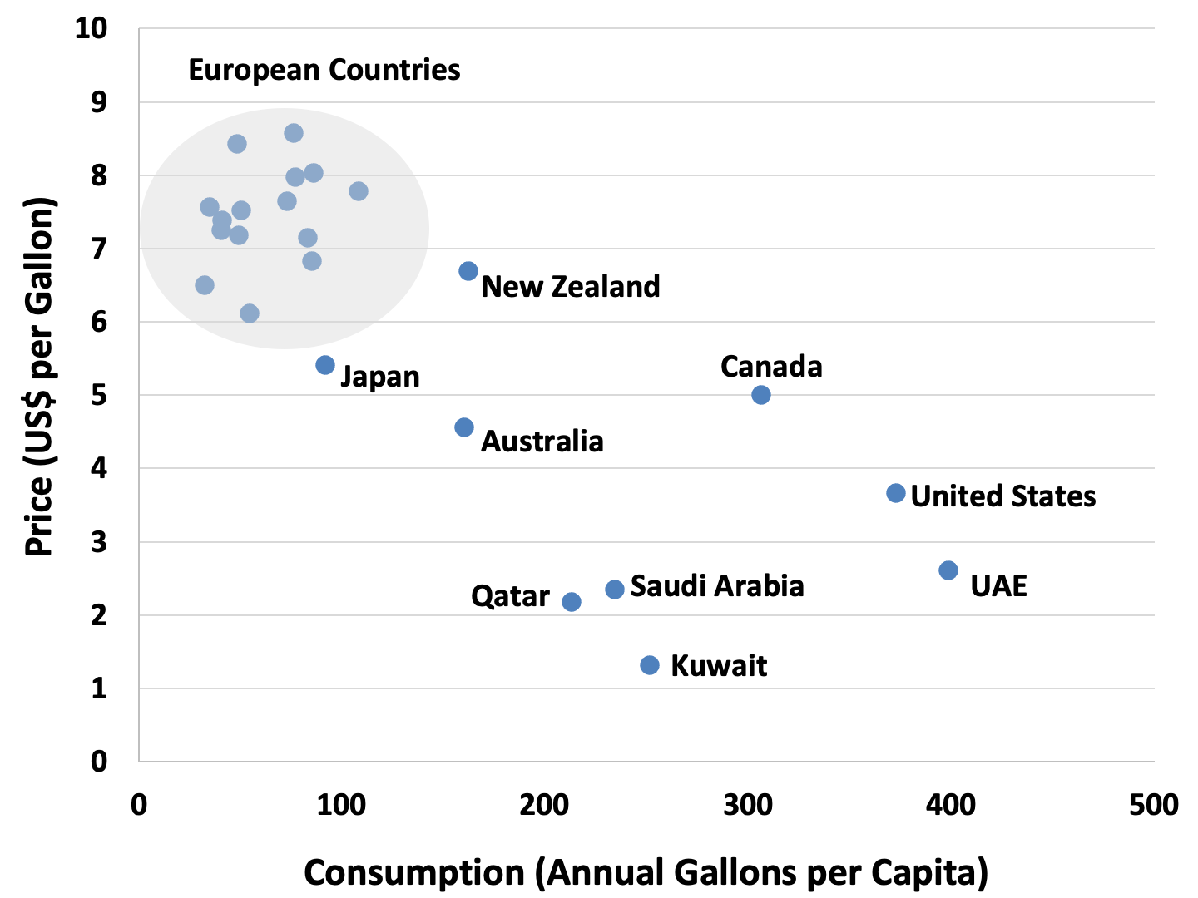
Figure 12.6 Gasoline Prices and Consumption, Select Countries
Note: Gas prices from 2022, gas consumption from 2020.
Sources: GlobalPetrolPrices.com, Gasoline Prices; U.S. Energy Information Administration, International Energy Statistics (gas consumption data).

Slide 8
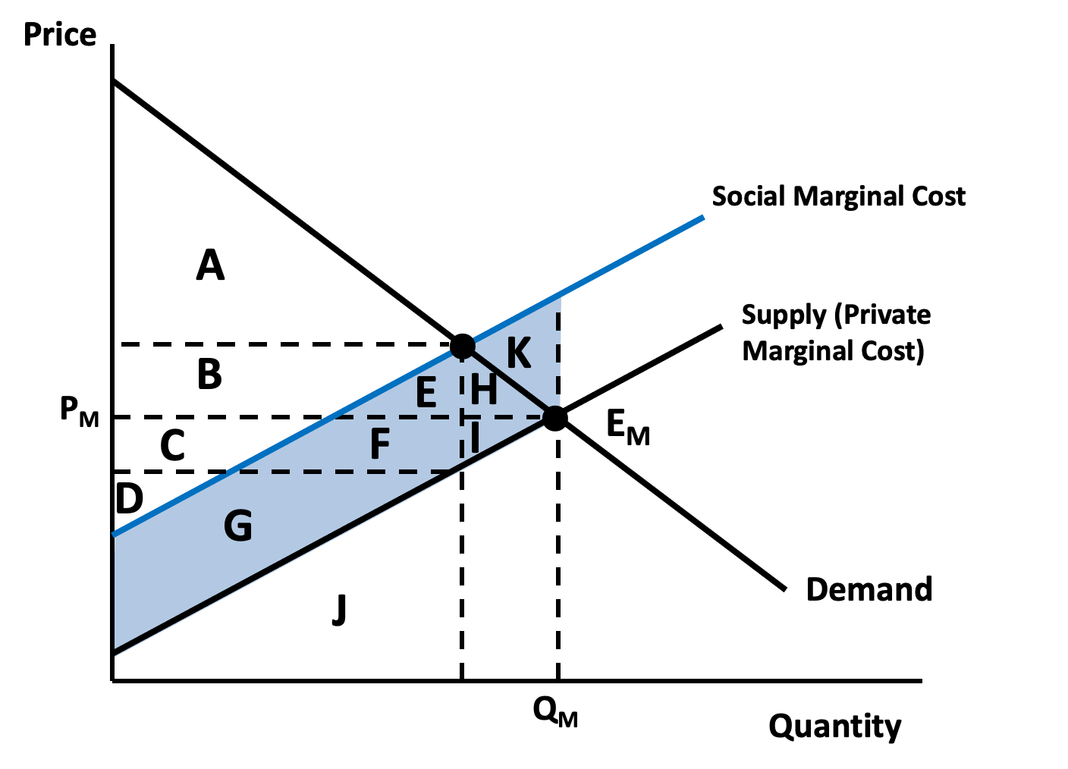
Figure 12.7 Welfare Analysis of a Negative Externality, Without a Pigovian Tax

Slide 9
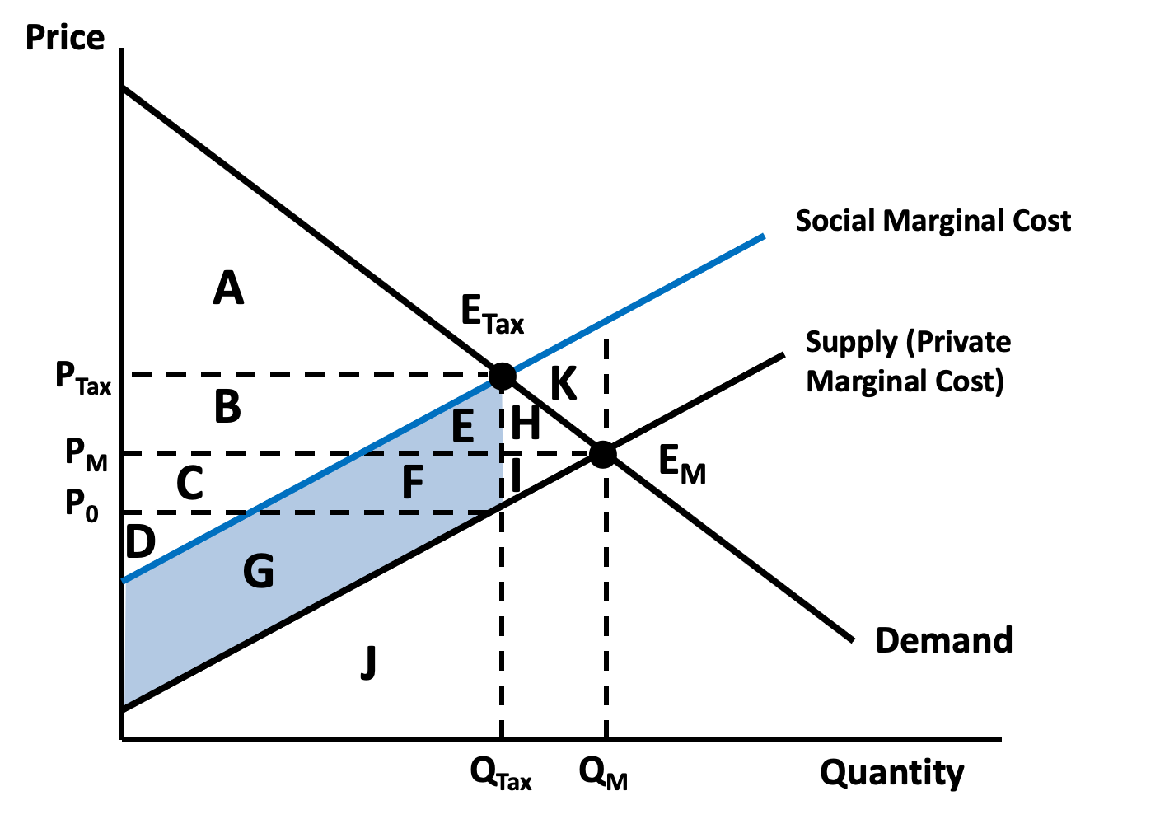
Figure 12.8 Welfare Analysis of a Negative Externality, With a Pigovian Tax

