Slide 1


Chapter Eleven:
Taxes and Tax Policy

Slide 2
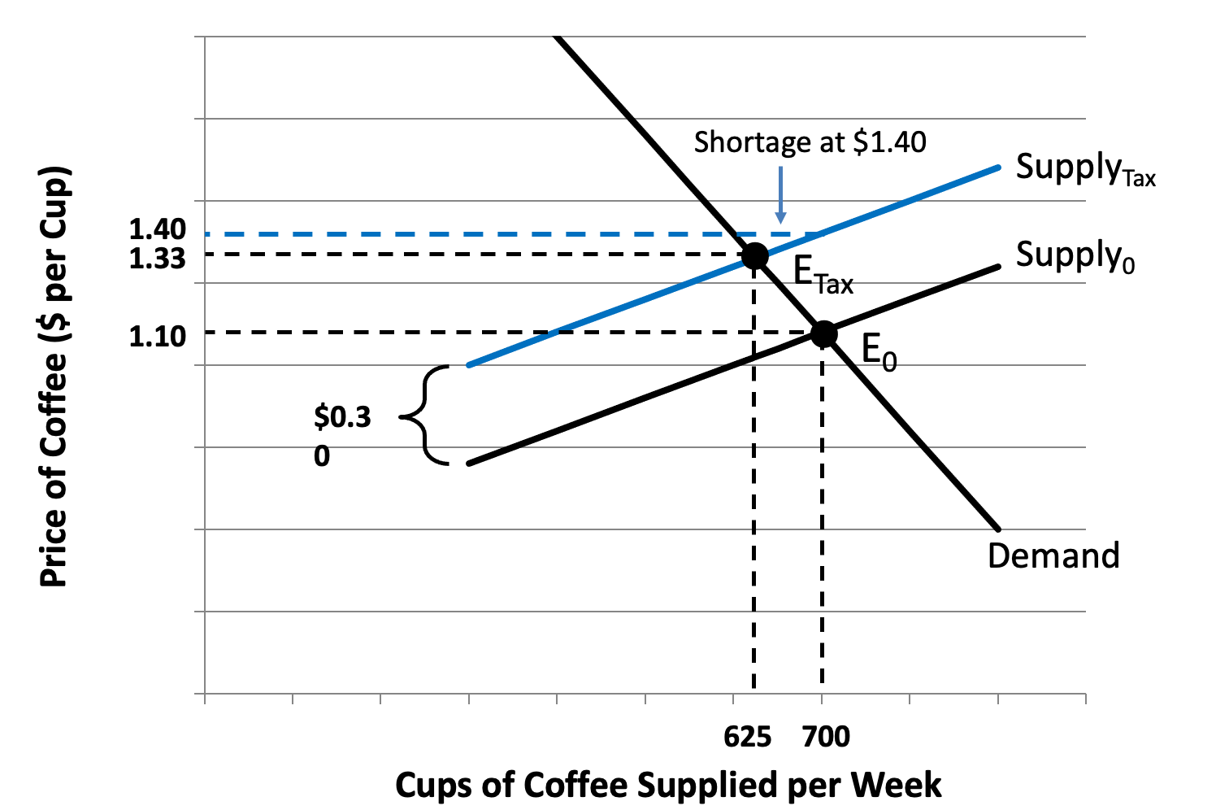
Figure 11.1 The Impact of a Tax on the Market for Cups of Coffee

Slide 3
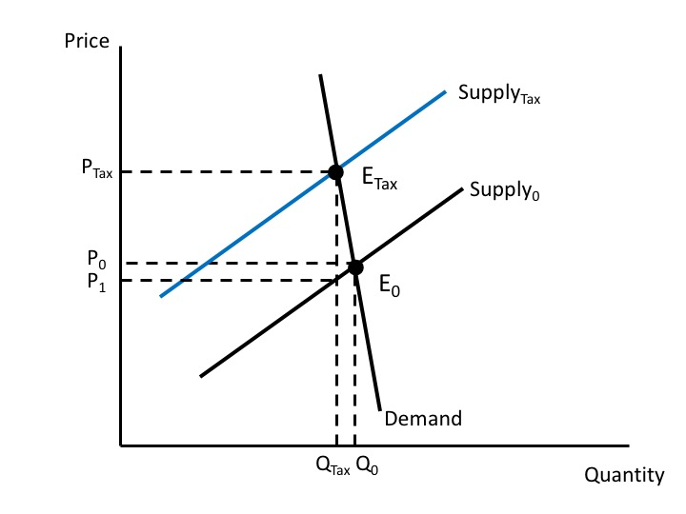
Figure 11.2 The Impact of an Excise Tax with an Inelastic Demand Curve

Slide 4
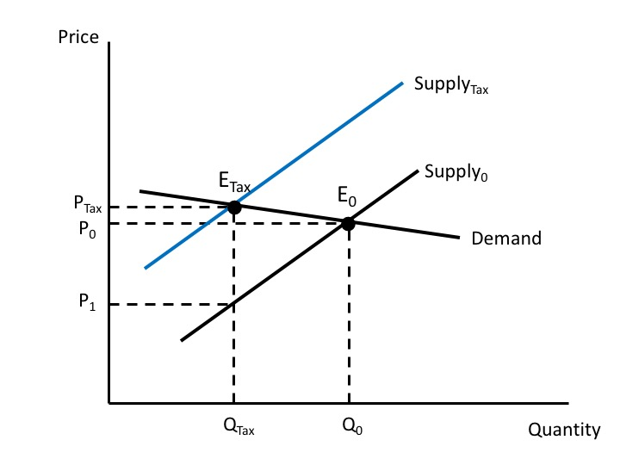
Figure 11.3 The Impact of an Excise Tax with an Elastic Demand Curve

Slide 5
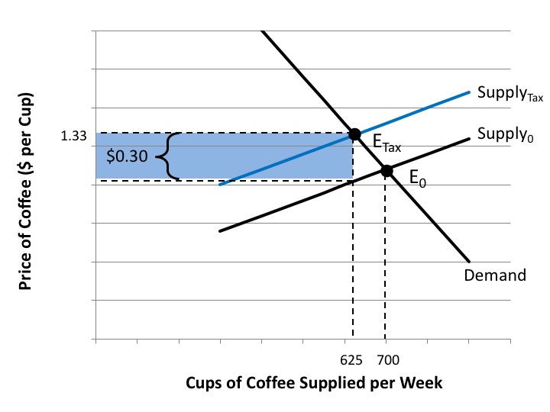
Figure 11.4 Tax Revenue from a Tax on Cups of Coffee

Slide 6
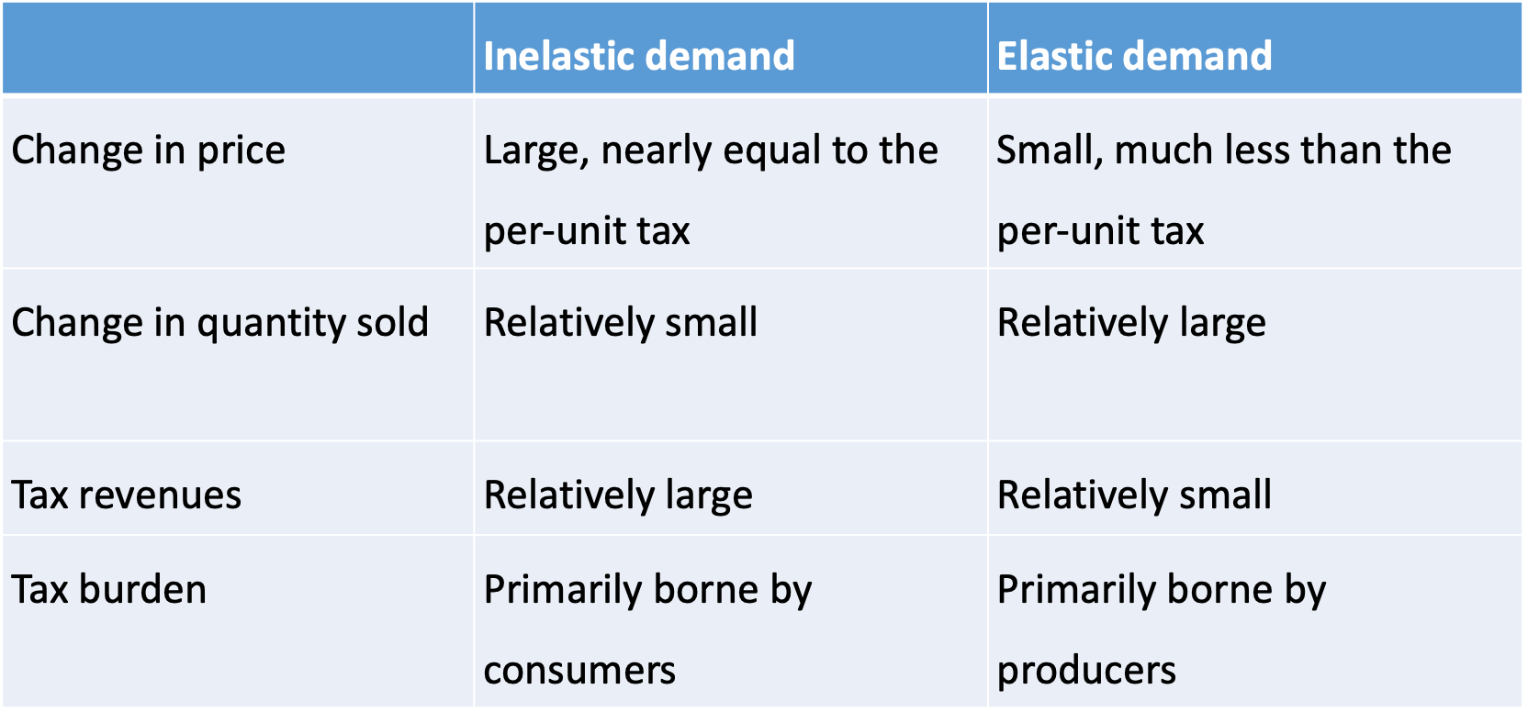
Table 11.1 Summary of Excise Tax Impacts for Products with Elastic and Inelastic Demand Curves

Slide 7
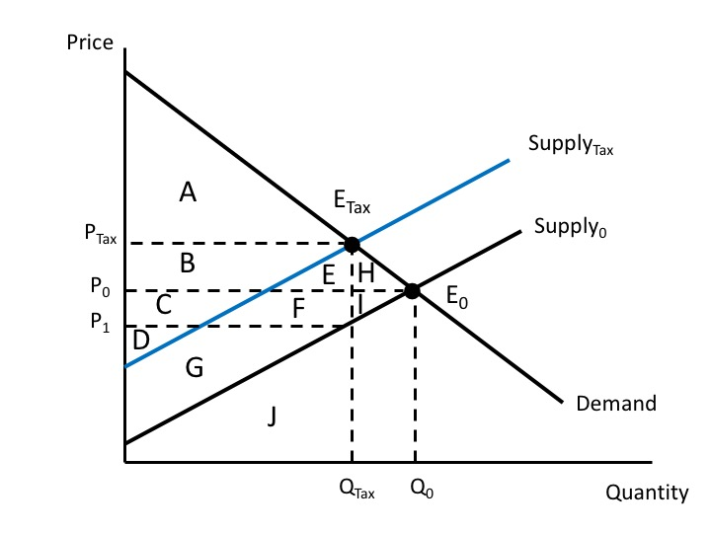
Figure 11.5 Welfare Analysis of an Excise Tax

Slide 8
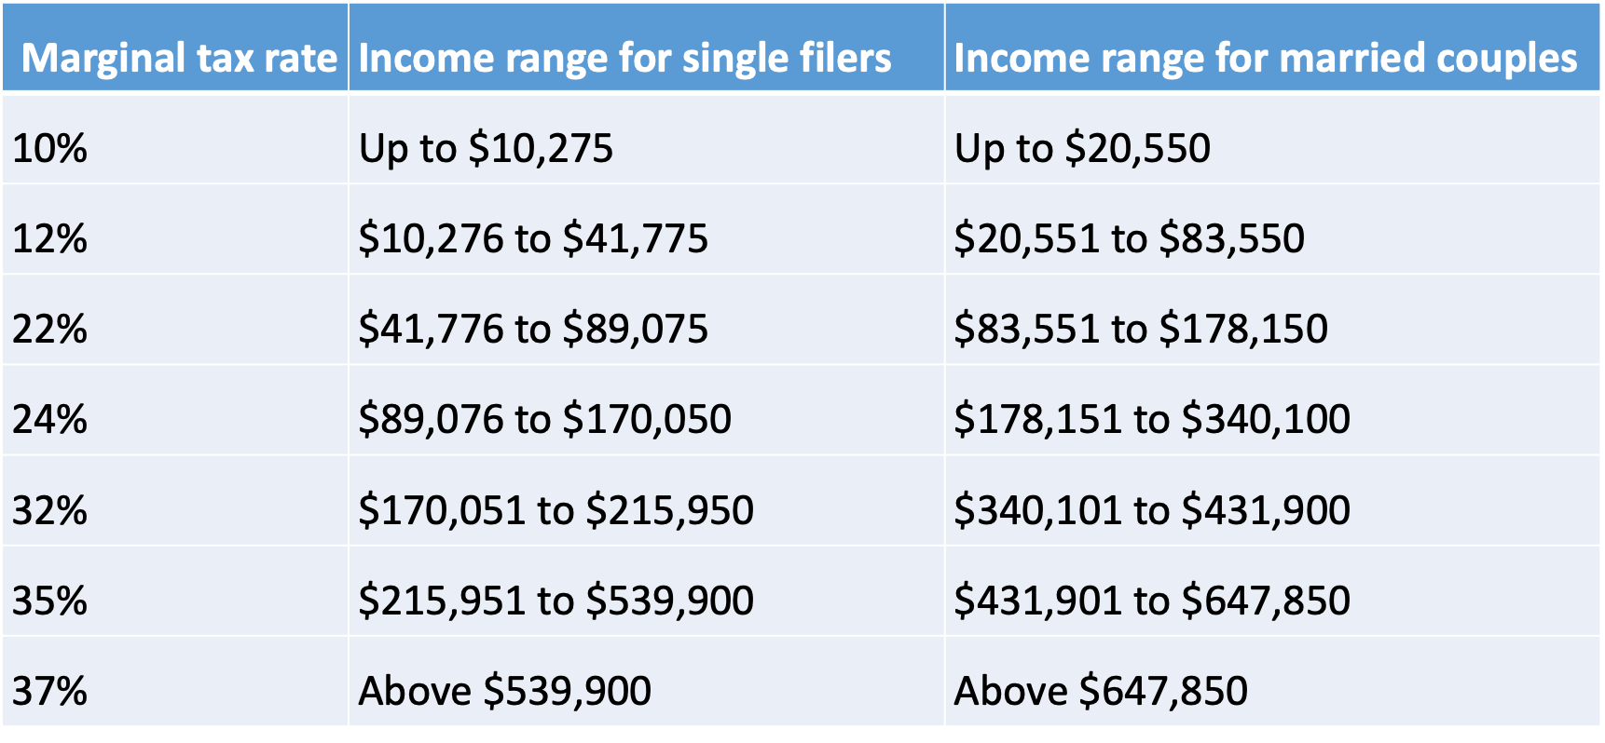
Table 11.2: U.S. Federal Marginal Tax Rates, 2022

Slide 9
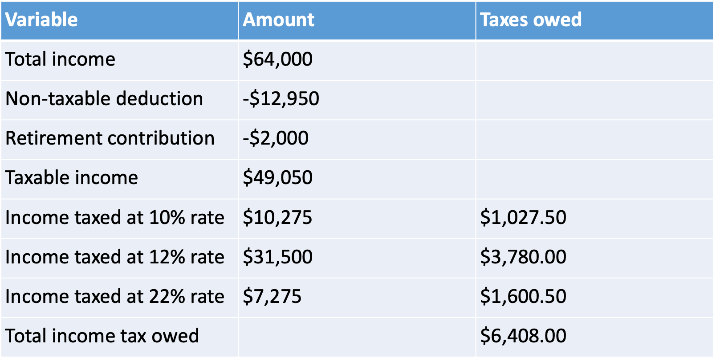
Table 11.3: Valeria’s Federal Income Tax Calculations

Slide 10
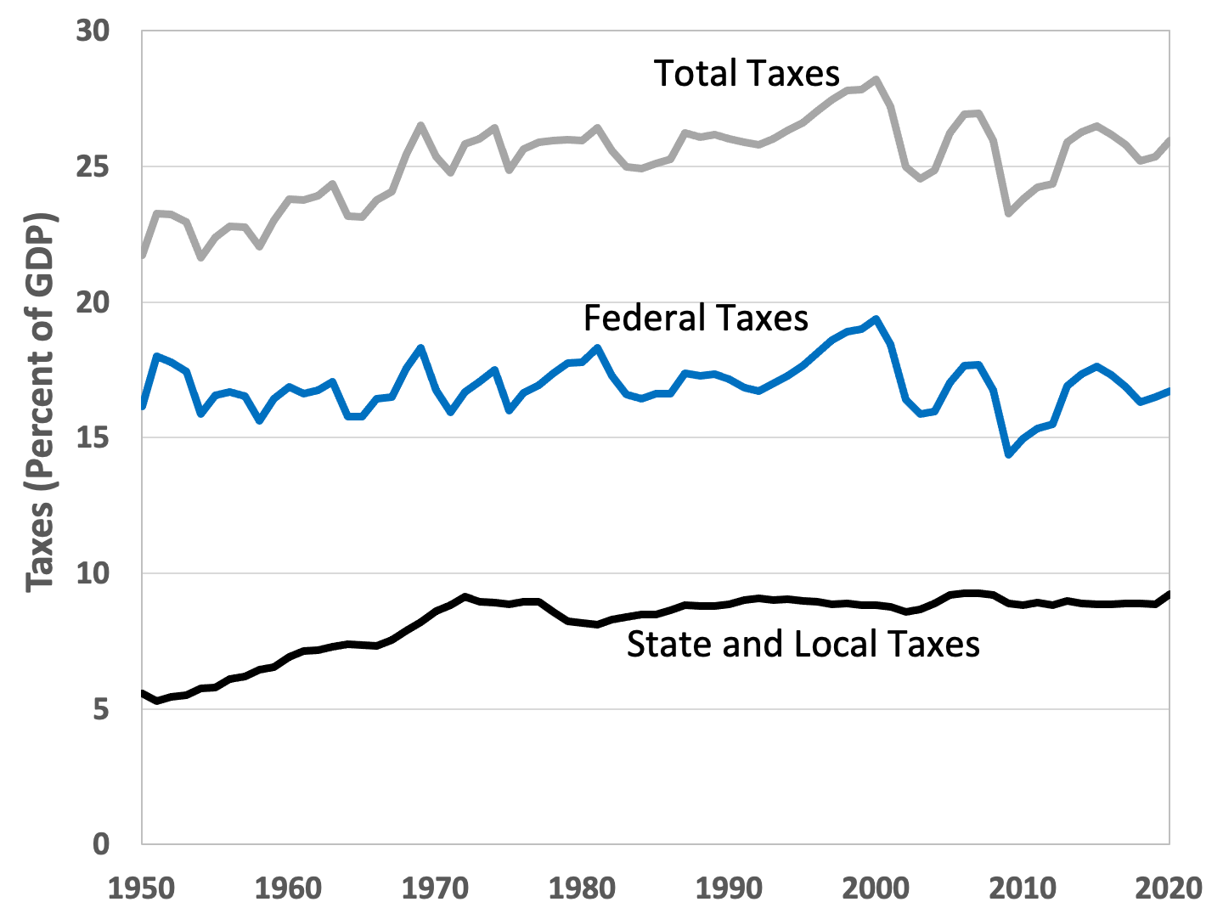
Figure 11.6 Tax Receipts in the United States, as a Percentage of GDP, 1950-2020
Source: U.S. Bureau of Economic Analysis, National Income and Product Accounts.

Slide 11
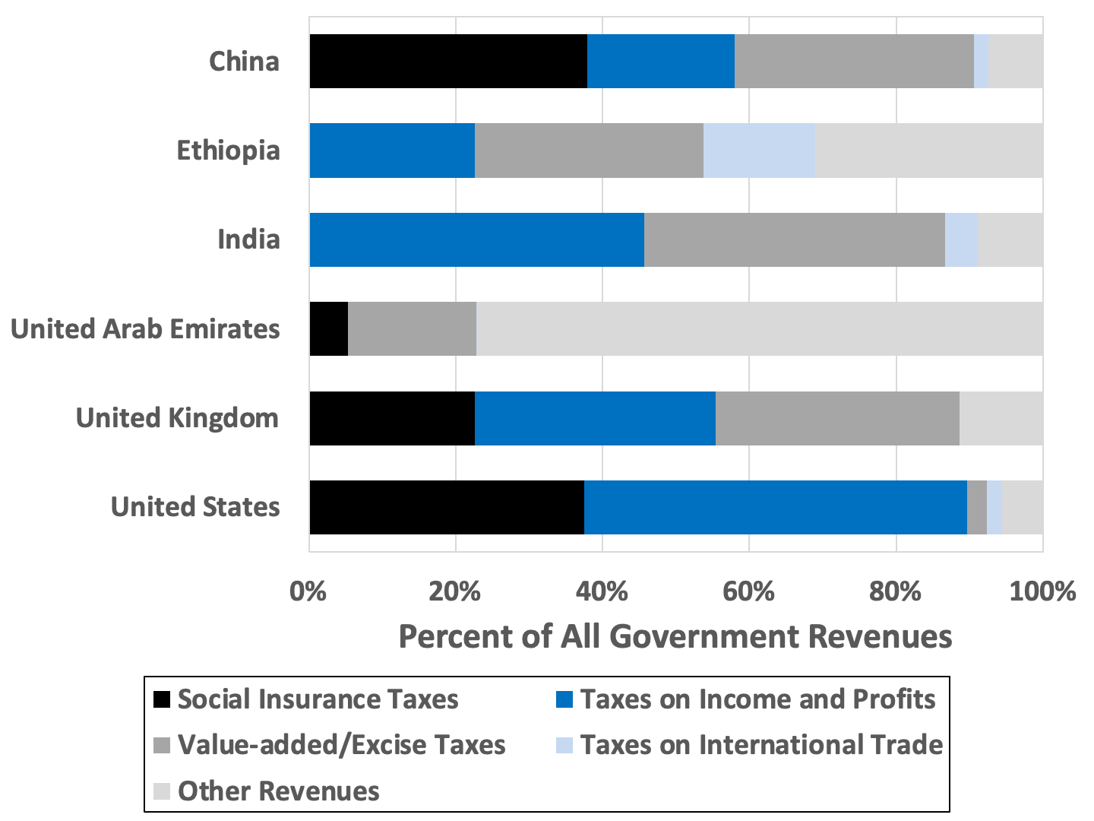
Figure 11.7: Comparison of Government Revenues in Select Countries, 2019
Source: World Bank, World Development Indicators database.
Note: Data for China and India are from 2018.

Slide 12
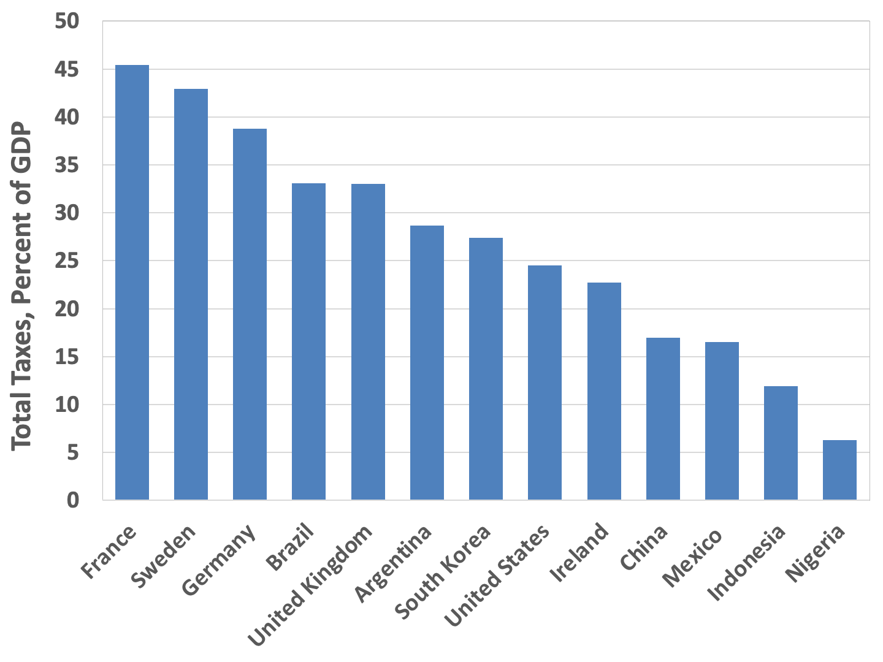
Figure 11.8 International Comparison of Overall Tax Receipts, Select Countries, 2019
Source: OECD, OECD.Stat, Global Revenue Statistics Database.
Note: Data for China, Japan, and Nigeria are for 2018.

Slide 13
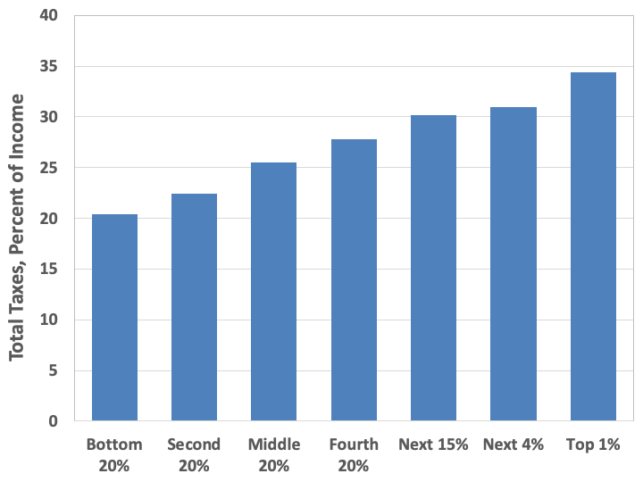
Figure 11.9. The Distribution of Taxes in the United States, 2020
Source: Wamhoff and Gardner, 2020.

Slide 14
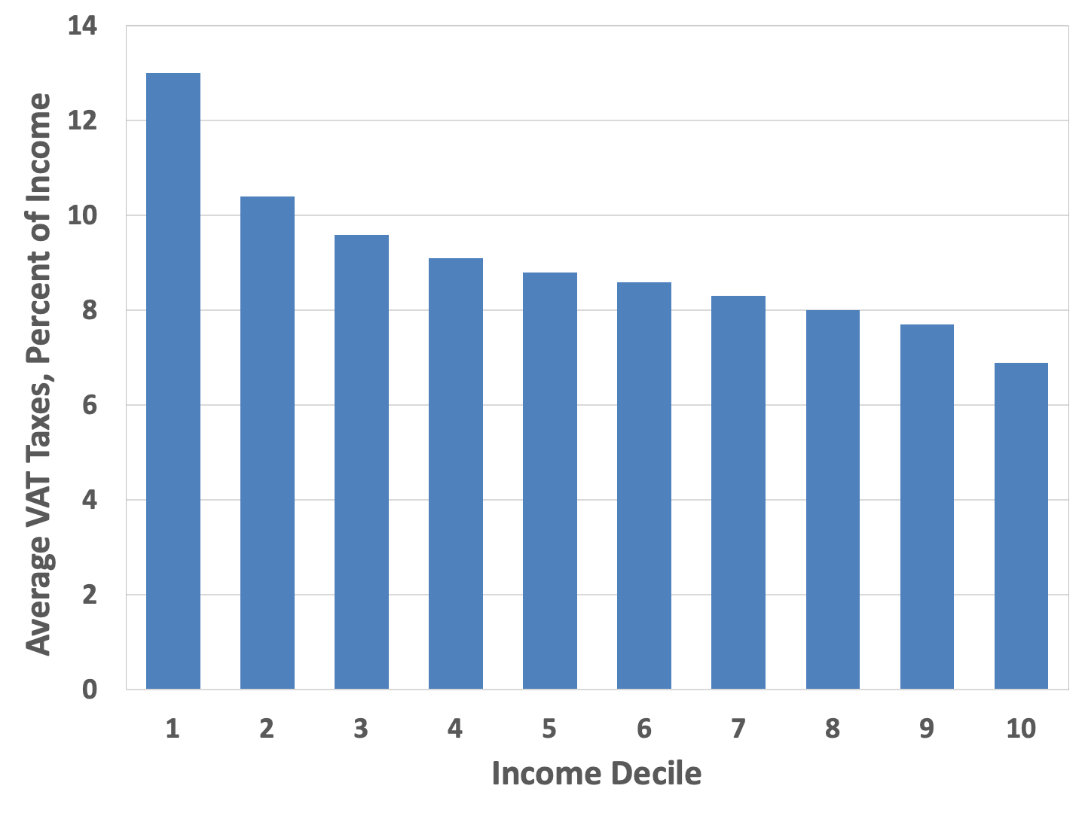
Figure 11.10: Value-Added Taxes as a Percent of Income, by Income Decile, for 26 OECD Countries
Source: Thomas, 2020.

Slide 15
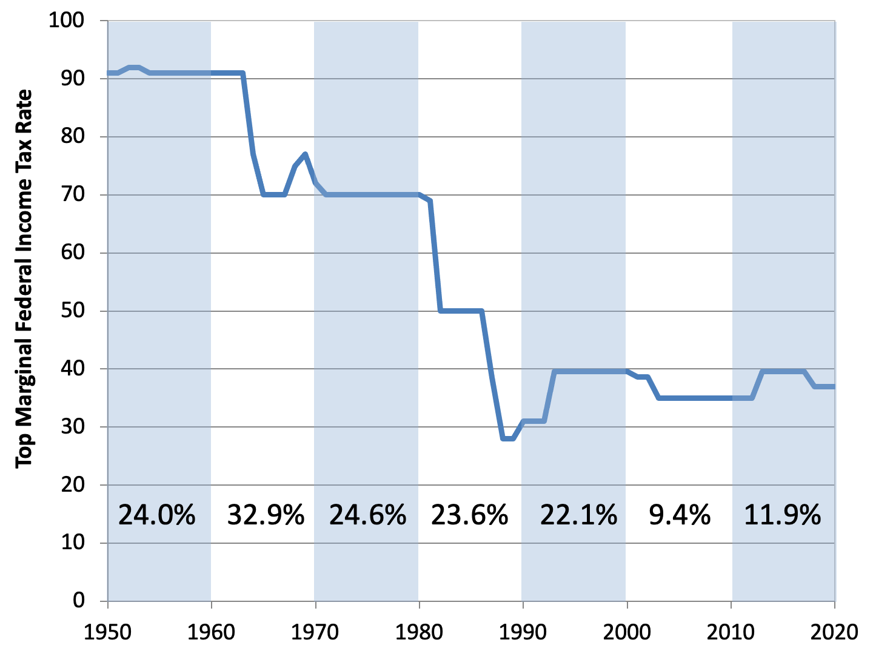
Figure 11.11 The Top Marginal Federal Income Tax Rate and Cumulative Growth of Real GDP per Capita by Decade, 1950-2020
Sources: Federal Reserve Economic Data, Real Gross Domestic Product per Capita; Tax Policy Center, https://www.taxpolicycenter.org/statistics/historical-highest-marginal-income-tax-rates.
Note: Percentages are cumulative growth of real GDP per capita per decade.

