Slide 1


Chapter Ten:
Economic and Social Inequality

Slide 2
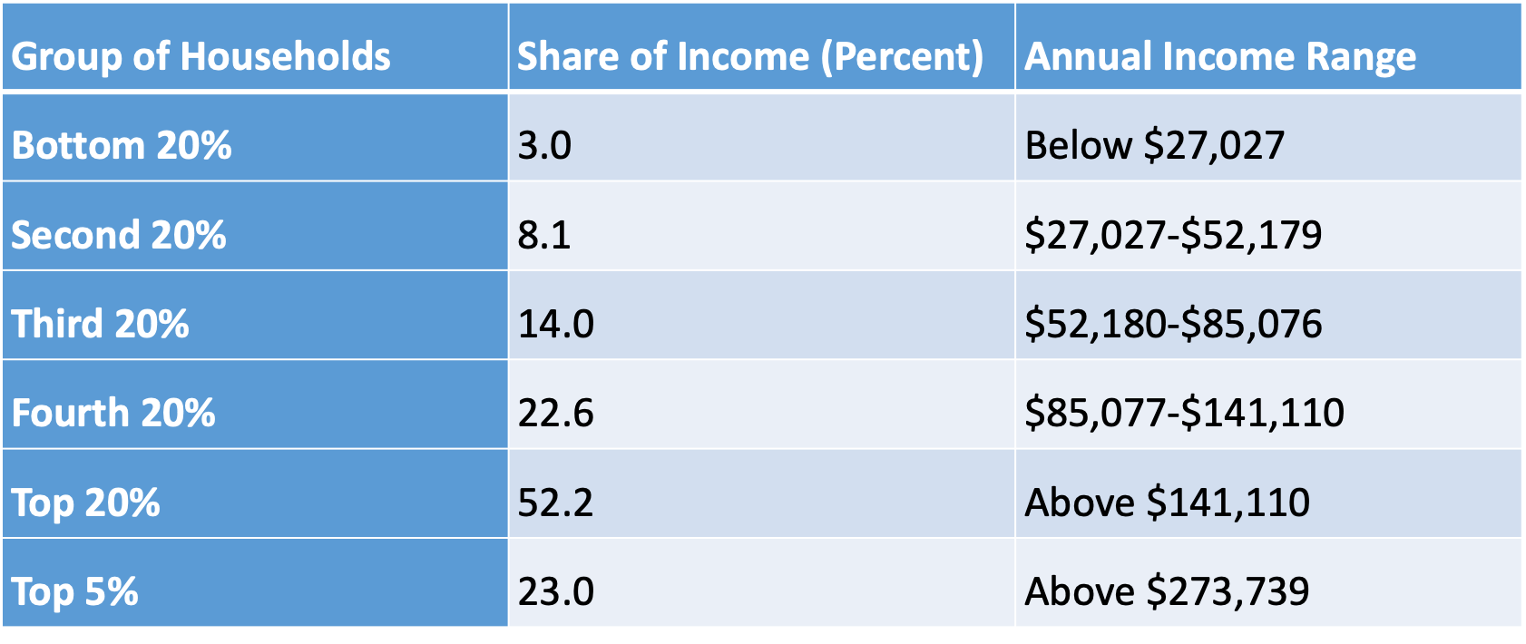
Table 10.1 Household Income Distribution in the United States, 2020
Source: Shrider et al., 2021.

Slide 3
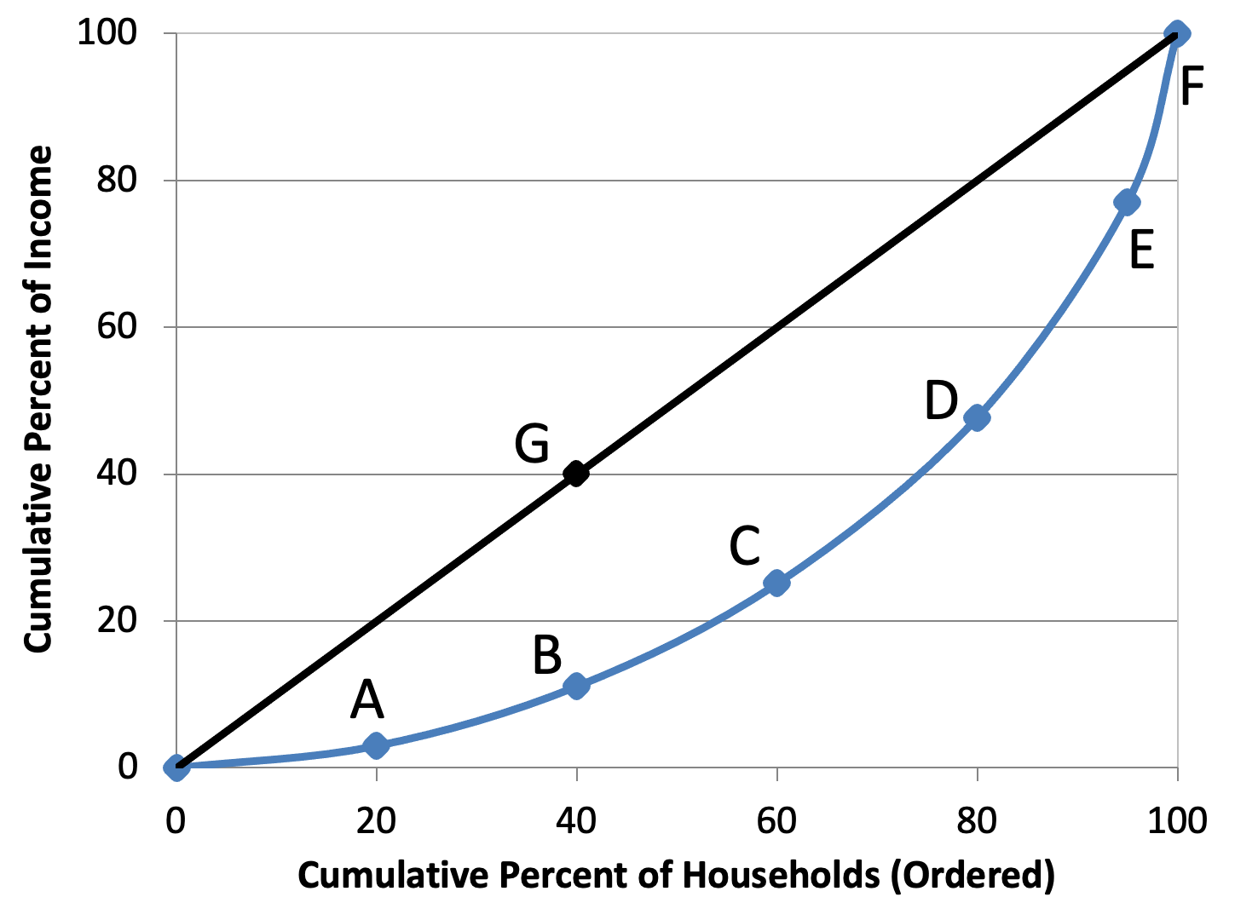
Figure 10.1 Lorenz Curve for the United States, 2020
Source: Shrider et al., 2021.

Slide 4
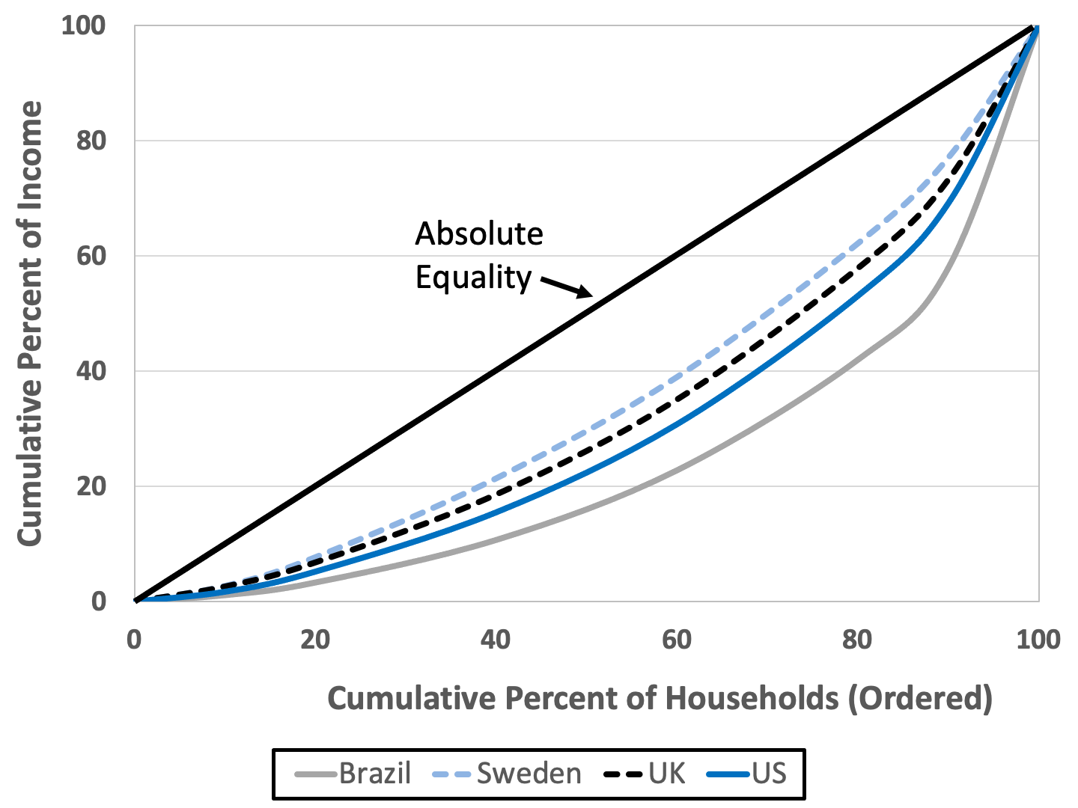
Figure 10.2 Lorenz Curves for Brazil, Sweden, the United Kingdom, and the United States
Source: World Bank, World Development Indicators database. Data are for 2018, except for the United Kingdom (2017).

Slide 5
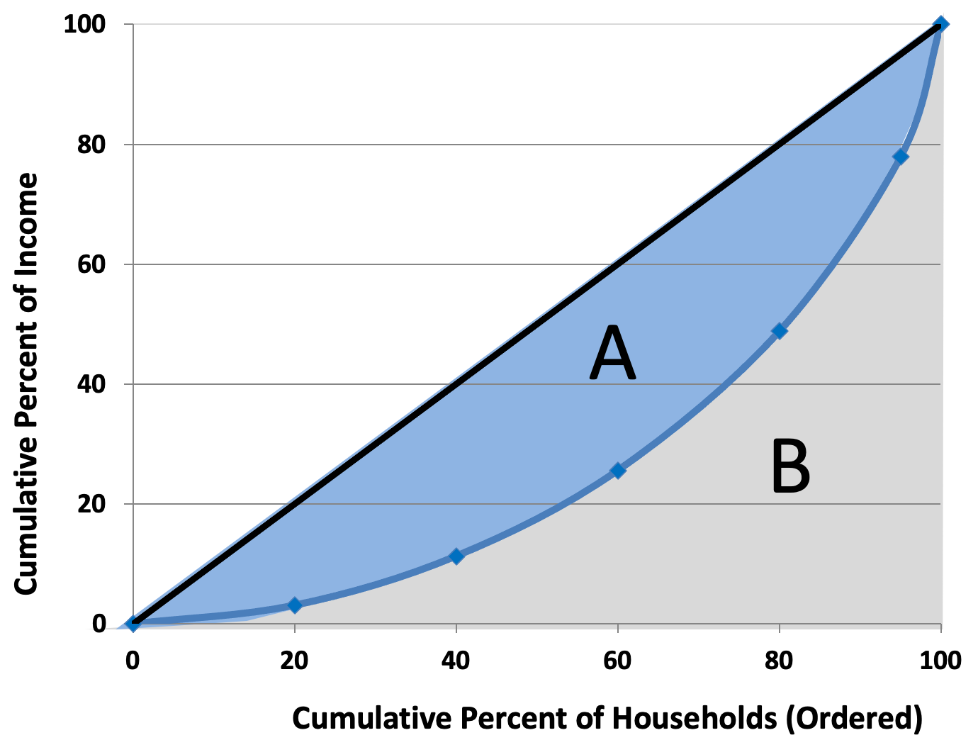
Figure 10.3 The Gini Coefficient: A / (A + B)

Slide 6
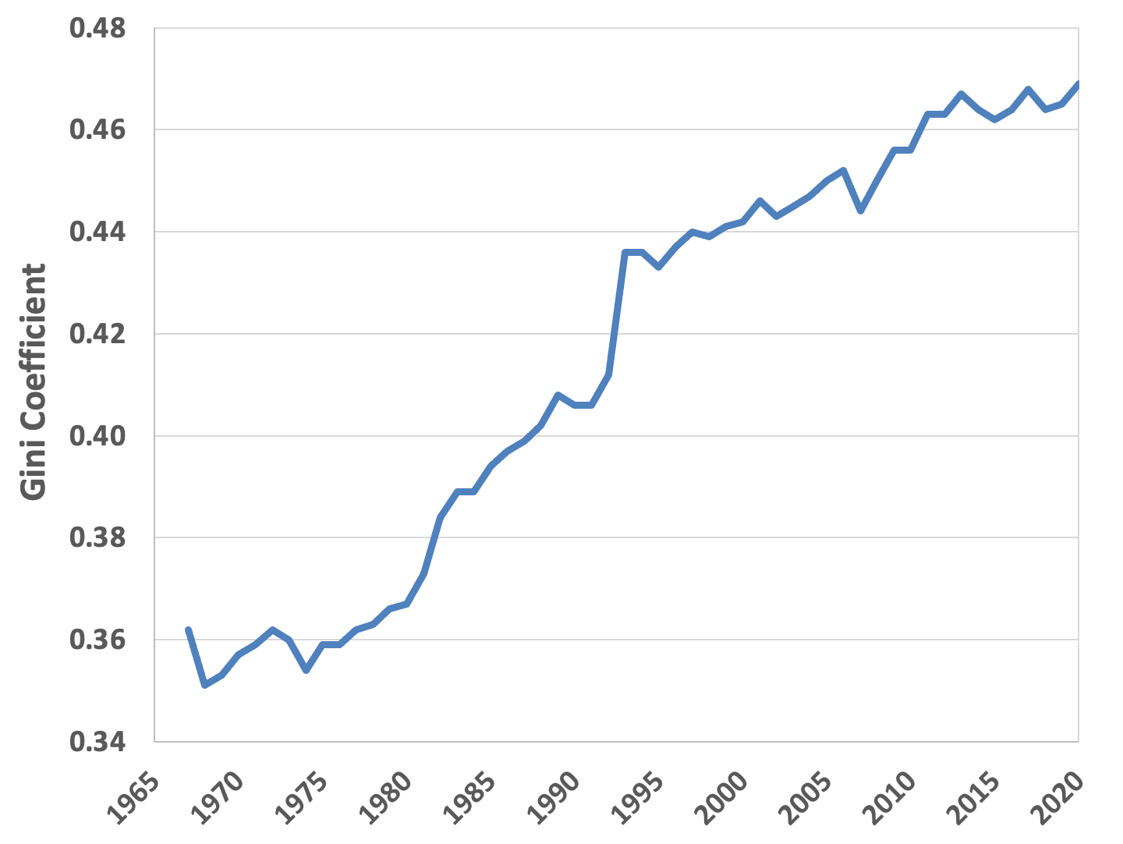
Figure 10.4 Gini Coefficient in the United States, 1967-2020
Source: Shrider et al., 2021, Table A-5.

Slide 7
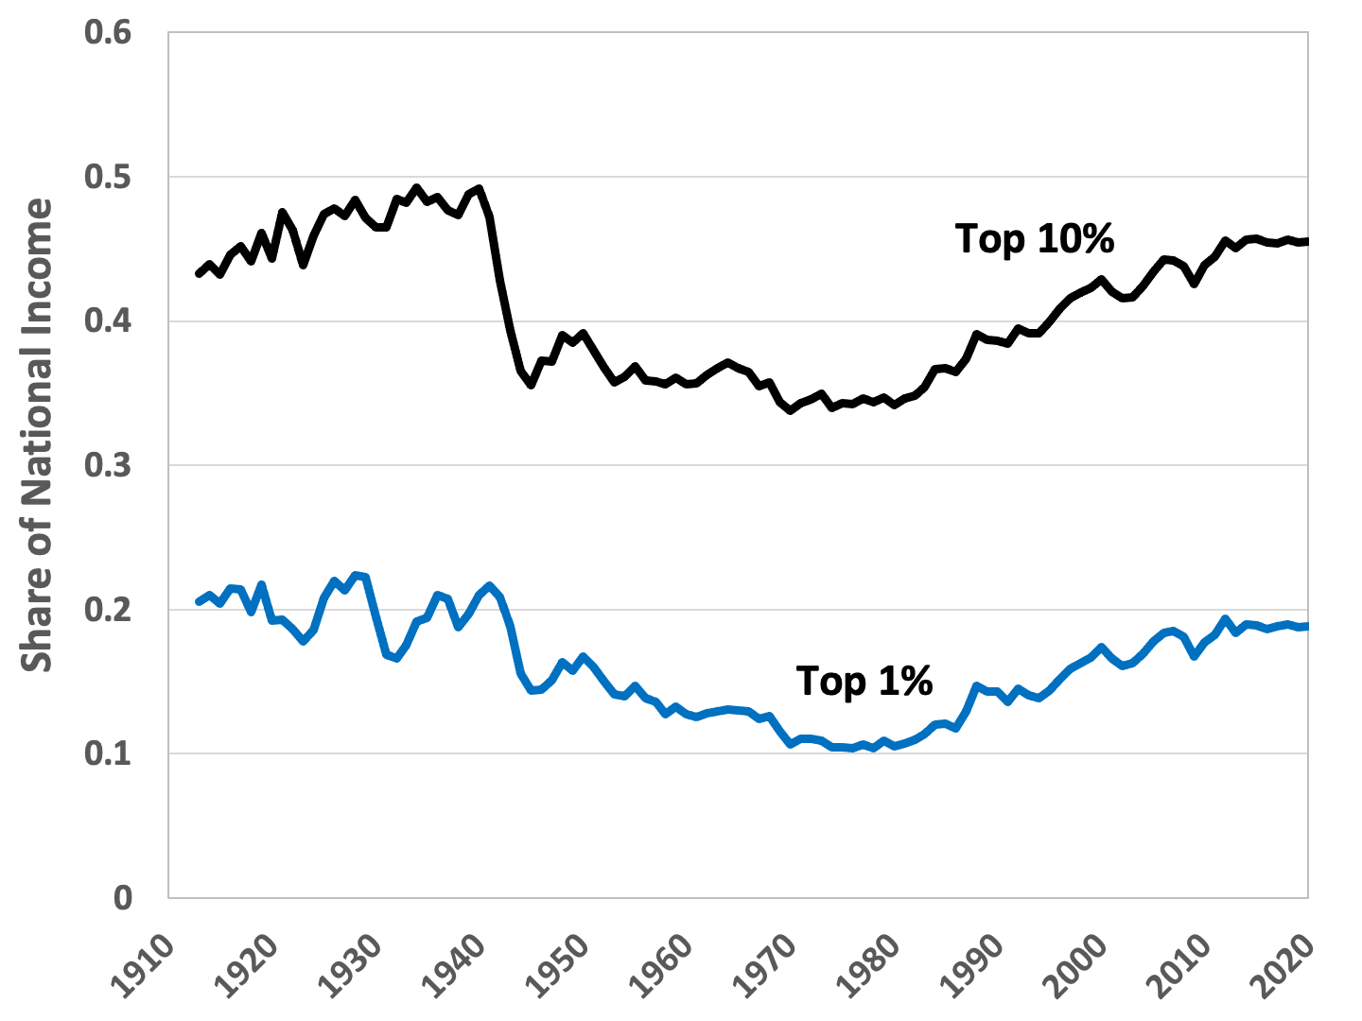
Figure 10.5 Income Shares of Top-Income Groups,
United States, 1913-2020
Source: World Inequality Database, https://wid.world/country/usa/.

Slide 8
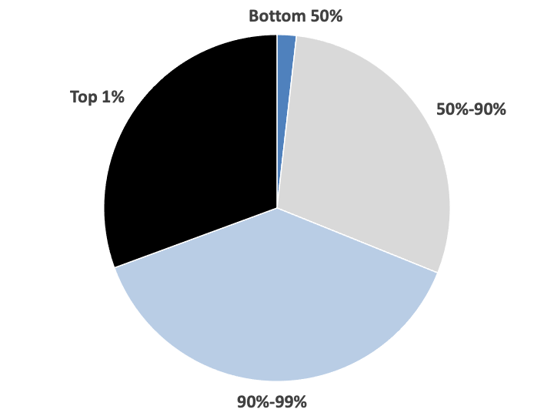
Figure 10.6 The Distribution of Wealth in the United States, 2020
Source: United States Federal Reserve, 2021.

Slide 9
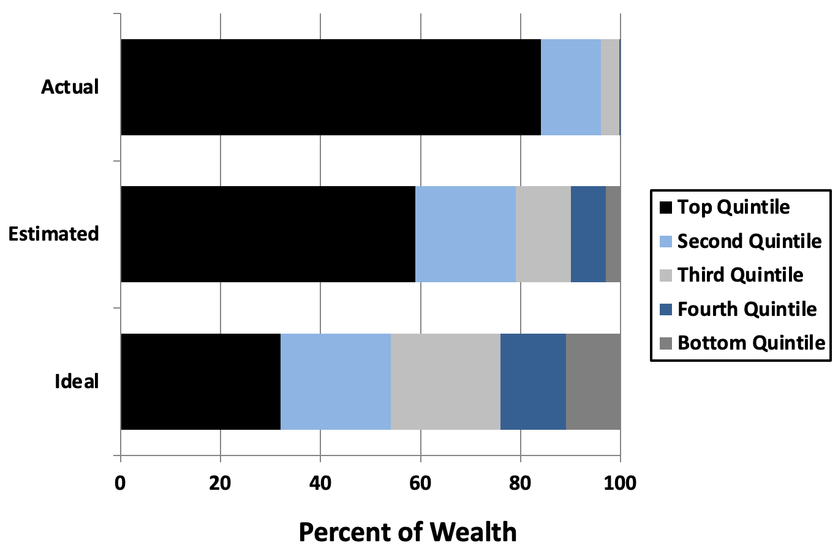
Figure 10.7 Actual, Estimated, and Ideal Distribution of Wealth in the United States
Source: Norton and Ariely, 2011.

Slide 10
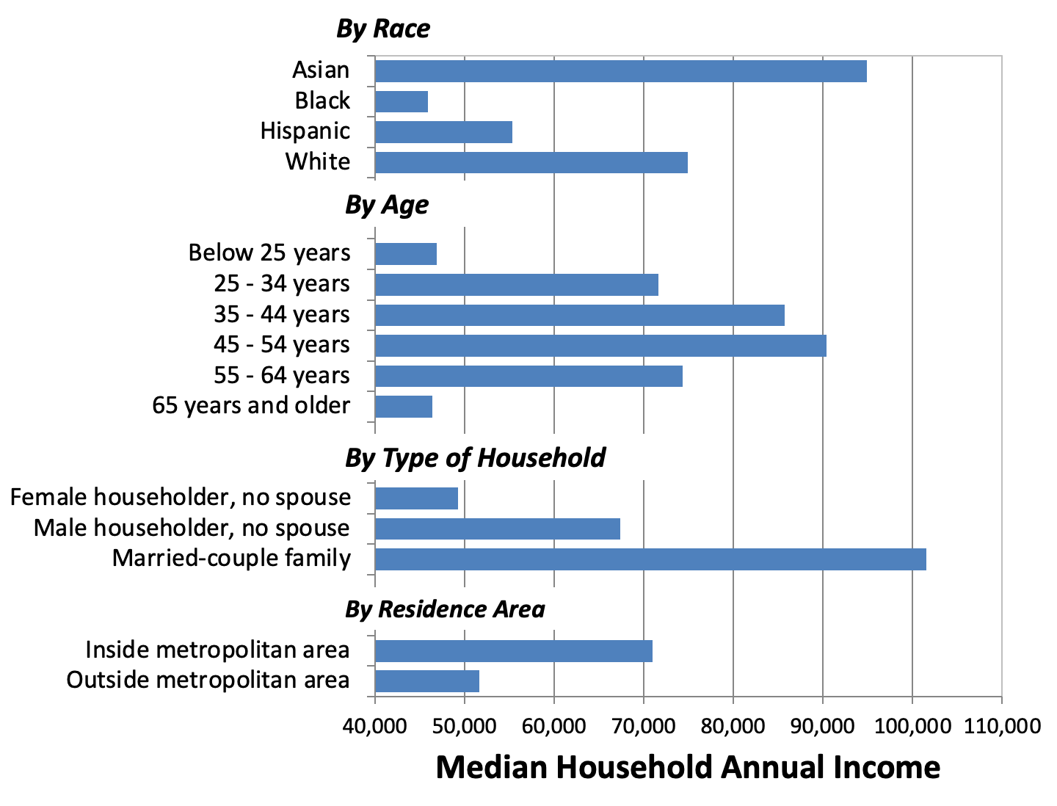
Figure 10.8 Median Household Income in the United States by Select Characteristics, 2020
Source: Shrider et al., 2021, Table A-1.

Slide 11
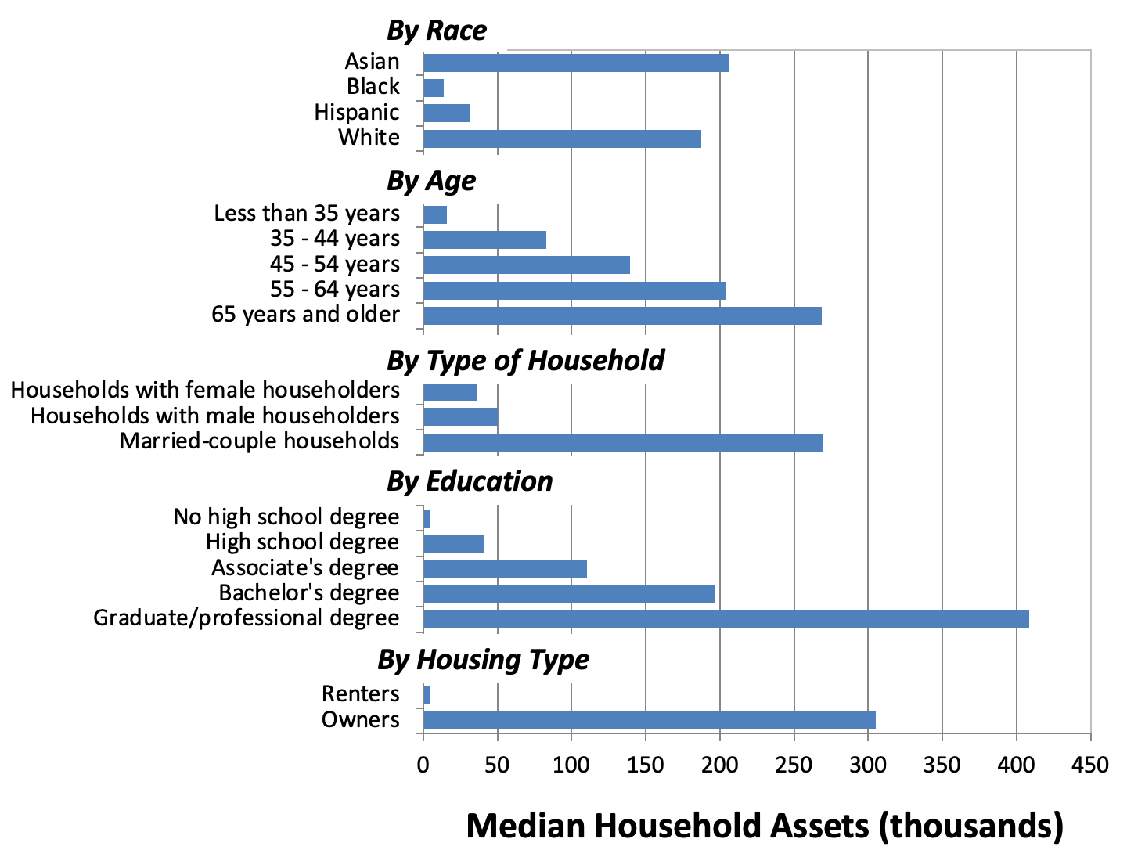
Figure 10.9 Median Value of Household Assets in the United States by Select Characteristics, 2019
Source: U.S. Census Bureau, Wealth, Asset Ownership, and Debt of Households Detailed Tables: 2019. Table 1.

Slide 12
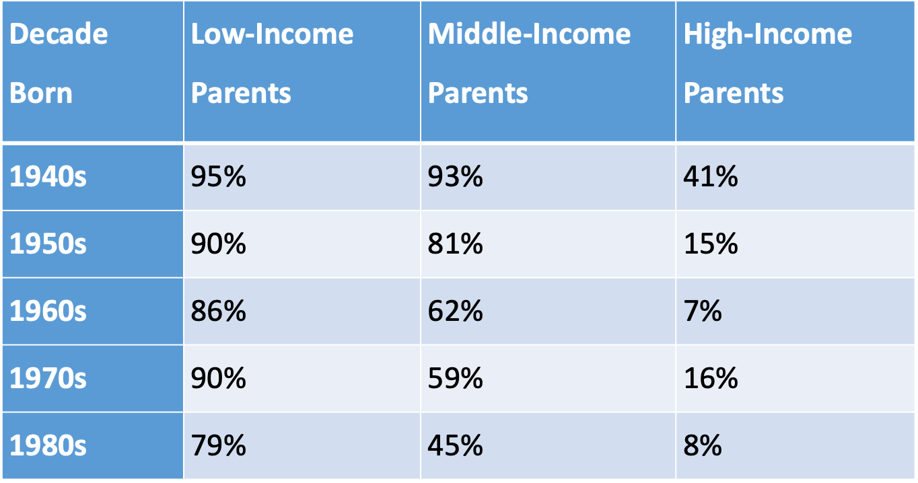
Table 10.2 Probability of Earning More than One’s Parents, United States

Slide 13
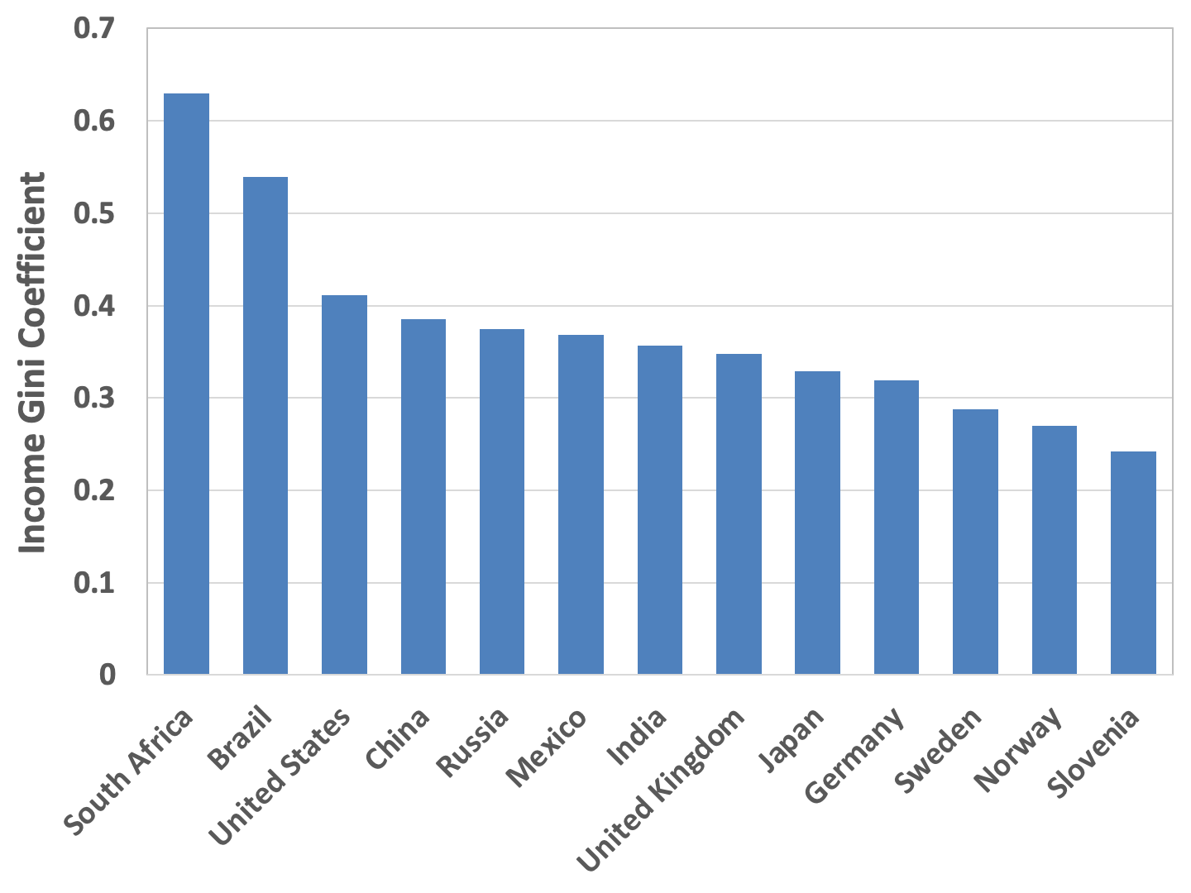
Figure 10.10 Income Gini Coefficient for Select Countries
Source: CIA World Factbook, United States Central Intelligence Agency.
Note: Year of data varies.

Slide 14
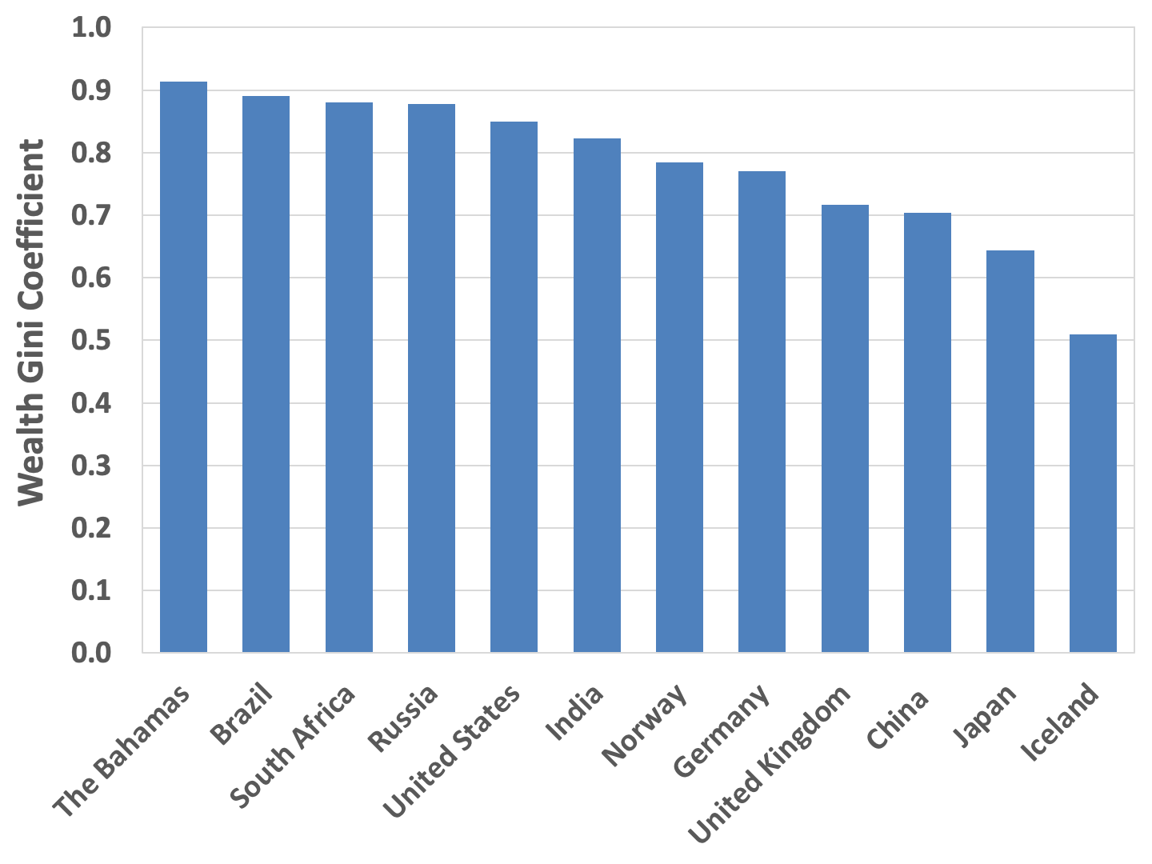
Figure 10.11 Wealth Gini Coefficient for Select Countries
Source: Credit Suisse, 2021.

Slide 15
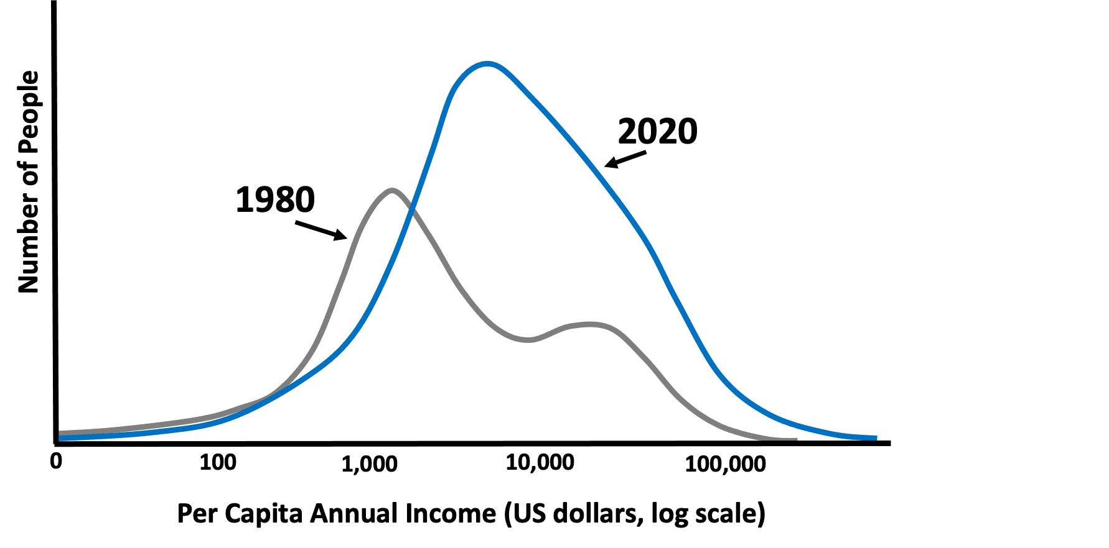
Figure 10.12 Global Income Distribution, 1980 and 2020
Source: Chancel et al., 2021.
Note: Income adjusted for inflation and purchasing power.

Slide 16
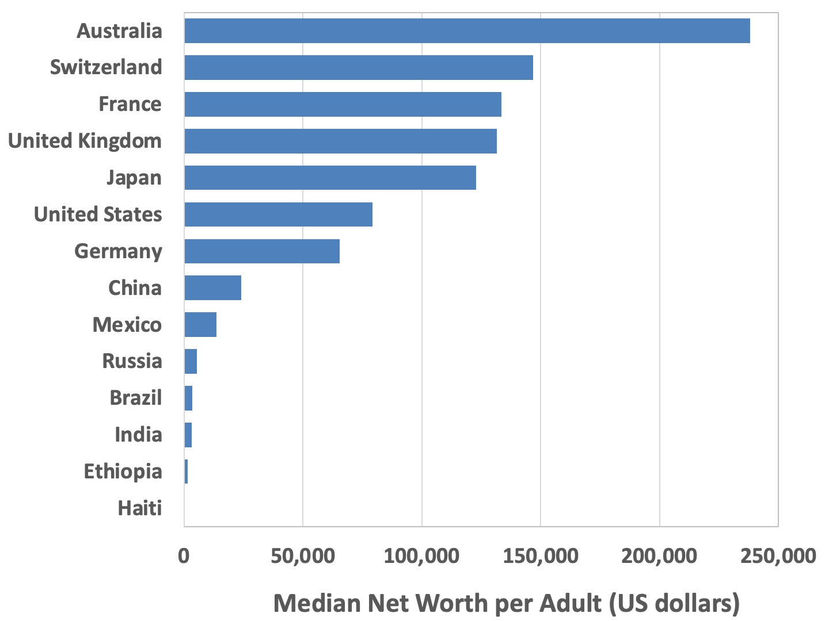
Figure 10.13 Median Net Worth per Adult, Select Countries, 2020
Source: Credit Suisse, 2021.

Slide 17
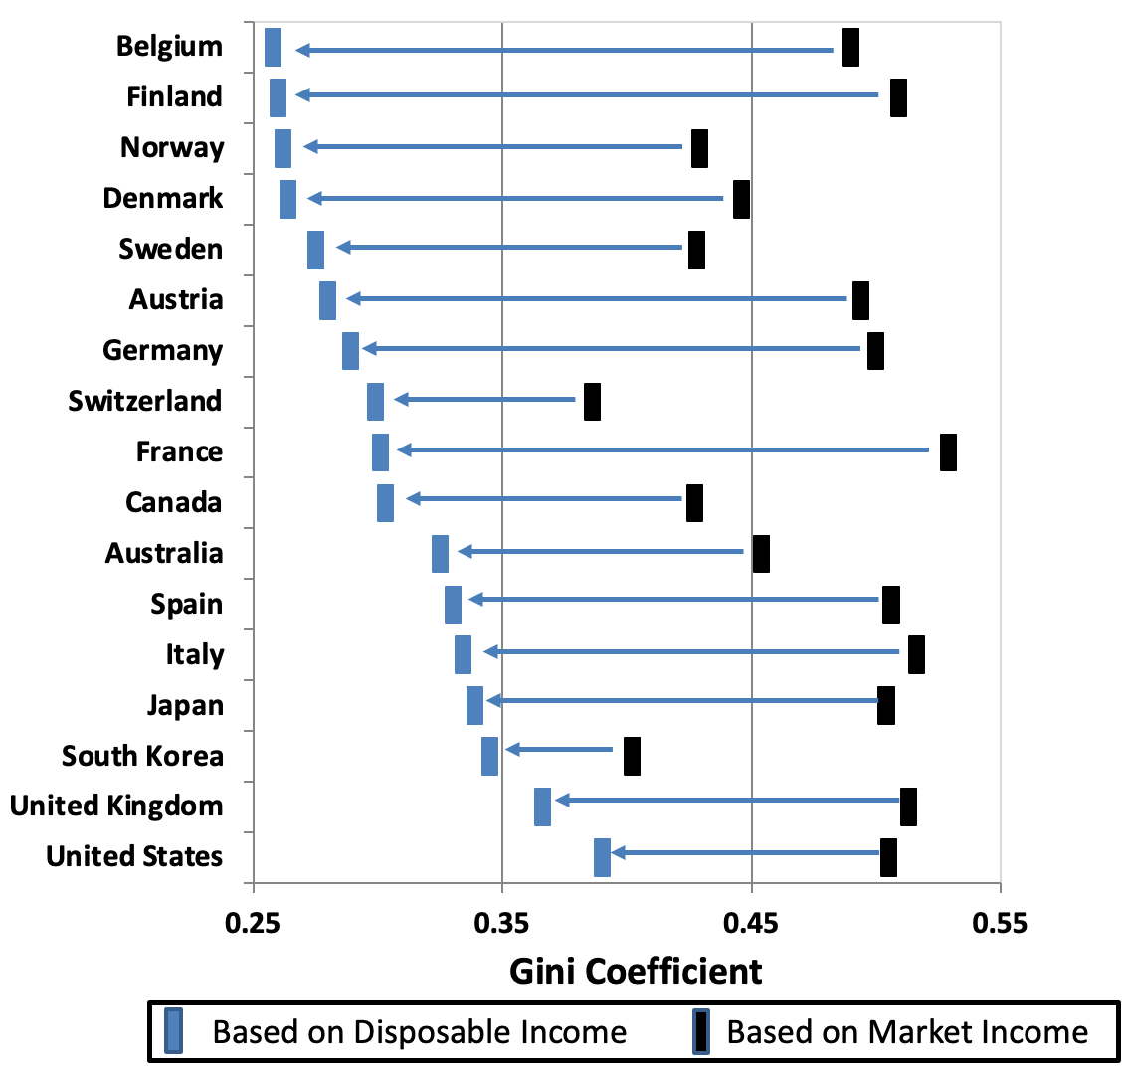
Figure 10.14 Market - and Disposable-Income Gini Coefficients, Select OECD Countries
Source: OECD online statistics database, Income Distribution Database
Note: Data for most countries are from 2017 and 2018.

