Slide 1

Chapter Two:
Markets and Society

Slide 2
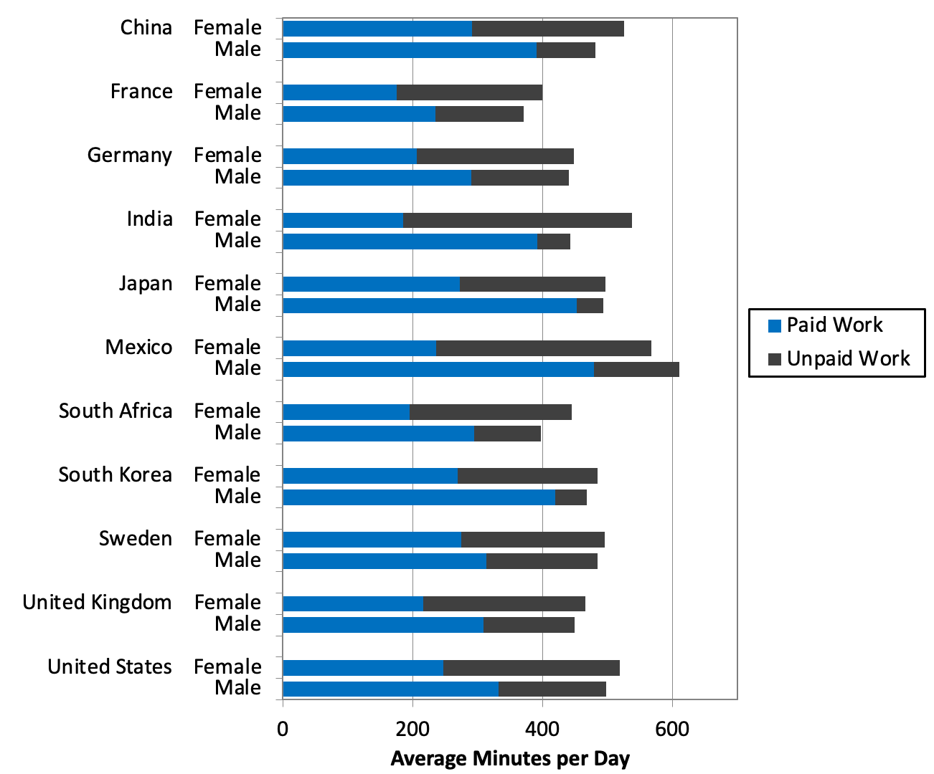
Figure 2.1 Paid and Unpaid Work, Male and Female, Selected Countries
Source: OECD, OECD.Stat, Time Spent in Paid and Unpaid Work, by Sex .

Slide 3
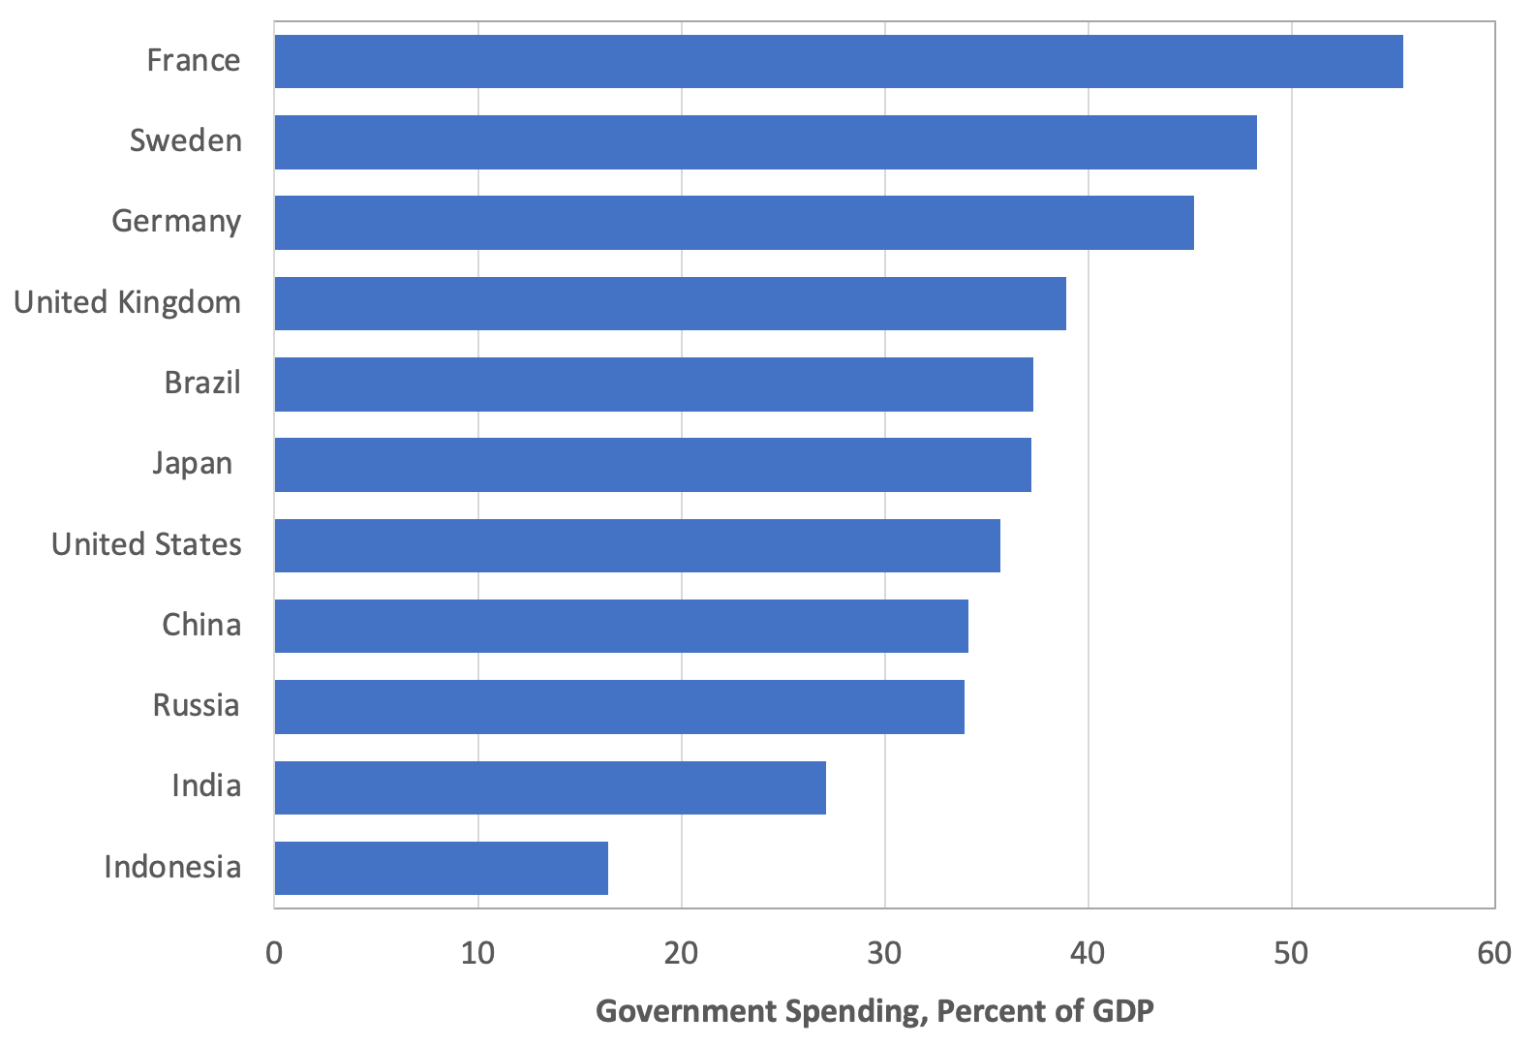
Figure 2.2 Government Spending, Percentage of GDP, Selected Countries, 2019
Source: International Monetary Fund, World Economic Outlook database.

Slide 4
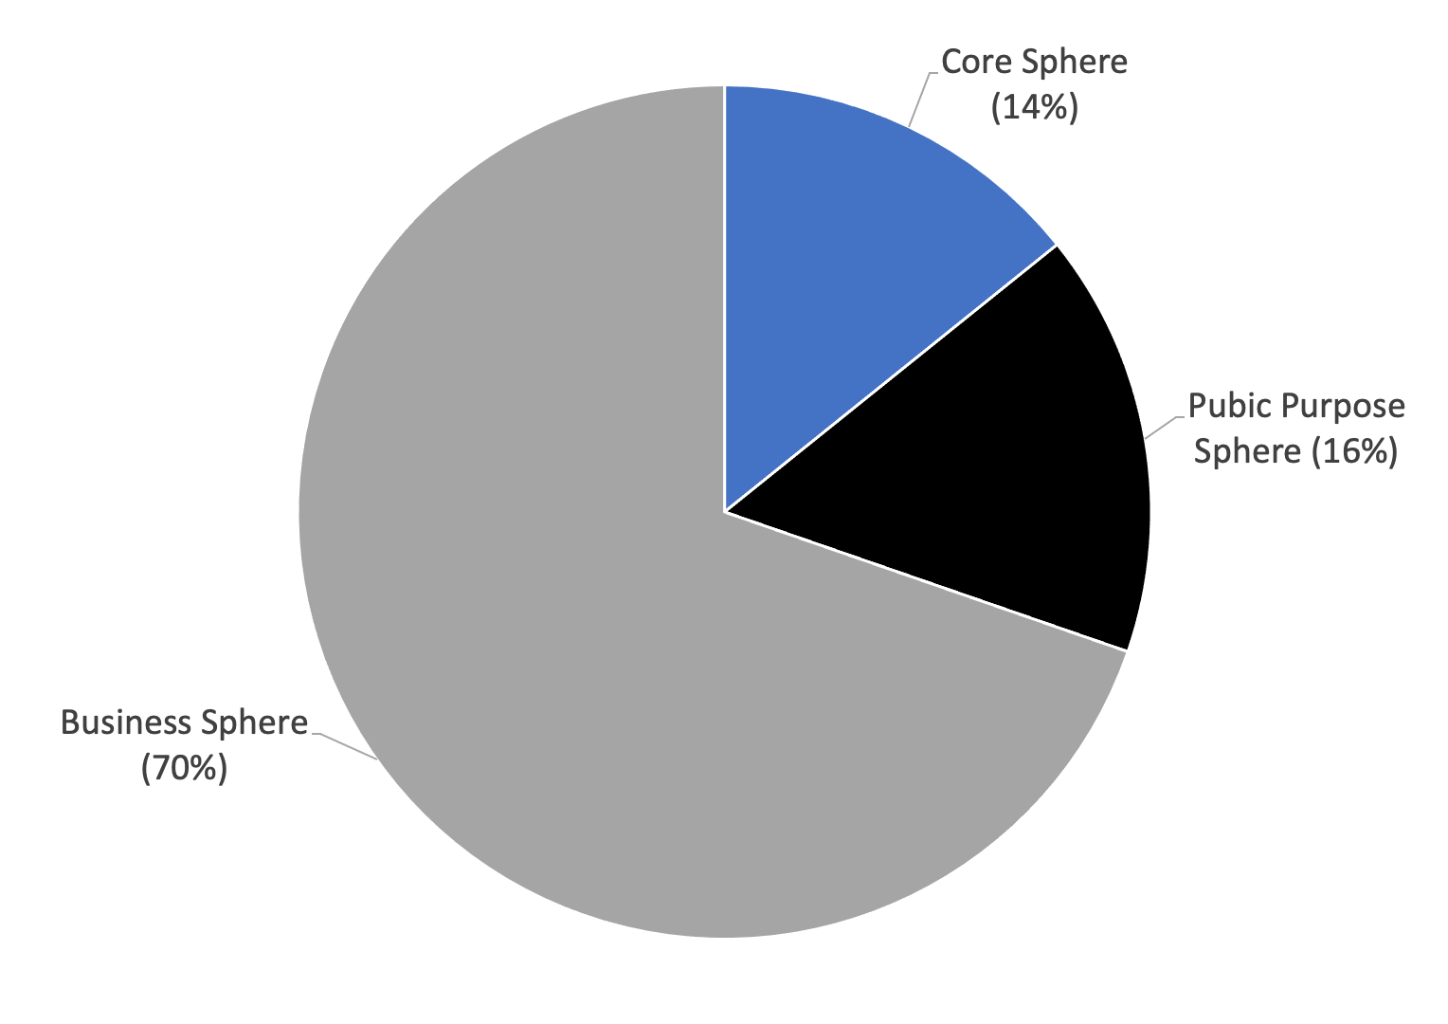
Figure 2.3 Estimated Size of the Three Spheres in the United States, 2020
Sources: U.S. Bureau of Economic Analysis, National Income and Products Account database; Hess et al., 2020; and authors’ calculations.

Slide 5
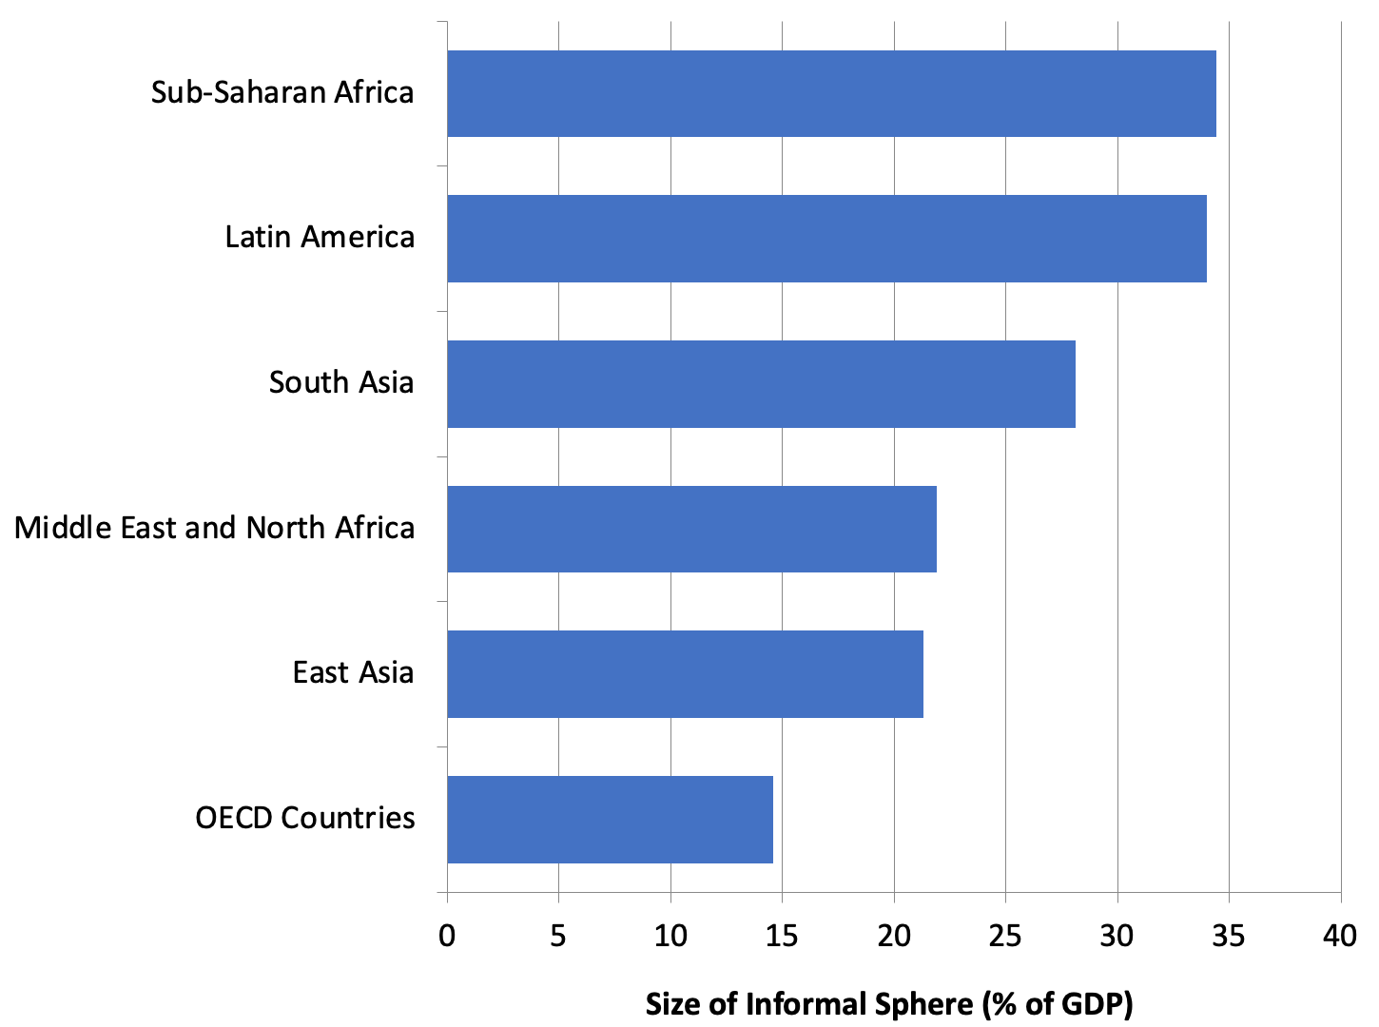
Figure 2.4 The Average Size of the Informal Sphere, Percentage of GDP, by World Region
Source: Medina and Schneider, 2019.

