Slide 1

Chapter 4
Macroeconomic Measurement: The Current Approach

Slide 2
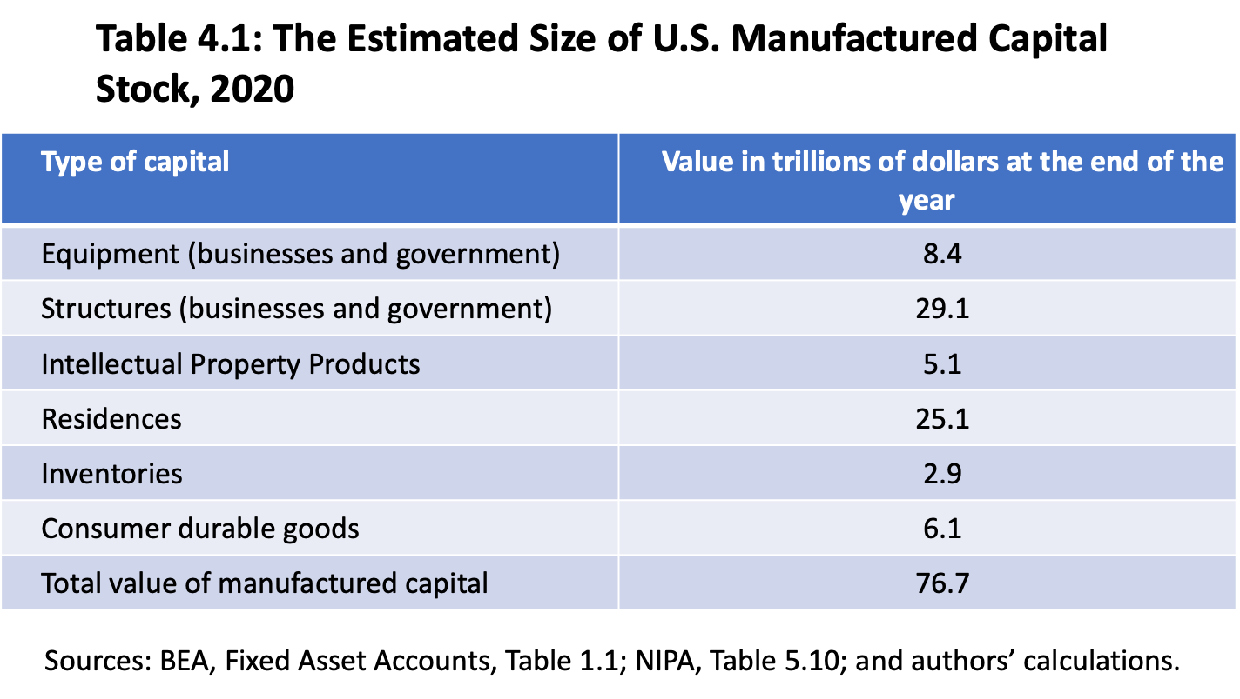

Slide 3
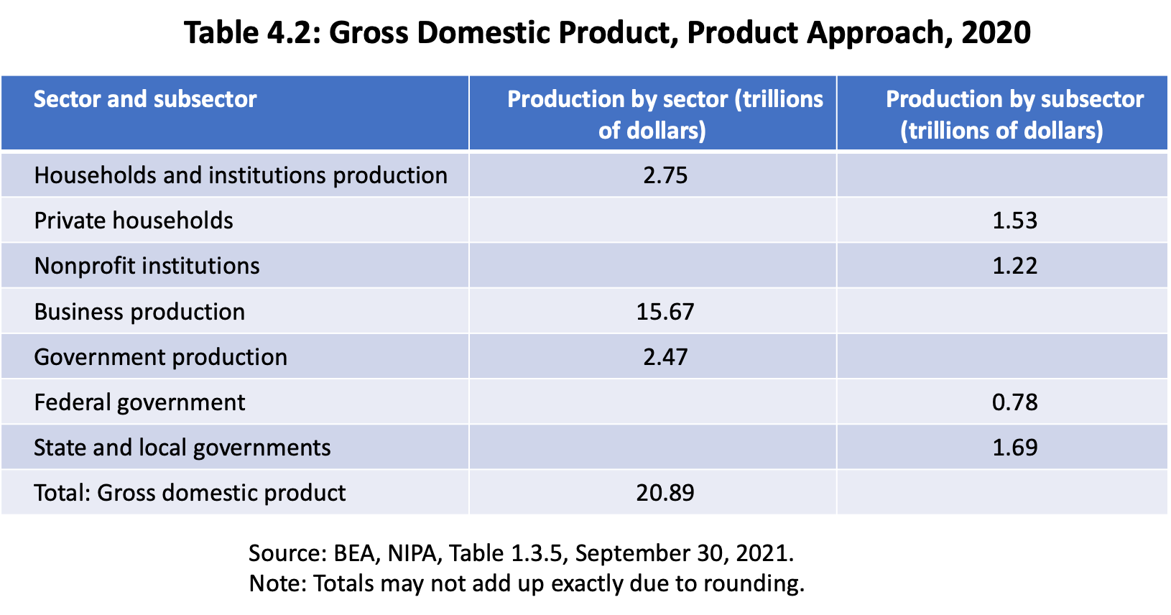

Slide 4
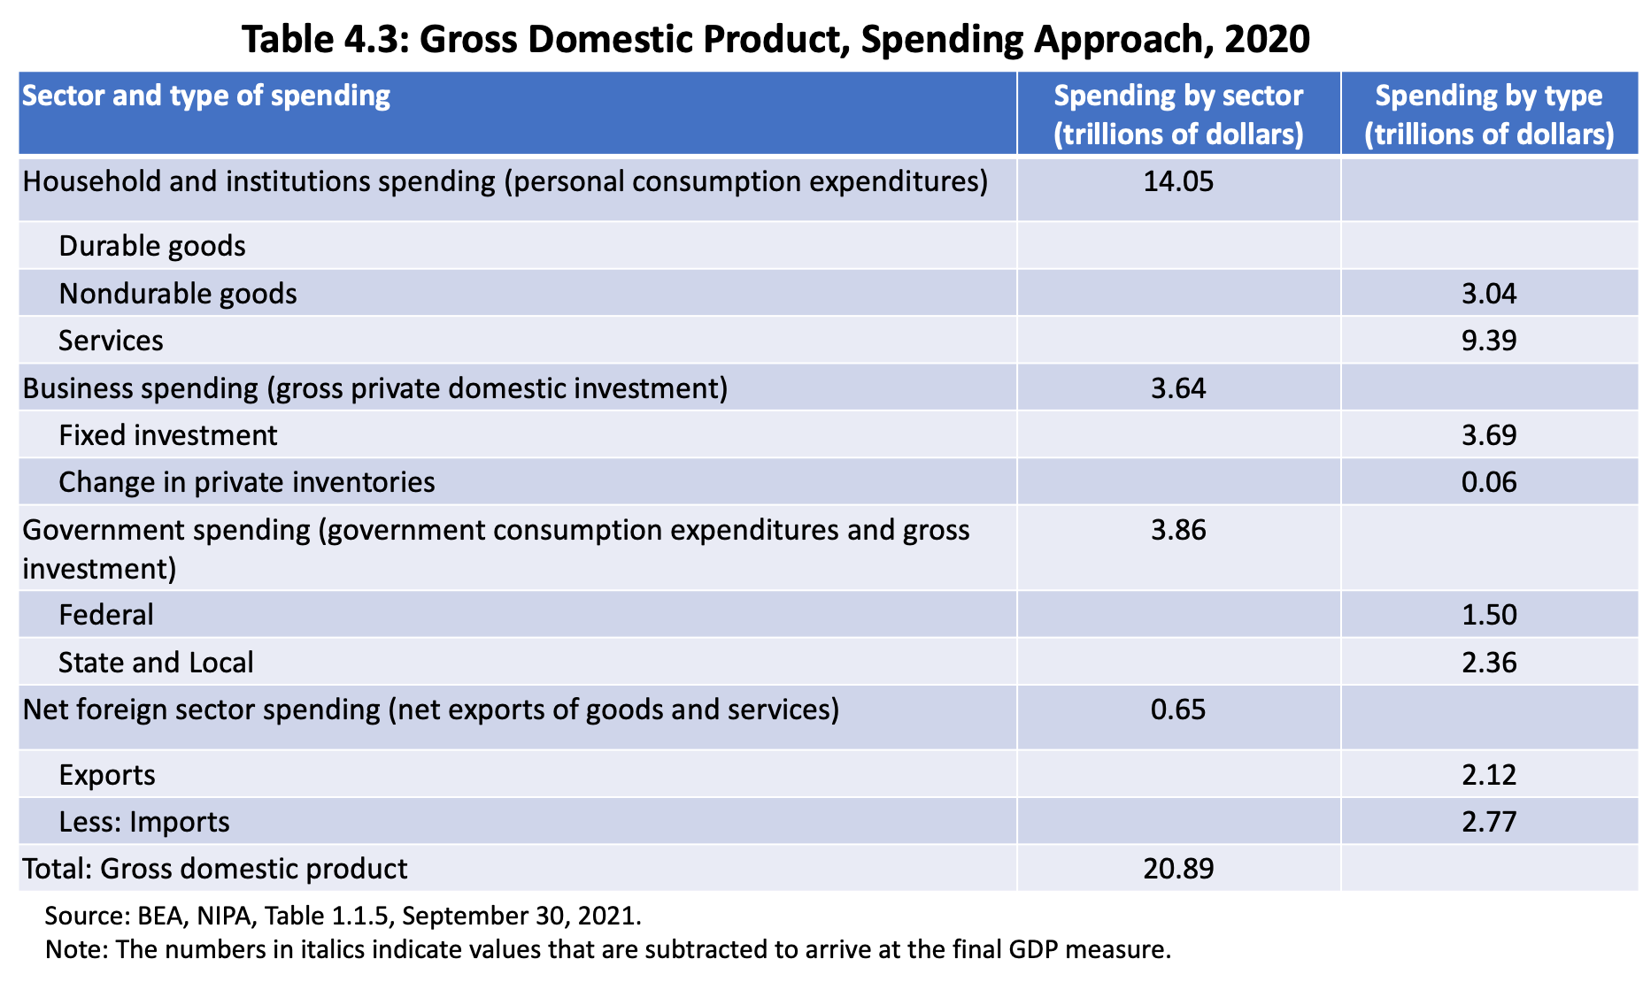

Slide 5
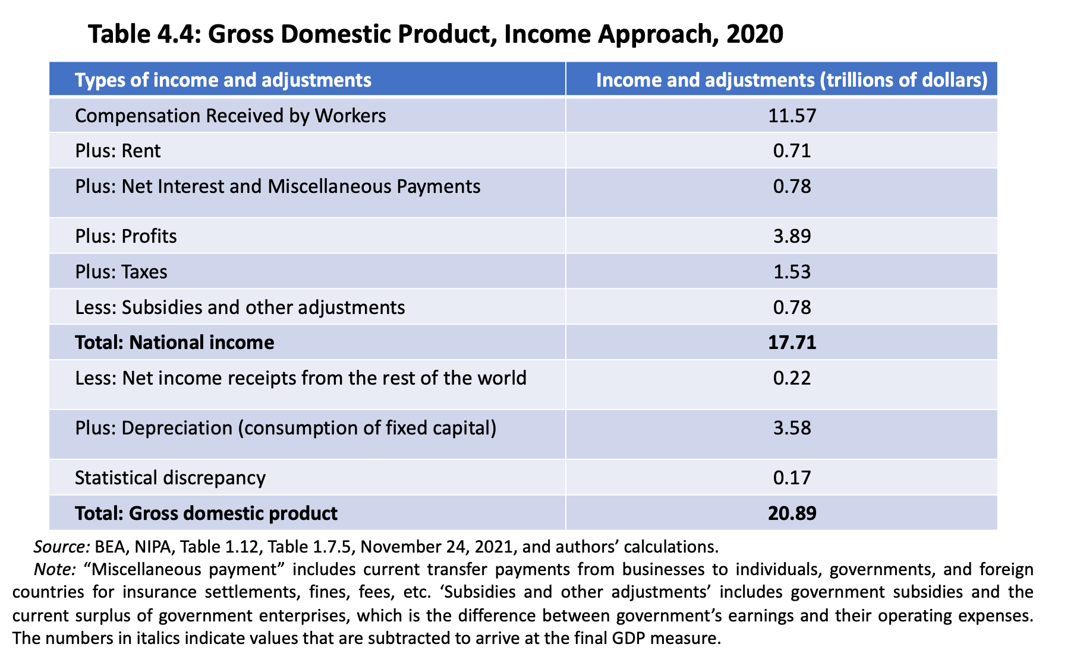

Slide 6
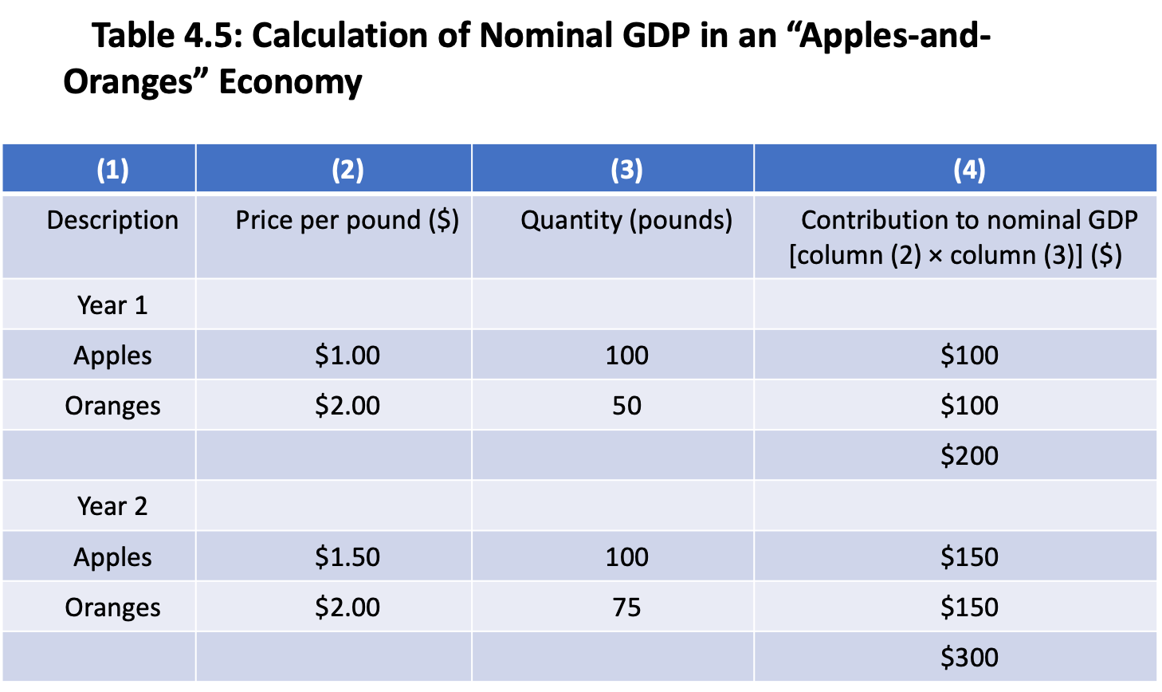

Slide 7
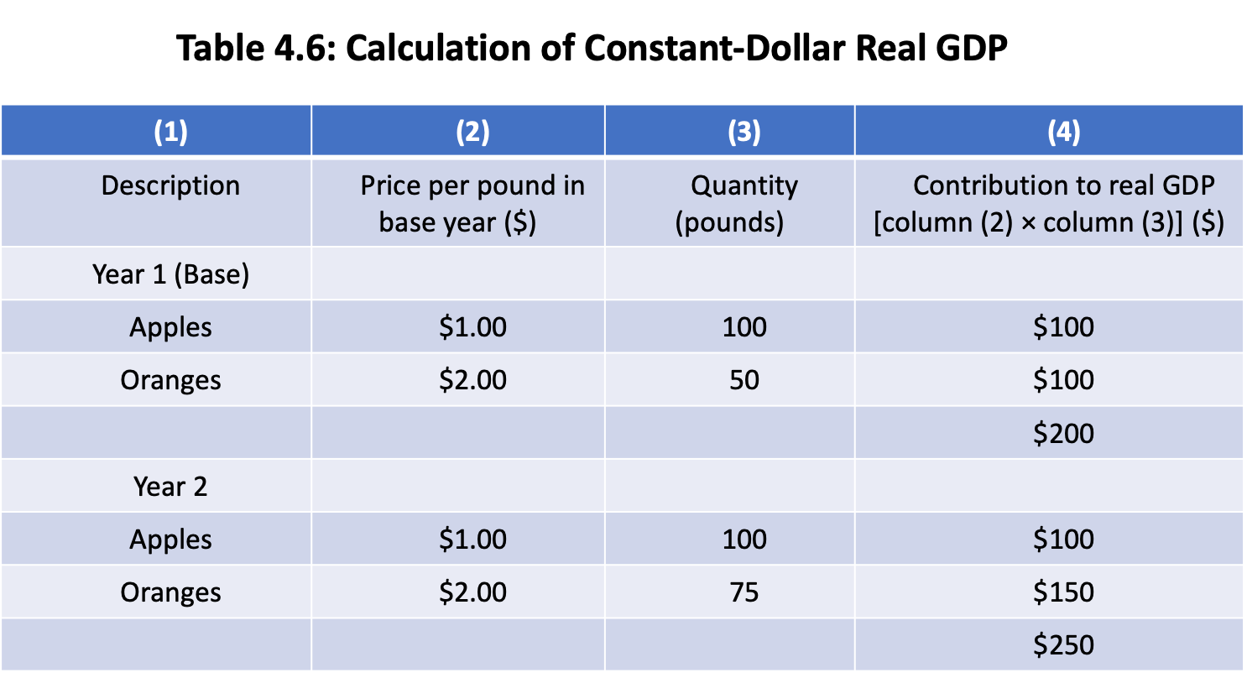

Slide 8
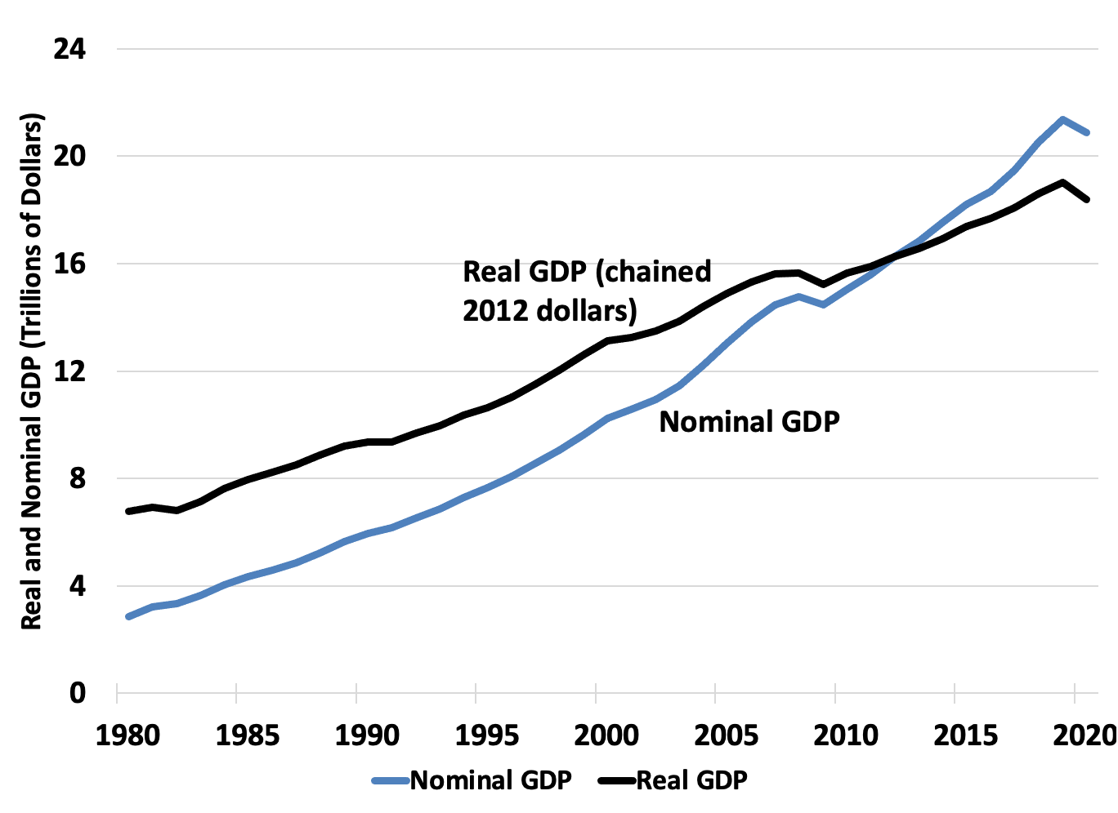
Figure 4.1: Real versus Nominal GDP, Chained 2012 Dollars, 1980–2020
Source: BEA NIPA Tables 1.1.5 and 1.1.6, published 09/30/2021.

Slide 9
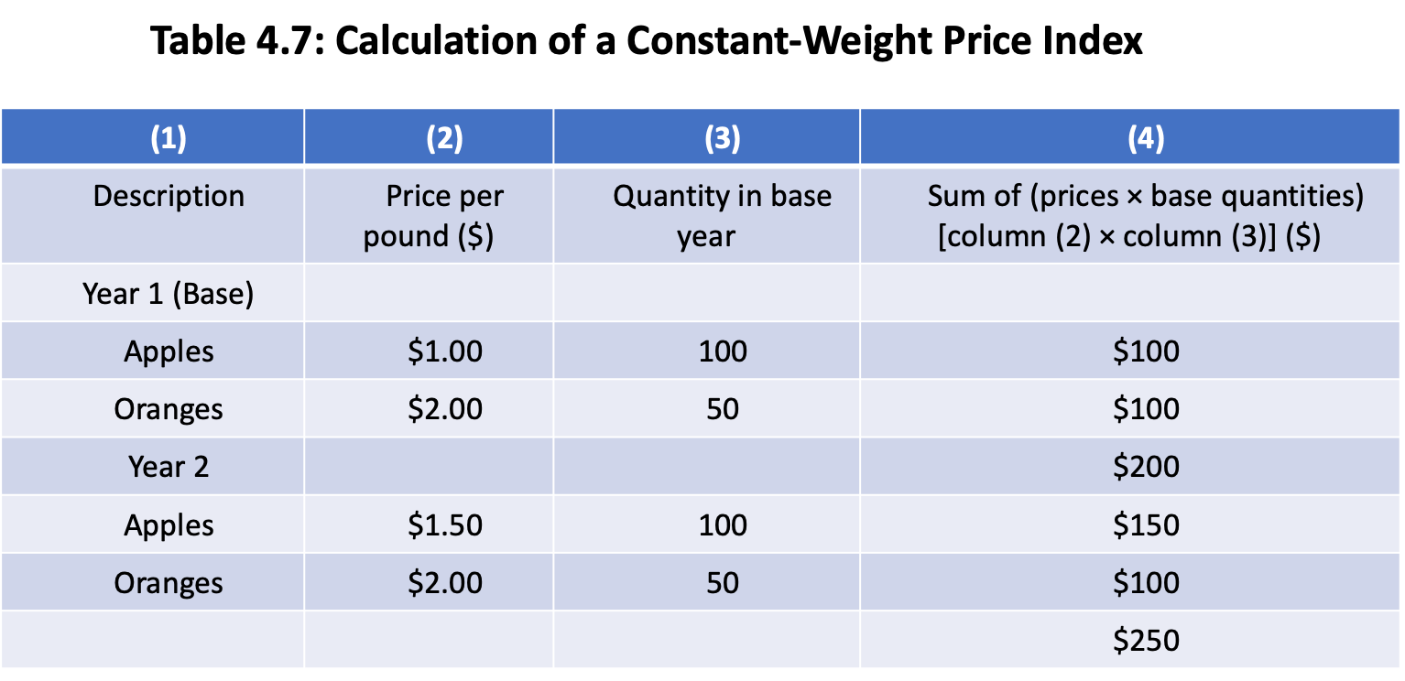

Slide 10
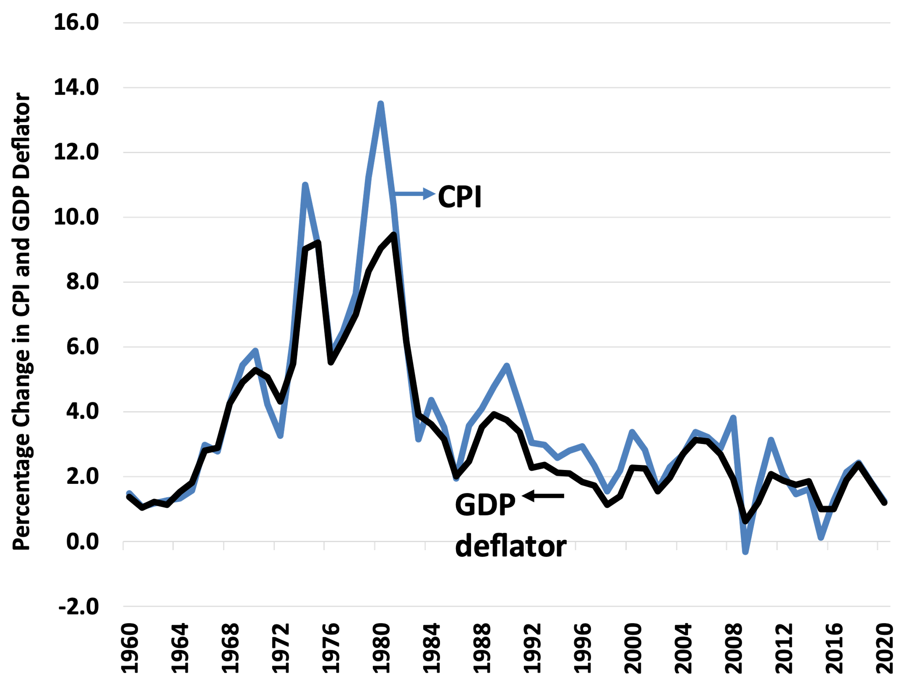
Figure 4.2: Rate of change in GDP deflator vs. CPI, 1960–2020
Source: BEA NIPA Tables 1.1.4 and BLS Table on CPI-All urban consumers.

Slide 11
