Slide 1

Chapter 2
Foundations of Economic Analysis

Slide 2
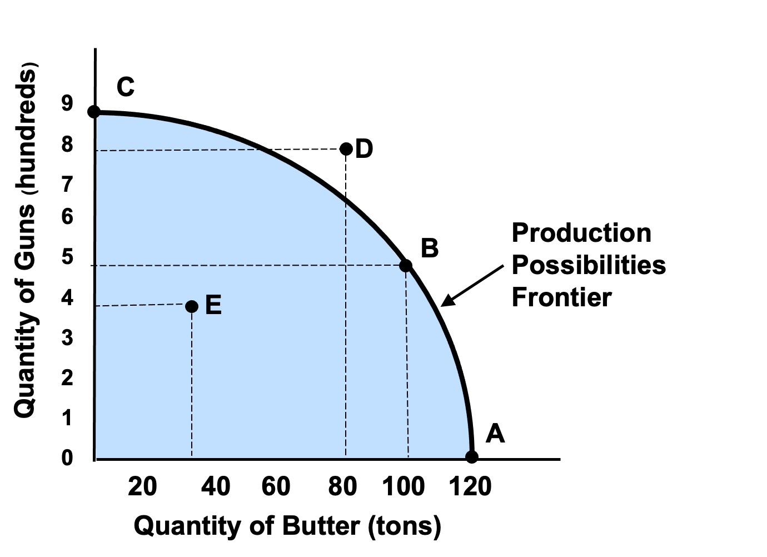
2.1 Society’s Production Possibilities Frontier

Slide 3
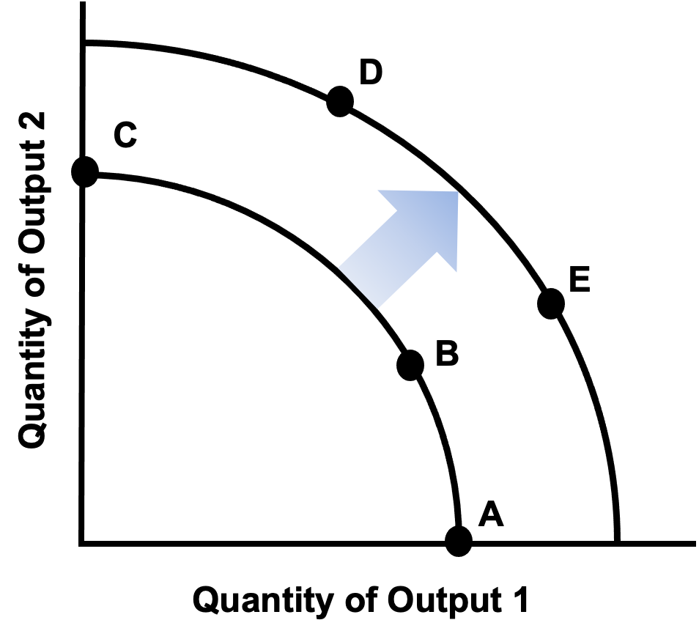
2.2 An Expanded Production Possibilities Frontier
Notes:
3

Slide 4
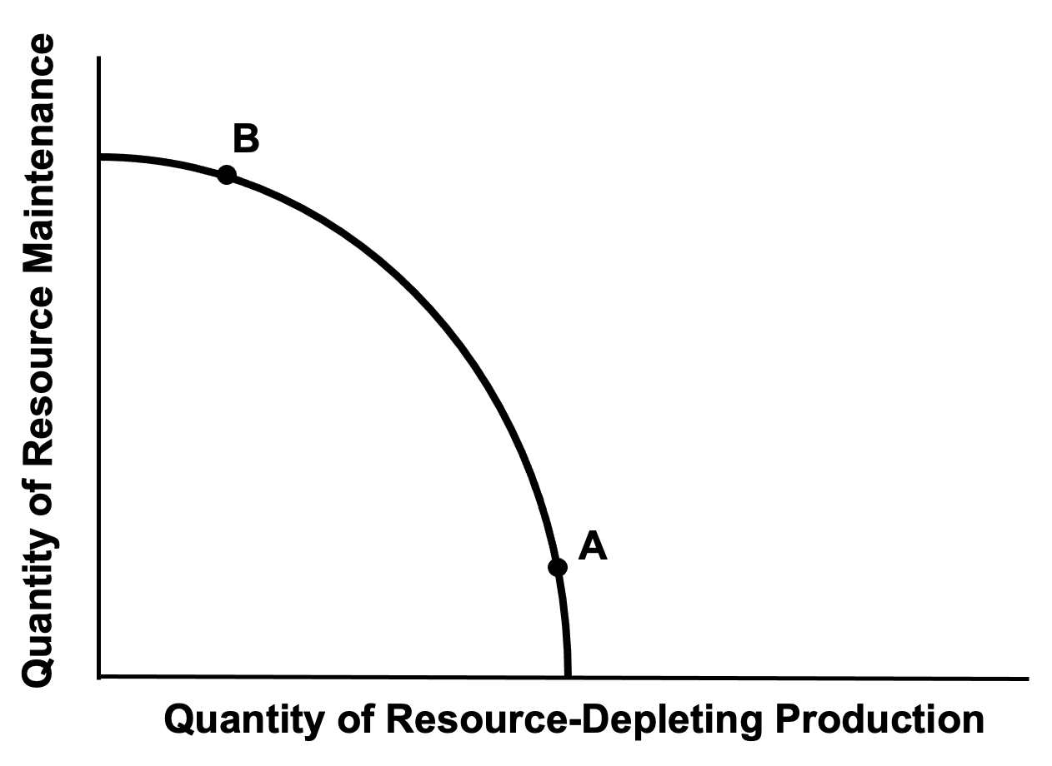
2.3 Society’s Choice between Current Production and Future Resource Availability
Notes:
4

Slide 5
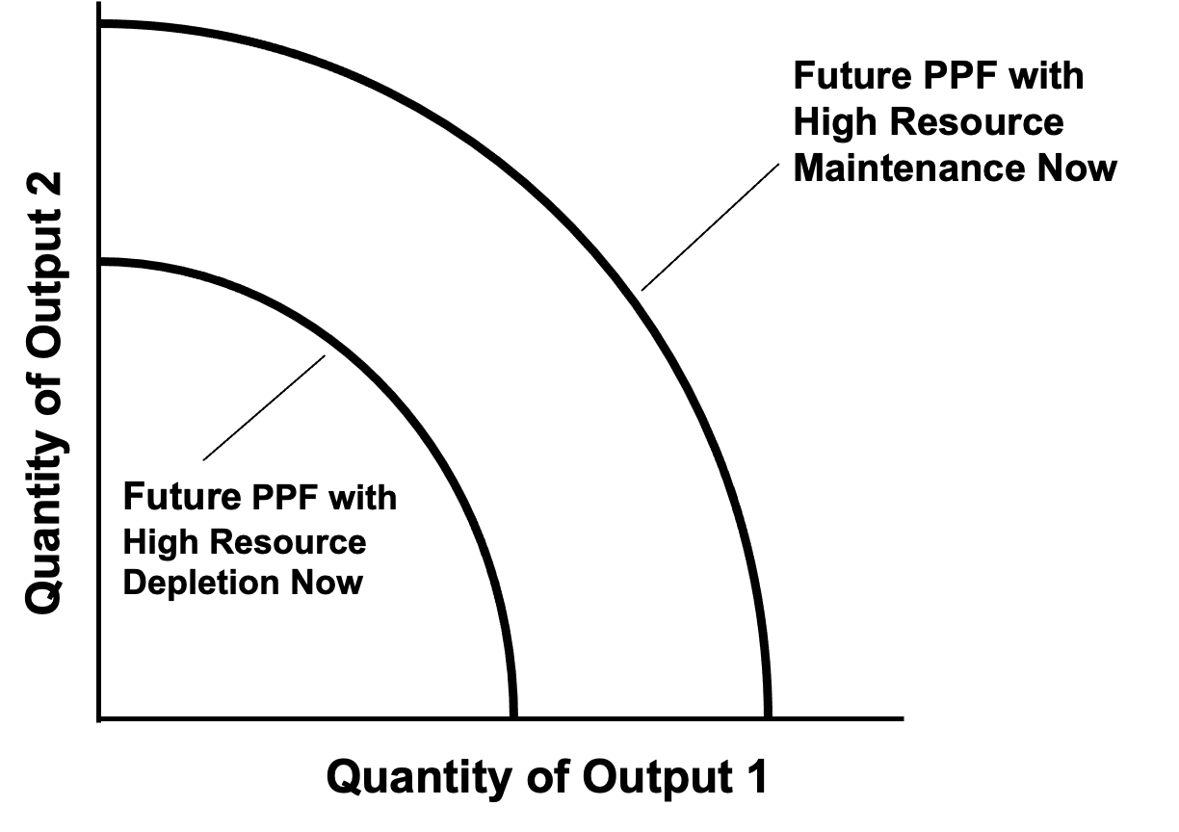
2.4 Potential Future Production-Possibilities Frontier
Notes:
5

Slide 6
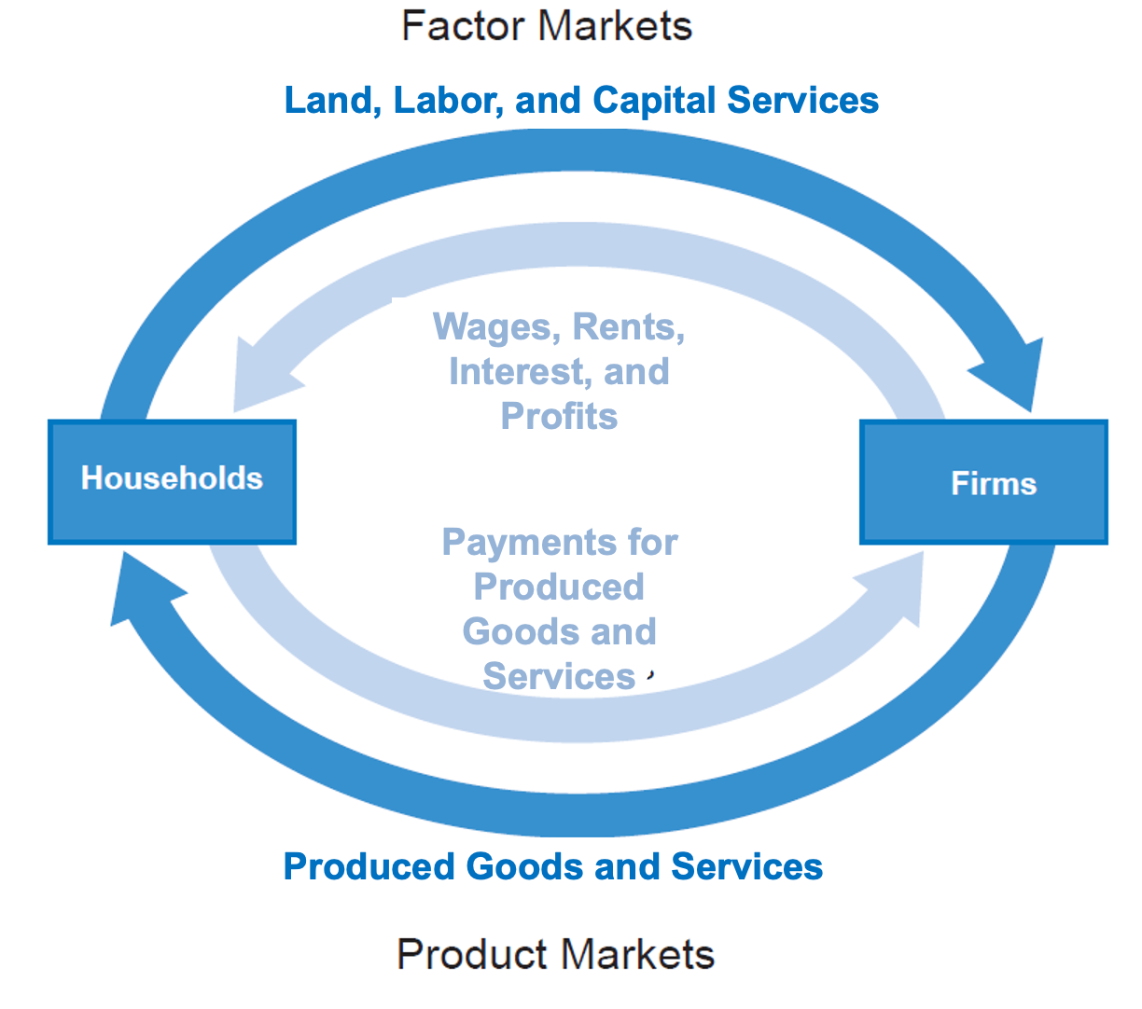
2.5 The Circular Flow Diagram for the Basic Neoclassical Model

Slide 7
2.6 Social and Environmental Contexts of Economic Activity
Environmental Context
Social Context
Economic Activity
Core Sphere
Business Sphere
Natural Inputs (Natural resources and environmental services)
Outputs (pollution and wastes)
Public Purpose Sphere

Slide 8
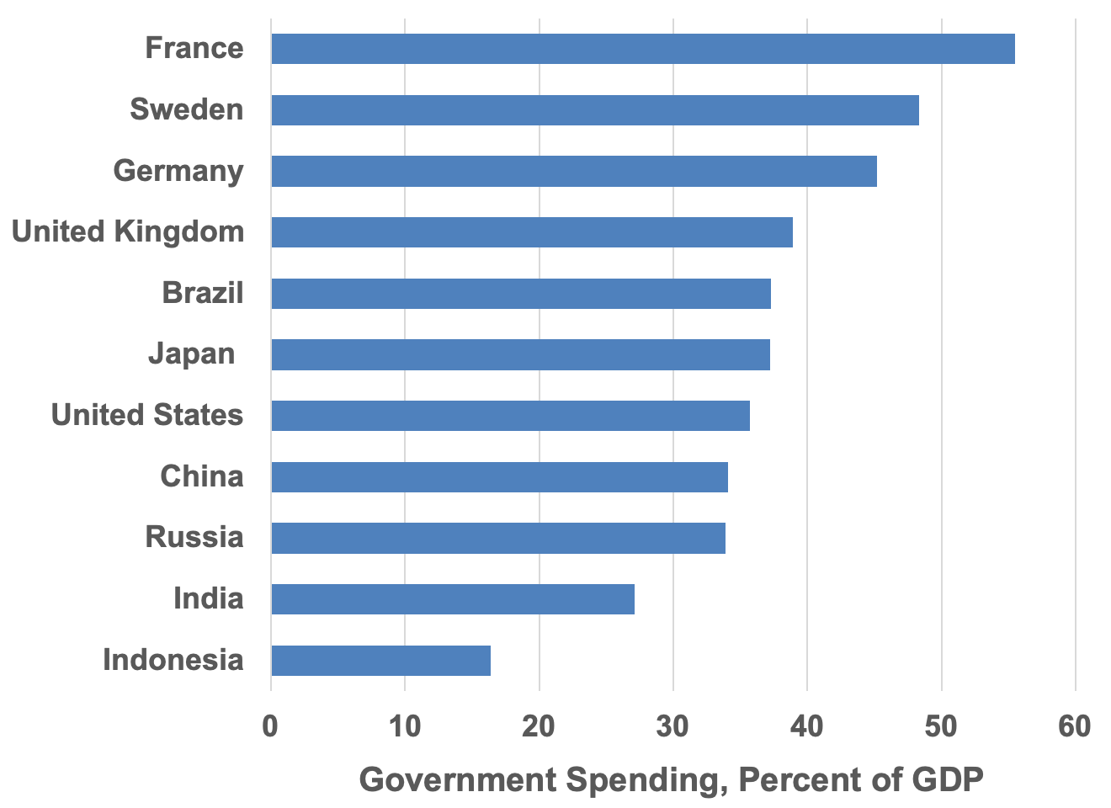
2.7 Government Spending, Percentage of GDP, Select Countries 2019
Source: International Monetary Fund, World Economic Outlook database, April 2021.

Slide 9
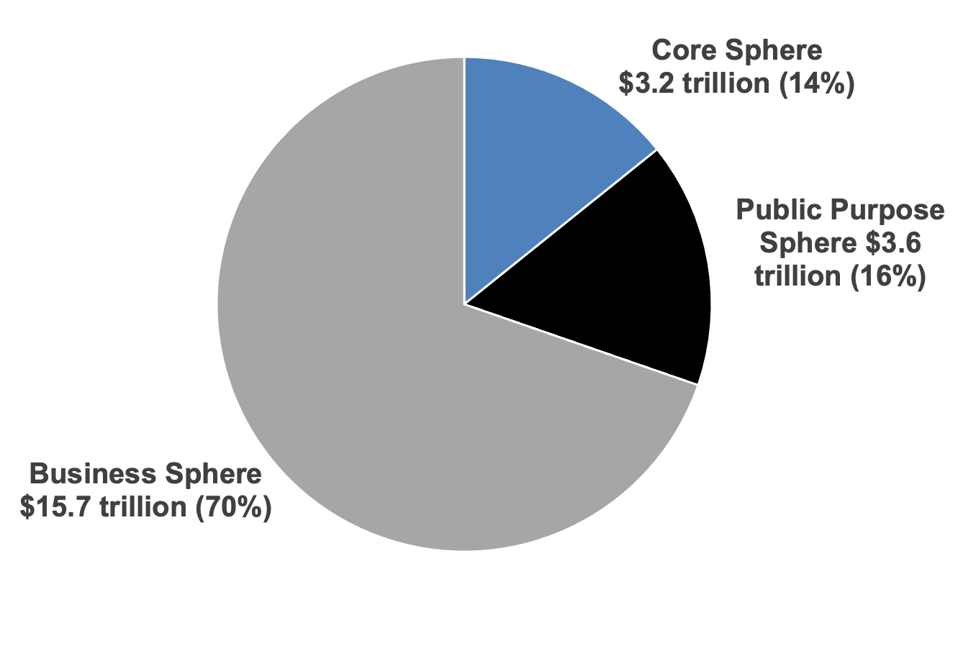
2.8 Estimates of the Size of the Three Spheres in the United States, 2020
Sources: U.S. Bureau of Economic Analysis, National Income and Products Account database; Hess et al., 2020; and authors’ calculations.

Slide 10
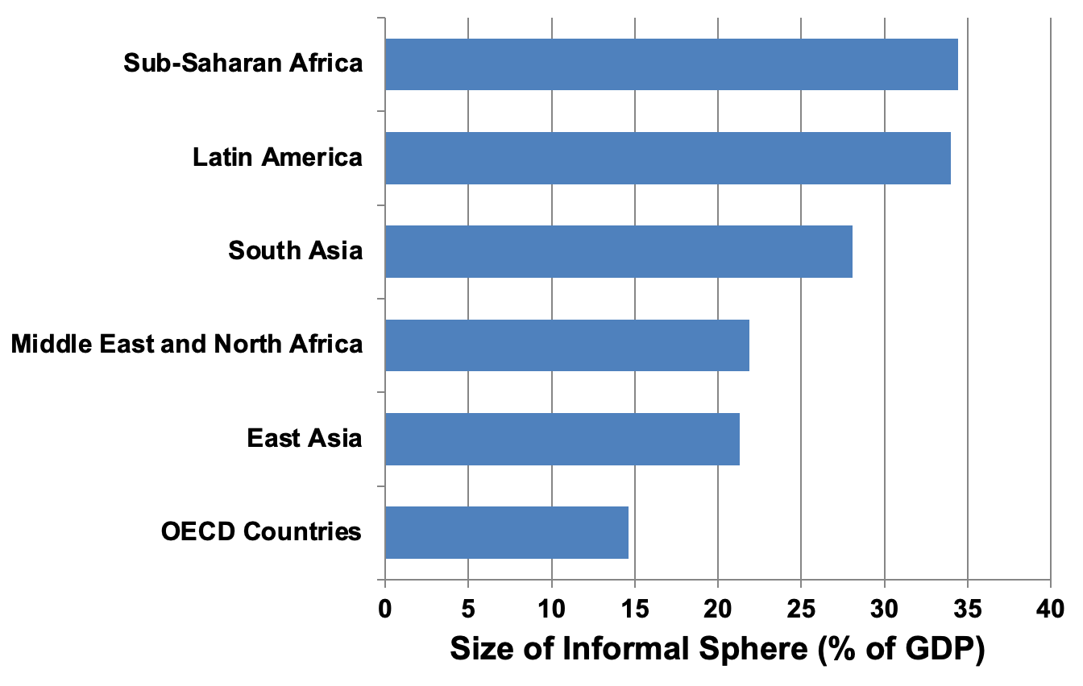
2.9 The Average Size of Informal Sphere, Percent of GDP , by World Region
Source: Medina, Leandro, and Friedrich Schneider. 2019.

Slide 11
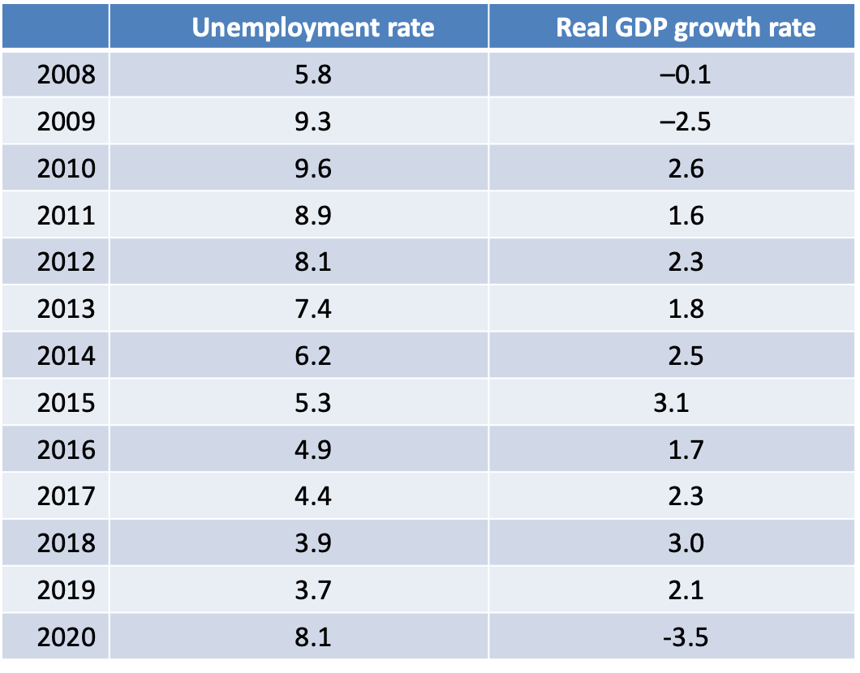
Table 2.1: Unemployment Rate and Real GDP Growth Rate, United States, 2008–2020 (in percent)
Sources: U.S. Bureau of Economic Analysis and U.S. Bureau of Labor Statistics.

Slide 12
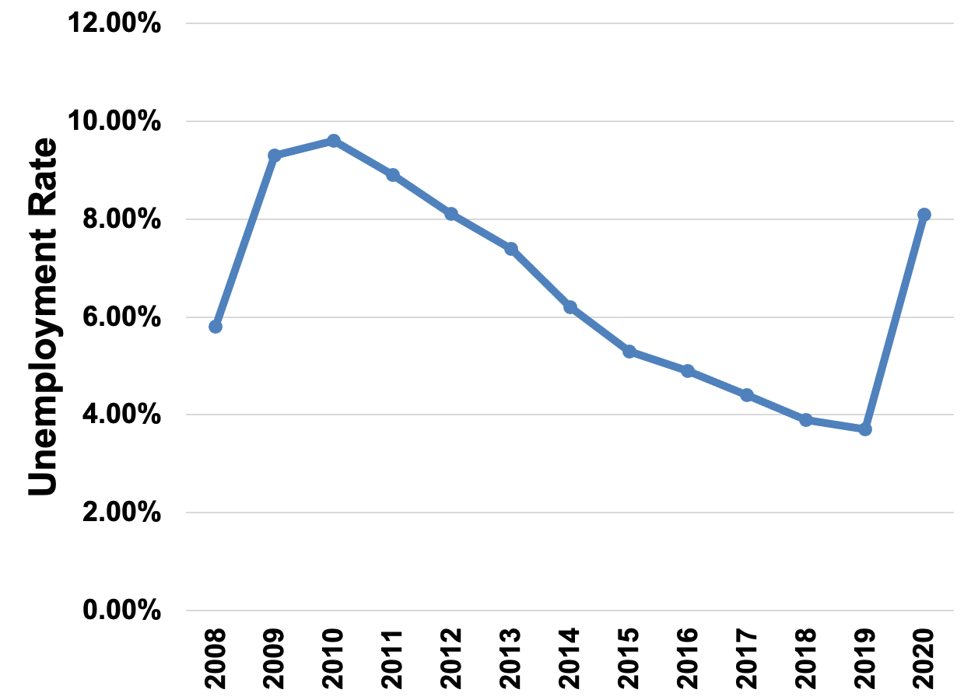
2.10 Unemployment Rate, United States, 2008-2020
Source: U.S. Bureau of Labor Statistics.

Slide 13
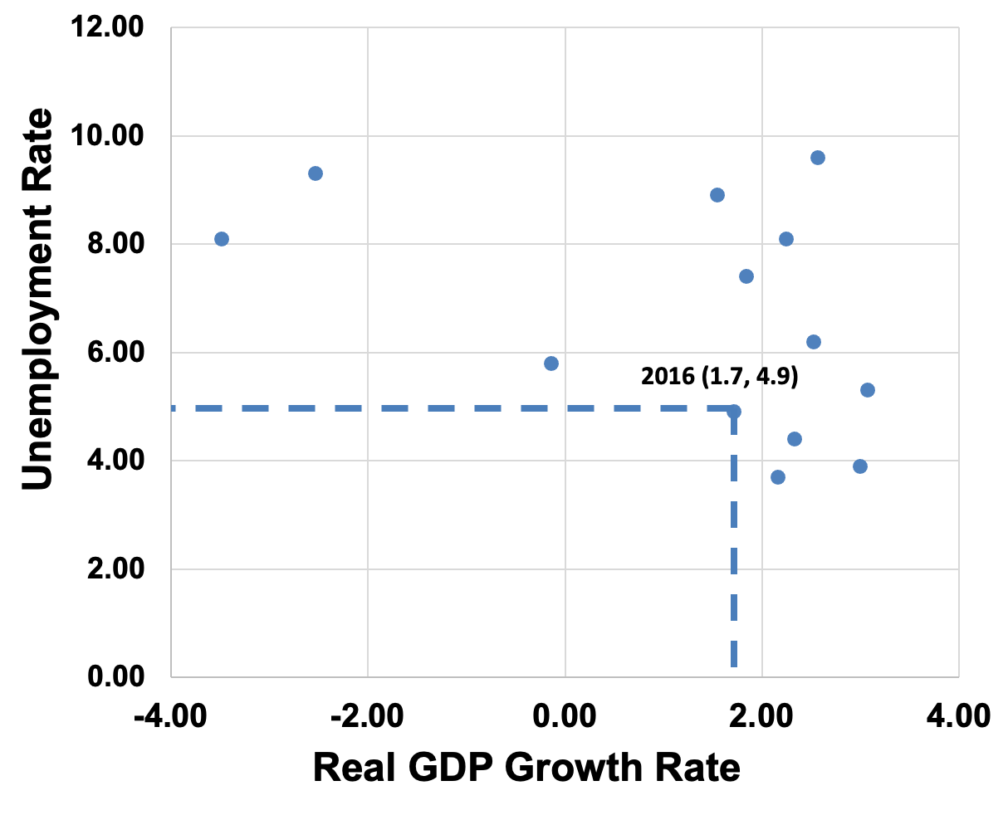
2.11 Relationship between Unemployment and GDP Growth Rate, United States, 2008-2020
Sources: U.S. Bureau of Economic Analysis and U.S. Bureau of Labor Statistics.

Slide 14
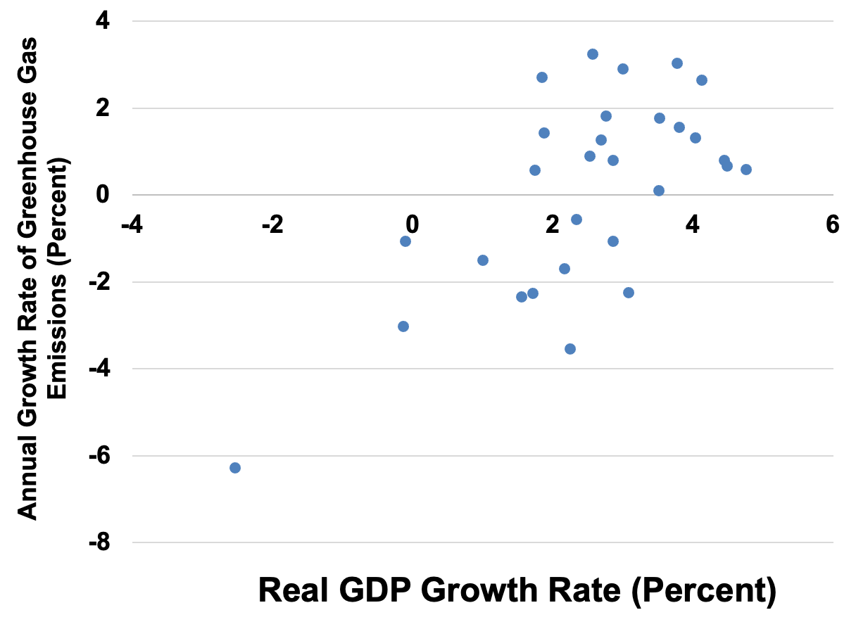
2.12 Relationship between GDP Growth Rate and Greenhouse Gas Emissions Growth Rate, United States, 1991-2020
Source: Greenhouse Gas data from United States Environmental Protection Agency and Real GDP data from Bureau of Economic Analysis, Table 1.1.1.

