Slide 1

Chapter 1
Macroeconomic Activity in Context

Slide 2
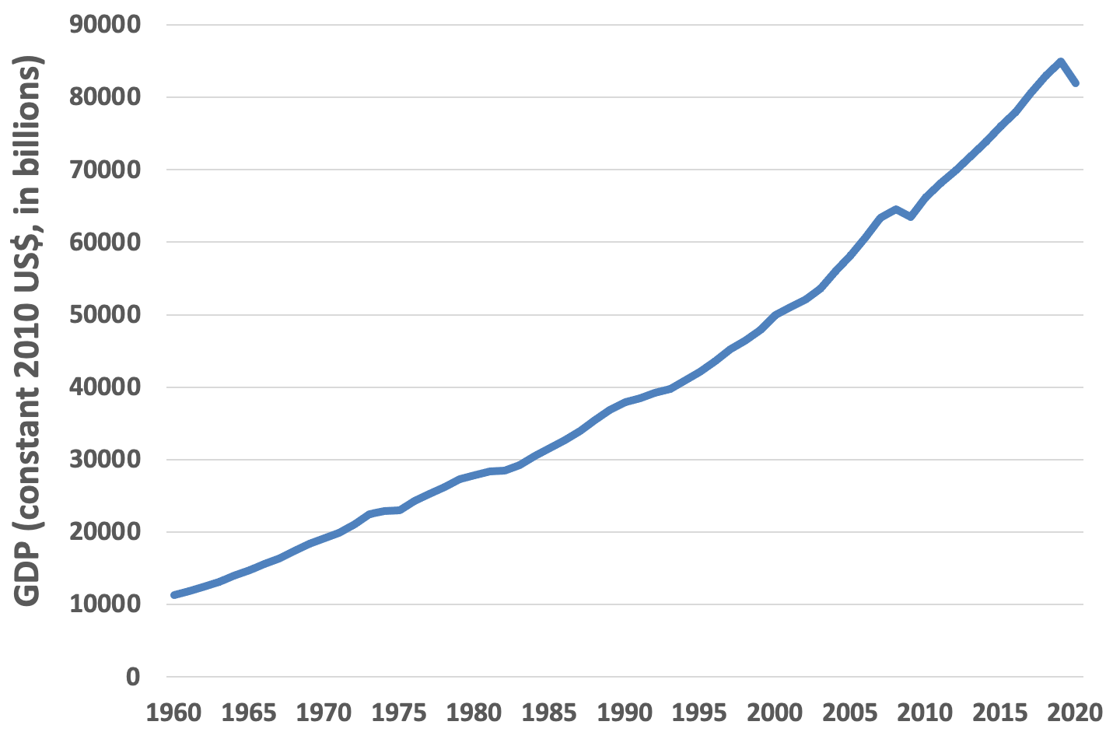
Figure 1.1 Global Production, 1960-2020
Source: The World Bank Group, World Development Indicators Online

Slide 3
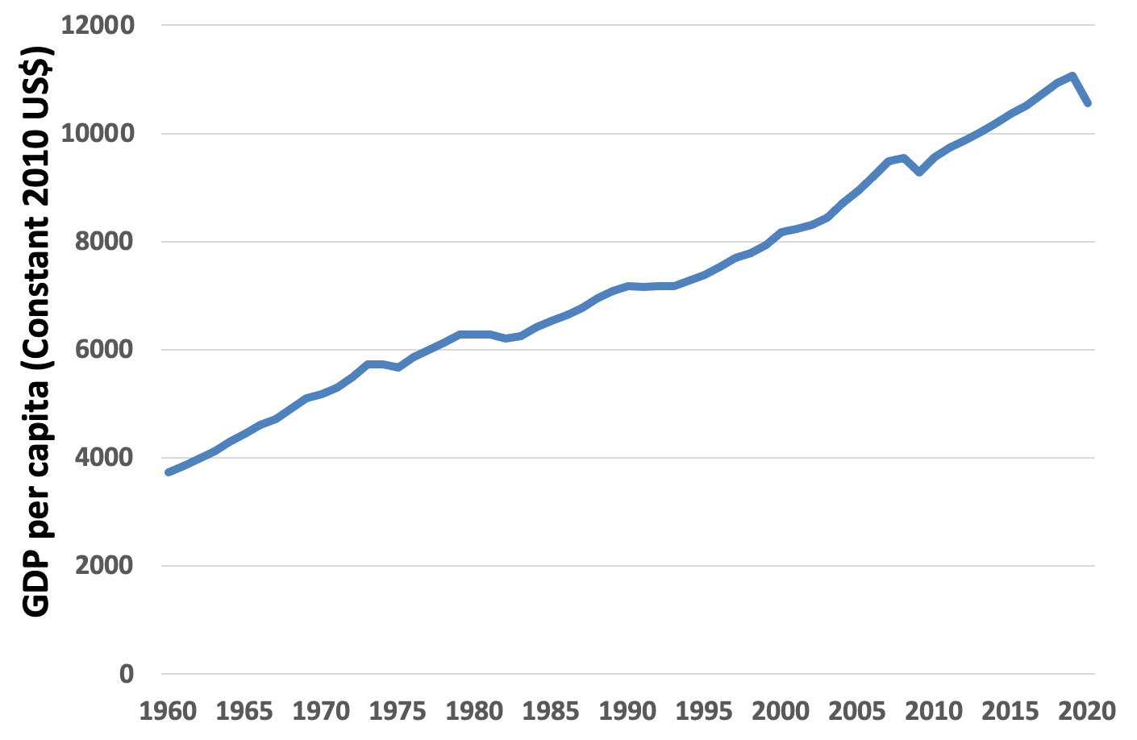
Figure 1.2 Global Production per Capita, 1960-2020
Source: The World Bank Group, World Development Indicators Online

Slide 4
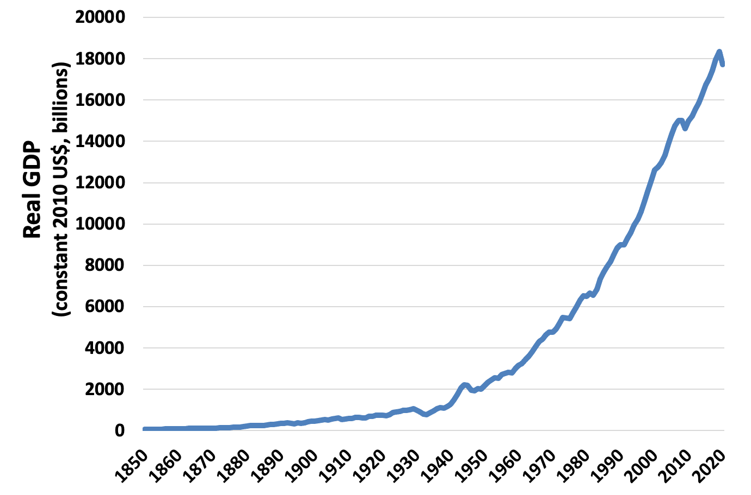
Figure 1.3 Real GDP in Billions of Dollars (Constant 2010US$) in the U.S., 1850-2020
Source: The World Bank Group, World Development Indicators Online

Slide 5
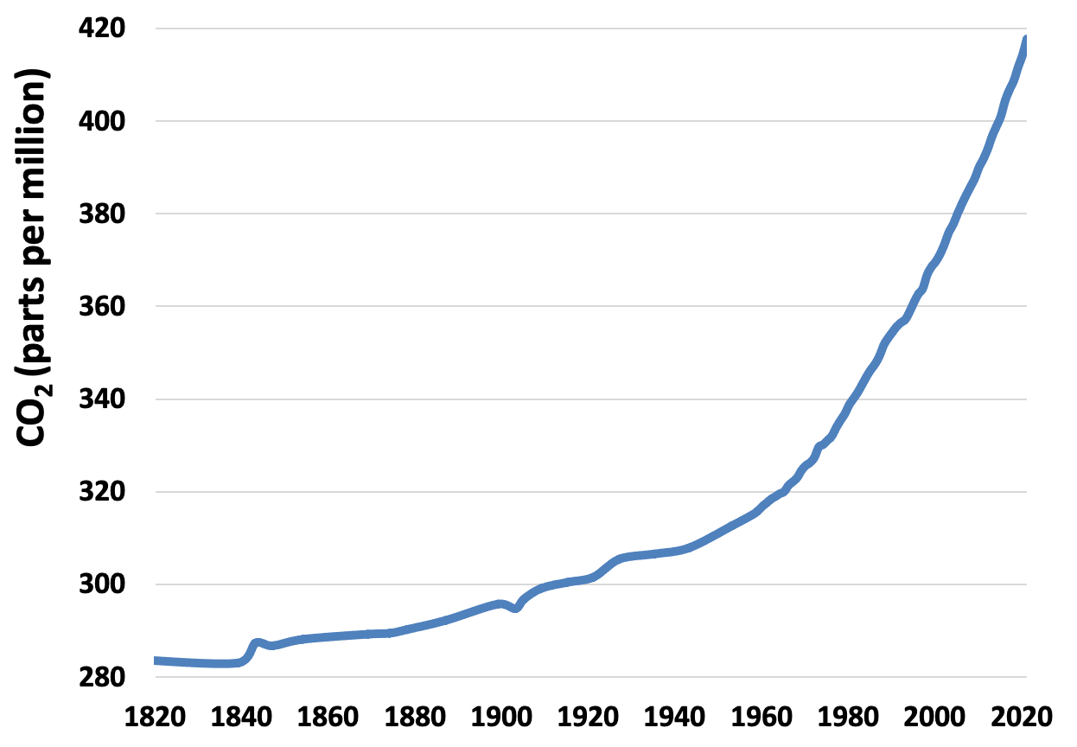
Figure 1.4 Growth in Atmospheric Carbon Dioxide, 1815-2020
Sources: Carbon Dioxide Information Analysis Center, and National Oceanic and Atmospheric Administration Earth System Research Laboratory data.

Slide 6
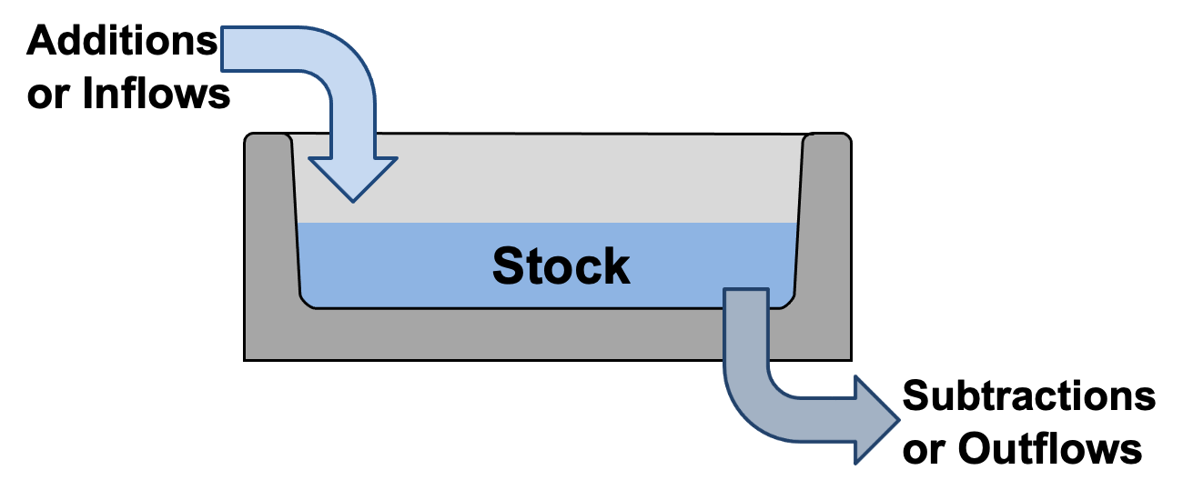
Figure 1.5 “Bathtub”-Style Stock-Flow Diagram

