Slide 1

Chapter 9
Fiscal Policy

Slide 2
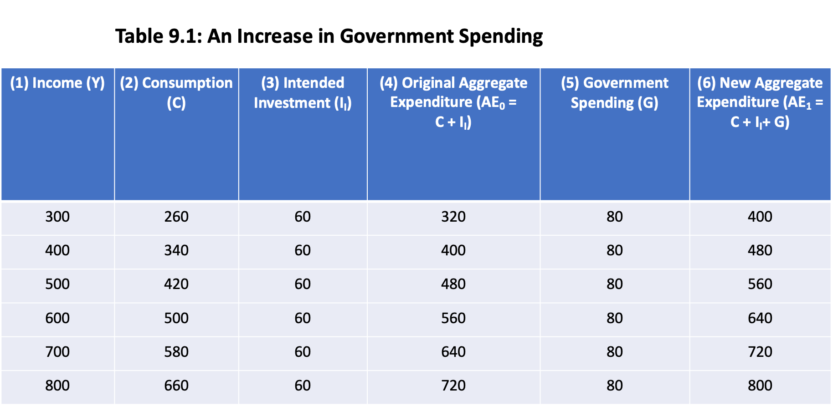

Slide 3
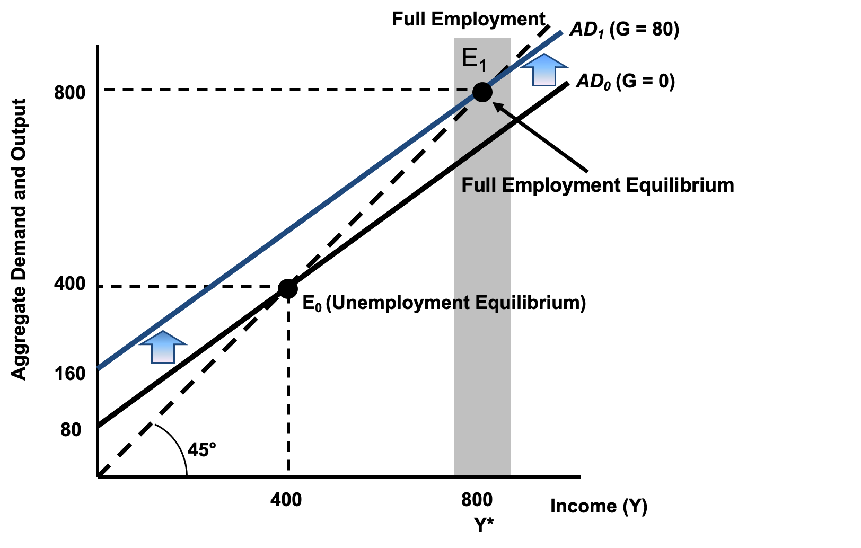
Figure 9.1: Increased Government Spending

Slide 4
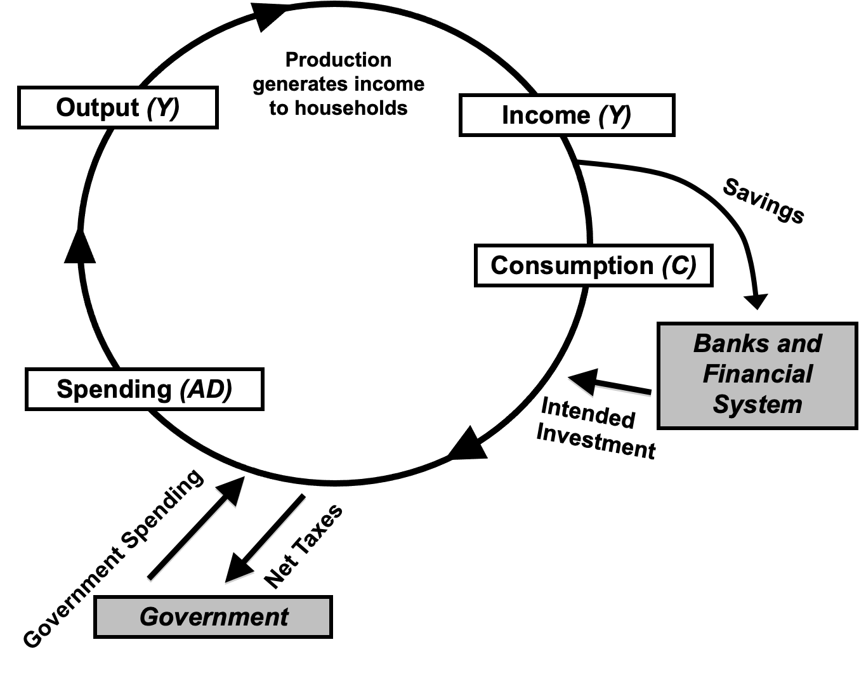
Figure 9.2: A Macroeconomic Model with Government Spending and Taxes

Slide 5
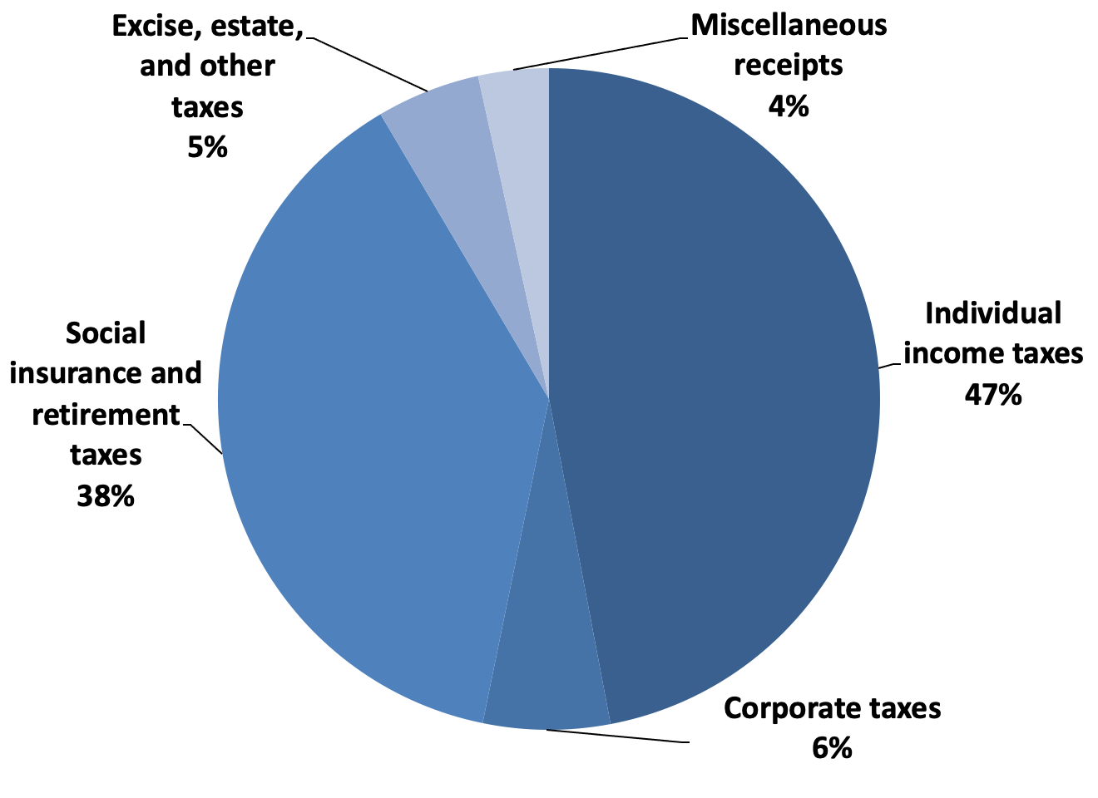
Figure 9.3a: United States Government Source of Funds, Fiscal Year 2021
Source: Office of Management and Budget, Historical Tables, 2021; Economic Report of the President, 2021.

Slide 6
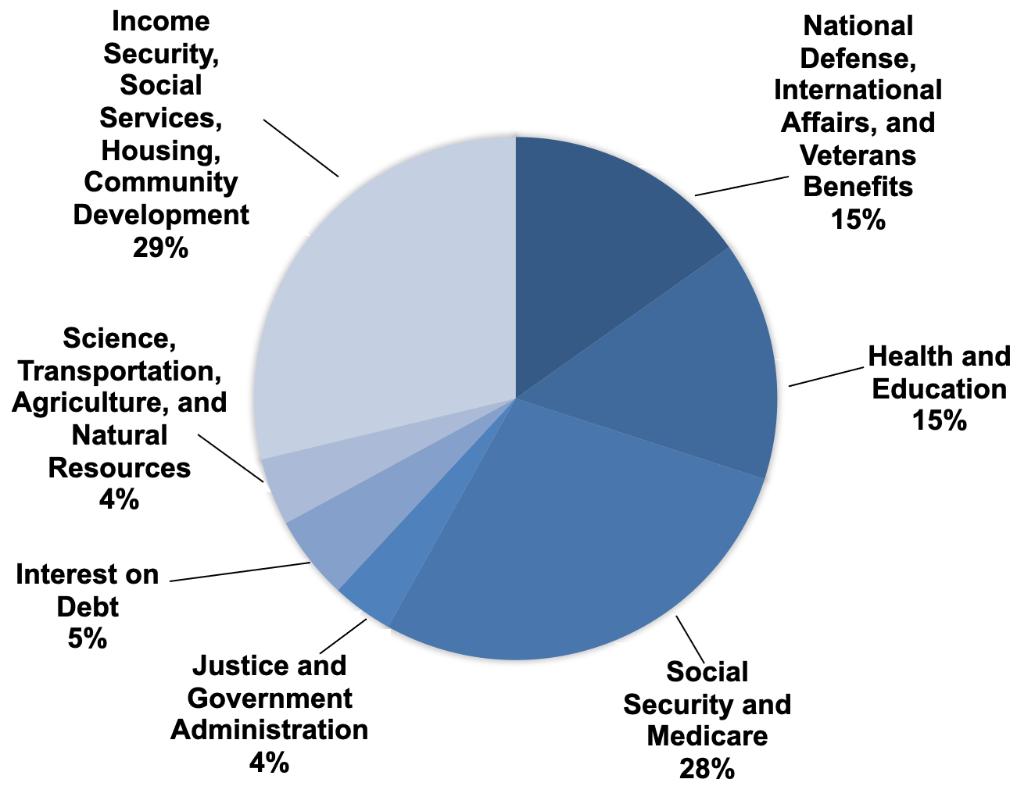
Figure 9.3b: United States Government Source of Outlays, Fiscal Year 2021
Source: Office of Management and Budget, Historical Tables, 2021; Economic Report of the President, 2021.

Slide 7
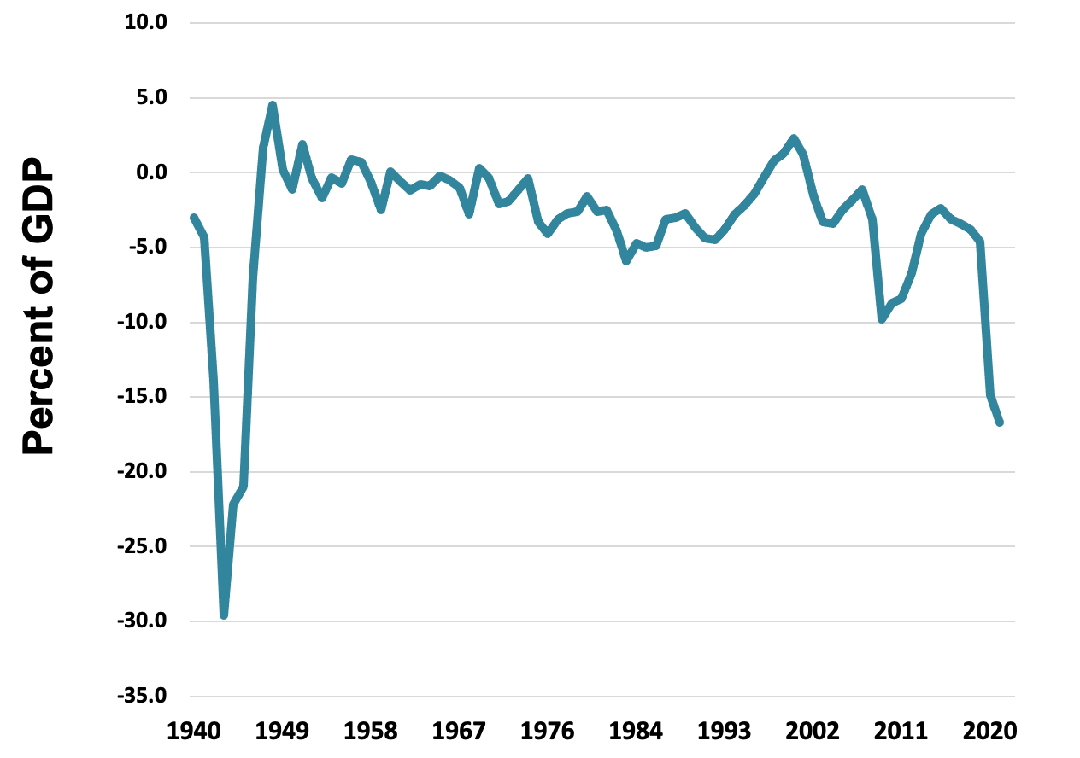
Figure 9.4: Federal Surplus or Deficit as a Percent of GDP, 1949–2020
Source: Economic Report of the President, 2021, Table B-46.

Slide 8
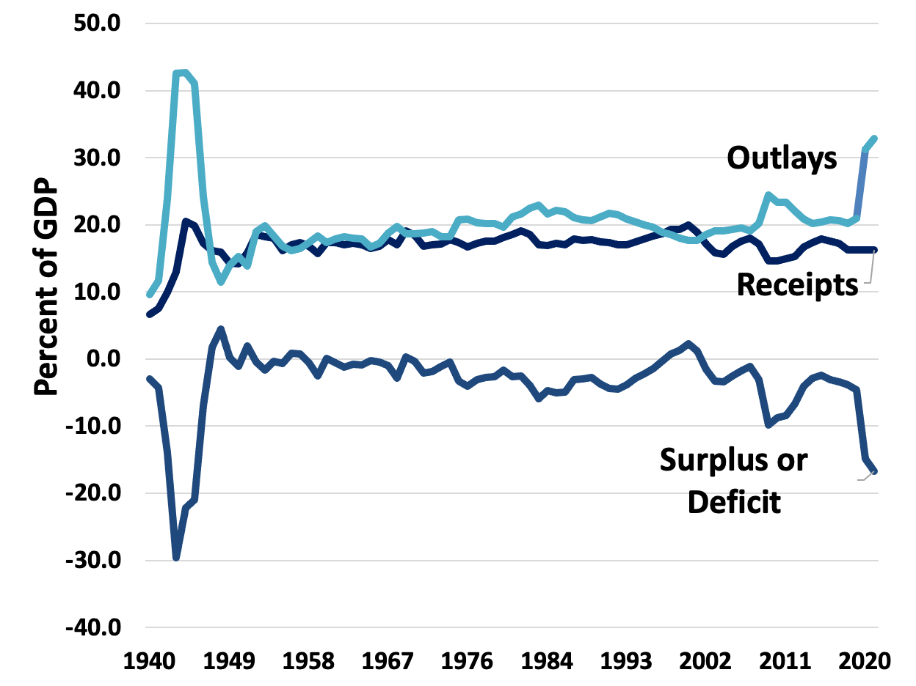
Figure 9.5: Federal Outlays, Receipts, and Surplus/Deficit, as a Percent of GDP, 1980–2020
Source: Economic Report of the President, 2021, Table B-46.

Slide 9
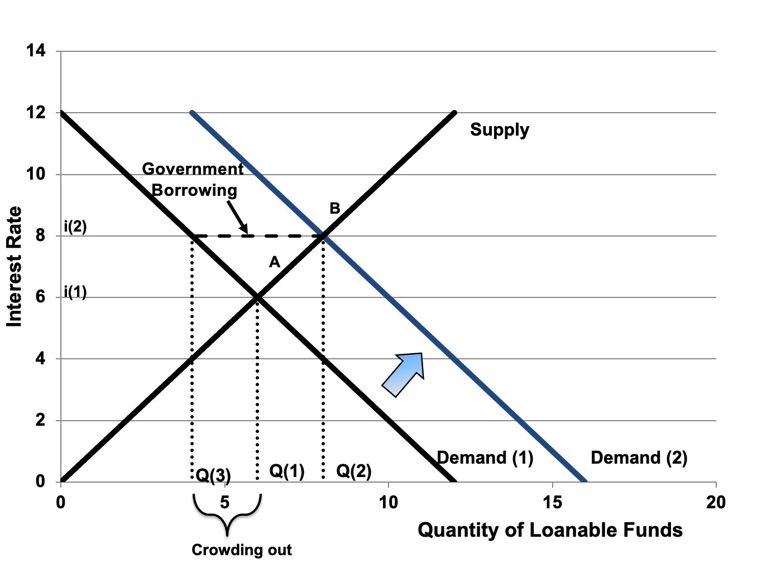
Figure 9.6: Crowding Out in the Loanable Funds Market
Notes:
\

Slide 10
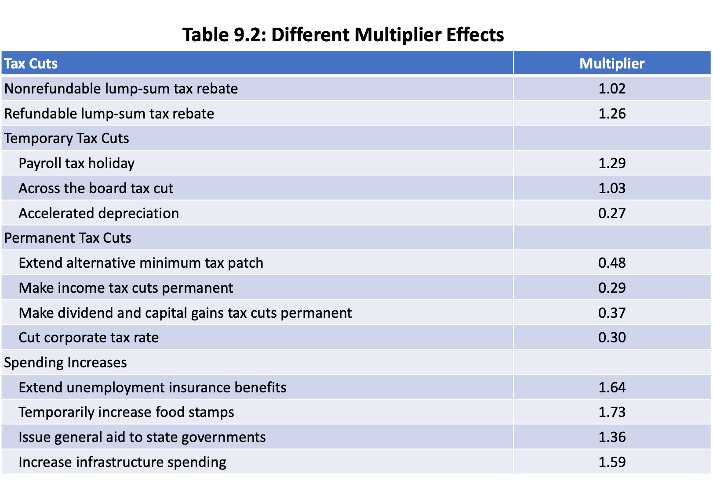

Slide 11
Figure 9.7: A Reduction in the Proportional Tax Rate

